Slide 1
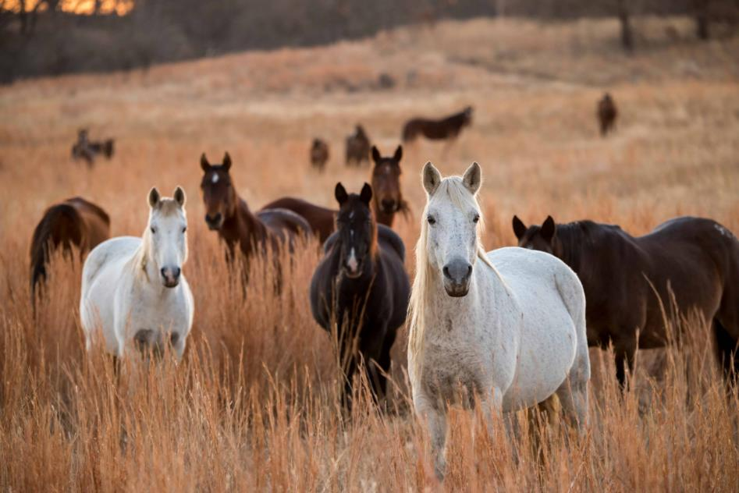

Wild Horses & Feral Animals
Blm.gov
Rangeland Principles (REM 151)
Notes:
Wild Horses and Feral Animals introduction

Slide 2
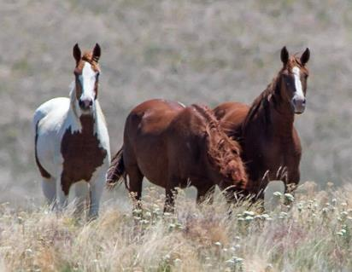
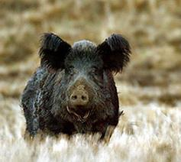
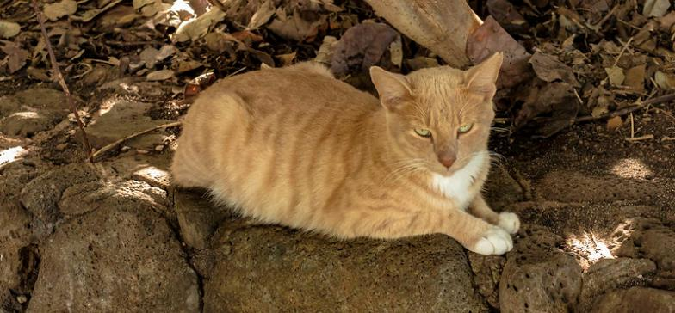
What is Feral?
Feral animal is any domesticated animal that has returned to live in wild conditions.
Any offspring born in the wild are immediately feral.
BLM.gov
wildlife.ca.gov
Thad Zajdowicz (Flickr)
Notes:
What is Feral/
Feral animal is any domesticated animal that has returned to live in wild conditions.

Slide 3
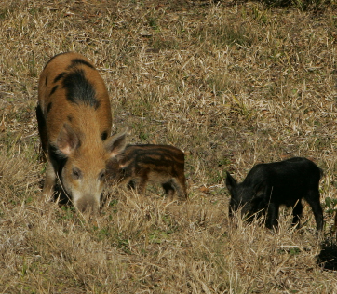
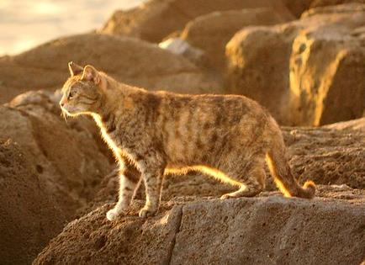
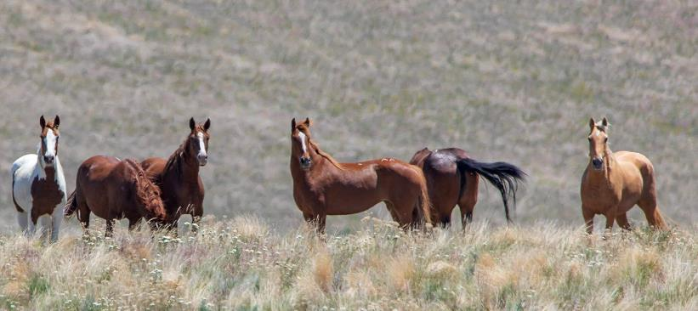
Example from United States
Feral Pigs ≈ 9 million
Feral Cats ≈ 90 million
Feral Horses ≈ 98,000
US Fish & Wildlife
Daniel Ramirez (Flickr)
BLM.gov
Notes:
Examples of feral animals from North America
Feral pigs and cats offer many of the same management issues as feral horses. Their population numbers are increasing along with management costs.

Slide 4
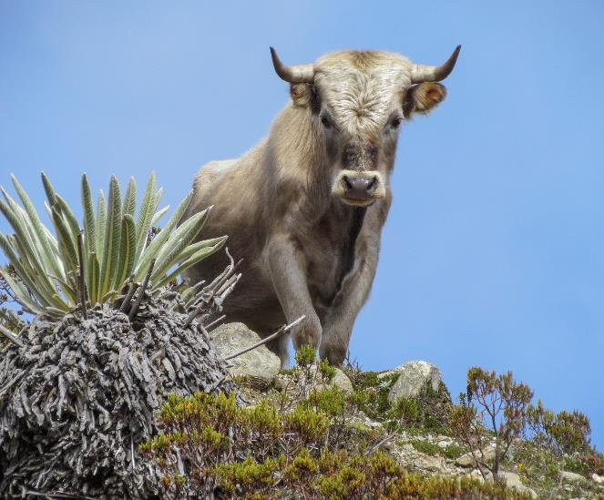
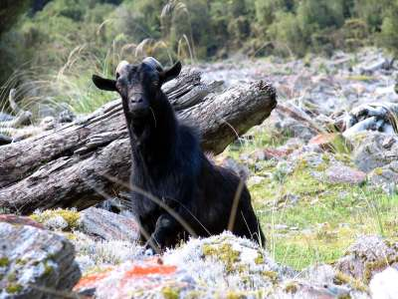
Examples from around the world
Feral Goats: New Zealand
Feral Cattle: Venezuela
Doc.nz
Notes:
Examples of feral animals from around the world
Feral goats in New Zealand are hunted along with feral cows in Venezuela.
(No copywrite/ photo credit needed)

Slide 5
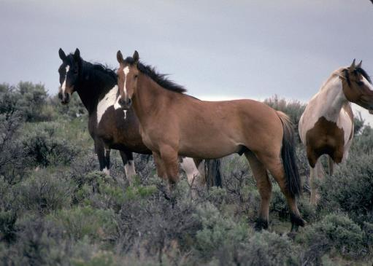
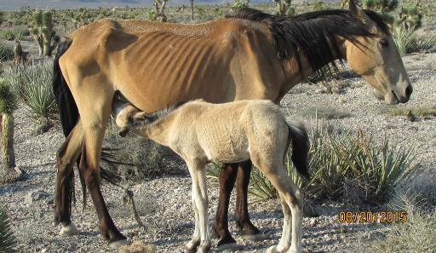
Why are Wild Horses a Challenge?
Forage Needs
Over Population
Habitat Degradation
Exclusion at Water Sources
Few Management Options
  Laws
  People's Emotions
Notes:
Wild Horses
Forage Needs
Exclusion at Water Sources
Over Population
Habitat Degradation
People's Emotions
Bring the focus to wild horses
What are the challenges?

Slide 6
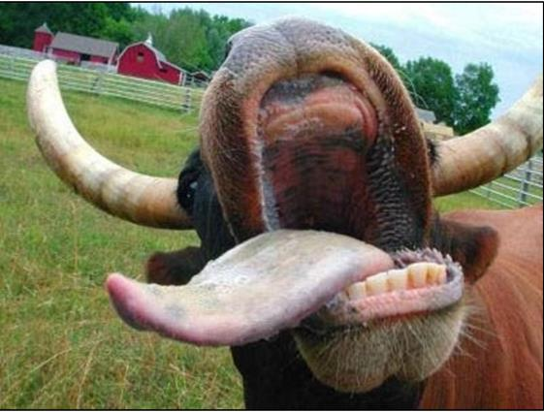
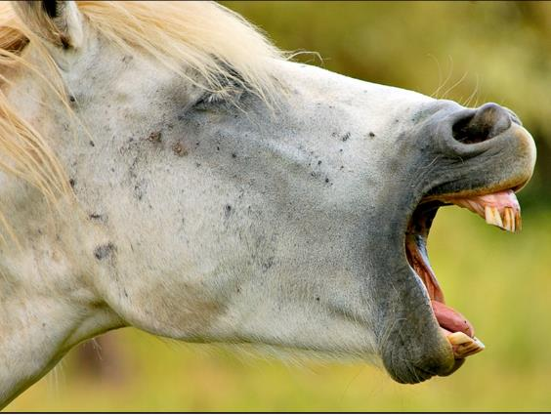
Wild Horse Foraging
  Wild horses are NOT ruminants – hind-gut
    Eat ≈ 3 to 4% of their body weight daily
    Can eat lower quality forage and survive
  Weigh 700 to 1,000 pounds
  Mouth Structure
    Cows with upper dental plate
    Horses with teeth top and bottom
Notes:
Forage Needs
Wild horses eat ≈ 3% of their body weight daily
Weigh 700 - 1,000 pounds
Cows with upper dental plate
Horses with teeth top and bottom
Will one do more damage to a plant than that other?
Because a horse has teeth they graze down farther than a cow. This can have a detrimental affect on grasses being grazed.
The meristematic tissue on grasses is down near the soil surface.

Slide 7
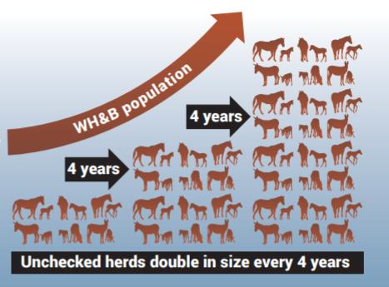
Over Population
Rapid population growth rates
≈ 89,000 wild horses and burros
BLM estimates healthy population numbers should be ≈ 27,000
www.blm.gov
Notes:
Over population
26.9 million acres of public land
≈ 73,000 wild horses and burros
BLM estimates healthy population numbers should be ≈ 27,000
https://www.blm.gov/sites/blm.gov/files/wildhorse_quickfacts_infographic_web.pdf
The AML for all HMA’s combined is ≈27,000 according to the BLM. Current estimates put feral horse numbers at 73,000 with around 33,000 of them being on the range.
The BLM is ≈6,000 over the AML
Adoption rates since the 70’s have fallen dramatically. Reproduction rates now outpace removal rates for feral horses on rangelands

Slide 8
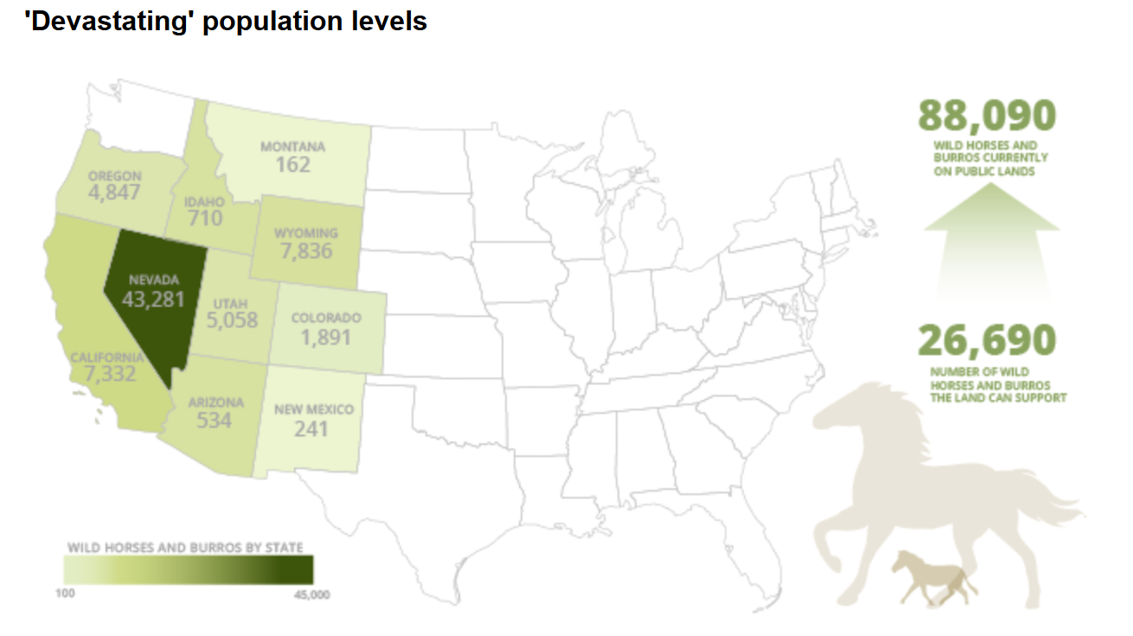
98,300

Slide 9
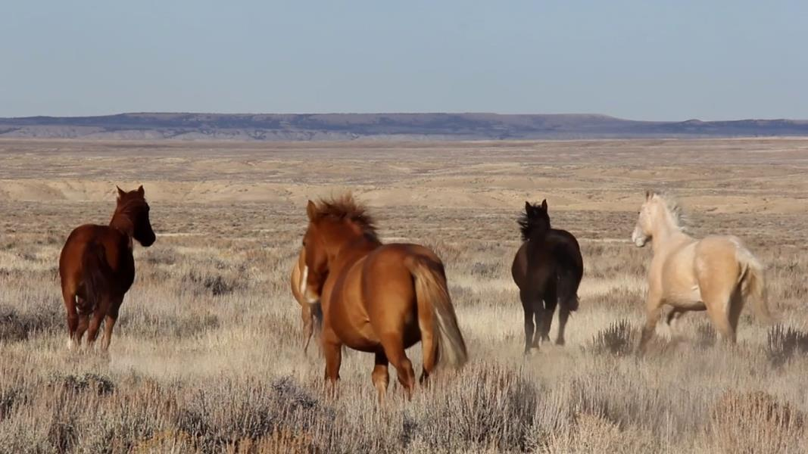
Habitat Degradation
WATCH
Healthy Horses on
Healthy Rangelands
https://youtu.be/zZqslC4hgrM
BLM.gov
Notes:
Habitat Degradation
"Healthy Horses on Healthy Rangelands"
A good video to introduce AML and HMA’s along with talk about BLM partnerships with wild horse advocacy groups

Slide 10


Slide 11
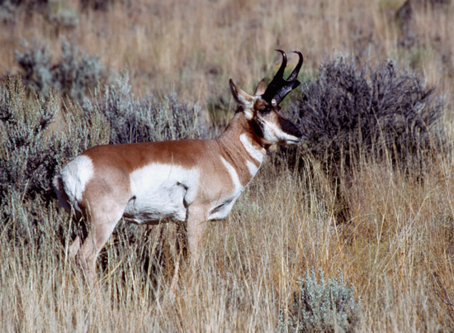
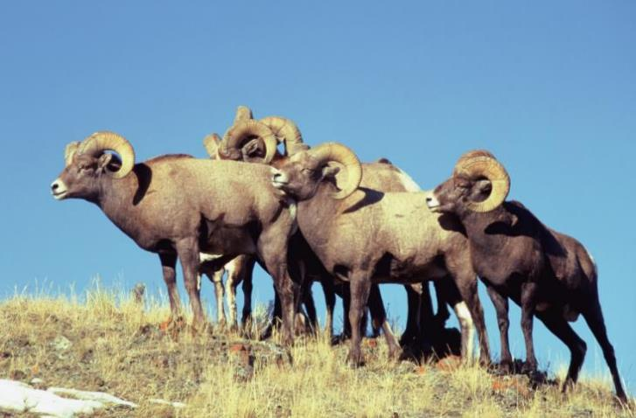
Exclusion at Water Sources
High water demands (5 to 8 gallons of water once/twice daily.
Interference competition
Idfg.Idaho.gov
Idfg.Idaho.gov
Feral horses excluded pronghorn at water sources
Big horns chose not to use water sources being used by feral horses
Notes:
Interference competition and exclusion at water sources
Because horses are larger and more aggressive they are considered socially dominant over pronghorn and big horn
Its not so much that the resource is scarce on rangelands, its that it is more concentrated. So their can be ample water that may not be accessed by either pronghorn or big horn.
Amy M.J. Gooch, Steven L. Petersen, Gail H. Collins, Tom S. Smith, Brock R. McMillan, Dennis L. Eggett. 2016. The impact of feral horses on pronghorn behavior at water sources. Journal of Arid Env 138: 38-43
Stacey Ostermann-Kelm Edward R. Atwill Esther S. Rubin Mark C. Jorgensen Walter M. Boycen. 2008. Interactions between Feral Horses and Desert Bighorn Sheep at Water. Journal of Mammology 89-2: 459-466

Slide 12
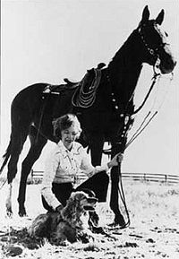
People's Emotions
“You occasionally see one, and it’s the thrill of a lifetime. But mostly all you ever see is a cloud of dust after they are gone. It’s their stubborn ability to survive that makes them so remarkable.”
— Velma “Wild Horse Annie” Johnston
Notes:
People's Emotions
Wild Horse Annie – started up a grass roots organization in the 50’s aimed at protecting wild horses. Prior to the 1971 act, wild horses were killed without prejudice in some of the most heinous manners. Wild Horse Annie spurred several laws concerning wild horses, most importantly being the free roaming horse and burro act of 1971.
Currently, a major advocate of wild horses would be the American Wild Horse Campaign. Their site contains a lot of emotionally charged language that shows their pro-feral horse argument.
The video plays a song that exhibits some of the emotionally charged language by these groups to get their point across
I don’t believe emotions should be discredited in an argument like this. The 1971 act ensures the preservation of wild horses on public lands. In most management scenarios, especially concerning animal management, the publics feelings and attitudes toward the animal of interest, more often than not, dictate the management actions.

Slide 13
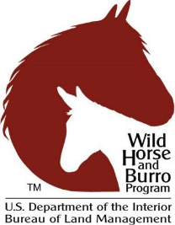
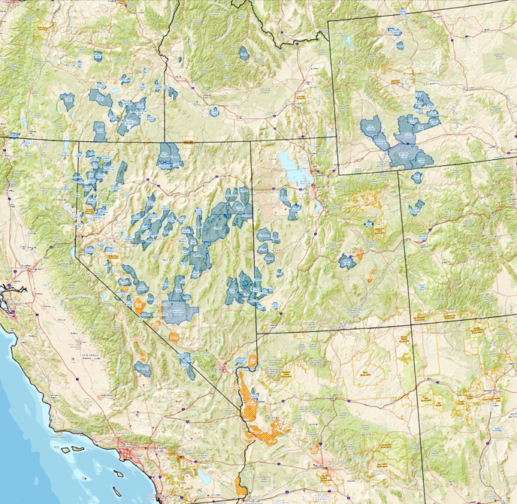
BLM Wild Horse and Burro Program
Wild Free-Roaming Horses & Burros Act (1971)
Requires protection, management, and control of wild free-roaming horses and burros on public lands
HMA’s (Horse Management Areas)
  27 million acres of public land
AML (Appropriate Management Level)
  Set at 26,690 animals
Notes:
BLM policy on Feral Horses and Burros
Since 1971, wild horses and burros have been removed from federal lands and adopted, or placed in long-term BLM-funded refuges
What is an HMA? Public land set aside for wild horse management. The map on the right shows all the HMA’s in the Western US. Notice most of them are located in Nevada.
AML? Appropriate management level dictated by the BLM based on habitat type and animal needs. Meant to be a sustainable population number for management.

Slide 14
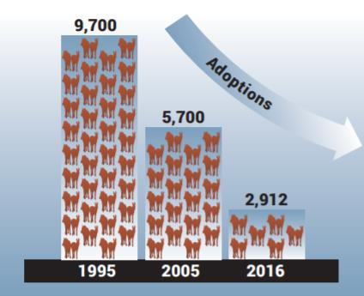
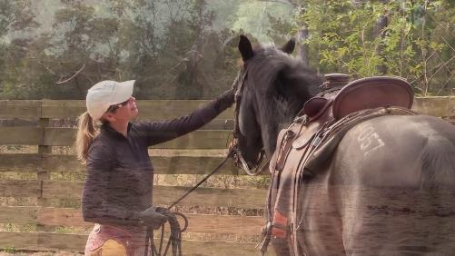
Solutions for Management?
Slaughter? NO
BLM policy does not allow selling or sending wild horses or burrows to slaughter.
Adoption
In last 5 years, the BLM has only been able to secure adoption for 2,000-4,000 wild horses & burros a year.
BLM currently spends $3,250 per adopted horse to promote adoptions
Adoption is cost effective because it costs ~$46,000 per horse in off range holding over the course of their lifetime.
BLM.gov

Slide 15
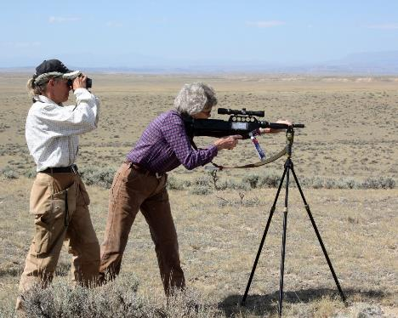
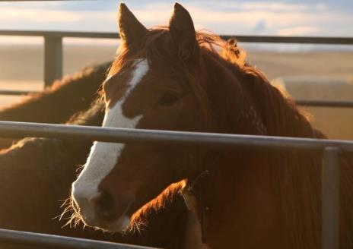
Solutions for Management?
Fertility Control
PZP-22 vaccine which blocks fertilization
Round up – Put in Holding Facilities
In 2016, BLM spent $49 million to support wild horses & burros kept in short-term and long-term holding facilities.
2012 and 2018, the BLM treated fewer than 4,400 (4% of the population)
Requires a booster every year. After 4 years treatment becomes permanent
More wild horses in captivity than exist on the range
In 2019 BLM maintained 36,906 wild horses & burros in large pasture facilities + 14,029 animals corral facilities.
BLM.gov
BLM.gov

Slide 16
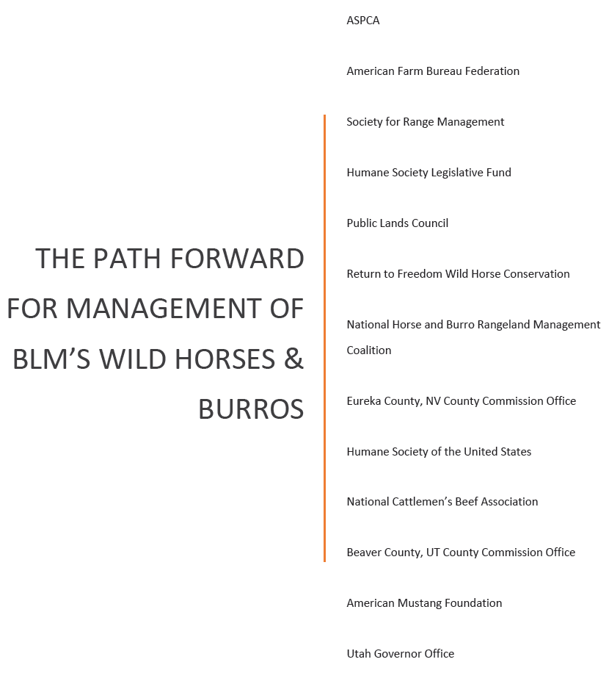
Solutions for Management?
Legislative action supported by many organization:
1) Relocate removed wild horses & burros to more cost-effective pasture facilities.
2) Contract with private parties to secure lower-cost leasing of land for long-term humane care of removed horses & burros.
3) Apply proven, safe and humane population control strategies to every herd that can be reached utilizing trained volunteers, Agency staff, and animal health professionals, as individual HMAs dictate to prevent repeated gathers.
4) Promote adoptions to reduce captive populations and costs.

Slide 17
Wild Horses & Feral Animals
Blm.gov
Rangeland Principles (REM 151)
Notes:
Wild Horses and Feral Animals introduction

