Slide 1
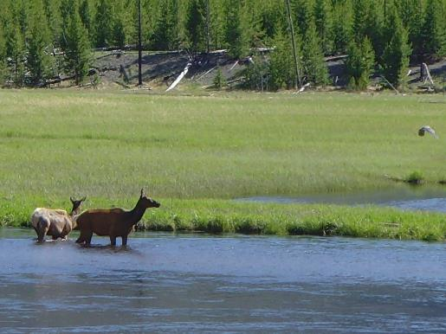
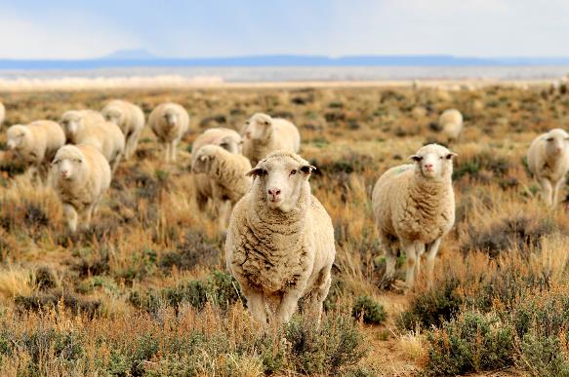
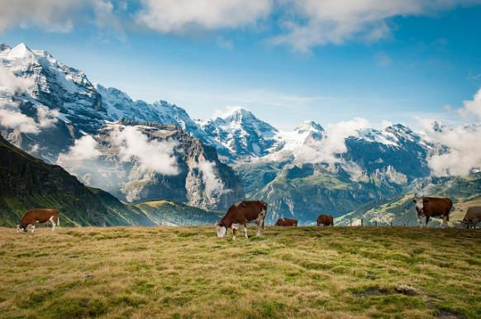

Habitat Selection & Learning
Justin Olnes
Tom Koerner (USFWS)
Ben & Gab (Flickr)
REM 456 - Integrated Rangeland Management

Slide 2
How do animals know good habitat?
Inherited? Innate attributes affecting habitat selection
Animals are not born knowing what is “good” or “bad” habitat
May have a Neural Template - inborn picture of appropriate habitat
Habitat Preparedness –
  Physical or physiological abilities appropriate for habitat
  Affect habitat that is “usable”
  Reinforcing or punishing properties of habitat

Slide 3
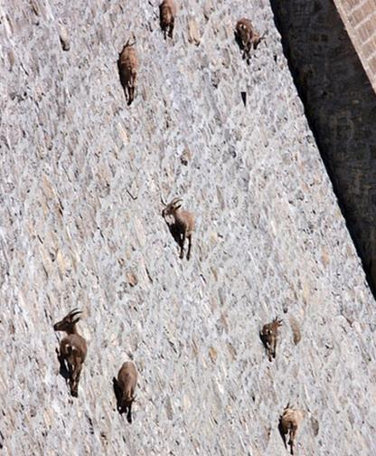
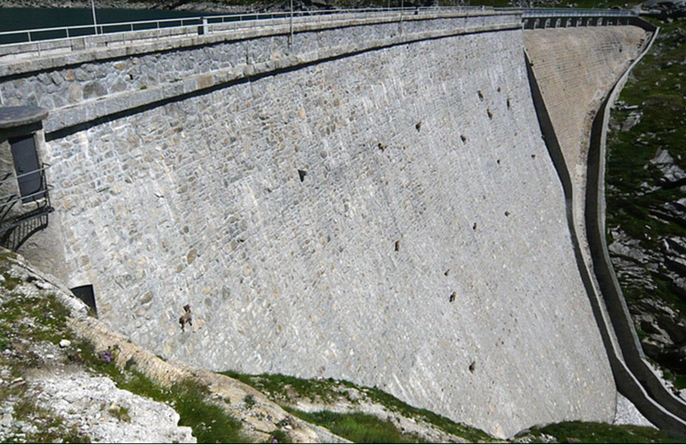
Habitat Preparedness example from Hoover Dam
www.dailymail.co.uk

Slide 4
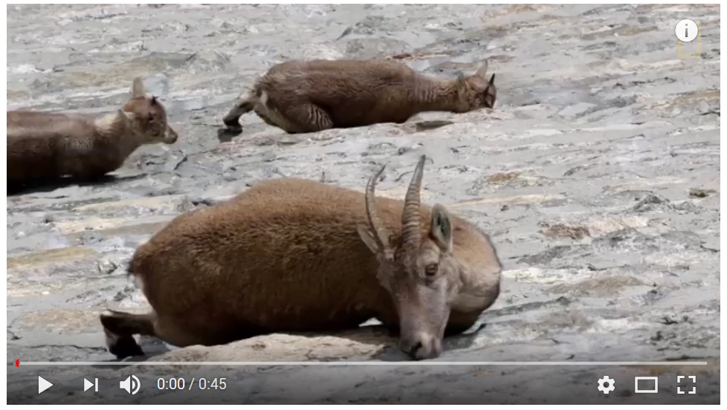
Ibex goats on Cingino Dam in Italy
Watch on National Geographic YouTube Channel
https://youtu.be/f0jMzdbEui0

Slide 5
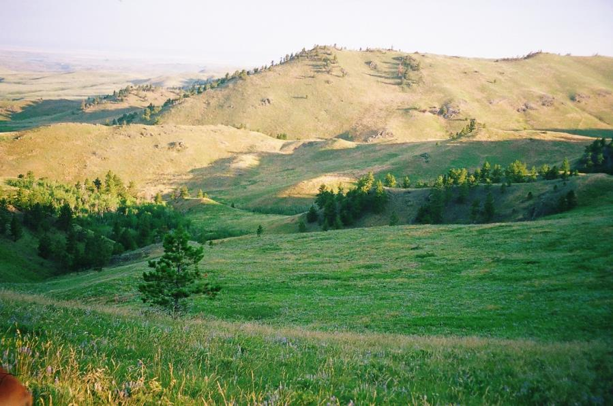
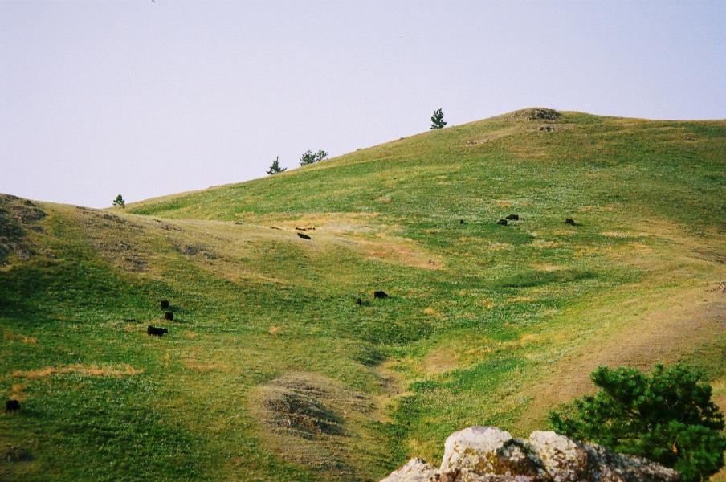
Thackeray Ranch
Havre, MT
D. Bailey
D. Bailey

Slide 6
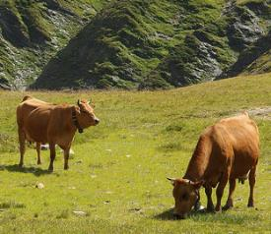
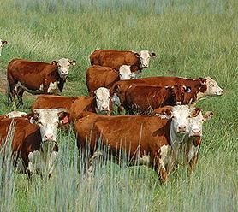
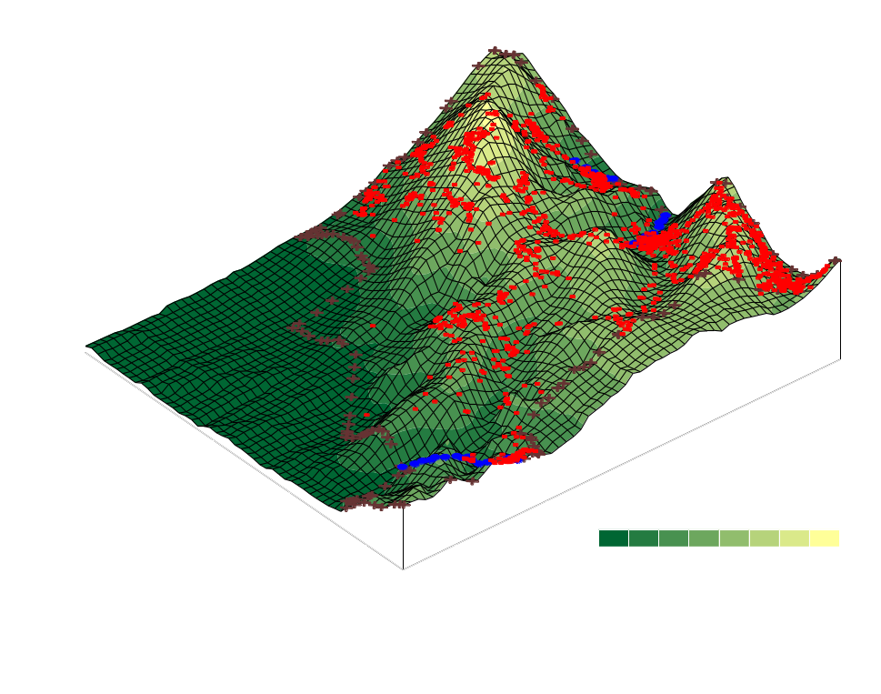
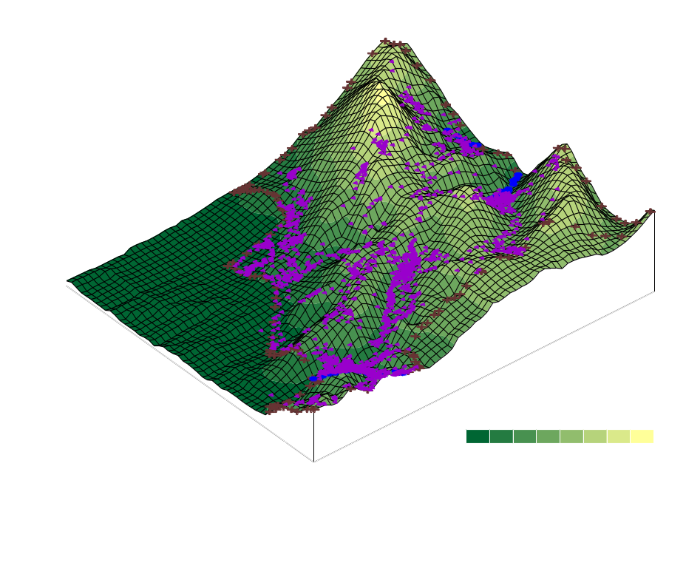
Breeds vary in ability to use steep terrain
Tarentaise versus Herefords
Guilhem Vellut (Flickr)
USDA
Tarentaise use steeper terrain than Herefords
Bailey et al. 2001

Slide 7
Elevation Use of Top Two Hill Climber and
Bottom Dweller Cattle
Notes:
This and the following two slides compare the top 2 hill climber and worst 2 bottom dweller cows. Hill climbers are depicted in blue and bottom dwellers are depicted in purple. Numbers in the legend are the total average of the thirteen week period. The averages include all the time they were at water and resting.
Hill climber cattle on average used elevations up to 176 m higher than the lowest bottom dweller. These cattle were fairly consistent throughout the study period.

Slide 8
Slope Use of Top Two Hill Climber and
Bottom Dweller Cattle
11.1 %
Notes:
Slope use aside from the first two weeks was consistent between categories throughout the study period (Hill climbers stayed on top and bottom on the bottom). Hill climber cattle used slopes twice as steep as bottom dweller.

Slide 9
Distance Traveled/day (km) of the Two Extreme Hill Climber and Bottom Dweller Cows
Notes:
Distance traveled was interesting to look at because bottom dweller cows traveled twice as far as hill climber cows. Reasons for this could be that the flats were grazed off and also the water points were farther apart. In the more mountainous areas there was more abundant feed.
Now that we have talked about what these cows did lets look at some actual points.

Slide 10
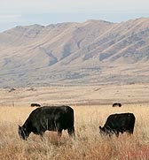
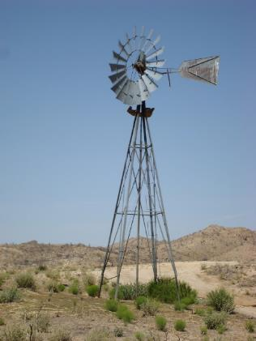
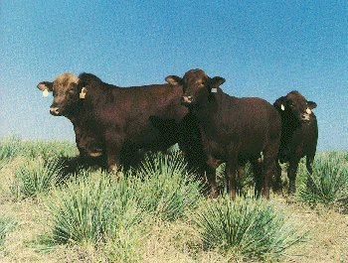
Breeds vary in ability to travel far from water
  Brangus…..traveled further from water than…..Hereford or Angus
USDA
www.ansi.okstate.edu
John Loo (Flickr)
USDA
Brangus consumed different diets than Hereford or Angus
Winder et al. 1996

Slide 11
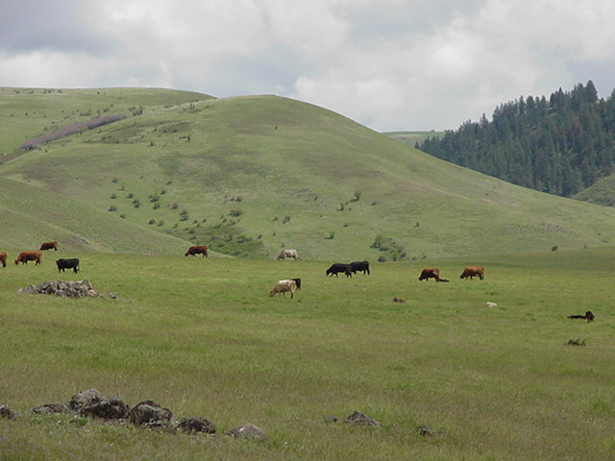
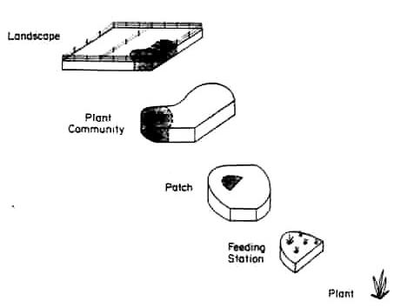
Diet Preferences Affect Habitat Selection
K. Launchbaugh
Heitschmidt and Stuth, 1991

Slide 12
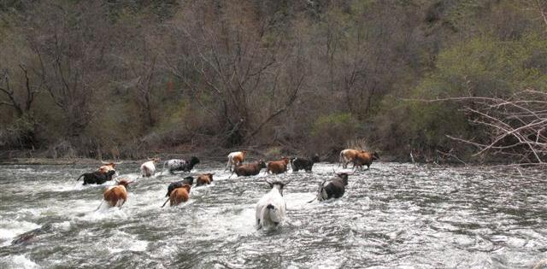
How Do Animals Learn?
  Individual Trial and Error
  Early Life Experience
  Peer Influence
K. Launchbaugh

Slide 13
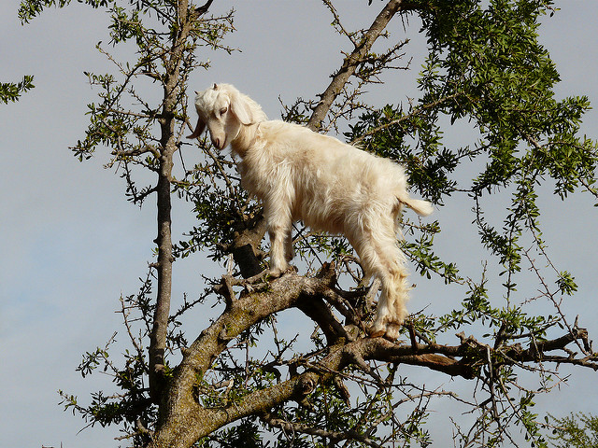
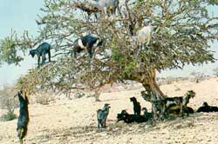
How Do Animals Learn?
  Individual Trial and Error
  Early Life Experience
  Peer Influence
Cuno de Boer (Flickr)
USGS.gov

Slide 14
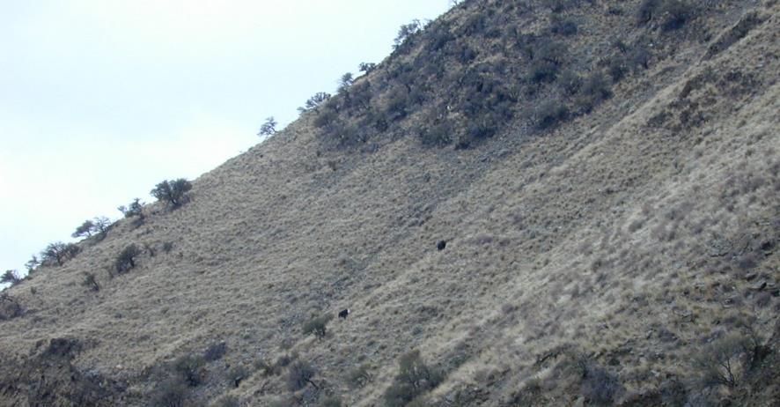

How Do Animals Learn?
  Individual Trial and Error
  Early Life Experience
  Peer Influence
K. Launchbaugh

Slide 15
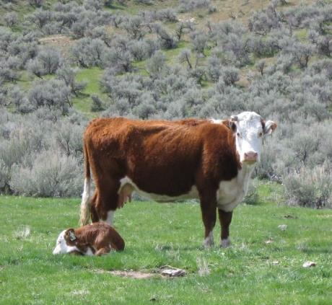
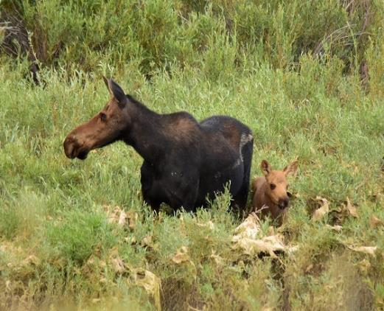
Social Models and Facilitation
Most important models for young animal is mother.
Provide critical information about hazards and resources:
  Food
  Water
  Cover
  Risk or Safety
K. Launchbaugh
Tom Koerner (USFWS)

Slide 16
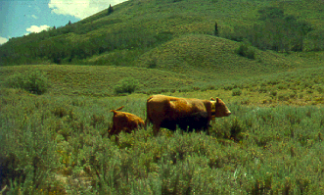
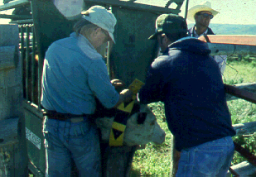
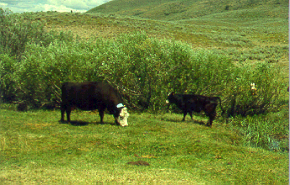
Social Learning Study
Determine if offspring learn location and habitat use from their mothers.
L. Howery
L. Howery
L. Howery
Howery et al., 1996 & 1998

Slide 17
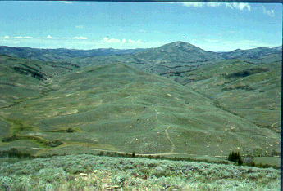
Cattle Location & Habitat Use Study
Maxfield-Thompson Allotment,
Sawtooth National Forest, Idaho
Central
Ridge
Maxfield
Creek
Thompson
Creek
L. Howery
Howery et al., 1996 & 1998
Notes:
This is the Maxfield-Thompson BLM allotment in southern Idaho. Maxfield creek is on the left and Thompson creek is on the right.
REF: Howery, L.D., F.D. Provenza, R.E. Banner and C.B. Scott. 1996. Differences in home range and habitat use among individuals in a cattle herd. Appl. Anim. Behav. Sci. 49:305-320.
Howery, L.D., F.D. Provenza, R.E. Banner and C.B. Scott. 1998. Social and environmental factors influence cattle distribution on rangeland. Appl. Anim. Behav. Sci. 55:231-244.

Slide 18
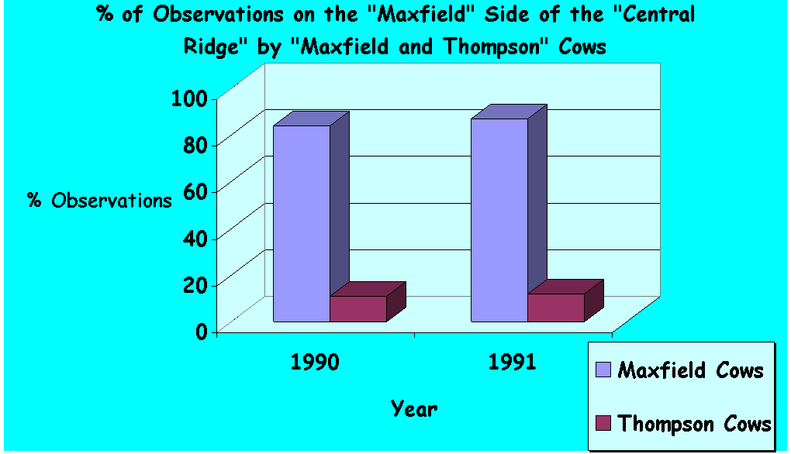
Cow Location
Howery et al., 1996 & 1998
Notes:
First checekd to make sure that cows were consistent in use of landscape.

Slide 19
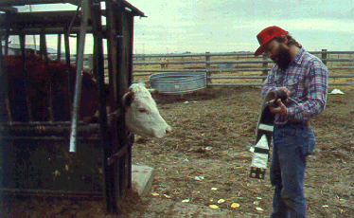
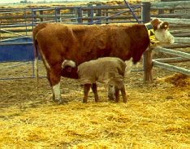
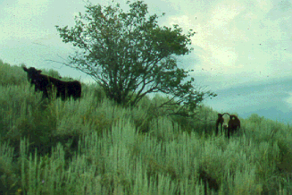
Calves and Cross-Fostering
L. Howery
Cows & calves collared
L. Howery
Cross-Foster
L. Howery
Observe Cows &
natural or cross-fostered Calves
Howery et al., 1996 & 1998

Slide 20
Natural Calves
Maxfield
Thompson
Calves (1990)
  Stay with mother
Yearlings (1991)
  Drought starts – Peer Influence
2-year olds (1992)
  Severe drought
3- year olds (1993)
  Drought Breaks
Howery et al., 1996 & 1998

Slide 21
Cross-Fostered Calves
Maxfield
Thompson
Calves (1991)
  Drought Starts
Yearlings (1992)
  Severe drought
2-year olds (1993)
  Drought Breaks
Howery et al., 1996 & 1998

Slide 22
Cattle Location & Habitat Use Study
Maxfield-Thompson Allotment,
Sawtooth National Forest, Idaho
Central
Ridge
Maxfield
Creek
Thompson
Creek
Habitat Fidelity based on Experience – Not Genetics
L. Howery
Howery et al., 1996 & 1998
Notes:
This is the Maxfield-Thompson BLM allotment in southern Idaho. Maxfield creek is on the left and Thompson creek is on the right.
REF: Howery, L.D., F.D. Provenza, R.E. Banner and C.B. Scott. 1996. Differences in home range and habitat use among individuals in a cattle herd. Appl. Anim. Behav. Sci. 49:305-320.
Howery, L.D., F.D. Provenza, R.E. Banner and C.B. Scott. 1998. Social and environmental factors influence cattle distribution on rangeland. Appl. Anim. Behav. Sci. 55:231-244.

Slide 23
Social Models and Facilitation
Mothers and peers affect habitat use.
Animals tend to prefer habitats in which they were raised.
As animals mature, they are increasingly influenced by peers.
Peers are important to learn about the hazards and resources of new environments.
Environmental changes (e.g., drought) influences habitat use.
Social learning can sometimes be maladaptive or counterproductive.

Slide 24
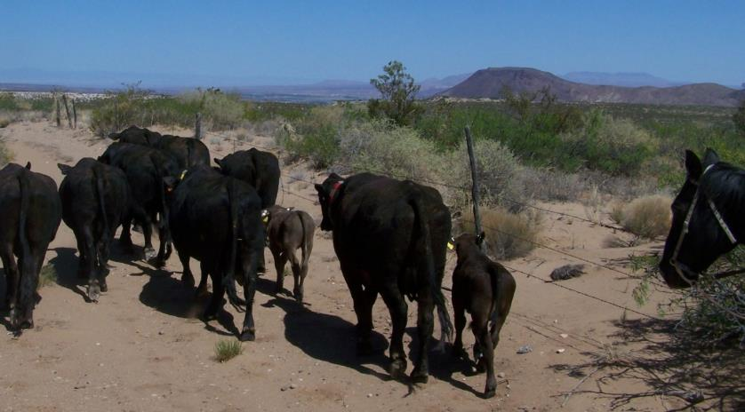
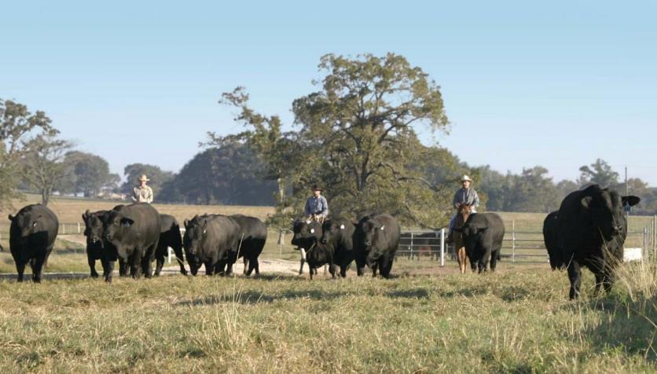
Individual Experience
9 inches of annual precipitation
Las Cruces, New Mexico
D. Bailey
41 inches of annual precipitation
Leona, Texas
D. Bailey
Derek Bailey, New Mexico State University

Slide 25
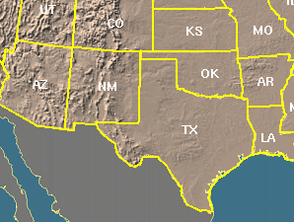
Individual Experience Matters
Cows from New Mexico were moved to Texas for 3 years
Cows from Texas were moved to the New Mexico

Slide 26
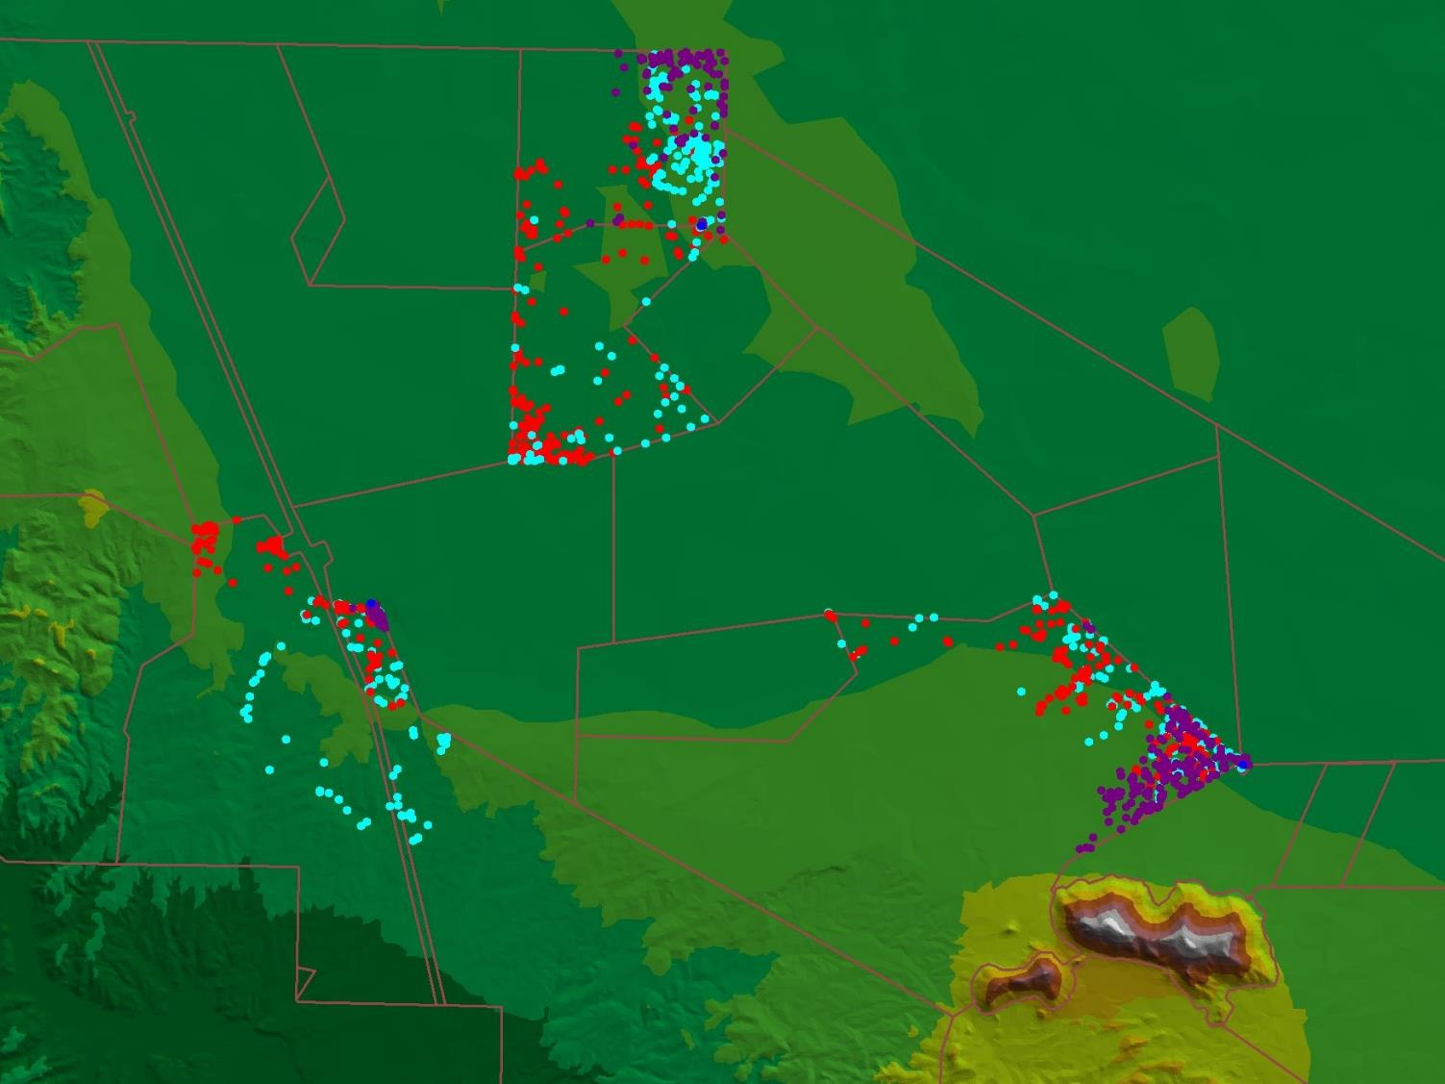
Average distance to water, m
Naïve 726
Native 1468
Tourist 941
SE 86
Naïve vs Others P = 0.04
Native vs Others P = 0.03
Naïve
Native
Tourist
H₂O
H₂O
H₂O
Winter- Back in New Mexico

Slide 27
Behavior Depends on Consequences
Preference
Behavior
& Cue
+
Consequences
-
Aversion

Slide 28
Not all Consequences are Equal
Cue-Consequence Specificity:
Taste related to nausea
→→→ affect food selection
  Food preferences and aversions
  Gut defense systems
Sight, Sound & Touch related to pain or pleasure
→→→ affect place selection
  Place preferences and place aversions
  Skin defense system
  Odor is effective in place selection and food selection

Slide 29
Cue Consequence Specificity
Skin and Gut Defense Systems
Animal easily associate:
  Smell-taste stimuli → gastro-intestinal illness
  → FOOD AVERSIONS
  Sight & sound stimuli → pain or discomfort
  → PLACE AVERSIONS

Slide 30
Behavior Depends on Consequences
Preference
Behavior
& Cue
+
Consequences
-
Aversion

Slide 31
Behavior Depends on Consequences
Habitat Selection
Seek or Stay
Preference
Security,
Relaxation,
Thermal Comfort,
Satiety
See, Hear,
Feel, Smell
Taste
+
Consequences

Slide 32
Behavior Depends on Consequences
Habitat Selection
See, Hear,
Feel, Smell
Taste
Consequences
-
Fear, Pain,
Weariness
Hot, Cold
Hunger or
Illness
Avoid or Leave
Aversion

Slide 33
Behavior Depends on Consequences
Habitat Selection
Seek or Stay
Preference
Security,
Relaxation,
Thermal Comfort,
Satiety
See, Hear,
Feel, Smell
Taste
+
Consequences
-
Fear, Pain,
Weariness
Hot, Cold
Hunger or
Illness
Avoid or Leave
Aversion

Slide 34
Behavior Depends on Consequences
+ Positive
  Preferred Forage
  Thermal Comfort
  Easy Access
  No Predators
  Few Pests
  Mother/Peers
- Aversive
  Inadequate Forage
  Too hot, cold, or windy
  Difficult to traverse
  Predators
  Pests
  No Conspecifics

Slide 35
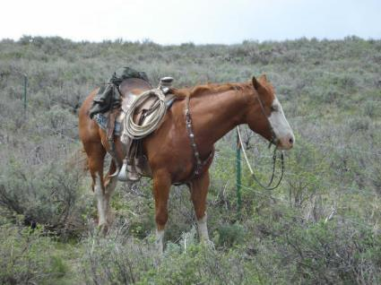
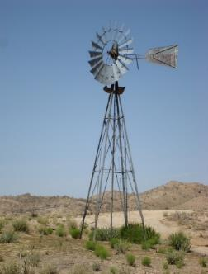
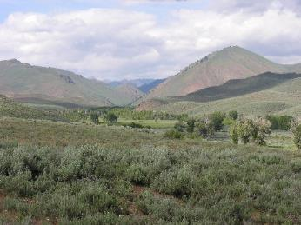
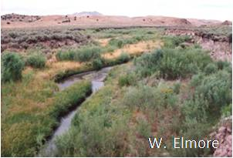
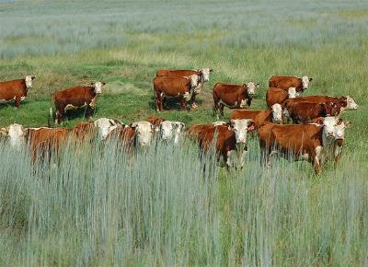
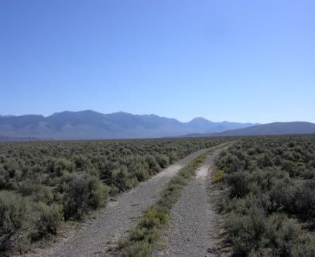
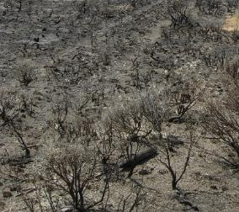
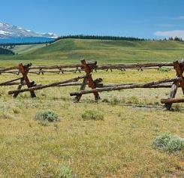
Visual cues can affect habitat use
Natural visual cues
Human-made visual cues
K. Launchbaugh
T. Lester
John Loo (Flickr)
USDA
N. Rimbey
J. Peterson
Rennett Stowe (Flickr)

Slide 36
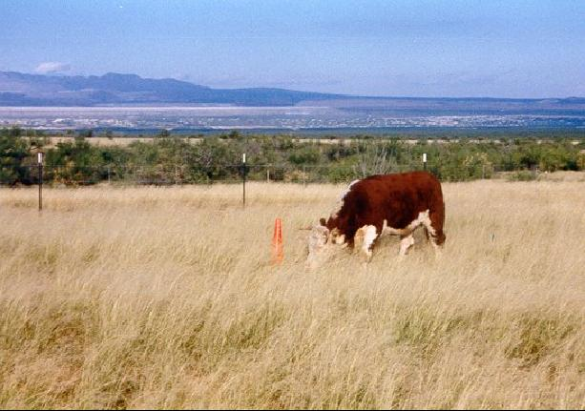
Spatial Memory and Visual Cues
Cattle spatial memory is comparable to other mammals and birds
Visual cues greatly enhance the spatial abilities of cattle, especially in variable environments
How might visual cues be used in the field?
L. Howery

Slide 37
Spatial Memory and Visual Cues
Spatial memory -- How well animals remember where resources are:
Reference memory = a memory of how the environment is laid out ... A spatial map.
Working memory = a memory or previous (usually recent) activities in a certain location.

Slide 38
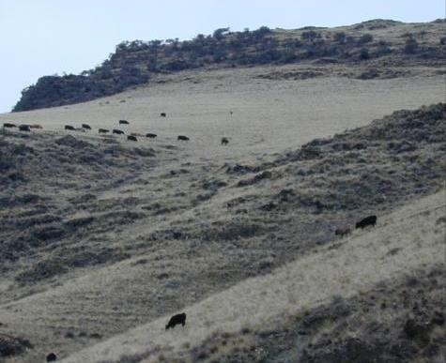
Habitat-Use Skills
Can animals develop physical skills to improve their landscape use?
  Animals can develop habitat skills to use steep slopes and travel far from water
  Habitat-use skills could affect habitat selection.
  As animals gain an ability to use steep slopes they may start to prefer those slopes.
K. Launchbaugh

Slide 39
Key Points- What affects habitat use?
Inherited Physical Attributes
  Species
  Breed
Social Models
  Mother
  Peers
Individual Experience
  Based on positive and negative consequences
  Type of consequences matters
  – sight, sound, smell related to pain, comfort, distress
  Managers can change consequences and habitat cues

Slide 40
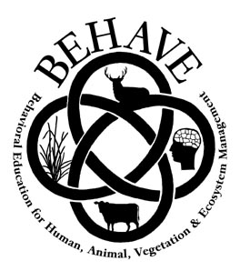
www.BEHAVE.net

Slide 41
References
Bailey, D.W., D..D. Kress, D.C., Anderson, D.L. Boss, D. L., & E.T. Miller. 2001. Relationship between terrain use and performance of beef cows grazing foothill rangeland. Journal of Animal Science. 79(7):1883-1891.
Bailey, D.W., G.R. Welling, & E.T. Miller. 2001. Cattle use of foothills rangeland near dehydrated molasses supplement. Journal of Range Management. 54(4):338–347.
Howery, L.D., F.D. Provenza, R.E. Banner & C.B. Scott. 1996. Differences in home range and habitat use among individuals in a cattle herd. Appl. Anim. Behav. Sci. 49:305-320.
Howery, L.D., F.D. Provenza, R.E. Banner & C.B. Scott. 1998. Social and environmental factors influence cattle distribution on rangeland. Appl. Anim. Behav. Sci. 55:231-244.
Winder, J. A., D.A. Walker, & C.C. Bailey. 1996. Effect of breed on botanical composition of cattle diets on Chihuahuan desert range. Journal of Range Management 49(3):209-214.

