Slide 1
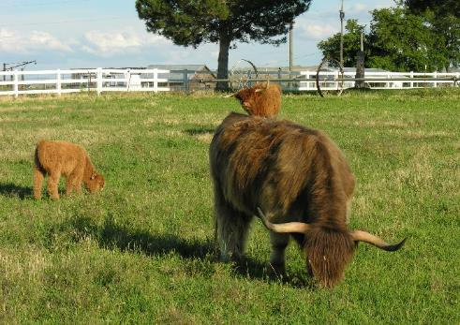
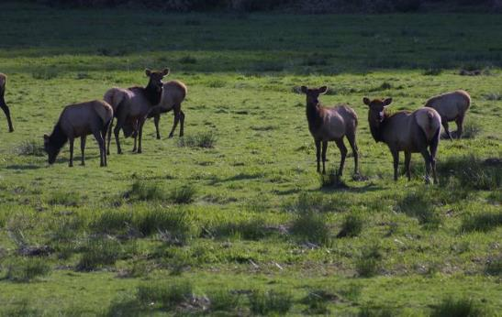
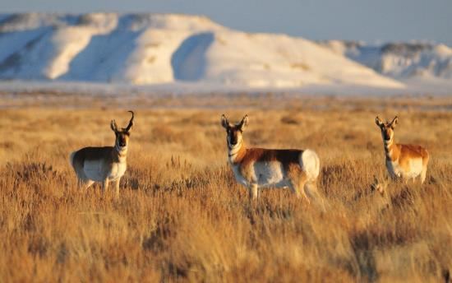

Herbivore Intake
K. Launchbaugh
BLM
Tom Koerner USFWS
REM 456 - Integrated Rangeland Management

Slide 2

Factors Affection Herbivore Intake
www.rangelandmanagement.wordpress.com

Slide 3
Factors Affection Herbivore Intake
Herbivore Species & Size
Physiological State of Herbivore
Forage Quality
Forage Water Content
Forage Characteristics & Foraging Behavior
Supplemental Feeding
Standing Crop
Environmental Factors
Herbivore
Forage
Management & Environment

Slide 4
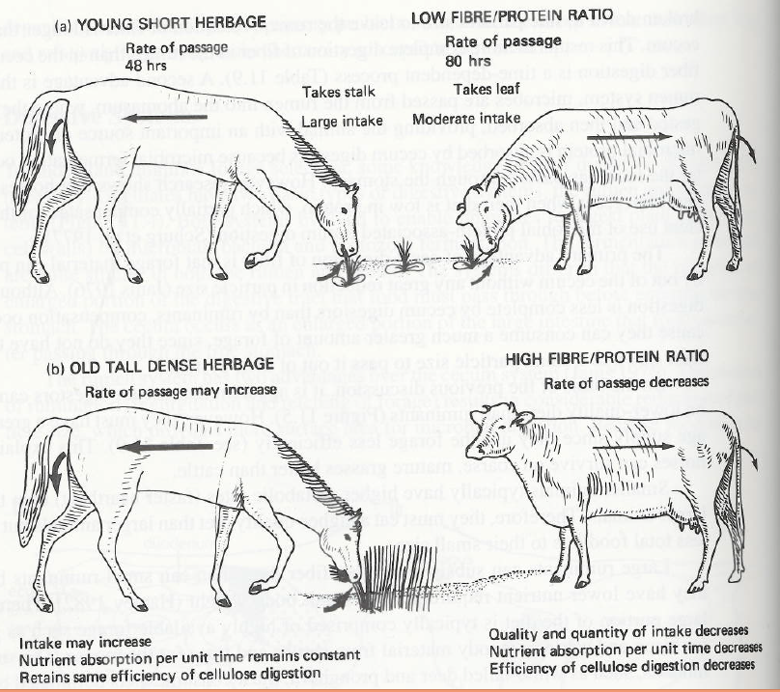
Herbivore Species
Ruminant vs Hind-gut
From: Holechek, Pieper, & Herbel, 1995. Range management: principles and practices (Prentice-Hall)

Slide 5
Herbivore Species
Ruminant vs Hind-gut
1) Horses have faster rate of passage
2) Horses eat about 70% more than ruminants of the same weight.
  1,000 lb cow eats about 25 pounds per day
  1,000 lb horse eats about 42 pounds per day
3) Cattle can digest rumen microbes for protein and vitamin B

Slide 6
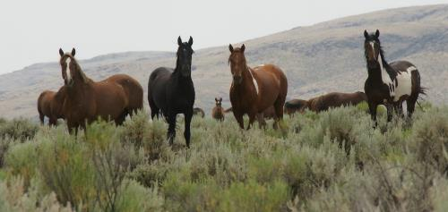
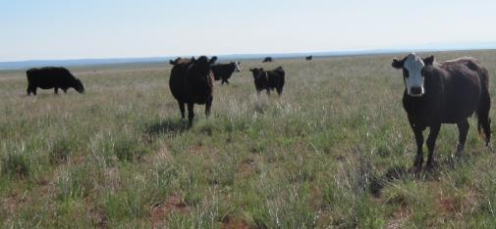
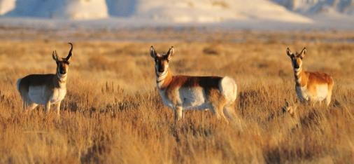
Herbivore Size
Intake of range herbivores varies from 2 to 4% of body weight consumed per day.
  This “intake factor” predicts amount of dry matter eaten per day as a % of live body weight.
Smaller herbivores eat a greater proportion of body weight per day.
  Smaller animals have greater nutrient requirements per pound of body weight than larger.
  Smaller herbivore select higher quality more digestible diet (i.e., leaves over stems).
Justin Trujillo
Connor White
Tom Koener (USFWS)

Slide 7
Herbivore Size
Smaller herbivores eat a greater proportion of body weight per day.
Ruminant wildlife and livestock intake factors for estimating daily forage demand.
Live weight (lb.) | Intake factor (% of live weight) | Intake (lbs)
1,000-1,500 | 2.5 | 25 to 37.5
500-1,000 | 3 | 15 to 30
100-500 | 3.5 | 3.5 to 17.5
less than 100 | 4 | < 4
Understanding forage intake in range animals. 1995. by Lyons, Machen, and Forbes.

Slide 8
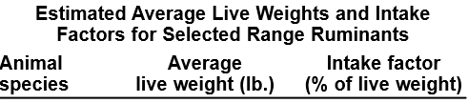
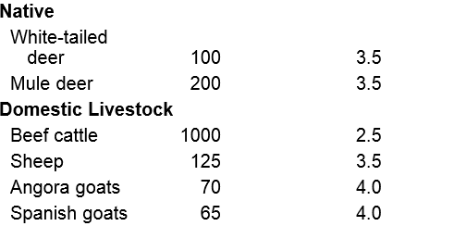
Herbivore Size
Smaller herbivores eat a greater proportion of body weight per day.
Understanding forage intake in range animals. 1995. by Lyons, Machen, and Forbes.

Slide 9
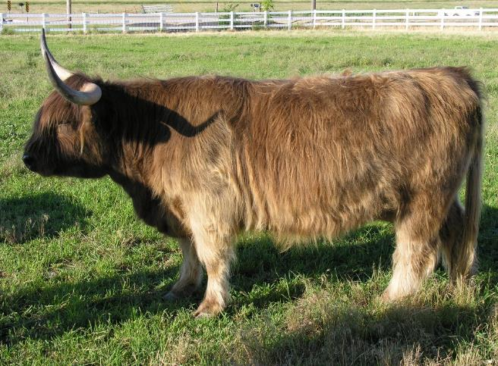
Physiological State
Greatest nutrient demand and intake during lactation
  Can eat 35 to 50% more forage when lactating than when dry
Intake generally declines in late gestation
  Fetus may take reduce space for rumen
  High estrogen levels may reduce appetite
K. Launchbaugh

Slide 10
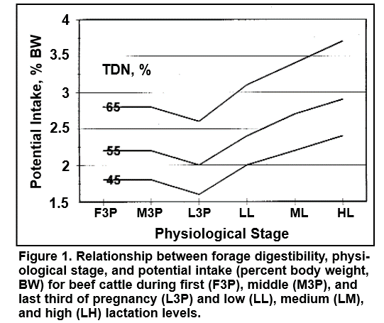






Physiological State
From -Understanding forage intake in range animals. 1995. by Lyons, Machen, and Forbes.

Slide 11
Forage Quality
How does intake vary throughout the year?
Winter
Spring
Summer
Fall

Slide 12
Forage Quality
Yes,
  Higher nutrient value & digestibility means animals need to eat less to meet demand.
But,
  Higher nutrient value & digestibility means forage is quickly digested and animals are able to eat more.
Therefore,
  Intake increases as forage quality increases

Slide 13
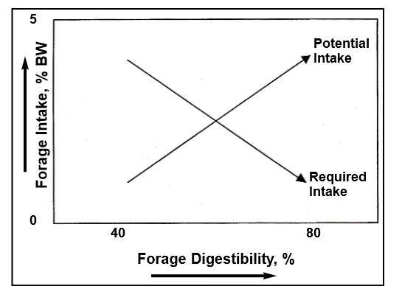
Forage Quality
From -Understanding forage intake in range animals. 1995. by Lyons, Machen, and Forbes.

Slide 14
Water Content
Often thought that high water content can reduce intake
  Not true
  Water is generally easily absorbed
Low intake early in the spring
  Due to limited forage available
  Not because of high moisture in forage

Slide 15
Forage Characteristics & Foraging Behavior
Moist leafy material more palatable and more easily eaten than dry stemmy forage.
Forages that provide larger bite size and greater bite rate afford great intake
Anti-quality compounds in forage can make animal nauseous and can reduce intake or halt foraging.

Slide 16
Supplemental Feeding
Protein:
  Low protein settings → Supplementing Protein (or nitrogen) can benefit rumen microbes and generally increase intake.
  Higher protein settings → Supplementing Protein (or nitrogen) will depress intake of other forages.
Energy:
  Low energy settings → Supplementing energy will help meet animals demand but animals will continue foraging (no effect on intake).
  Higher energy settings → Supplementing energy will “substitute” for forage and reduce intake.

Slide 17
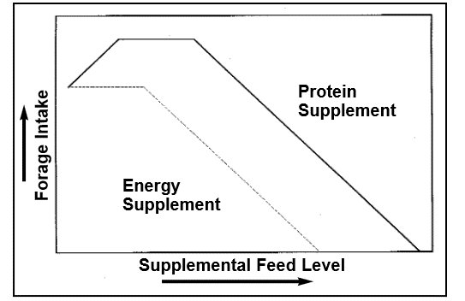
Supplemental Feeding
From -Understanding forage intake in range animals. 1995. by Lyons, Machen, and Forbes.

Slide 18
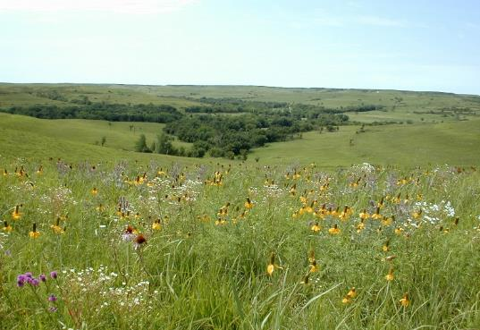
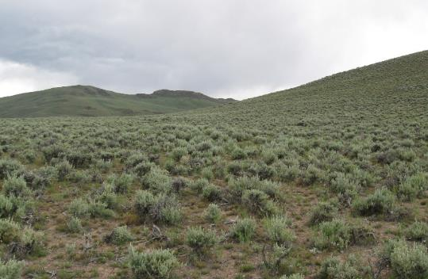
Forage Standing Crop
Forage Quantity can affect intake
  Standing crop > 2,500 lbs/acre no effect on intake
  2,500 to 1,000 lbs/ac = declining intake
  <1,000 lbs/ac = rapidly declining intake
Forage Allowance = Amount of forage available per animal (lbs of forage/100 lbs animal weight)
  More relate to intake than standing crop
M. Haddock
K. Launchbaugh

Slide 19
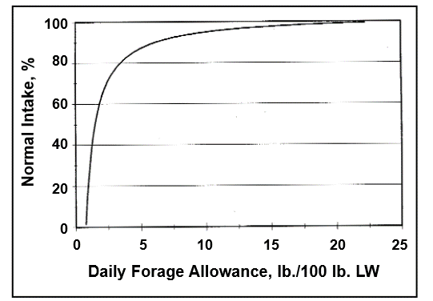
Forage Standing Crop
Forage Allowance = lbs forage/lb live weight of animal
From -Understanding forage intake in range animals. 1995. by Lyons, Machen, and Forbes.

Slide 20
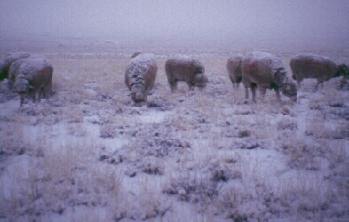
Environmental factors affect intake
Cold temperatures
  Increase demand and intake
  Can reduce intake if snow, ice, or storms limit
  ability of animal to forage
Hot temperatures
  Decrease intake
  Night cooling & foraging at night can improve intake in hot season
K. Launchbaugh

Slide 21
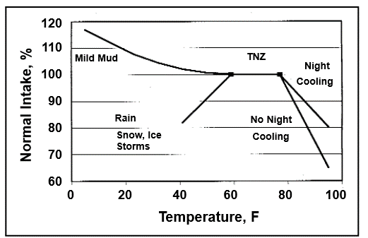
What environmental factors affect intake?
From -Understanding forage intake in range animals. 1995. by Lyons, Machen, and Forbes.

Slide 22
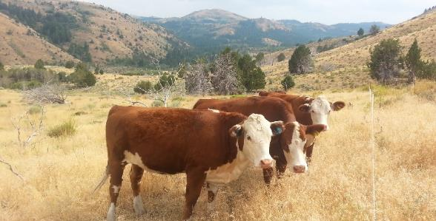
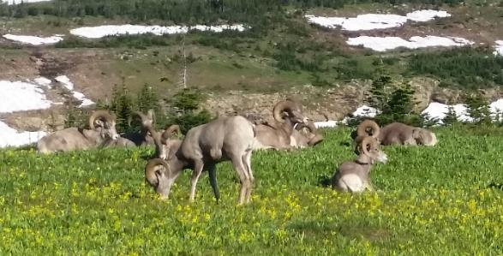
Conclusions – Intake affect
Many characteristics or factors affect intake:
  Animal
  Forage
  Environment
Understanding forage intake is important, because it affects animal nutrient status.
Estimates of intake on a yearly basis (i.e., 2.5% of BW/day throughout year) are gross averages that gloss over true variation.
B. Jacobson
K. Launcbaugh

Slide 23
Herbivore Intake
K. Launchbaugh
BLM
Tom Koerner USFWS
REM 456 - Integrated Rangeland Management

