Slide 1
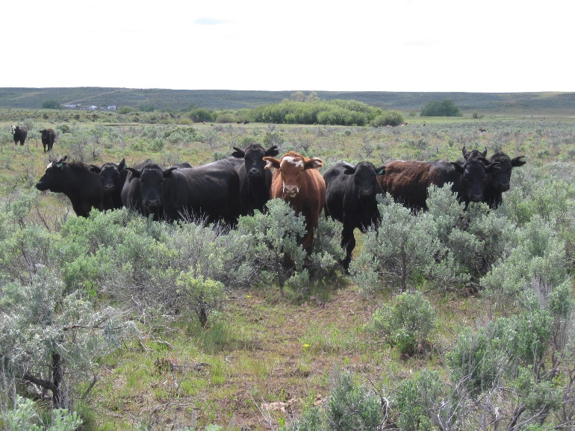
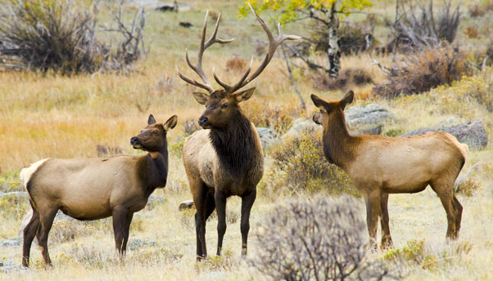
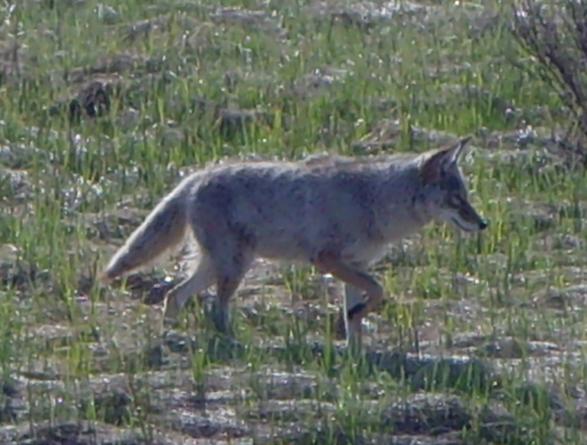

Animal Foraging Characteristics
K. Launchbaugh
NPS.gov
J. Olness
REM 456 - Integrated Rangeland Management

Slide 2
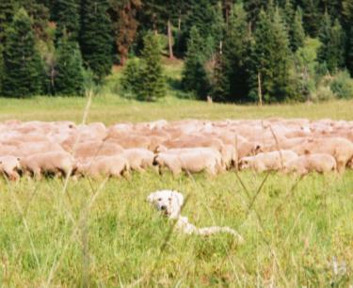
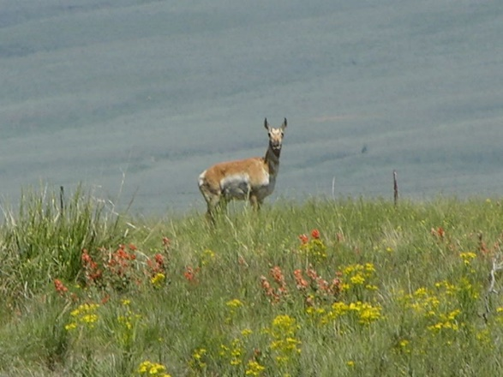
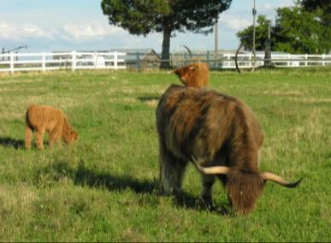

Animal species differ in:
Digestive anatomy
Body size
Diets
Foraging strategies
Habitat requirements
K. Launchbaugh
J. Peterson
K. Launchbaugh
J. Olness

Slide 3
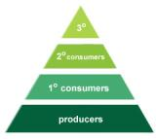
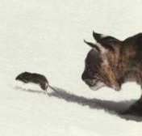
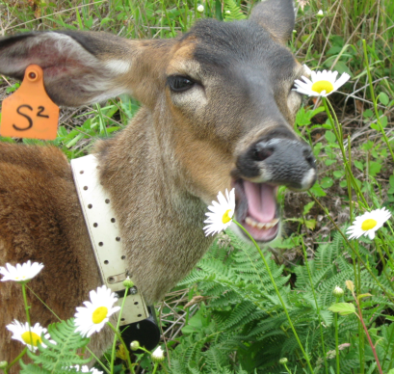
Herbivore Carnivore
Food Source
Plants
Stationary
Abundant
Lo energy & time
Hi success
10,000 bites/day
Hi Intake
Animals
Mobile
Rare
Hi energy & time
Lo success
Few prey/day
Lo intake
Food Capture

Slide 4
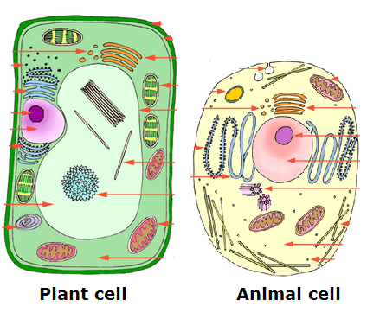
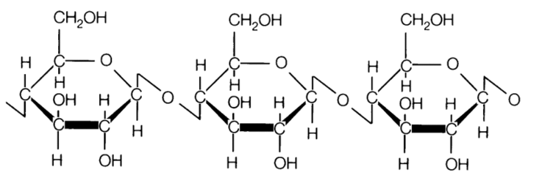
Herbivore Carnivore
Food Quality
Lo & variable in protein & energy
High fiber in cell wall
Hi & uniform in protein & energy
No fiber or cell wall
Cellulose
Cell wall
Cell membrane
Chain of glucose molecules
Vertebrates can’t break bonds

Slide 5
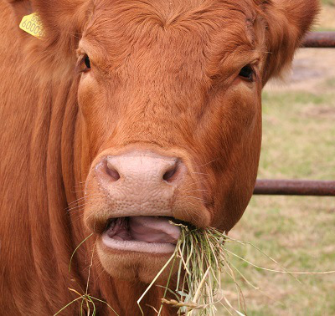
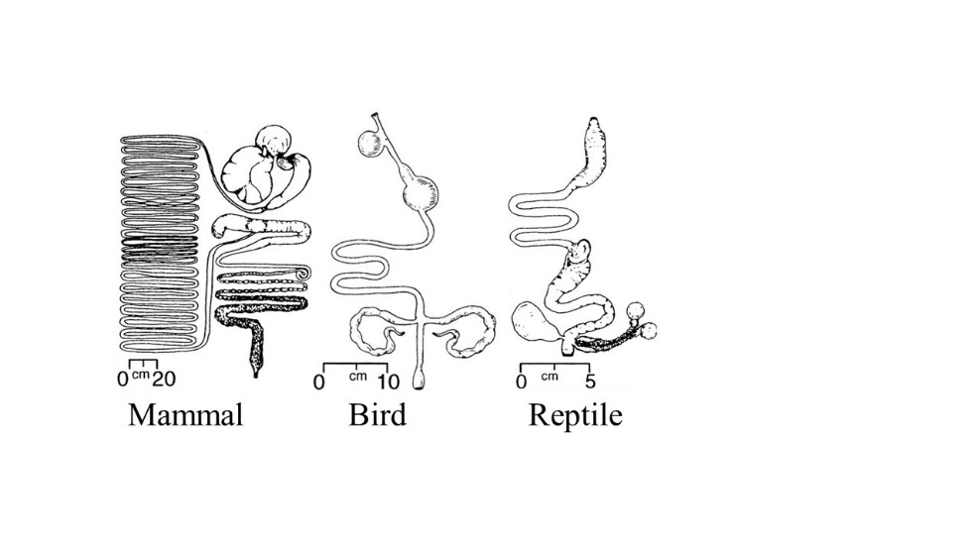
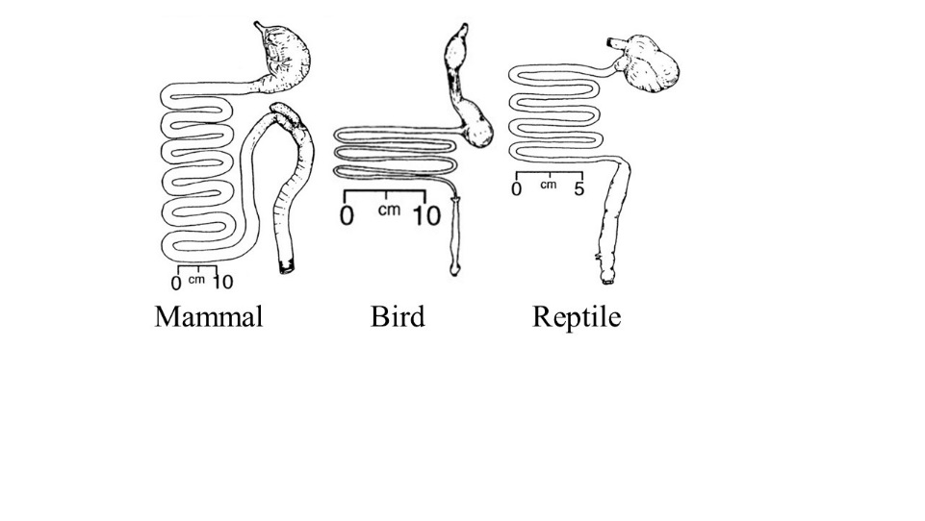
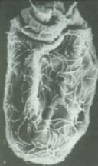
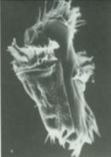
Herbivore Carnivore
Digesting food
Much chewing
Complex digestive tract
Energy & protein from microbial fermentation
Little chewing
Simple digestive tract
Energy & protein from catabolism

Slide 6
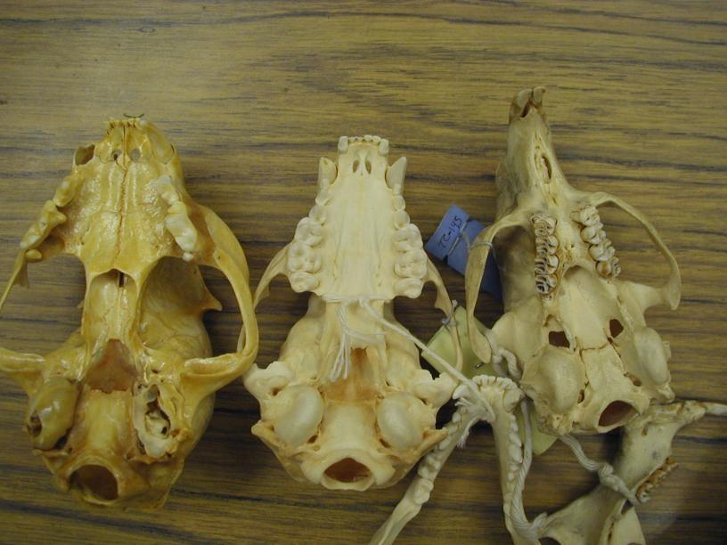
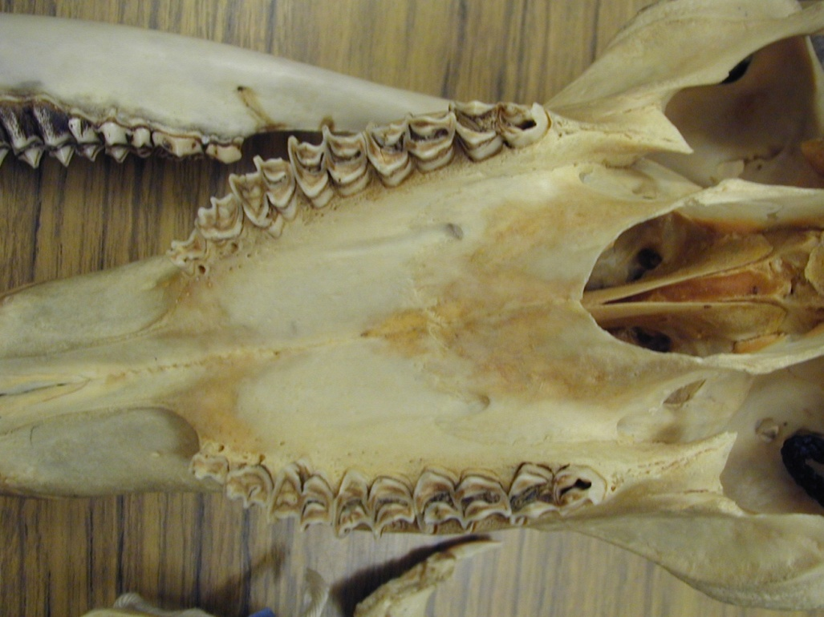
Mammalian Digestive Systems: teeth
Herbivores have ridged molars
for better grinding
Carnivore
Omnivore
Herbivore

Slide 7

What is wrong with this picture?

Slide 8
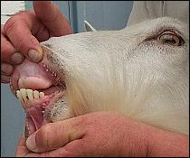
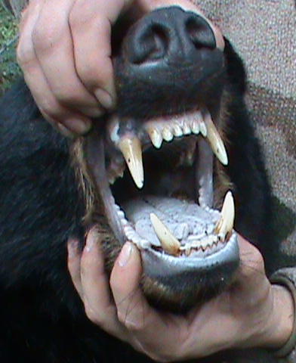
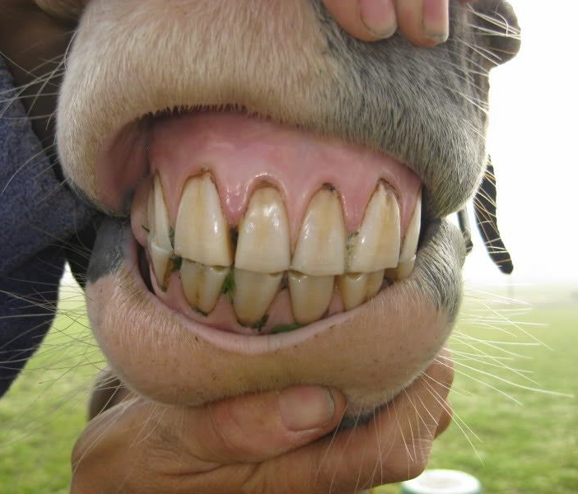
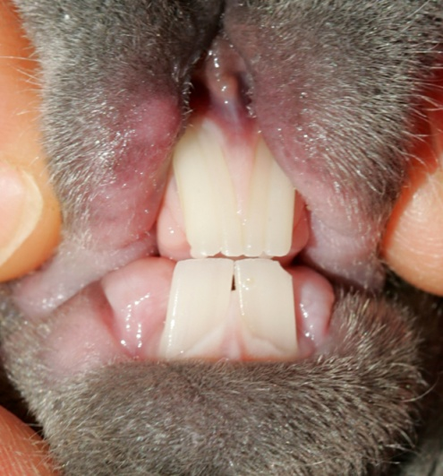
Mammalian Digestive Systems: teeth
Ruminants do not have upper incisors, thus use palate, molars, and tongue to crop bites
Most mammals have upper and lower incisors, that allow them to scrape bark, crop grasses closely and gnaw on stems

Slide 9
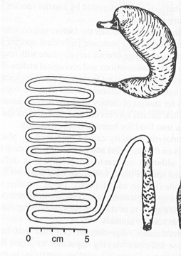
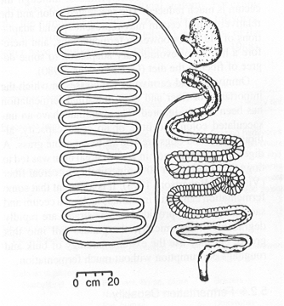
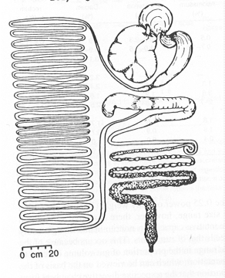
Mammalian Digestive Systems: Gut
Carnivore
Omnivore
Herbivore
Abomasum
True Stomach – secretes enzymes for digestion – acid/pepsin
Small Intestines – absorption of nutrients
Large Intestines – Absorption of water, some nutrients
Can Animal Digest Cellulose?
No
Somewhat
Yes

Slide 10
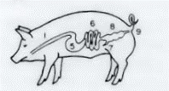
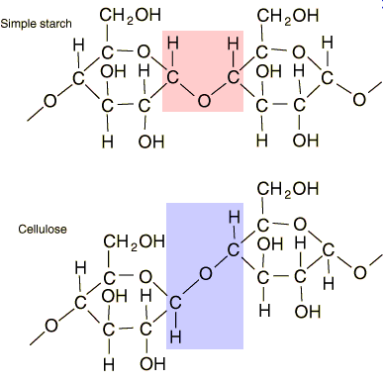
Limited Cellulose Digestion -
Carnivores & omnivores = Monogastrics
No rumen or large cecum/colon for fermentation
Get energy from simple carbohydrates
  Sugar
  Starches
Examples: Swine, humans, raccoons, bears

Slide 11
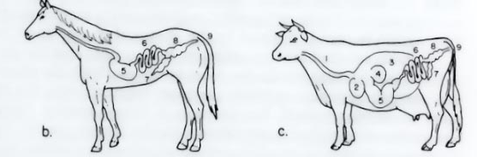
Cellulose Digestion
Herbivores
Requires Large Fermentation Organ:
  Houses microbes
  Microbes
    Break cellulose β1-4 bonds
    Release VFAs as byproduct
    VFA transported to liver converted to usable energy compounds:
      Glucose, aceyl coA, oxyacetyl acid, and fats
Examples: Cows, horses, sheep, goats, deer, elephants, rabbits & rodents

Slide 12

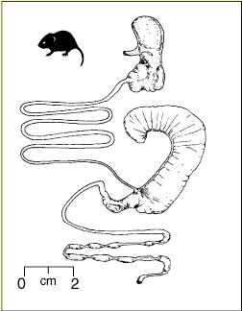
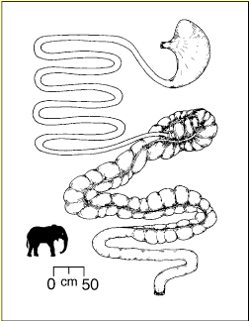
Mammalian Digestive Systems: fermentation
3 places to ferment cellulose
Foregut (rumen)
Hindgut: cecum
Hindgut:colon

Slide 13




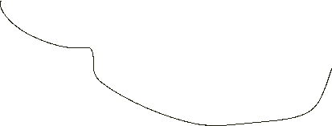






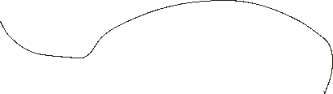






Cellulose Digestion - Foregut
Ruminants and Camelids
  Examples: Cow, sheep, deer, bison, elk, pronghorn, alpacas, llamas, camels
  Have a rumen for fermentation – fermentation comes BEFORE enzymatic digestion
  Most regurgitate food for extra chewing (rumination)
  How it works:

Slide 14

















Cellulose Digestion - Hindgut
Cecal and colon fermenters
  Examples: Horses, rabbits, & some rodents
  Have a cecum or colon for fermentation – fermentation comes AFTER enzymatic digestion
  If cecatrophic, reingest cecal pellets for more thorough digestion and to retain nutrients
  How it works:

Slide 15
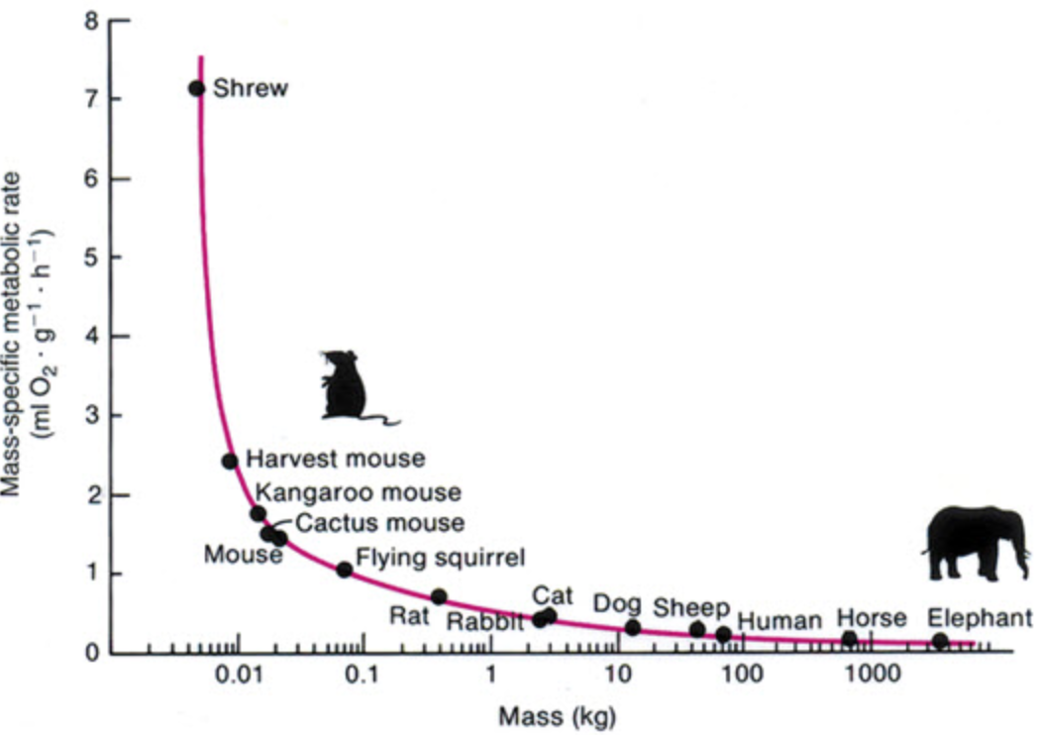
Body size interacts with digestive strategies
Small animals have relatively high metabolism, thus require energy faster relative to their size
Small herbivores can speed up digestion by eating higher quality food and passing food through the digestive system faster
Mouse to elephant curve
Body mass (kg)
Notes:
15

Slide 16
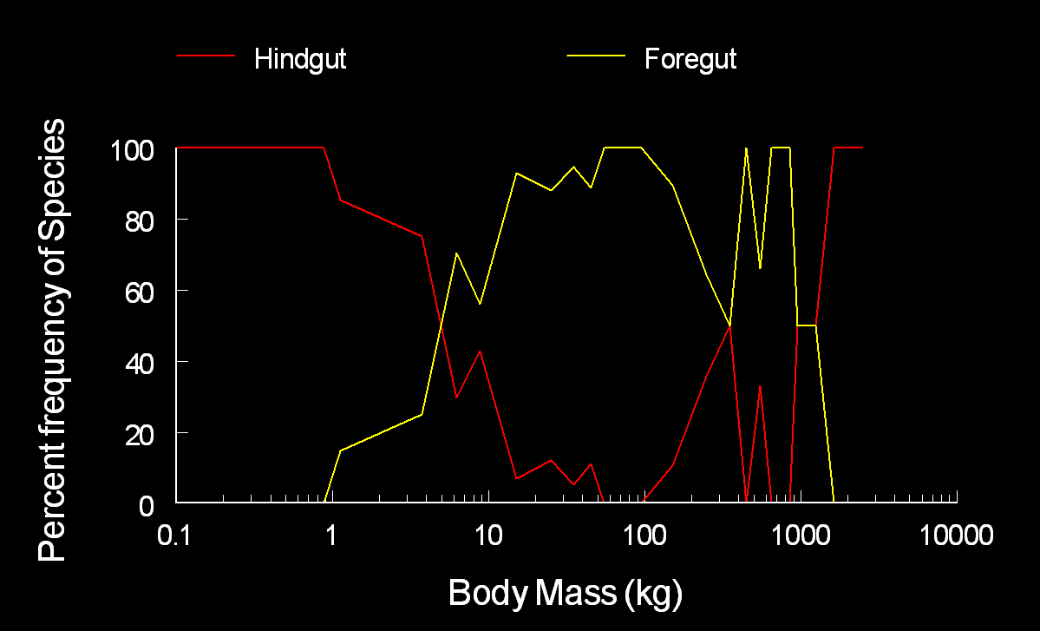
Size distribution of herbivore types
Cecum
Rumen
Colon

Slide 17
Summary of herbivore digestive systems
Foregut
Cecum
Colon
Fermented before digested, often ruminated
Slow passage, low intake
Uses microbial protein & energy
Efficient digestion of cellulose
Inefficient digestion of cell solubles
Medium to large herbivores
Moderate quality food
Digested before fermented
Faster passage, moderate intake
If cecatrophic, uses microbial protein & energy
Less efficient digestion of cellulose
Efficient digestion of cell solubles
Small herbivores
Highest quality food
Digested before fermented
Fast passage, high intake
Doesn’t use microbial protein & energy
Less efficient digestion of cellulose
Efficient digestion of cell solubles
Large to very large herbivores
Low quality food
Notes:
17

Slide 18
Animal Foraging Characteristics
K. Launchbaugh
NPS.gov
J. Olness
REM 456 - Integrated Rangeland Management

