Slide 1
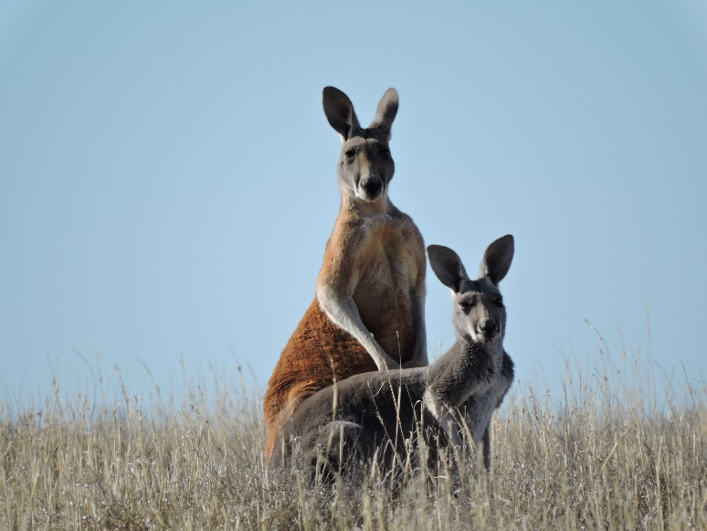
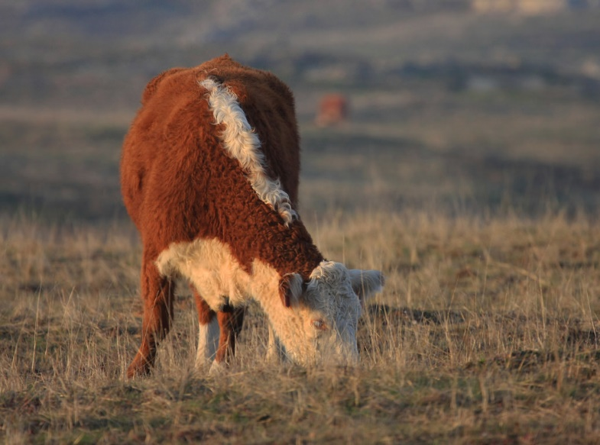
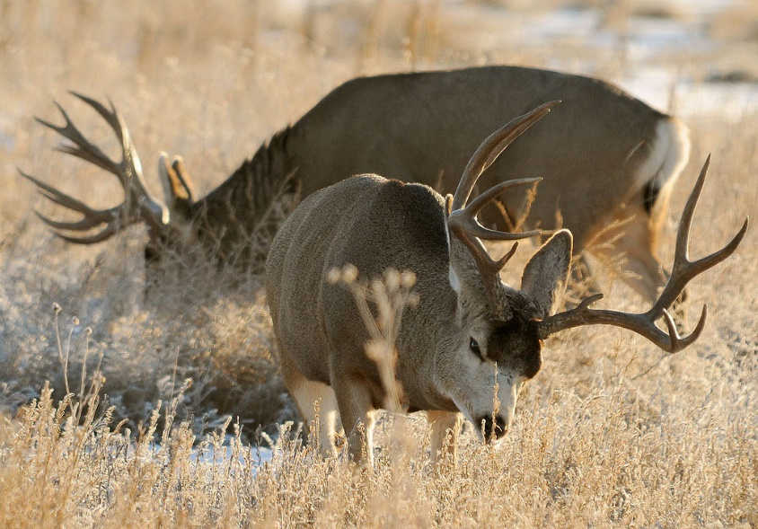

Diet Selection – New Foods
K. Launchbaugh
Erik Charlton ( Snow Ranch)
Rich Keen(USFWS)
REM 456 - Integrated Rangeland Management

Slide 2
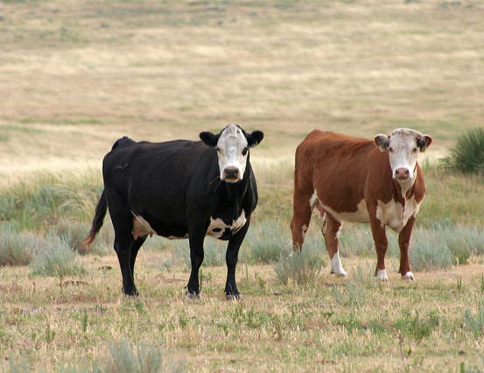
Which foods to eat or avoid?
Animals can tell what food made them feel “good” or “ill”
Even in meals with dozens of foods
How?
Vicki Frank (Flickr)
Notes:
Animals divide foods into two categories: novel and familiar. They use this information to determine which new foods are good and which are harmful.

Slide 3
Animals sample novel foods cautiously
Neophobia = fear of new things
Creates low intake of new foods
Intake of Rice (g)
Intake of familiar food can be
decreased with a new flavor
Day
Provenza et al. 1995
Notes:
When they encounter a new food, they sample the new food carefully and as long as their experience with the food is positive, they slowly increase consumption of that food. If the flavor of the food changes, intake declines but then increases again as long as consequences are positive.
REF: Provenza, F.D., J.J. Lynch and C.D. Cheney. 1995. Effects of flavor and food restrictions on the response of sheep to novel foods. Appl. Anim. Behav. Sci. 43:83-93.

Slide 4

Animals Avoid Novel Foods
Video Available on Youtube
https://youtu.be/hXI4J9f3TZE
Notes:
This video simply demonstrates how animals behave when they encounter novel foods. Insert video novel foods

Slide 5
Animals “blame” the novel food
Oats
Barley
Alfalfa
Food Intake (grams)
Corn – prior illness
LiCl
Rye - novel
Day
Burritt and Provenza. 1991
Notes:
When animals eat a meal of familiar foods and a novel food then experience illness, they reduce consumption of the novel food. These sheep were dosed with LiCl on day 1 of this experiment after eating a meal of 4 familiar foods and 1 novel food. Corn, barley, alfalfa and oats were familiar foods, rye was novel. Likewise, when animals eat a meal of familiar foods and a novel food and get a calorie boost, they associate the calorie boost with the novel food.
Note in the graph above, corn consumption also declined. When these lambs were first introduced to corn, we found regurgitated corn in their pen and believe they got sick on corn. When they got sick again they reduced corn consumption because it had made them ill in the past. A follow up study confirmed that this is likely what happened.
REF: Burritt, E.A. and F.D. Provenza. 1991. Ability of lambs to learn with a delay between food ingestion and consequences given meals containing novel and familiar foods. Appl. Anim. Behav. Sci. 32:179-189.

Slide 6
Animals avoid foods similar to foods that previously made animal ill.
Sheep that did not like cinnamon rice also did not like cinnamon wheat
Launchbaugh and Provenza. 1993
Notes:
Sheep averted to cinnamon-flavored rise did not like cinnamon-flavored wheat. The sheep generalized their aversion to the flavor cinnamon from rice to wheat.
Ref: Launchbaugh, K. L., & Provenza, F. D. (1993). Can plants practice mimicry to avoid grazing by mammalian herbivores?. Oikos, 501-504

Slide 7
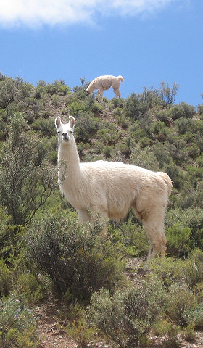
Novelty is key – but other factors play a role
Novel vs Familiar Foods
  Blame sickness on new foods
Prior experience
  Did this food make animal ill in the past?
Generalization
  Is food similar to foods that made animal sick in the past?
Amount eaten
  Did food make up the bulk of the diet?
Timing
  What was the last food eaten?
Hanna Norlin (Flickr)
Notes:
Generalization – Animals use past experiences with familiar foods to make foraging decisions about new foods. If new foods have flavors similar to foods that have made the animal ill in the past animals are less likely to eat these foods. If new foods have flavors similar to nutritious foods animals will ingest these foods more readily.
Prior experience - Animals pair illness with foods that have made them ill in the past.
Amount - Animals pair feedback (positive or negative) with the food they ate in the greatest amount provided both foods are equally novel.
Timing – when lambs were fed two foods that were equally familiar and then dosed with LiCl, lambs formed an aversion to the food that was most closely paired in time with illness.

Slide 8
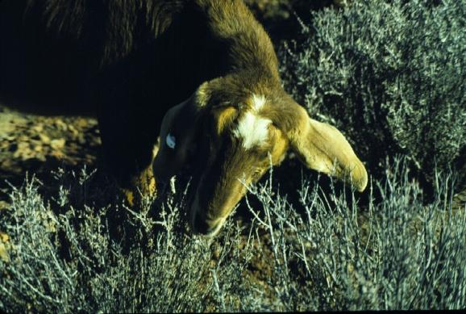
Animals must learn what & how to eat
Herbivores need to learn how to eat.
Develop Foraging Skills
Notes:
The rate at which goats and sheep are able to ingest grasses and shrubs increases with experience. In one study, bite rates tripled as experience increased from no experience to 30 days of browsing the shrub blackbrush. Younger animals 6 months of age learned foraging skills more readily than older animals 18 months of age.
I generally skip this slide and go straight to the video on foraging skills.

Slide 9

Animals must learn how to eat
Video Available on Youtube
https://youtu.be/1DbUaZ3SHH8

Slide 10
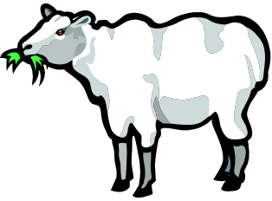
Foraging Skills
Grass
(Crested Wheatgrass)
Shrub
(Serviceberry)
Test Ingestion of
Grass & Shrub
Flores et al. 1989
Notes:
REF: Flores, E. R., Provenza, F. D., & Balph, D. F. 1989. Role of experience in the development of foraging skills of lambs browsing the shrub serviceberry. Applied Animal Behaviour Science., 23(4):271-278.

Slide 11
Foraging Skills
Plant Offered
Flores et al. 1989
Notes:
REF: Flores, E. R., Provenza, F. D., & Balph, D. F. 1989. Role of experience in the development of foraging skills of lambs browsing the shrub serviceberry. Applied Animal Behaviour Science., 23(4):271-278.

Slide 12
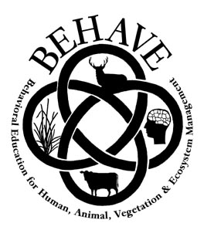
www.BEHAVE.net

Slide 13
References
Burritt, E.A. and F.D. Provenza. 1991. Ability of lambs to learn with a delay between food ingestion and consequences given meals containing novel and familiar foods. Appl. Anim. Behav. Sci. 32:179-189.
Flores, E. R., Provenza, F. D., & Balph, D. F. 1989. Role of experience in the development of foraging skills of lambs browsing the shrub serviceberry. Appl. Anim. Behav. Sci. 23:271-278.
Launchbaugh, K. L., & Provenza, F. D. (1993). Can plants practice mimicry to avoid grazing by mammalian herbivores?. Oikos 501-504
Provenza, F.D., J.J. Lynch and C.D. Cheney. 1995. Effects of flavor and food restrictions on the response of sheep to novel foods. Appl. Anim. Behav. Sci. 43:83-93.

Slide 14
Diet Selection – New Foods
K. Launchbaugh
Erik Charlton ( Snow Ranch)
Rich Keen(USFWS)
REM 456 - Integrated Rangeland Management

