Slide 1
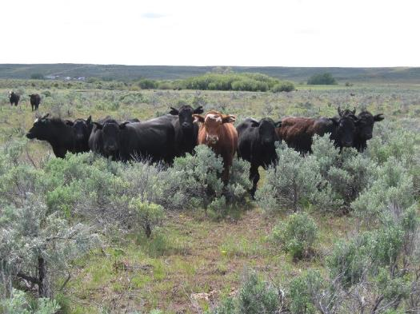
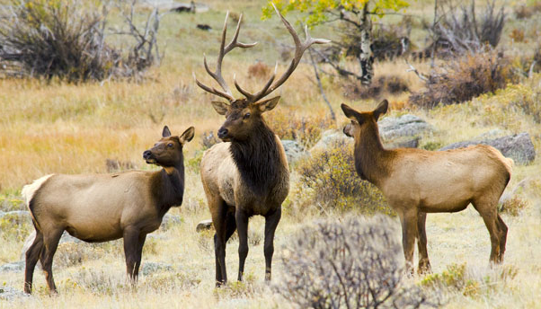
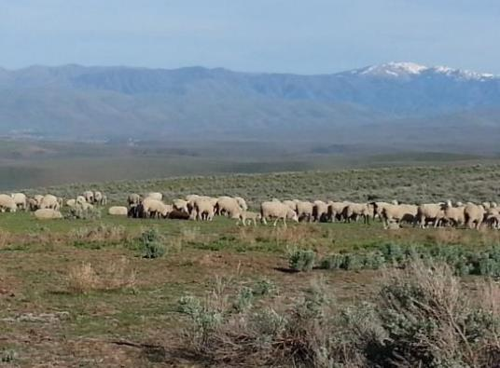

Matching Forage Supply with Animal Demand
K. Launchbaugh
NPS.gov
K. Launchbaugh
REM 456 - Integrated Rangeland Management

Slide 2
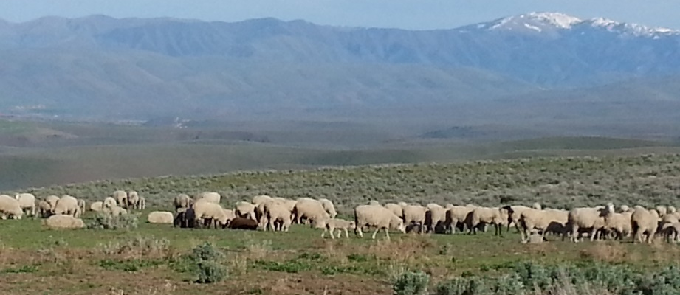
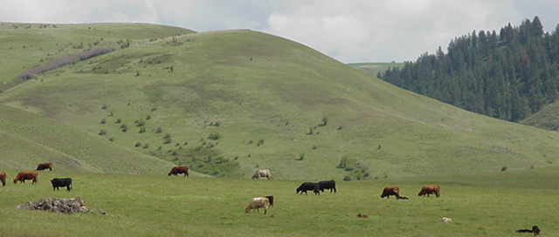
The Big Picture
Range livestock production should:
    Maintain healthy rangelands and healthy animals.
    Generate income for family and community.
    Forage production is driven by temperature, soil characteristics, and plant residue—changes from year to year
    Understand the system to produce healthy and productive rangelands.

Slide 3
The Big Picture
High
Protein Energy
Vitamins
Minerals
Fiber
Lignin
Low
Young
Mature
Dormant
Stage of Growth

Slide 4
Forage Supply Cycle Rangeland
Forage Supply
Amounts of
Energy & Nutrient
Spring
Summer
Fall
Winter
Notes:
Winter growth period begins after fall growth slows due to cooling temperatures, shorter days, and lower light levels.
Rapid spring growth begins with the onset of warming spring temperatures, longer days, and higher light intensities
Peak forage production occurs at the end of rapid spring growth

Slide 5
Yearly Change in Demand for Pregnant
Female Range Herbivore (i.e., cow, sheep, elk, deer)
Animal Demand
Amounts of
Energy & Nutrient
Spring
Summer
Fall
Winter
Notes:
Winter growth period begins after fall growth slows due to cooling temperatures, shorter days, and lower light levels.
Rapid spring growth begins with the onset of warming spring temperatures, longer days, and higher light intensities
Peak forage production occurs at the end of rapid spring growth

Slide 6


Supply Demand
Forage Supply
Animal Demand
Amounts of
Energy & Nutrient
Spring
Summer
Fall
Winter
- - - - - - - - Season - - - - - - - - -
Notes:
Winter growth period begins after fall growth slows due to cooling temperatures, shorter days, and lower light levels.
Rapid spring growth begins with the onset of warming spring temperatures, longer days, and higher light intensitiies
Peak forage production occurs at the end of rapid spring growth

Slide 7
Supply Demand
Forage Supply
Animal Demand
Amounts of
Energy & Nutrient
Spring
Summer
Fall
Winter
- - - - - - - - Season - - - - - - - - -
Notes:
Winter growth period begins after fall growth slows due to cooling temperatures, shorter days, and lower light levels.
Rapid spring growth begins with the onset of warming spring temperatures, longer days, and higher light intensitiies
Peak forage production occurs at the end of rapid spring growth

Slide 8
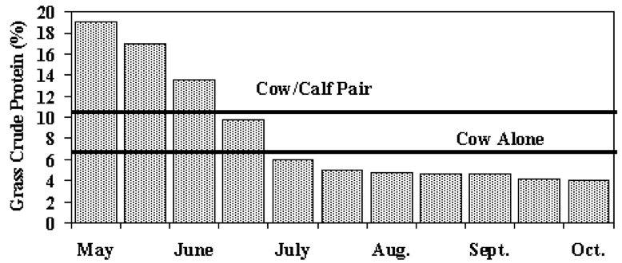
Supply and Demand
Estimated seasonal crude protein concentration of sagebrush-bunchgrass range associated requirements of lactating and non-lactating cows (Turner and DelCurto, 1991)

Slide 9
How to Meet Demand?
Dry Matter Intake (DMI) – The plant material the animal consumes that is void of water
No DMI requirement: Animal consume approximately 1.5-4% of their BW on a Dry Matter (DM) basis
  Spanish goat, Blackbuck antelope, and calf (<100 lb) ~ 4% DMI
  Fallow deer, Sheep, Mule deer, White-tailed deer ~ 3.5%
  Beef cattle 1,000-1,500 lb ~ 2.0%
Notes:
Important to know how much plant material will be consumed by different species to decrease plant biomass. Implications for fire management, rangeland management, and carrying capacity
Forage CP < 6-8% results in decreased forage intake in ruminants—decreased microbe activity in rumen

Slide 10
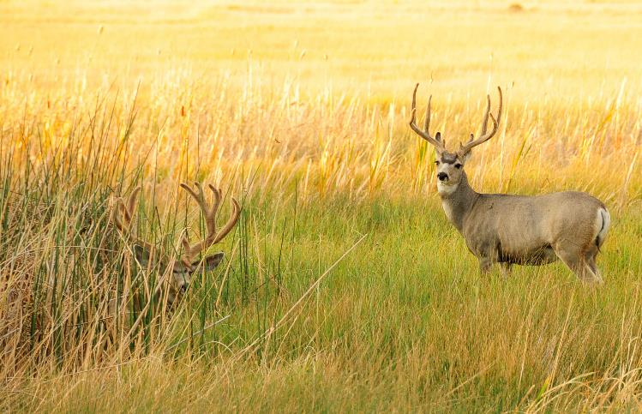
How to Meet Demand?
Dry Matter Intake (DMI)
Example: If a 200 lb Mule deer consumes ~3.5% of their body weight on a DM basis, they will consume 7 lb of plant material on a DM basis
US Fish & Wildlife Service
Notes:
Important to know how much plant material will be consumed by different species to decrease plant biomass. Implications for fire management, rangeland management, and carrying capacity
Forage CP < 6-8% results in decreased forage intake in ruminants—decreased microbe activity in rumen
DMI is influenced by weight, condition, stage of production, level of milk production, forage quality, amount and type of supplement or feed provided, environmental conditions

Slide 11
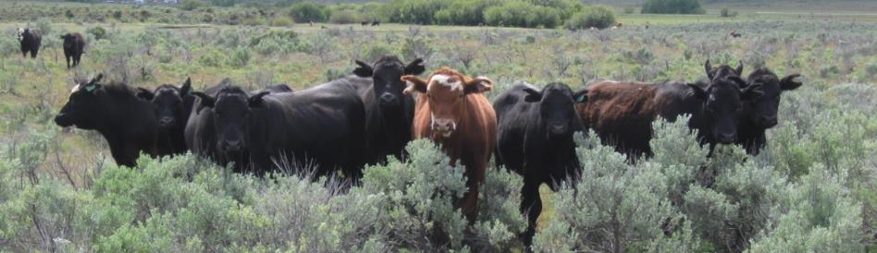
How to Meet Demand?
Stock Conservatively – set demand well below supply
More forage for each animals to choose from:
  Each animal can select most nutritious foods for diet.
  Maximum selectivity results in improved diet quality.
Reduces energy required to find adequate diet.
Notes:
Stocking conservatively also reduces energy requirements because the animals don’t have to go very far to access the plant material.
Know how much plant biomass herbivores will consume

Slide 12
How to Meet Demand?
Timing - Plan so time of greatest animal need coincides with time of greatest nutrient supply.
Birth in spring when forage is of greatest quality.
  Native animals already do this through natural selection.
Timing is the basis for season suitability grazing
  Animals moving up in elevation as season progresses?
Consider type of forage
  Winter forage?
Consider type of operation
  Stocking steers during growing season vs year-round cow/calf?
Notes:
Get the timing right
Consider type of forage: Try to time lactation and young when green grass is abundant.
Consider type of operation: stocking steers don’t have the high lactation or gestation energy demands.
Sheep grazing system where sheep follow green to meet forage supply of the animals.
Timing is the basis for season suitability grazing. Native animals naturally adapt to season suitability grazing.

Slide 13
How to Meet Demand?
Manipulate Vegetation to meet animal needs.
Plant introduced pastures - to provide abundant high quality forage during a particular season.
For example:
  Crested wheatgrass provides good spring/fall grazing because of its growth pattern.
  New rye grasses are being developed with maintain energy and even protein values well into winter.
Notes:
Management Side
Black body tents

Slide 14
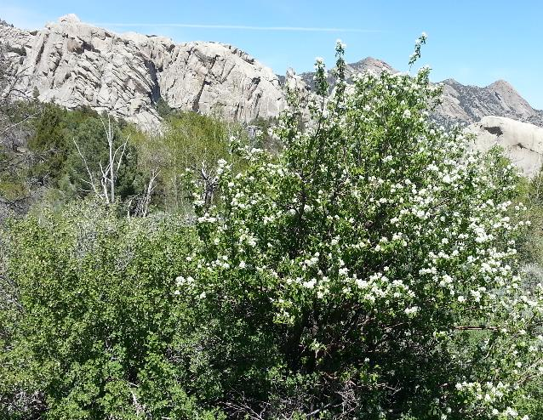
How to Meet Demand?
Manipulate Vegetation to meet animal needs.
Manage for palatable shrubs - protein and phosphorus during dormancy.
  Shrubs on mountain benches for deer winter habitat.
  Cattle grazing to reduce grass biomass and promote shrubs.
Manage for plant diversity.
  Seasonal forage supply improved with increased plant diversity because plant mature at different rates and have different levels of nutrients
K. Launchbaugh
Notes:
Management Side
Black body tents

Slide 15
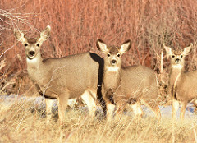
How do grazing animals cope with period of low forage quality?
Build up fat when forage quality is high
  Grazing animals with good fat reserves can survive 30-60 days with little or no food consumptions.
  Mule deer does with high levels of fat reserves have survived periods of complete starvation up to 64 days.
  Fat supplies energy & Vitamin A which stored in fat
Native animals lower their metabolic rate
and consequently lower energy requirements.
US Fish & Wildlife Service

Slide 16
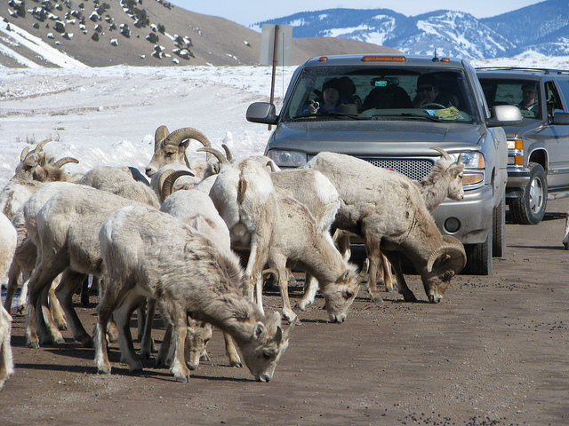
How do grazing animals cope with periods of low forage quality?
Nitrogen recycling in ruminants
  Nitrogen absorbed out of the rumen is put in saliva where it goes back into the digestive system, for possible absorption, instead of being lost in urine.
Soil ingestion
  Can play critical role in permitting ruminants
  to meet mineral needs.
US Fish & Wildlife Service

Slide 17
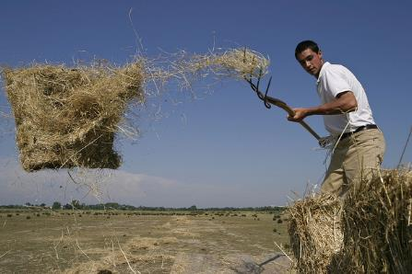
How do grazing animals cope with periods of low forage quality?
ENERY SUPPLEMENTATION
Major operations expense confronting the range livestock industry.
Rarely economical to supplement.
When energy is supplemented, use of range vegetation generally decreases.
High Quality Energy (grains) - generally impractical on rangelands except under drought and heavy snow.
  Can be used effectively for young animals in a creep feeder.
Low Quality Energy - Hay or straw is necessary to
supplement when animals cannot meet daily dry matter requirements on rangeland (winter and drought).
  Remember hay or straw are an energy source - cellulose.
Petteri Sulonen

Slide 18
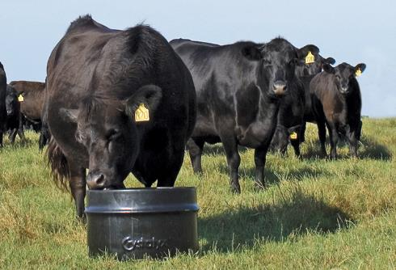
How do grazing animals cope with periods of low forage quality?
PROTEIN (or Nitrogen) SUPPLEMENTATION - Use of rangeland forage may increase with nitrogen supplementation.
Non-Protein Nitrogen (Urea and Biuret) - Lower cost than true protein. Converted to protein by rumen microbes. Can meet about 1/3 total protein requirements.
High-protein feeds - alfalfa, cottonseed meal, soybean meal.
Protein supplementation important when crude
protein values of range forage falls below 6%.
Because below 6%, rumen microbial growth is
inhibited and structural CHO's cannot be
adequately digested.
Crustalix.com

Slide 19
Summary
Plant quality decreases as plant matures.
Animal nutritional demand changes throughout the year and depends on state of life sycle (i.e., growing, lactating, fattening, gestating)
Meet demand by timing nutrient supply with animal demand

Slide 20
Summary
Manage land to increase diverse vegetation to meet animal needs
Wildlife can lower their metabolic rate to limit energy expenditure when plant nutrients are scarce.
Supplementation may help meet animal demand, but is costly.

Slide 21
Matching Forage Supply with Animal Demand
K. Launchbaugh
NPS.gov
K. Launchbaugh
REM 456 - Integrated Rangeland Management

