Slide 1
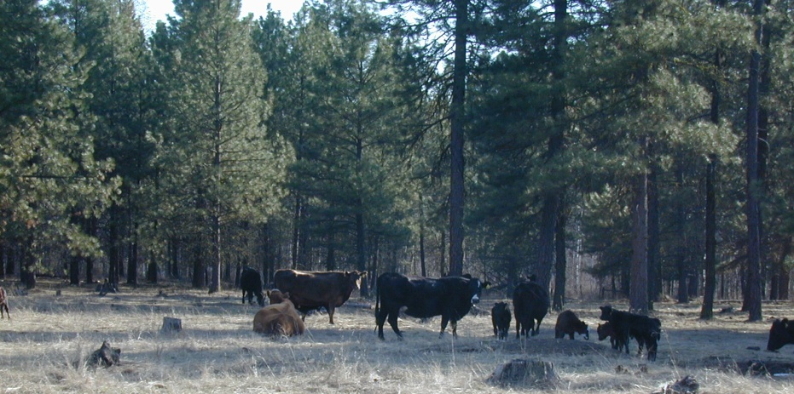
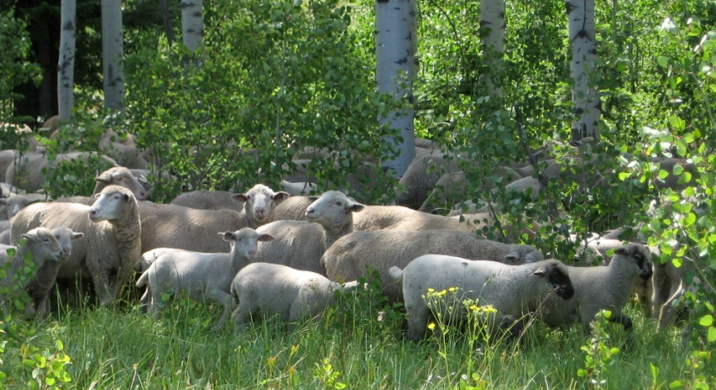

Forest Grazing: Impacts & Management
REM 456 - Integrated Rangeland Management

Slide 2

A Problem in Plantations:
Competition between young seedlings and existing vegetation can reduce growth of young trees.
Dense ground vegetation can improve habitat for voles, and other small rodents, which can damage trees.
Dense vegetation can increase risk of fire.
Grazing could provide a solution... but grazing can also cause damage.

Slide 3
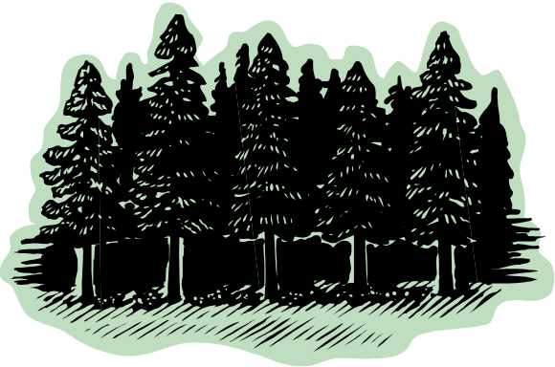
Controlled Grazing...
A Potential Solution
Heavy livestock grazing can reduce weeds and prepare site before tree planting.
Grazing can reduce herbaceous fuels and risk of fire.
Grazing can reduce herbaceous vegetation that competes.

Slide 4
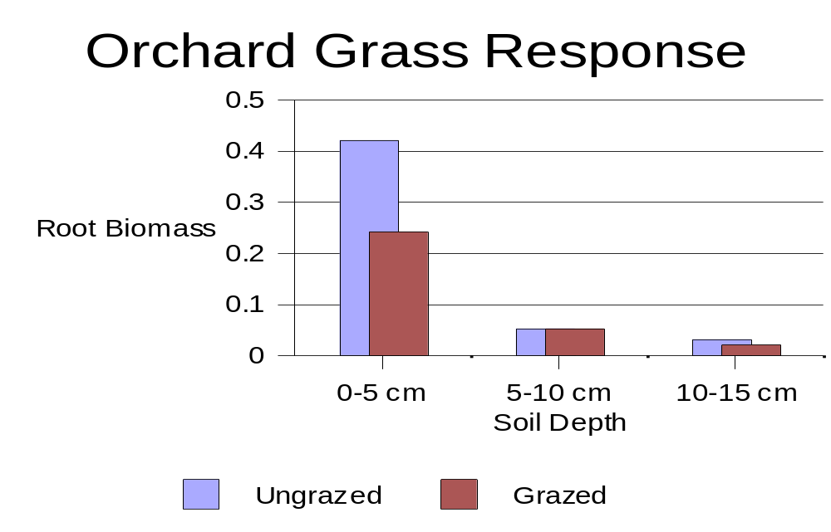
Grazing reduces root growth of competing herbaceous plants.

Slide 5
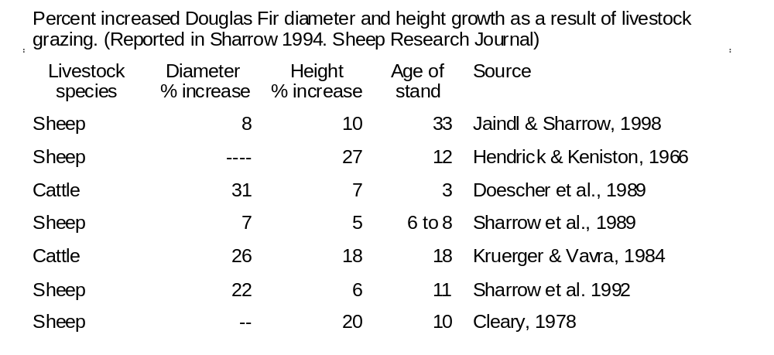
Increased Tree Grows

Slide 6
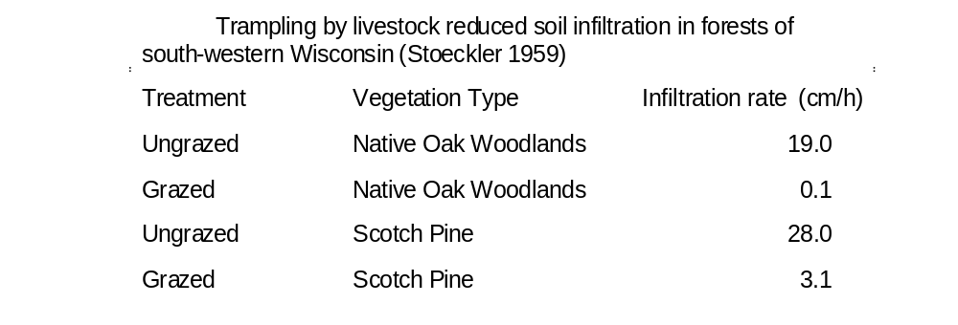
Potential Damage from Livestock:
Trampling of seedlings
Soil compaction

Slide 7

Potential Damage from Livestock:
Browsing
  Depends on -
    Season
    Livestock species
    Understory vegetation.
  Can be severe –
    30% or more of young trees can suffer browsing damage.

Slide 8


Plantation Grazing Guidelines
Effectiveness of prescribed grazing depends on species of tree and understory.
  Deciduous trees are generally more palatable than evergreens.
  Evergreens differ in their palatability among species.
  Understory must contain abundant and palatable forage.
  Herbaceous forage species can be selected and planted during site prep for tree plantings.

Slide 9
Plantation Grazing Guidelines
Palatable herbaceous forage must be available.
  Depends on species of animal
    Cattle generally eat more grass than sheep.
    Cattle generally cause more trampling damage than sheep.
    Sheep more readily browse deciduous trees than cattle.
    Goats can be used, but this is difficult because they are browsers.
  Season
    When herbaceous forage is available and palatable.
    Before conifers start “bud break.”

Slide 10
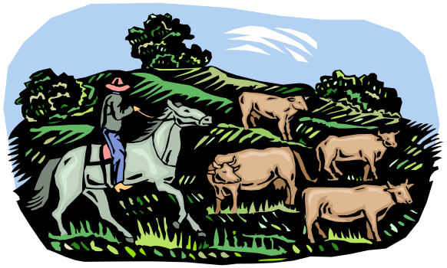
Plantation Grazing Guidelines
If moisture in region is limited... graze before stored moisture is depleted.
Animal numbers and distribution must be controlled.
  Herding and fencing.
  Careful placement of water, salt, and supplement.
  Appropriate stocking rate.
  Consistent monitoring.

Slide 11
Orchard & Vineyard Grazing
Lamb in the Vineyards:
The Benefits of Targeted Grazing
https://youtu.be/C0quSRoBnSk
Or, search “Lambs in the Vineyards”

Slide 12
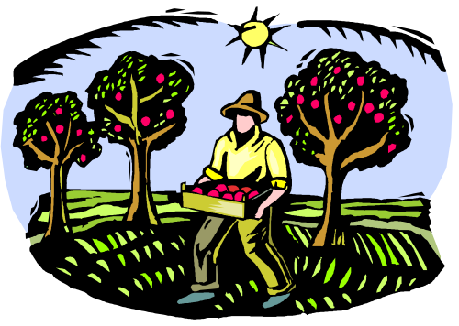
Orchard & Vineyard Grazing
Orchard trees planted in traditional wide-spaced patterns – can be grazed.
Ground cover must be managed for orchard health and productivity.
Excess ground cover competes with trees for water and nutrients.
Sheep and goats have been used for centuries to graze understory vegetation.
Livestock must be monitored carefully
to avoid overgrazing or browsing.

Slide 13
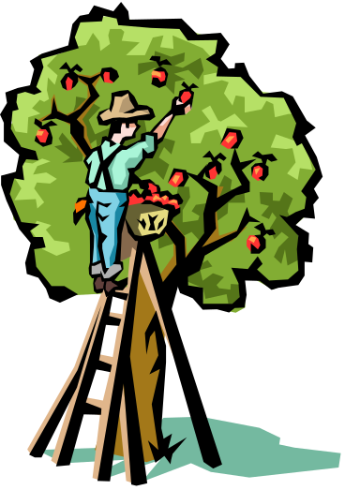
Orchard & Vineyard Grazing
The number of animals needed for targeted grazing fluctuates during the growing season.
Livestock should be removed when the orchard is wet.
May need to remove animals for orchard management and harvest.
May be health considerations with fecal material in orchards and vineyards.
Livestock can remove fruit that falls
to ground.

Slide 14
Literature Referenced
Cleary, B.D. 1978. Vegetation management and its importance in reforestation. Oregon State University, Forest Resources Lab., Corvallis. Res. Note 60. 4.
Doescher, P.S., S.D. Tesch, and W.E. Drewien. 1989. Water relations and growth of conifer seedlings during three years of cattle grazing on a southwestern Oregon plantation. Northwest Science 63:232-240.
Hedrick, D.W. and R.F. Keniston. 1966. Grazing and Douglas-fir growth in the Oregon white-oak type. Journal of Forestry 64:735-738.
Jaindl, R.G. and S.H. Sharrow. 1988. Oak/Douglas-fir/sheep: A three-crop silvopastoral system. Agroforestry Systems 6:147-152.
Krueger, W.C. and M. Vavra. 1984. Twentieth year results from a plantation grazing study. 20-24. IN: Research in rangeland management. Oregon Agriculture Experimental Station Special Report 715. p. 20-24
Sharrow, S.H., W.C. Leininger, and B. Rhodes. 1989. Sheep grazing as a silvicultural tool to suppress brush. Journal of Range Management 42:2-4.
Sharrow, S.H., W.C. Leininger, and K.A. Osman. 1992. Sheep grazing effects on coastal Douglas-fir forest growth: A ten-year perspective. Forest Ecology and Management 50:75-84.
Sharrow, S. H. 1994. Sheep as a silvicultural management tool in temperature conifer forest. Sheep research journal. Special Issue pp. 97–104
Stoeckler, J.H. 1959. Trampling by livestock drastically reduces infiltration rate of soil in oak and pine woods in southwestern Wisconsin. USDA For. Serv., Lake State Forest. Exp. Sm. Tech. Note 55

