Slide 1
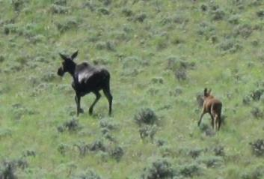
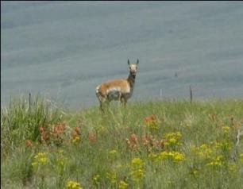
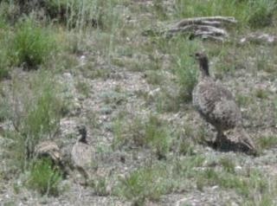

Habitat Requirements
K. Launchbaugh
J. Peterson
K. Launchbaugh
REM 456 - Integrated Rangeland Management

Slide 2
What is Habitat?
Habitat = The natural “home” of an animal including all biotic, climatic, topographic, and edaphic (soil), factors that affect life.
4 basic components:
  Water
  Food
  Cover
  Space
Water
Food
Cover
Space

Slide 3
Water
Water requirements vary for animals, depending on the species, weather, and climate
  Sheep: 1-1 ½ gallons once/2 days
  Goats: 1-1 ½ gallons once/2 days
  Donkeys: 3-4 gallons once or twice/day
  Horses: 5-8 gallons once or twice/day
  Cattle : 8-10 gallons once/day
  Bison: 8-10 gallons once/1 to 2 days

Slide 4
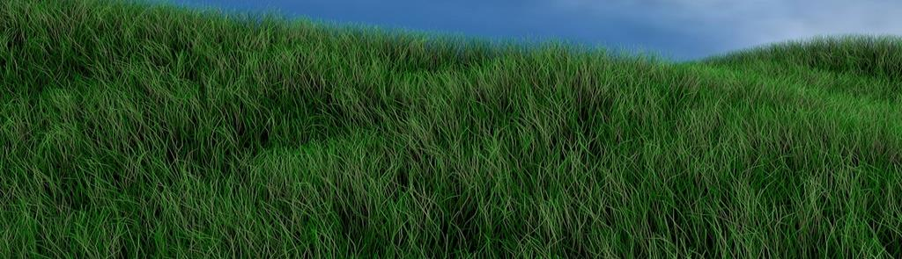
Water
Moisture content of forage
  Immature forage has lots of water in it!
  Immature grasses may be up to 75% water
        An animal eating 26 pounds of young forage will consume about 2.5 gallons of water.
Jochem Oogink (Flickr)

Slide 5
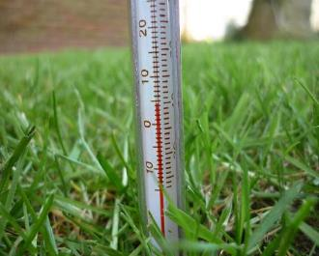
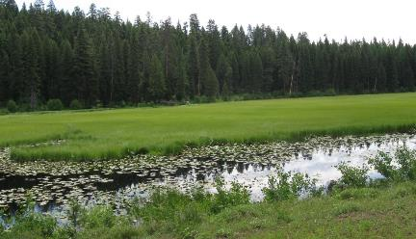
Water Demand
Depends on:
  Weather – Hot temperature increases demand
  Physiological State – Lactation increases demand
Affects landscape-use patterns:
  Riparian Areas
    Streams & Creeks
    Seeps & Wetlands
Kris Lord
K. Launchbaugh

Slide 6
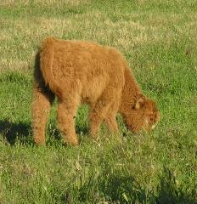
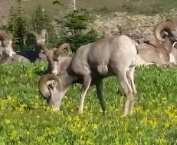
Food – Meet Growth & Maintenance Requirements
Energy - from cellulose (i.e., structural carbohydrates), starches, sugars, and fats
Nutrients
  Protein – Compounds contain nitrogen
  Vitamins – Mostly A, D, and E
  Minerals – Mostly phosphorus, potassium, and calcium
K. Launchbaugh
K. Launchbaugh

Slide 7
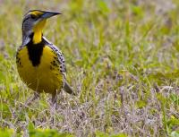
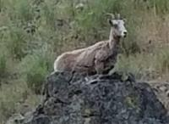
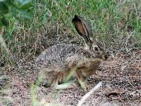
Food – How much to eat?
Depends on type of digestive system:
Monogastric - Concentrate selectors
  Such as birds, bears, and mice
  1-10% of their body weight per day
Ruminant Fermentation
  Including bison, deer, elk, cattle, sheep and goats
  Eat 2.5-3.5% of body weight per day
Hind-gut fermenters
  Such as horses and rabbits
  Eat 3.5-6.0% of their body weight per day
Pete G (Flickr)
K. Launchbaugh
Greg Schechter

Slide 8
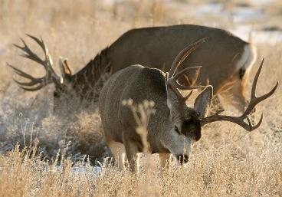
Foods can be classified as:
Preferred ─ More abundant in an animal’s diet than available in the field.
Staple ─ Eaten on a regular basis and meet the nutritional needs, but not sought or preferred.
Emergency ─ Only rarely eaten to fulfill short-term nutritional needs. Generally have low forage value.
Fill ─ Eaten only if nothing else is available, would not meet animal needs.
Rich Keen(USFWS)

Slide 9
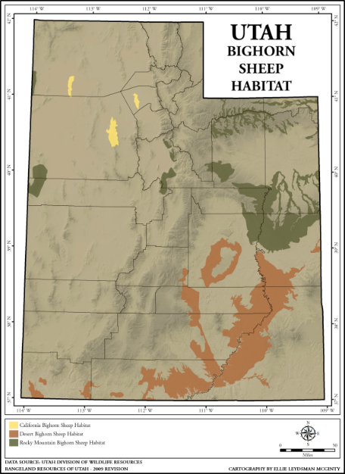
Manage Food Resources
Evaluate land based on
food requirements:
  Vegetation/forage present
  Diet preferences
  & requirements of animal
Also must evaluate spatial
arrangement of food.
K. Launchbaugh
Examples from Utah Rangelands:
http://extension.usu.edu/utahrangelands/htm/wildlife/

Slide 10
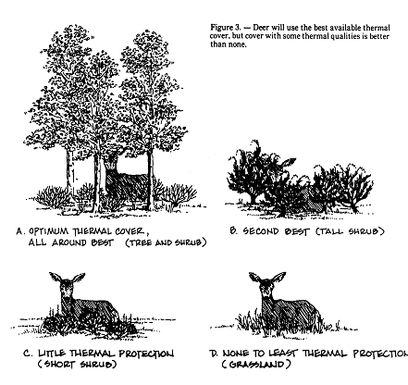
Cover
Thermal
  Shade in summer
  Shelter from
  cold wind in winter

Slide 11
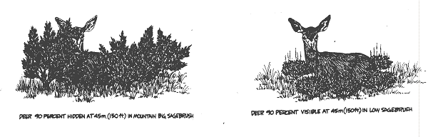
Cover
Hiding - Protection from predators
  Vegetation as visual obstruction

Slide 12

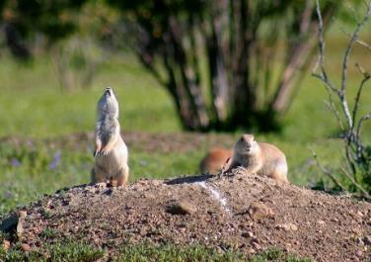
Cover
Unobstructed - Protection from predators
  Lack of visual obstruction (i.e., pronghorn and prairie dogs)
Jen Peterson
USFWS

Slide 13
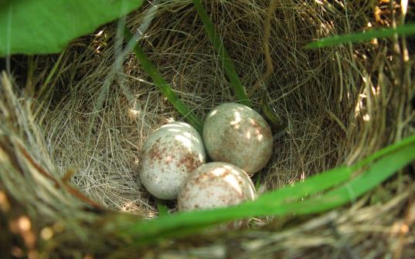
Space
Important consideration for:
Breeding and nesting
Home range
Territories
Social intolerance
Disease transmission
Dave Huth (Flickr)

Slide 14
Habitat Selection
The act of selecting specific habitat among habitats
Potential Range or Potential Habitat = Area that contains all elements necessary for growth and reproduction.
Actual or Occupied Range = Area where a species currently occurs.
Historic Range = Area once occupied by a species.

Slide 15

Habitat Quality
Limiting Factors = basic requirement that
limits the size, growth, &/or quality of
animal populations.
  Water ○ Food
  Climate ○ Topography
  Disease ○ Predation

Slide 16
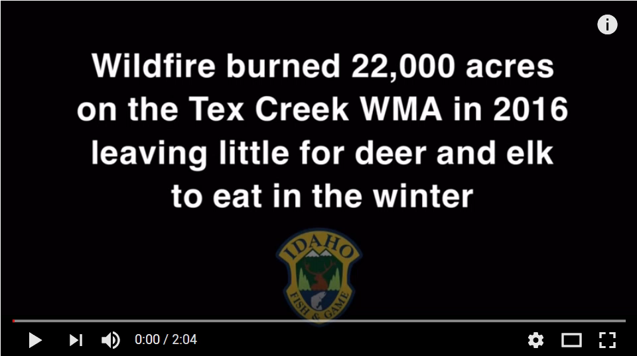
Limiting Factors
Human impact on limiting factors
  Remove limiting factors

Slide 17
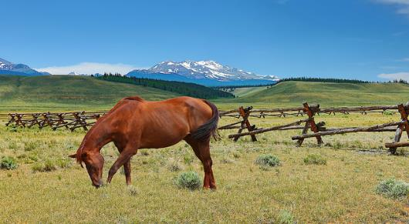
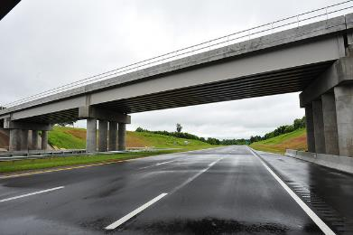
Limiting Factors
Human impact on limiting factors
  Remove limiting factors
  Add limiting factors
    Fences
    Roads
Rennett Stowe (Flickr)
NC Dept of Transportation

Slide 18
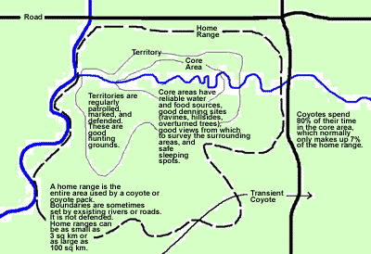
Home Range
The area in which an individual animal conducts its normal annual activities.
www.stanleyparkecology.ca

Slide 19
Habitat Selection
Home Range = the area in which an individual animal conducts its normal annual activities
  can be shared with other individuals
  directly related to body weight
  carnivores > omnivores > herbivores
  varies by diet habits
  human encroachment has greatest effect on animals with large home ranges

Slide 20
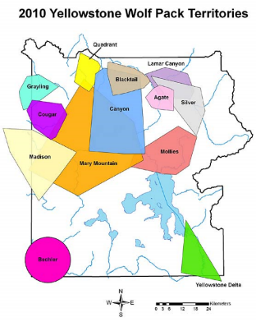
Territory
Territory = an area that an animal will defend (usually for breeding or rearing young)
  Exclusive to individual
  or unit (i.e., pack)
http://forums.yellowstone.net

Slide 21
Home Ranges & Territories
Why do animals select home ranges or territories?
  It allows animals to be familiar with food resources and develop foraging skills.
  Results in increased knowledge of cover to decrease risk of predation.
  Any disadvantages?

Slide 22
Habitat Use
Philopatry = the “love” for a particular place, usually referring to one’s homeland or place of rearing. In some species, like salmon, philopatry is so strong that no place but that place is acceptable.
Predation = habitat selection takes into account the risk of predation in habitat.
Quality of information = Perfect habitat selection requires perfect habitat information.
Not possible because animal do not know:
  all appropriate habitat available
  may not be able to assess habitat quality
  of may not know the risk of predation

Slide 23
Habitat Use
What natural events challenge the quality of wildlife habitat?
What human activities challenge the quality of wildlife habitat?

Slide 24
Habitat Requirements
K. Launchbaugh
J. Peterson
K. Launchbaugh
REM 456 - Integrated Rangeland Management

