Slide 1
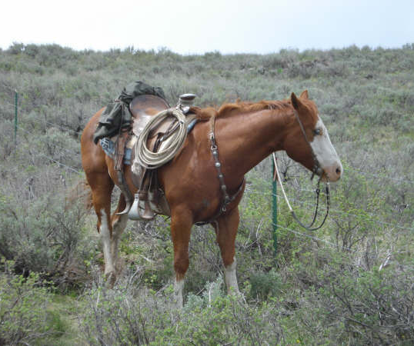
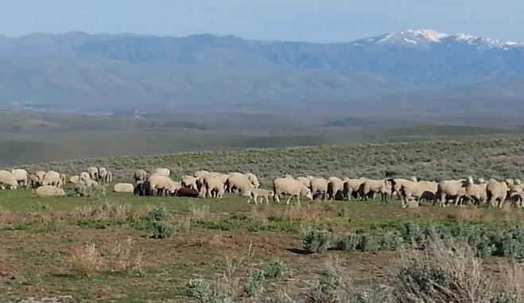
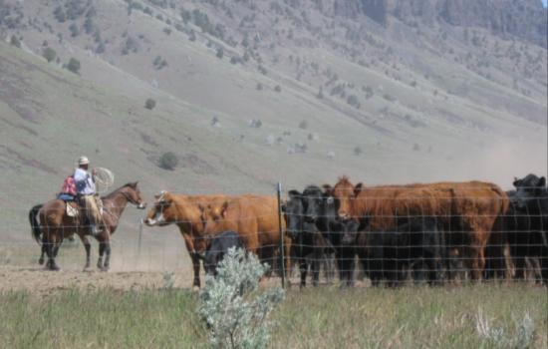

Public Land Grazing
S. McFarland
T. Lester
K. Launchbaugh
S.McFarland
REM 456 - Integrated Rangeland Management

Slide 2
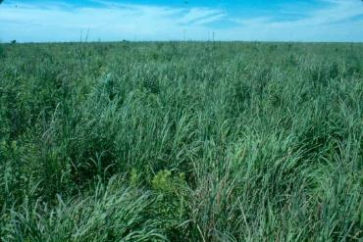
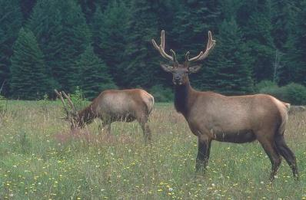
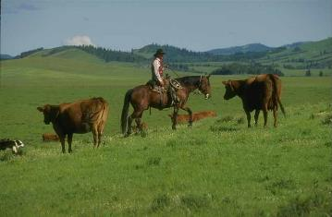
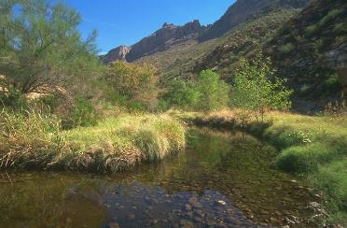
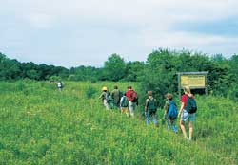
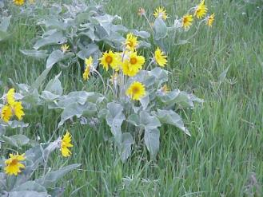
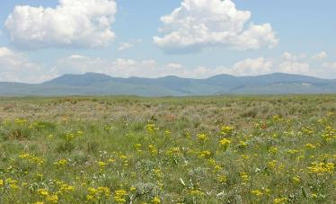
Rangelands are Important
Forage
Wildlife Habitat
Water
Livestock Production
Recreation
Open Space
Native Plants

Slide 3
The Ranching Challenge
= few resources can be sold to pay for land and taxes
Forage
Wildlife Habitat
Water
Livestock Production
Recreation
Open Space
Native Plants

Slide 4
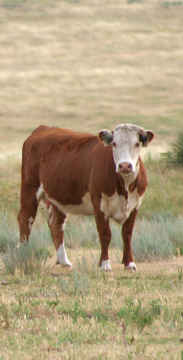
What are Rangelands?
Rangelands are a kind of land
– not a specific land use.
Rangelands are inherently tied to grazing.
  Grazing as an important ecological process on all rangeland.
  But, not all rangelands are grazed by livestock.
  Grazing of domestic livestock affects more
  of the land surface than any other human activity.
Vicki Frank(Flickr)
Notes:
All rangelands are grazed in some form or another – herbivory is a key factor in defining rangelands. However, not all rangelands are grazed by livestock. Ask audience if they can think of other important herbivores (e.g. insects and wildlife). Insects generally eat more on rangelands than livestock.

Slide 5
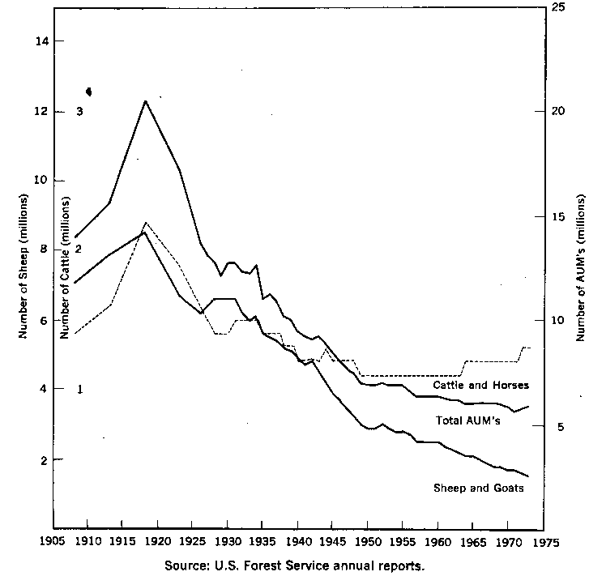
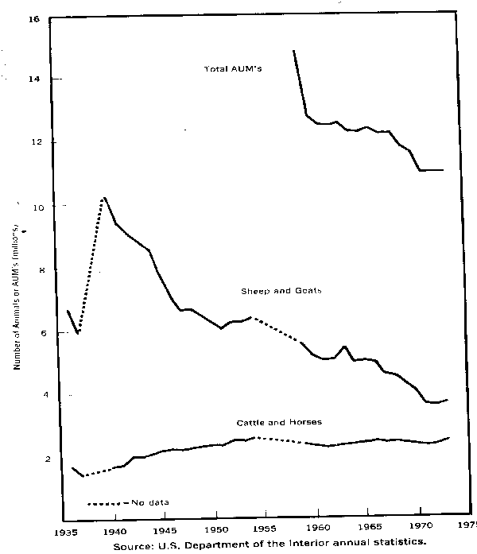
Grazing in United States
US Forest Service
Bureau of Land Management
1905 to 1975
1935 to 1975

Slide 6
35
Trends in Grazing on
Federal Grazing Lands
25
Millions of AUM’s
15
05
1900
1950
2000
------------Year--------------

Slide 7
Why historic decrease in livestock numbers?
35
25
Millions of AUM’s
15
End of the grazing commons
Livestock sold by pound not by head
05
1900
1950
2000
------------Year--------------

Slide 8
Why modern decrease in livestock numbers?
35
25
Millions of AUM’s
15
Multiple uses – especially recreation
Litigation against grazing
FLPMA, NEPA & ESA
05
1900
1950
2000
------------Year--------------

Slide 9
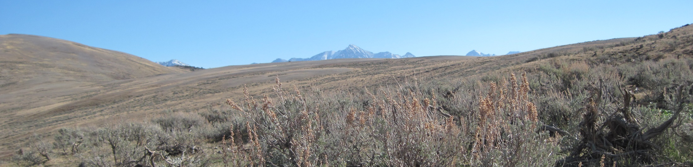
Grazing on Public Lands
Public land is owned and managed by federal and state governments for the good of the public.
Most significant land management agencies are the Bureau of Land Management, the U.S. Forest Service, and state Departments of Land.
K. Launchbaugh
Notes:
Basic points – need to get specific % of rangeland owned by these agencies.

Slide 10
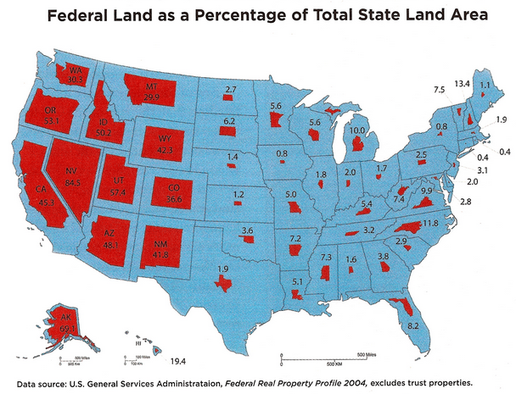
Grazing on Public Lands
Notes:
Map entitled “Who Owns the West” by the U.S. General Services Association
The main point is, most of the West is mostly public land and most of the rangeland is in the west. Therefore, most rangeland is publicly owned.

Slide 11
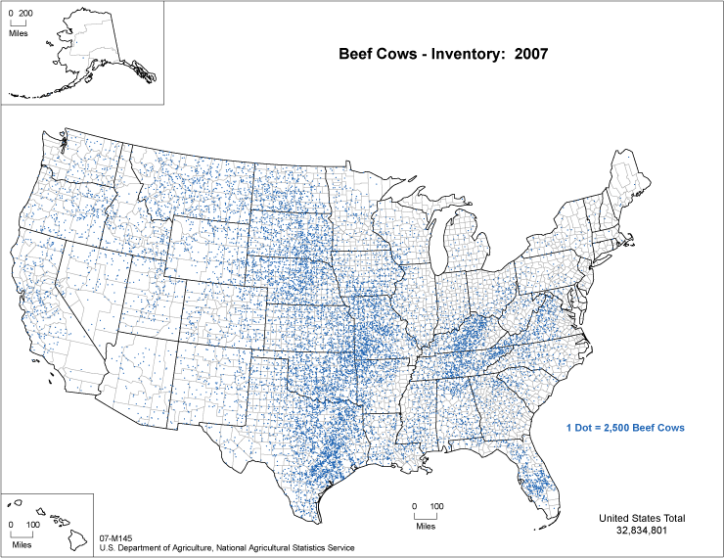
USDA Beef Cows, 2007
Notes:
About 20 percent of the US Beef cows are in the 11 western states.

Slide 12
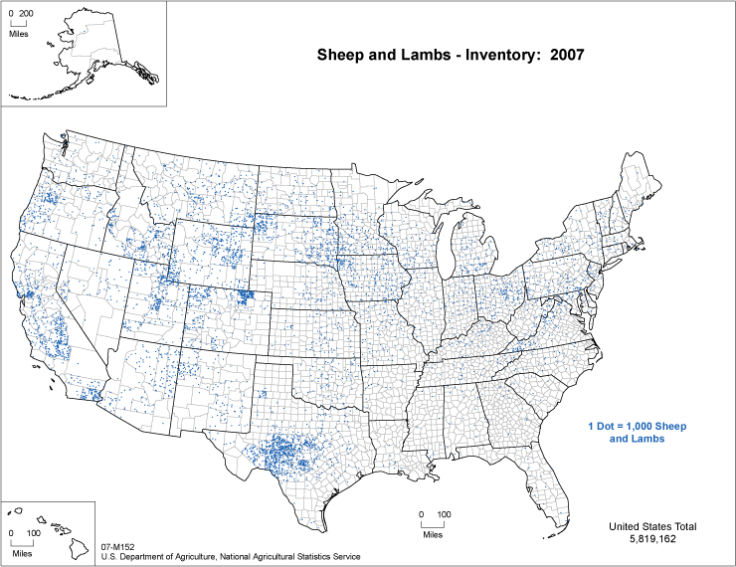
USDA Sheep and Lambs, 2007
Notes:
Sheep numbers are about evenly split between the west and the rest of the nation.

Slide 13
2011-12 Grazing Use
Land Type | # Permits | AUMs
Bureau of Land Mgmt Fiscal Year 2011 | 15,897 | 8,985,228
Forest Service Grazing Season 2012 | 6,155 | 6,496,423
Total | 22,052 | 15,481,651
SOURCES: Public Land Stats (BLM); Grazing Statistical Summary (USFS)
Notes:
Jacobs (1991) – only 2% of nations beef producers use public lands.
Livestock Industry estimates up to 40% of the Nation’s beef-cow inventory spends time on public lands (Newsweek 1991).
AUM use reduced from 15.8 M AUMs in 2001-02. Recent grazing use reduced because of drought, cattle cycle and continuous sheep declines

Slide 14
Importance of Public Land Grazing in the 11 Western States
2012 Forage Use
2012 Inventory | Head | AUMs
Beef Cows | 34.7 M | 416 M
Sheep | 5.2 M | 12 M
Total |  | 428 M
15.4 M Federal AUMs
428 M Total AUMs
Idaho: 25-30% for last 15 years
Notes:
One of the contentions of those that would eliminate grazing on public lands is that these lands supply only 2 – 4 % of the nations beef supply is produced on public lands (based on forage use).
SUMMARY:
11-western states had about 19% of the 2002 beef cow inventory
Public lands supplied about 21% of the AUMs in the Western States (Much higher percentage of May – Sept Forage)
Public lands supplied about 2-3% of the beef cow AUMs for the Nation
About 40% of the beef cows in the West spend some time on public lands (Torell, Importance of Public Lands).
Similar to the findings of Backiel (1985) in a Congressional Briefing paper:
“Federal rangelands provide forage for approximately 3% of the U.S. beef cattle population and 28% of the total sheep, but provide 17% of the forage in the West.”

Slide 15

Seasonal Dependence on Federal Land Forage
Summer
Spring
BLM
BLM/USFS
Seasonal Grazing
Patterns
Fall
Deeded
Aftermath
Winter
Feed hay
Notes:
Public lands are important for the complementary grazing they provide for other private forage sources in other grazing seasons.
Seasonal dependencies are critical factors to bring out in the discussion.
Taylor, Bartlett, and Lair (1982) used 1977 data in Colorado to estimate seasonal dependencies on federal land forages by season. They found public land dependencies during the summer and fall to be as high as 50-60%
Seasonal dependency much more and without many alternatives (eg. Owyhee County, Idaho is 87% public land, with year-long dependencies ranging from about 25-70+%, and seasonal dependencies much higher for spring-fall grazing seasons)

Slide 16
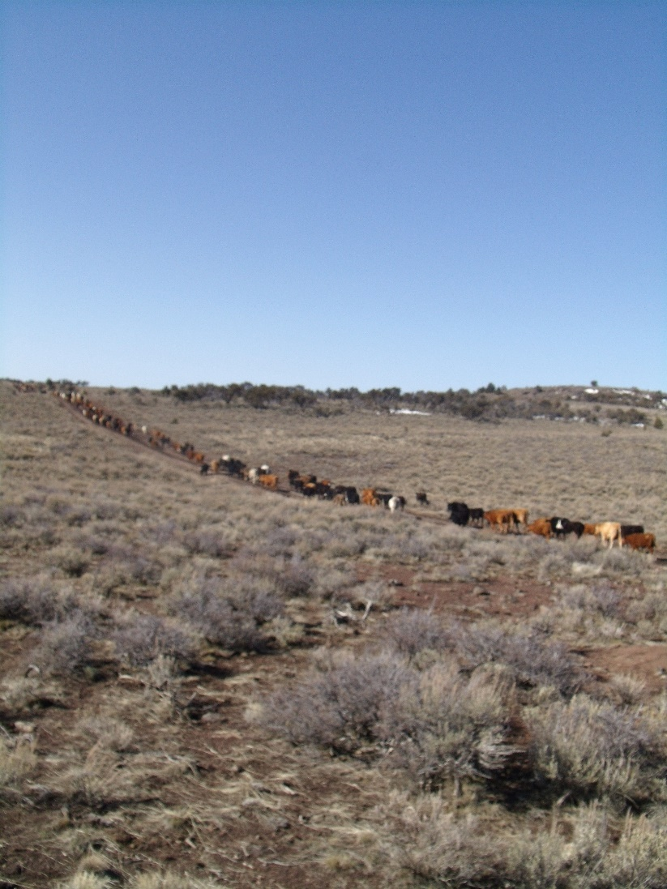
Grazing on Public Lands
Grazing on private lands is wholly integrated with public grazing lands.
  Livestock grazing occurs on:
    80% of BLM land
    58% of U.S. Forest Service lands
  88% of all beef cows in Idaho graze at least part of each year on BLM or USFS lands.
T. Lester
Notes:
When you think of ranching in Idaho, you have to think about integrated land ownership – checkerboard land ownership.

Slide 17
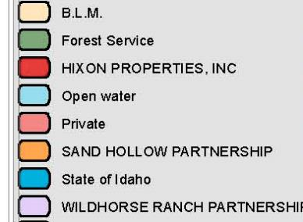
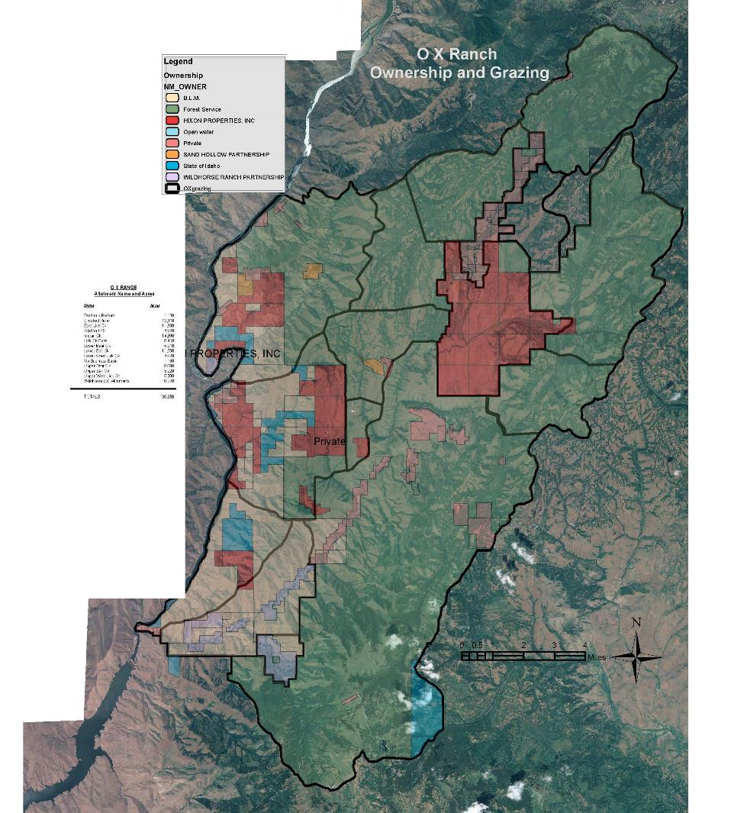
Wholly
Integrated
OX Ranch Idaho
130,000 acres
Notes:
When you think of ranching in Idaho, you have to think about integrated land ownership – checkerboard land ownership.

Slide 18
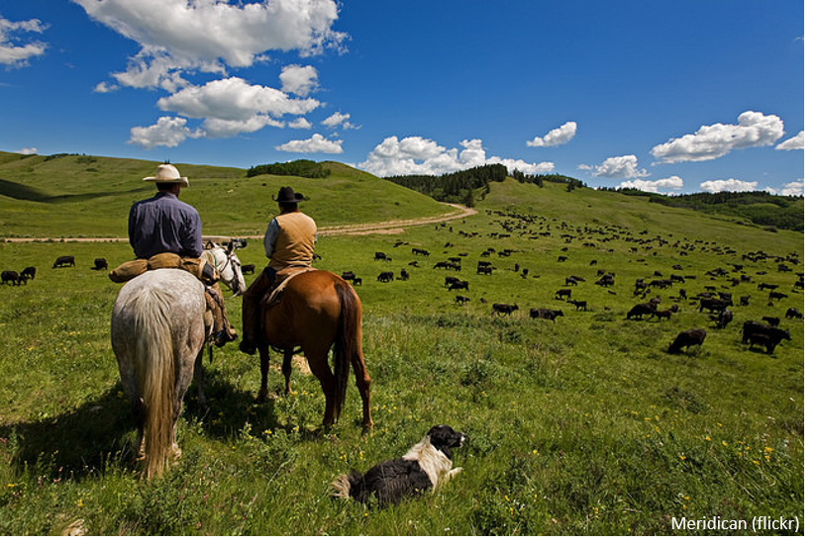
Federal Grazing Permits
Originally issued to those who met:
  “Prior Use” – Had previously been grazing area
  “Commensurability” – Deeded land/water to support livestock when not on federal land
Any U.S. citizen or business can apply for permit. To do so:
  Buy or control “base property” (BLM) or livestock (USFS)
  Acquire property and transfer permit
Current Permit Holder has “Preference”

Slide 19
Controversy - Federal Grazing Fee
Grazing on Federal Lands often called “Welfare Ranching”
  Federal Fee = $1.35/AUM (BLM & USFS 2014)
  State Fee = $10-$15/AUM
  Lease Fee on Private land = $15-$30/AUM
  …. It depends on what comes with the lease and what it costs the rancher.

Slide 20
Example – 2 Bedroom Apartment Rent
Bunting Apartments = $350/ month
Strand Apartments = $500/ month
Launchbaugh Apartments = $700/month
Is Bunting “subsidizing” renters?

Slide 21
Federal Grazing Fee
Why is Federal Fee $1.35/AUM?
Set by PRIA -Public Land Improvement Act of 1978
Fee = $1.23 ((FVI + BCPI – PPI)/100)
  FVI = Forage Value Index - related to private land lease rates
  BCPI = Beef Cattle Price Index - related to price received for beef
  PPI = Prices Paid Index - related to costs of beef production
Adjusted Annually
Executive Order – grazing fee cannot fall below $1.35

Slide 22
Federal Grazing Fee ($/AUM)
(1992, Idaho, Wyoming, New Mexico)
 | Public | Private
Lease Fee | 1.35 | 9.06

Slide 23
Federal Grazing Fee ($/AUM)
Idaho, Wyoming, & New Mexico, 1992 (Rimbey et al.)
 | Private | Public
Lease Fee | 9.06 | 1.35
Lost Animals | 2.10 | 3.65
Moving Livestock | 1.93 | 3.35
Herding | 2.94 | 4.31
Imprv. Maintenance | 1.84 | 3.18
Other | 2.52 | 3.66
Total | $20.39 | $19.50
Difference | $0.89

Slide 24
Federal Grazing Fee ($/AUM)
Idaho, Wyoming, & New Mexico Updated to 2010 Values (Rimbey & Torell)
 | Private | Public
Lease Fee | 12.35 | 1.35
Lost Animals | 2.92 | 5.21
Moving Livestock | 3.05 | 5.36
Herding | 5.67 | 9.33
Imprv. Maintenance | 6.77 | 9.22
Other | 1.27 | 4.1
Total | $32.03 | $34.58
Difference | $2.55

Slide 25
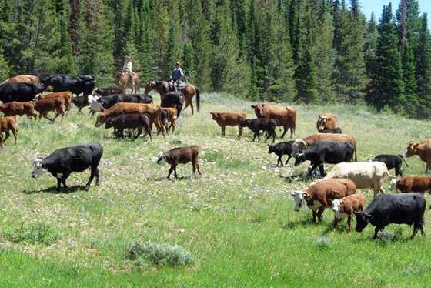
Economic Value of Ranches
Federal Grazing Permits have no value (according to the federal government & IRS)
But, ranches with federal permits sell for more than those without.
Why?
  Base property required
  Permits follow land
  or livestock

Slide 26
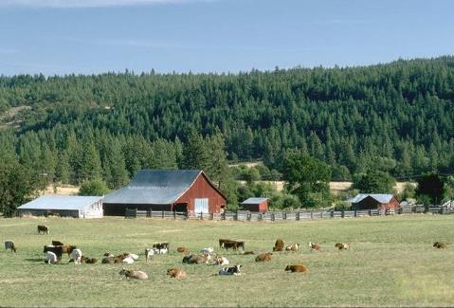
Economic Value of Ranches
Market Value of Ranches > Income Earning Potential
Why Keep Ranching?
  Recreate and relax
  Raise a family
  Maintain lifestyle
  Investment you can see & feel
  Tax shelter
  Land appreciation
    Investment gain value over time

Slide 27
Is Grazing on Public Lands Important?
Supports Local Communities
  Roads
  Schools
  Weed Management
  Etc.
Creates open space – Working Landscapes

Slide 28
Public Land Grazing
S. McFarland
T. Lester
K. Launchbaugh
S.McFarland
REM 456 - Integrated Rangeland Management

