Slide 1
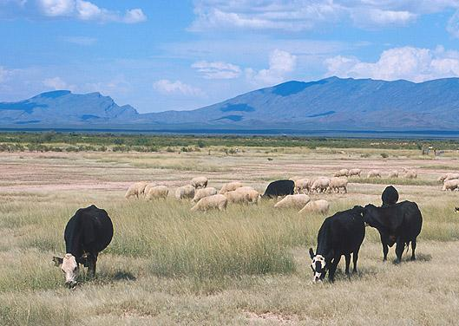
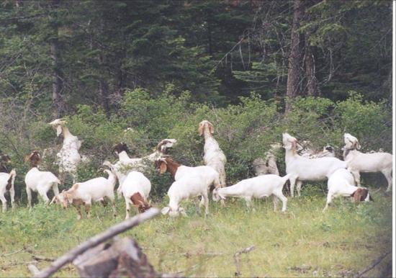

How Plants Respond to Grazing
REM 456 - Integrated Rangeland Management

Slide 2
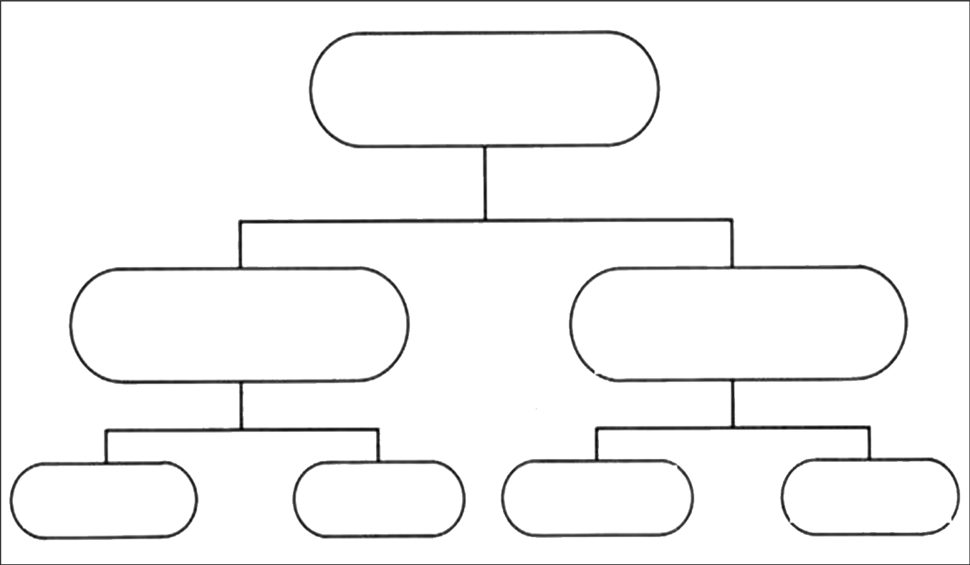
Grazing Resistance
Grazing Resistance
(Mechanisms enabling plants to survive in grazed systems)
Avoidance
(Mechanisms that reduce the probability of grazing)
Tolerance
(Mechanisms that increase growth following grazing)
Morphological
Characteristics
Biochemical
Compounds
Morphological
Characteristics
Physiological
Characteristics
Notes:
The focus will be on avoidance and tolerance

Slide 3
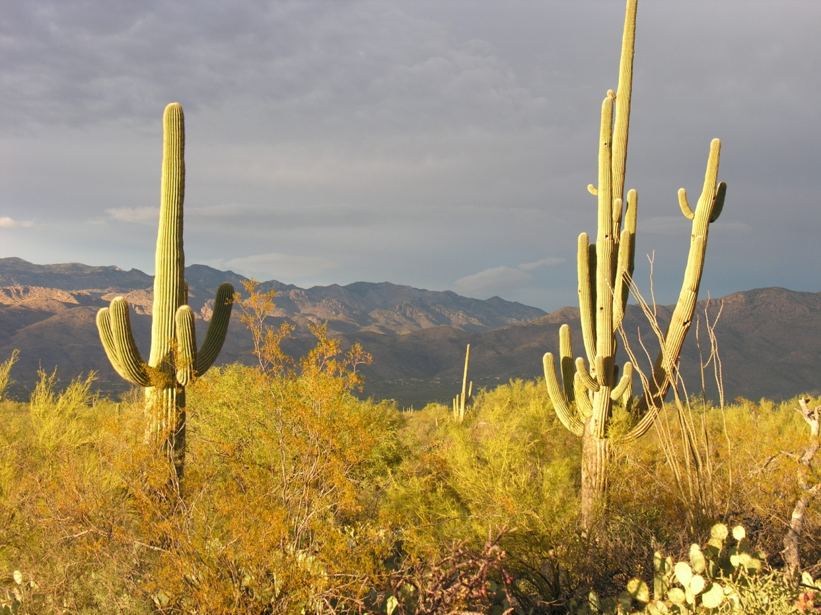
Plants Avoid Grazing - MORPHOLOGICAL
Thorns, Prickles, Spines
In some cases these defenses are “inducible”

Slide 4
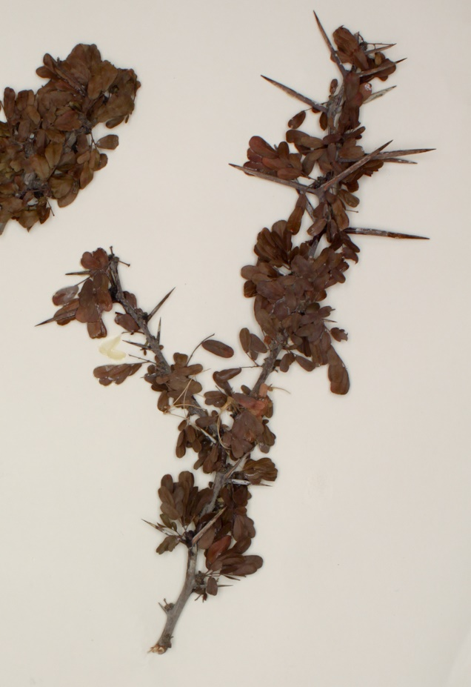
Plants Avoid Grazing - MORPHOLOGICAL
Plant parts
  Spines, Awns, Pubescence
Plant maturity
  Leaf:Stem ratio
  Live:Dead
  Reproductive:Vegetative tillers
Tensile/shear strength
  Cell walls
  Lignin
  Silica
Notes:
Plants that have a lot of leaves (high leaf to stem ratio) are more attractive.

Slide 5
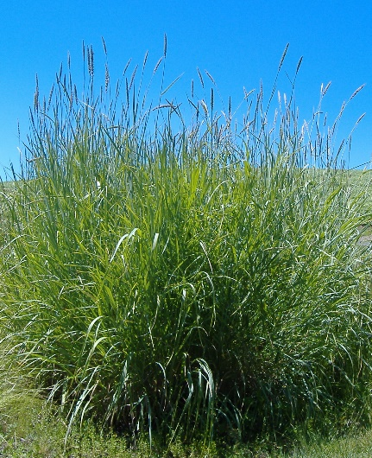
Plants Avoid Grazing - MORPHOLOGICAL
Growth Form - Specific growth forms can reduce the amount of biomass removed by grazers.
  Bunchgrass < Sodgrasses
  Plants with prostrate growth forms
Plant Size
  Grazing intensity is inversely related to basal area of grasses.
  Likely true for forbs and shrubs.
Josh Corbett

Slide 6
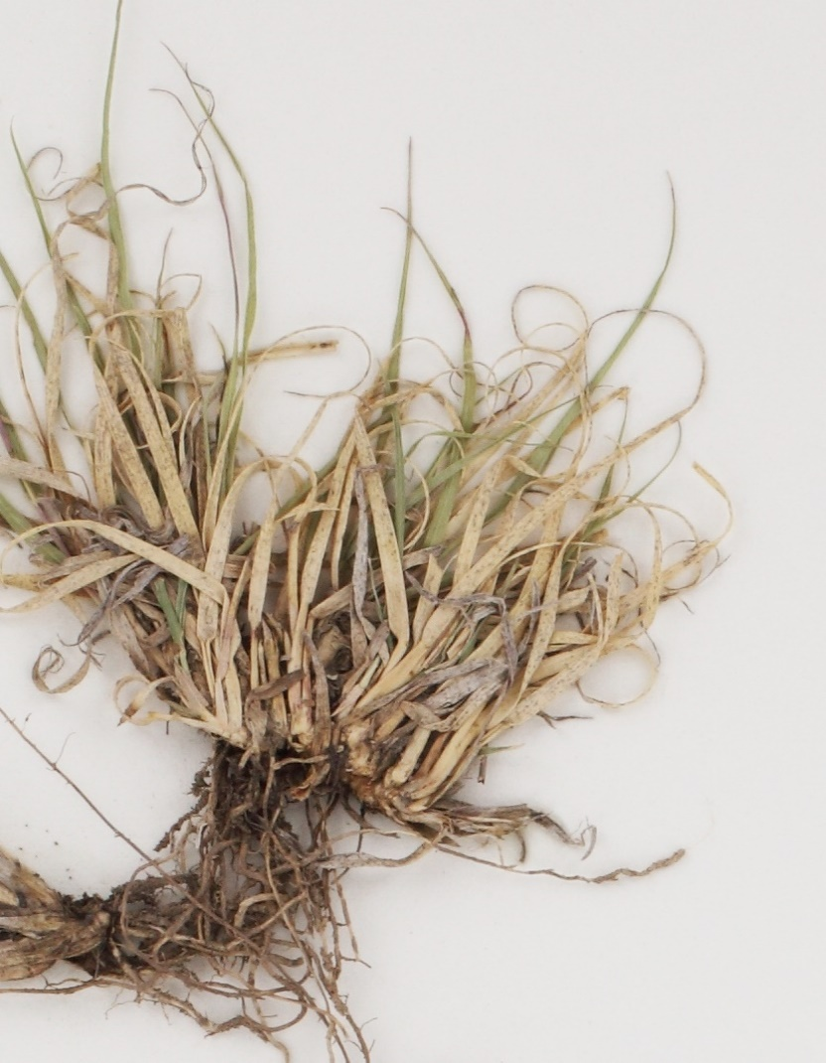
Plants Avoid Grazing - MORPHOLOGICAL
Live:Dead ratio of culms or shoots
  Greater ration of dead decreases herbivory
Location of Meristems - Plant that protect their meristems or keep them out of reach of herbivores:
  Meristems near ground surface experience lower grazing intensities (i.e., avoid grazing).
  This generally explains why forbs express less mechanical grazing avoidance than grasses.

Slide 7
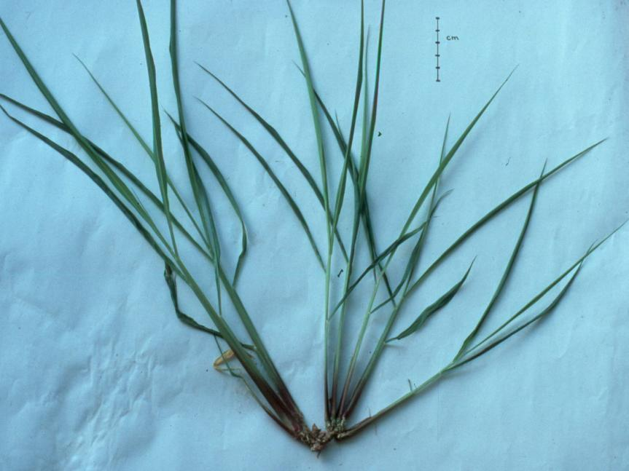
Plants Avoid Grazing - MORPHOLOGICAL
Protect Growing Points
Keep meristems out of reach
Notes:
Morphological characteristics such as meristems at the base of the plant

Slide 8
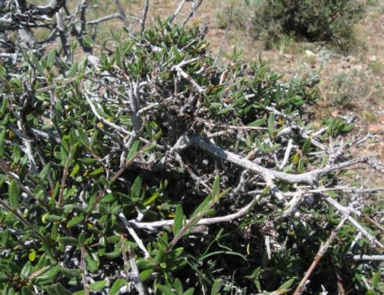
Plants Avoid Grazing - MORPHOLOGICAL
Protect Growing Points & Leaves
Protect with stems & thorns

Slide 9
Plants Avoid Grazing - BIOCHEMICAL
How do they work?
Reduce digestive benefit
  Reduce preferences
Create negative feedback
  Create aversion
Notes:
Plants that have limited digestibility are not attractive to grazers. Think about if you would rather eat paper or spaghetti. The spaghetti is more flavorful and nutritious, so you would select that food over the other.

Slide 10
Plants Tolerate Grazing
Grazing Resistance
(Mechanisms enabling plants to survive in grazed systems)
Avoidance
(Mechanisms that reduce the probability of grazing)
Tolerance
(Mechanisms that increase growth following grazing)
Morphological
Characteristics
Biochemical
Compounds
Morphological
Characteristics
Physiological
Characteristics
Notes:
Change the focus to tolerance. Reduce the intensity or tolerability of grazing.

Slide 11
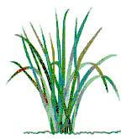

Plants Tolerate Grazing - MORPHOLOGICAL
Leaf replacement potential
Meristematic potential for growth
Notes:
Have greater ability to reduce leaves and stems after they are gone. Meristematice potential is key – the more growing points, the better the ability to regrow after grazing.

Slide 12
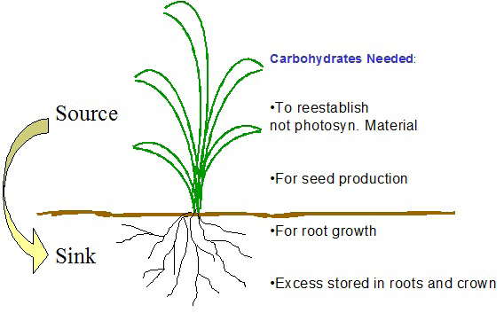
Plants Tolerate Grazing - PHYSIOLOGICAL
Compensatory Photosynthesis
Carbon Allocation Patterns
CHOs Needed:
To reestablish photosyn material
For seed production
For root growth
Excess stored in roots & crowns
Notes:
Some plants are better able to photosynthesize after grazing = compensatory photosynthesis. Bluebunch wheatgrass is very susceptible to grazing compared to crested wheatgrass because it is not as good at moving resources around. Crested wheatgrass has a lot of seedheads and leaves compared to Bluebunch.

Slide 13
Resource Allocation
Biomass partitioning to roots and sheath is reduced much more than to leaves following partial defoliation (in blue grama)
Treatment Total growth Blade growth Sheath growth Root growth
mg mg % total mg % total mg % total
Undefoliated 69 23 33 17 25 20 29
Defoliated 38 20 53 8 21 7 18
Detling, J. K, M. I. Dyer, and D. T. Winn. 1979. Oecologia. 41:127-134.

Slide 14
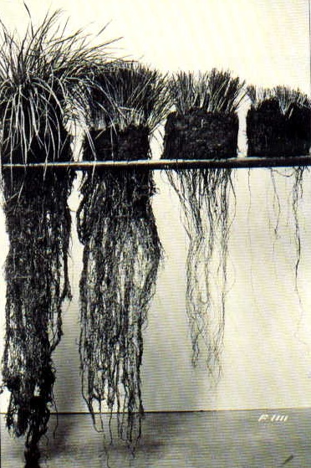
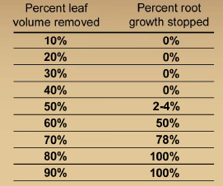
Root Responses to Defoliation
50%
70%
90%
Level of Removal
Notes:
14
Classic investigation from mid1950s; lead to take half – leave half rule. At high levels of grazing, root growth is severely limited because plants are allocating resources to leaf growth to increase photosynthesis.

Slide 15
Root Responses to Defoliation
Root growth decreases as defoliation removes greater than 50% of the plant leaf area.
Frequency of defoliation interacts with defoliation intensity to determine the total effect of defoliation on root growth.
  The more intense the defoliation, the greater the effect of frequency of defoliation.

Slide 16
Effects of Grazing on Plants
Removal of photosynthetic tissues reduces a plant’s ability to assimilate energy.
Removal of meristems delays or stops growth.
Removal of reproduce flowers & seeds reduces a plant’s ability to produce new individuals.
But remember:
Grazing is a natural ecological process and overgrazing occurred prior to humans.
Properly managed grazing is a sustainable enterprise, but destructive grazing can occur.
Dr. Mort Kothmann – Texas A&M University

Slide 17
Plants Tolerate Grazing
Grazing Resistance
(Mechanisms enabling plants to survive in grazed systems)
Avoidance
(Mechanisms that reduce the probability of grazing)
Tolerance
(Mechanisms that increase growth following grazing)
Morphological
Characteristics
Biochemical
Compounds
Morphological
Characteristics
Physiological
Characteristics
Notes:
Change the focus to tolerance. Reduce the intensity or tolerability of grazing.

Slide 18
SUMMARY
Plant Morphology
  Affects tolerance & avoidance
Plant Physiology
  Affects tolerance & avoidance
Notes:
Some plants are better able to photosynthesize after grazing = compensatory photosynthesis. Bluebunch wheatgrass is very susceptible to grazing compared to crested wheatgrass because it is not as good at moving resources around. Crested wheatgrass has a lot of seedheads and leaves compared to Bluebunch.

