Slide 1
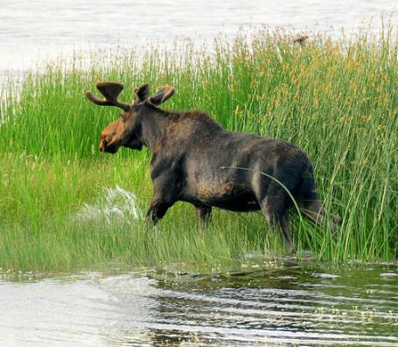
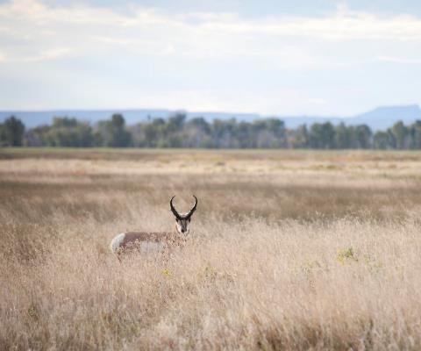
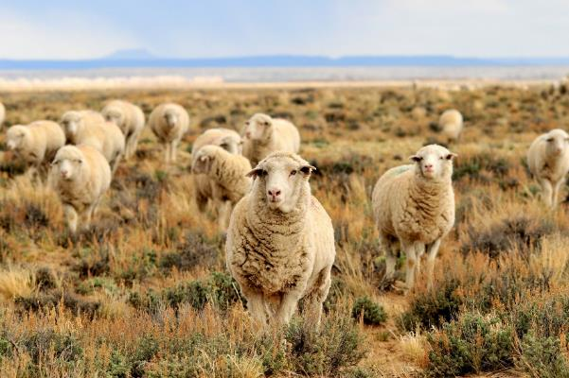

Diet Selection-Preferences & Aversions
Tom Koerner-(USFWS)
Katie Theule (USFWS)a
Tom Koerner-(USFWS)
REM 456 - Integrated Rangeland Management

Slide 2
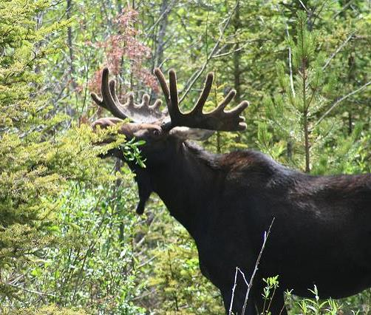
Palatability vs Preferences
Palatability = “attractiveness” of a plant as forage
Preference = selection of a plant give a choice
Both are an interrelationship between flavor and post-ingestive feedback from nutrients and toxins, determined by:
an animal’s physiological condition
a food’s chemical characteristics
an animal’s experiences with the food
Clyde Hurst (Flickr)
Notes:
We contend that palatability is more than a matter of taste. Read definition.

Slide 3
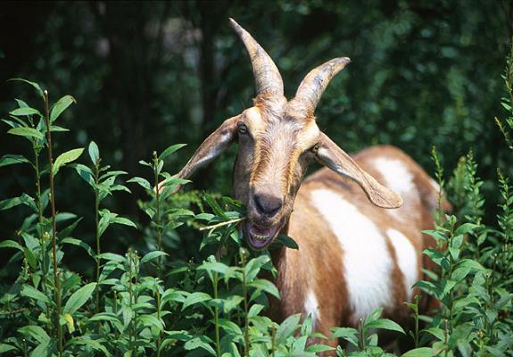
Principles
Palatability depends on feedback
Animals can detect positive feedback (nutrients & energy) and negative feedback (anti-quality factors & toxins)
Animals discriminate based on
flavor-feedback interactions
USDA_ARS(Scott Bauer)
Notes:
Basically, nutrient increase palatability and toxins decrease palatability.

Slide 4
Post-Ingestive Feedback
Preference
+
Eat
Plant
(taste)
Digestive
Feedback
-
-
Aversion
Notes:
Basic model of how feedback changes palatability

Slide 5
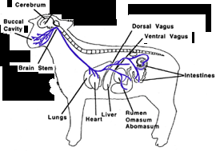
Animals are built to link Flavor to Feedback
This detection ability is simply the result of the way the body is constructed.

Slide 6

Flavor & Positive Digestive Feedback
Conditioning Group 1 Group 2
odd days Onion Straw Oregano Straw
+ water + water
even days Oregano Straw Onion Straw
+ starch + starch
-----------------------------------------------------------------------
Testing = choice between Onion or Oregano flavored straw
What flavor did Group 1 prefer?
Villalba and Provenza 1997
Notes:
Basically, nutrient increase palatability and toxins decrease palatability.

Slide 7
Energy Increases Palatability
Intake of straw, g
Day
Preference persisted for at least 8 weeks after starch feedback was stopped
Villalba and Provenza 1990
Notes:
The amount of starch in the starch solution was increased during the study from 2.5% to 10% of the lambs’ daily energy requirement. Lambs preferred the flavor paired with calories regardless whether the flavor was apple or maple. The preference for one flavor over the other increased as the trial progressed due to increasing amounts of energy used in the trial and increase exposure to the foods.
REF: Villalba, J.J. and F.D. Provenza. 1997. Preference for wheat straw by lambs conditioned with intraruminal infusions of starch. Br. J. Nutr. 77:287-297.

Slide 8

Sheep Who Love Straw!
Watch Video on Youtube
https://youtu.be/cIR_5362qQc

Slide 9

Conditioned Preference
Immediate Feedback
(starch within 90 min)
straw
Delayed Feedback
(starch within 8 hours)
No Feedback (Control)
(water 1 & 7 hours)
Smith 1999
Notes:
Results show that animals can detect difference in foods based on how long they take to digest (i.e., yield energy). Sheep preferred foods with immediate energy feedback (within 1 hour) which is equivalent to soluble carbohydrate digestion. Next they preferred flavors that yielded energy within 8 hours which is equivalent to structural carbohydrates that require fermentation.
Ref: Smith, E.A. 1999. Carbohydrate Availability Impacts Dietary Preferences by Sheep. M.S. Thesis. University of Idaho, Moscow, ID

Slide 10
Conditioned Preference
Lambs prefer feed that give an energy boost shortly after it is eaten.
Treatments
Smith 1999
Notes:
Results show that animals can detect difference in foods based on how long they take to digest (i.e., yield energy). Sheep preferred foods with immediate energy feedback (within 1 hour) which is equivalent to soluble carbohydrate digestion. Next they preferred flavors that yielded energy within 8 hours which is equivalent to structural carbohydrates that require fermentation.
Ref: Smith, E.A. 1999. Carbohydrate Availability Impacts Dietary Preferences by Sheep. M.S. Thesis. University of Idaho, Moscow, ID

Slide 11


Conditioned Aversion
Mountain-
Mahogany
Nausea
(LiCl)
No Feedback
(empty capsule)
Burritt and Provena 1989
Notes:
Ref:
Burritt, E.A. and F.D. Provenza. 1989. Food aversion learning: conditioning lambs to avoid a palatable shrub (Cercocarpus montanus). J. Anim. Sci. 67:650- 653.

Slide 12
Conditioned Aversion
Lambs quit eating mountain mahogany when consumption was followed by nausea
Control
Averted
(LiCl 3g/day)
Burritt and Provena 1989
Notes:
Sheep were quickly averted to Mountain Mahogany
REF: Burritt, E.A. and F.D. Provenza. 1989. Food aversion learning: conditioning lambs to avoid a palatable shrub (Cercocarpus montanus). J. Anim. Sci. 67:650- 653.

Slide 13
Principle – Magnitude Matters
The stronger the feedback, the stronger the resulting preference or aversion
Preference
Preference
Preference
Preference
Preference
Eat
Plant
(taste)
Digestive
Feedback
Aversion
Aversion
Aversion
Aversion
Aversion
Notes:
Strong positive feedback yields strong preferences and strong negative feedback yields strong aversions.

Slide 14
Stronger Feedback = Stronger Aversion
Preference %
LiCl, g
Low preference indicates strong aversion
Du Toit et al. 1991
Notes:
The higher the dose the stronger the response. Toxins decrease intake and nutrients increase intake. Remember though that high amounts of readily available nutrients (protein or energy) can cause food aversions in ruminants because high doses of nutrients can cause acidosis or ammonia toxicity.
REF: Du Toit, J.T., F.D. Provenza, & A. Nastis. 1991. Conditioned taste aversions: how sick must a ruminant get before it learns about toxicity in foods? Applied Animal Behaviour Science. 30(1):35-46.

Slide 15
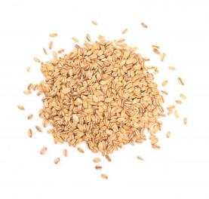
Does intake vary with toxin concentration?
Intake of oats (g)
1.5% LiCl
0% LiCl
0.75% LiCl
Launchbaugh et al. 1993
Notes:
Animals don’t refuse to eat plant with toxins. As long as the toxins cause nausea and most toxins do, animals can figure out how much of a toxin-containing food they can eat. Toxins set a limit on intake. In the experiment above, lambs fed oats coated with 0.75% LiCl eat about twice as much food as lambs receiving oats with 1.5% LiCl.
REF: Launchbaugh, K.L., F.D. Provenza and E.A. Burritt. 1993. How herbivores track variable environments: Response to variability of phytotoxins. J. Chem. Ecol. 19:1047-1056.

Slide 16
Intake varies with toxin concentration
Intake of oats (g)
Launchbaugh et al. 1993
Notes:
Animals don’t refuse to eat plant with toxins. As long as the toxins cause nausea and most toxins do, animals can figure out how much of a toxin-containing food they can eat. Toxins set a limit on intake. In the experiment above, lambs fed oats coated with 0.75% LiCl eat about twice as much food as lambs receiving oats with 1.5% LiCl.
REF: Launchbaugh, K.L., F.D. Provenza and E.A. Burritt. 1993. How herbivores track variable environments: Response to variability of phytotoxins. J. Chem. Ecol. 19:1047-1056.

Slide 17

www.BEHAVE.net

Slide 18
References
Burritt, E.A. & F.D. Provenza. 1989. Food aversion learning: conditioning lambs to avoid a palatable shrub (Cercocarpus montanus). J. Anim. Sci. 67:650- 653
Du Toit, J.T., F.D. Provenza, & A. Nastis. 1991. Conditioned taste aversions: how sick must a ruminant get before it learns about toxicity in foods? . Appl. Anim. Behav. Sci. 30(1):35-46.
Launchbaugh, K.L., F.D. Provenza & E.A. Burritt. 1993. How herbivores track variable environments: Response to variability of phytotoxins. J. Chem. Ecol. 19:1047-1056.
Smith, E. 1999. Carbohydrate Availability Impacts Dietary Preferences by Sheep. M.S. Thesis. University of Idaho, Moscow, ID
Villalba, J.J. & F.D. Provenza. 1997. Preference for wheat straw by lambs conditioned with intraruminal infusions of starch. Br. J. Nutr. 77:287-297.

Slide 19
Diet Selection-Preferences & Aversions
Tom Koerner-(USFWS)
Katie Theule (USFWS)a
Tom Koerner-(USFWS)
REM 456 - Integrated Rangeland Management

