Slide 1
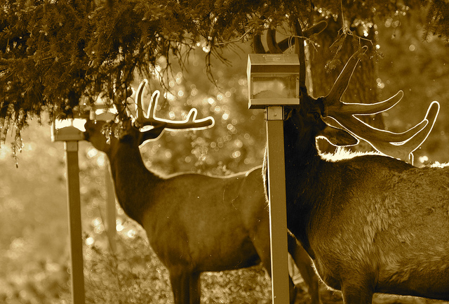
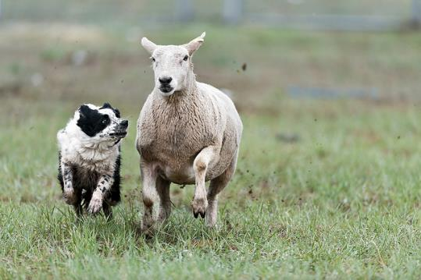
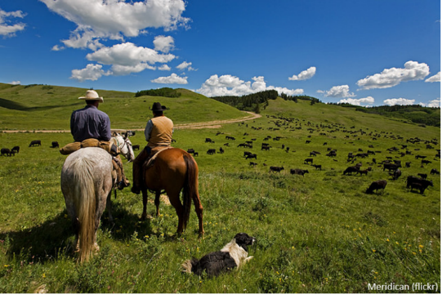

Grazing Animal Behavior
Roy Luck (Flickr)
SheltieBoy (Flickr)
REM 456 - Integrated Rangeland Management

Slide 2
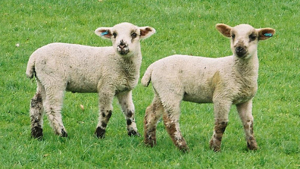
Basis for Animal Behavior
What affects how animals behave?
Born with certain abilities:
  Inherited abilities:
    Physical, sensory & physiological abilities
Born knowing what to do:
  Called Instincts
Learn how behave based on consequences
Karen Roe

Slide 3
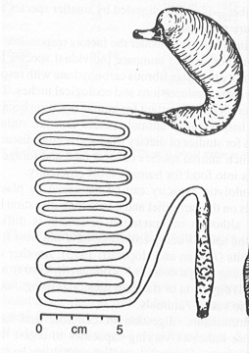
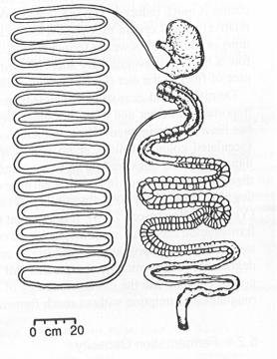
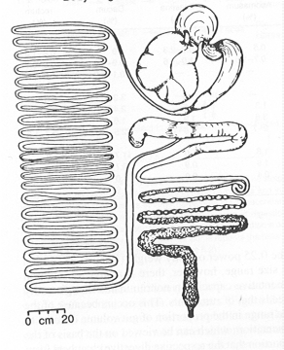
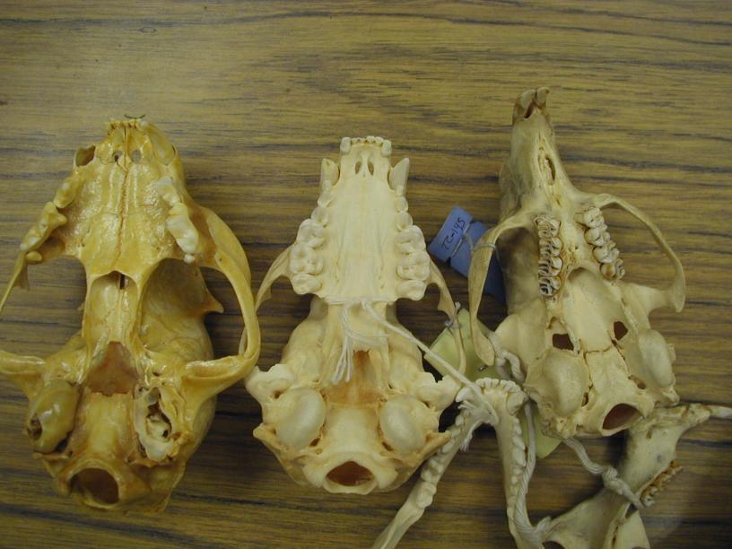
Inherited Abilities
Physical abilities affect what animals eat
  Ability to digest cellulose
  Capture and consume prey
Carnivore
Omnivore
Herbivore

Slide 4
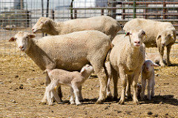
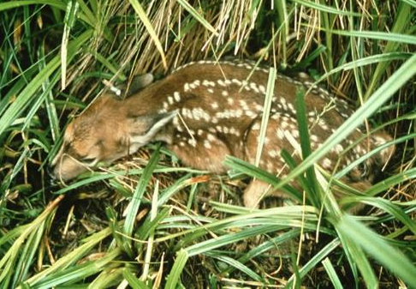
Inherited Behaviors - Instincts
Mammals know how to find milk & stay close to mother
Basic ideas of what is cover & how to hide
Preference for salty foods
Preference for sweet…
  Not always
Avoidance of bitter ….
  Not always
Stephen Ausmus(USDA)
Washington Dept. of Fish & Wildlife

Slide 5
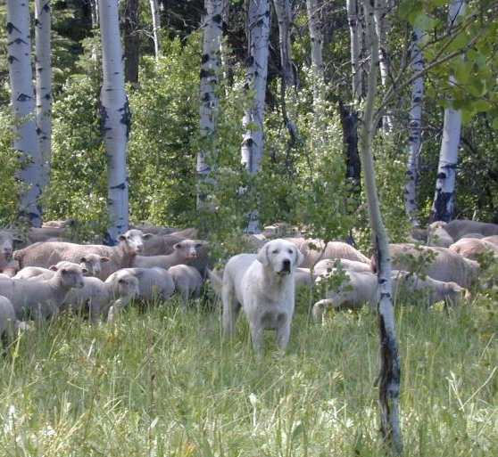
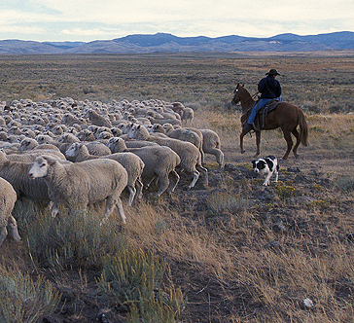
Inherited Behavior - Instincts
Behavioral characteristics can be inherited
  Example = Guard Dogs vs Herding Dogs
k. Launchbaugh
USDA - ARS

Slide 6
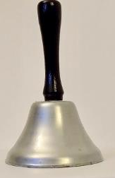
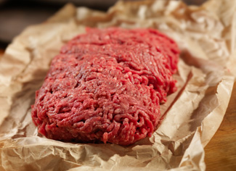
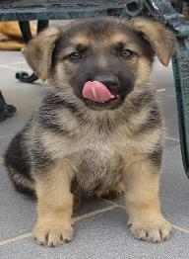
Classical or Pavlovian Conditioning
  Start with Unconditioned Reflex (i.e., instinctive involuntary response)
  Unconditioned Stimulus Unconditioned Response
Kevin Pack
CDC.gov
Ângela Antunes
  Neutral Stimulus Unconditioned Stimulus Unconditioned Response
  Conditioned Stimulus Unconditioned Stimulus Conditioned Response
U = Unconditioned ; C = Conditioned S = Stimulus; R = Response

Slide 7
Classical or Pavlovian Conditioning
Responses (UR & CR) are similar
Stimuli (US & CS) are NOT similar
What is learned is the relationship between the CS & US
  The bell (CS) and the meat (US)
  The response (i.e., salivation) occurs “automatically” or innately
What increases the strength of the CS : CR relationship?
  Salience or clarity of the CS
  Length of time between the CS and the US
  Number of pairings of the CS and the US

Slide 8
Classical or Pavlovian Conditioning
What causes extinction of the CS : CR relationship?
  Lack of US after CS occurs
  CS and US presented randomly - sometimes together sometimes individually
Other examples?
  Neutral Stimulus Unconditioned Stimulus Unconditioned Response
  Conditioned Stimulus Unconditioned Stimulus Conditioned Response

Slide 9
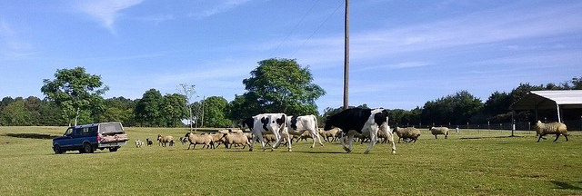
Classical or Pavlovian Conditioning
Sign tracking
  Affinity for the CS if it is a good predictor of an important US.
www.rikkisrefuge.org

Slide 10
Operant Conditioning
  Based on Reinforcement or Consequences
Stimulus : Response + Consequences Response Increases
Stimulus : Response - Consequences Response Decreases

Slide 11
Operant Conditioning
  Based on Reinforcement or Consequences
+
Behavior
Behave
Consequences
-
Behavior

Slide 12
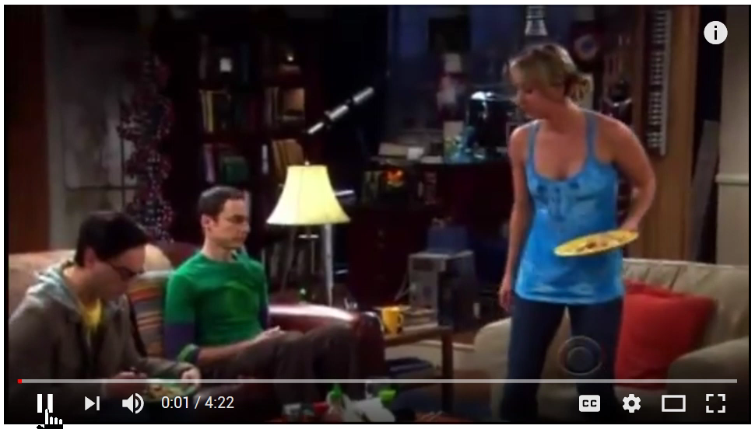
Operant Conditioning
Sheldon trains Penny
-- Big Bang Style
Watch Full Video
https://youtu.be/Mt4N9GSBoMI

Slide 13

Operant Conditioning
What increases the response (R) in this model?
  Salience or clarity of the stimulus
  Magnitude of reinforcer
  Time between response and reinforcement
    the shorter the better
  Schedule of reinforcement
    partial vs fixed reinforcement

Slide 14
Operant Conditioning
What reduces the response (causes extinction of the response)?
  Lack of reinforcement after response
  Inconsistency between stimulus and sesponse
What does it mean to “shape” behavior or “put under stimulus control”?

Slide 15
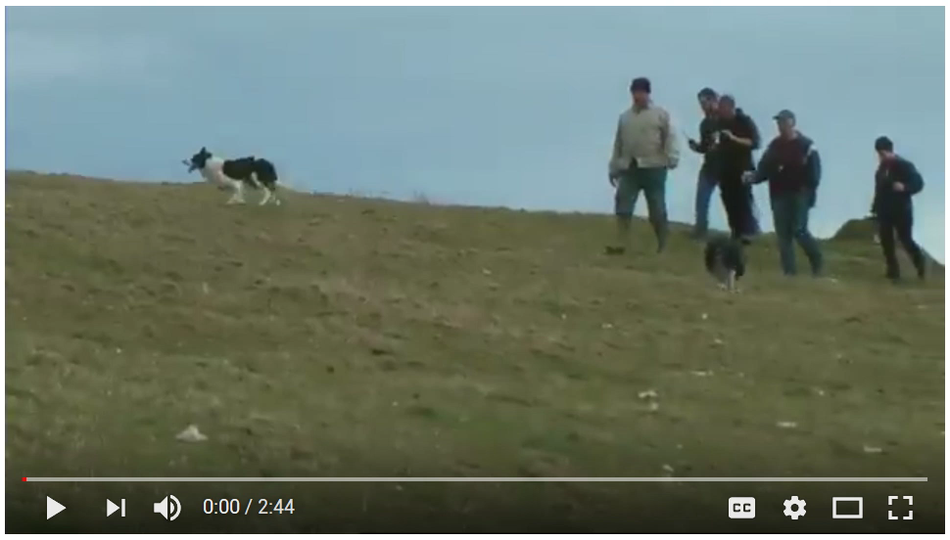
Operant Conditioning
Extreme
Sheepherding
Watch Full Video
https://youtu.be/D2FX9rviEhw

Slide 16
4 Basic Learning Paradigms
 | “Good” Consequence | “Bad” Consequence
Add or Apply | Behavior Increases (Positive Reinforcement) | Behavior Decreases (Positive Punishment)
Remove | Behavior Decreases (Negative Punishment) | Behavior Increases (Negative Reinforcement)

Slide 17

For More Information -
www.behave.net

