Slide 1
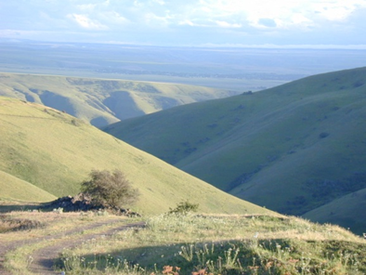
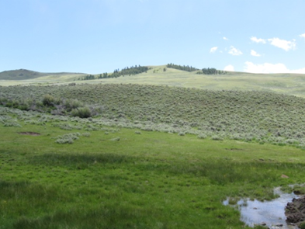
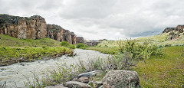

Rangeland Watersheds
K.Launchbaugh
K.Launchbaugh
Edwham(flickr)
REM 456 - Integrated Rangeland Management

Slide 2
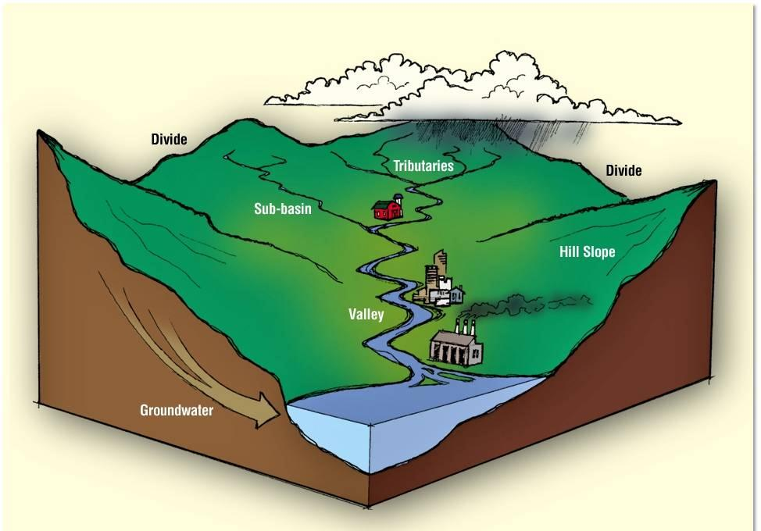
What is a Watershed?
http://www.wbtownship.org

Slide 3
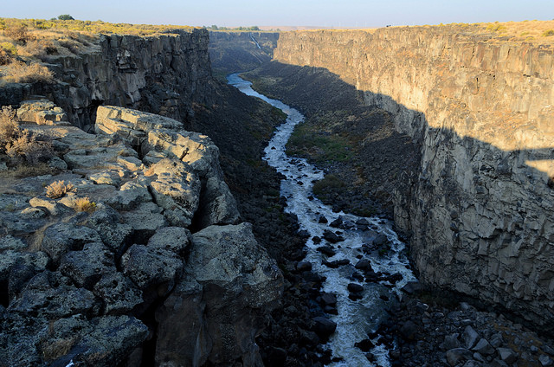
What is a Watershed?
A surface water designation
The area that flows into a distinct drainage
  stream, river, creek, pond
Separated from other watershed by ridge-top boundaries
  divides
DIVIDE
DIVIDE

Slide 4
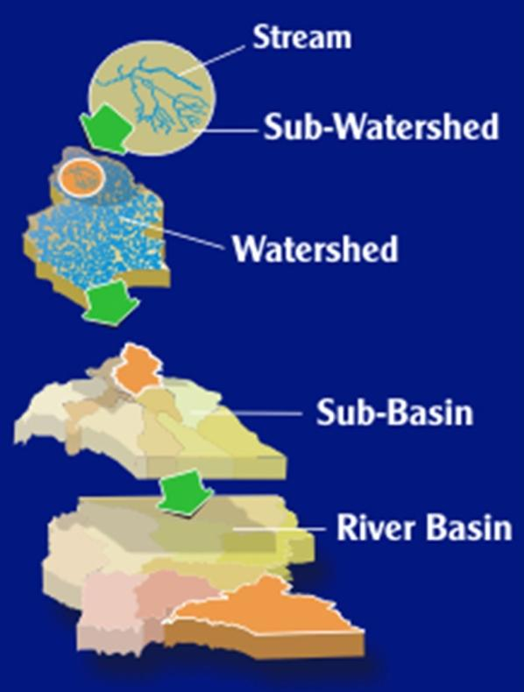
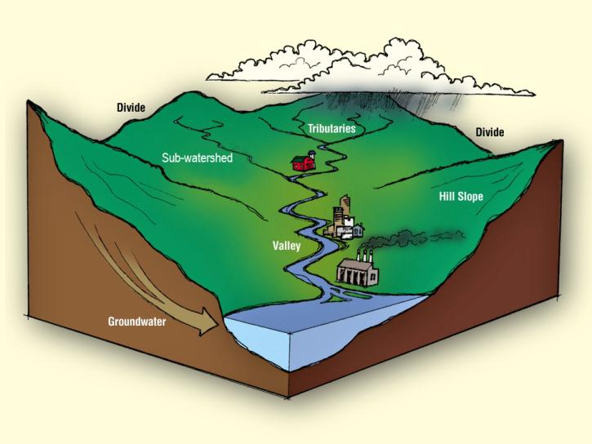
WATERSHED
http://www.wbtownship.org
Notes:
Watersheds are nested systems and include smaller watersheds called sub-watersheds, and larger collections of watersheds called sub-basins and river basins. We can look at a watershed from any of these different scales, the smallest being the stream itself, all the way up to a scale as large as a river basin, which is simply a collection of many different watersheds.

Slide 5
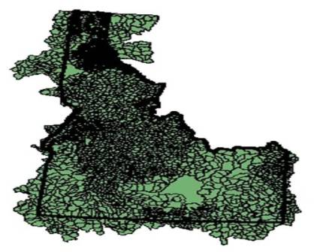
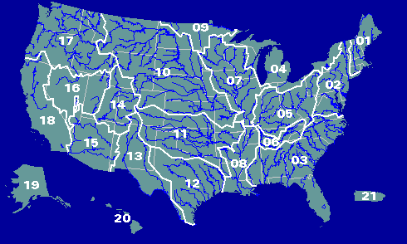
Major Watersheds
HUC Watersheds:
Hydrologic Unit Codes
http://water.usgs.gov/GIS/regions.html

Slide 6
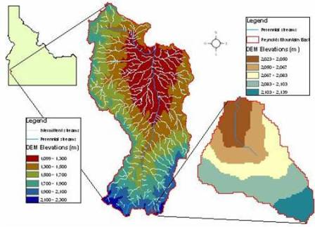
Reynolds Creek Experimental Watershed
Attribute to USDA-ARS.gov

Slide 7
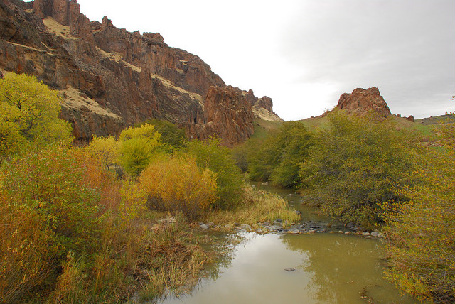
Watershed (Ecosystem) Services
Regulation of climate
Provision of shade and shelter
Prevention of soil erosion
Maintenance of soil fertility
Maintenance of soil health
Maintenance of healthy waterways
Water filtration
Regulation of river flows and groundwater levels
Ecosystem Services Project
T.O’Keefe(flickr)

Slide 8
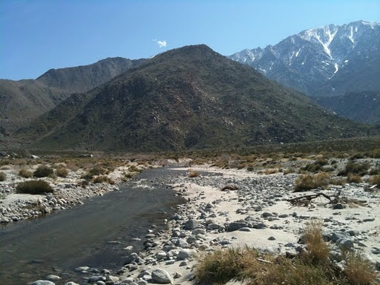
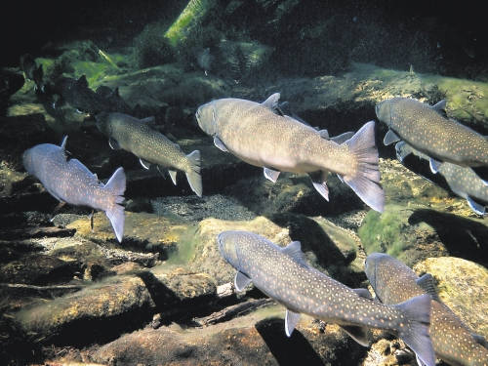
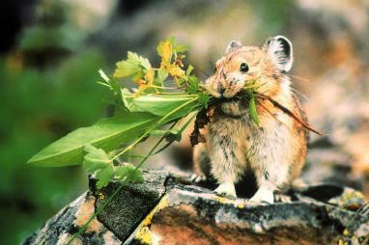
Watershed Functions
Hydrological Functions
  Water capture
  Water storage
  Water release
Ecological Functions
  Provide diverse sites for biogeochemical reactions
  Provide habitat for plants and animals
Brian Crawford
Capitalpress.com
geo.lsa.umich.edu

Slide 9
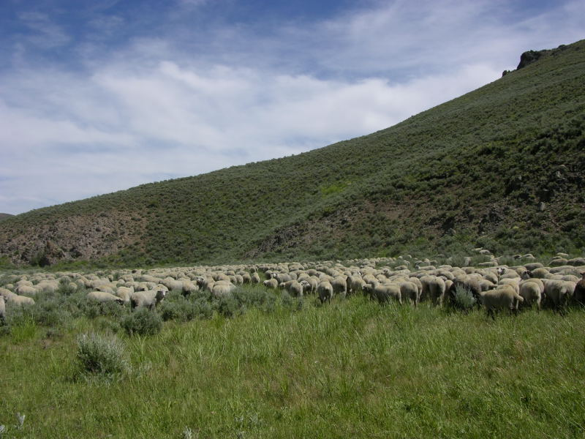
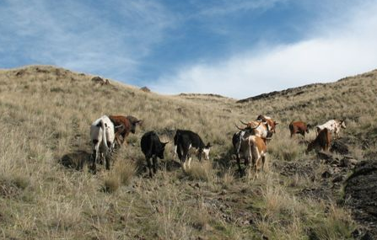
How Does Grazing Affect Watershed
Services and Functions?
Forage Utilization
  Consumption
    Promote re-growth
    Remove dead biomass
  Trampling
Soil Impacts
  Compaction
  Seedbed creation
Biodiversity
  Control weeds/invasive species
  Introduce weeds/invasive species
Management Actions
  Creating water storage
  Prescribed fire
J. Peterson
K. Launchbaugh

Slide 10
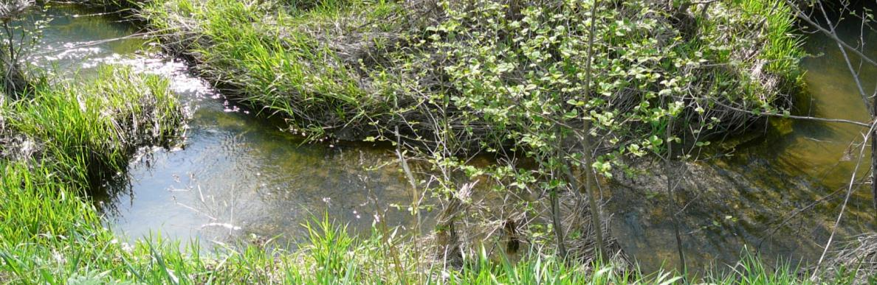
The Hydrologic Cycle
Water is classified as:
Surface water or overland flow
  in a watershed context
Underground water
  rangeland focus is on aquifers & recharge zones
K. Launchbaugh

Slide 11
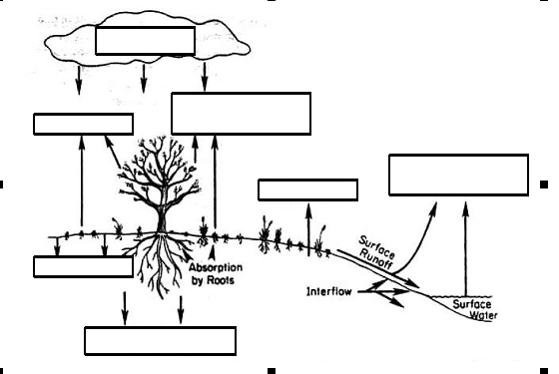
Fate of Water in Hydrologic Cycle
Hydrology and Erosion by T. Thurow
http://cnrit.tamu.edu/rlem/textbook/Chapter6.htm

Slide 12
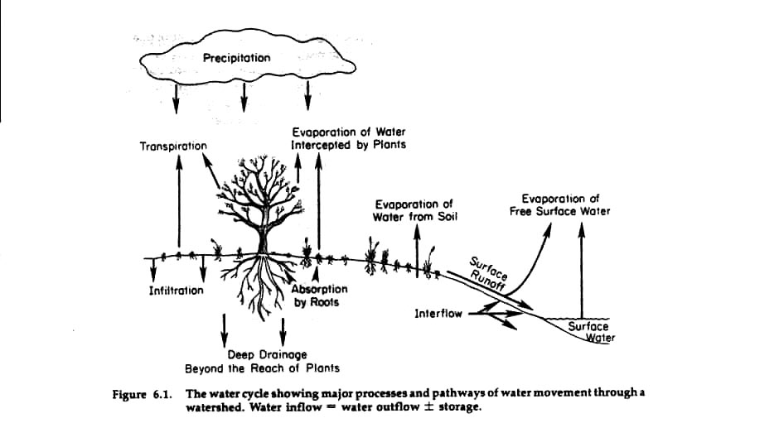
Fate of Water in Hydrologic Cycle
Hydrology and Erosion by T. Thurow
http://cnrit.tamu.edu/rlem/textbook/Chapter6.htm

Slide 13
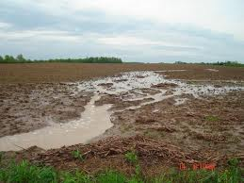
Water Capture
Precipitation - accumulation of water vapor forming rain drops, snow, or hail.
Interception - precipitation that strikes objects such as vegetation, litter, or rocks and may eventually enter soil... but not necessarily.
Infiltration – water moving into the soil
Percolation – water moving through the soil
Capture is dependent on:
  Vegetation
  Soil
  Landcover
  Storm intensity
ecomerge.blogspot.com

Slide 14
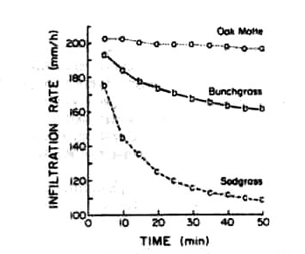
Infilitration
Infiltration rate - water passing through the soil surface per unit of time.
Thurow et al. 1986. Hydrologic characteristics of vegetation types as affected by livestock grazing systems, Edwards Plateau, Texas. Journal of Range Manage. 39:505-509.
Notes:
http://ojssandbox.library.arizona.edu/index.php/jrm/article/download/17178/15217

Slide 15
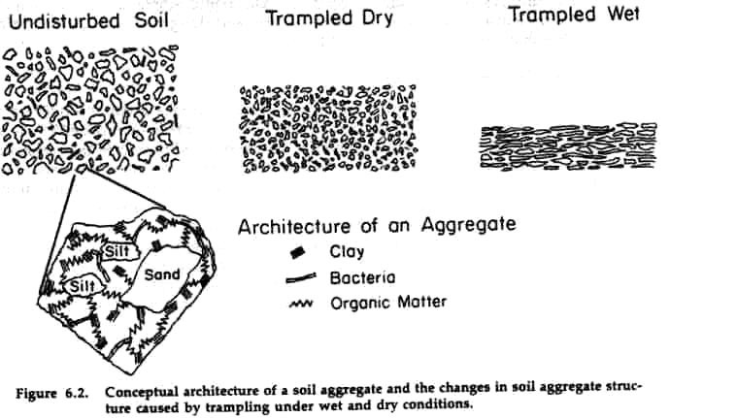
Infiltration
Depends on soil structure:
Aggregation = soil particles held together in clusters
Porosity = the amount of pores in the soil; creates air space in soils
http://cnrit.tamu.edu/rlem/textbook/Chapter6.htm

Slide 16
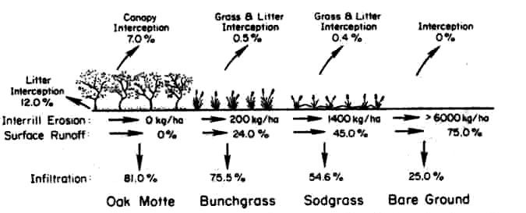
Effect of Vegetation on Water Transit
Vegetation type: Oak Motte, Bunchgrass, Sodgrass, Bare ground (10 cm rainfall in 30 minutes)
Thurow, et al. 1986. Hydrologic characteristics of vegetation types as affected by livestock grazing systems, Edwards Plateau, Texas. Journal of Range Manage. 39:505-509.

Slide 17
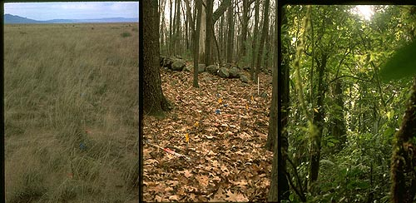
Effect of Vegetation on Water Transit
Litter accumulation - slows runoff and decreases droplet impact
Biomass differences - affects runoff, interception, and droplet impact
Soil organic matter - increases water holding capacity of soil and increases infiltration
nceas.uscb.edu
Notes:
� A decrease in cover reduces interception. Consequently, less kinetic energy is dissipated prior to striking the soil with the consequence that greater force per storm is applied to the soil tending to break aggregate bonds. �
A decrease in above-ground biomass (standing crop and litter) results in less organic matter eventually being incorporated into the soil. Organic matter is an important factor in aggregate formation and stability. �
A decrease in above-ground biomass is eventually mirrored by a decrease in root biomass. Grass roots create a network physically binding soil particles together. Furthermore, grass roots induce aggregate formation by exuding biochemical byproducts which bind soil particles and distribute organic matter throughout the soil profile.

Slide 18
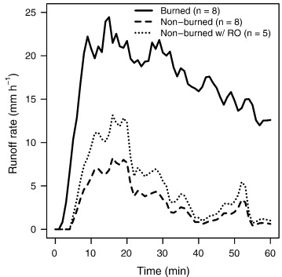
Effect of Fire on Runoff on Range
Runoff after prescribed burn
w/RO shows average of areas that had runoff (n=5) and removes areas without runoff (n=3)
Runoff on sagebrush-steppe in SE Idaho – Reynolds Creek Watershed
Moffet et al. 2007. Modeling soil erosion on steep sagebrush rangeland before and after prescribed fire. Catena. 71(2):218-228.
Notes:
Fig. 1. Mean hydrographs for 60-minute simulated rainfalls on burned and non-burned plots (n = 8). Three non-burned plots yielded no runoff and the mean hydrograph for the five plots that did generate runoff is also shown (n = 5).

Slide 19
Water Storage
Surface Detention – Water held in micro-relief formed by topography, vegetation growth, and accumulated litter. Is affected by micro-relief, slope, soil texture, soil structure, and soil depth.
Water Table – Upper surface of the ground water (saturated zone) can be above the ground surface e.g. streams, ponds, lakes.
Aquifer – Large volume of water underground on the top of an impermeable layer of soil or bedrock
Recharge – Water added to the water table or aquifer
Constructed water storage – Reservoirs

Slide 20
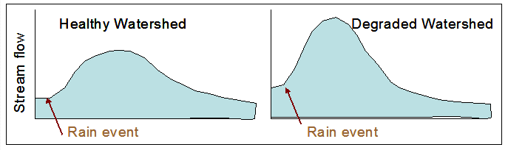
Water Release
Runoff
Surface runoff - water not entering soil, moving into streams or wetlands.
Interflow - water below the surfacing moving horizontally. Can create springs and seeps.

Slide 21
Water Release
Evapo-transpiration - combined effect of transpiration and evaporation
Transpiration - plants lose water as part of respiration and cooling
Evaporation - loss of water by heat.
  Vegetation tends to reduce evaporation through shade and reduce wind at soil surface.
  However, loss from evaporation on leaves often outweighs reduced evaporation from shade and reduced wind.

Slide 22
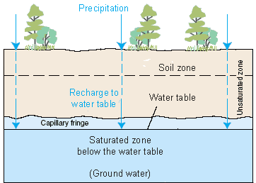
Water Release – Deep Drainage
Deep Drainage – loss of water below the root zone
Low bulk density because
of trampling can
decrease deep
drainage
Any factor that
decreases infiltration
will likely decrease
deep drainage
http://ga.water.usgs.gov/edu/watercyclesummary.html

Slide 23
Impacts on Runoff and Infiltration
Water Inflow - generally little affect of grazing management on precipitation patterns
    Overgrazing could ... biomass & litter ... albedo ... convection precipitation events
    Overgrazing could ... air-borne bacteria ... water droplet
    formation... precipitation

Slide 24
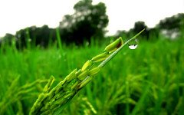
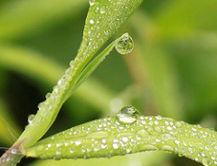
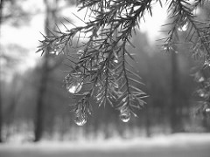
Interception
Grasses = 10-20% interception
Deciduous trees & shrubs = 25-50% interception (when leaves are on)
Evergreen trees = 50 - 100% (for example essentially no rain may hit the ground under a full juniper tree.
A.Kabir(flickr)
M.Fathe All (flickr)
T.Martin(flickr)

Slide 25
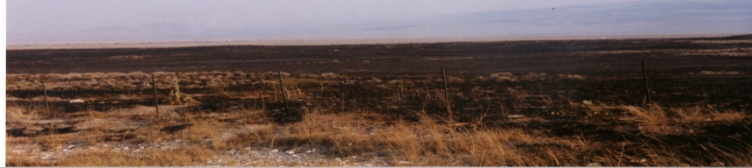
Fire and Grazing at the Watershed Level
Wildfires – Must Consider:
  Appropriate rest period following fire
  Invasive plants– livestock can control or introduce weeds
  Seed bed preparation – hoof action can break up hydrophobic soils
  Erosion potential is high following fire
Prescribed Burning
K. Launchbaugh

Slide 26
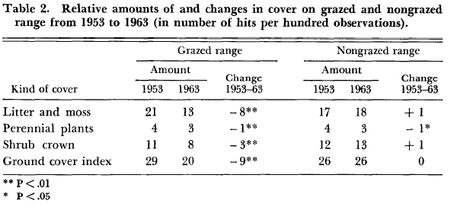
Infiltration
Depends on how grazing affects:
Aggregate soil stability
Soil bulk density or compaction
Standing crop/litter biomass
Turner. 1971. Soil and Grazing Influences on a Salt-Desert Shrub Range in Western Colorado. Journal of Range Management. 24:31-37

Slide 27
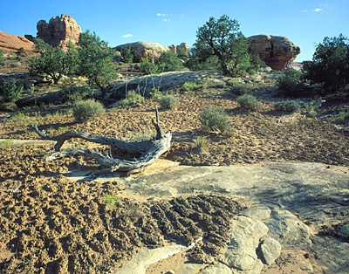
Trampling Effects
“Herd Effect” or “Hoof Action”
Compacts soil and/or breaks up soil aggregation at surface
Effect depends on soil type, grazing intensity, climatic condition, etc.
May enhance seed germination - Incorporates seeds into soils
Disturb biotic (or cryptogamic) crust on soil -
Can increase infiltration in some area
But, usually decreases infiltration and increases erosion.
http://www.soilcrust.org/

Slide 28
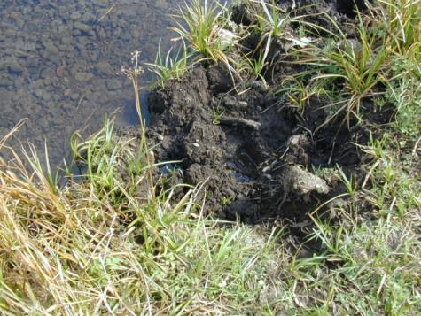
Surface detention
Depends on grazing intensity & soil moisture:
Can _____surface detention and micro-relief at moderate grazing intensities
At very heavy intensities on
dry soils trampling can
_____ micro-relief
K.Launchbaugh

Slide 29
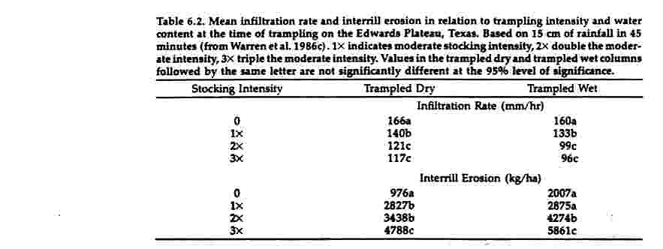
Trampling Effects
http://cnrit.tamu.edu/rlem/textbook/Chapter6.htm

Slide 30
Vegetation Impacts
Decreased cover =
↓ interception and ↑ droplet impact
Decreased above-ground biomass =
↓ soil organic matter… ↓ soil aggregation
Decreased below-ground biomass =
↓ soil aggregation ... ↓ percolation
Type conversion from herbaceous to woody = affects interception & infiltration

Slide 31
Effect of Stocking Rate
Effect depends on veg. type -
Ungrazed areas generally have higher infiltration rates than grazed plots
Moderate and light grazing intensities have similar infiltration rates
Only excessive grazing influences infiltration
Heavily grazed areas cause reduction in infiltration rates

Slide 32
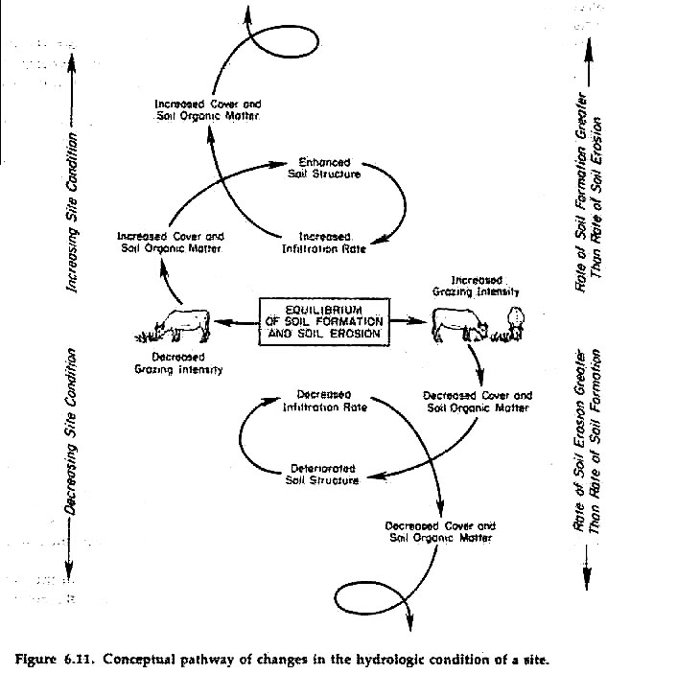
http://cnrit.tamu.edu/rlem/textbook/Chapter6.htm

Slide 33
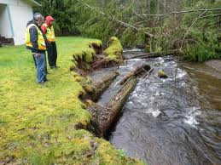
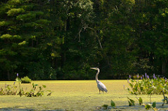
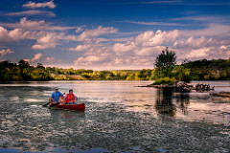
Human Needs, Desires, and Influences
Clean water supply
Food
Recreation
Wildlife viewing
Flood protection
Others
rco.wa.gov
S.Herlihy(flickr)
J.Smith(flickr)

Slide 34
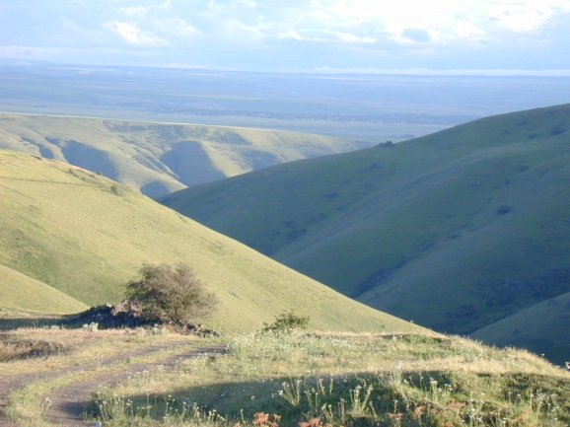
Conclusions
What happens at the top of the watershed affects the bottom of the watershed
Many ecosystem functions and services are provided by watersheds
Proper grazing management is critical to maintain these functions and services
  Interception
  Infiltration
  Recharge
The watershed is a complicated
area with many interactions
K.Launchbaugh

Slide 35
