Slide 1
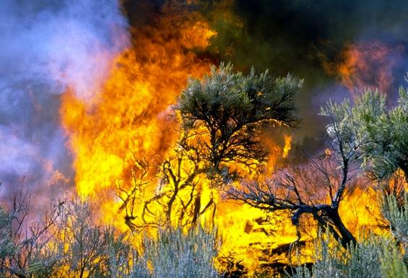
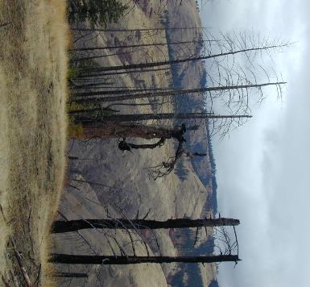
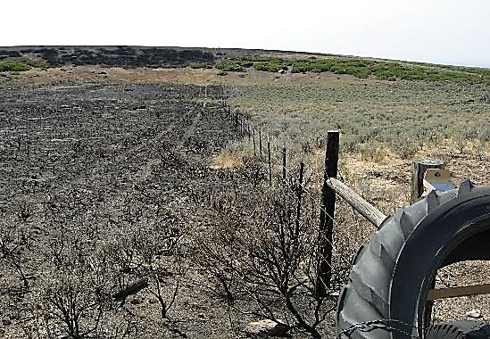

Grazing & Fuel for Wildfire
S. Bunting
Josh Corbett
N. Rimbey
REM 456 - Integrated Rangeland Management

Slide 2
Potentially Influenced by Grazing
Biomass Composition
(woody or herbaceous)
Fuel Amount
Live/Dead Fuel Mix
Continuity of Fuels
Fire Spread, Severity and Intensity
Weather
Fuel Characteristics
Landscape Features
and Context
Fuel Diameter
Fuel Moisture
Fuel Chemical Composition
Relative
Humidity
Slope
Temperature
Aspect
Adjacent
Vegetation
Wind
Direction
Wind
Speed
Landscape
Heterogeneity
Strand, E. K., Launchbaugh, K. L., Limb, R. F., & Torell, L. A. (2014). Livestock grazing effects on fuel loads for wildland fire in sagebrush dominated ecosystems. Journal of Rangeland Applications, 1:35-57.
Notes:
Strand, E. K., Launchbaugh, K. L., Limb, R. F., & Torell, L. A. (2014). Livestock grazing effects on fuel loads for wildland fire in sagebrush dominated ecosystems. Journal of Rangeland Applications, 1:35-57.

Slide 3
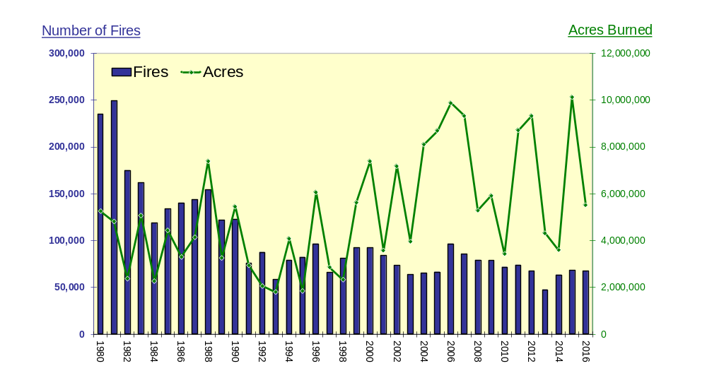
Historic Patterns
Total US Wildland Fires, 1980-2016
Data from National Interagency Fire Center

Slide 4
Historic Patterns
35
Trends in Grazing on
Federal Grazing Lands
25
Millions of AUMs
15
05
1900
1950
2000
------------Year--------------

Slide 5
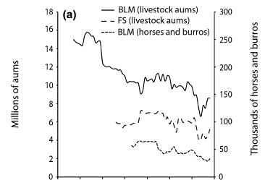

Historic Patterns Affect Wildfire
Beschta, R.L., et al. 2013. Adapting to Climate Change on Western Public Lands: Addressing the Ecological Effects of Domestic, Wild, and Feral Ungulates. Environmental Management 51:474-491.
Notes:
Beschta, R.L., et al. 2013. Adapting to Climate Change on Western Public Lands: Addressing the Ecological Effects of Domestic, Wild,
and Feral Ungulates. Environmental Managemnet 51:474-491.

Slide 6
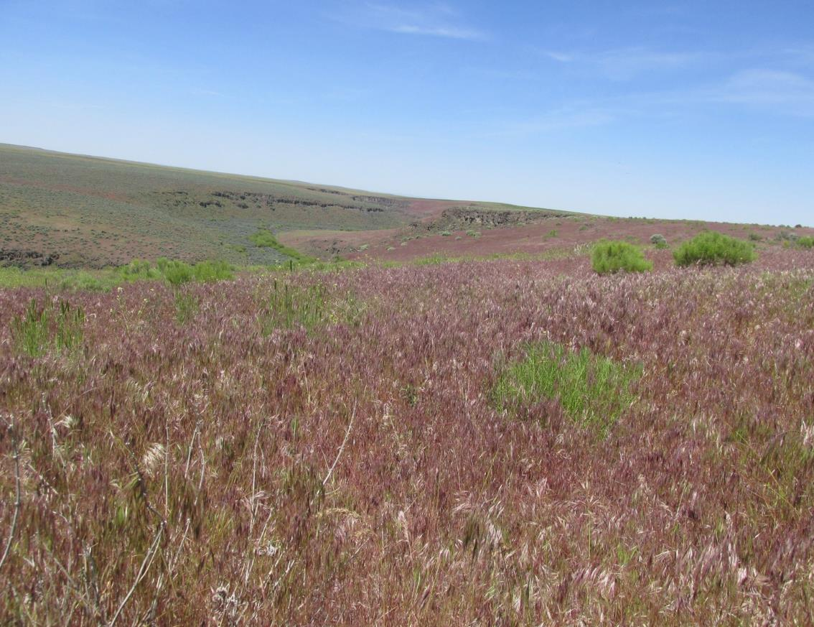
Historic Patterns
Introduction of Annual Grasses – late 1800’s
  Cheatgrass
  Medusahead
  Red Brome
Fine textured, flammable,
early maturing
Effect on fire
  Extend fire year
  Increase ignition risk
  Decrease fire return interval
K. Launchbaugh

Slide 7
Historic Patterns
Livestock Numbers
Human Development
Cheatgrass & Other Annual Grasses
Longer, hotter, drier summers
1900
1950
2000
------------Year--------------

Slide 8
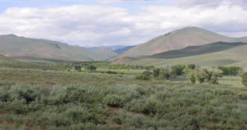
Where Grazing Fits In
Sagebrush
Steppe
Annual
Grasses
Fire
Fuel
Livestock
Grazing
Photo by K. Launchbaugh

Slide 9
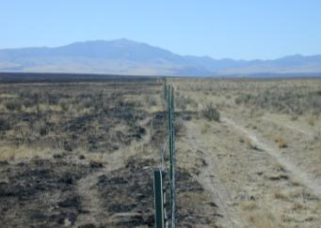
Grazing Fire/Fuel
Grazing Affects Fire Behavior
Perimeter or Extent
Intensity
Patchiness
Flame Length
K. Launchbaugh

Slide 10
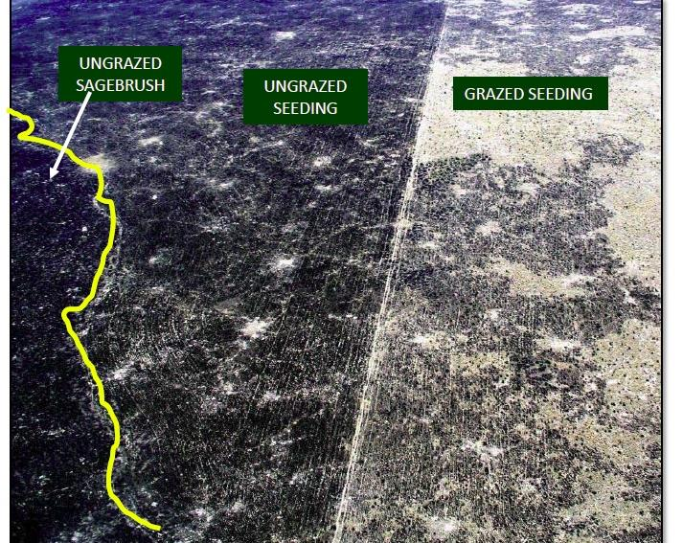
Grazing Affects Fuel Loads
M. Pellant

Slide 11

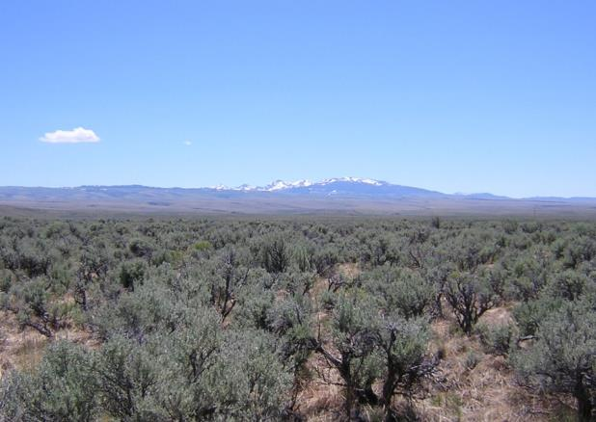
Grazing Can Affect Fire Behavior
Fire
Modeling
Simulated grazing effects on fire behavior while incrementally reducing herbaceous fuel loading and holding other fuel and environmental factors constant.
K. Launchbaugh
Launchbaugh et al. 2008
Notes:
Fuel model- a description of the living and dead fuel amounts by different size classes.
Assumptions: 1) uniform fuel continuity, weather, slope conditions, 2) spotting was not included,
Launchbaugh, Karen, Bob Brammer, Matthew L. Brooks, Stephen C. Bunting, Patrick Clark, Jay Davison, Mark Fleming, Ron Kay, Mike Pellant, and David A. Pyke. Interactions among livestock grazing, vegetation type, and fire behavior in the Murphy Wildland Fire Complex in Idaho and Nevada, July 2007. No. 2008-1214. US Geological Survey, 2008.

Slide 12
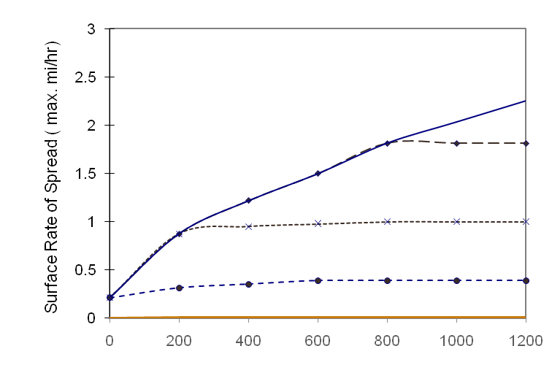
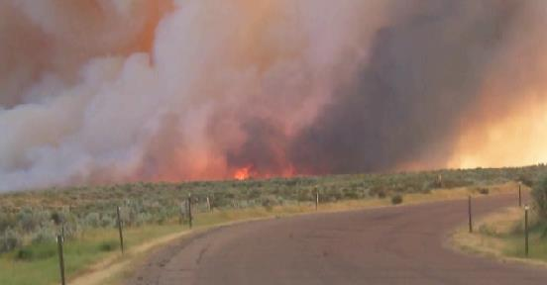
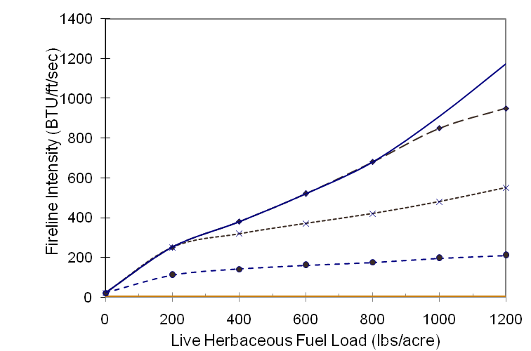
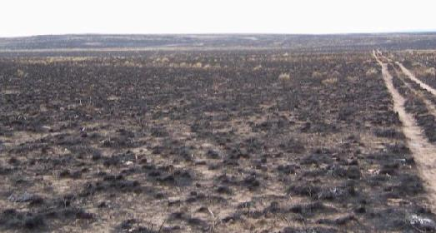
Fire Behavior
Midflame Wind Speed (upslope)
miles/hour
>15
15
10
5
0
>15
Mike Pellant
15
10
5
0
Mike Pellant
10% Dead Fuel Moisture – Sagebrush Steppe(GS1) Model
Notes:
Rules of thumb: Direct control difficult when the fireline intensity is greater than 100 BTUs or when flame length is greater than 4 ft.

Slide 13
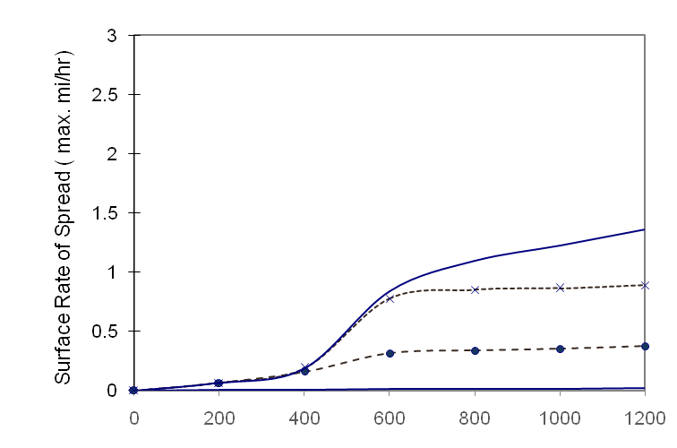
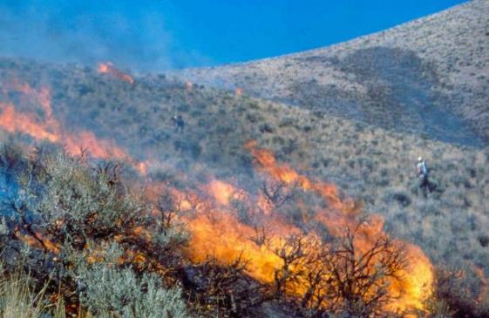
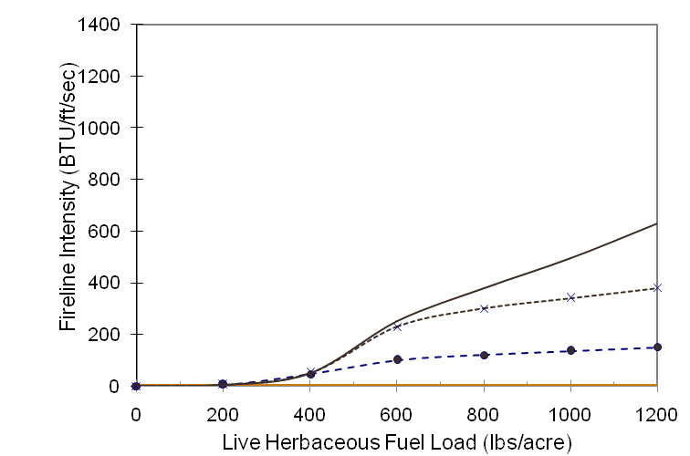
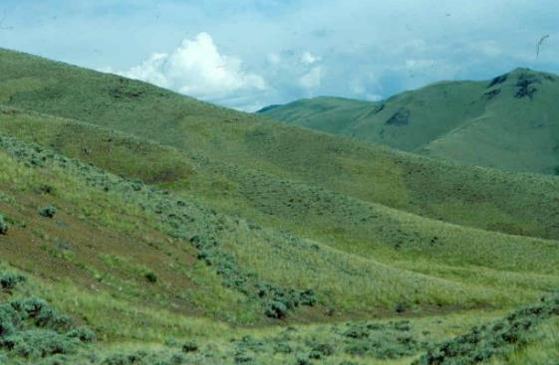
Fire Behavior
Midflame Wind Speed (upslope)
miles/hour
>10
10
5
0
S. Bunting
>10
10
5
0
J. Peterson
12% Dead Fuel Moisture – Sagebrush Steppe(GS1) Model

Slide 14
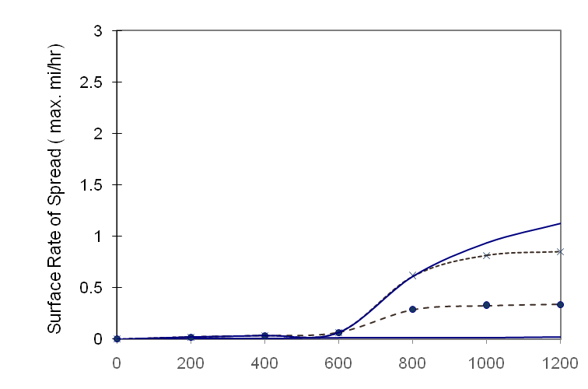
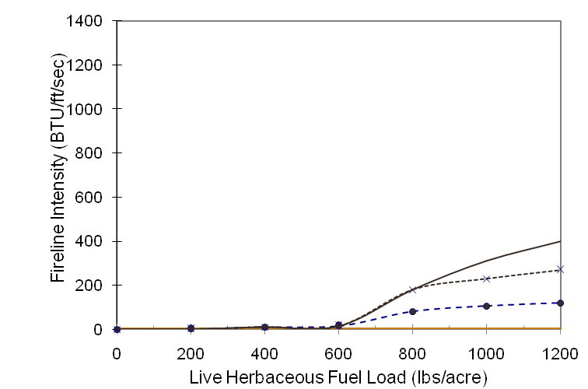
Grazing in Previous Year
Midflame Wind Speed (upslope)
miles/hour
Midflame Wind Speed (upslope)
miles/hour
12% Dead Fuel Moisture
>10
>10
10
10
5
Carryover herbaceous fuels reduced by 50%
5
0
0
>10
>10
10
10
5
5
0
0

Slide 15
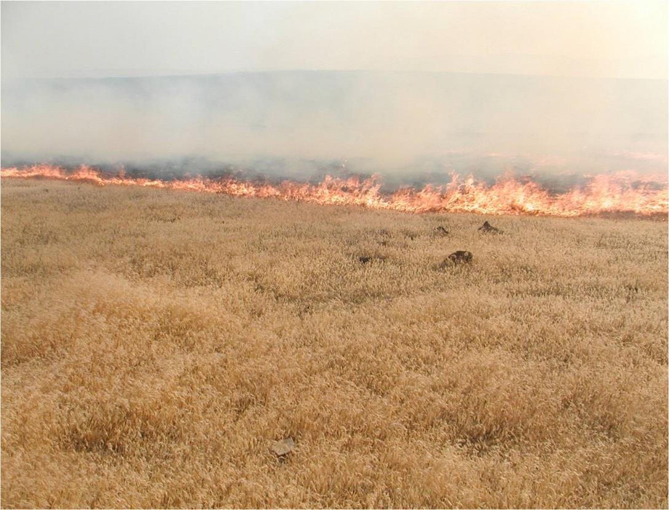
Cheatgrass Burning
Barry Perryman

Slide 16
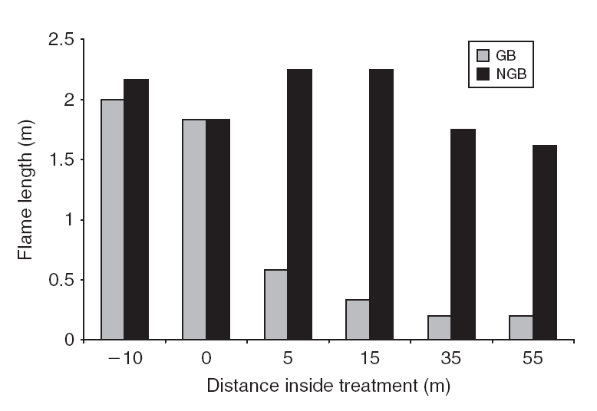
Grazing Affects Flame Length - Cheatgrass
Graze & Burn
No-graze & Burn
Diamond, J. M., Call, C. A., & Devoe, N. (2010). Effects of targeted cattle grazing on fire behavior of cheatgrass-dominated rangeland in the northern Great Basin, USA. International Journal of Wildland Fire, 18, 944-950.
Notes:
Diamond, J. M., Call, C. A., & Devoe, N. (2010). Effects of targeted cattle grazing on fire behavior of cheatgrass-dominated rangeland in the northern Great Basin, USA. International Journal of Wildland Fire, 18, 944-950.

Slide 17
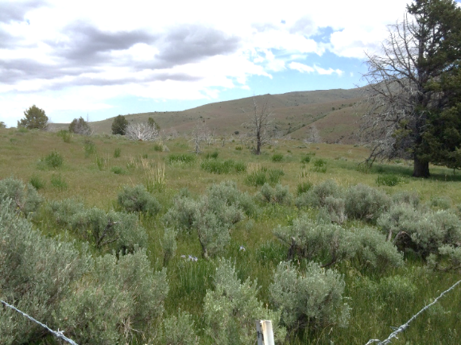
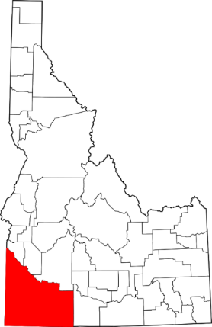
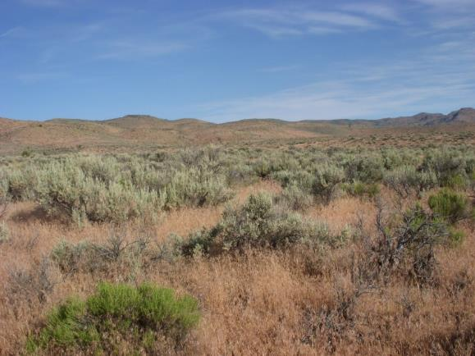
Research on Managing Fuel Loads
Targeted grazing by cattle
Two sites in Idaho
Big sagebrush
Wyoming Big Sagebrush
Mountain Big Sagebrush
C. Schachtschneider
C. Schachtschneider

Slide 18
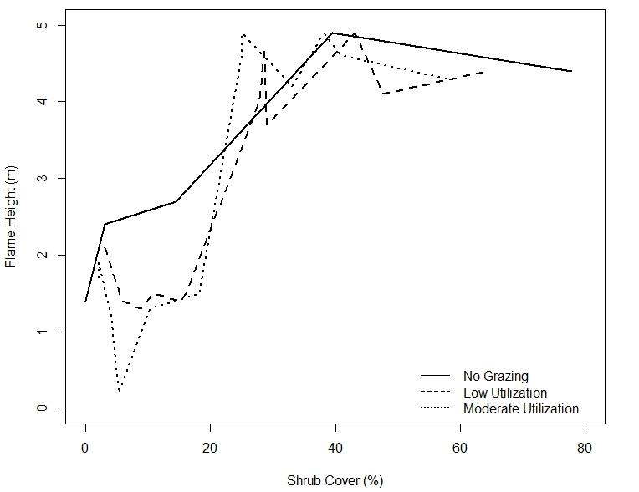
Flame Height
Grazing was influential in areas with less than 20% sagebrush cover.

Slide 19
Where Grazing Fits In
Sagebrush
Steppe
Annual
Grasses
Fire
Fuel
Livestock
Grazing
Continuity
Photo by K. Launchbaugh

Slide 20
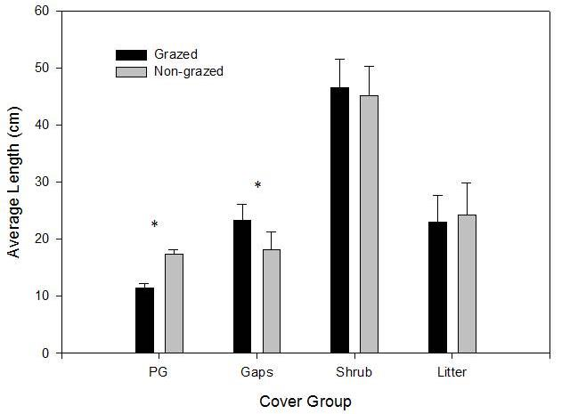
Grazing can Affect Fuel Continuity
Grazing Affects
Amount Herb Fuel
Fuel Continuity
Davies et al. 2010. Effects of Long-Term Livestock Grazing on Fuel Characteristics in Rangelands:
An Example From the Sagebrush Steppe. Rangeland Ecology and Management. 63(6):662-669.

Slide 21
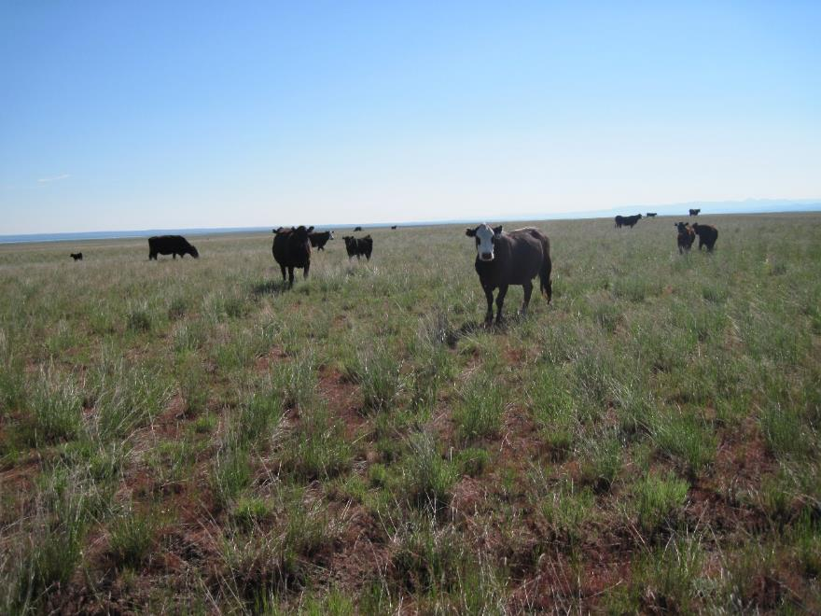
Grazing & Fuel - What do we really know?
Grazing can reduce fuel loads:
  Stop or slow fires
  Reduce flame length
Grazing can affect fuel even if it occurs the year before the fire.
Grazing cannot stop fires if it is very dry and very windy.
Conner White

Slide 22
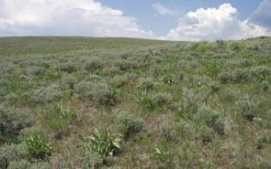
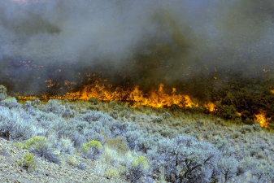
A fuel management plan:
Prevention - Reduce likelihood of human-caused fires
Control - Ways to compartmentalize fire and keep them small.
  Green strips
  Fire breaks
Coordinate & Collaborate
  Work with fire professionals and neighbors
  Rangeland Fire Protection Associations
  Become aware and trained
  Have equipment ready
Juley Hankins-Smith
Steve Bunting

Slide 23
Grazing & Fuel for Wildfire
S. Bunting
Josh Corbett
N. Rimbey
REM 456 - Integrated Rangeland Management

