Slide 1
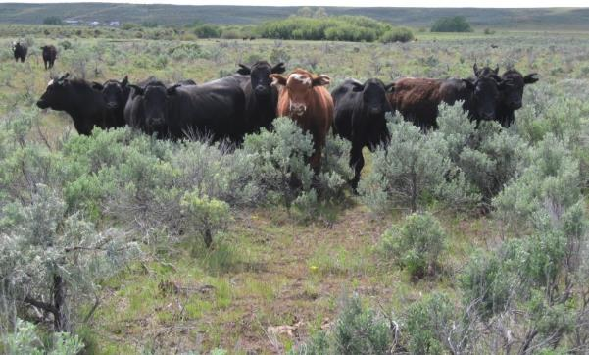
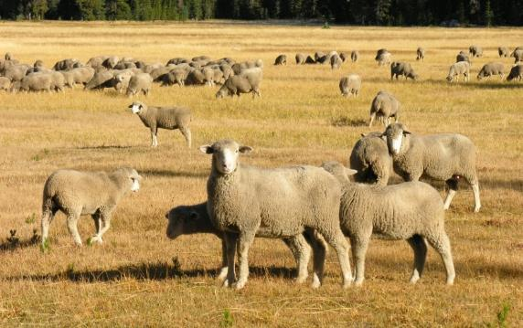

Grazing Systems
K. Launchbaugh
K. Launchbaugh
REM 456 - Integrated Rangeland Management

Slide 2
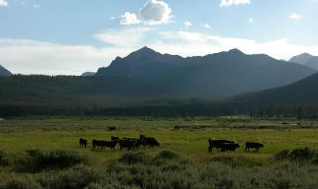
What can grazing methods accomplish?
Maintain or accelerate improvement in vegetation and facilitate proper use of the forage on all grazing units.
Improve efficiency of grazing through uniform use of all grazing units.
Stabilize the supply of forage throughout the grazing season.
Enhance forage quality to meet livestock and wildlife needs.
Improve the functioning of the ecological processes.
Improve watershed protection.
Enhance wildlife habitat.
Jen Peterson
From National Range and Pasture Handbook

Slide 3
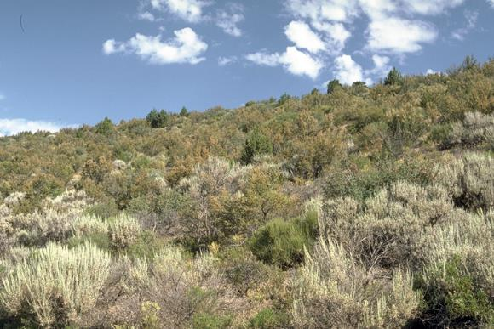
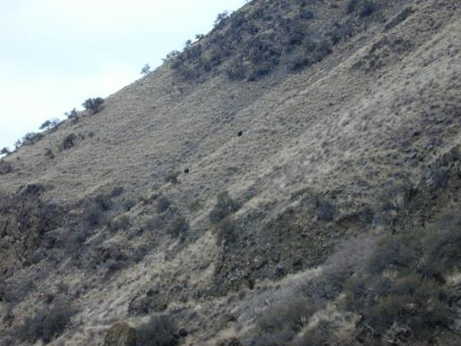
Grazing Methods Cannot:
Rectify mismanagement because of:
  Wrong species or class of animal
  Incorrect stocking rate
  Major distribution problems because of water availability or topography
Achieve range improvement in plant communities that are dominated by long-lived woody plants.
S. Bunting
K. Launchbaugh

Slide 4
Continuous Season-Long
Ranch
Headquarters
Map Legend
Water tanks
Salt
Perennial Stream
Steep rocky
range site
Continuous Season-Long: Livestock placed in pasture in spring and removed at end of grazing season, or grazing all year in one pasture

Slide 5
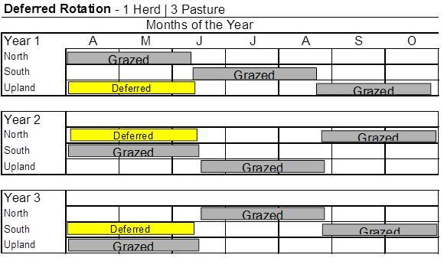
Deferred Rotation
North River Pasture
Upland Pasture
Water tanks
South River Pasture
Perennial Stream

Slide 6
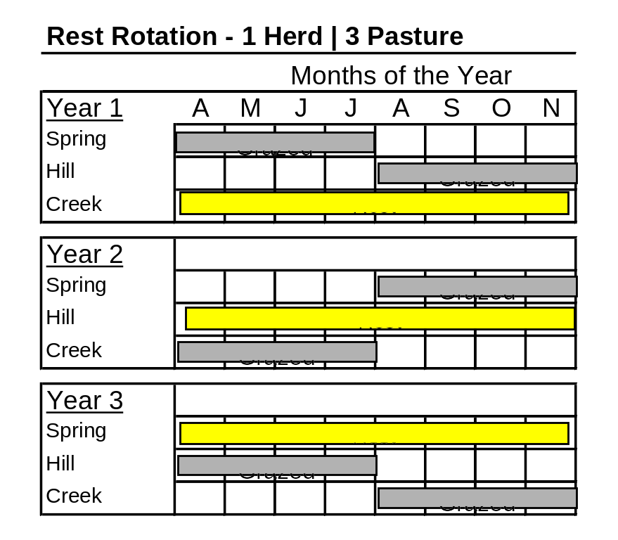
Rest-Rotation (also called the Hormay System)
These are summer pastures.
Livestock are moved to winter range from December though March.
Hill Pasture
Spring Pasture
Perennial Stream
Creek Pasture

Slide 7
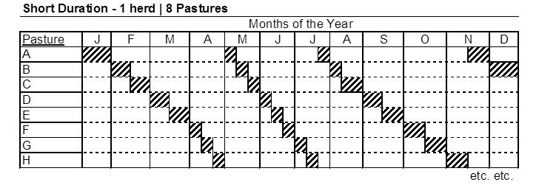
Intensive Rotation (Short Duration or HILF)
Pasture A
Pasture B
Pasture H
Pasture C
Water tanks
Pasture G
Well with water line
Pasture D
Pasture F
Pasture E

Slide 8
Decisional or Management Intensive
One Herd : Multiple Pastures
Make decisions based on management considerations such as:
  Available forage
  Available water
  Cover for calving or lambing
  To facilitate other practices such as haying or prescribed fire
These systems are probably the most common in the world and their success
  depends on the experience and decisions of the manager.

Slide 9
Decisional Methods
Best-pasture system - Move livestock to pasture that looks the "best" in terms of forage availability:
  Designed for arid areas where rain may improve forage on one part of a ranch but not affect another part.
Complementary system - Designed in the central prairies where animals rely on:
  cultivated or improved pastures for part of the year and then are moved to native range.
Seasonal-suitability - Movement of livestock to different areas of range depending on:
  the growth patterns of different vegetation types

Slide 10
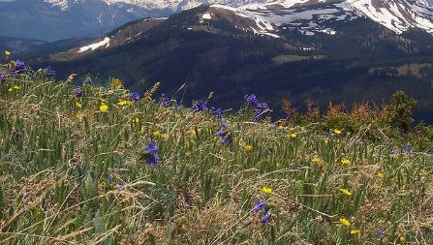
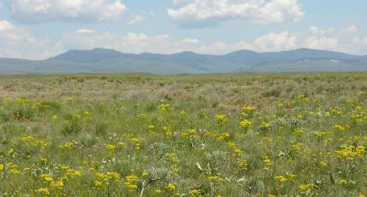
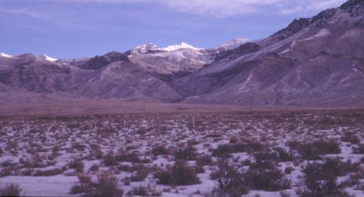
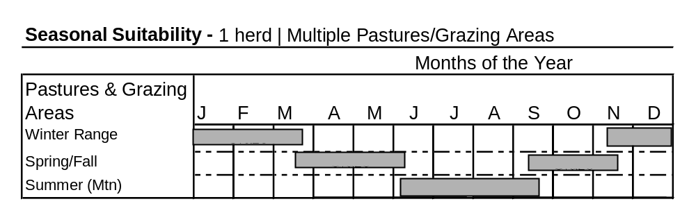
Seasonal Suitability – Follow the green
National Science Foundation
Summer Range
Jen Peterson
Spring/Fall
K. Launchbaugh
Winter Range

Slide 11
Which Method is Best?
Livestock animal performance and why?
Riparian areas and why?
Wildlife populations and why?
Wildfire risk and response?

Slide 12
Grazing Methods in Summary:
There is no one-size-fits-all grazing system
Depends on the skill of the manager. Nearly all of these systems will work with a well-skilled manager.
There are thousands of variations on a theme. The exact ways that rest, deferment, grazing, and rotation are combined can create new and appropriate systems.
No matter the system – stocking rate, species of grazing animal, and distribution patterns are very important in determining how the systems affect vegetation communities.
All systems need to be flexible to manage unexpected disturbance such as fire or weed invasions.

Slide 13
Grazing Systems
K. Launchbaugh
K. Launchbaugh
REM 456 - Integrated Rangeland Management

