Slide 1
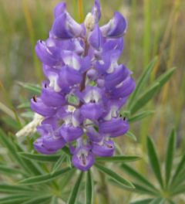
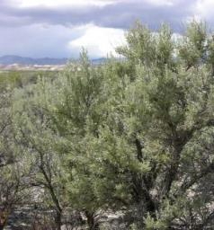
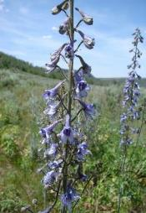
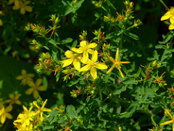

Toxic Rangeland Plants
J. Peterson
K. Launchbuagh
Sheri Hagwood - BLM
Rusty Clark
REM 456 - Integrated Rangeland Management

Slide 2
Anti-Quality & Toxic Agents
1) Compounds Resistant to Digestion
  Lignin, silica, tannins
  Most common defenses in grasses
  Decrease positive feedback (i.e., reduce palatability)
2) Inhibit Digestion
  Kill rumen microbes
    Like, essential oils in sagebrush or pine
  Bind nutrients making them indigestible
    Like tannins that bind proteins
3) Compounds that are “Toxic”
  What is a “Toxic” Plants?

Slide 3

Toxic Plants
Toxic (or Poisonous) Plant Compounds
  What is a toxic plant?
    Plant that causes negative digestive or physiological effect.
  What effects do toxic plants have?
    Death
    Birth Defects (called “Teratogenic” effects)
    Reproductive Dysfunction
    Bloat
    Dermatitis and Skin Sores
    Neurological Effects
    Etc. etc. etc.

Slide 4
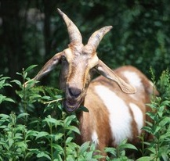
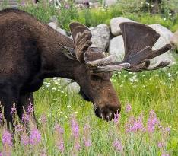
How animals avoid toxic plants?
Animals learn based on consequences
Skin Defense Systems
  Causes Pain
Gut Defense System
  Causes Nausea
USDA (Scott Bauer)
Sara Edwards

Slide 5
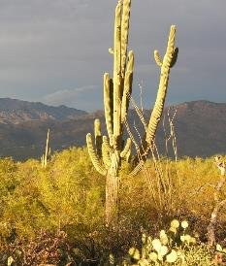
Animals Learn Based On Consequences
Skin Defense System:
Touch
Pain
Avoid
K. Launchbaugh

Slide 6
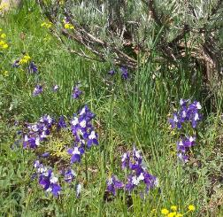
Animals Learn Based on Consequences
Gut Defense System:
Preference
+
Eat
Plant
(taste)
Digestive
Feedback
-
Aversion

Slide 7
Animals Learn Based on Consequences
Negative Digestive Feedback
Flavor becomes
“distasteful”
Encounter
New Plant
See & Smell
Eat & Taste
Encounter Plant
In Future
Factors that could lead to consumption:
Behavior of peer
Previous experience with plant
Natural habit to sample plants
Avoidance Behavior

Slide 8
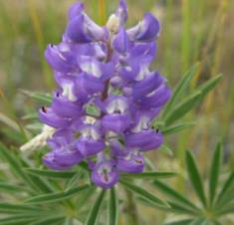
Why do plants make “toxins”?
Anti-microbial
Anti-herbivore
  insects and mammals
Anti-plant
  called allelopathy
To mediate environmental extremes
  UV Radiation
  Low temperature
  Moisture stress
J. Peterson

Slide 9
How do plants make toxins?
Often called “Secondary Compounds”
  Primary metabolism contributes to growth and reproduction
  Secondary metabolism does not lead to growth and reproduction… often yielding toxins.
Excessive primary metabolites (like nitrates) can also be toxic.

Slide 10
Toxicity Depends On → Plant & Environment
Phenological stage (or stage of development like bolting, flowering, etc.)
Ecological site or soil nutrient levels
Weather (e.g., frost or high temperature)
Environmental stress (e.g., drought)
Plant part (e.g., leaves may be more toxic than stems or other parts)

Slide 11
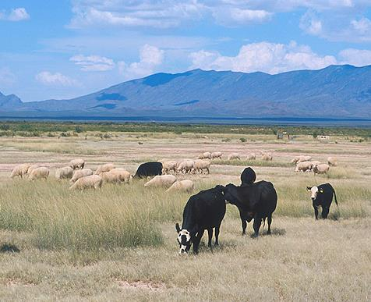
Toxicity Depends On→ Animal Attributes
  Amount eaten
    The poison depends on dose”
  Animal species
    Rumen microbes
    Liver activity
    Cellular enzymes
  Other plants in the diet
    Some plants cancel each other out
    Other combinations become more toxic
  Hormonal state
  Body condition
USDA-ARS(Scott Bauer)

Slide 12
Toxic Agents in Plants
  Alkaloids
  Glycosides
  Nitrates
  Soluble Oxalates
  Tannins
  Essential oils (or terpenes)
  Compounds that cause photosensitization
  Plants that cause dermatitis

Slide 13
Alkaloids
  Most powerful of toxic plant substances
    caffeine, morphine, codeine, heroine, cocaine
  Often toxic in small quantities
  Remain toxic as plant matures or freezes
  Causes nervous disorders
    Negative reinforcement in skin-defense system (cause pain or sensitivity)
  Often don’t make animals sick so they eat a lot of plants containing alkaloids

Slide 14
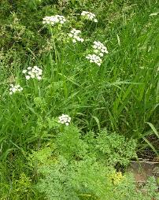
Plants that contain Alkaloids
Lupines (Lupinus)
Locoweeds (Oxytropis and Astragalus)
Larkspurs (Delphinium)
  Tall larkspur causes more livestock deaths than any other toxic plants
Bitterweed (Hymenoxys odorata)
Poison hemlock (Conium maculatum) and Water hemlock (Cicuta douglasii)
J. Peterson
Sheri Hagwood - BLM
K. Launchbaugh

Slide 15
Glycosides
Naturally occurring compounds found in many rangeland plants and forages
Block oxygen transport and release in blood
Can be highly toxic even causing death
Don’t usually provide a negative post digestive feedback
Highly variable in time and space - Careful management to prevent high ingestion levels

Slide 16
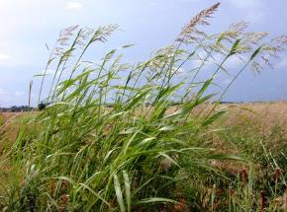
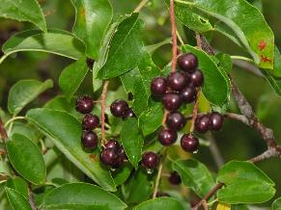
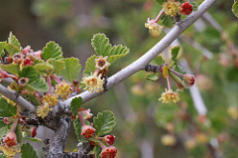
Plants that contain Glycosides
Johnson grass (Sorgham halepense)
Choke cherry (Prunus virginiana)
Mountain mahogany (Cercocarpus montanus)
Serviceberry (Amelanchier alnifolia)
Bur buttercup (Ranunculus testiculatus)
White clover (Trifolium repens)
agriculture.ks.gov
K. Launchbaugh
Andrey Zharkikh

Slide 17
Nitrates
Nitrates accumulate in plants under certain conditions:
  High nitrogen soils
  Drought
  Low light conditions
  Treatments with some herbicides (such as 2,4-D)
Block ability of blood to carry oxygen
Doesn’t usually cause illness leading to aversions

Slide 18
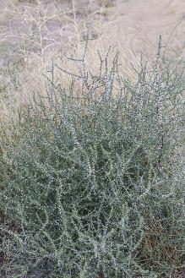
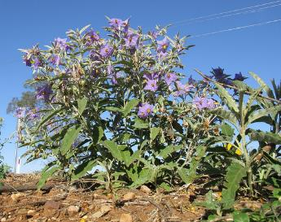
Plants that contain Nitrates
Russian thistle (Salsola iberica)
Silverleaf nightshade (Solanum elaeagnifolium)
Kochia (Kochia scoparia)
Careless weed (Amaranthus retroflexus)
Ed Ogle
Harry Rose

Slide 19
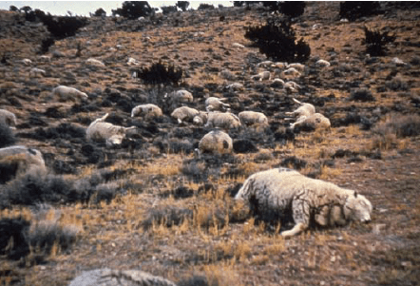
Soluble Oxalates
Oxalates chelate cations, especially calcium, to form insoluble crystalized salts that damage vessels.
Mostly toxic to sheep - Catastrophic Loses
  1942 – Wells NV – 160 sheep
  1945 – Twin Falls ID – 275 sheep
  1945 – Raft River Valley ID – 750 sheep
  1945 – Raft River Valley ID – 1620 sheep
  1952 – Park Valley UT – 1200 sheep
Only occasionally toxic to cattle
1250 sheep died after over-ingested halogen near Garrison, UT in 1971

Slide 20
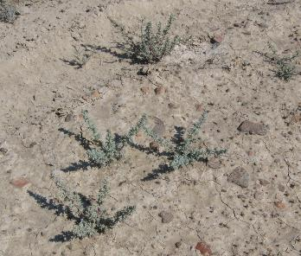
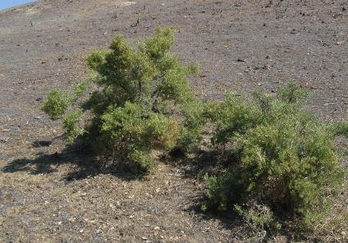
Plants that contain Oxalates
Halogeton
(Halogeton glomeratus)
Greasewood
(Sarcobatus vermiculatus)
K. Launchbaugh
K. Launchbaugh

Slide 21
Tannins
Reduce protein digestion
Don’t cause nausea leading to aversions accept at very high levels
Decrease weight gain because of decreased protein availability
Lethal at high quantities – not common but can occur such as does in “oak poisoning”

Slide 22
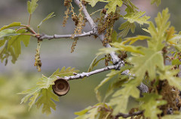
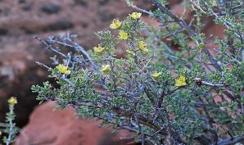
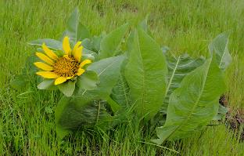
Plants that contain Tannins
Most oak-brushes
(e.g., Quercus gambellii)
Blackbrush
(Coleogyne ramosissima)
Mulesear
(Wyethia amplexicaulis)
Andrey Zharkikh
Andrey Zharkikh
Miguel Vieira

Slide 23
Essential Oils or Terpenes
Give distinctive odor to plant (an essence)
Kill rumen microbes (i.e. “pine-sol effect”)
Can cause illness and nausea
Decrease weight gain
Lethal in high quantities

Slide 24
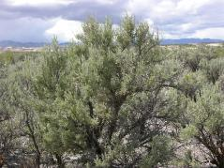
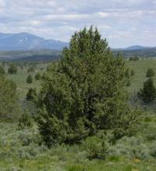
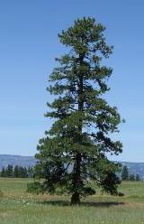
Plants that contain Essential Oils
Sagebrush
  (e.g., Artemisia tridentata)
Juniper
  (e.g., Juniperus occidentalis)
Pine
  (e.g., Pinus ponderosa)
J. Peterson
J. Peterson
J. Peterson

Slide 25
Compounds that cause Photosensitization
Causes swelling of head and ears.
Sloughing of skin when exposed to sun.
Prevents liver ability to breakdown certain pigments
Can cause death
Does not generally cause illness that could lead to conditioned flavor aversions.

Slide 26
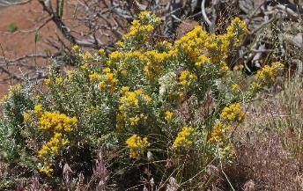
Plants that cause Photosensitization
St. John’swort
(Hypericum perforatum)
Horsebrush
(Tetradymia canescens)
Rusty Clark
Andrey Zharkikh

Slide 27
Plants substances causing Dermatitis
Toxins that are poisonous upon contact
Affect skin defense system
Rarely lethal but cause production losses

Slide 28
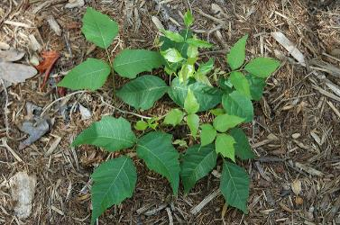
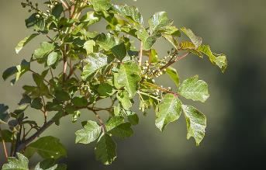
Plants causing Dermatitis
Poison ivy
(Rhus rydbergii )
Poison sumac
(Rhus venix)
Poison oak
  (Toxicodendron diversilobum)
flickr.com/cygnus921
Greg Shine, BLM

Slide 29
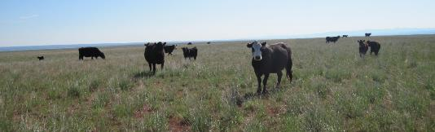
Preventing Animal Poisoning
Provide adequate supply of good forage
Provide salt and minerals
Don’t put hungry animals in pastures with abundant toxic plants
Be careful when introducing animals to new pastures
Be aware of conditions that create toxic plants and where toxic plants are located
Connor White

Slide 30
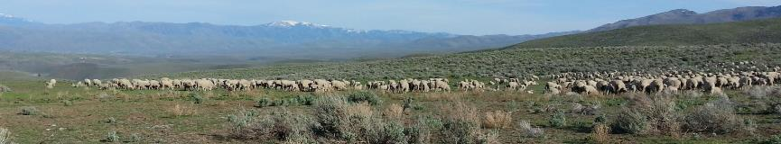
Preventing Animal Poisoning
Consider removing animals from pastures that have been treated with herbicides
Graze pastures in seasons when poisonous plants are least toxic
Prevent introducing toxic plants or try to control toxic plants
Use the correct animal species
K. Launchbaugh

Slide 31
Toxic Rangeland Plants
J. Peterson
K. Launchbuagh
Sheri Hagwood - BLM
Rusty Clark
REM 456 - Integrated Rangeland Management

