Slide 1
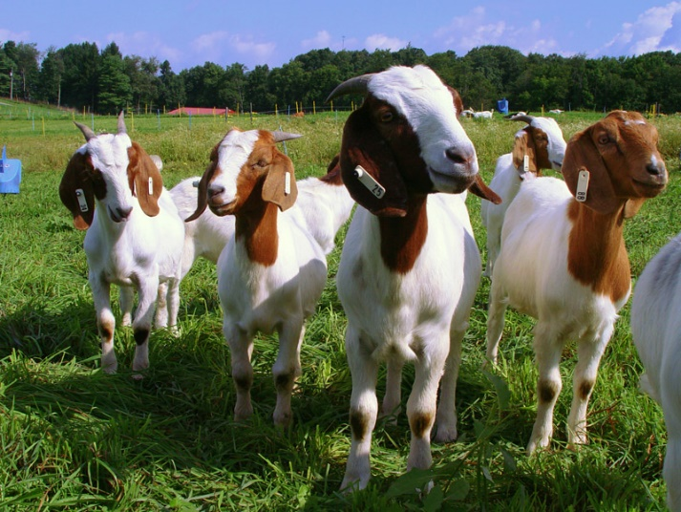
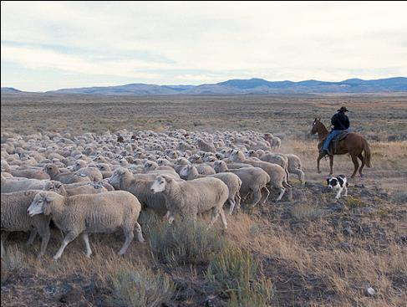
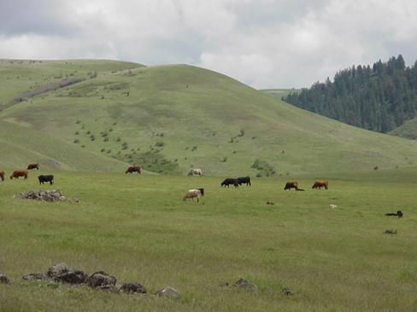

Guidelines for Setting “Proper” Stocking Rate
S. Boyer (USDA)
UDSA-ARS
K. Launchbaugh
REM 456 - Integrated Rangeland Management

Slide 2
Natural &
Human
Resources
Grazing
Management
Decisions
Community
Response
Climate
Topography
Veg. Community
Wildlife
Mgmt. Philosophy
& Goals
Livestock
Species
cattle, sheep, goats or horses
Stocking Rate
how many animals
Grazing Plan
season of grazing
season of rest
duration of grazing
Vegetation Community
Livestock Production
Wildlife Community
Grazing Distribution
Important point:
Once grazing management decisions are made, there are continual interactions between livestock, wildlife, & vegetation

Slide 3
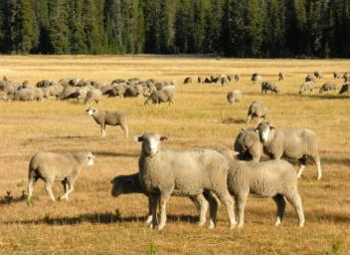
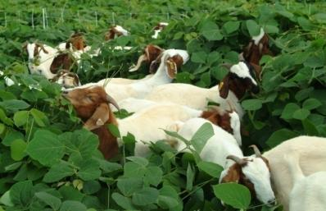
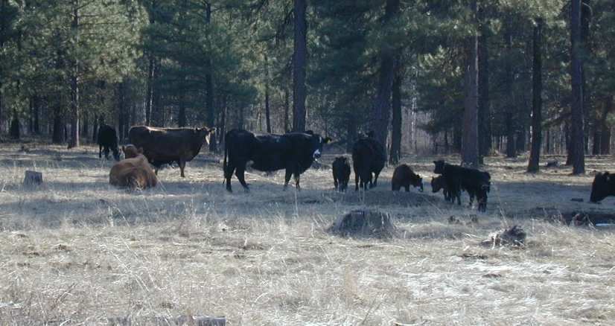
Four Grazing Mgmt Factors:
Which animal? -Animal Species & Class
How many animals? -Stocking Rate
When to grazing or not graze? -Grazing Plan
Where animals graze? – Grazing Distribution
K. Launchbaugh
J.M. Lingenbuhl
K. Launchbaugh

Slide 4
Carrying Capacity
The number of animals that a piece of land can support on a long-term basis without causing damage to the ecosystem.
  Land and vegetation determine grazing capacity
  Expressed as animals/area/year (usually acres per AUM per year)
  Land is usually bought and sold on this basis

Slide 5
Stocking Rate
The number of animals a land manager places on a piece of land for a specified period of time.
  Must include:
    Number of animals or Animal Unit
    Specific area (acres or hectares)
    Specific period of time (days or months)
  Most important grazing decision because it affects:
    Rangeland health
    Economic returns

Slide 6
Animal Unit (AU)
1,000 pounds of grazing animal … ruminant
AUE #/AU
Cow = 1 1
Horse = 1.8 0.56
Yearling Steer = .75 1.3
Sheep = 0.2 5
Jackrabbit = 0.02 50
Animal Unit Equivalent (AUE) = A conversion factor reflecting the # of AU in an average animal

Slide 7
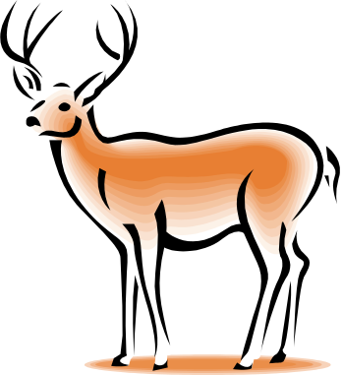
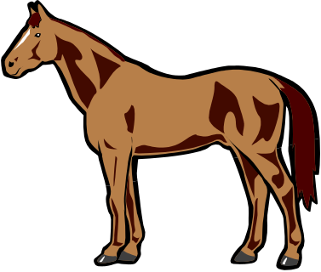
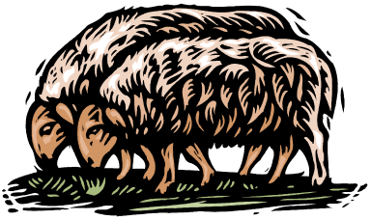
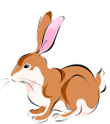
Forage Demand
Ruminants
Hind-Gut Fermenters
Eat 3.0% of body weight/day in dry matter of forage.
Horses
Rabbits and rodents
Eat 2.5% of body weight/day in dry matter of forage.
Cattle, sheep, goats
Deer, elk, bighorn sheep, moose, etc.

Slide 8
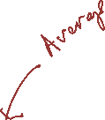




Forage Demand
Animal Requirements
Forage Quality
Eat more during periods of high demand:
Lactation
Late gestation
Winter for thermal regulations
Eat more when forage is of high quality & digestible:
Young actively growing plants
Spring

Slide 9
Animal Unit Month (AUM)
Amount of forage an AU will eat in a month
  How many pounds is this?

Slide 10
Animal Unit Month (AUM)
Amount of forage an AU will eat in a month
AU = 1000 lbs of grazing animal
  Grazing ruminant animals eat about 2.5% body weight per day.
  30 days in month
  How much is an AUM?
Each AU = 1,000 lbs ×2.5% = 25 lbs/day
AUM= 25 lb * 30 days = 750 lbs

Slide 11
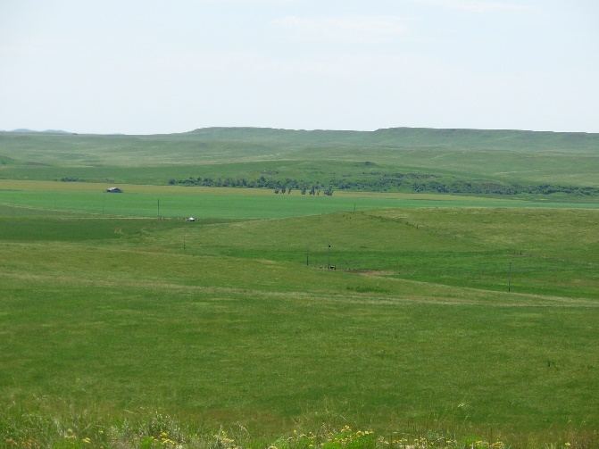
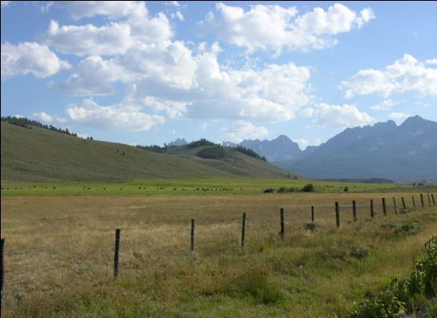
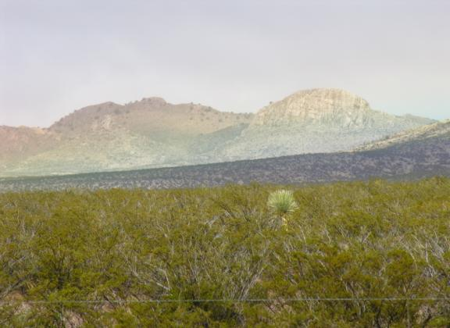
Proper Stocking Rate?
Range Health standpoint
A. Gearhart
J. Peterson
K. Launchbaugh

Slide 12
Basis for Stocking Rates
Proper stocking based on maintaining sufficient plant residue for:
  Plant health/regrowth
  Wildlife forage
  Prevent erosion & promote soil health
Set stocking rate below carrying capacity
  To allow for drought
  Forage for low productivity years
  Reduce invasion by weedy plants
  May increase fuels and risk of wildfire

Slide 13
Utilization Guidelines:
Based on ecological research
% Use of
Major Plants
40-50
30-40
30-40
30-40
Range Type
Shortgrass prairie
Sagebrush grasslands
Coniferous forest
Oak woodlands

Slide 14
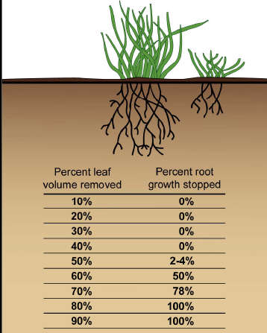
Root Response to Defoliation
Root growth is an indication of ability of plant to recover from defoliation.
Must forage grasses can sustain removal of up to 50% of leaf material before root growth is slowed or stopped.
http://forestandrange.org/modules/livestockwildlife/edu/Presentation6.ppt
Notes:
By examining the table, one can see that by trying to "squeeze in" an additional 10% of harvest, 50% of the roots stop growing.

Slide 15
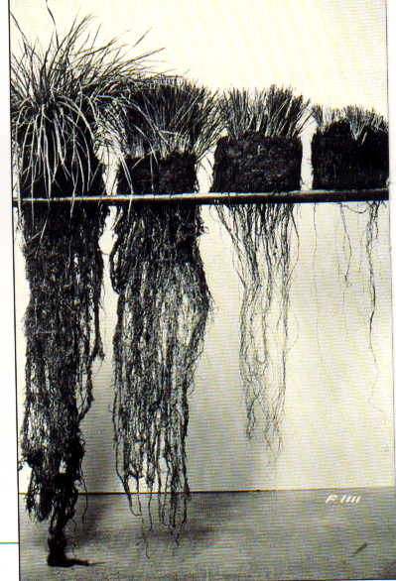
Root Response to Defoliation
50%
70%
90%
Level of Removal
Crider - 1955
Notes:
15
Classic investigation from mid1950s; lead to take half – leave half rule. At high levels of grazing, root growth is severely limited because plants are allocating resources to leaf growth to increase photosynthesis.

Slide 16
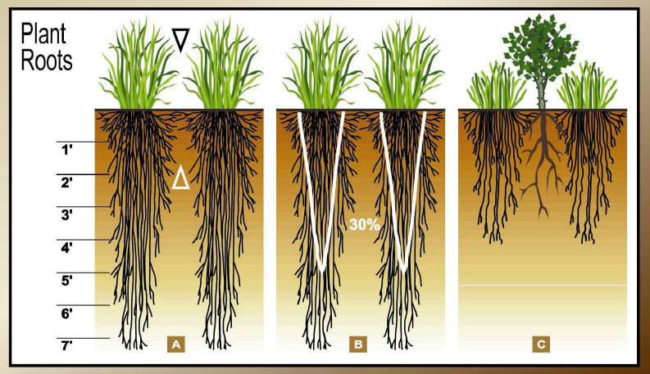
Importance of Roots
Remove the leaves ----- Can reduces root mass
Space & resources for invasive plants
Notes:
The healthier roots you have depends on how healthy the aboveground plant is. So if aboveground roots are overgrazed, you open up available soil resources to shrubs and other weeds.

Slide 17
Utilization Guidelines – Not Rules
Effects of defoliation or utilization depend on:
  Season of year
    Winter < Spring < Flowering/Seed Set
  Moisture and nutrients available for recover
    Reduced effect if resources are available
  Life history characteristics of plant
    Some plants are better than others at handling defoliation
  Time for recover
    Frequency of defoliation is important

Slide 18









Recommended Use Level
“Allowable Use” , “Recommended Use” or “Proper Use Factors” to estimate usable forage supply
Total Forage × Recommended Use = Usable Forage Supply

Slide 19
Heavy use ≠ Overgrazing
Overgrazing = repeated heavy grazing such that damage to the plant community occurs.
Overstocking = heavy grazing during a specific season such that high levels of utilization are observable.
Overstocking does not always lead to Overgrazing

Slide 20
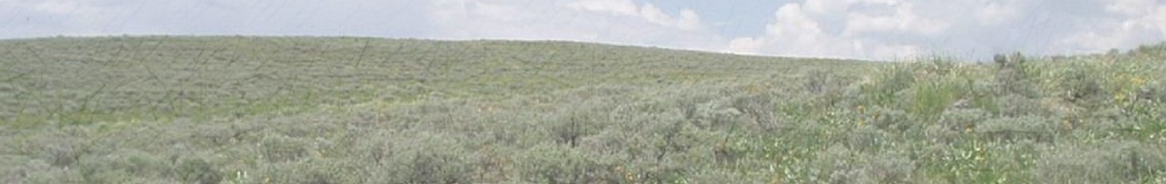
For Rangeland Health:
Set Stocking Rates Below Carrying Capacity
Healthy soil.
Slows weedy plant invasion.
Improves drought resistance.
Improves condition of degraded land.

Slide 21
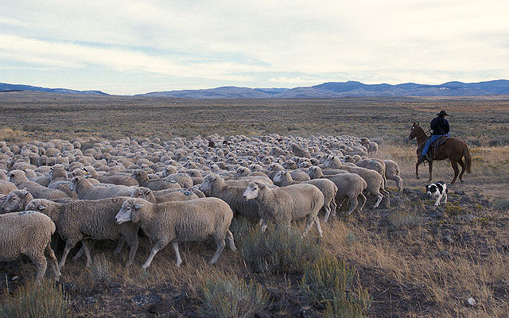
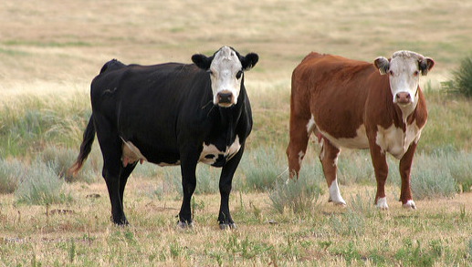
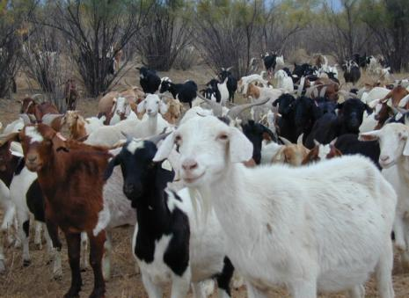
Proper stocking rate?
Animal Production standpoint
Scott Bauer (USDA)
Vicky Frank
K. Launchbaugh

Slide 22
Stocking rate affects cattle gains:
Launchbaugh, J.L. 1957. Kansas Agric. Experiment Station Bulletin 394.

Slide 23
Stocking rate affects cattle gains:
Production per animal
?

Slide 24
Stocking rate affects cattle gains:
Less forage per animal
Lower diet quality
More energy required
to forage
Increased stress &
disease
Production per animal

Slide 25
Stocking rate affects total production:
Production per acre

Slide 26
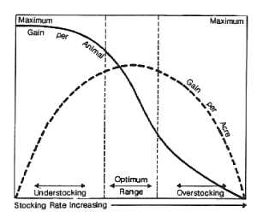
Proper stocking rate
Bement 1969

Slide 27
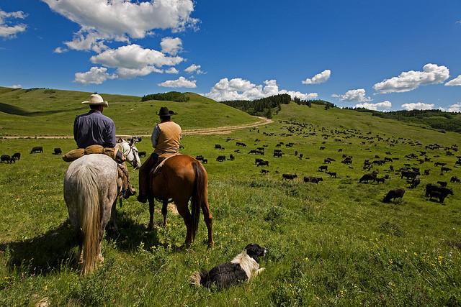
For Livestock Production:
Set Stocking Rates At or Below Carrying Capacity
Desirable production per animal
Optimal production of animals per acre
What is “Desirable” or “Optimal” depends on the manager’s goals and objectives.
Meridican (flickr)

Slide 28
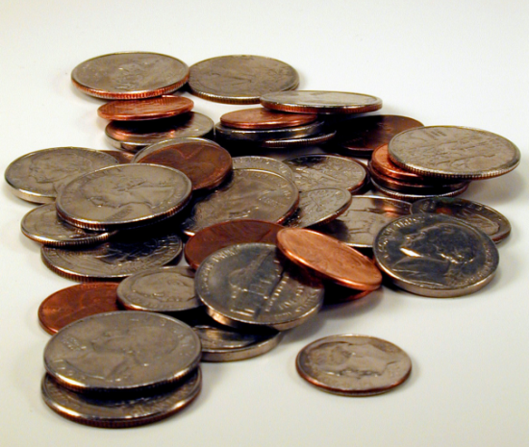
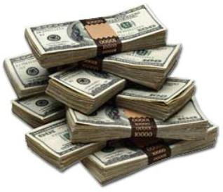

Proper stocking rate?
From an Economic Standpoint.

Slide 29
Fixed costs of production:
Do not vary with amount produced:
  - fencing
  - land taxes
  - pickup

Slide 30
Variable costs of production:
Increase with amount produced:
  - feed
  - veterinary supplies
  - hired labor

Slide 31
Effect of costs on stocking rate:
production/acre
total costs
Optimal Stocking Rate – depends on costs
Can’t overgraze and make money - at some point, putting another animal on the range will cost more than potential revenue return from the herd or flock.

Slide 32
Net Revenue from Grazing affected by:
Annual forage production
Livestock production (lbs/acre)
Market price
Production costs
    fixed
    variable

Slide 33
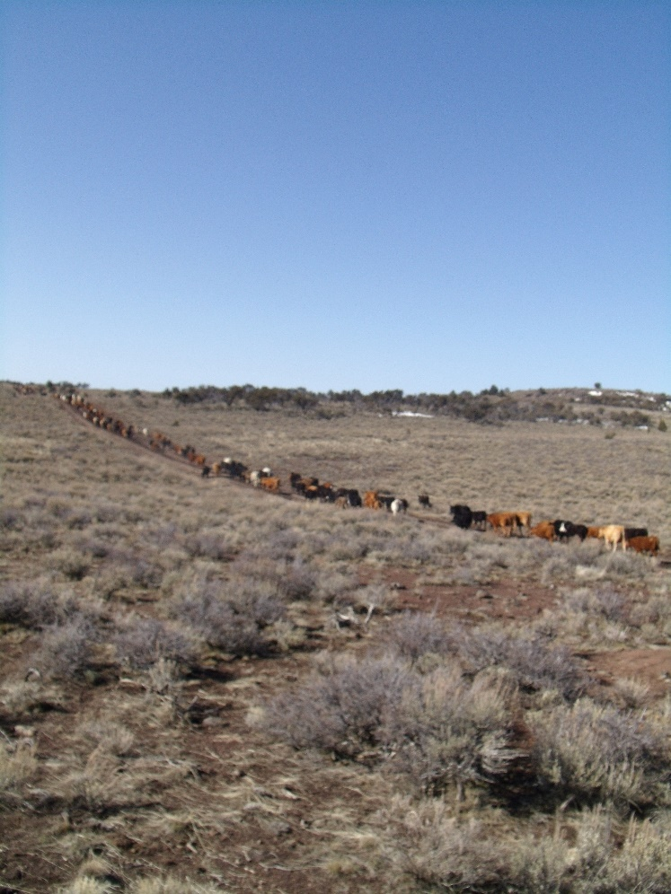
Summary Carrying Capacity & Stocking Rates
For Range Health
  Stocking Rate < or = Carrying Capacity
For Livestock Production:
  Stocking Rate < or = Carrying Capacity
For Economic Gain
  Stocking Rate < or = Carrying Capacity
T. Lester

Slide 34
Summary Carrying Capacity & Stocking Rates
Why Does Overgrazing Still Occur?
UDSA-ARS
K. Launchbaugh

Slide 35
Guidelines for Setting “Proper” Stocking Rate
S. Boyer (USDA)
UDSA-ARS
K. Launchbaugh
REM 456 - Integrated Rangeland Management

