Slide 1
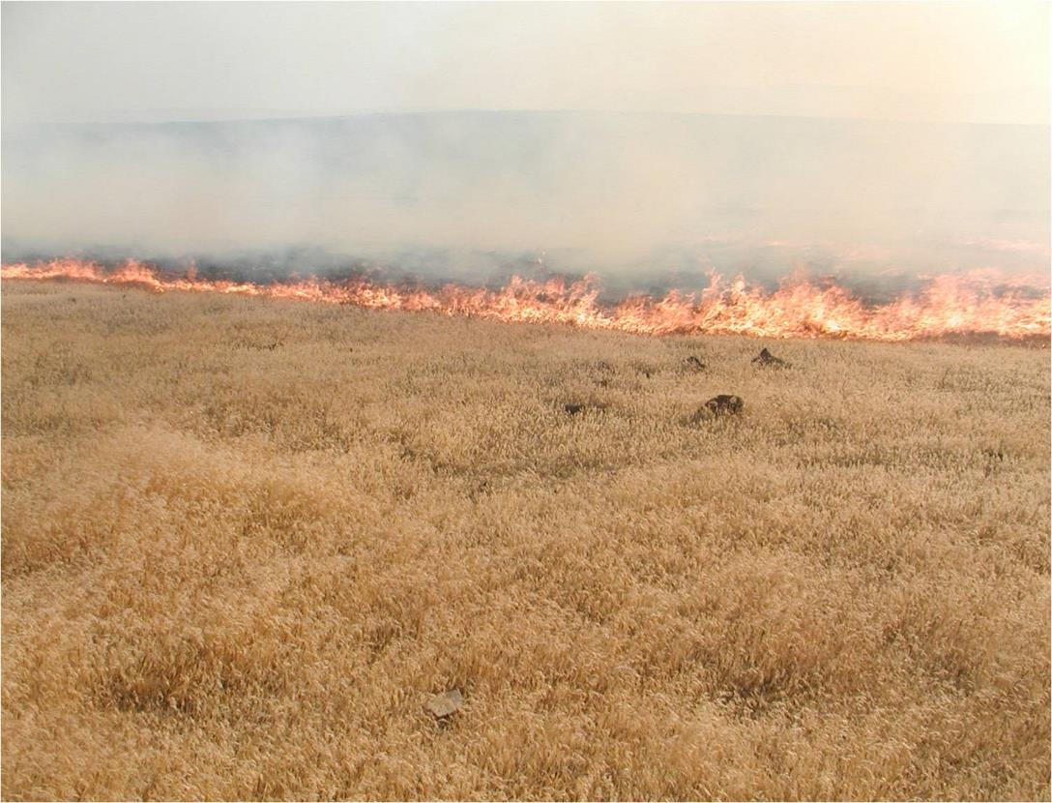
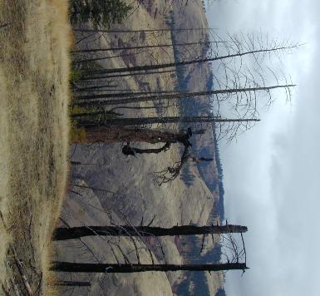
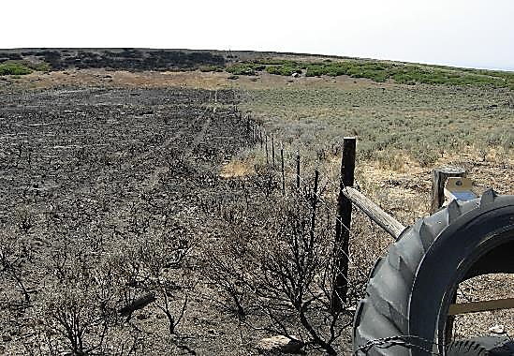

Grazing & Annual Grasses
B. Perryman
Josh Corbett
N. Rimbey
REM 456 - Integrated Rangeland Management

Slide 2
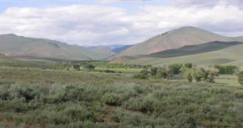
Where Grazing Fits In
Sagebrush
Steppe
Annual
Grasses
Fire
Fuel
Livestock
Grazing

Slide 3
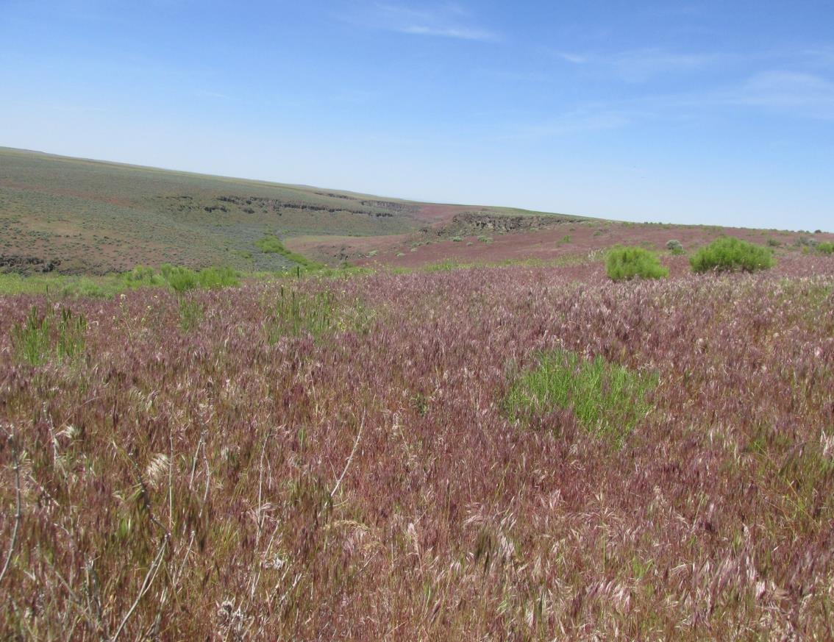
Historic Patterns
Introduction of Annual Grasses – late 1800’s
  Cheatgrass
  Medusahead
  Red Brome
Fine textured, flammable,
early maturing
Affect on fire
  Extend fire year
  Increase ignition risk
  Decrease fire return interval
K. Launchbaugh

Slide 4
Cheatgrass Burning
B. Perryman

Slide 5
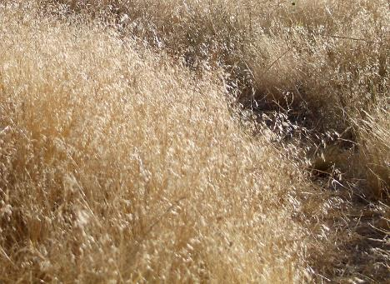
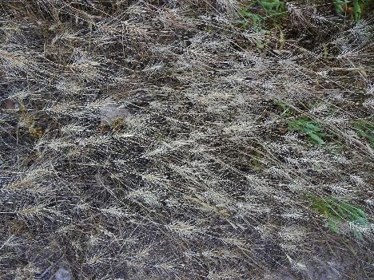
Grazing and Annual Grasses
Grazing can promote annual grass invasion.
Grazing does not stop invasion.
Grazing can suppress annual grasses.
It depends:
  Season of grazing
  Available moisture
Cheatgrass
USDA - Jaepil Cho
Medusahead
Andrey Zharkikh

Slide 6
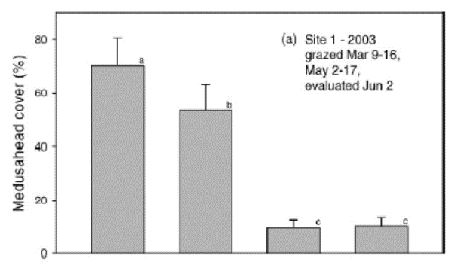
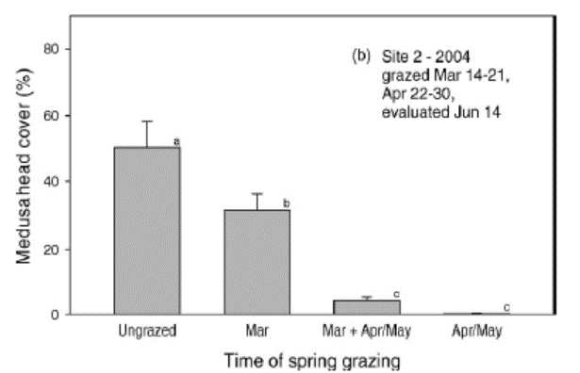
Grazing and Medusahead
DiTomaso, et al. 2008. Control of Medusahead (Taeniatherum caput-medusae) Using Timely Sheep Grazing. Invasive Plant Science and Management.1:241-247.

Slide 7
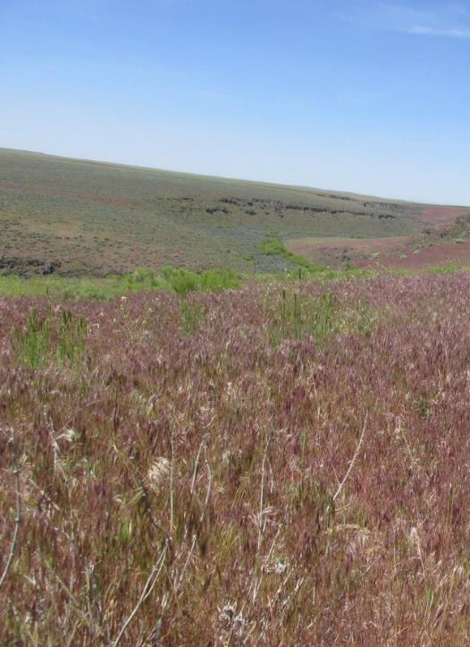
Grazing and Cheatgrass
No Sheep Grazing After 2002
K. Launchbaugh
Early Spring Grazing can Reduce Cheatgrass
Davison et al. 2004

Slide 8
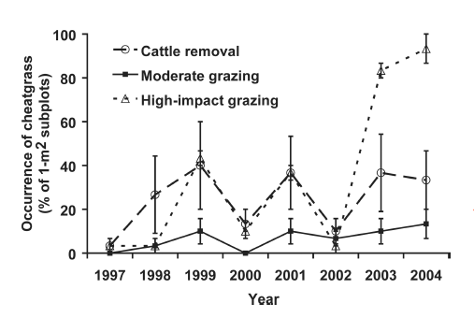





Grazing and Cheatgrass
Moderate grazing had less cheatgrass then no grazing
Moderate grazing also had less cheatgrass than heavy “High impact” grazing
High impact grazing caused a great increase in cheatgrass after drought year.
8-year Grazing Study in Northern Arizona
Loeser et al. 2007. Impact of Grazing Intensity during Drought in an Arizona Grassland. Conservation Biology 21(1):87–97.

Slide 9
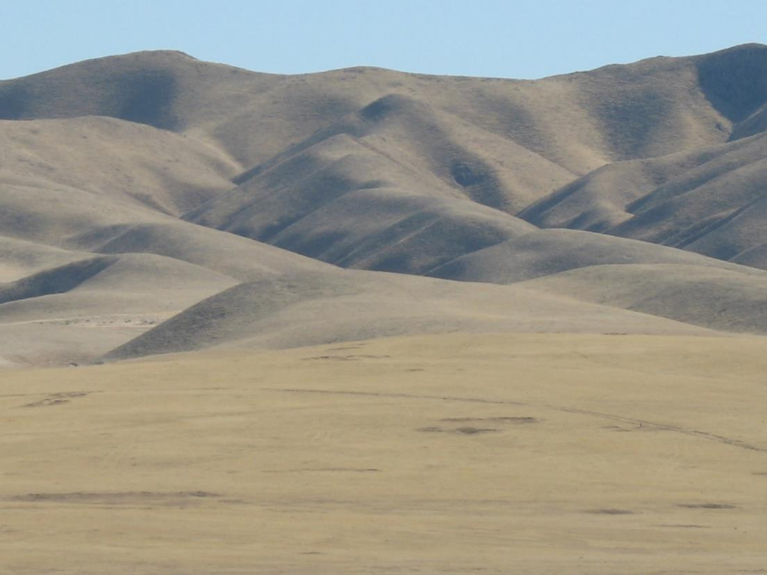
Cheatgrass Rangeland
B. Perryman

Slide 10
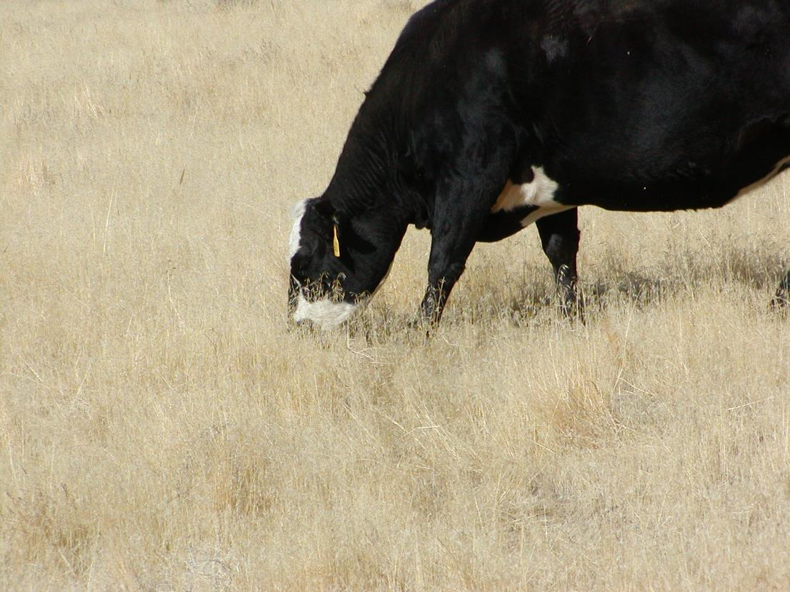
Winter Grazing
B. Perryman

Slide 11
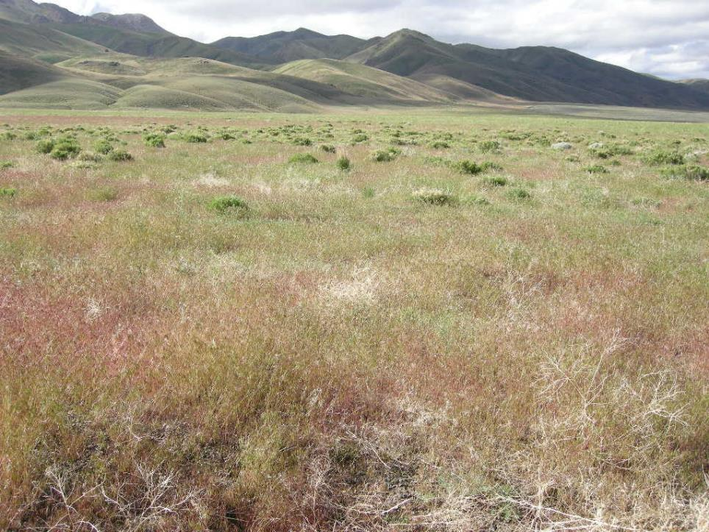
B. Perryman

Slide 12
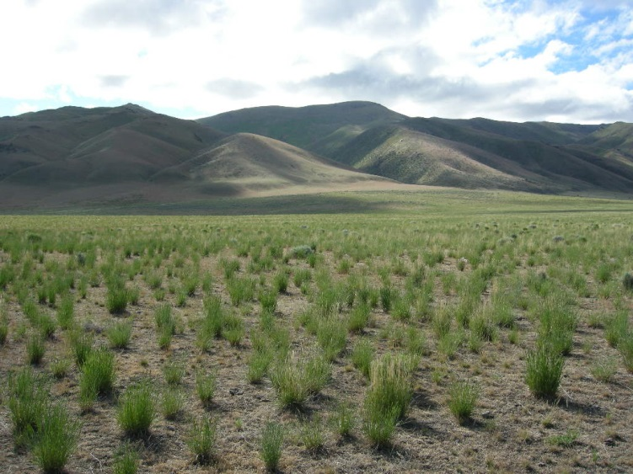
B. Perryman

Slide 13
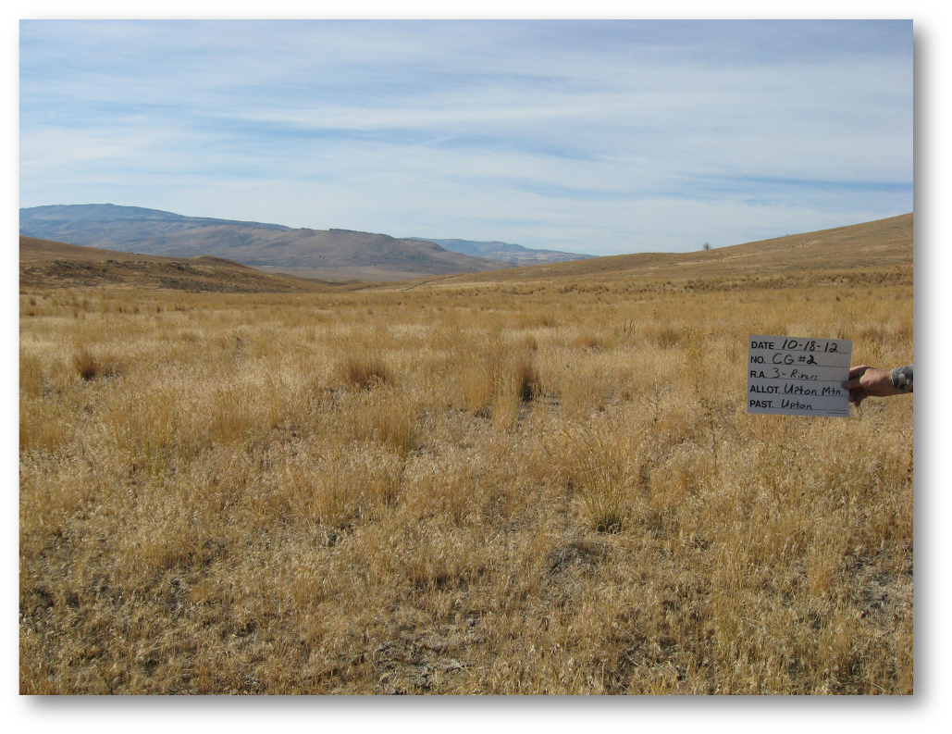
October 2012
B. Perryman

Slide 14
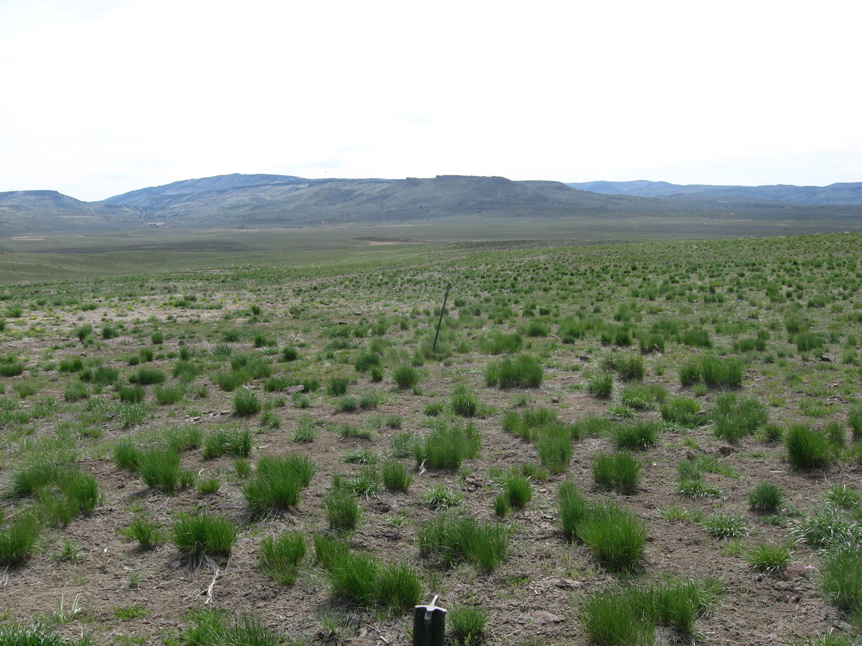
April 2016
B. Perryman

Slide 15
Fall/Winter Grazing - Cheatgrass
Schmelzer et al. 2014. Case study; Reducing cheatgrss (Bromus techtorum L.) fuel loads using fall cattle grazing. The Professional Animal Scientist 30 (2014):270-278.

Slide 16
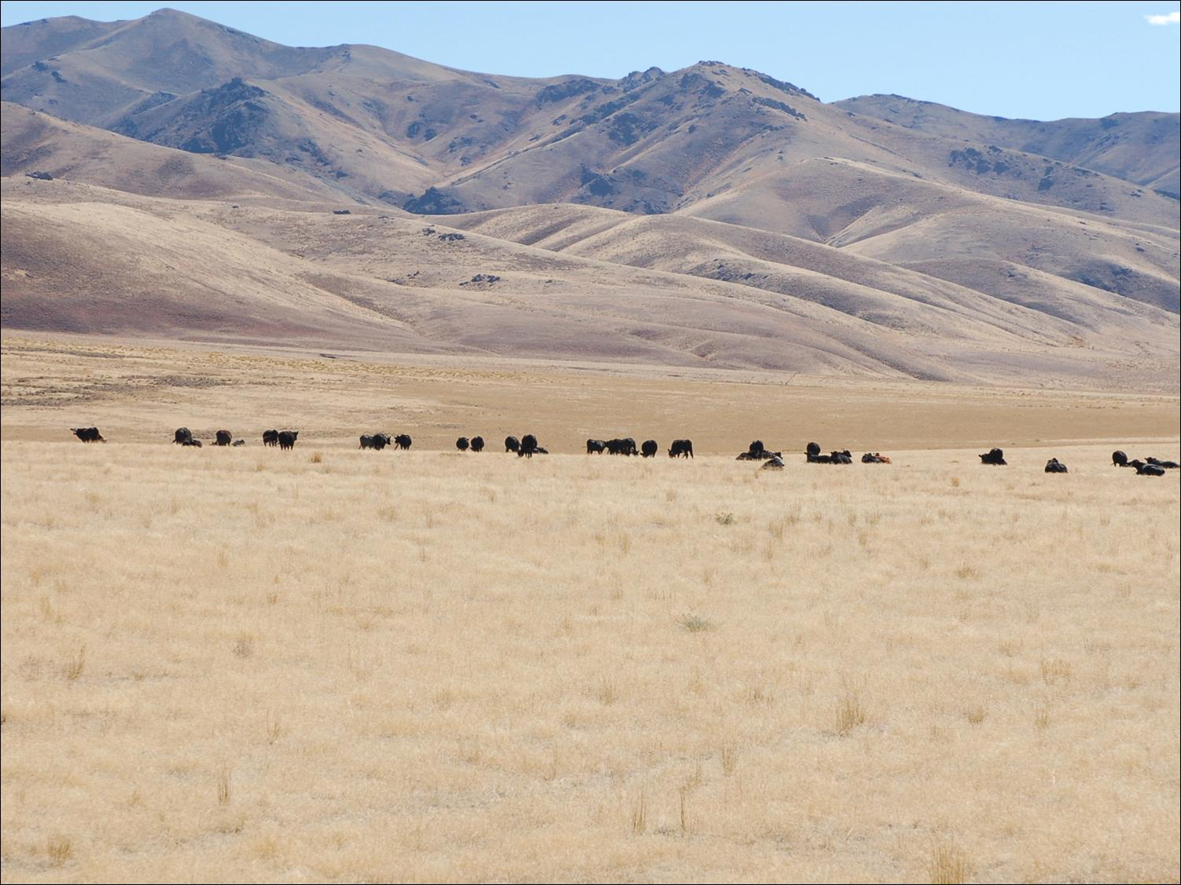
Winter Grazing
Reduces mulch/litter on soil surface
Making site unhospitable for cheatgrass establishment

Slide 17
High
Grazing during the dormant season does not affect cover of perennial grass but can reduce fuel loads and density of cheatgrass.
Early spring grazing can suppress cheatgrass and promote perennial grasses
Cheatgrass Cover
In the absence of livestock grazing, cheatgrass will likely increase to its ecological potential for the site.
If grazing occurs as perennial grasses begin to flower, cheatgrass will likely increase.
Low
No Grazing Early Spring Peak Season Dormant Season

Slide 18
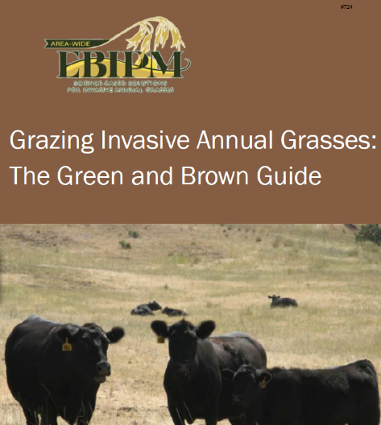

www.EBIPM.org

Slide 19
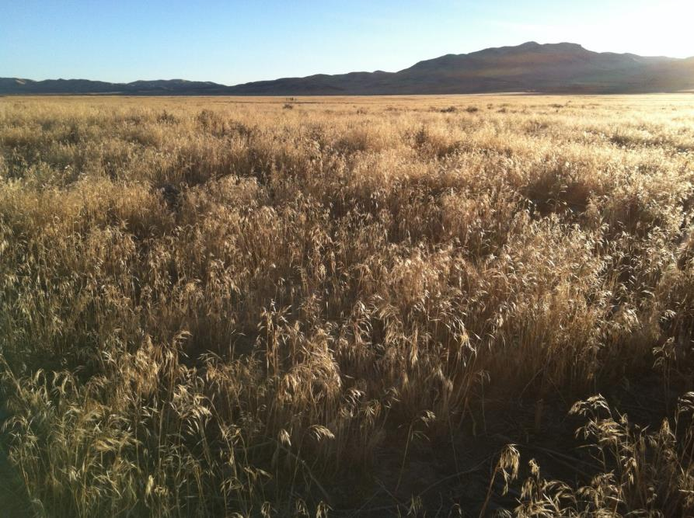
Grazing & Annual Grasses - What do we really know?
Cheatgrass is palatable when young or dormant in winter
Unpalatable when red
Grazing can reduce cheatgrass
Grazing can increase cheatgrass
B. Perryman

Slide 20
Grazing & Annual Grasses
B. Perryman
Josh Corbett
N. Rimbey
REM 456 - Integrated Rangeland Management

