Slide 1
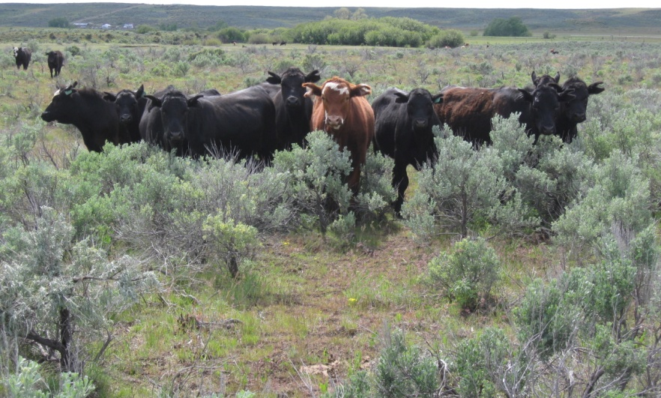
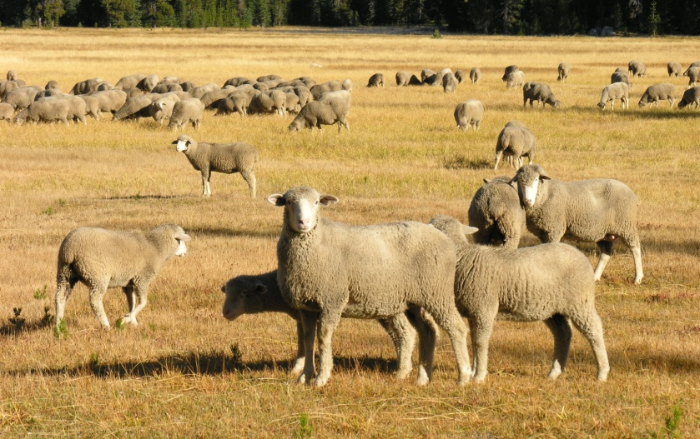

Calculating a Stocking Rate a few tips from Karen Launchbaugh
Rangeland Ecology & Management at the University of Idaho
K. Launchbaugh
K. Launchbaugh

Slide 2


Stocking Rate
Comparing Supply & Demand
The final step will be to compare:
  Forage Supply
  Animal Forage Demand
Estimate Forage Supply
Estimate Animal Demand for Forage
Evaluate Stocking Rate
Supply
Demand

Slide 3
Estimate Supply
Supply
Supply can be expressed in 2 ways:
  Weight/acre expressed as:
    Pound/acre -or- lbs/ac
    Kilograms/hectare -or- kg/ha
  AUM’s/acre or Acres/AUM based on:
    AUM = Animal Unit Month or amount of forage an Animal Unit will eat in a month
    AUM = 750 pounds air dry forage

Slide 4
Estimate Supply
Supply
Supply can be expressed in 2 ways:
  Weight/acre expressed as:
    Pound/acre -or- lbs/ac
    Kilograms/hectare -or- kg/ha
  AUM’s/acre or Acres/AUM based on:
    AUM = Animal Unit Month or amount of forage an Animal Unit will eat in a month
    AUM = 750 pounds air dry forage
In Western US, we generally express forage supply in
pounds/acres or acres/AUM

Slide 5
Supply in Pounds/Acre
Supply
If you start with forage production in pounds
Wt of biomass/acre× area = total biomass supply
Convert total biomass to total forage
  Not all biomass is forage
  Not all biomass should be grazed
  Use a “Proper Use Factor” to calculate forage
Total biomass × proper use(%)= total forage supply

Slide 6
Supply in Pounds/Acre
Supply
For Example – The range produces 800 lbs/ac and you have a pasture of 550 acres and the Proper Use for this region is to remove 45% of biomass.
  What is your forage supply?
Wt of biomass/acre × area = total biomass supply
800 lbs/ac× 550 ac = 440,000 lbs total biomass
Total biomass × proper use(%)= total forage supply
440,000 lbs× 45%= 198,000 lbs total Forage

Slide 7
Supply in Pounds/Acre
Supply
Another Example – You manage a 1,200 acre ranch and the average production is 760 lbs/acre. The ranch is located in the intermountain bunchgrass region and based on this vegetation type, a proper use factor would be to remove up to 40% of annual biomass.
  What is your forage supply?

Slide 8
Supply in Pounds/Acre
Supply
Answer – You manage a 1,200 acre ranch and the average production is 760 lbs/acre. The ranch is located in the intermountain bunchgrass region and based on this vegetation type, a proper use factor would be to remove up to 40% of annual biomass.
  What is your forage supply?
1,200 ac × 760 lbs/ac = 912,000 lbs of biomass
× 40%= 364,800 lbs total Forage

Slide 9
Supply in Pounds/Acre
Supply
Another Example – Your ranch is 4,200 acres large and there are two different vegetation types (or ecological) sites on your ranch:
  Stony Upland Site covers 35% of the ranch and produces 650 lbs/ac and proper use is 40%.
  Deep Loamy Site covers 65% of the ranch and produces 1,100 lbs/ac with a proper use factor of 45%
What is your forage supply?

Slide 10
Supply in Pounds/Acre
Supply
Answer – Your ranch is 4,200 acres large and there are two different vegetation types (or ecological) sites on your ranch:
  Stony Upland Site covers 35% of the ranch and produces 650 lbs/ac and proper use is 40%.
  Deep Loamy Site covers 65% of the ranch and produces 1,100 lbs/ac with a proper use factor of 45%
What is your forage supply?
4,200 ac × 35 % = 1470 acres × 650 lbs/ac × 40% = 382,200
+ 4,200 ac × 65 % = 2730 acres × 1,100 lbs/ac×45% = 1,351,350
Pounds of total Forage = 1,733,550

Slide 11
Supply in Acres/AUM
Supply
If you start with forage production AUMs
  If forage is expressed in AUM’s you can assume this is actual forage, not total biomass.
  In regions where biomass production is less than 1,000 lbs/acre, stocking rates are usually expressed as Ac/AUM (Ac/AUM are used widely in the Western U.S.)
  Acres/AUM÷ Acres = AUMs of total forage supply
  If forage production is high this may be expressed in AUMs/Acre
  Acres/AUM× Acres = AUMs of total forage supply

Slide 12
Supply in Acres/AUM
Supply
For Example – The range produces 2.5 ac/AUM (in other words, it takes 2.5 acres to create an AUM) and you have a pasture of 650 acres.
  What is the forage supply?
  Acres/AUM÷ Acres = AUMs of total forage supply
  650 ac ÷ 2.5 Ac/AUM = 260AUMs of forage supply

Slide 13
Supply in Acres/AUM
Supply
Another Example – You are managing a 1690 acre wildlife management area (WMA) and the production of forage in the region of the WMA is 3.25 acres/AUM.
  What is forage supply on the WMA?

Slide 14
Supply in Acres/AUM
Supply
Answer – You are managing a 1690 acre wildlife management area (WMA) and the production of forage in the region of the WMA is 3.25 acres/AUM.
  What is forage supply on the WMA?
  Acres/AUM÷ Acres = AUMs of total forage supply
  1690 ac ÷3.25 Ac/AUM = 520AUMs of forage supply

Slide 15
Start with lbs/acre?
Weight/Area (lbs/ac) × Area (acres)
× Proper Use Factor(%)
Total Forage Supply in Pounds
Supply
Demand
Total Forage Supply in AUMs
Acres/AUM ÷ Area (acres)
- or –
AUMs/Acre ×Area (acres)
Start with Ac/AUM or AUM/Ac?

Slide 16
Estimate Demand
Demand
Demand can be expressed in 2 ways:
  Forage required in pounds or kilograms
    For day → month → season → year
    For animal → herd
  Demand expressed in AUM’s:
    AUM = Animal Unit Month or amount of forage an Animal Unit will eat in a month
    AUM = 750 pounds air dry forage

Slide 17
Demand in Pounds
Demand
Intake or demand can be estimated based on the weight of animals
  Ruminants eat about 2.5% of their body weight per day on rangeland or pastures
  Horses eat about 3% of their body weight per day on rangeland or pastures
If you know number of animal and how many days they graze on the range, the total demand per season or year can be estimated.

Slide 18
Demand in Pounds
Demand
For example – you manage a herd of cows with an average weight of 1200 pounds and they graze on the ranch for 3 months (or 90 days).
  How much air-dry forage would you expect them to eat?

Slide 19
Demand in Pounds
Demand
For example – you manage a herd of 55 cows with an average weight of 1200 pounds and they graze on the ranch for 3 months (or 90 days).
  How much air-dry forage would you expect the whole to eat in a season?
  1,200 lb cow × 2.5% = 30 pounds forage eaten per day
  30 pounds × 90 days = 2,700 lbs/cow/season
  2,700 lbs × 55 = 148,500 lbs demand for the whole herd

Slide 20
Demand in Pounds
Demand
Another example – You have a ranch where graze a small herd of cows and a flock of sheep for 125 days each summer. You have 60 cows that weigh 1150 and 45 sheep that weight 200 lbs. You also want to make sure there is enough forage for 20 head of elk that average 650 lbs each and graze on the ranch for about 35 days in the fall.
  How much forage would you expect the cows, sheep and elk to eat each year on the ranch?

Slide 21
Demand in Pounds
Demand
Answer – You have a ranch where graze a small herd of cows and 2 horses for 125 days each summer. You have 60 cows that weigh 1000 and the horses weight 1200 lbs. You also want to make sure there is enough forage for 20 head of elk that average 650 lbs each and graze on the ranch for about 35 days in the fall.
  How much forage would you expect the cows, sheep and elk to eat each year on the ranch?
Cows: 1000 lb ×2.5 % = 25 lb/day×60 cows×125 days=187,500 lbs
+ Horses: 1100 lb ×3 % =33lb/day×2 horses×125 days= 8,250lbs
+ Elk: 650 lb× 2.5 % =16.25lb/day×20 elk×35 days = 11,375 lb
Pounds of total Forage Demand = 207,125 lbs

Slide 22
Demand in AUMs
Demand
Demand can be expressed in AUMS
  AU = Animal Unit = 1,000 lb ruminant animal with offspring (calf, lambs, kid, etc).
  AUM = Animal Unit Month
  AUM= 750 lbs which is 1,000 lbs grazing ruminant×2.5% to get lbs/day of intake ×30 days in a month
  AUE = Animal Unit Equivalent = the relationship between the number of actual animals in an animal Unit

Slide 23
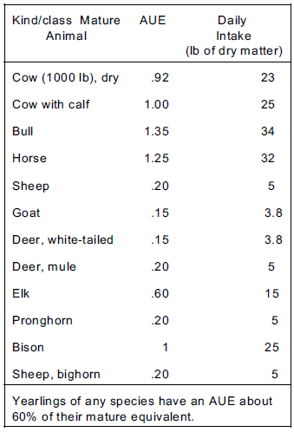
Demand in AUMs
Demand
Number of Animals × the AUE for that species and type = AUs
For example,
  6 bulls×1.35 = 8.1 AU
  270 goats×0.15 AUE = 40.5 AU
  100 elk×0.6 AUE = 60 AU
AEUs from National Range and Pasture Handbooks
www.glti.nrcs.usda.gov/technical/publications/nrph.html
Chapter 6

Slide 24
Demand in AUMs
Demand
Calculate number of AUs:
Number of animals× AUE = AU
Calculate number of AUMs:
AU × number of months grazing= AUMs
For Example - 15 horses that graze for 6 months:
15 horse× 1.25 AUE × 6 months = 112.5 AUMs

Slide 25
Demand in AUMs
Demand
Another Example – You manage an allotment that has 2 bands of sheep (2,000 ewes) that graze for 1 month in spring. Then, 240 cows-calf pairs graze for 2.5 months during the summer.
  How many AUM’s of demand do you have?

Slide 26
Demand in AUMs
Demand
Answer – You manage an allotment that has 2 bands of sheep (2,000 ewes) that graze for 1 month in spring. Then, 240 cows-calf pairs graze for 2.5 months during the summer.
  How many AUM’s of demand do you have?
Sheep: 2,000× 0.2 AUE × 1 month = 400 AUMs
Cattle: 240× 1 AUE × 2.5 months = 600 AUMs
Total Forage Demand = 1000 AUMs

Slide 27
Animal Weight Ruminant × 2.5%
- Or -
Animal Weight Horse × 3%
× number animals × days
Total Forage Demand in Pounds
Supply
Demand
Total Forage Supply in AUMs
× Months
Number of Animals × AUE

Slide 28
Calculate Stocking Rate
A stocking rate must include:
  Number of animals or animal units
  Specified area (acres, hectare, pasture, or ranch)
  Specified time (days, months, or season)
The following are stocking rates because they include all 3 of the necessary elements:
  Ac/AUM or AUM/Ac
  15 cows/35 acre pasture/4 months
  Flock of 450 ewes and lambs on ranch for a year

Slide 29
Evaluate Stocking Rate
Compare Supply and Demand to determine if:
  Current stocking rate (Demand) is too high or too low for current production (Supply)
  Based on this comparison, it may be appropriate to increase or decrease the current stocking rate.
Supply
Demand

Slide 30
Start with lbs/acre?
Animal Weight Ruminant × 2.5%
- Or -
Animal Weight Horse × 3%
Weight/Area (lbs/ac) × Area (acres)
× Proper Use Factor(%)
× number animals × days
Total Forage Supply in Pounds
Total Forage Demand in Pounds
Supply
Demand
Total Forage Supply in AUMs
Total Forage Supply in AUMs
Acres/AUM ÷ Area (acres)
- or –
AUMs/Acre ×Area (acres)
× Months
Number of Animals × AUE
Start with Ac/AUM or AUM/Ac?

Slide 31
Can’t compare “Apples” & “Oranges”
May need to convert either SUPPLY or DEMAND to pounds or AUMs so that both Supply and Demand are in the same units.
Total Forage Supply in Pounds
Total Forage Demand in Pounds
Supply
Demand
Total Forage Supply in AUMs
Total Forage Supply in AUMs
Remember: 1 AUM = 750 pounds
AUM × 750 = Pounds
Pounds ÷ 750 = AUM’s

Slide 32
Make Comparison – Fore Example
15 cows weighing 1200 lbs on pasture for 35 days
1,200 lbs×2.5% ×15 cows×35 days = 15,750 lbs
Total Forage Demand in Pounds
Supply
Demand
Total Forage Supply in AUMs
90 acre pasture with Recommended
Stocking of 2.25 Ac/AUM = 40 AUMs
Can’t compare 40 AUMs to 1570 pounds….
Need to convert supply to pounds or demand to AUM’s

Slide 33
Make Comparison – For Example
15 cows weighing 1200 lbs on pasture for 35 days
1,200 lbs×2.5% ×15 cows×35 days = 15,750 lbs
Convert AUMs to Pounds:
40 AUM × 750 lbs
= 30,000 lbs of Supply
Total Forage Demand in Pounds
Supply
Demand
Convert Pounds to AUMs:
15,570 lbs ÷ 750 lbs
= 21 AUM’s of Demand
Total Forage Supply in AUMs
90 acre pasture with Recommended
Stocking of 2.25 Ac/AUM = 40 AUMs

Slide 34
Make Comparison – For Example
15 cows weighing 1200 lbs on pasture for 35 days
1,200 lbs×2.5% ×15 cows×35 days = 15,750 lbs
Convert AUMs to Pounds:
40 AUM × 750 lbs
= 30,000 lbs of Supply
Total Forage Demand in Pounds
Supply
Demand
Convert Pounds to AUMs:
15,570 lbs ÷ 750 lbs
= 21 AUM’s of Demand
Total Forage Supply in AUMs
90 acre pasture with Recommended
Stocking of 2.25 Ac/AUM = 40 AUMs
More supply than demand Could increase stocking rate
Comparison in pounds: 30,000 lbs of supply 15,750 lbs demand
Comparison in AUMs: 40 AUMs supply and 21 AUM’s demand

Slide 35
Stocking Rate
Comparing Supply & Demand
Just take it step by step
Estimate Forage Supply
Estimate Animal Demand for Forage
Evaluate Stocking Rate
Supply
Demand

Slide 36
Calculating a Stocking Rate a few tips from Karen Launchbaugh
Rangeland Ecology & Management at the University of Idaho
K. Launchbaugh
K. Launchbaugh

