Slide 1
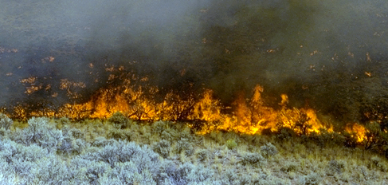
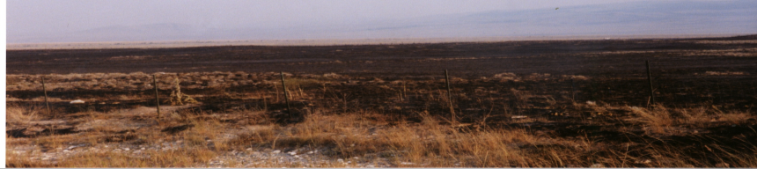

Grazing & Recovery after Fire
S. Bunting
K. Launchbaugh
REM 456 - Integrated Rangeland Management

Slide 2
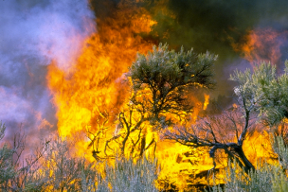
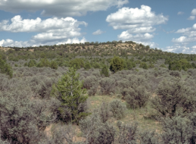
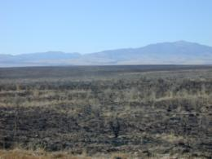
Grazing Management Before and Fire
S Bunting
J. Peterson
K. Launchbaugh
Before Fire
After Fire

Slide 3
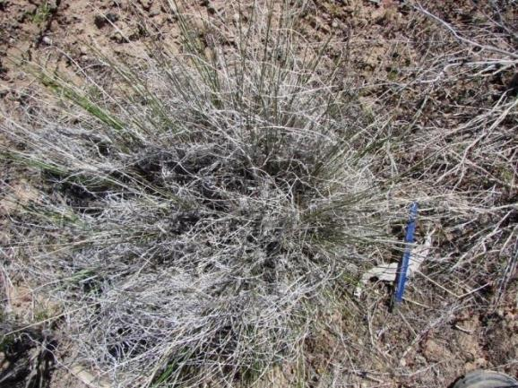
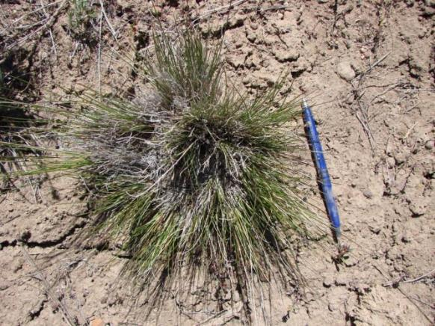
Grazing Before Fire Affects
Accumulation of biomass & litter
Distribution of litter around ungrazed perennial grass crowns
  3-fold accumulation
  increased litter depth
Plant Community Response
Ungrazed
Grazed
Photos: Kirk Davies

Slide 4
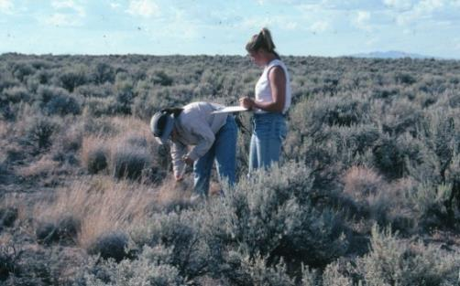
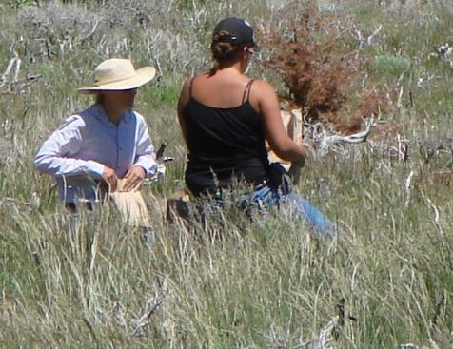
Methods: Davies et al. (2009)
Treatments
  1) ungrazed unburned, 2) ungrazed burned, 3) grazed unburned, and 4) grazed burned.
  Applied at 3 different sites
Livestock exclosures erected 1936
  No difference in plant density between exclosures and grazed
  Livestock grazing at moderate levels ~40% utilization
In 1992 and 1993 – estimated cover and biomass
Burned fall 1993
2005-2007 (12-14 years later) – estimated cover and biomass
K.W. Davies
K.W. Davies
Davies, K. W., Svejcar, T. J., & Bates, J. D. (2009). Interaction of historical and nonhistorical disturbances maintains native plant communities. Ecological Applications, 19(6), 1536-1545.
Notes:
Davies, K. W., Svejcar, T. J., & Bates, J. D. (2009). Interaction of historical and nonhistorical disturbances maintains native plant communities. Ecological Applications, 19(6), 1536-1545.

Slide 5
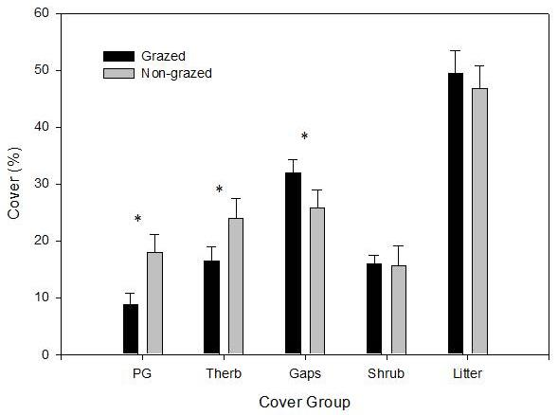
Before Fire
Differences in Biomass and Litter
1992-1993 Before Fire
*Less Perennial Grass
*Less Total Herbaceous
* More Gaps
Perennial Grass
Total Herbaceous
Gaps
Shrubs
Litter
Davies, K. W., Svejcar, T. J., & Bates, J. D. (2009). Interaction of historical and nonhistorical disturbances maintains native plant communities. Ecological Applications, 19(6), 1536-1545.
Notes:
Davies, K. W., Svejcar, T. J., & Bates, J. D. (2009). Interaction of historical and nonhistorical disturbances maintains native plant communities. Ecological Applications, 19(6), 1536-1545.

Slide 6
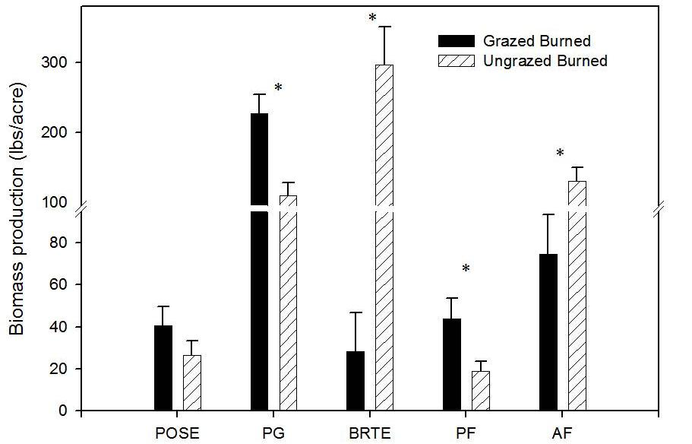
After Fire
Plant Community Response
12-14 years After Fire
Plots grazed before fire
*More Perennial Grass
*Less Cheatgrass
Sandberg
Bluegrass
Perennial
Grass
Cheatgrass
Perennial
Forb
Annual
Forb
Davies, K. W., Svejcar, T. J., & Bates, J. D. (2009). Interaction of historical and nonhistorical disturbances maintains native plant communities. Ecological Applications, 19(6), 1536-1545.
Notes:
Davies, K. W., Svejcar, T. J., & Bates, J. D. (2009). Interaction of historical and nonhistorical disturbances maintains native plant communities. Ecological Applications, 19(6), 1536-1545.

Slide 7
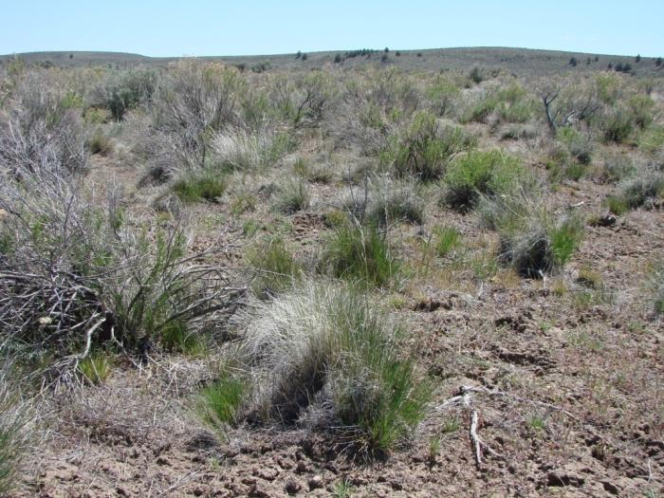
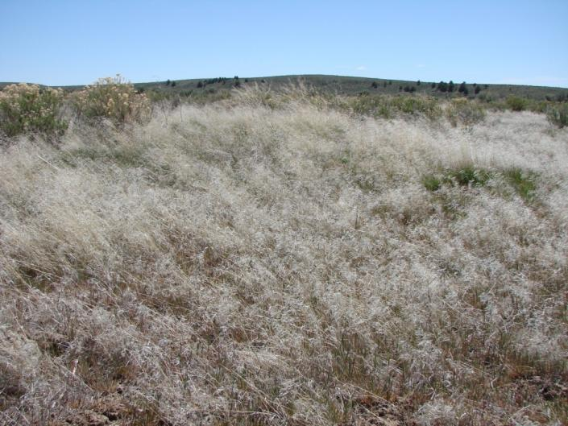
Grazed then Burned
15 years post-fire
Ungrazed then Burned
15 years post-fire
K.W. Davies
K.W. Davies
Davies, K. W., Svejcar, T. J., & Bates, J. D. (2009). Interaction of historical and nonhistorical disturbances maintains native plant communities. Ecological Applications, 19(6), 1536-1545.
Notes:
Davies, K. W., Svejcar, T. J., & Bates, J. D. (2009). Interaction of historical and nonhistorical disturbances maintains native plant communities. Ecological Applications, 19(6), 1536-1545.

Slide 8
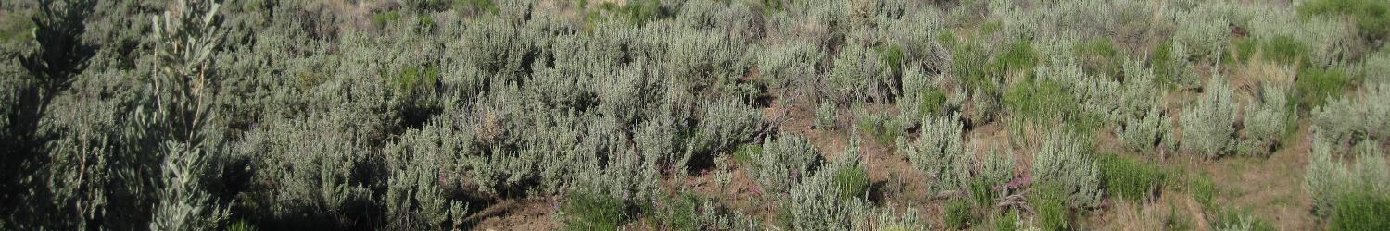
Results
Substantial cheatgrass invasion following fire in ungrazed areas (exclosures).
Less perennial grasses in exclosures post-burning compared to moderately grazed treatment.
Few differences between ungrazed and grazed plots that were not burned.
K. Launchbaugh
Davies, K. W., Svejcar, T. J., & Bates, J. D. (2009). Interaction of historical and nonhistorical disturbances maintains native plant communities. Ecological Applications, 19(6), 1536-1545.
Notes:
Davies, K. W., Svejcar, T. J., & Bates, J. D. (2009). Interaction of historical and nonhistorical disturbances maintains native plant communities. Ecological Applications, 19(6), 1536-1545.

Slide 9
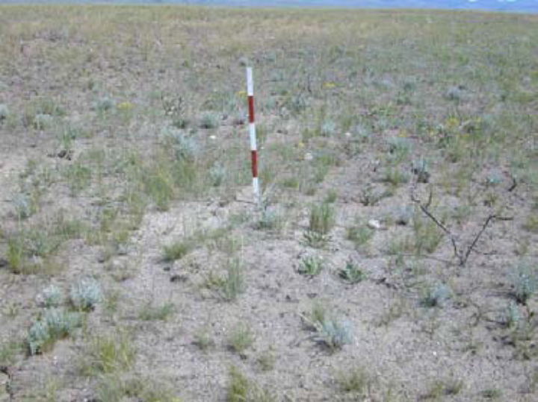
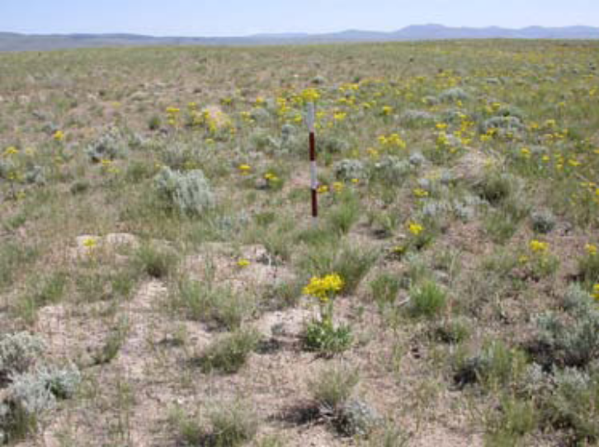
Historic Interactions
Fire
Animals drawn to recently burned areas.
Why?
S. Bunting
K. Launchbaugh
After Fire
L. Englund
Year After Fire
L. Englund
3 Years After Fire

Slide 10
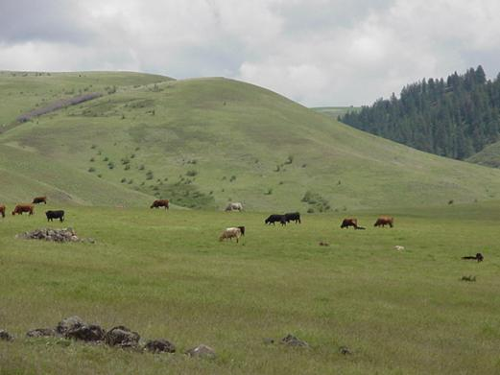
Where animals graze after fire?
Patch burning changes distribution of livestock on the landscape.
K. Launchbaugh

Slide 11
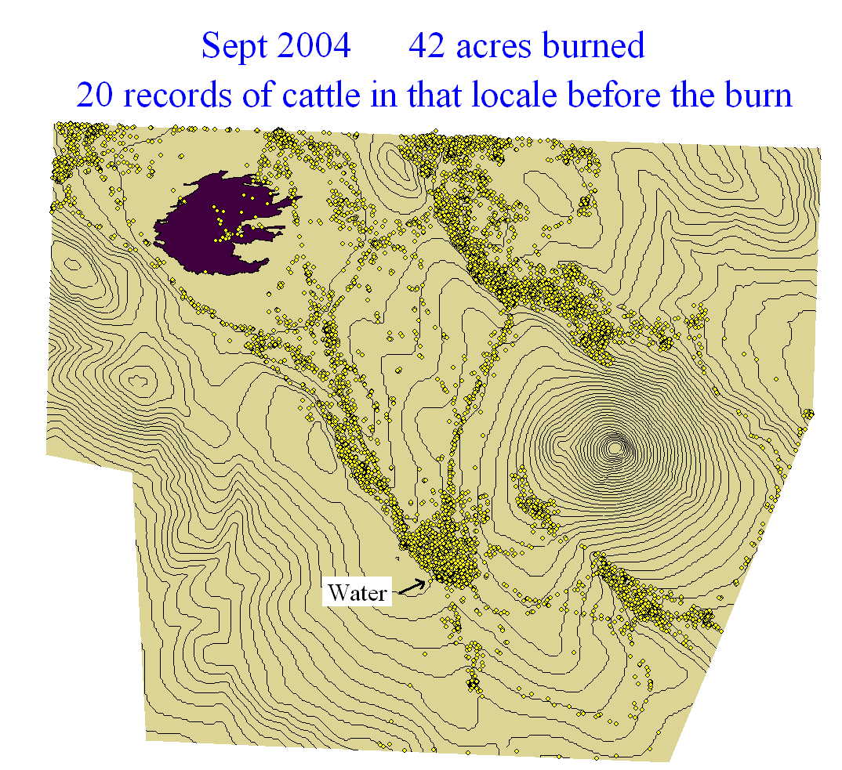
Where animals graze after fire?
Fall
Burn
Livestock observations in 2,000 acre pasture showing distribution for 15 days pre-burn (2004) and the subsequent June (2005).
– David Ganskopp – ARS Eastern Oregon Agricultural Research Center

Slide 12
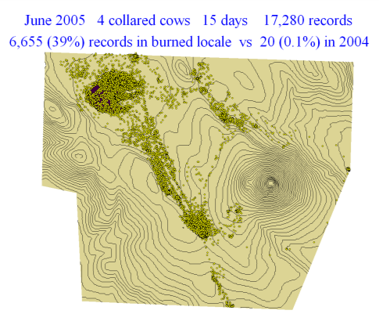
Where animals graze after fire?
Livestock observations in 2,000 acre pasture showing distribution for 15 days pre-burn (2004) and the subsequent June (2005). – David Ganskopp – ARS Eastern Oregon Agricultural Research Center

Slide 13
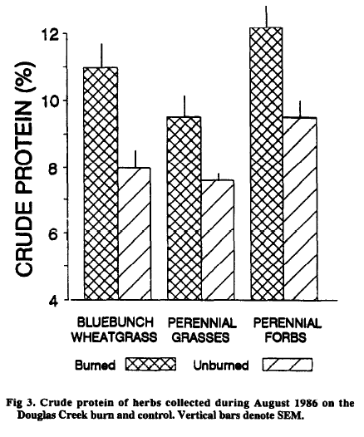
Forage Response After Fire
Increased Forage Quality
1 to 2 years after fire
K. Launchbaugh
After Fire
L. Englund
Year After Fire
L. Englund
3 Years After Fire
Cook et al. 1964

Slide 14

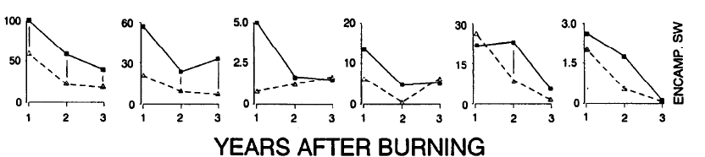
Forage Response After Fire
Increased Forage Quantity After Fire
Burned
Annual Growth (g/m²)
Unburned
Cook et al. 1994. Vegetative response to burning on Wyoming mountain-shrub big game ranges. Journal of Range Management, 47:296-302.

Slide 15
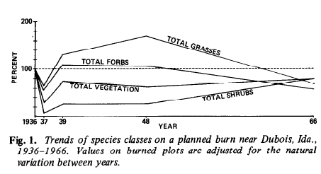
Forage Response After Fire
Increased Forage Quantity After Fire
Harniss,& Murray. 1973. 30 years of vegetal change following burning of sagebrush-grass range. Journal of Range Management, 26:322-325.

Slide 16
Grazing After Fire
2001 – one year after fire
Concern about recovery of plant community after fire
Is rest after fire ecologically significant?
Don’t forget invasive plants …. especially annual grasses including cheatgrass.
L. Englund
2004
L. Englund
Roselle et al. 2010. Delaying sheep grazing after wildfire in sagebrush steppe may not affect vegetation recovery. International Journal of Wildland Fire, 19:115-122.
Notes:
16
Livestock grazing may accelerate sagebrush recovery after fire (Pechanec and Stewart 1944). Livestock can reduce fine fuels, alter plant community structure, and result in reduced competition from herbaceous species (Miller et al. 1999). An increase in sagebrush cover may provide safe sites for juniper establishment and sapling growth (Miller et al. 1999).
Another study recommended against deferment of grazing in areas where cheatgrass dominated before a fire because perennial grass recovery is not feasible and the area may be unsuitable for seeding (Young et al. 1987). When restoration is desired, re-seeding or passive re-invasion and increase of native plants, followed by decades of rest or reduced livestock grazing and favorable precipitation may be required (Anderson and Inouye 2001).
It is widely accepted that perennial grass seeds require a layer of soil as coverage to successfully germinate and establish, contrary to the competitive cheatgrass species (Hormay 1961). Thus, grazing may be beneficial post-fire in promoting better soil coverage on seeded rangelands, particularly if the perennial plants were of good vigor before the fire.

Slide 17

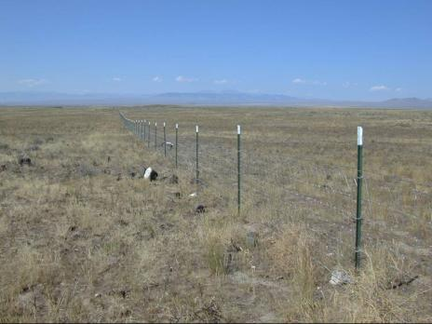
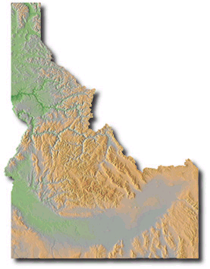
Grazing After Fire Study
US Sheep Experiment Station
Sagebrush Steppe:
  Three-tip sagebrush
  with an understory of
  bunchgrasses & forbs
Precipitation:
  Winter snows & spring rains
  8-10 inches/yr
K. Launchbaugh
Study Conducted 2001-2004
Roselle et al. 2010. Delaying sheep grazing after wildfire in sagebrush steppe may not affect vegetation recovery. International Journal of Wildland Fire, 19:115-122.

Slide 18
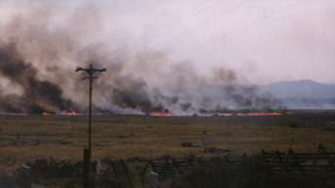
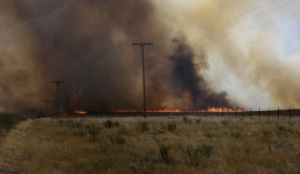
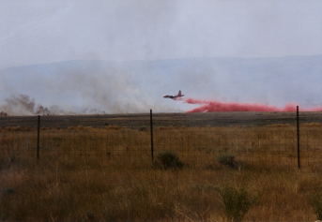
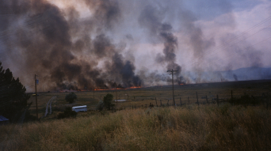
Fire – July 31, 2000
Fire Burned total of
474 ha
Roselle et al. 2010. Delaying sheep grazing after wildfire in sagebrush steppe may not affect vegetation recovery. International Journal of Wildland Fire, 19:115-122.
Photos by K. Launchbaugh

Slide 19
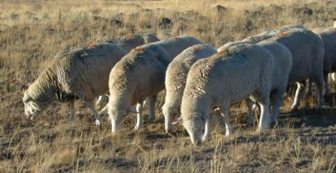
Grazing After Fire Study
Examine effects of spring and fall grazing by sheep 1, 2, and 3 years after wildfire on:
  Sagebrush recruitment and establishment
  Abundance of annual invasive grasses
  Persistence of native forbs and grasses
L. Englund

Slide 20
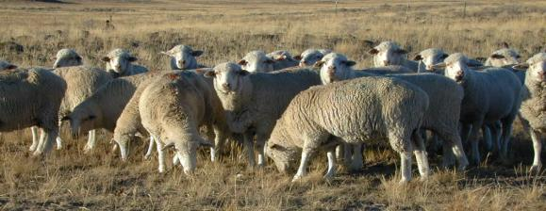
Grazing Treatments
Grazing Season | Years After Fire
Fall | 1, 2, 3
Fall | 2, 3
Fall | 3
Spring | 2, 3
Spring | 3
No Grazing | Control
Fenced 65 ha into 24 paddocks
4 Replications of each treatment
L. Englund

Slide 21
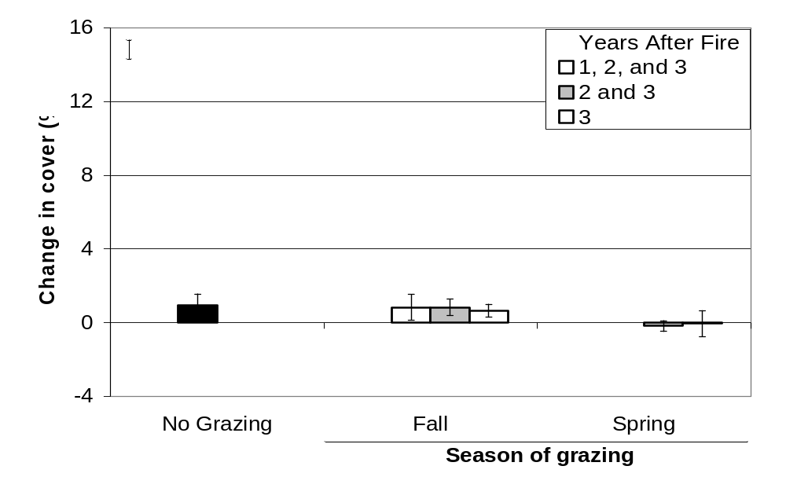
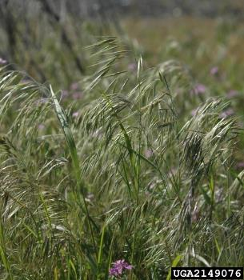
Annual Grasses
Chris Evans
* No Effect of Annual Grasses

Slide 22
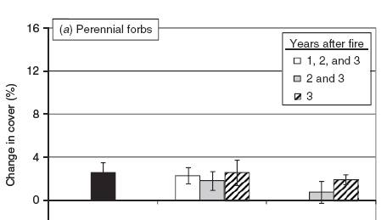
Forbs
* No effect on recover of Perennial Forbs

Slide 23
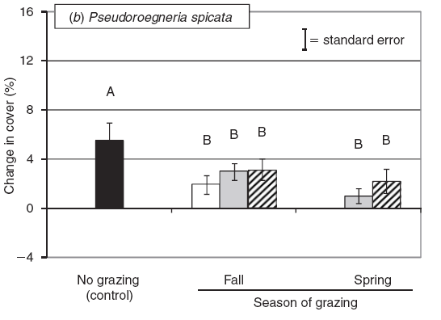
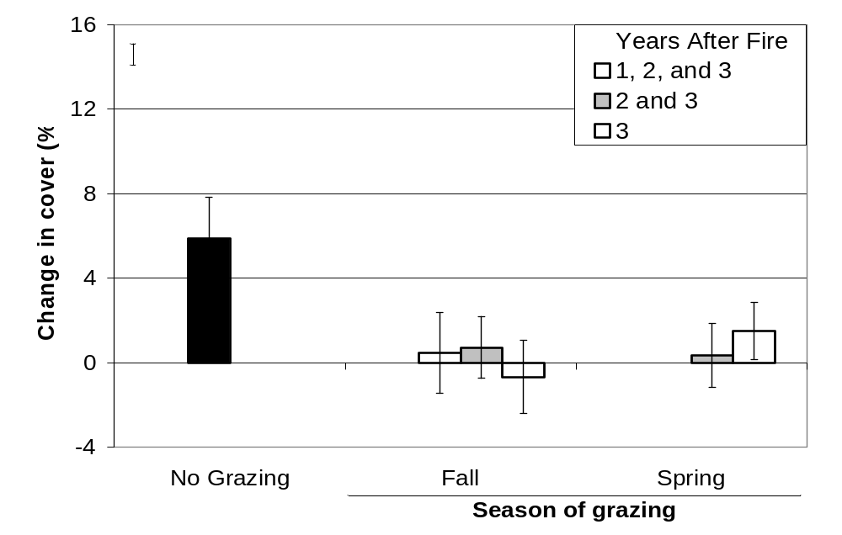
Grasses
Perennial Grass
Bluebunch Wheatgrass
No effect grazing on recover of Perennial Grasses, overall
Grazing in spring & fall after fire slowed recovery of Bluebunch Wheatgrass

Slide 24
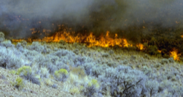
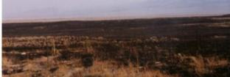
Grazing After Fire
Delay of grazing after fire? It depends
  Pre-fire vegetation community
  Fire severity
  Presence of invasive species
  Rest from grazing after fire could promote weeds
Hardship on land managers & livestock owners
May create fuel loads for subsequent fires
S. Bunting
But, don’t Forget…
K. Launchbaugh

Slide 25
Role of Grazing in Restoration?
Grazing Effects:
  Herbivory
  Physical Impact
  Deposition
  Transport
Potential Livestock Tools:
  Reduced Weed Competition
  Seedbed Preparation
  Seed Dispersal
  Nutrient Distribution
K. Launchbaugh
Notes:
25
Deferring livestock grazing for several seasons after fire is a practice employed by land managers intended to promote plant vigor and ecosystem recovery. The concept of extended rest periods to compensate for the cumulative effect of both grazing and fire seems intuitive. However, extended rest periods may not be ecologically important to plant recovery and altered grazing systems can impose unwarranted financial hardship on livestock producers. In addition delayed grazing after fire can create a subsequent fuel load of standing dead grass.
Removal of grazing after fire could also inadvertently promote weed establishment. Without grazing to suppress them, invasive or noxious weeds may take advantage of nutrient and water resources in the early spring when native species have not yet initiated growth.
The challenge to land managers is to determine when and how to begin grazing after fire to maintain productivity of native perennial herbaceous species.

Slide 26
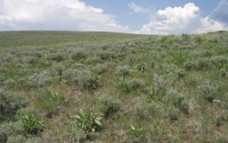
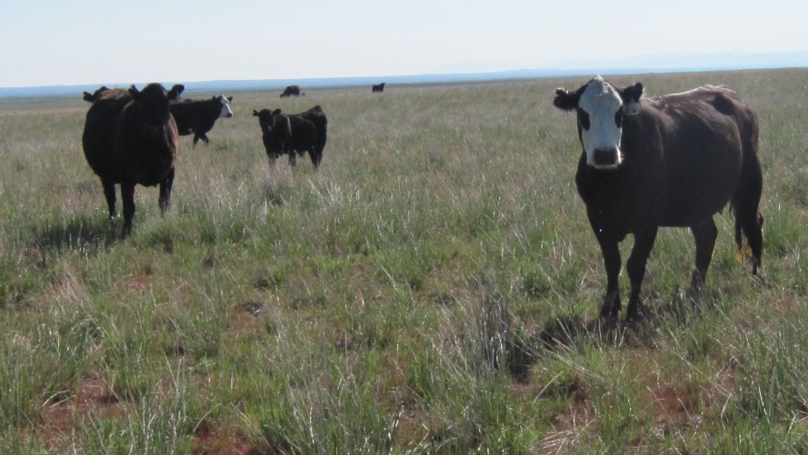

Grazing After Fire - How long to wait?
It depends..
Community before fire
Fire intensity
Weather after fire
J. Hankins-Smith
Connor White
S. Bunting
Lovina Roselle

Slide 27
Grazing & Recovery after Fire
S. Bunting
K. Launchbaugh
REM 456 - Integrated Rangeland Management

