Slide 1
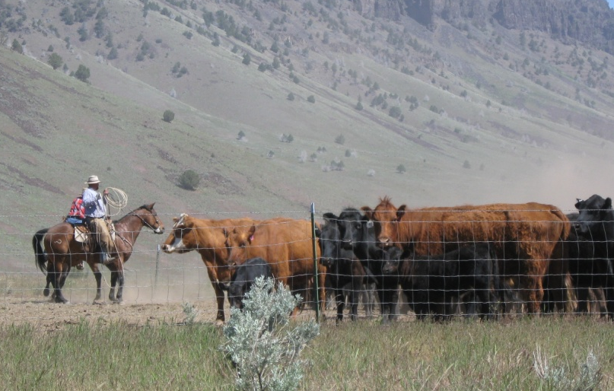
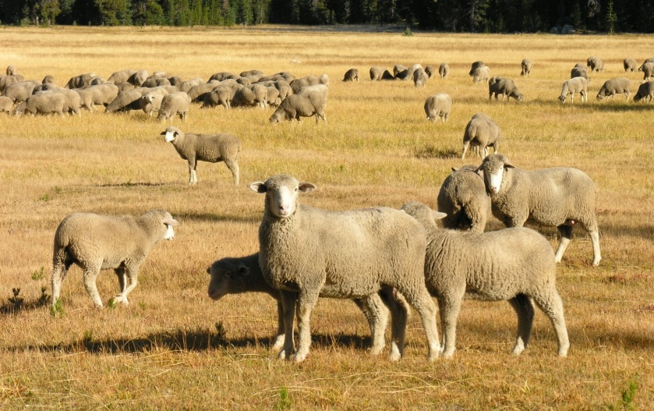

Grazing Methods & Plans
S. McFarland
K. Launchbaugh
REM 456 - Integrated Rangeland Management

Slide 2
Natural &
Human
Resources
Grazing
Management
Decisions
Community
Response
Climate
Topography
Veg. Community
Wildlife
Mgmt. Philosophy
& Goals
Livestock
Species
cattle, sheep, goats or horses
Stocking Rate
how many animals
Grazing Methods
season of grazing
season of rest
duration of grazing
Vegetation Community
Livestock Production
Wildlife Community
These are elements of Grazing Methods
(or grazing systems)

Slide 3
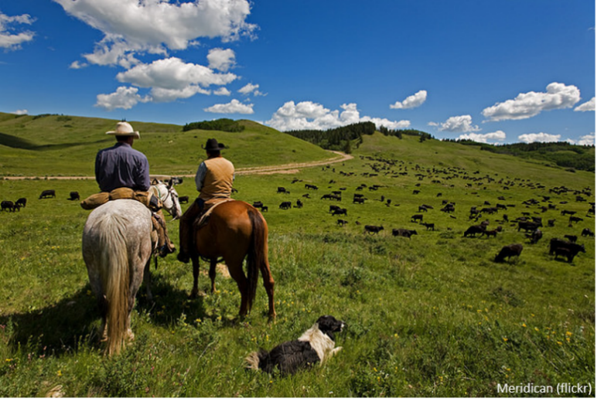
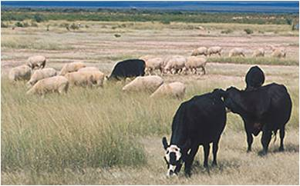
Grazing Principles
Which animal(s)? Animal Species & Class
How many animals? Stocking Rate
When to graze or not graze? Grazing Season
How long to graze or rest? Duration of Grazing
USDA-ARS

Slide 4
Grazing Principles
Which animal(s)? -Animal Species & Class
How many animals? -Stocking Rate
When to graze or not graze? -Grazing Season
How long to graze or rest? –Duration of Grazing
Grazing Methods
or Grazing Systems

Slide 5
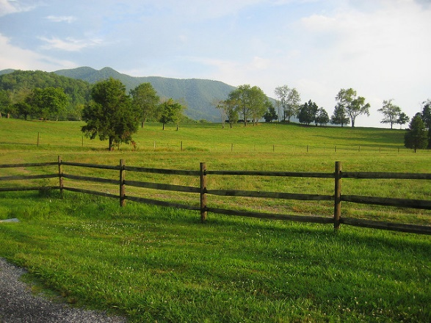

Deferment vs. Rest
Deferment – a period of non-grazing during part of the growing season.
Rest – different from deferment in that nonuse occurs for 12 consecutive months rather than just part of the growing season.
Bruce Thomson
J. Peterson

Slide 6
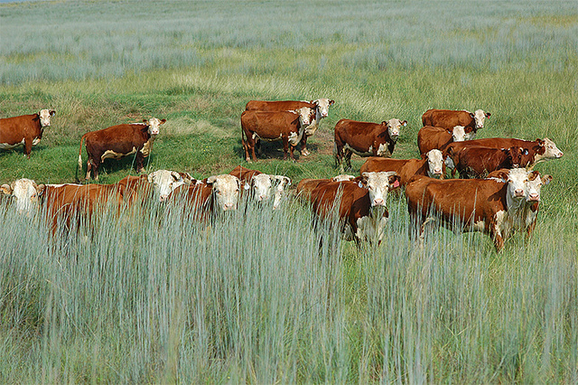
Season of Use = Grazing Season
Yearlong
  Used primarily in tropical & sub-tropical climates
Seasonal
  Temperate regions or Dry/wet cycles
  Graze during growing season
Rotational
  Grazing Systems control periods of grazing
US Dept. of Agriculture

Slide 7
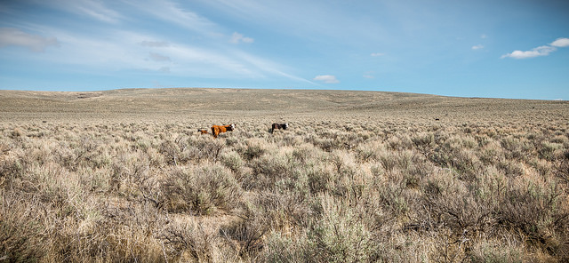
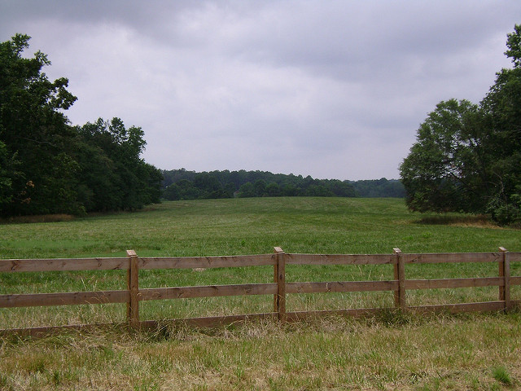
Grazing Season vs Growing Season
Rangelands– Grazing season is generally longer than the growing season.
  Requires stockpiling forage for use during the dormant season.
  Frequently involves light use during the peak growing season.
Tame Pasture– Grazing season is matched with the growing season to harvest forage near maximum quality.
  Stockpiling forage by shortening the grazing period during active growth.
Greg Shine- Bureau of Land Mgmt.
Southern Land Exchange

Slide 8
Grazing Methods (or grazing systems)
Controlled grazing management practices manipulate livestock to manage periods of grazing, deferment, or rest.
Designed to control the effects of grazing at the individual plant:
  Season of grazing
  Frequency of defoliation by controlling the length of the grazing period

Slide 9
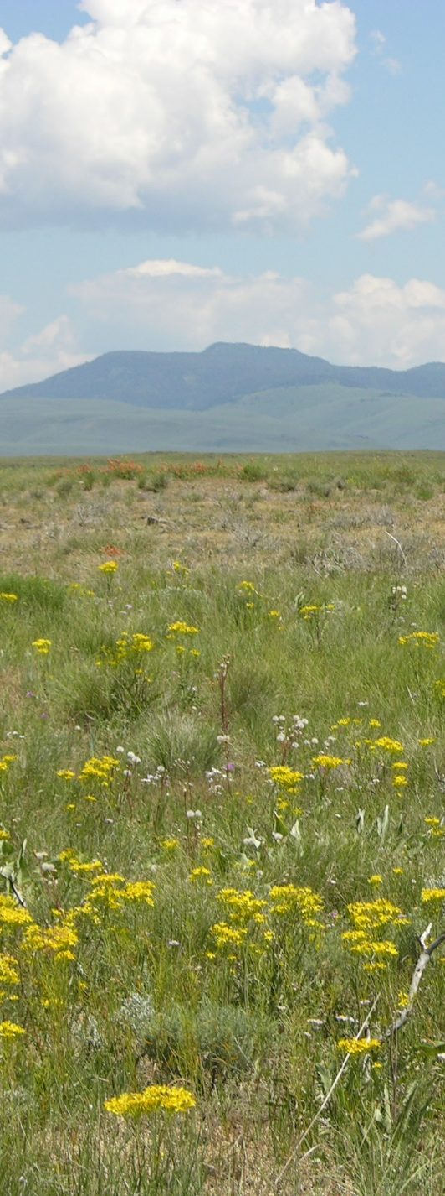
Timing of Grazing
Effect of grazing varies according to:
  Season of Use & Phenological Stage
  Plants are more resistant to intense herbivory during dormancy than during active growth.
  Opportunity for Re-growth
  Will plants be able to produce new leaves and develop strong root systems prior to entering dormancy following defoliation?
J. Peterson

Slide 10

Timing of Grazing
Potential Damage to Herbaceous Plants from Defoliation
Potential Damage
Green-up
Growth Initiation
Flowering/Seed Set
Dormancy
High Demand
for energy and nutrients
Limited Resources for recovery
Low Demand
Low biomass & low need for CHOs
Abundant Resources for recovery
time, moisture, nutrients temperature
Very Low Demand

Slide 11
Objectives for good grazing method:
Restoration of forage plant vigor
Allowing plants to produce seeds
Heavier and more uniform utilization
Increased animal production

Slide 12
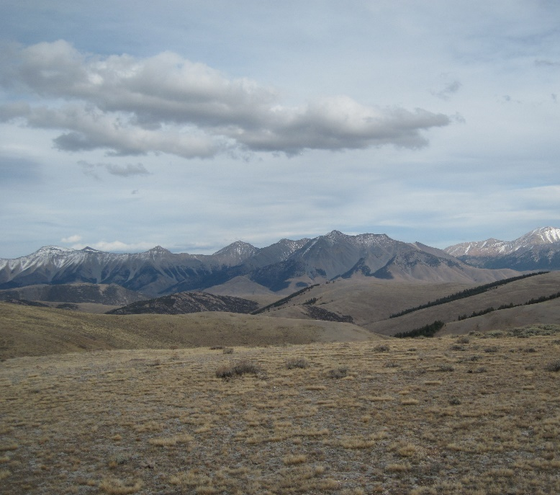
Objectives for good grazing method:
Maintain forage plant vigor
  allowing plants to produce seeds
Meet animal production goals
Maintain soil health
Uniform or patchy utilization patterns
  depending on land management goals
K. Launchbaugh

Slide 13
Steps in a Grazing Mgmt Plan:
Research past grazing history and issues
Determine current conditions & resources
Identify goals and concerns of land owner
Consider grazing strategies to address goals & concerns including other land mgmt. goals:
  Wildlife
  Fire
  Weeds
  Water
Greg Shine- Bureau of Land Mgmt.

Slide 14
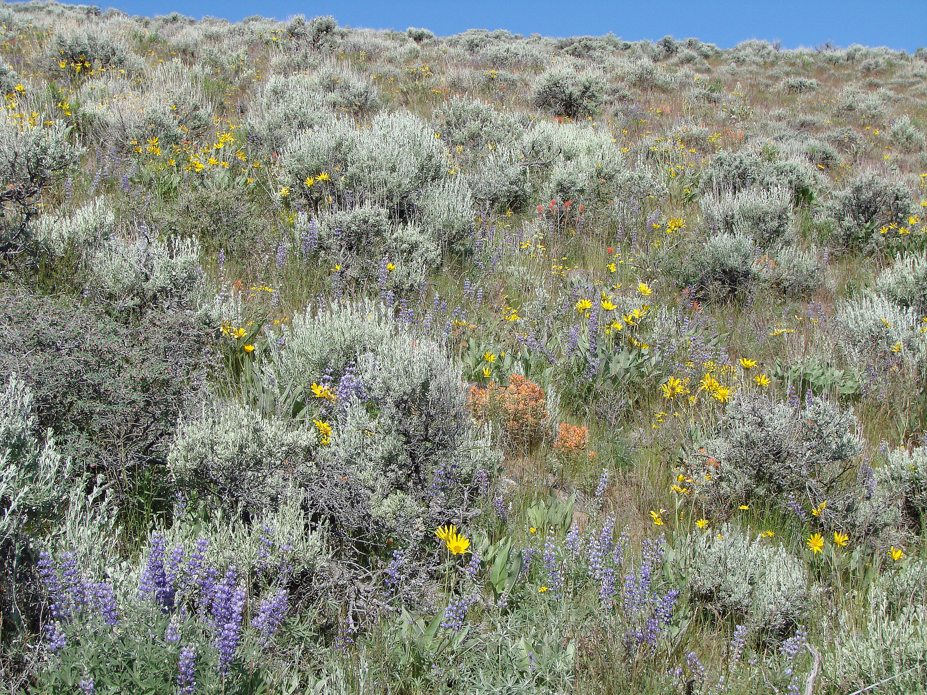
Steps in a Grazing Mgmt Plan:
Develop grazing plan
  what species and type of animal
  how many
  season of grazing
  how long and how often
Consider laws and policies
  clean water act
  endangered species act
  agency policies (i.e., NEPA)
USDA-ARS (Tony Svejcar)

Slide 15
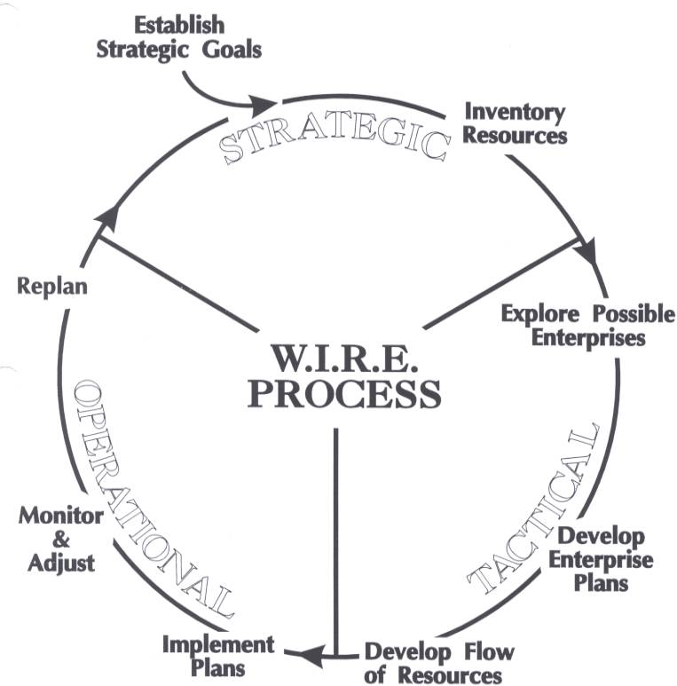
Steps in a Grazing Mgmt Plan:
One Example of a
Planning Model
Re-evaluate plan throughout season and adjust on regular basis

Slide 16
Grazing Methods & Plans
S. McFarland
K. Launchbaugh
REM 456 - Integrated Rangeland Management

