Slide 1
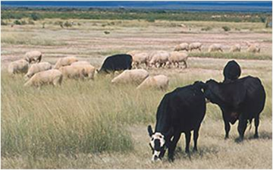
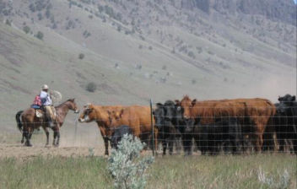
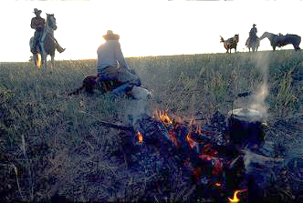

Creating Working Landscapes & Preserving Open Space
S. McFarland
USDA-ARCS
S.McFarland
K.Baker(flickr)
REM 456 - Integrated Rangeland Management

Slide 2
Ranching in the New West
TODAY
“Western Family Ranch”
FUTURE
?
?
?
Fragmentation/
Preservation
Working Landscapes
“New Ranch”
Corporate Ranches

Slide 3
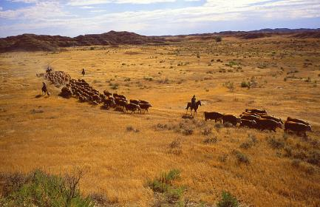
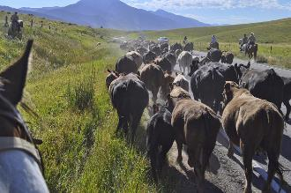
Ideas for Working Landscapes
Commitment to Ecology
Preserving Open Space
Grass Banks
Landscapes for Endangered Species
Coordinated Weed Management
Wildlife Habitat Goals
Recreation?
J.Dykinga(flickr)
B.Gast(flickr)
Photos from: www.ars.usda.gov/is/graphics/photos/

Slide 4
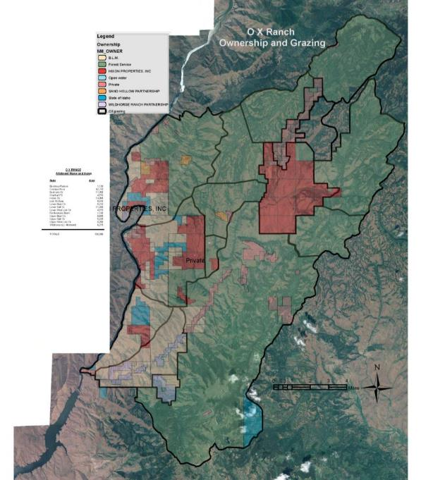
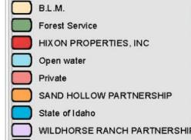
Wholly
Integrated
OX Ranch Idaho
130,000 acres
Notes:
When you think of ranching in Idaho, you have to think about integrated land ownership – checkerboard land ownership.

Slide 5
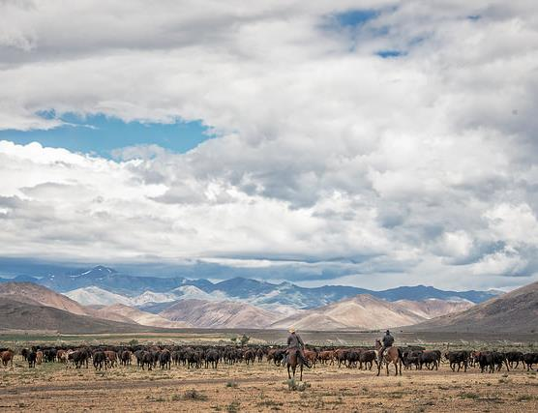
Grazing on Public Lands
Grazing on private lands is wholly integrated with public grazing lands.
  Livestock grazing occurs on:
    95% of BLM land
    58% of U.S. Forest Service lands
  88% of all beef cows in Idaho graze at least part of each year on BLM or USFS lands.
E.Haslam(flickr)
Notes:
When you think of ranching in Idaho, you have to think about integrated land ownership – checkerboard land ownership.

Slide 6
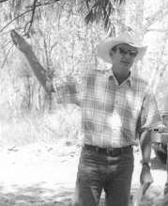
Commitment to Ecology
Jim Winders
  “We feel that economic activities… must be subordinate to the needs of a healthy ecosystem”
    Ecosystem protection
    Recognize public goals
    Produce healthy foods
Author of the
“New Ranch Handbook”
Notes:
“Operations on these lands are governed by a management philosophy that appreciated complexity and the vital role of each species from the large predators to the smallest soil microbe. We feel that economic activates like grazing and recreation must be subordinate to the needs of a healthy ecosystem. And that although we have had the honor of managing lands owned by the American public for five generations, we have no ownership right to these lands. Our tenure on the land should be based on our ability to successfully meet three criteria: protection and enhancement of ecosystem health, recognition and application of public goals and, finally, to produce healthy food for a growing population.” Jim Winder in The art of Resource Management in the Chihuahuan Desert (on the Quivira Coalition web page)
The New Ranch is a place where cooperation has replaced confrontation, where common interests and common sense prevail, where environmentalists might come for supper.

Slide 7
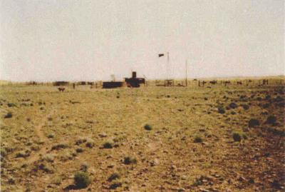
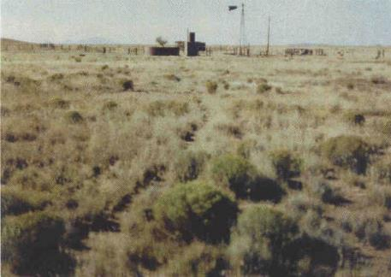
Commitment to Ecology
1986
Attention to slow but
steady change
1994
“… application of small stresses and disturbances such as grazing and hoof action exercises the recovery mechanisms….”

Slide 8
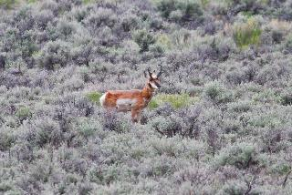
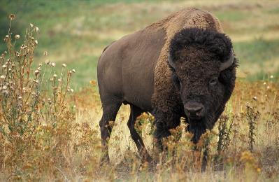
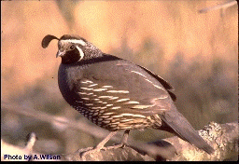
Commitment to Ecology
Deseret Land & Livestock
  “sees wildlife as an essential part of the complex web of beings and interaction that make up the vital organs and life function of ecosystems upon which a ranch, its people, and its livestock, and even the surrounding community depend and survive.”
  Dan Daggett, Beyond the Rangeland Conflict
J.Matthews(flickr)
K.Park(flickr)
Notes:
“Operations on these lands are governed by a management philosophy that appreciated complexity and the vital role of each species from the large predators to the smallest soil microbe. We feel that economic activates like grazing and recreation must be subordinate to the needs of a healthy ecosystem. And that although we have had the honor of managing lands owned by the American public for five generations, we have no ownership right to these lands. Our tenure on the land should be based on our ability to successfully meet three criteria: protection and enhancement of ecosystem health, recognition and application of public goals and, finally, to produce healthy food for a growing population.” Jim Winder in The art of Resource Management in the Chihuahuan Desert (on the Quivira Coalition web page)
The New Ranch is a place where cooperation has replaced confrontation, where common interests and common sense prevail, where environmentalists might come for supper.

Slide 9
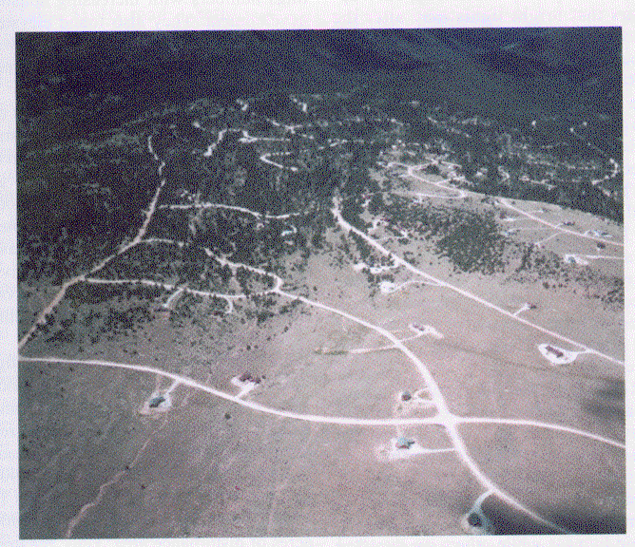
Preserving Open Space
Ecological Impacts of Subdivision
The amount of land affected by sprawl & development = 3% per year
Since 1978, Colorado ranchland has decreased by 90,000 ac/yr
In the last 30 years, 16-23% of the land in the counties adjacent to Yellowstone-Tetons has been platted for or converted to ranchettes (20-40 ac parcels)
Intermountain West is only region US where rural counties are growing
Notes:
“Operations on these lands are governed by a management philosophy that appreciated complexity and the vital role of each species from the large predators to the smallest soil microbe. We feel that economic activates like grazing and recreation must be subordinate to the needs of a healthy ecosystem. And that although we have had the honor of managing lands owned by the American public for five generations, we have no ownership right to these lands. Our tenure on the land should be based on our ability to successfully meet three criteria: protection and enhancement of ecosystem health, recognition and application of public goals and, finally, to produce healthy food for a growing population.” Jim Winder in The art of Resource Management in the Chihuahuan Desert (on the Quivira Coalition web page)
The New Ranch is a place where cooperation has replaced confrontation, where common interests and common sense prevail, where environmentalists might come for supper.

Slide 10
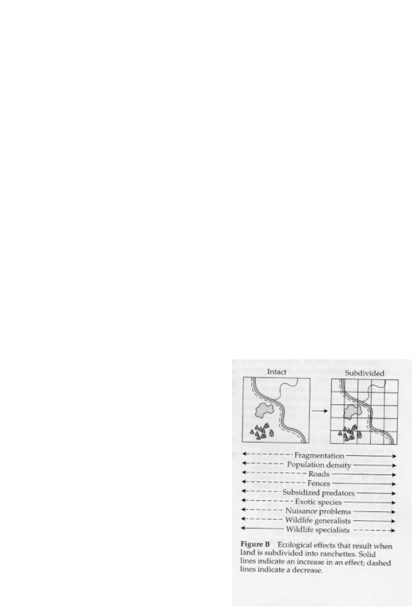
Is Subdivision Good or Bad?
Fragmentation
Population Density
Roads
Fences
Predators
Exotic Species
Wildlife Generalists/Specialists

Slide 11
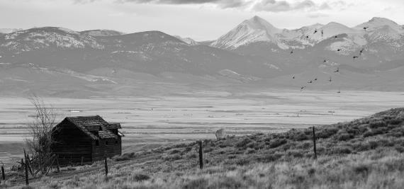
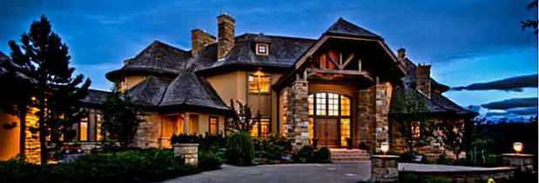
The New Ranch House
David Stubbs
www.huffingtonpost.ca

Slide 12
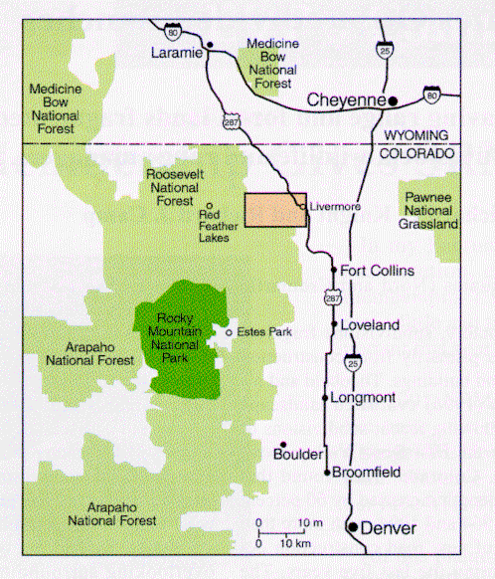
Changes 1957 to 1994
Study in Colorado
Compare Ranches: 1957-1994
Mitchell, Knight & Camp. 2002. Landscape Attributes of Subdivided Ranches

Slide 13
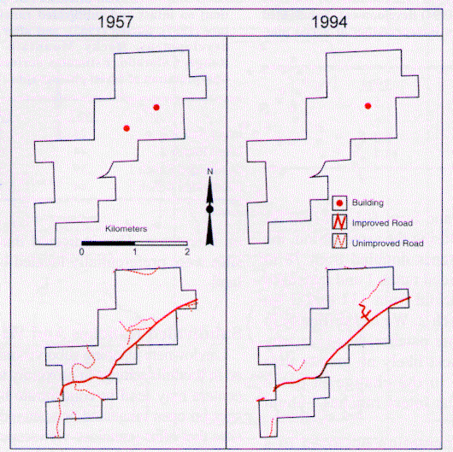
Intact Ranch # 1

Slide 14
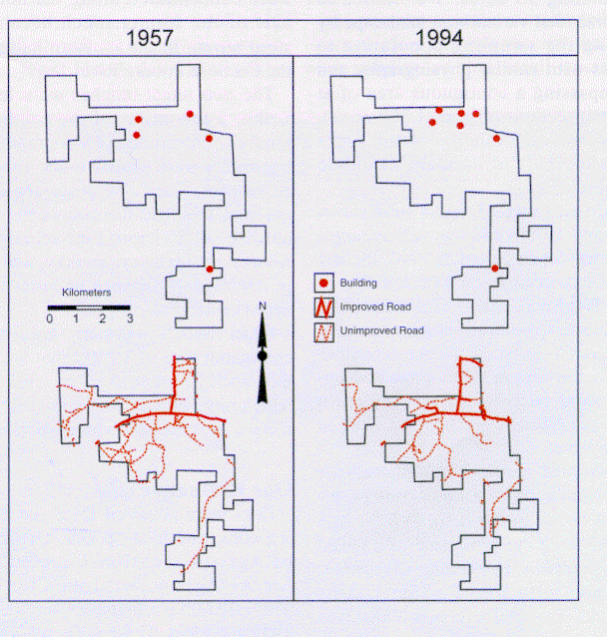
Intact Ranch # 2

Slide 15
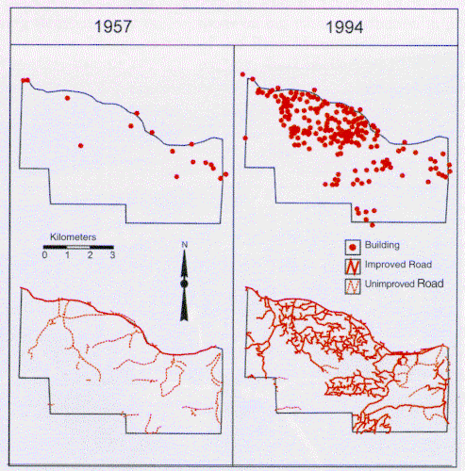
Subdivided Ranch #1

Slide 16
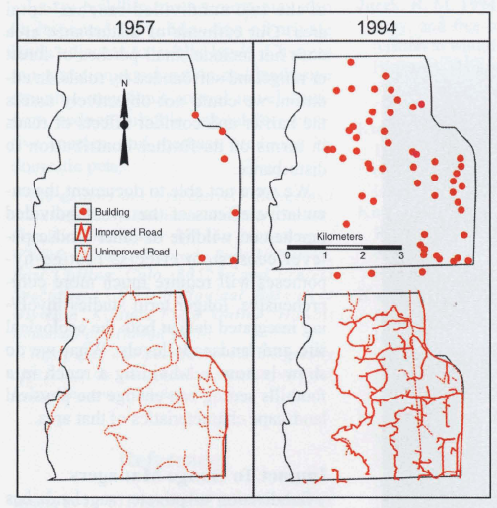
Subdivided Ranch #2

Slide 17
Preserving Open Space
 | Road Density (mi./sec.) | No. of Buildings (no./sec.) | No. of Rangeland Patches
 | 1957 1994 | 1957 1994 | 1957 1994
Intact Ranch | 0.84 1.08 | 0.8 0.5 | 35 49
Sudivided Ranch | 0.41 4.55 | 0.7 9.5 | 55 411
Mitchell, Knight & Camp. 2002. Landscape Attributes of Subdivided Ranches
Notes:
“Operations on these lands are governed by a management philosophy that appreciated complexity and the vital role of each species from the large predators to the smallest soil microbe. We feel that economic activates like grazing and recreation must be subordinate to the needs of a healthy ecosystem. And that although we have had the honor of managing lands owned by the American public for five generations, we have no ownership right to these lands. Our tenure on the land should be based on our ability to successfully meet three criteria: protection and enhancement of ecosystem health, recognition and application of public goals and, finally, to produce healthy food for a growing population.” Jim Winder in The art of Resource Management in the Chihuahuan Desert (on the Quivira Coalition web page)
The New Ranch is a place where cooperation has replaced confrontation, where common interests and common sense prevail, where environmentalists might come for supper.

Slide 18
Preserving Open Space
Plant Cover by Management Regime
a
a
a
y
y
z
Maestas, Knight, and Gilgert. 2002. Cows, Condos, or Neither?
Notes:
“Operations on these lands are governed by a management philosophy that appreciated complexity and the vital role of each species from the large predators to the smallest soil microbe. We feel that economic activates like grazing and recreation must be subordinate to the needs of a healthy ecosystem. And that although we have had the honor of managing lands owned by the American public for five generations, we have no ownership right to these lands. Our tenure on the land should be based on our ability to successfully meet three criteria: protection and enhancement of ecosystem health, recognition and application of public goals and, finally, to produce healthy food for a growing population.” Jim Winder in The art of Resource Management in the Chihuahuan Desert (on the Quivira Coalition web page)
The New Ranch is a place where cooperation has replaced confrontation, where common interests and common sense prevail, where environmentalists might come for supper.

Slide 19

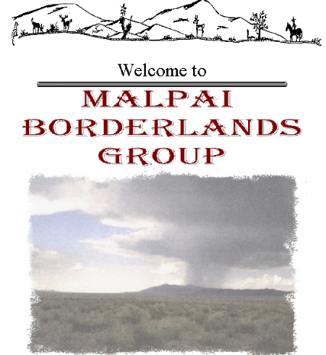
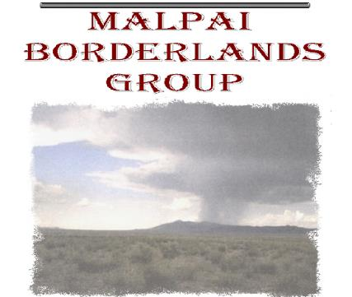
Preserving Open Space
www.malpaiborderlandsgroup.org
Our goal is to restore and maintain the natural processes that create and protect a healthy, unfragmented landscape to support a diverse, flourishing community of human, plant and animal life in our borderlands region.
Together, we will accomplish this by working to encourage profitable ranching and other traditional livelihoods, which will sustain the open space nature of our land for generations to come.

Slide 20
Preserving Open Space
The Malpai Borderlands Group www.malpaiborderlandsgroup.org
Started with informal discussions among ranching neighbors:
  recognized that a way of life, and a wild landscape, that they all loved was being threatened by spread of development and subdivision from nearby towns.
Activities directed at protecting and restoring the ecological diversity and productivity.
Land protection: Protected 75,000 acres of private land through conservation easements
Innovative cooperative land management:
  Employ “Grass Banking”
  Conduct watershed improvement projects.
Habitat restoration: Undertaken many restoration projects to restore native grassland and savanna habitat.
Community outreach: Host several meetings each year that are focused on sharing new scientific and land management information with our neighbors and cooperators.

Slide 21
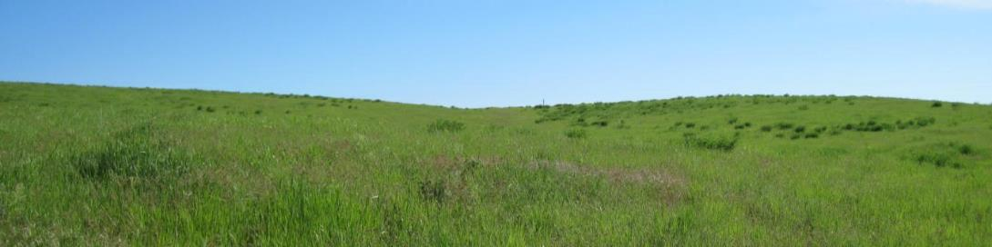
Tools for Creating:
Open Space
Natural Working Landscapes

Slide 22
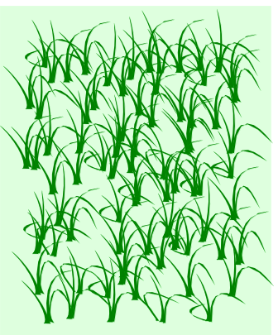
Grass Banks
Just like a “bank” where people save their $$$ which is used by others when they need $$$
In grass banks, ranchers commit
and use banked when needed, for:
  Fire fuel
  Restoration
  Forage in drought
  Wildlife considerations
  Etc.
Notes:
“Operations on these lands are governed by a management philosophy that appreciated complexity and the vital role of each species from the large predators to the smallest soil microbe. We feel that economic activates like grazing and recreation must be subordinate to the needs of a healthy ecosystem. And that although we have had the honor of managing lands owned by the American public for five generations, we have no ownership right to these lands. Our tenure on the land should be based on our ability to successfully meet three criteria: protection and enhancement of ecosystem health, recognition and application of public goals and, finally, to produce healthy food for a growing population.” Jim Winder in The art of Resource Management in the Chihuahuan Desert (on the Quivira Coalition web page)
The New Ranch is a place where cooperation has replaced confrontation, where common interests and common sense prevail, where environmentalists might come for supper.

Slide 23
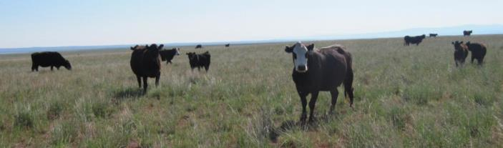
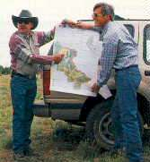
Grass Banks
  Grays Ranch in Arizona
  New Mexico …… Valle Grande Grass Bank
  Grass banks allow cows to graze
  while other land is rested
  before & after fire.
Connor White
Notes:
“Operations on these lands are governed by a management philosophy that appreciated complexity and the vital role of each species from the large predators to the smallest soil microbe. We feel that economic activates like grazing and recreation must be subordinate to the needs of a healthy ecosystem. And that although we have had the honor of managing lands owned by the American public for five generations, we have no ownership right to these lands. Our tenure on the land should be based on our ability to successfully meet three criteria: protection and enhancement of ecosystem health, recognition and application of public goals and, finally, to produce healthy food for a growing population.” Jim Winder in The art of Resource Management in the Chihuahuan Desert (on the Quivira Coalition web page)
The New Ranch is a place where cooperation has replaced confrontation, where common interests and common sense prevail, where environmentalists might come for supper.

Slide 24
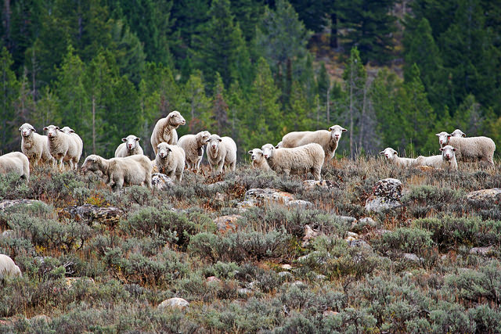
Coordinated Weed Management
Weeds don’t stop at property boundaries.
Most funds available for weed control require cooperation between land owners.
Livestock can be part of the solution if managed properly.
NicholasD.(flickr)
Notes:
“Operations on these lands are governed by a management philosophy that appreciated complexity and the vital role of each species from the large predators to the smallest soil microbe. We feel that economic activates like grazing and recreation must be subordinate to the needs of a healthy ecosystem. And that although we have had the honor of managing lands owned by the American public for five generations, we have no ownership right to these lands. Our tenure on the land should be based on our ability to successfully meet three criteria: protection and enhancement of ecosystem health, recognition and application of public goals and, finally, to produce healthy food for a growing population.” Jim Winder in The art of Resource Management in the Chihuahuan Desert (on the Quivira Coalition web page)
The New Ranch is a place where cooperation has replaced confrontation, where common interests and common sense prevail, where environmentalists might come for supper.

Slide 25
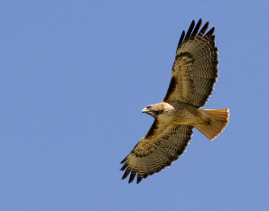
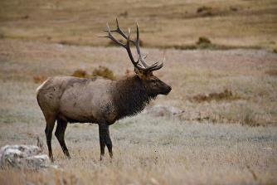
Wildlife Habitat Improvement
Conflicts and Compatibilities
  Disease
  Competition
  Compatibility
  Maintain open space
  Improve forage quality
  Etc.
S/C.Harris(flickr)
J.Rolinc(flickr)
Notes:
“Operations on these lands are governed by a management philosophy that appreciated complexity and the vital role of each species from the large predators to the smallest soil microbe. We feel that economic activates like grazing and recreation must be subordinate to the needs of a healthy ecosystem. And that although we have had the honor of managing lands owned by the American public for five generations, we have no ownership right to these lands. Our tenure on the land should be based on our ability to successfully meet three criteria: protection and enhancement of ecosystem health, recognition and application of public goals and, finally, to produce healthy food for a growing population.” Jim Winder in The art of Resource Management in the Chihuahuan Desert (on the Quivira Coalition web page)
The New Ranch is a place where cooperation has replaced confrontation, where common interests and common sense prevail, where environmentalists might come for supper.

Slide 26
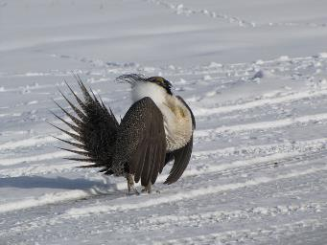
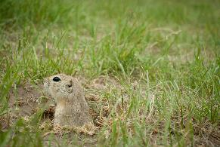
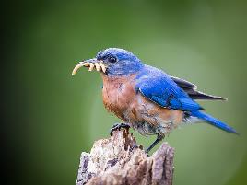
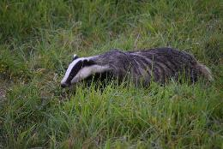
Wildlife Working Groups for example Locals Sage Grouse Working Groups
Wildlife Corridors
Habitat Conservation Plans
Restoration Projects
B.Olsen(flickr)
D.Gavey(flickr)
DC Gardens(flickr)
J.Campbell(flickr)
Notes:
“Operations on these lands are governed by a management philosophy that appreciated complexity and the vital role of each species from the large predators to the smallest soil microbe. We feel that economic activates like grazing and recreation must be subordinate to the needs of a healthy ecosystem. And that although we have had the honor of managing lands owned by the American public for five generations, we have no ownership right to these lands. Our tenure on the land should be based on our ability to successfully meet three criteria: protection and enhancement of ecosystem health, recognition and application of public goals and, finally, to produce healthy food for a growing population.” Jim Winder in The art of Resource Management in the Chihuahuan Desert (on the Quivira Coalition web page)
The New Ranch is a place where cooperation has replaced confrontation, where common interests and common sense prevail, where environmentalists might come for supper.

Slide 27
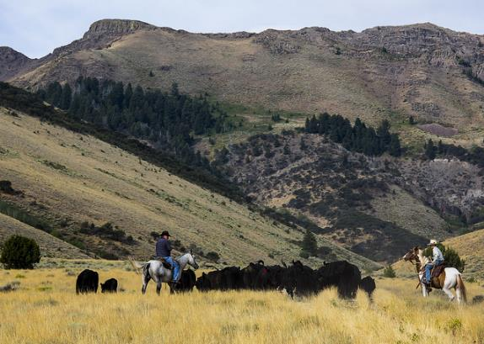
CRM – Coordinated Resource Management Groups
Collaboration among all land managers & owners on a single landscape:
  Agencies
    Federal – such as BLM, USFS & NRCS
    State – such as State Lands and Fish & Game
  Ranchers
  Other Publics
    Conservation Groups
    Extension and Education
B.Wick BLM(flickr)
http://www.rangelands.org/education_crm.shtml

Slide 28
CRM – Coordinated Resource Management Groups
  helps people manage natural resources in a productive, environmentally-friendly, and economical manner, for the long term.
  is a coalition-building process which involves those using the resources in the decision making about those resources.
  integrates local wisdom and technical expertise, while taking advantage of group synergy.
  some CRM teams have been initiated solely as "brain trusts" to reap the benefits of diversity and group creativity.
http://www.rangelands.org/education_crm.shtml

Slide 29
Modern Challenges?
??
??
??
??

Slide 30
Creating Working Landscapes & Preserving Open Space
S. McFarland
USDA-ARCS
S.McFarland
K.Baker(flickr)
REM 456 - Integrated Rangeland Management

