Slide 1
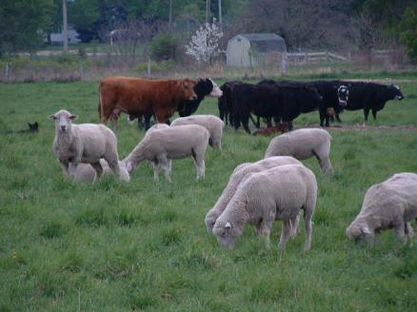
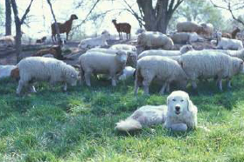
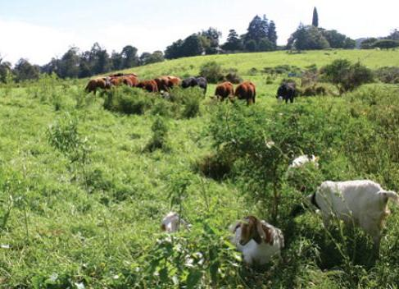

Multi-Species Grazing
REM 456 - Integrated Rangeland Management

Slide 2

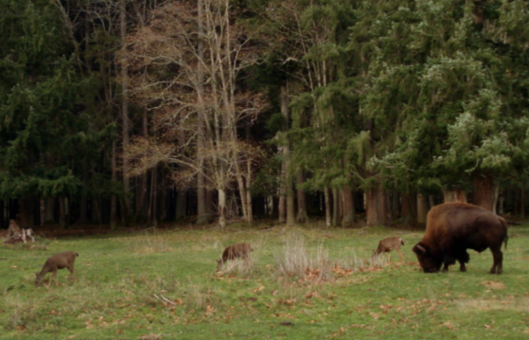
Multi-Species Grazing
More than one species grazing the same unit of land.
The grazing can occur at the same time or at different times
Can include a mixture of domestic and wild animals.

Slide 3
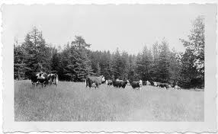
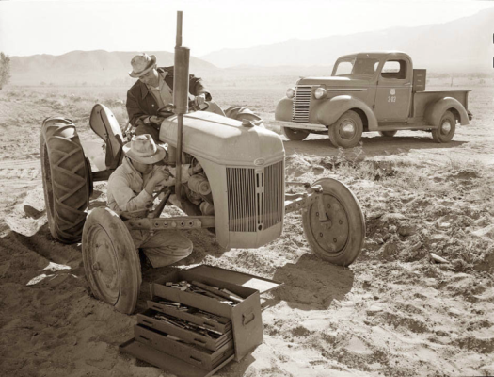
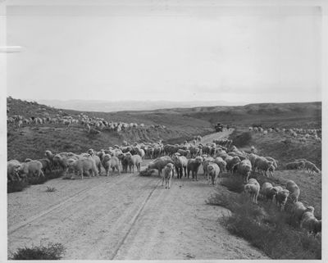
Multi Species Grazing
And old idea from era of integrated agricultural systems

Slide 4
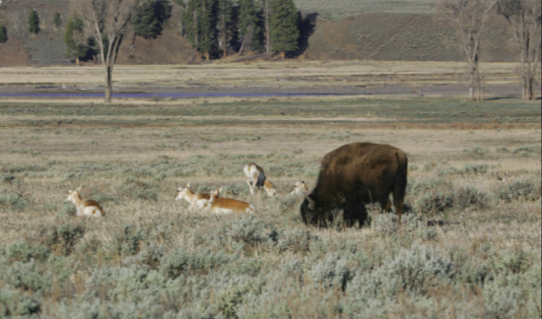
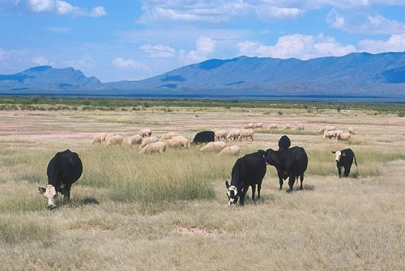
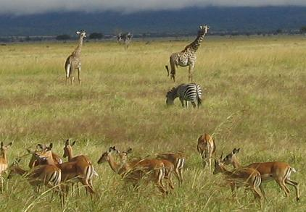

Multi Species Grazing
Multi-species grazing is the norm for wild and natural ecosystems.

Slide 5
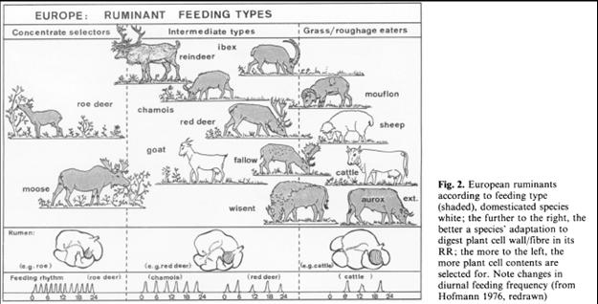
From: Hofmann, R. R. 1989. Evolutionary steps of ecophysical adaptation and diversification of ruminants: A comparative view of their digestive system. Oecologia 78:443-457.

Slide 6
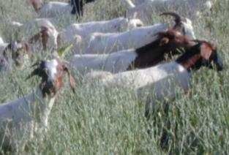
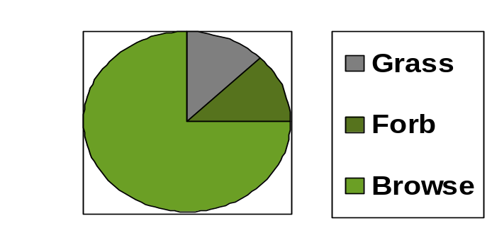
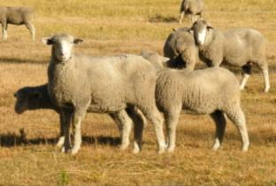
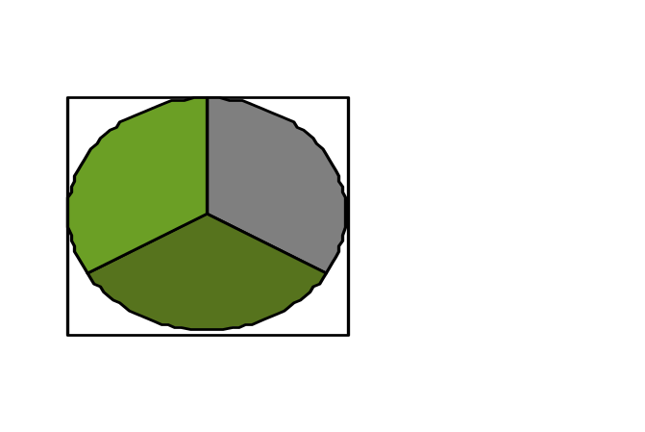
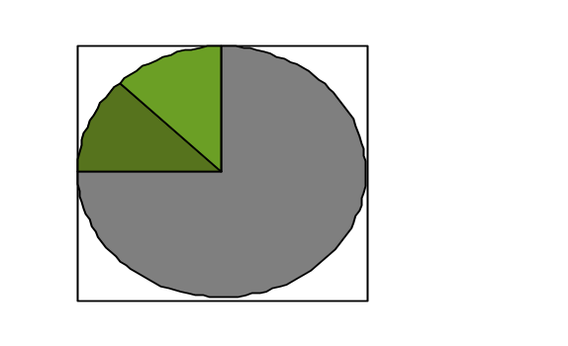
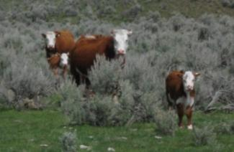
Based on Species Differences
Concentrate Feeder (browse)
Intermediate Feeder (forbs)
Roughage Feeder (grass)
Notes:
Photos by K. Launchbuagh

Slide 7
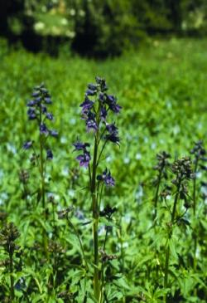

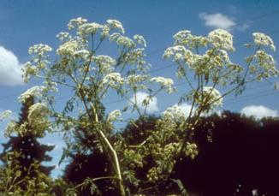

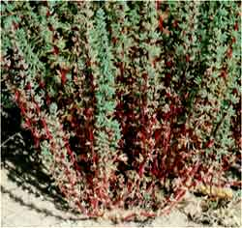
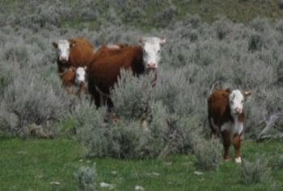
Based on Species Differences
Toxic or Not?

Slide 8
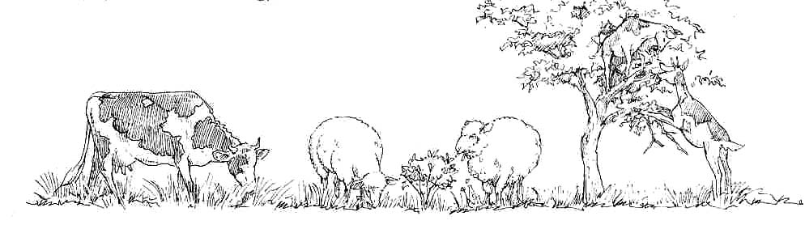
Based on Species Differences
Where and how to graze?

Slide 9
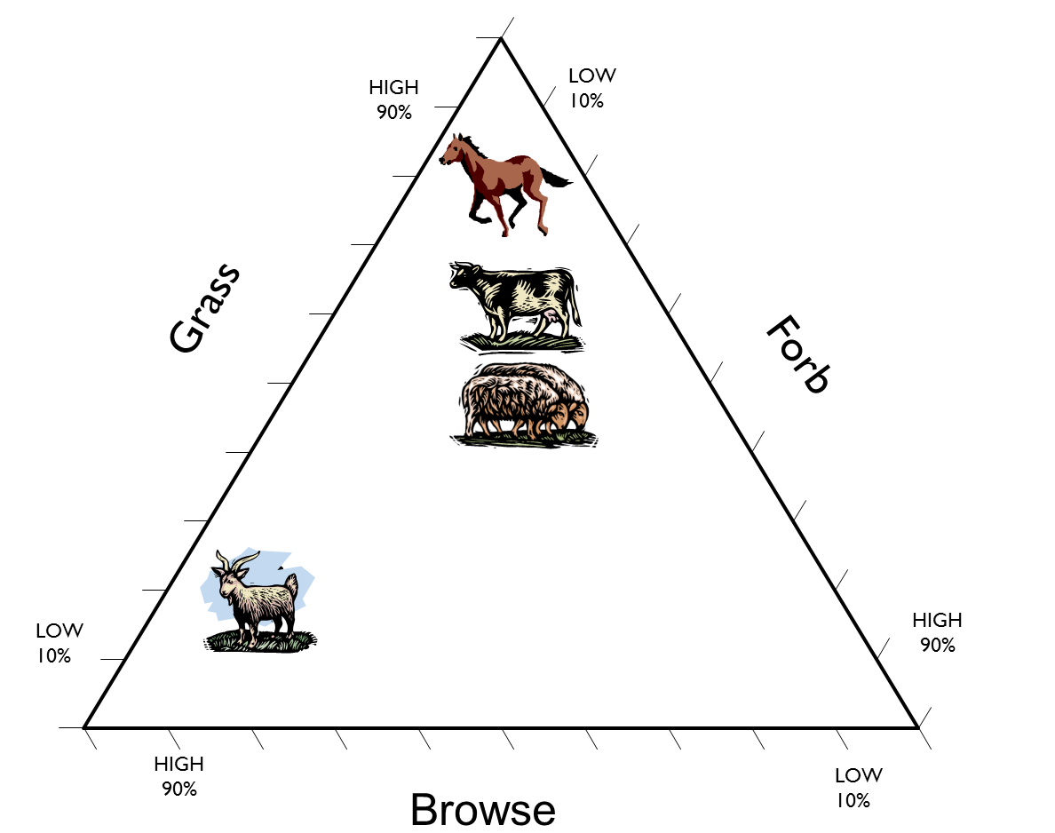
Domestic Grazers - Diets of Grass, Forb & Browse

Slide 10
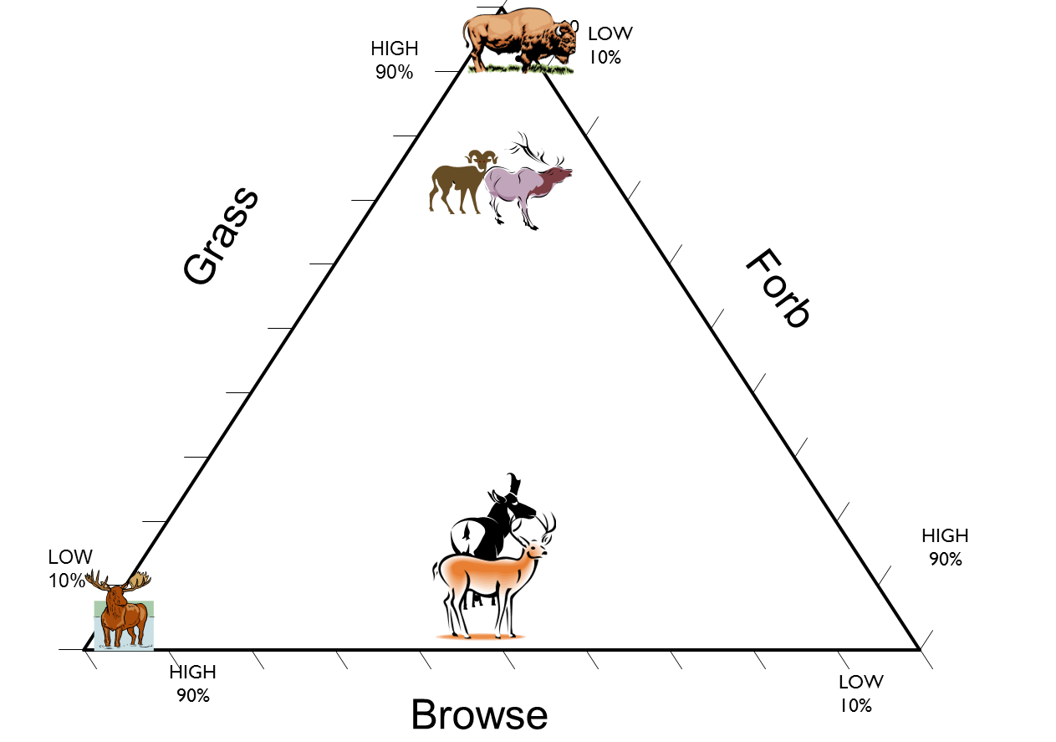
Wild Grazers - Diets of Grass, Forb & Browse

Slide 11
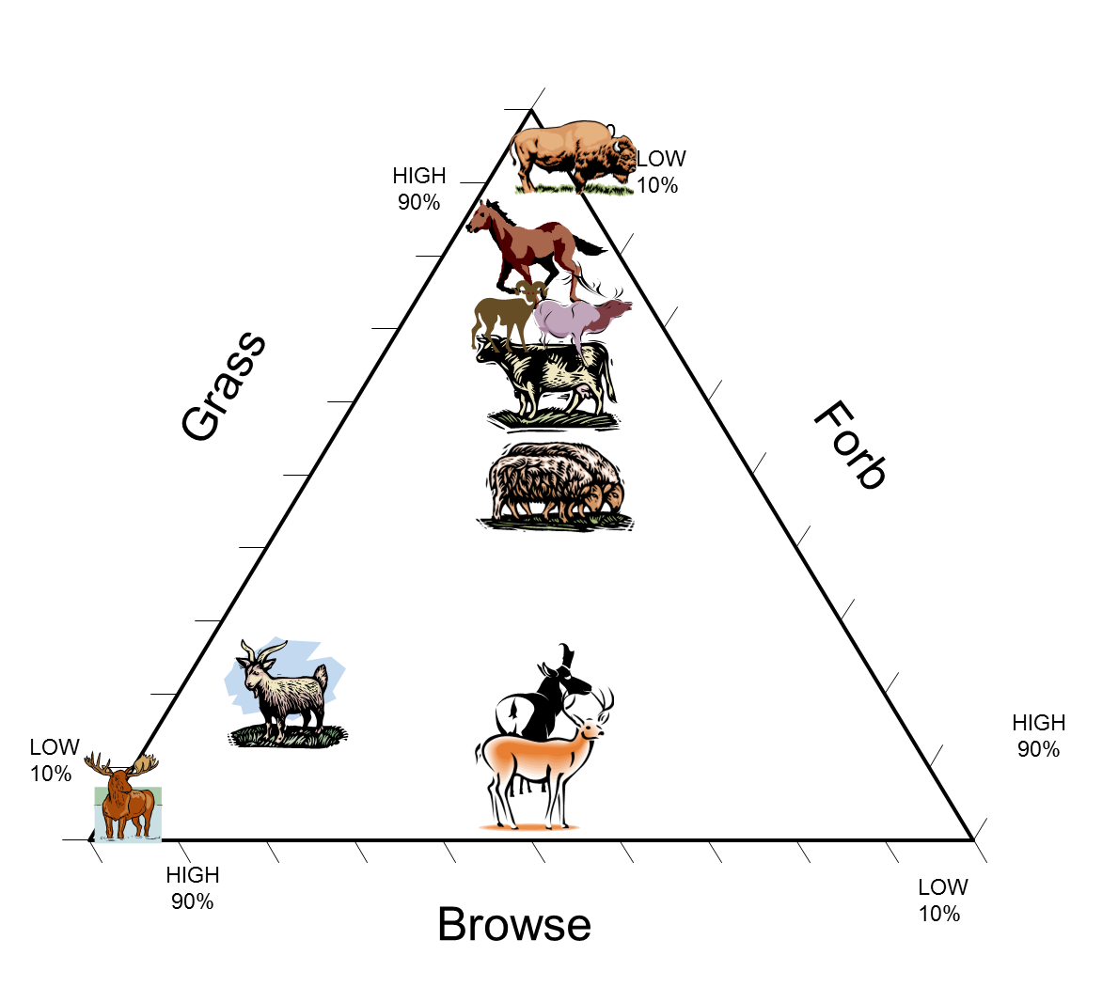
Wild & Domestic - Diets of Grass , Forb & Browse

Slide 12
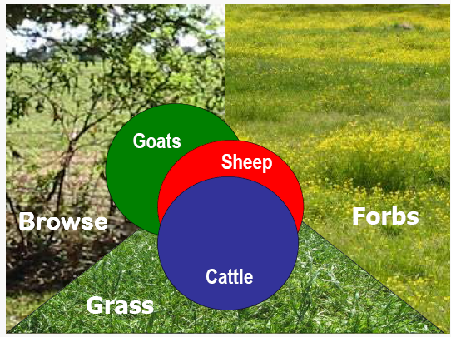
Dietary Preferences
Dietary Overlap
Notes:
Photos by K. Launchbuagh

Slide 13
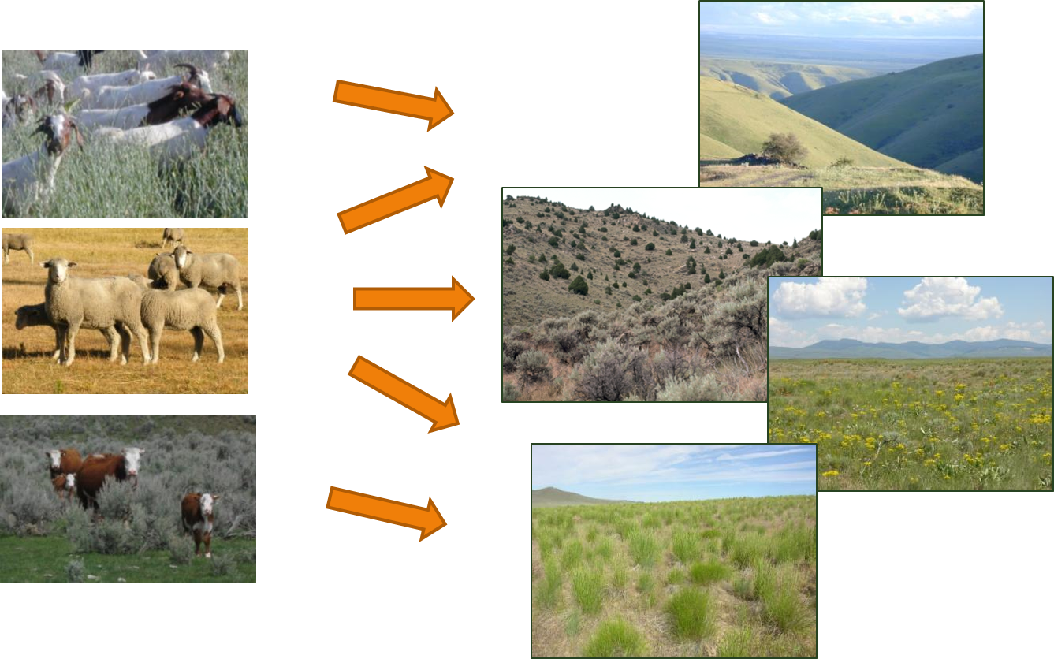
Match herbivore with Landscape

Slide 14
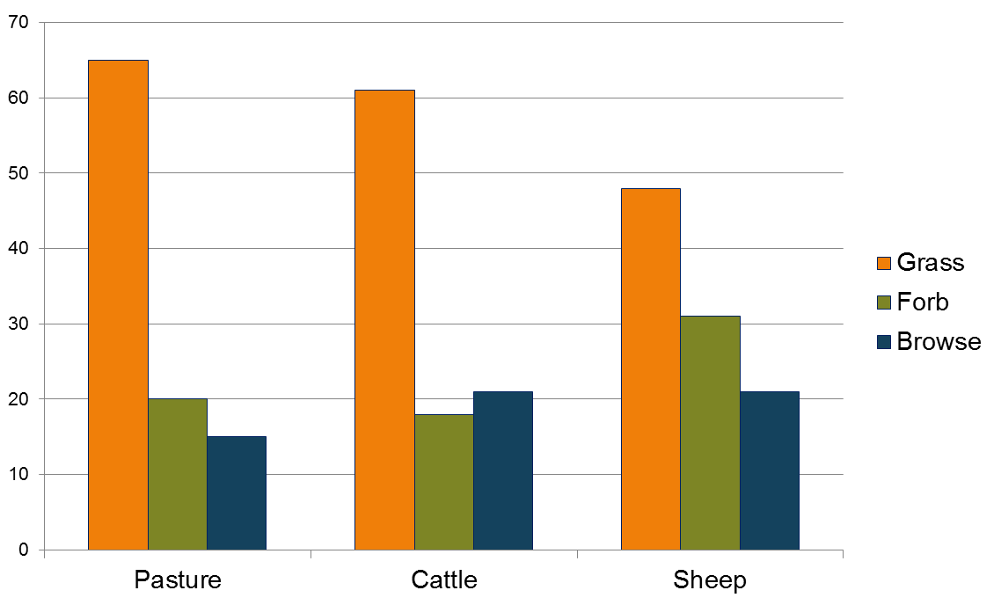
Example 1 - Grassy Pasture
Similarity between pasture and cattle diet = 94%
Similarity between pasture and sheep diet = 83%

Slide 15
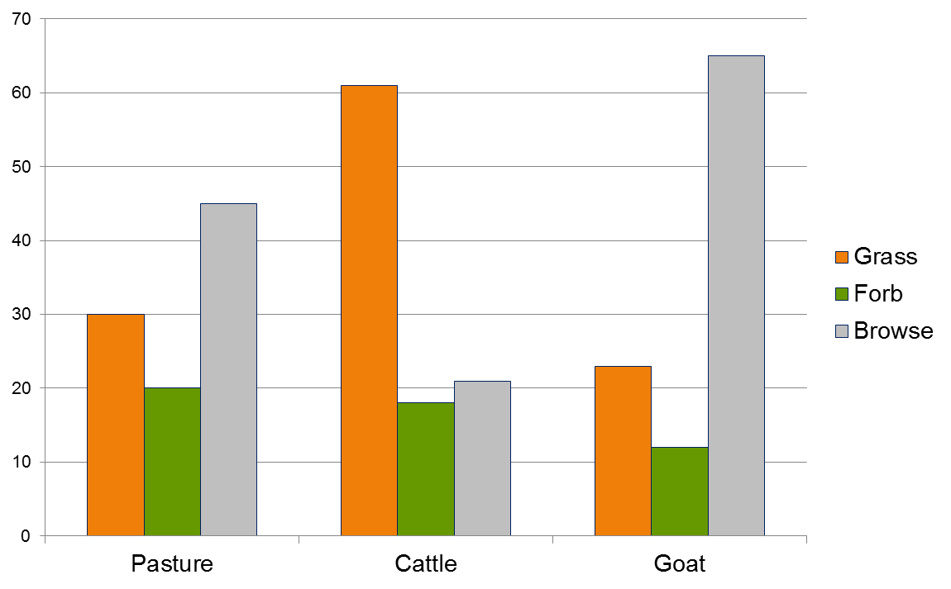
Example 2 – Shrubby Pasture
Similarity between pasture and cattle diet = 69%
Similarity between pasture and goat diet = 80%

Slide 16
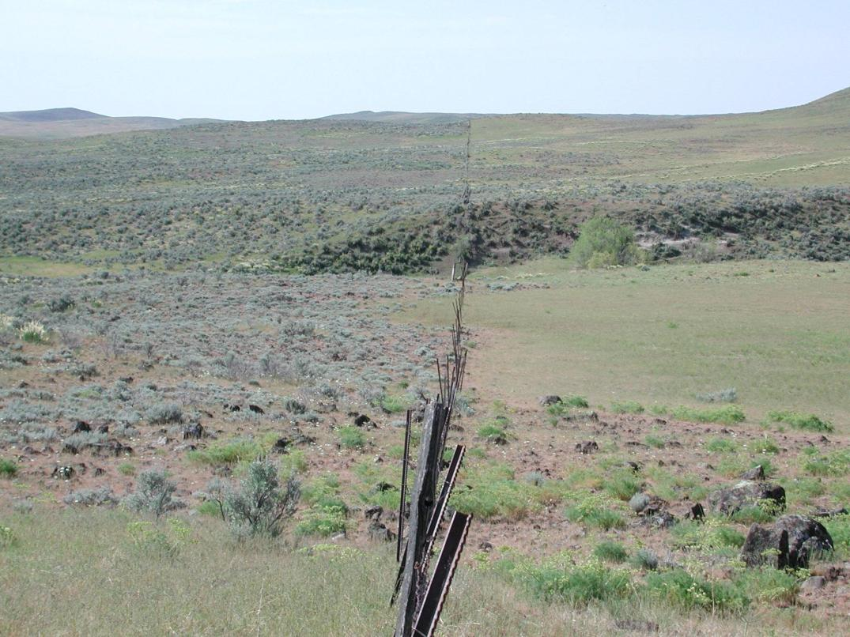
Advantages of multi-species livestock grazing over single-species grazing include?
Change Range Condition – Shrubs & Grass

Slide 17
Advantages of multi-species livestock grazing over single-species grazing include?
Increased carrying capacity
  24% greater with sheep & cattle rather than cattle only
    May be greater when goats are used in multi-species setting
    Depends on the landscape & plants available
Increased economic returns
  20 to 25% increased net income
    More animals, better condition, healthier
    Improved cash flow - marketing different products at different times of the year.
    Reduced financial risk - increased enterprise diversity

Slide 18
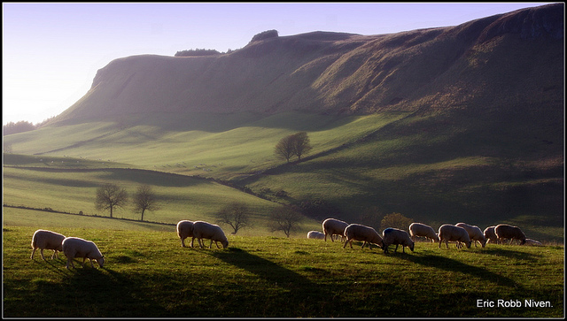
Advantages of multi-species livestock grazing over single-species grazing include?
Improved animal performance
  Greater weight gain in multi-species pastures
  9 to 24% greater production in sheep + cattle over cattle only.
Improved animal health
  Reduced parasite load
  Reduced disease transmission
Improved land condition
  Depends on goals and perspective

Slide 19

Advantages of multi-species livestock grazing over single-species grazing include?
Reduced predation of sheep or goats grazing among or bonded to cattle.

Slide 20
Major challenges to multi-species grazing
Increased fencing requirements – if sheep and goats are added to cattle or horse pastures.
Lack of knowledge of animal husbandry for a variety of species.
Increased complexity because of enterprise diversity.
Potential disease transmission from sheep to cattle.
    e.g., Malignant Catarrhal Fever – sheep can serve as carrier to infect cattle

Slide 21
Multi-Species Grazing:
Opportunities?
Challenges?

Slide 22
Multi-Species Grazing
REM 456 - Integrated Rangeland Management

