Slide 1
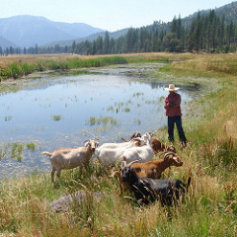
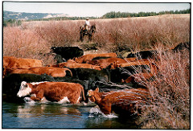
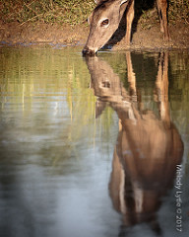

Grazing Management in Riparian Systems
Feather River Land Trust (flickr)
D. Vanderhoff(flickr)
M.Lytle(flickr)
REM 456 - Integrated Rangeland Management

Slide 2
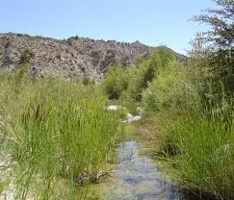
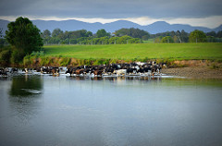
Riparian Area
Transition between the aquatic (saturated) and upland areas
Vegetation and physical (soil) characteristics reflect the influence of permanent surface or ground water
Land along streams, ponds, marshes, springs, and seeps
sccwrp.org
M.Bradbury(flickr)

Slide 3
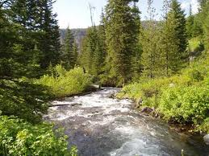
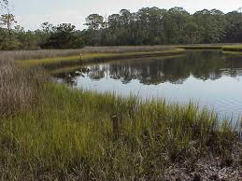
Types of Wetlands
Lotic
  Flowing water systems (streams)
    Defined channel
    Gradient
Lentic
  Standing surface water
    Lakes, reservoirs, ponds, marshes
  Ground Water
    Seeps and springs
    Bogs and wet meadows
mtwatercourse.org
learnnc.org

Slide 4
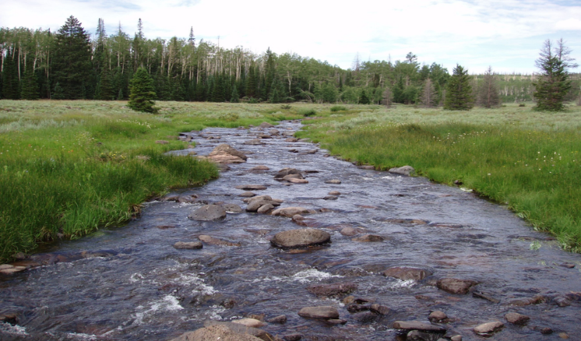
Healthy?
Mammoth Creek, Utah – PFC Presentation 2011

Slide 5
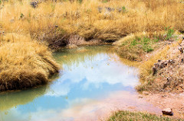
Healthy Riparian Area
Vegetation and roots protect and stabilize banks
Elevated saturated zone -- increased subsurface storage of water
Increased summer streamflow
Cooler water in summer, warmer
& less icy in winter
Improved habitat for fish and other
aquatic organisms
High forage production and quality
High diversity of wildlife habitat
J.White(flickr)

Slide 6
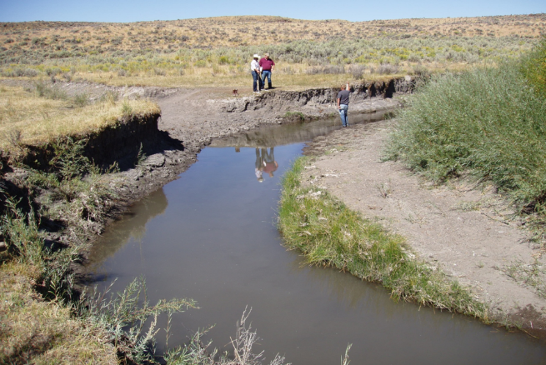
Healthy or Not Healthy?
N. Fork Humboldt River – PFC Presentation 2011

Slide 7
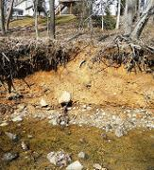
Degraded Riparian Area
Little vegetation to protect & stabilize banks
Lowered saturated zone
Little or no summer stream flow
Warm water in summer & icy water in winter
Poor habitat for fish and other aquatic organisms
Low forage production & quality
Low diversity of wildlife habitat
DEP Montgomery County, MD(flickr)

Slide 8
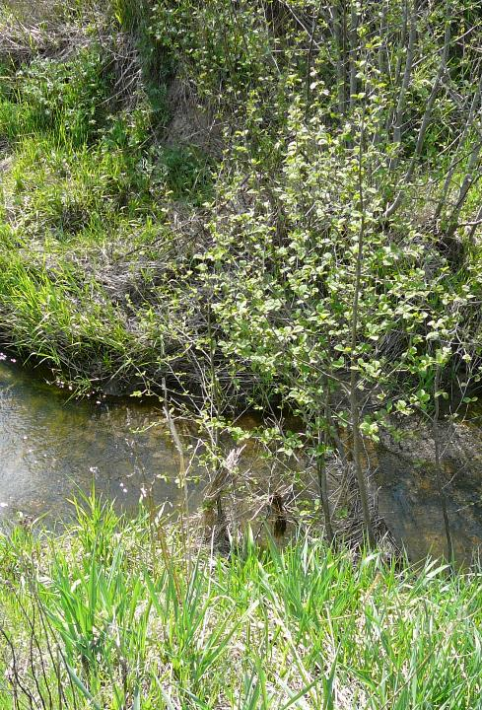
Proper Functioning Condition of riparian areas
PFC exists when adequate vegetation, landform, or large woody debris is present to:
Dissipate stream energy associated with high waterflows, thereby reducing erosion and improving water quality
Filter sediment, capture bedload, and aid floodplain development
Improve floodwater retention and ground-water recharge

Slide 9
Proper Functioning Condition of riparian areas
PFC exists when adequate vegetation, landform, or large woody debris is present to:
Develop root masses that stabilize streambanks against cutting action
Develop diverse ponding and channel characteristics to provide the habitat and water depth duration, and temperature necessary for fish production, waterfowl breeding, and other uses
Support greater biodiversity

Slide 10
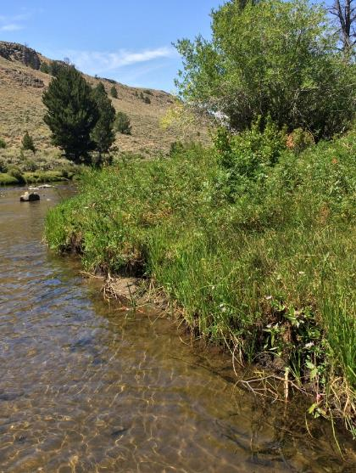
Grazing Management is Vegetation Management
Rest & regrowth produces vigorous, productive riparian plants,
Energy stored in roots will sustain healthy riparian growth,
Healthy plants build strong stream banks,
Woody vegetation adds reinforcement,
Plant species diversity adds forage and shelter values.
BLM.gov

Slide 11
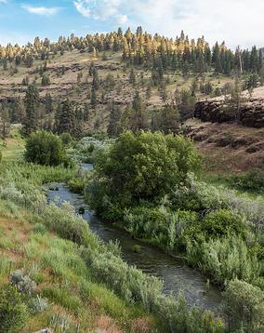
Grazing Management is Vegetation Management
Dissipates stream energy
Traps sediments & build stream banks
Builds ground water reserves
Maintains stream channel shape
G.Shine BLM (flikcr)
BLM.gov

Slide 12
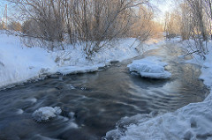
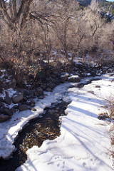
Grazing Management is Vegetation Management
Protect During Vulnerable Stages:
  protect banks from trampling when fragile
  protect brush species during periods of dormancy
  maintain productive forage species
S.Ponomarev(flickr)
E.Wilson(flickr)

Slide 13
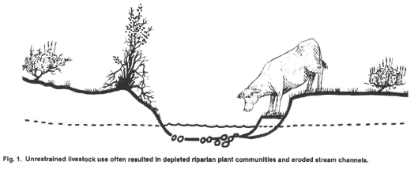
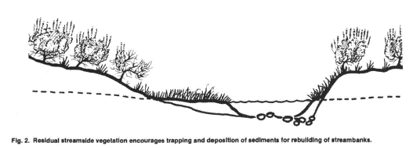
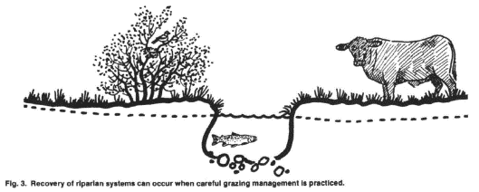
Grazing Management is Vegetation Management
Clary, W. P., & Webster, B. F. (1990). Recommended riparian grazing practices. In Proceedings of Conference XXI-International Erosion Control Association. (pp. 77-81). International Erosion Control Association.

Slide 14
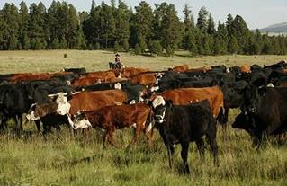
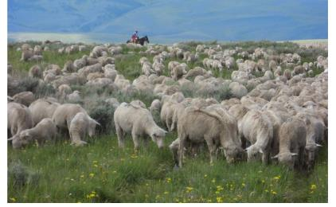
Aspects of Managing Grazing
Distribution problems often exist and must be addressed
Stocking rate problems may exist, but changes to stocking rate often do not solve concerns
Proper season of use determines effect of grazing on plants and riparian systems
USFS photo
USFS photo

Slide 15
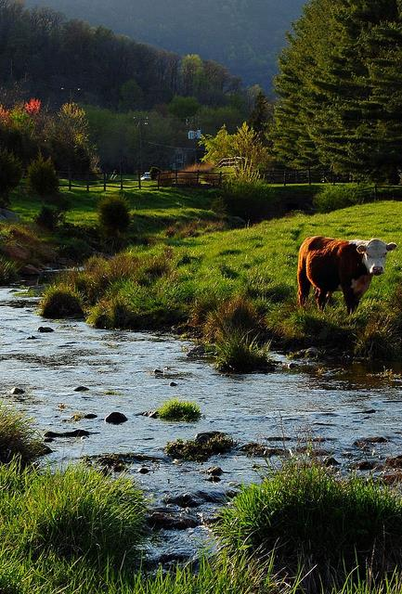
Why do cattle use riparian areas?
Water
Cool temperatures/shade
Good quality forage in summer
Flat terrain
Cover from wind
Chandler(flickr)

Slide 16
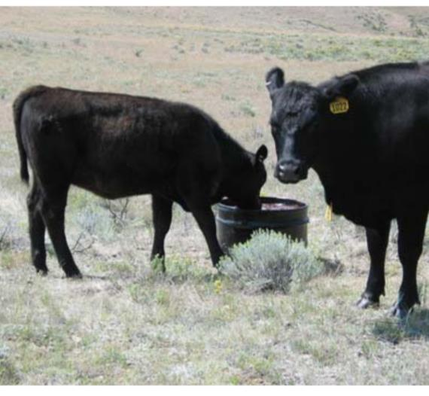
Attracting livestock to uplands
Upland water development
Careful salt placement & supplements
Create trails
Supplement strategically
Fertilization - improve upland forage
Burning of brush control
Seed palatable upland species
Reduce palatable riparian species
S. Wyman (BLM)

Slide 17
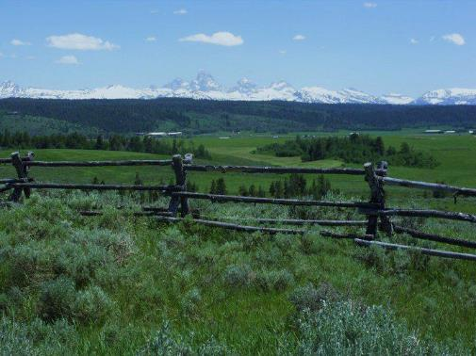
Restricting livestock from riparian areas
Drift fences
Exclosures
Natural or constructed barriers
Dense vegetation
Range riding & herding
Electric shock collars
Low quality vegetation
USDA NRCS Montana
Idaho State Parks & Recreation
Make the right thing easy and the wrong things hard.

Slide 18
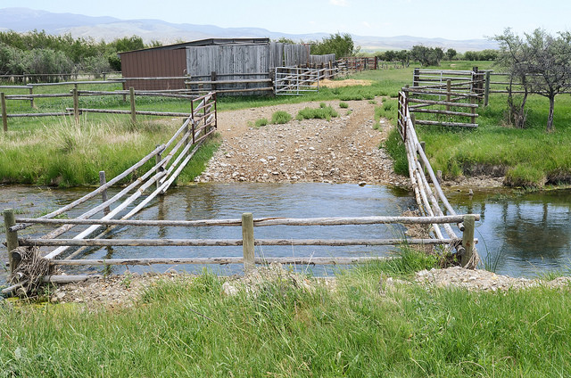
Controlling livestock access
Hard stream crossing
Fenced access “gaps”
Stream diversions
Pumped water slightly off stream
USDA NRCS Montana

Slide 19
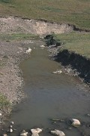
Sustainable Grazing?
Yes, grazing can cause damage
W.Elmore

Slide 20
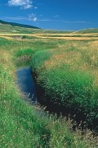
Sustainable Grazing?
But, grazing can
be managed.
Callum Creek 1980
Callum Creek 1996
W.Elmore
W.Elmore

Slide 21
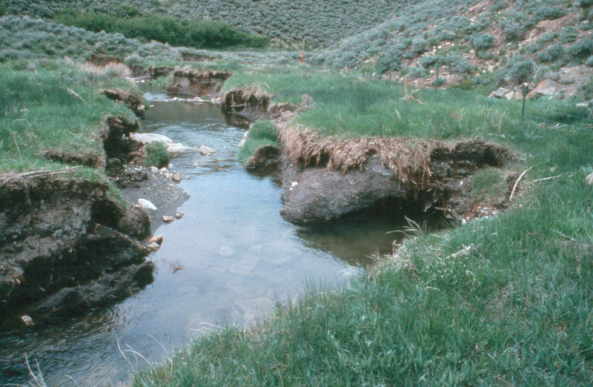
Potential for Recovery?
W. Elmore
Notes:
One problem we have is not being able to tell wide varitey of audiences what potential of degraded systems really is. This is a before picture of a stream that has downcut and widened and is ready to recover.

Slide 22
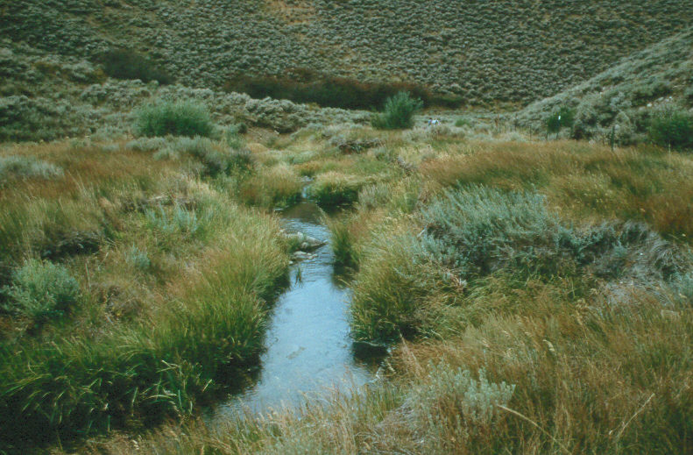
12 years later
W. Elmore
Notes:
This is the after picture 12 years later with a change in management. This is totally natural recovery.

Slide 23
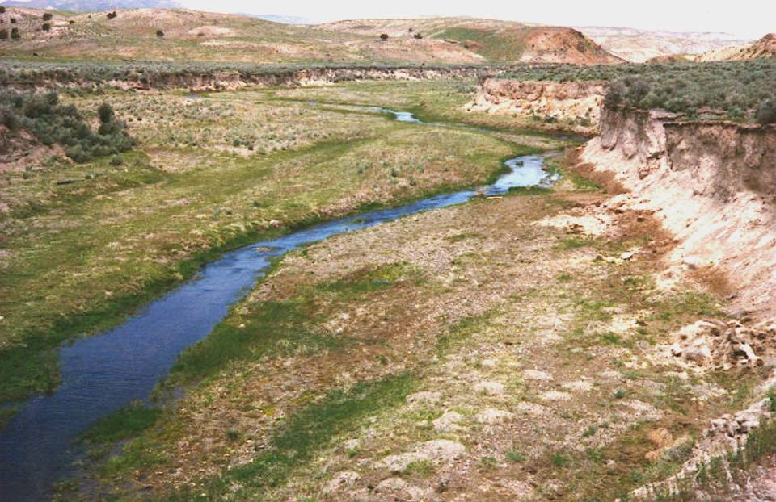
Potential for Recovery?
W. Elmore
Notes:
Another example of before management change. What do you think the potential is for this site.

Slide 24
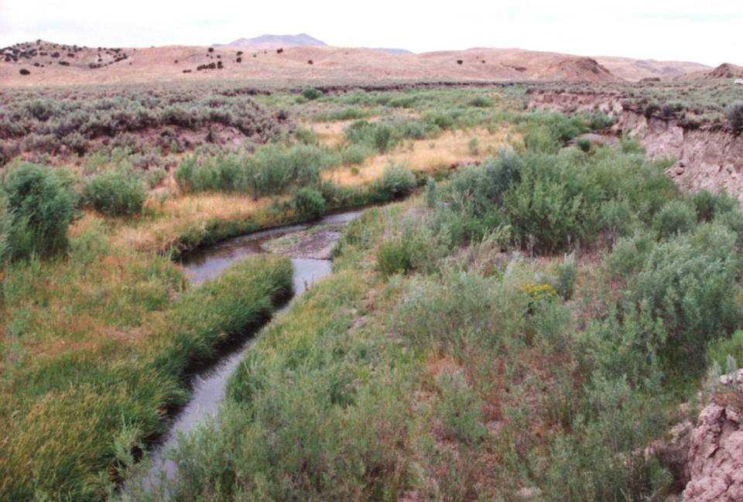
10 years later
W. Elmore
Notes:
Approximately 10 years later. No reduction in livestock numbers only a change in the season of use. Ask what differences so you see between the before and after.

Slide 25
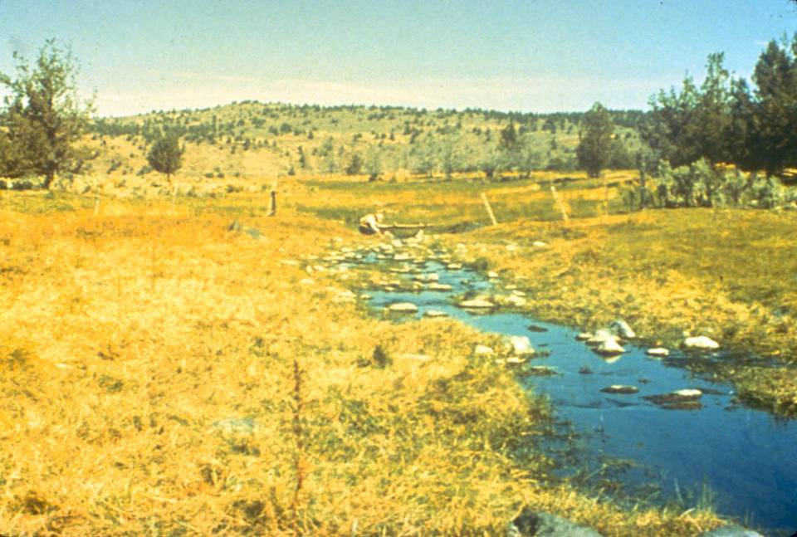
SF Crooked River, OR 1976
Season long use
W. Elmore
Notes:
SF Crooked River, OR 1976
Season long use

Slide 26
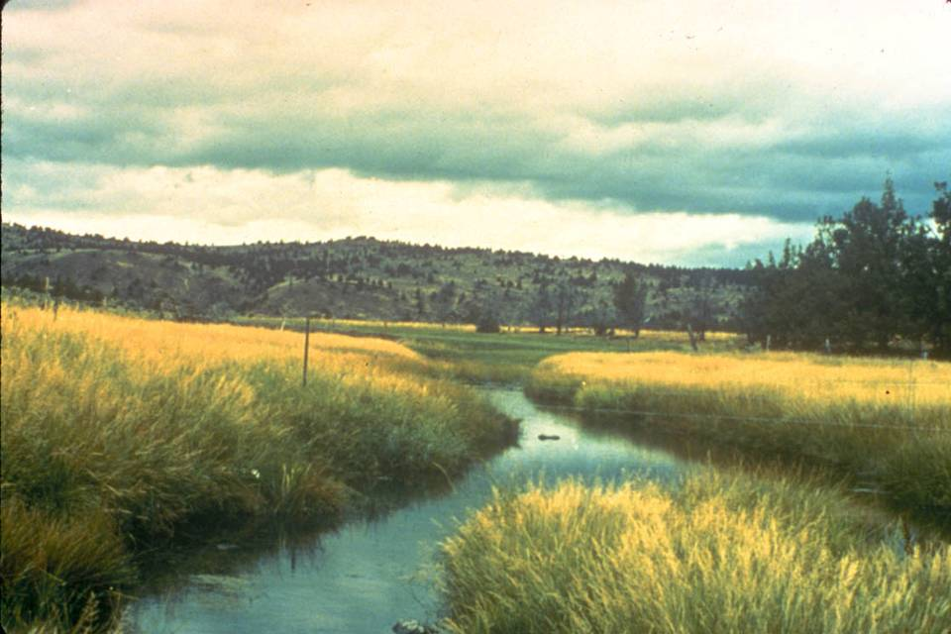
S. Fork Cr. River 1984 after two years of rest followed by early season grazing
W. Elmore
Notes:
S. Fork Cr. River 1984 after two years of rest followed by early season grazing. What species would like this benefit from this change and which one would not.

Slide 27
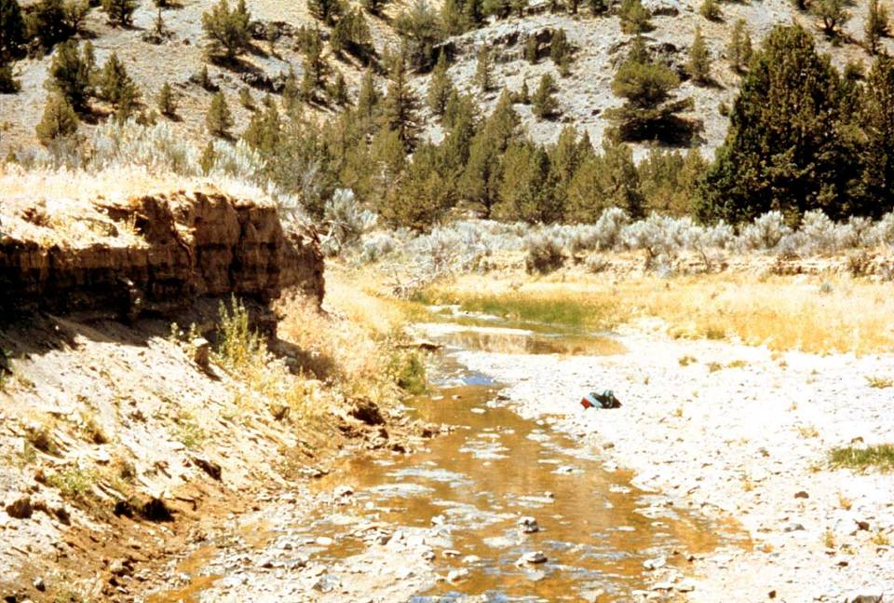
W.Elmore
W. Elmore
Bear Creek May 1977
Notes:
Bear Creek was season long grazed for 100+ years. In the 1950’s the willows were sprayed to reduce water use and in 1964 there was a 100+ year event (rain on snow 12-24-64) and the stream downcut and in this photo has widened out. The current livestock use is 25 cows/calves for three months (June, July, Aug) or 75 AUM’s. The vegetation is mostly upland species with some Baltic rush (dark green in center of picture). Uplands are dominated by basin big sagebrush and western juniper. Reference points are the plump juniper on the right and the snag on the left. The juniper in the foreground will be cut before the next photo was taken. The following is 27 years of change on this stream. The management was changed initially to two years of rest, followed by late winter (mid Feb) to early spring (mid April) grazing.

Slide 28
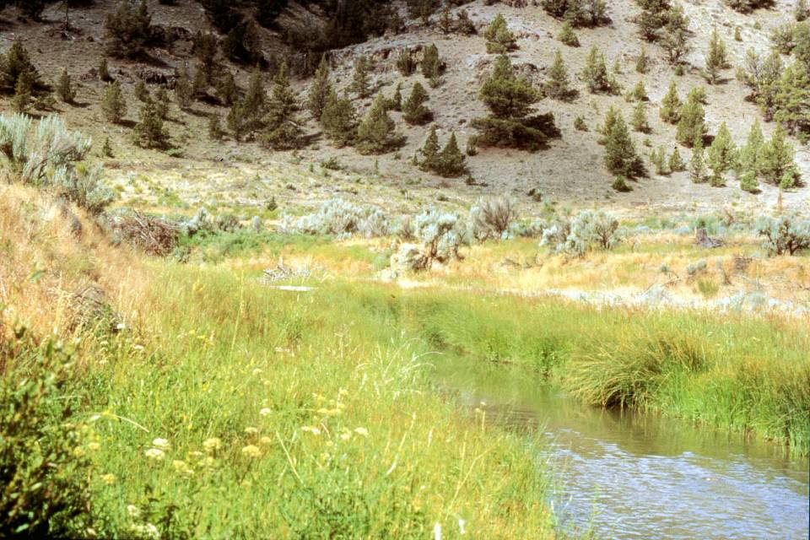
W. Elmore
9 years
Bear Creek Aug 1986
Notes:
A flood plain is developing on both sides of the stream and vegetation has changed to a more mesic (water loving) mix of plants that includes Nebraska sedge, Small-fruit bulrush, beaked sedge, spike rush, brook grass, three square bulrush, and some reed canarygrass.

Slide 29
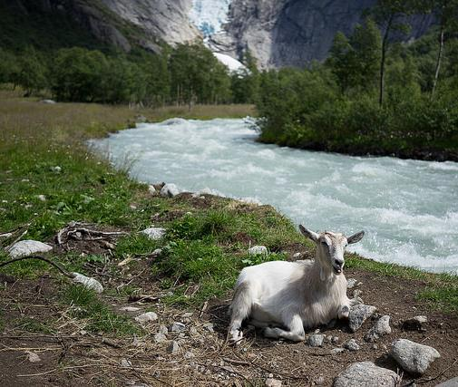
Grazing Mgmt. Includes:
Herbivore species
Intensity (stocking rate)
Season of rest
Season of grazing
Duration & frequency

Slide 30
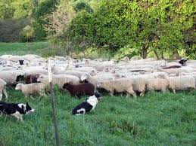
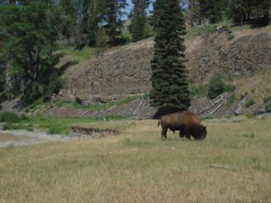
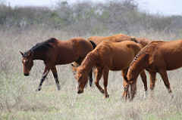
Kind and class of animal?
Cow-calf vs Yearling Cattle
Sheep
  unherded vs herded
Horses
Bison
leydenglenlamb.com
P.Scanlan(flickr)
theriverdamsel.com

Slide 31
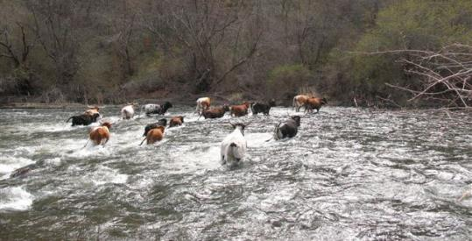
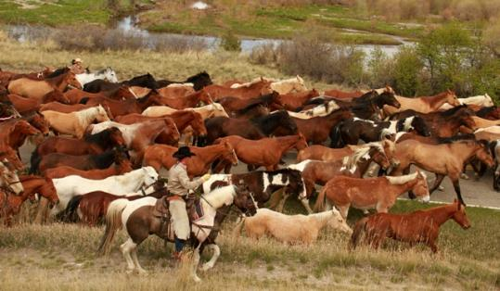
Herd Management
& Animal Husbandry
Culling Work:
  Traditionally used to improve animal performance
  Can be applied to habitat use tendencies
  Inherited & learned attributes can be culled out of herd.
    Example = hill climbers & bottom dwellers
  Terrain use can be modified by management & training when animals are young.
K. Launchbaugh
P.Bauchman(flickr)

Slide 32
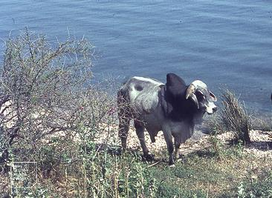
Herd Management
& Animal Husbandry
Breed of livestock
  Most people would not change breed just to improve distribution – but it can be effective
  Braham crosses can be used for higher heat tolerance
  Mountainous terrain can be more effectively used by animals that were bred in mountainous areas
M.Gillham(flickr)

Slide 33
Stocking Rate
Even when pastures are understocked …riparian areas can overgazed
= A Distribution Problem
Stocking rate can be unimportant, yet one needs to start with an appropriate rate
A temporary reduction may be necessary to allow recovery of highly utilized areas

Slide 34
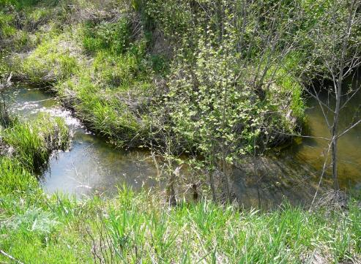
Season of Grazing
Dormant Season or Winter
Early Season or Spring
Hot Season or Summer
Late Season or Fall
K. Launchbaugh

Slide 35
Dormant Season (Winter) Use
++ PRO ++
- - CON - -
No opportunity for re-growth before spring run off
Woody plants can sustain heavy use
Soil compaction minimal
Limited bank trampling
Utilization of herbaceous plant not detrimental

Slide 36
Early Season (spring) Use
++ PRO ++
- - CON - -
Better livestock distribution
Reduced use of riparian vegetation
Opportunity for regrowth
Availability of palatable herbaceous plants reduce use of woody species
Potential soil compaction
May affect plant vigor
Likely to adversely affect wildlife in area

Slide 37
Hot Season (summer) Use
++ PRO ++
- - CON - -
Streambanks are stable
Usually sufficient moisture for regrowth
Nutritious riparian vegetation
Greater tendency of cattle to use riparian areas
  Dormant upland veg.
  Green riparian veg.
  Cool temp in riparian
  Available water
Grazing occurs when plants are most sensitive

Slide 38
Late Season (fall) Grazing
++ PRO ++
- - CON - -
Plants have completed growth
Soils are dry
Less impact to wildlife
Regrowth potential is low
Limited ability to regrow before spring runoff
Livestock more likely to use woody species
Distribution problems

Slide 39
Monitoring Riparian Vegetation
Utilization or Residual Levels:
Residual = stubble heights
Utilization needs to be appropriate for key species
Utilization mapping is excellent tool to check livestock distribution
Annual measurements can vary substantially… so a range of stubble height should be used.

Slide 40
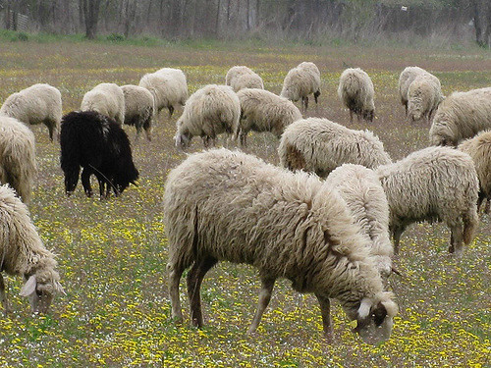
Guidelines for grazing systems:
Maximize:
  Time for post grazing growth
  Residual cover after grazing season in fall
Minimize:
  Length of grazing season
  Duration of summer grazing
  Years of consecutive summer grazing
R.Luna(flickr)

Slide 41
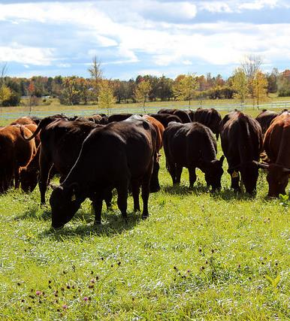
Guidelines for grazing systems:
Continuous - Usually most damaging to riparian areas
Late-Season Deferment - Design systems so that pastures containing significant riparian areas are not grazed (deferred) during summer/fall months
Rest Rotation - Rotate a year of complete rest between pastures in different years.
C.Herrick(flickr)

Slide 42
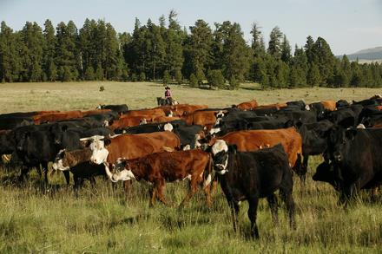
Guidelines for grazing systems:
Management-Intensity Grazing:
  Large herds of animals created by herding or fencing
  Grazing one area of land for just a day or two
  Don’t graze twice in one year
  Provides sufficient rest
  Implement herd effect
USDA.gov

Slide 43
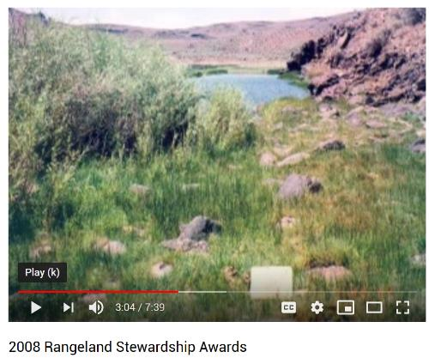
Management Intensive Grazing
Rancher Chris Black in Idaho
Recommended Video
2008 Rangeland Stewardship Awards
Bureau of Land Management
https://youtu.be/T3K_23A-154

Slide 44
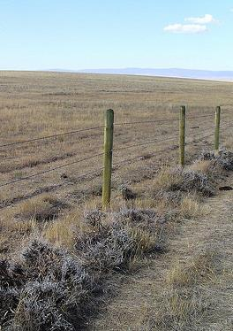
Guidelines for grazing systems:
Pasture Size:
  Riparian area in pastures difficult to effectively managed without exclusion fencing
  In large pastures, include as much of stream as possible in pasture
  Do not use stream as pasture boundaries (stream in middle of pasture)
  Riparian Pastures = pastures where riparian goals are dominant consideration
USDA.gov

Slide 45
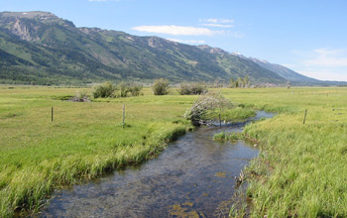
Guidelines for grazing systems:
Riparian Pasture Management:
  Create small pastures around riparian areas
  Devise pastures with either mostly upland or
  most riparian vegetation
  Manage riparian pastures with riparian goals in mind
  Fencing costs may be great but usually less than ribbon
  fencing riparian areas.
Jake Beaulieu (NSF.gov))

Slide 46
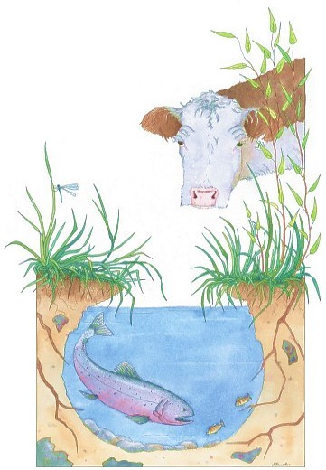
Grazing Management...
Livestock are just one “human induced” impact on riparian systems.
Yes, we can almost always manage riparian areas with cattle.
It isn’t always easy.
It isn’t always necessary.
But, it can be done.
www.cowsandfish.org

Slide 47


