Slide 1
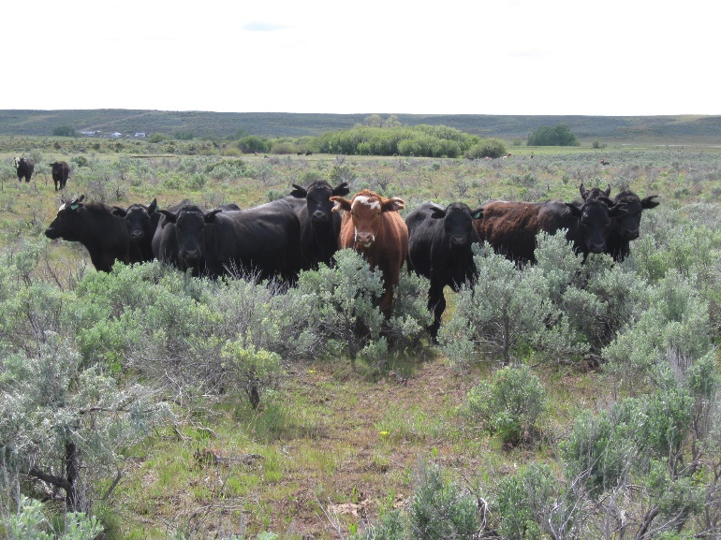
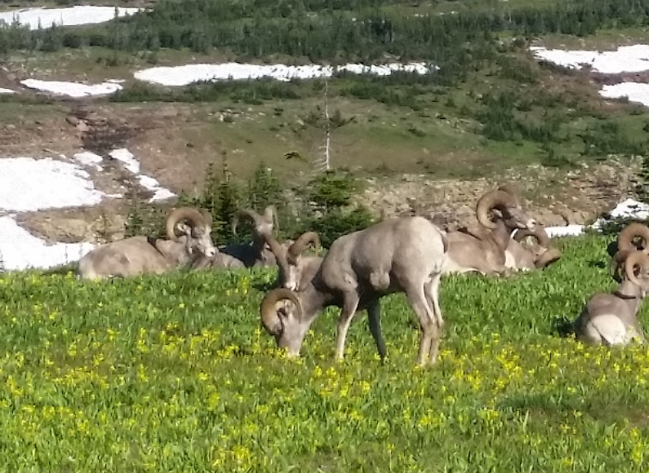
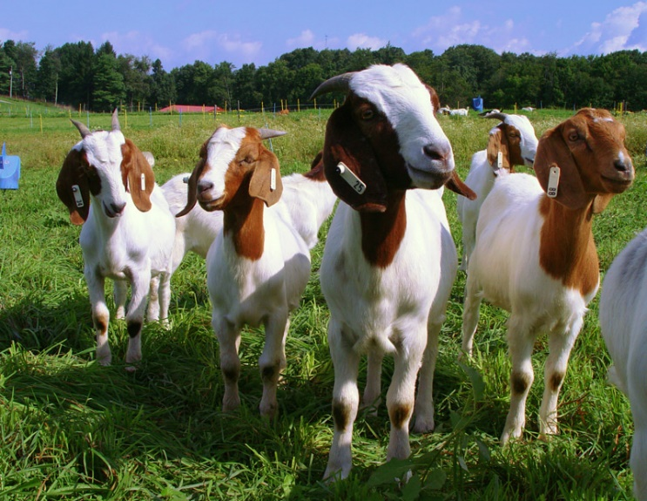

Range Animal Nutrition
K. Launchbaugh
K. Launchbaugh
Susan Boyer - USDA
REM 456 - Integrated Rangeland Management

Slide 2
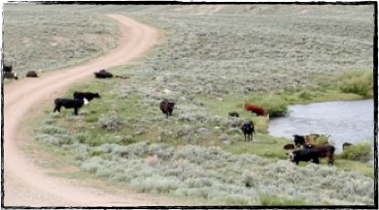
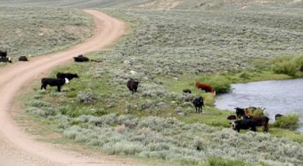
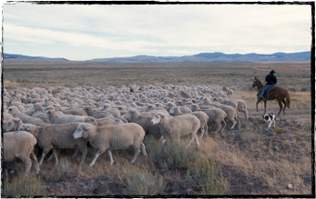
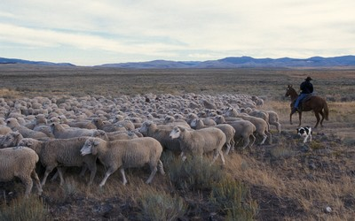
Range Nutrition
Grazing animals for production of usable products
  Meat, milk, fiber
Allows for the utilization of forage
  Seasonal variation in forage quality
  Highly inconsistent availability
blm.gov
USDA-ARS
Notes:
The chief product is the offspring of mature females, and in some cases, wool or hair.
Some dairies use grazing but this is becoming less common in the U.S.
Different compared to concentrate or intensive production systems where animals are confined in a limited area and their food is brought to them.

Slide 3
Classes of Nutrients
Water
Carbohydrates
Lipids
Proteins
Vitamins
Minerals

Slide 4
Water
Largest single component of the body
Important for:
  Chemical reactions
    e.g., enzymatic digestion in GIT and cellular metabolism
  Regulating body temperature
Notes:
Common sources of water include: wells, streams, farm ponds, reservoirs, and plants
Consumption of water per day:
1,000 lb non-lactating cow consumes about 9-12 gallons/d at 50F
Sheep and goats consume about 0.5-1.5 gallons/d
Pronghorn antelope consumes about 1 gallon per day but it depends on the amount of water in its diet

Slide 5
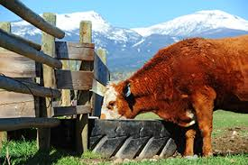
Water
    High Temperatures (°F)
        Require more water
      Require less water
    Low Temperatures (°F)
    Animals will access forage near water sources.
    Moisture in forage affects demand for drinking water.
Eliza Wiley (USDA-NRCS)
Notes:
Water intake influences the amount of dry matter intake. Improve the use of range plant material by dispersing water sources.
Sage Grouse get their water requirement met through water-rich succulent plant material, however, they will visit streams or water sources in the summer or in the winter.

Slide 6
Carbohydrates
Main source of energy in livestock diets
Energy supplied by CHO’s is used for maintenance, growth, reproduction, and lactation
Nitrogen Free Extract (NFE)
  Soluble sugars and starches
Notes:
More NFE in younger plants because they have more cell contents comared to mature plants that have more cell wall components

Slide 7
Fiber Analysis
Neutral Detergent Fiber (NDF) used to:
  Determine total fiber concentration
    Hemicellulose, cellulose, and lignin
Acid detergent fiber (ADF) used to:
  Measure the portion that is harder to digest
    Cellulose and lignin
Notes:
Forbs and browse have less fiber than grass

Slide 8
Lipids
Contains 2.25 times more energy than CHO’s
Quantified as ether extract (EE)
Seeds are high in fats compared to rest of plant material
Used in the body for hydrophobic interactions
Notes:
Sage grouse will eat seeds during winter when other plants are unavailable or are low in energy

Slide 9
Proteins
Made of amino acids that are composed of C, H, O, N, and S
Building block for muscle tissue and proper cellular function
% Crude Protein (CP) = %N x 6.25
Typically the most expensive nutrient
Range: ~30% CP (Excellent) to ~4% CP (Poor)
Notes:
leaves have more CP than stems in Grass, Forbs, and Browse species
DM basis

Slide 10
Proteins
Protein in forage correlates with forage maturity
Forbs
Grasses
Relative % CP
Spring
Summer
Fall
Winter
Notes:
Variation in season and year

Slide 11
Vitamins
Organic compounds required in trace amounts in the diet for normal metabolism
Fat Soluble Vitamins: A, D, K, and E
Water Soluble Vitamins: B complex and C
Notes:
Fat soluble vitamins stored in tissue while Water Soluble Vitamins are not.
Vit A: necessary for vision and reproduction. Present in green leafy plants but destroyed by U.V. light and decreases with maturity. Mature ruminants can be stored in the liver for 6-12 months whereas calves have limited storage
Vit D: synthesized by animal and used for calcium absorption.
Vit E: Immunity and integrity of cells. Present in green plant material
Vit K: Blood clotting-synthesized by microbes
A, K and E are high in green leafy plants but decrease with maturity

Slide 12
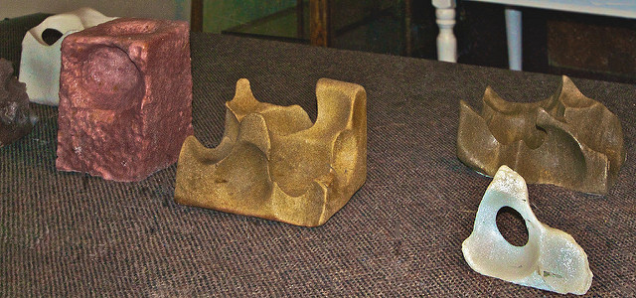
Minerals
Inorganic elements needed in the diet
Divided into two classes:
  Macrominerals
    Fed in g/d
    Mg, Ca, P, Na, Cl, K, S
  Microminerals
    Fed in ppm
    Mn, Fe, Cu, Zn, Mo, Se
Alan Davey

Slide 13
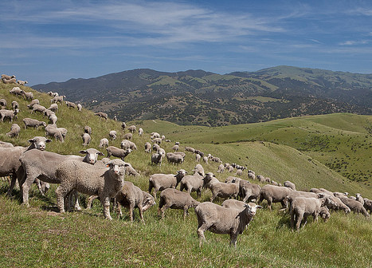
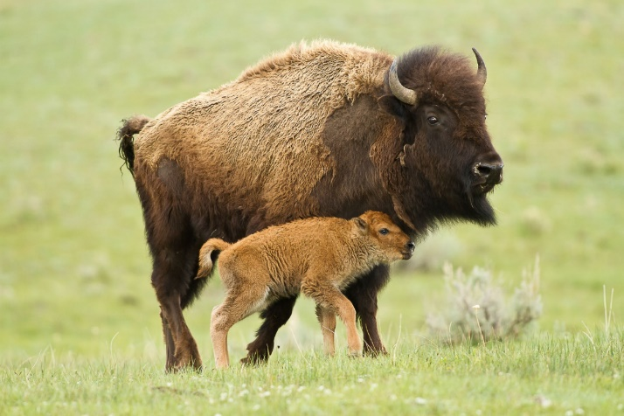
Energy
The most difficult to determine
Important for various stages of life
  Maintenance
  Growth
  Lactation
  Gestation
BLM.gov
DOI.gov

Slide 14
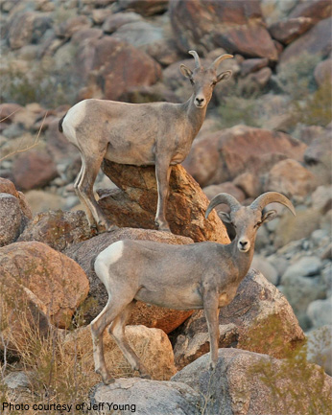
Energy
Important for maintenance of Body Condition
Energetic value of a feedstuff
  Total digestible nutrients (TDN)
  Net energy (NE)

Slide 15
TDN
Calculated estimates of the digestible components of a feed
    %TDN = Crude Protein + Crude Fiber + Nitrogen Free Extract + Ether Extract*2.25
Lab measurement of digestibility, relative to its energetic value
Notes:
TDN values are common on forage analysis reports, TDN is not commonly used in ration formulation because it does not account for all the losses that can occur in the fermentation and metabolism when forages are fed.

Slide 16
Energy Flow Diagram
Net Energy System
IE
(intake energy)

Slide 17
Energy Flow Diagram
Net Energy System
IE
(intake energy)
FE
(fecal energy)
DE
(digestible energy)

Slide 18
Energy Flow Diagram
Net Energy System
IE
(intake energy)
FE
(fecal energy)
DE
(digestible energy)
GE (gaseous energy)
UE (urinary energy)
ME
(metabolizable energy)

Slide 19
Energy Flow Diagram
Net Energy System
IE
(intake energy)
FE
(fecal energy)
DE
(digestible energy)
HE
(heat energy)
GE (gaseous energy)
UE (urinary energy)
ME
(metabolizable energy)
NE
(net energy)
Notes:
NE is important to know whether you meet the animal nutrient requirements.

Slide 20
Summary
There are six nutrients that are essential for normal maintenance, growth and production.
  ● Water ● Vitamins ● Minerals
  ● Carbohydrates ● Fats ● Proteins
Nutritional composition of forage depends on the stage of plant maturity—seasonal variation
%TDN is how much of a feed the animal is expected to digest and utilize
Net Energy (NE) utilizable energy from plant material

Slide 21
Range Animal Nutrition
K. Launchbaugh
K. Launchbaugh
Susan Boyer - USDA
REM 456 - Integrated Rangeland Management

