Slide 1
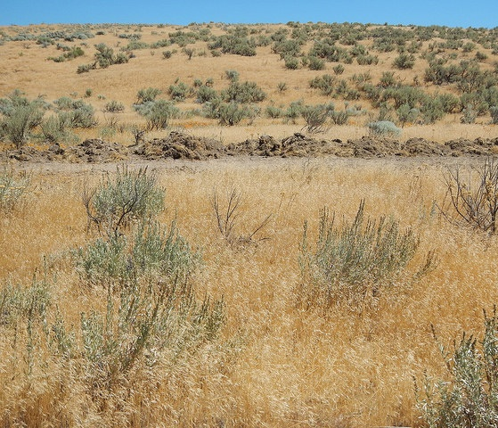
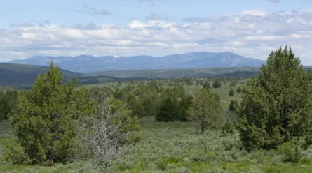
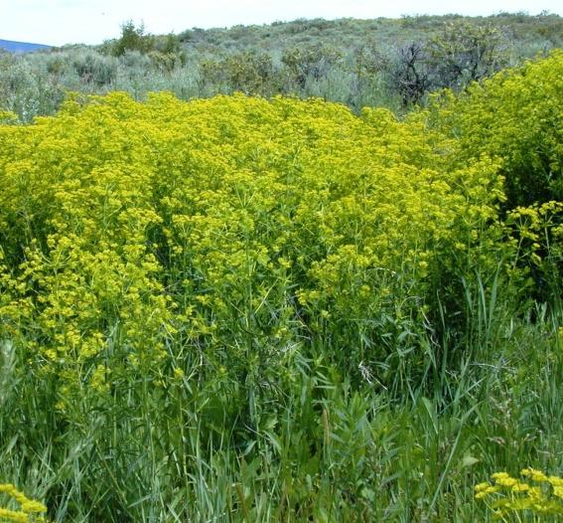

Invasive Plants and Weeds
Matt Lavin
Jen Peterson
Thad Berrett
Rangeland Principles (REM 151)

Slide 2
Types and Categories or Range Plants
Origin
Area where the plant evolved
Native Plants
Invasive Species
Noxious Weeds
Introduced Plants
Notes:
Area where the plant evolved
Native Plants: originated in North America
Introduced Plants: Intentionally or accidentally brought to North America
Invasive Species: based on plant characteristics
Noxious Weeds: Weeds that have been specifically identified as “noxious” by state law. Threaten to agriculture, horticultural crops, natural habitats or ecosystems, or humans or livestock.

Slide 3
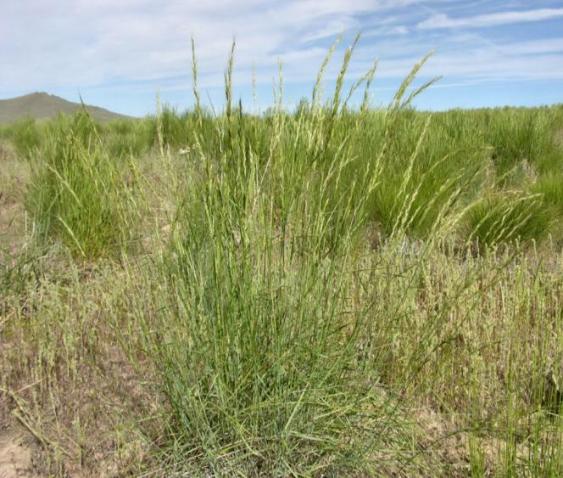
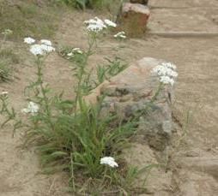
Types and Categories or Range Plants
Origin
Native Plants
Originated where they now occur without the help of humans.
Well-adapted to the local climate, soils, animals, and microbes.
Jennifer Peterson
Jennifer Peterson
Notes:
All organisms have a home where they existed and evolved for thousands of years. A native or indigenous species is one that occurs in a plant without the help of humans (not always easy to determine!). Species native to North America are generally those that occurred prior to European settlement.
How long have they been here?
An organism’s home is determined by a host of influences. Native plants are well adapted to the local climate, soils, animals, and microbes.

Slide 4
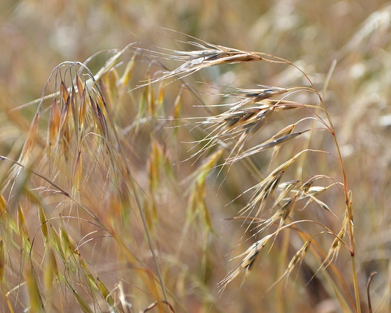
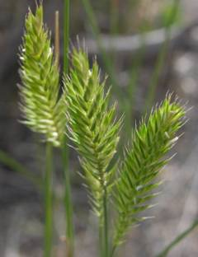
Types and Categories or Range Plants
Origin
Introduced Plants
An organism occurring outside of its natural home range.
Introduced by humans.
USFWS (Jennifer Strickland)
Jennifer Peterson
Notes:
Introduced plants, other names include: non-native, exotic, alien, foreign, non-indigenous
An organism is considered exotic or non-native when it has been introduced by humans to an area outside of its natural home range. This designation also applies to species introduced from other continents, another ecosystem, and even another habitat within an ecosystem. An estimated 3,500 species of plants have escaped cultivation and become established or naturalized.
Since the discovery of America in the 15th century, people have played a very significant role in moving plants, animals, diseases, and other organisms around the world to places far beyond their native home range.
How did and how are humans introducing non-native plants? Grains and food crops, seeds in ship ballast, ornamentals, plants for erosion control, plants with higher forage value, accidental.
Introductions of exotic plants continue today and are increasing due to a large and ever-expanding human population and increased international travel and trade.

Slide 5
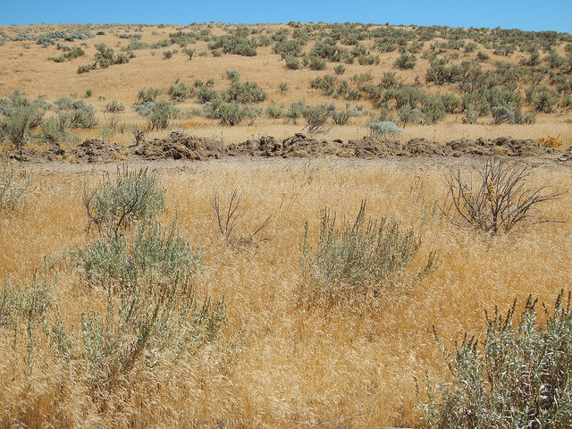
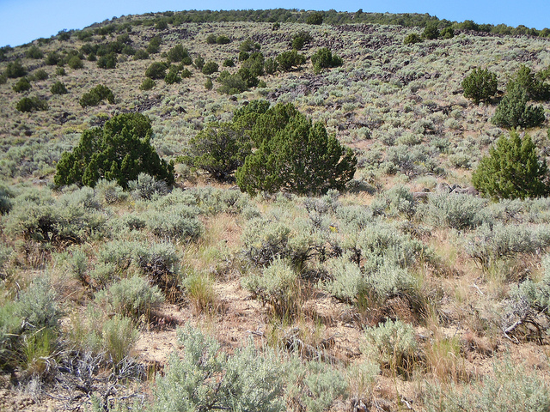
Invasive Species
An organism that spreads and establishes over large areas and persists.
Causes or is likely to cause economic or environmental harm or harm to human health.
http://www.invasivespeciesinfo.gov/
Matt Lavin
Matt Lavin
Notes:
Many of theses species (native or introduced) can exist in apparent harmony in areas where they were introduced by humans or found historically. However, how native or introduced species respond to new environmental conditions influences whether we consider them invasive species. Which means, non-natives are not necessarily invasive…and some native species can be invasive.
An invasive species is one that spreads and establishes over large areas and persists. Persistent invasive species often displace native species.
Cheatgrass (introduced annual grass)
Juniper (native tree, encroachment).

Slide 6
Invasive Species
What growth characteristics allow invasive species to dominate the ecosystem?
Abundant seed producers
Long-term survival of seeds
Rapid population establishment
Occupy disturbed sites
Competitive
Lack of natural enemies
Notes:
Growth characteristics that allow it to spread and dominate the ecosystem.
Abundant seed producers: Russian thistle can produce > 200,000 seeds per plant.
Long-term survival of seeds: Leafy spurge has viable seeds for ~8 years; sagebrush has viable seeds typically 1-2 years (if we are lucky)
Rapid population establishment: pioneer species when we think about succession…first to occupy disturbed sites…competitive.
Lack of natural enemies: insects, microbes, animals, etc.

Slide 7
Weeds
vs
Noxious Weeds
What is a Weed?
What is a Noxious Weed?
Plant of little value or a plant “out of place”
Competes with crops and native species
Negatively affects the health and productivity of native landscapes
“plants that interfere with the growth of desirable plants and that are unusually persistent and pernicious. They negatively impact human activities and as such are undesirable” Ross & Lembi – Applied Weed Science. 1999
“a plant whose virtues have not yet been discovered”... Ralph Waldo Emerson
Notes:
Plant of little value or a plant “out of place”
Competes with crops and native species
Affects the health and productivity of native landscapes (competitive, persistent).
“…a plant whose virtues have not yet been discovered…” Ralph Waldo Emerson

Slide 8
Weeds
vs
Noxious Weeds
What is a weed?
What is a Noxious Weed?
Plant of little value or a plant “out of place”
Competes with crops and native species
Negatively affects the health and productivity of native landscapes
A noxious weed is any plant designated by a Federal, State, or county government as injurious to public health, agriculture, recreation, wildlife or property. (blm.gov)
Notes:
Noxious weeds: designated by law…has economic damage and threats to human interests.
Noxious weeds does not encompass all invasive plant species.

Slide 9
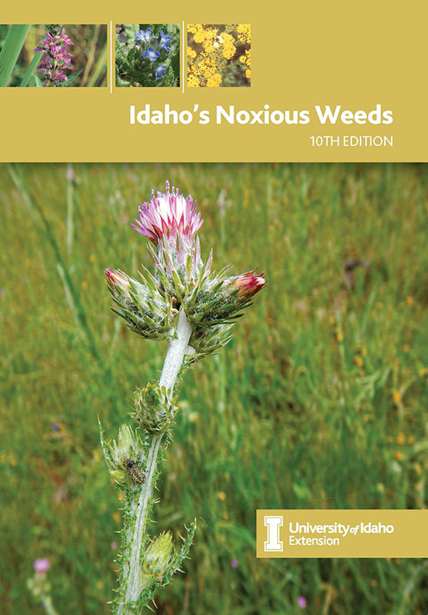
Noxious Weeds
What is a Noxious Weed?
A noxious weed is any plant designated by a Federal, State, or county government as injurious to public health, agriculture, recreation, wildlife or property. (blm.gov)
In Idaho, hundreds of weed species exist.
Only 73 are designated noxious by Idaho law.
https://idahoweedawareness.org/idahos-noxious-weeds/
Notes:
In Idaho, hundreds of weed species exist. However, only 67 are designated noxious by Idaho law (in 2017).
Comparison purposes: 47 in Nevada, 27 in Utah.

Slide 10
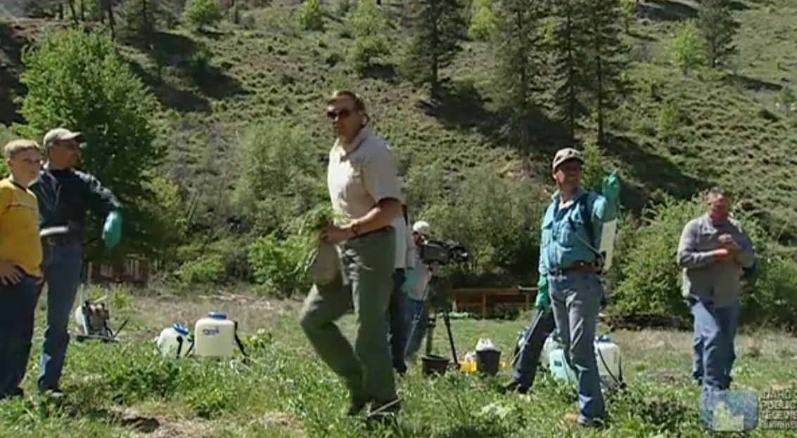

War of the Weeds
Watch: video.idahoptv.org/video/outdoor-idaho-war-of-the-weeds/
(26 minutes)
Notes:
War of the Weeds: Watch this video, fill out the noteguide.

Slide 11
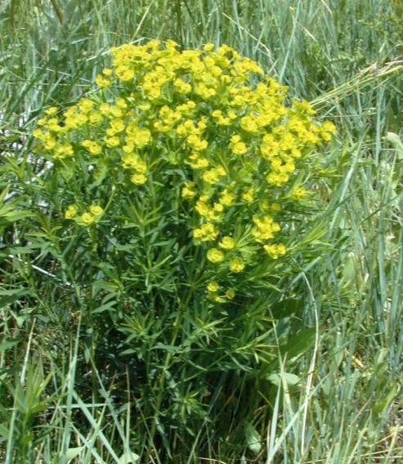
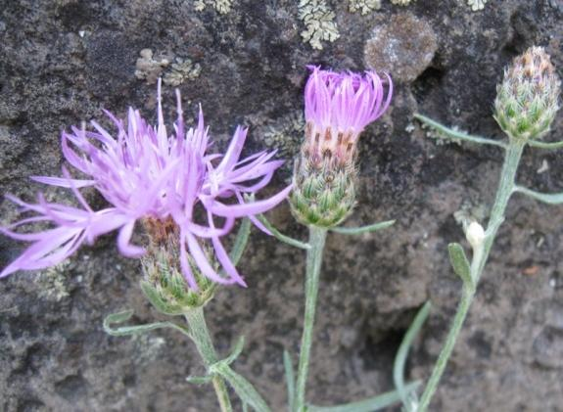
How do weeds impact rangelands?
Reduce biological diversity
Replace complex communities with monocultures
Alter hydrologic conditions
Alter soil characteristics
Alter fire intensity and frequency
Interfere with natural succession
Compete for native pollinators
Displace rare plant species
Thad Berrett
K. Launchbaugh
Notes:
How do weeds impact rangelands:
Hydrologic conditions:
Soil characteristics: allelopathy (biochemical)…or even salt.
Cheatgrass-Wildfire cycle

Slide 12
Type | Name | Longevity | Origin
Grass | Cheatgrass | Annual | Introduced
Forb | Leafy Spurge | Perennial | Introduced & Noxious
Forb | Spotted Knapweed | Perennial | Introduced & Noxious
Woody | Salt Cedar | Perennial | Introduced & Noxious
Woody | Juniper | Perennial | Native
Notes:
4 plants that you need to be able to identify for the exam that fall into the invasive weed category include: leafy spurge, spotted knapweed, salt cedar, and juniper.

Slide 13
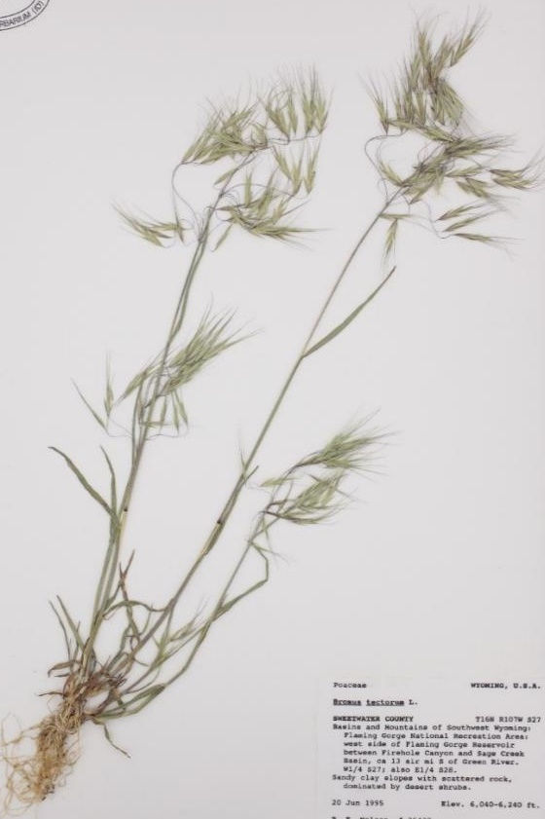
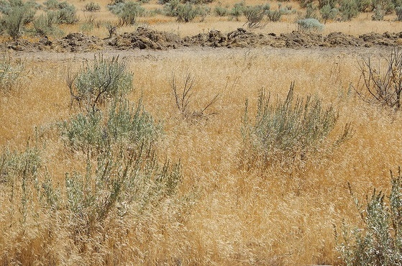
Cheatgrass or Downy Brome
Annual | Introduced
Small bunchgrass with weak annual roots
Leaf blades, sheaths, and glumes are hairy (pubescent)
Matt Lavin
Northwest Herbarium Consortium

Slide 14
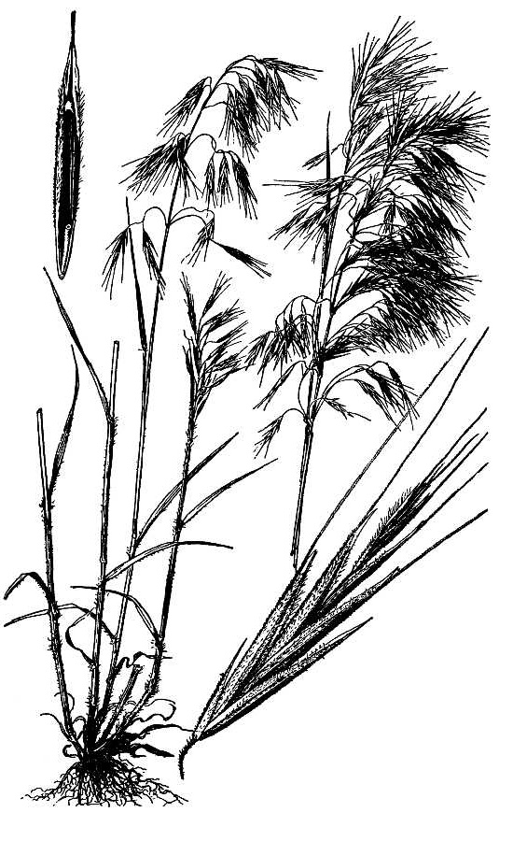
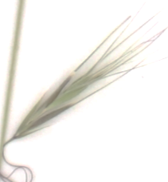
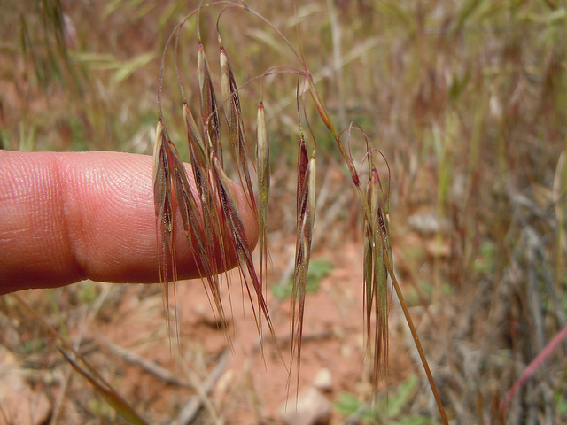
Cheatgrass or Downy Brome
Annual | Introduced
Seedhead = panicle with slender, weak branches
Spikelets hang in disarray
Florets have stiff, scabrous awns
Spikelet often turn purple at maturity
Northwest Herbarium Consortium
Matt Lavin

Slide 15
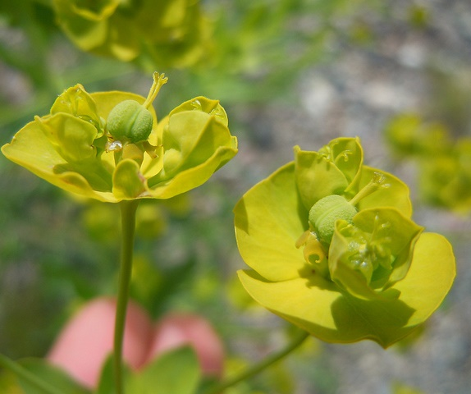
Leafy Spurge
Introduced
Perennial
Showy, heart shaped yellow bracts surrounding the flower
Dark roots with pink buds
Milky resin
Matt Lavin
http://www.ag.ndsu.edu
Notes:
Flowers are yellow-green color and arrange in clusters of 7-10 flowers surrounded by heart shaped yellow bracts.
Leafy spurge roots can reach depths of 30 feet. Buds on roots allow this plant to reproduce by seed and by root.

Slide 16
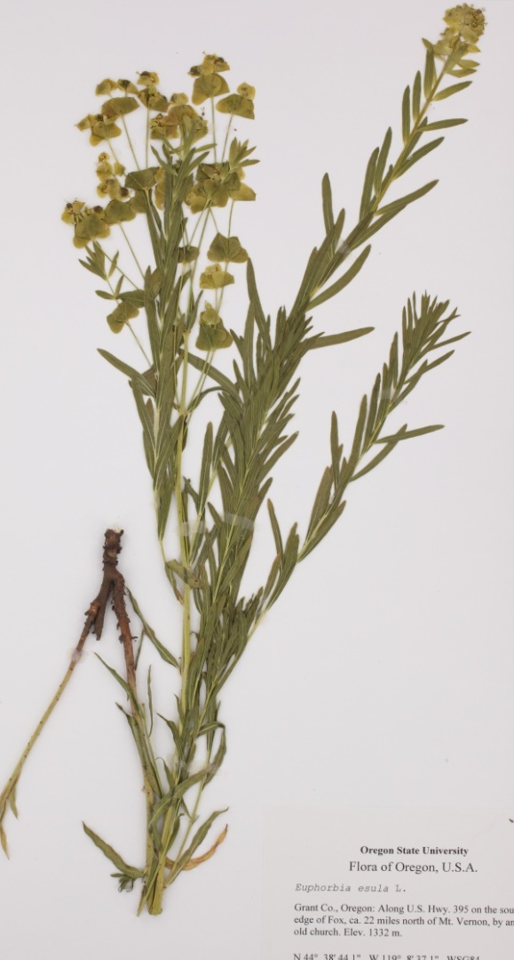
Leafy Spurge
Noxious Weed
Thad Berrett
Thad Berrett
University of Idaho Stillinger Herbarium
Pacific Northwest Herbarium Consortium
www.pnwherbaria.org

Slide 17
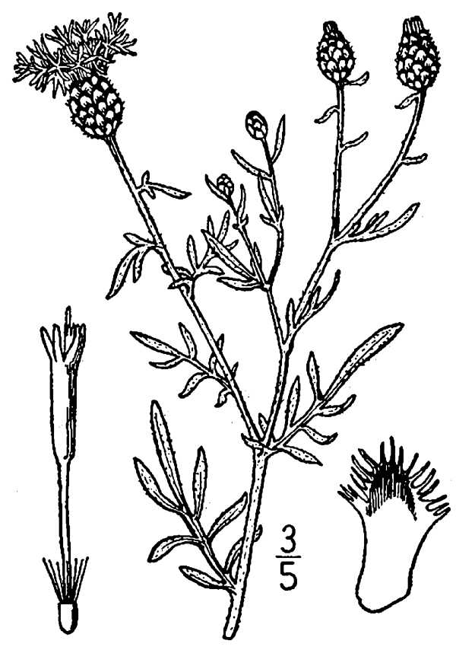
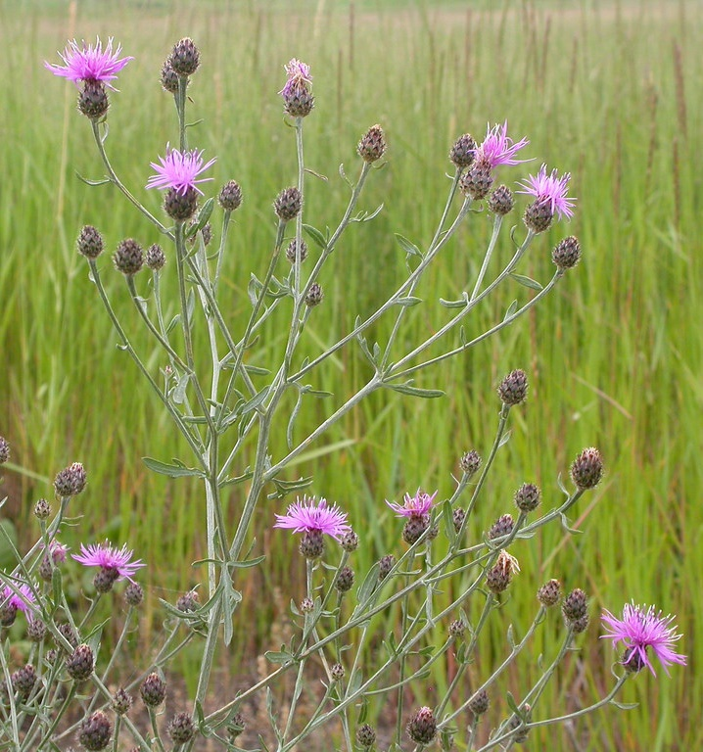
Spotted Knapweed
Perennial
Introduced
Noxious weed
Composite seedhead with Disk flowers
Lower leaves are deeply lobed, hairy
Matt Lavin
www.usu.edu/weeds/plant_species/weedspecies/spottedknap.html

Slide 18
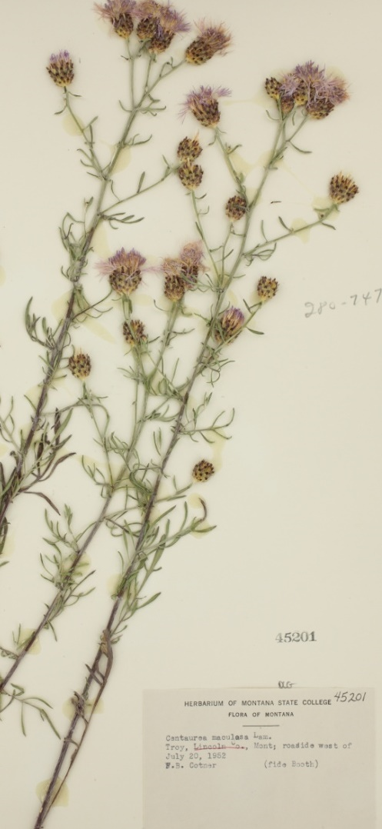
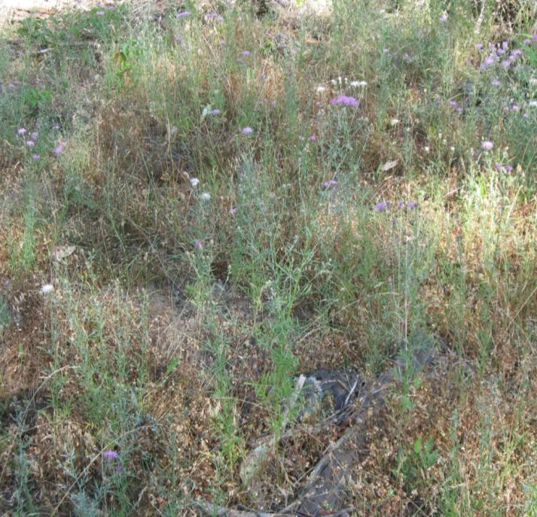
Spotted Knapweed
Noxious weed
K. Launchbaugh
Distinct “spots”
K. Launchbaugh
Montana State University Herbarium
Pacific Northwest Herbarium Consortium
www.pnwherbaria.org
K. Launchbaugh
Notes:
Bracts with black tips directly under the flowerhead.

Slide 19
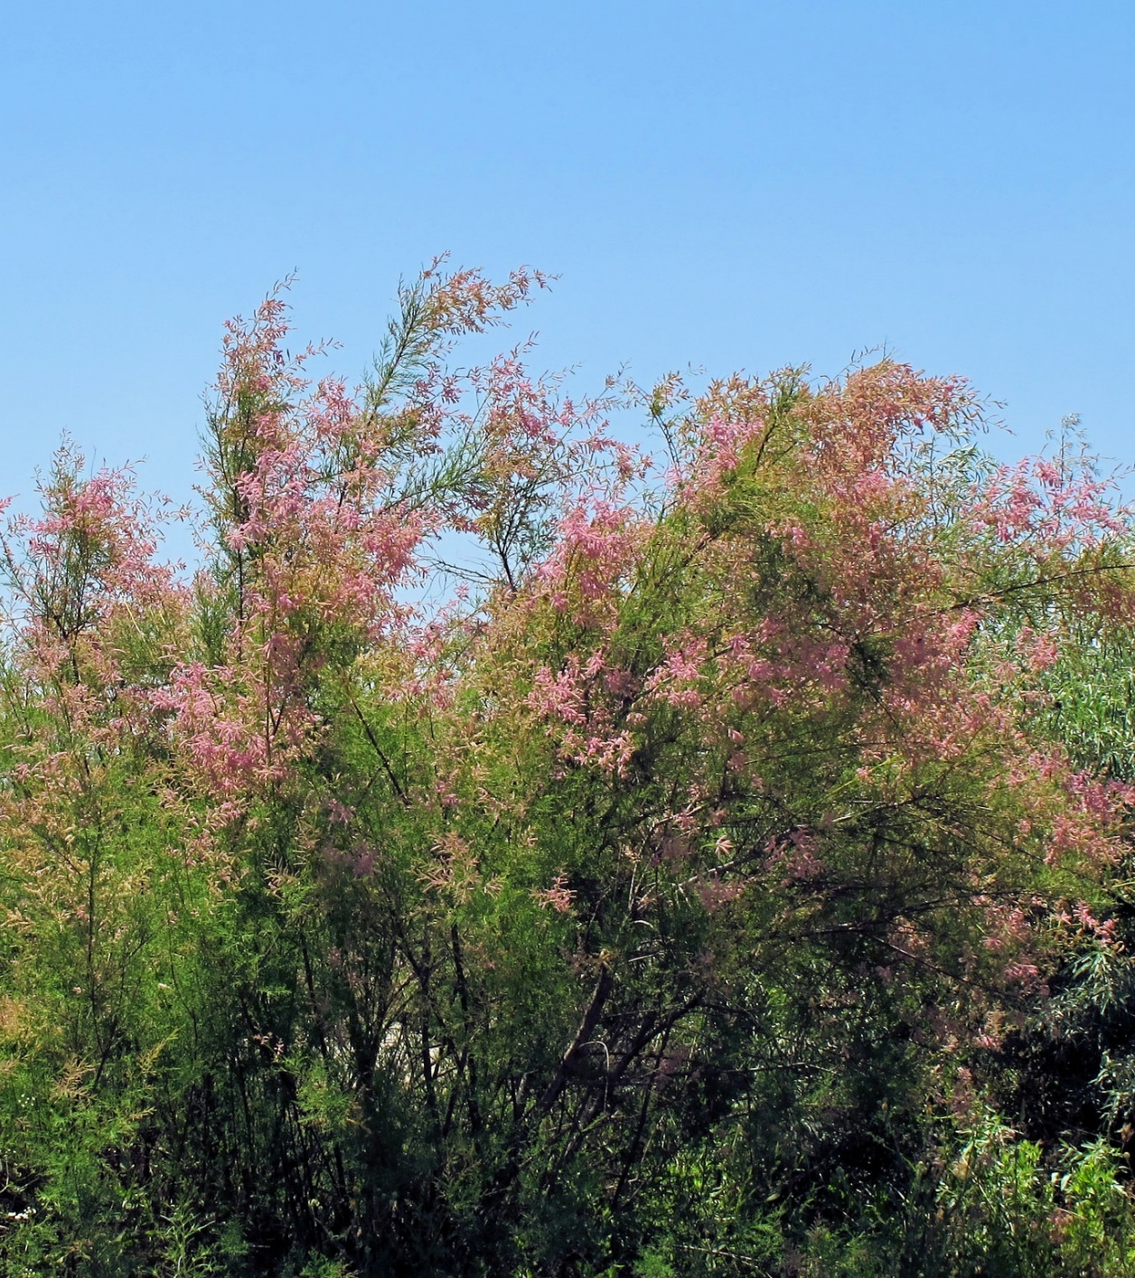
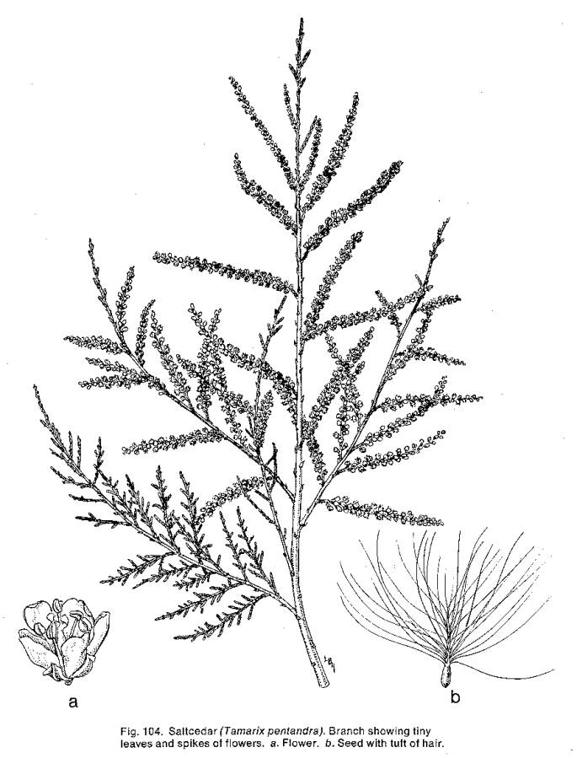
Salt Cedar
Perennial
Introduced
Noxious weed
Feathery green or blue-green foliage.
Alexandru Panoiu (Flckr)
Notes:
Introduced as ornamental
Shrub or tree…

Slide 20
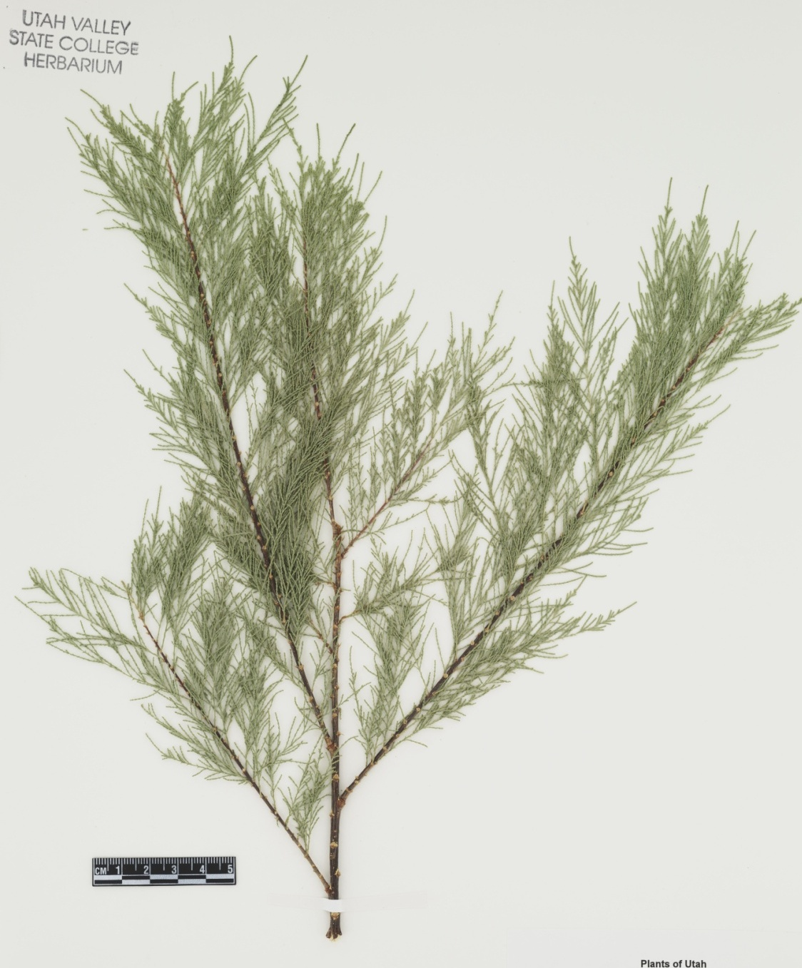
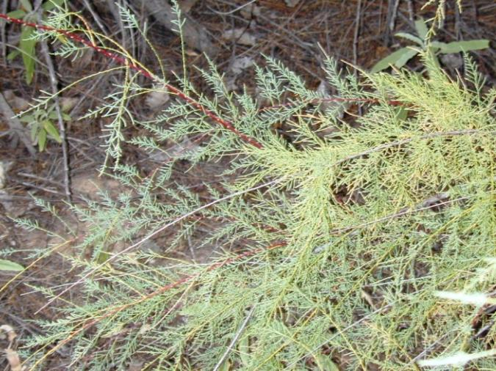
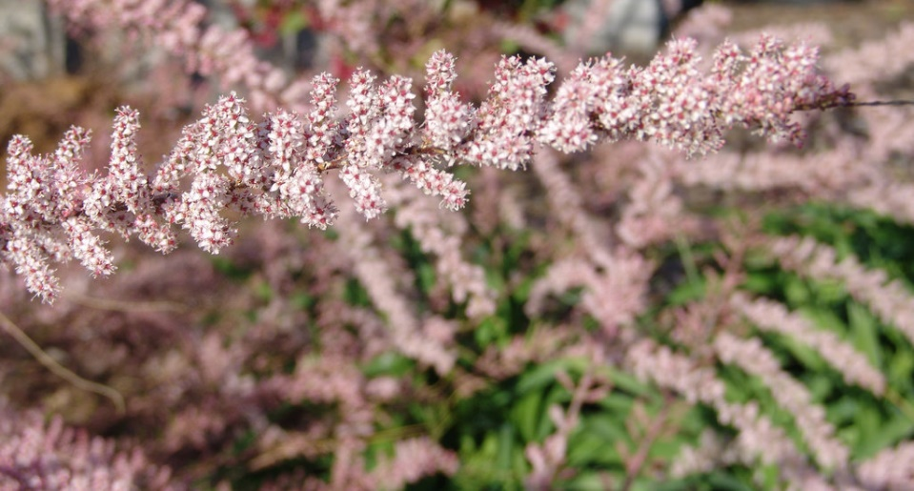
Salt Cedar
Utah Valley State College Herbarium
Pacific Northwest Herbarium Consortium
www.pnwherbaria.org
Highly invasive riparian plant
White to pink flowers
K. Launchbaugh
Drew Avery (Flickr)
Notes:
These plants contain salt that they deposit onto the soil through their deciduous leaves. Other riparian species are unable to survive the salty conditions and Salt Cedar can then dominate the plant community.
Showy pink to white flower that bloom in clusters along tips of stems.

Slide 21
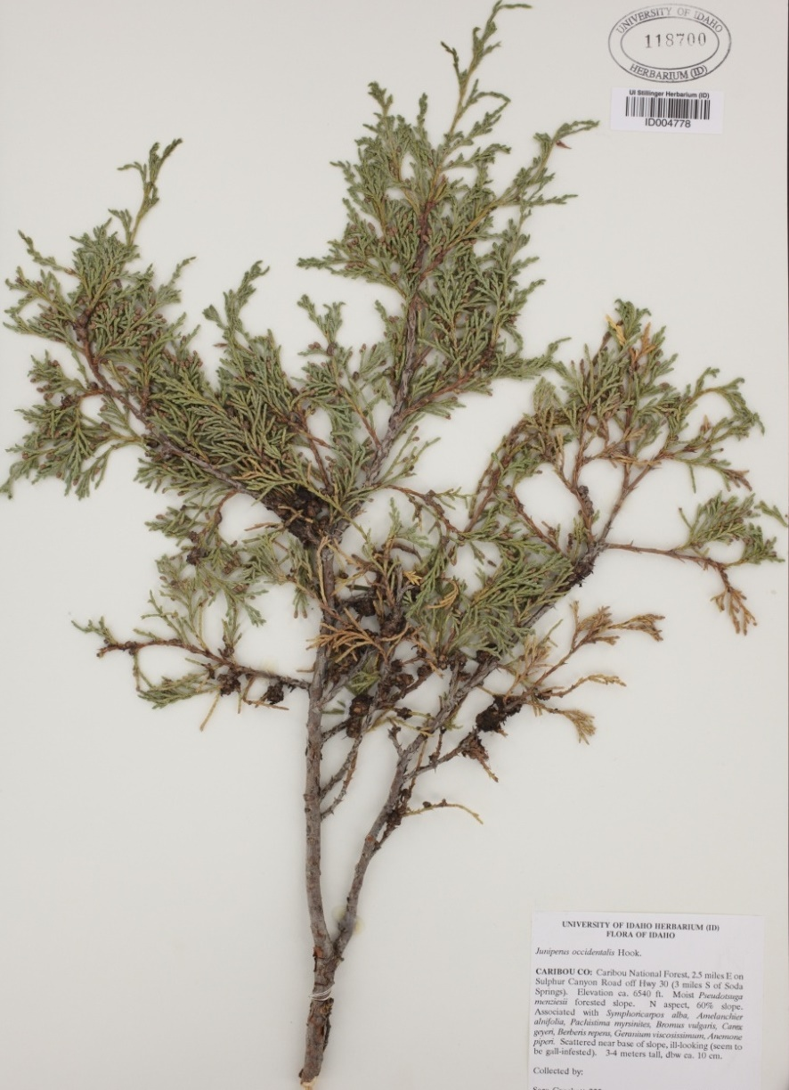
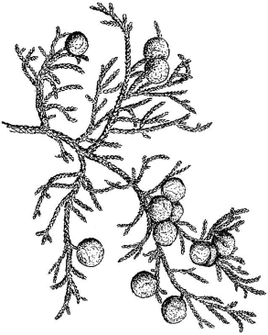
Juniper
Perennial
Native
Leaves look like overlapping scales
University of Idaho Stillinger Herbarium www.pnwherbaria.org
Notes:
Leaves: pressed close to the twig.
Flowers/Fruit: Berry-like fruit, bright blue (often covered with a white coating).

Slide 22
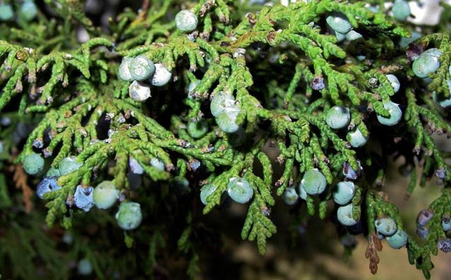
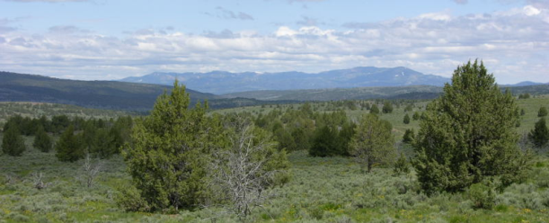
Juniper
Encroach rangelands
Important winter wildlife habitat
Evergreen (non-deciduous)
Leaves look like overlapping scales
NPS.gov
Berry-like fruit
Jen Peterson
Notes:
Due to fire suppression, juniper encroach rangelands displacing sagebrush steppe communities (shrubs and perennial grasses and forbs). Alter hydrological cycle by increasing bare ground so we have higher erosion rates…making it difficult for native plant species to come back.

Slide 23
Invasive Plants and Weeds
Matt Lavin
Jen Peterson
Thad Berrett
Rangeland Principles (REM 151)

