Slide 1
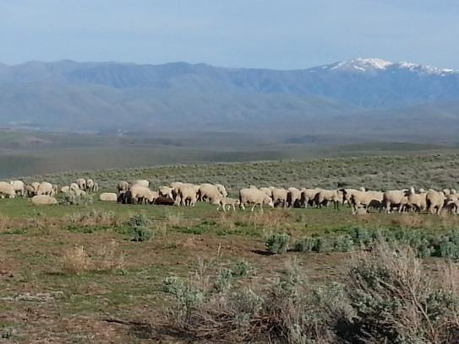
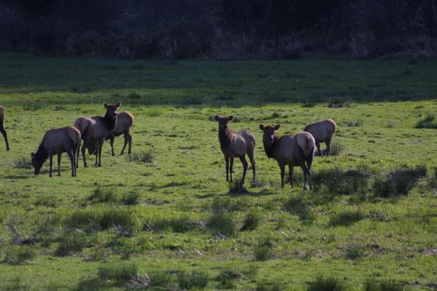
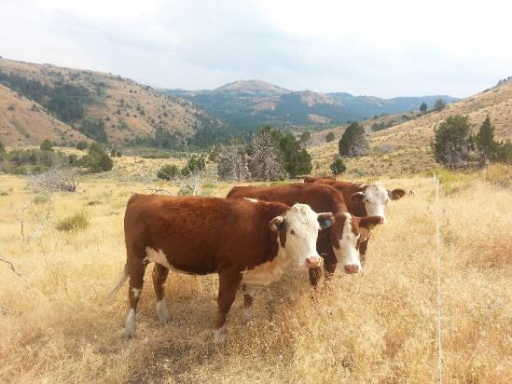

Stocking Rate Principles
K. Launchbaugh
BLM.gov
Brooke Jacobson
Rangeland Principles (REM 151)
Notes:
Setting Stocking Rates introduction

Slide 2
Grazing Principles
Which animal(s)?
How many animals?
When to graze or not graze?
How long to graze or rest?
Where animals graze on landscape?
Livestock species, type, and age
Stocking Rate
Grazing Systems also called grazing methods
Animal Distribution

Slide 3
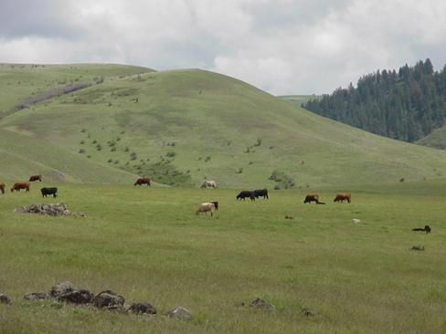
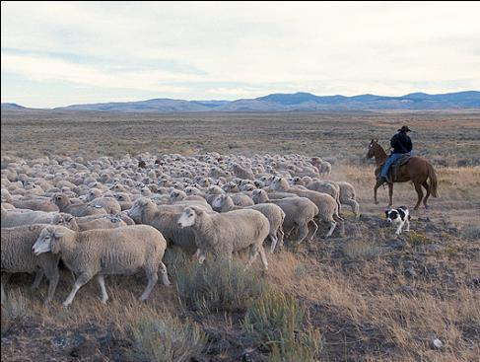
Carrying Capacity
The number of animals that a piece of land can support on a long-tern basis without causing damage to the ecosystem.
Expressed as animals/area/time—
acres per AUM per year.
K. Launchbaugh
UDSA-ARS
Notes:
Carrying Capacity
Land and vegetation determine grazing capacity.
Land is usually bought and sold on this basis.

Slide 4
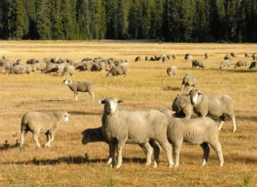
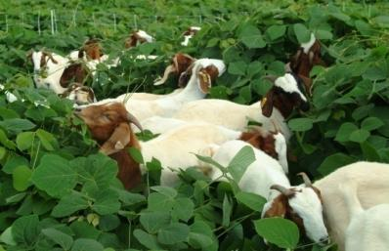
Stocking Rate
The number of animals a land manager places on a piece of land for a specified period of time.
Days, Months or Years
Animal or Animal Unit
K. Launchbaugh
Acres or Hectares
Consider the most important grazing decisions because it affects…
rangeland health + economic returns
J. M. Luginbuhl
Notes:
Stocking Rate
Must include:
Number of animals or Animal Unit
Specified area (acres or hectares)
Specific period of time (days or months).
The most important grazing decisions because it affects: rangeland health, and economic return.
Stocking rate is …. So this is a management decision. Can you see the difference between the two terms. Carrying capacity is how many animals the land will support. Stocking rate is how many animals we choose to put on the land.

Slide 5
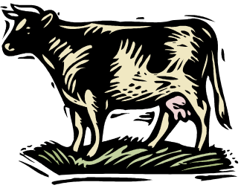
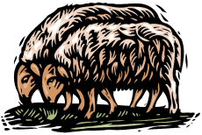
Stocking Rate
supply
Balance forage ________
with animal ________
demand
Notes:
Stocking Rate
Balance Supply and demand

Slide 6
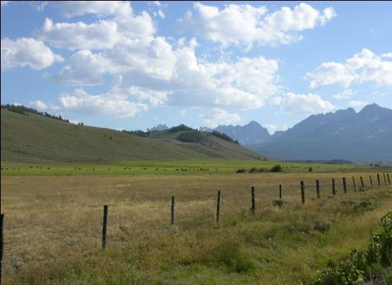
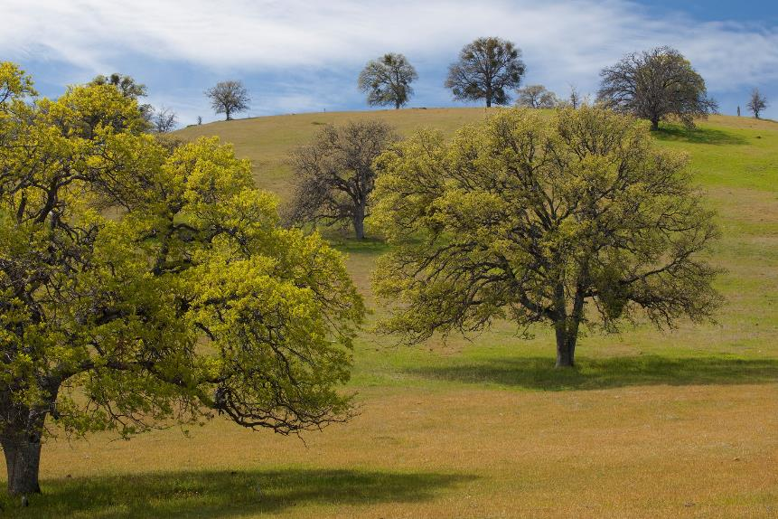
Proper Stocking Rate?
J, Peterson
Bob Wick, BLM
…rangeland health standpoint
Notes:
Proper Stocking Rate
Based on Range Health

Slide 7
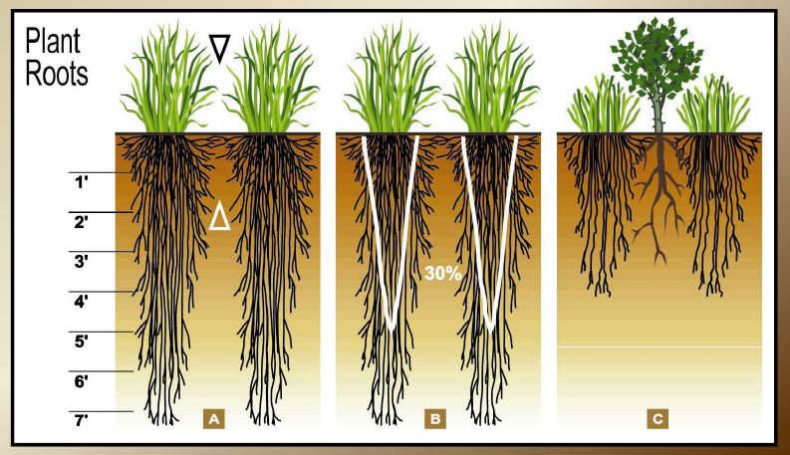
Level of Proper Use
Proper stocking rates are based on maintaining sufficient plant residue for:
Remove the Leaves ----- Affect the Roots
Plant health & ability to regrow
Wildlife forage
Erosion prevention & soil health
Notes:
Proper Use Factor
The healthier roots you have depends on how healthy the aboveground plant is. So if aboveground plants are overgrazed, you open up available soil resources to shrubs and other weeds.
Trying to squeeze an additional 10% of harvest, 50% of roots stop growing.

Slide 8
Proper Use Factor
% of plant biomass that can be removed each year without causing long-term damage
Set stocking rate below carrying capacity.
Utilization guidelines for Proper Use based on research:
% utilization
Range Type
30-40% Sagebrush grassland
40-50% Shortgrass prairie
30-40% Coniferous Forest
30-40% Oak woodlands
Source: J.L. Holecheck (1988). An Approach for Setting the Stocking Rate. Rangelands. 10:10-14.
Notes:
Proper Use Factor
Carrying capacity: the number of animals that a piece of land can support on a long-tern basis without causing damage to the ecosystem.
Set stocking rate below carrying capacity to allow for drought, to allow for low productivity years.
Healthy soil
Slows weedy plant invasion
Improves drought resistance
Improves condition of degraded land.

Slide 9
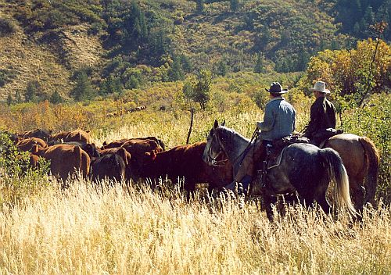
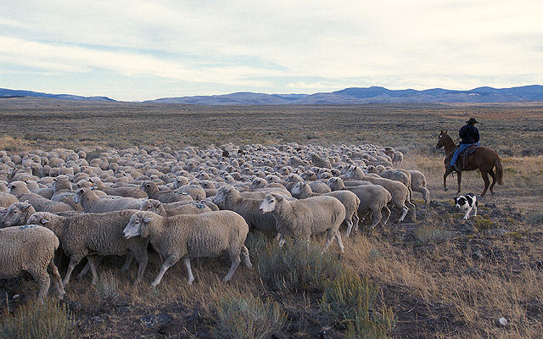
Proper Stocking Rate?
D. Bradford
USDSA- ARS
…animal production standpoint
Notes:
Proper Stocking Rate
Animal Production Standpoint

Slide 10
Stocking rate affects cattle gains:
?
Production per animal
Notes:
Stocking Rate affects cattle gains (average daily gain: ADG)

Slide 11
Stocking rate affects cattle gains:
Less forage available
for each animal
Lower diet quality
More energy required
to forage
Increased stress & disease
Production per animal
Notes:
Stocking Rate affects cattle gains
Lower quality, less available per animal, more energy output to forage, increased stress and disease

Slide 12
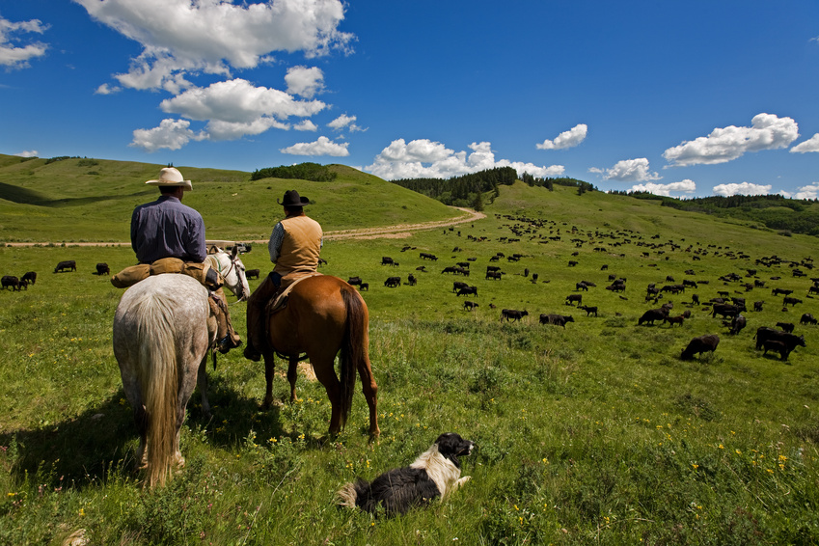
Proper Stocking Rate
…rangeland health standpoint
…animal production standpoint
J, Peterson
Notes:
Proper Stocking Rate
Based on Range Health

Slide 13
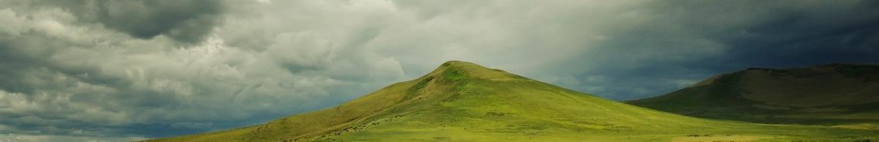
Proper Stocking Rate?
Amount of forage varies from year to year
long-term
average
Notes:
Proper stocking rate
Changes during year to year

Slide 14
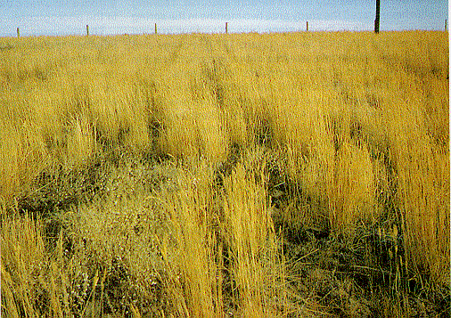
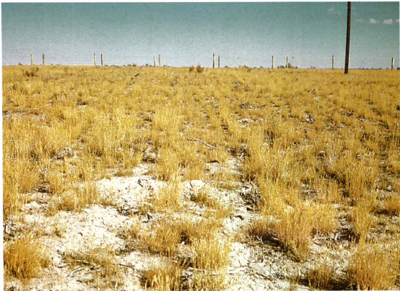
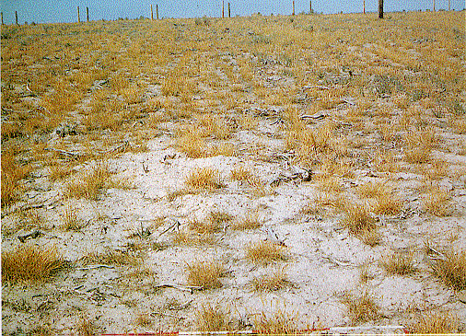
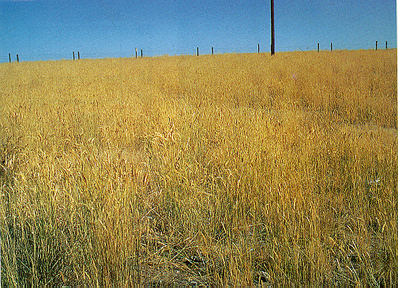
1957
Precipitation = 11.7”
Grass Production = 846 lb/ac
1959
Precipitation = 11”
Grass Production = 416 lbs/ac
1960
Precipitation = 6.5”
Grass Production = 186 lbs/ac
How do you set a stocking rate amidst variability?
1971
Precipitation = 16.2”
Grass Production = 1090 lbs/ac
Photos by K. Sanders, Univ. of Idaho

Slide 15
Proper Stocking Rate?
Amount of forage varies from year to year
long-term
average
Flexible: No more than 60% of herd in breeding stock.
Constant: Herd size that could be sustained if rainfall was 25% below average.
Notes:
Proper Stocking Rate
Flexible versus Consistant

Slide 16
Heavy use ≠ Overgrazing
Overgrazing: repeated heavy grazing that yields damage to the plant community.
Overstocking: heavy grazing during a specific season such that high levels of utilization are observable.
Over-resting: excessive resting (no grazing) periods that results in damage to the plant community.
Overstocking does not always lead to Overgrazing

Slide 17
Set a stocking rate and then MONITOR
Stocking rate is determined by trial and error over years and then monitored by Range Trend.
Use caution when estimating carrying capacity.
Combine utilization measurements, interpretation of range conditions, knowledge of past and present stocking rates.
Monitor!
Adjust as needed.

Slide 18
Stocking Rate Principles
K. Launchbaugh
BLM.gov
Brooke Jacobson
Rangeland Principles (REM 151)
Notes:
Setting Stocking Rates conclusion

