Slide 1
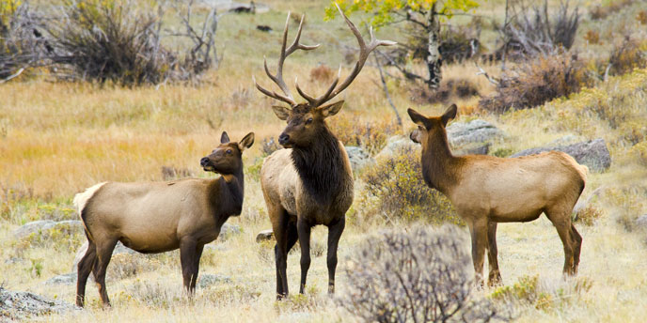
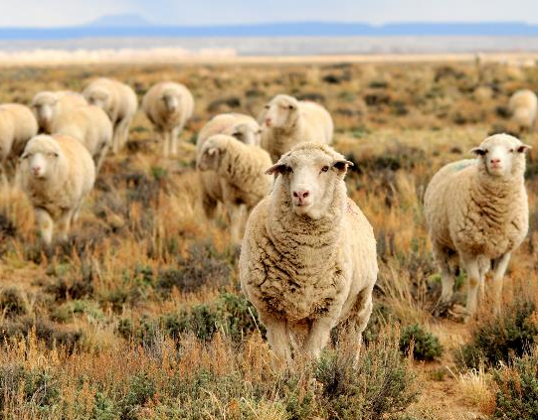
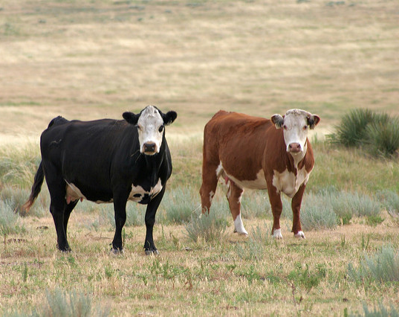

Setting Stocking Rates
Brooke Jacobson
Tom Koerner-USFWS
Tom Koerner-USFWS
Vicki Frank-Flickr
Rangeland Principles (REM 151)

Slide 2
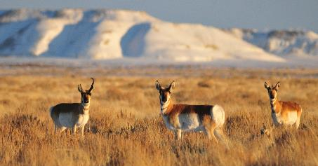
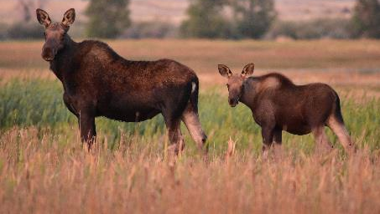
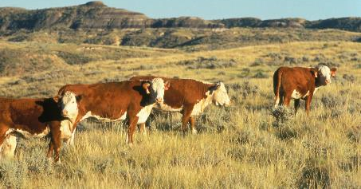
Carrying Capacity
The number of animals that a piece of land can support on a long-term basis without causing damage to the ecosystem.
Expressed as animals/area/time
Acres/AUM
Tom Koerner-USFWS
Tom Koerner-USFWS
Notes:
Hereford cows on range is free stock photo with not copyright restrictions.

Slide 3
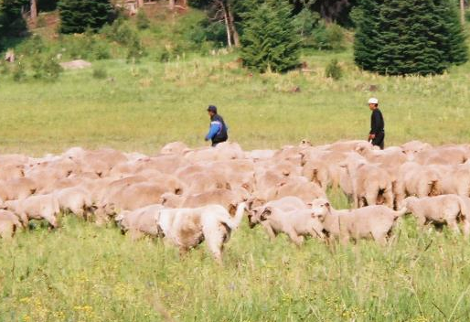
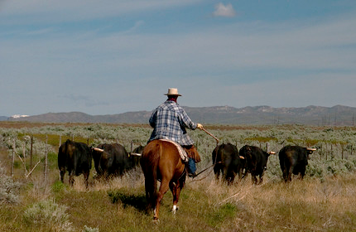
Stocking Rate
The number of animals a land manager places on a piece of land for a specified period of time.
Describe as Acres/AUM
K. Launchbaugh
K. Launchbaugh
Consider the most important grazing decisions because it affects rangeland health, animal productivity, and economic returns.
Idaho BLM
Notes:
Stocking Rate
Must include:
Number of animals or Animal Unit
Specified area (acres or hectares)
Specific period of time (days or months).
The most important grazing decisions because it affects: rangeland health, and economic return.
Stocking rate is …. So this is a management decision. Can you see the difference between the two terms. Carrying capacity is how many animals the land will support. Stocking rate is how many animals we choose to put on the land.

Slide 4
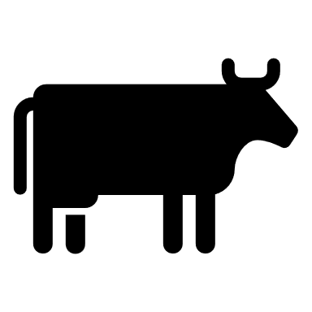
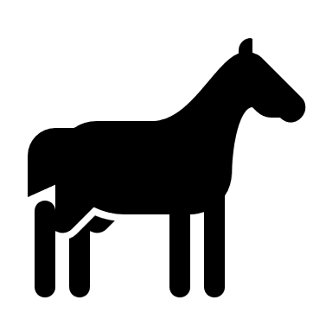
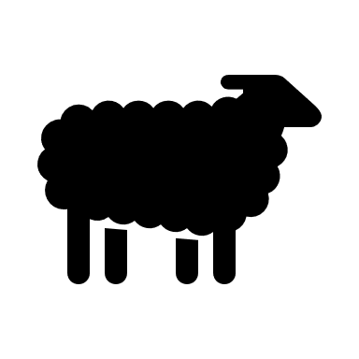
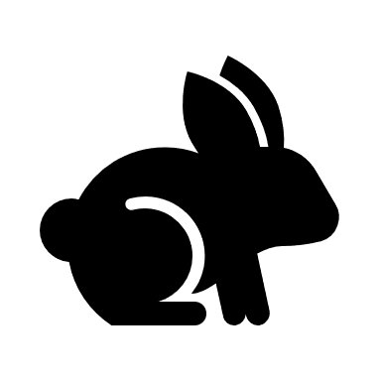
Animal Units (AU)
1 AU = 1,000 pounds of grazing animals (ruminant)
Cow = 1
Horse = 0.56
Yearling Steer = 1.3
Sheep = 5
Jackrabbit = 50
Animal Unit Equivalent (AUE) =
a conversion factor reflecting the # of AU in an average animal.
Cow = 1
Horse = 1.8
Yearling Steer = 0.75
Sheep = 0.2
Jackrabbit = 0.02
This is an OLD way of doings. There is a newer and easier way
Notes:
Animal Units

Slide 5
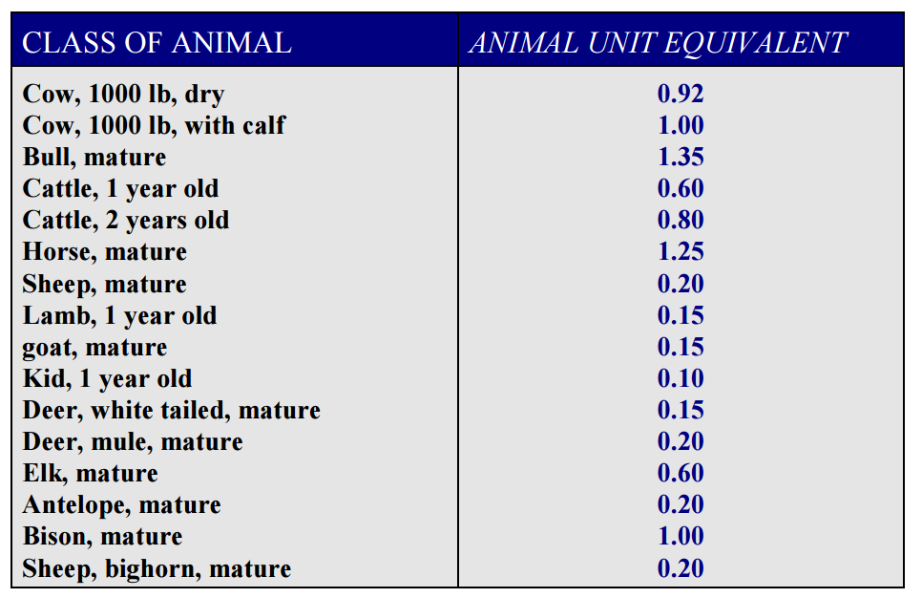
Animal Unit (AU)
This is an OLD way of doings. There is a newer and easier way
Notes:
Animal Unit equivalent

Slide 6
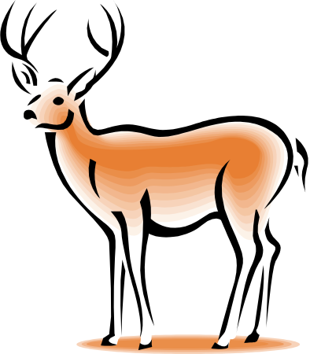
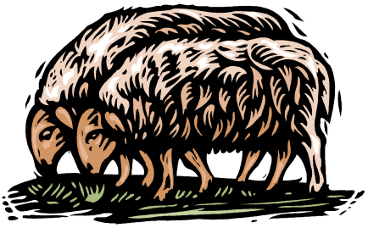
Forage Demand of Animals
RUMINANTS
Large ruminants like a beef cow or big bison or moose bullweighing 1,000 pounds or more, would be expected to eat about 2.5% of body weight each day.
Medium-sized ruminants weighing 500 to 1,000 pounds like growing beef steers or heifers or elk cows would eat about 3.0% of body weight each day.
Small ruminants like sheep, goats, pronghorn, deer, or bighorn sheep weighing 100 to 500 pounds would eat 3.5% of their body weight each day.
Notes:
Forage demands
Ruminants versus hindgut fermenters

Slide 7
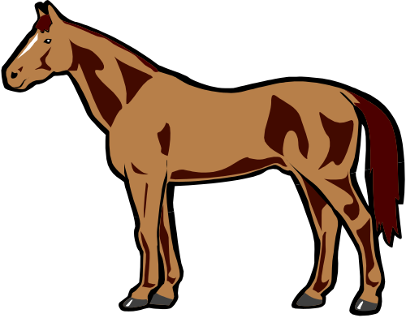
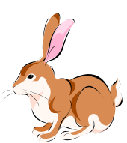
Forage Demand of Animals
HIND-GUT FERMENTERS
Eat 25% more than an equivalent sized ruminant
Notes:
Forage demands
Ruminants versus hindgut fermenters

Slide 8
Animal Unit Month
Amount of forage an AU will eat in a month.
Grazing ruminant animals eat about 2.5% body weight per day.
30 days per month
How many pounds is an AUM?
1,000
25
Each AU = _________ lbs × 2.5% = ____ lbs/day
AUM = _____ lbs × 30 days = ________ lbs
25
750
Notes:
Animal Unit month
How many pounds is this?

Slide 9
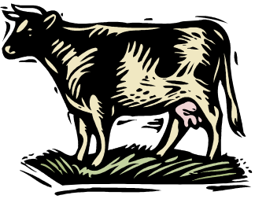
Stocking Rate
supply
Balance forage ________
with animal ________
demand
How do you set stocking rate?

Slide 10
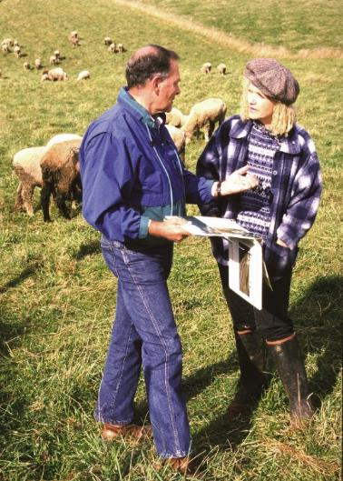
4-step Method: Forage-Demand Method
Calculate usable forage
Adjust for terrain, water, or other constraints
Calculate forage demand of animals
Calculate stocking rate
Forage-Demand Method is used:
When you have no stocking information from previous years.
To estimate carrying capacity in biological surveys or land appraisal
When considering changes in kind of class of animals.
USDA-NRCS
USDA-NRCS
Notes:
Four step Method
Forage demand method
Establish stocking rate based on:
Past experience
Current situation
Long-range weather forecast
Financial goals
Etc….

Slide 11
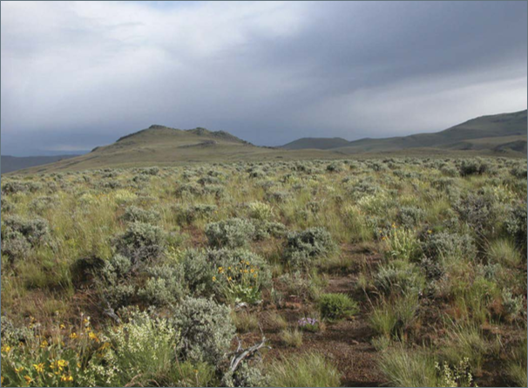
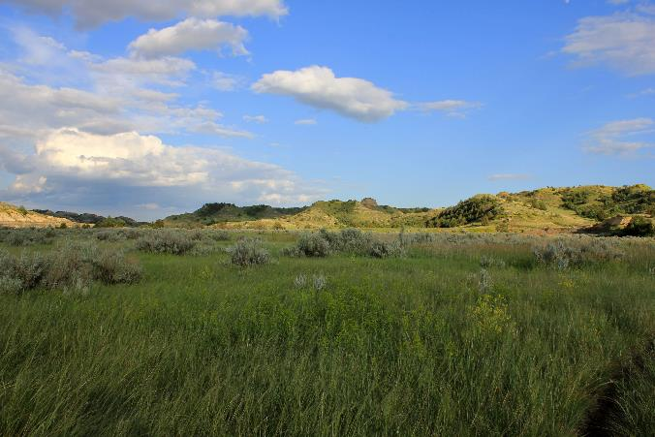
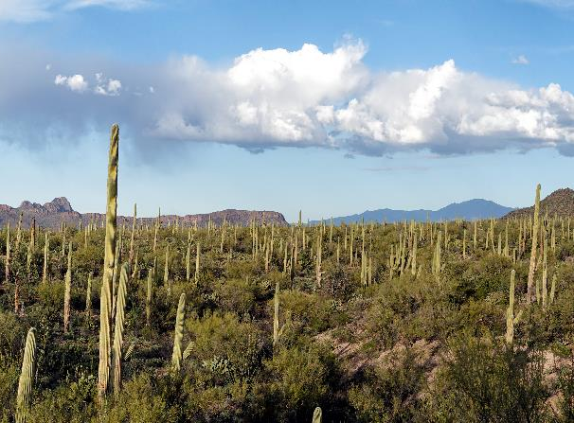
Step 1: Calculate Usable Supply
Determine biomass supply.
Wt of biomass/acre × area = total biomass supply
Kirk Davies – USDA ARS
John Fowler-Flickr
Notes:
Step 1: Calculate usable supply
Not all biomass is forage.
Not all biomass should be grazed.

Slide 12
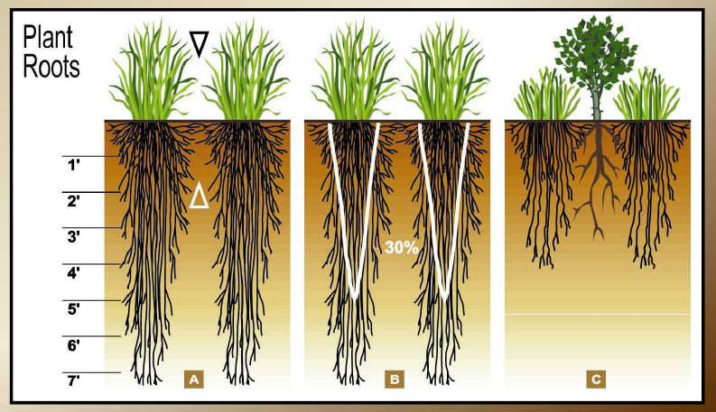
Proper Use Factor
Proper stocking rates are based on maintaining sufficient plant residue for:
Remove the Leaves ----- Affect the Roots
Plant health/regrowth
Wildlife forage
Erosion prevention
Notes:
Determine Proper Use Factor
The healthier roots you have depends on how healthy the aboveground plant is. So if aboveground plants are overgrazed, you open up available soil resources to shrubs and other weeds.
Trying to squeeze an additional 10% of harvest, 50% of roots stop growing.

Slide 13
Proper Use Factor
Set stocking rate below carrying capacity.
Utilization guidelines (based on ecological research):
% use for “proper use”
Range Type
30-40% Sagebrush grassland
40-50% Shortgrass prairie
30-40% Coniferous Forest
30-40% Oak woodlands
Source: J.L. Holecheck (1988). An Approach for Setting the Stocking Rate. Rangelands. 10:10-14.
Notes:
Proper Use Factor
Carrying capacity: the number of animals that a piece of land can support on a long-tern basis without causing damage to the ecosystem.
Set stocking rate below carrying capacity to allow for drought, to allow for low productivity years.
Healthy soil
Slows weedy plant invasion
Improves drought resistance
Improves condition of degraded land.

Slide 14
Basis for Stocking Rates
Basis for “Allowable Use” or “Recommended Use” Levels
Total Forage × Recommended Use = Usable Forage Supply
Notes:
Basis for Stocking Rates
Allowable Use or Recommended Use Levels

Slide 15
Step 1: Calculate Usable Supply
Determine biomass supply.
Convert total biomass to total forage.
Wt of biomass/acre x area = total biomass supply
Total biomass/acre × Proper use (%) × area = total forage supply
Notes:
Not all biomass is forage.
Not all biomass should be grazed.

Slide 16
Step 1: Calculate Usable Supply
An Example – You manage a 1,200-acre ranch and the average production is 500 lbs/acre. The ranch is located in a sagebrush steppe plant community and has a proper use factor of up to 30% of the annual forage.
What is your usable forage supply/year?
1,200
500
600,000
_______ acre ranch × _______ lbs/ac = __________ lbs of biomass
180,000
× 0.30 = ______________ lbs of forage.
Notes:
Calculate Usable Supply
Calculation

Slide 17
Step 1: Calculate Usable Supply
Supply can be expressed in AUMs
750
AUM = _______ lbs
How many AUM’s are there in 180,000 lbs forage/pasture
180,000
240
lbs forage ÷ lbs = AUMs/pasture
750
Notes:
Calculate Usable Supply
How many AUM's are available?

Slide 18
Step 2: Adjust for Accessibility
Not all forage is available for grazing.
Distance from water
Miles | KM | REDUCTION IN GRAZING CAPACITY
0 - 1 | 0 - 1.6 | None
1 - 2 | 1.6 - 3.2 | 50%
> 2 | Over 3.2 | 100% (consider this area ungrazable)
Depends on type of animal, topography, and season…
Some animals can travel further from water than other!
Source: J.L. Holecheck (1988). An Approach for Setting the Stocking Rate. Rangelands. 10:10-14.
Notes:
Step 2: Adjust for Accessibility
Distance from water

Slide 19
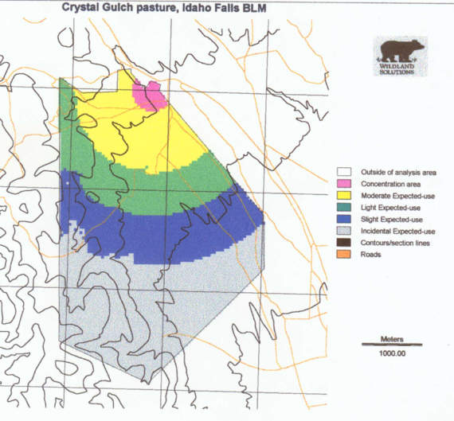
Step 2: Adjust for Accessibility
Expected-use map of a pasture with a single water source and relatively gentle terrain.
Notes:
Adjust for Accessibility

Slide 20
Step 2: Adjust for Accessibility
Not all forage is available for grazing.
Slope
PERCENT SLOPE |  | PERCENT REDUCTION IN GRAZING CAPACITY
0-10 |  | None
11-30 |  | 30
31-60 |  | 60
Over 60 |  | 100 (consider the slopes ungrazable)
Depends on type of animal and land
… Some animals can use rougher country than others!!
Source: J.L. Holecheck (1988). An Approach for Setting the Stocking Rate. Rangelands. 10:10-14.
Notes:
Adjust for Accessibility
Slope

Slide 21
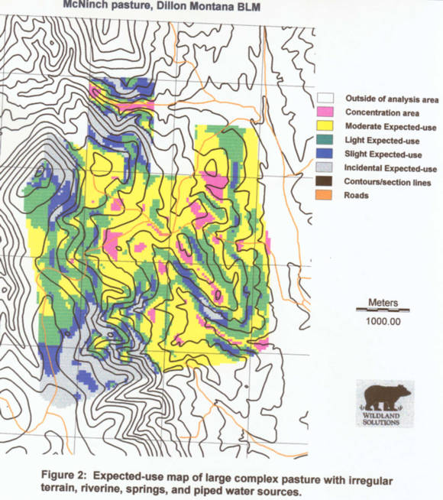
Step 2: Adjust for Accessibility
Expected-use map of a large complex pasture with irregular terrain, riverine, spring, and piped water sources.
Notes:
Adjust for Accessibility

Slide 22
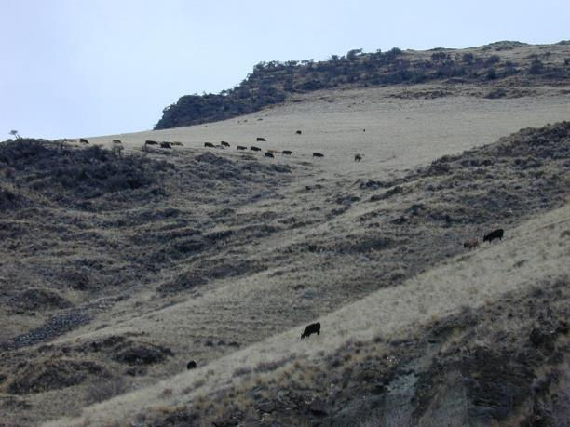
Step 2: Adjust for Accessibility
Adjustments for slope and distance from water are guidelines not rules.
Depends on:
Animal species, breed, & experience
Topography and soils
Season
K. Launchbaugh
Notes:
Adjust for Accessibility
Depends on: Animal species, breed, and experience…topography and soils, seasons (temperature, snow, forage moisture).

Slide 23
Step 3: Calculate Forage Demand
Estimated on the weight of animals.
Weight of animal × daily dry matter intake × number of days pasture will be grazed = forage demand/animal/year.
Ruminants = 2.5% of body weight/day
Hind-gut Fermenters = 3.0 % of body weight/day
Notes:
Step 3: Calculate Forage Demand
Based on animals on forage available

Slide 24
Step 3: Calculate Forage Demand
Example: On average cows in your herd weigh 1,000 lbs and graze on the ranch for 3 months (or 90 days).
How much forage would you expect each cow to eat?
1,000
2.5
25
_______ lb cow × _______ % of body wt/day = __________ lbs forage/day
90
2,250
25 lbs × _____ days = _________ lbs/cow/season.
Notes:
Calculate Forage Demand

Slide 25
Step 3: Calculate Forage Demand
Demand can be expressed in AUMs
750
AUM = _______ lbs
How many AUM’s are there in 2,250 lbs forage/cow?
2,250
3
lbs forage ÷ lbs = AUMs
750
Notes:
Calculate Forage Demand

Slide 26
Step 4: Calculate Stocking Rate
Stocking rate with pounds
  Example: How many cows should you have in your base herd if your usable forage is 180,000 lbs/pasture and the forage demand of each cow is 2,250 lbs?
lbs supply ÷ lbs demand = cows
180,000
2,250
80
Notes:
Step 4: Calculate Stocking Rate
Usable forage

Slide 27
Step 4: Calculate Stocking Rate
Stocking rate with AUMS
  Example: How many cows should you have in your base herd if you have 240 AUM’s in your pasture and each cow requires 3 AUM’s?
3
AUMs supply ÷ AUMs demand = cows
240
80
Notes:
Calculate Stocking Rate
AUM's

Slide 28
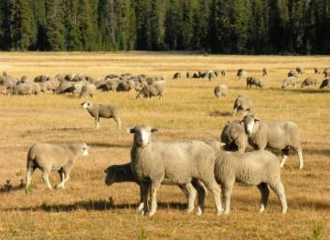
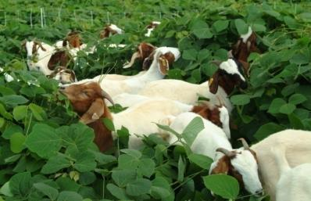
Stocking Rate
The number of animals a land manager places on a piece of land for a specified period of time.
Days or Months
Animal or Animal Unit
K. Launchbaugh
Acres or Hectares
Consider the most important grazing decisions because…
… affects rangeland health + economic returns
J. M. Luginbuhl
Notes:
Calculate Stocking Rate
Must include:
Number of animals or Animal Unit
Specified area (acres or hectares)
Specific period of time (days or months).
The most important grazing decisions because it affects: rangeland health, and economic return.
Stocking rate is …. So this is a management decision. Can you see the difference between the two terms. Carrying capacity is how many animals the land will support. Stocking rate is how many animals we choose to put on the land.

Slide 29
Set a stocking rate and then MONITOR
Stocking rate is determined by trial and error over years and then monitored by Range Trend.
Use caution when estimating carrying capacity
Combine: utilization measurements, interpretation of range conditions, knowledge of past and present stocking rates.
Monitor
Adjust when needed.
Notes:
Set Stocking Rate and then Monitor
Range trend: changes in plant composition or rangeland health overtime.

Slide 30
Heavy use ≠ Overgrazing
Overgrazing: repeated heavy grazing that yields damage to the plant community.
Overstocking: heavy grazing during a specific season such that high levels of utilization are observable.
Over-resting: excessive resting (no grazing) periods that results in damage to the plant community.
Overstocking does not always lead to Overgrazing
Notes:
Heavy Use versus Overgrazing
Over-grazing
Over-stocking
Over-resting

Slide 31
Setting Stocking Rates
Brooke Jacobson
Tom Koerner-USFWS
Tom Koerner-USFWS
Vicki Frank-Flickr
Rangeland Principles (REM 151)
Notes:
Setting Stocking Rates introduction

