Slide 1
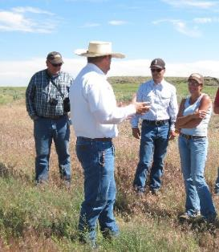
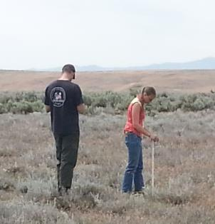
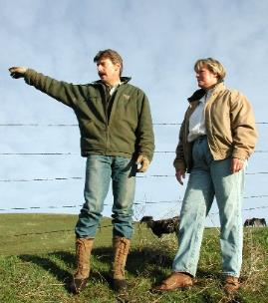
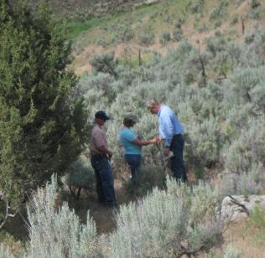
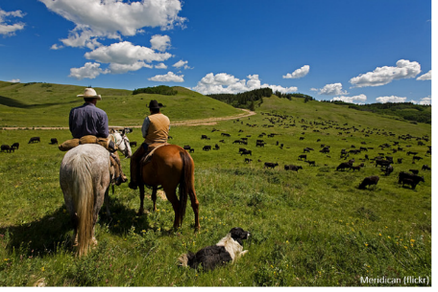

What is Rangeland Management?
K. Launchaugh
K. Launchaugh
R. Daines
K. Launchaugh
Rangeland Principles (REM 151)
Notes:
Pictures provided by K. Launchbaugh

Slide 2
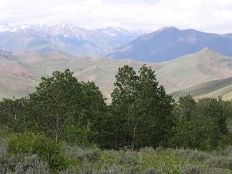


Rangeland Management is:
The use and stewardship of rangeland resources to meet goals and desires of humans.
A Planning Process
Planning examines different alternatives to see which is the “best” future world.
CURRENT
FUTURE
K. Launchbaugh
Notes:
What things might society need from rangelands in the future? Oil shale exploration, energy exploration like solar and wind development, the “unknowns” like plants or insects that offer a cure to cancer that we may not know about yet.
We have to think about what is the best world. What do you value out of life and what determines your future? Your ambition and skill. Land is the same way. You have to understand the current state to plan for the future.

Slide 3
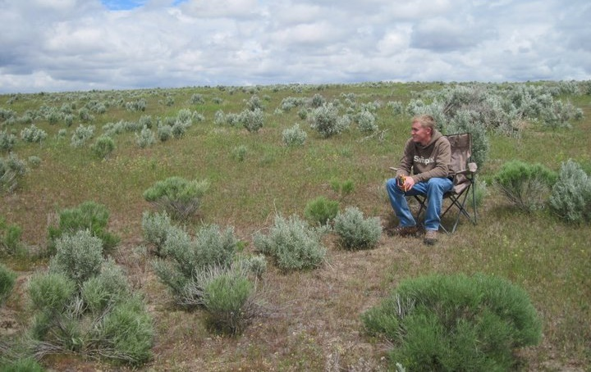
What is “Best”
It depends on your point of view.
  Preservationists
  Conservationists
  Utilitarianisms
  Pragmatists
  Etc. etc.
Connor White
Notes:
The values of society determine what is best for the future of rangelands. What are you?
Your land view will depend on your experience

Slide 4
What is “Best”
Preservationists –
  Emphasize protecting large areas of land from mining, timber, grazing & development so they can be enjoyed by present and future generations. .. John Muir and Aldo Leopold.
Conservationists –
  View land as a resource to be used now to enhance economic growth. But, protected from degradation by efficient management, based on scientific principles, for sustained yield and multiple use. .. T.R. Roosevelt, Gifford Pinchot, and John Wesley Powell.
Utilitarianists –
  View land as a substrate for saleable products. Management is based on land manipulation and exogenous inputs (e.g., fertilizer or herbicides) are usually required to keep production at an optimum level.
Notes:
These definitions are in the noteguide. Discuss the definition of each and have students think about what definition best describes them. When you try to make an argument with someone, if you are going to win, you will get more mileage by trying to understand who is on the other side of the table. It’s important to be open-minded and understand what others need out of the land.

Slide 5
Rangeland Management
Source of Decision?
?
?
?
?
CURRENT
FUTURE
K. Launchbaugh
Notes:
What determines what you decide to do or not to do? Natural resource policy, how much you know (experience, facts and science), your values (what you think the land should be used for), your needs (what you need to survive on the land).

Slide 6
Rangeland Management
Source of Decision?
tradition
guesses
information
needs
hunches
CURRENT
FUTURE
K. Launchbaugh
Notes:
Range management is the ART and SCIENCE of managing rangelands. You can’t manage based off of science alone.

Slide 7
Why do we need science?
Managers must integrate scientific knowledge with ideas, "hunches", traditions, etc., to make wise decisions.
To understand the physical, biological, and social processes that affect rangelands.
To discover principles on which to base the wise use of rangelands.
Others?
Notes:
What are limitations you have? Sociologists and economists help us understand what people on the land need. Ecology helps us understand the land.

Slide 8
Rangeland Management
What kinds of decisions do we make?
CURRENT
FUTURE
K. Launchbaugh
Direct actions of land owners & managers
Political – laws & policies
Economic – buy & sell
Notes:
These have a big impact on what we can do. A lot of range management is accomplished in the courts these days.

Slide 9
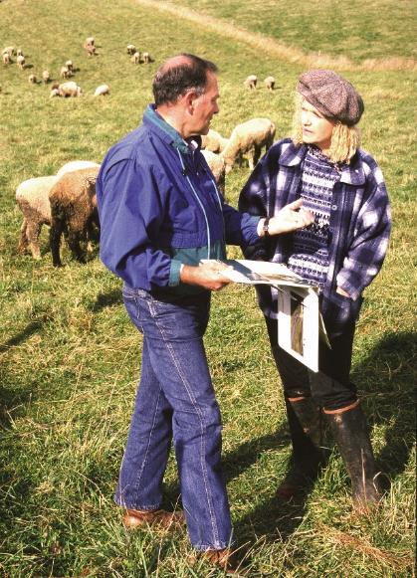
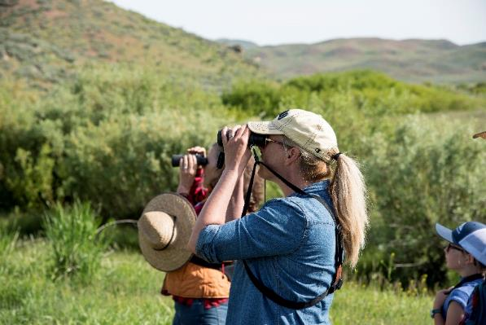
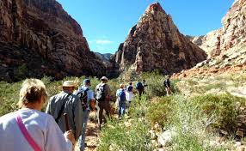
Rangeland Management is:
the use and stewardship of rangeland resources to meet goals and desires of humans.
What do people want from rangelands?
University of Idaho.
BLM.gov
USDA NRCS
Notes:
The use and stewardship of land to meet the needs of society.
Goals and desires of humans have changed

Slide 10
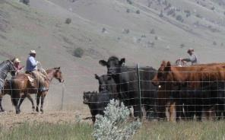
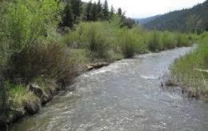
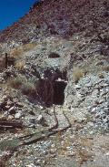
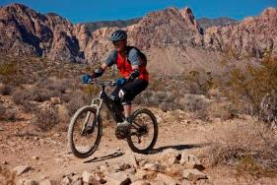
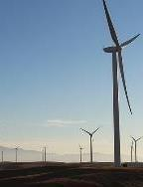
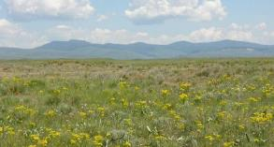
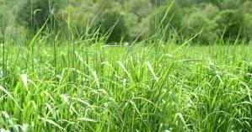
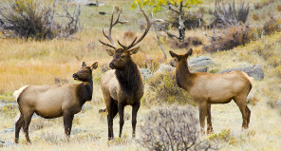
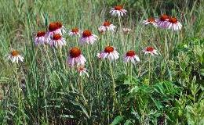
What people want from rangelands?
Water
Minerals
Livestock Production
Recreation
Energy
K. Launchbaugh
BLM.gov
BLM.gov
BLM.gov
Open Space
Scott Flaherty USFWS
Wildlife Habitat
Forage
Native Plants
BLM.gov
Jen Peterson
NRCS.USDA.gov
NPS.gov
Michale Haddock
Notes:
These are the major resources that we can manage for:
Livestock production, recreation, water, energy, open spaces, minerals, open space, wildlife habitat, forage, and native plants
Photo credits: Livestock Production = Seth McFarland; Forage & Open Space = Jennifer Peterson; Wildlife Habitat, Recreation, Energy & Minerals = USDI-BLM(http://www.blm.gov/wo/st/en/bpd.html); Water=Juley Hankins; Native Plants =K. Launchbaugh

Slide 11
Rangeland Management is:
The use and stewardship of rangeland resources to meet goals and desires of humans.
What tools do we have for Range Management?
Notes:
The use of rangeland to meet the needs of humans to meet the needs of humans

Slide 12

Natural Forces & Human Impacts
Ecological Services
& Resources
Forage for livestock
Wildlife habitat
Watershed management
Biodiversity conservation
Open space
Carbon sequestration
Herbivory
Climate
Change
Fire
Human Uses
Development,
Fragmentations,
& Recreation
Invasion
Rangelands
Grasslands, Shrublands, Woodlands
J. Peterson
Notes:
What changes nature? Discuss the forces of change (more discussion later in class). What services and products can rangelands provide? What are the tools that we have to manage these services and goods? These are essentially the same as the forces of change – the same tools that nature uses.

Slide 13
Natural Forces & Human Impacts
Ecological Services
& Resources
Forage for livestock
Wildlife habitat
Watershed management
Biodiversity conservation
Open space
Carbon sequestration
Herbivory
Climate
Change
Fire
Human Uses
Development,
Fragmentations,
& Recreation
Invasion
Rangelands
Grasslands, Shrublands, Woodlands
J. Peterson
Fire
Tools for Stewardship
Weed
Mgmt
Livestock
Grazing
Human
Impacts
Restoration/
Rehabilitation
Notes:
What changes nature? Discuss the forces of change (more discussion later in class). What services and products can rangelands provide? What are the tools that we have to manage these services and goods? These are essentially the same as the forces of change – the same tools that nature uses.

Slide 14
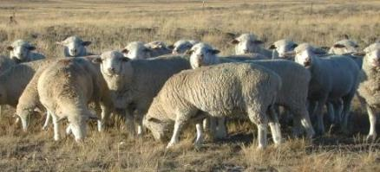
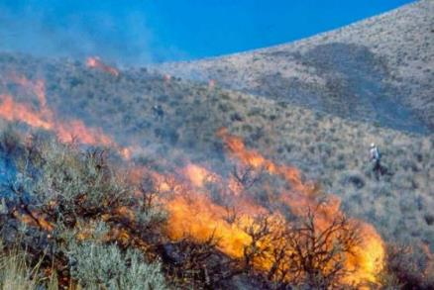
Tools of Range Management
Fire
Livestock grazing
Integrated weed management
Human Impacts
  Recreation
  Development
Restoration & rehabilitation
Lovina Englund
Steve Bunting
S. Bunting
BLM.gov
Notes:
The tools of range management:
Fire, livestock grazing, integrated weed management, human Impacts, restortation and rehabilitiation

Slide 15
Rangeland Management – Basic Concepts
Rangelands are renewable resources; they can produce on a sustained yield basis if properly managed.
Managed to maintain soil and water quality and health and basic biogeochemical cycles.
Managed by extensive and ecological principles, not intensive and agronomic principles.
Focus on the landscape, not one acre.
Notes:
We have a must faster scale of recovery on rangelands compared to forested ecosystems. We can have a fire one year and remove all the aboveground vegetation and have just as much return the next year.

Slide 16
Rangeland Management – Basic Concepts
Rangelands have variety of values (e.g., forage, recreation, water) therefore multiple use principles are important.
Natural forces and values happen across multiple ownerships (i.e., fire, watershed processes, weeds, open space).
You can’t please all the people all the time. What one person wants my not meet the desires of plans of another.
Notes:
What kinds of laws impact what happens across lands? The Clean Water Act, the Endangered Species act, tax laws, burning effects on air quality all affect what people can do on private land.

Slide 17
Principles of Rangeland Management
Rangelands change through succession and disturbance. Managers can only apply, control, or respond to disturbance based on knowledge of succession.
Only constant on rangeland is CHANGE. Conditions change from place to place (spatially) and time to time (temporally). Management needs to be “dynamic”.
If you do nothing, the land will not return to some natural paradise. The land will change with or without humans.
Notes:
You can have a goal of what land will look like, but you can’t just leave it alone and expect it will go back to what it looked like 200 years ago.

Slide 18
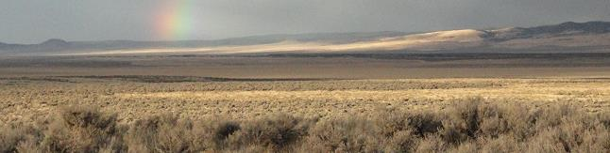
Rangelands are Challenged
Many forces that threaten rangeland integrity!
  Unsustainable grazing practices
  Damaging fire regimes
  Invasive plant species
  Global climate change
  Human development
  Disease and insect damage
BLM.gov
Notes:
Rangelands are challenged with many forces that can threaten rangeland integrity:
Unsustainable grazing practices, damaging fire regimes, invasive plants, global climate change, human development, disease and insect damage

Slide 19
What is Rangeland Management?
K. Launchaugh
K. Launchaugh
R. Daines
K. Launchaugh
Rangeland Principles (REM 151)
Notes:
Pictures provided by K. Launchbaugh

