Slide 1
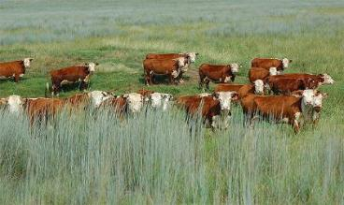
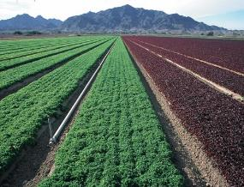
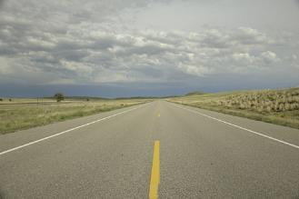
Land-Use and Ownership of Rangelands
NRCS USDA.gov
Jeff Vanuga USDA-NRCS
Mark Goebel-Flickr
Rangeland Principles
Notes:
Land ownership and use in the U.S.

Slide 2
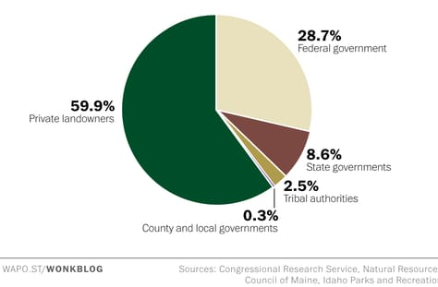
Who owns the United States?
Washington Post (Christopher Ingraham) December 21, 2017
Notes:
Most land in the US is privately owned (60%) The federal government owns about 30% of US land and state & local governments (i.e., state parks, wildlife management areas, or state endowment lands) account for ~ 10% of the U.S. land

Slide 3
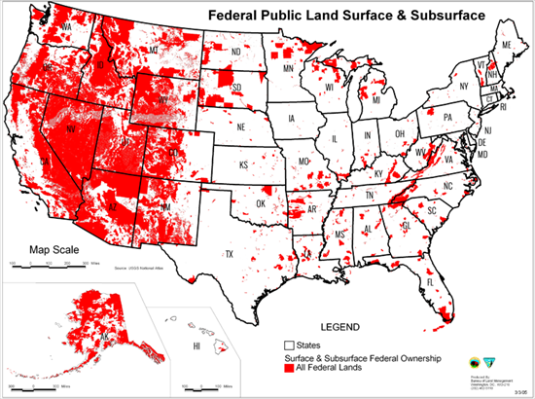
Where are federal land located?
The federal government manages ~ 650 million acres of land in the U.S.
About 30 % of the nation’s total surface area.
Mostly in the west
Notes:
Most federal land is in the west; 65 million acres

Slide 4
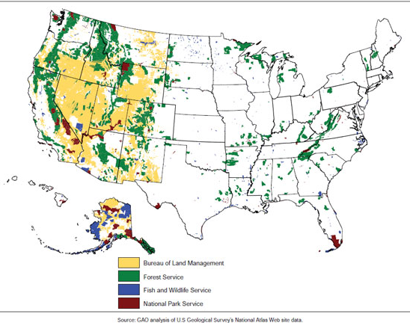
Which agencies manage federal lands?
Bureau of Land Management
  247 million acres
Forest Service
  193 million acres
Fish and Wildlife Service
  90 million acres
National Park Service
  84 million acres
Notes:
The major agencies that manage federal land include the BLM, USFS, Fish & Wildlife Service, and National Park service. Other agencies such as the Department of Defense and Bureau of Reclamation also own significant amounts of land in some areas.

Slide 5





Land Management Agencies
Department of the Interior
Agency | Mission | Primary Resources Managed
National Park Service Established in 1916 | ..to promote and regulate the use of the...national parks...which purpose is to conserve the scenery and the natural and historic objects and the wild life therein and to provide for the enjoyment of the same in such manner and by such means as will leave them unimpaired for the enjoyment of future generations. | Land, wildlife, and historical conservation.
Fish and Wildlife Service Established in 1940 | Working with others to conserve, protect and enhance fish, wildlife, and plants and their habitats for the continuing benefit of the American people. | Wildlife and habitat conservation, wildlife-related recreation.
Bureau of Land Management Established in 1946 | ...to sustain the health, diversity and productivity of the public lands for the use and enjoyment of present and future generations. | Domestic grazing, mining, timber, energy extraction, fish and wildlife habitat.
Department of Agriculture
US Forest Service Established in 1905 | ...to sustain the health, diversity, and productivity of the Nation’s forests and grasslands to meet the needs of present and future generations. | Forest products, domestic grazing, fish and wildlife habitat.
Natural Resources Conservation Service Established in 1935 as the Soil Conservation Service Works with private land owners | … to provide resources to farmers and landowners to aid them with conservation. Ensuring productive lands in harmony with a healthy environment is our priority. | Soil, water, plant communities, and wildlife habitat through partnerships with private land owners.
Notes:
Land management agencies
National Parks Service, Fish and Wildlife Services, Bureau of Land Management, Department of Agriculture, US Forrest Service, Natural Resources Conservation Services.
Each agency has a slightly different mission and purpose. This information was outlined at: https://www.fws.gov/invasives/volunteersTrainingModule/nwrsystem/agencies.html

Slide 6
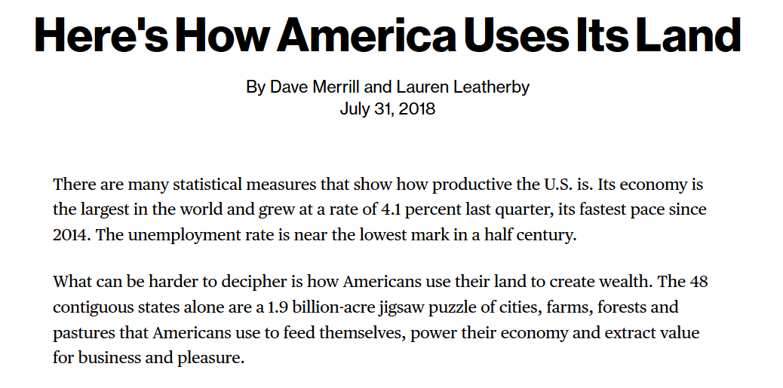
Uses of Land in US.
www.bloomberg.com/graphics/2018-us-land-use/
Published by Bloomberg New - Bloomberg.com
Notes:
Uses if Land in the US and how it is used
To learn more about land uses consider this story (next 15 slides) recently published by Dave Merrill and Lauren Leatherby in Bloomberg News https://www.bloomberg.com/graphics/2018-us-land-use/

Slide 7
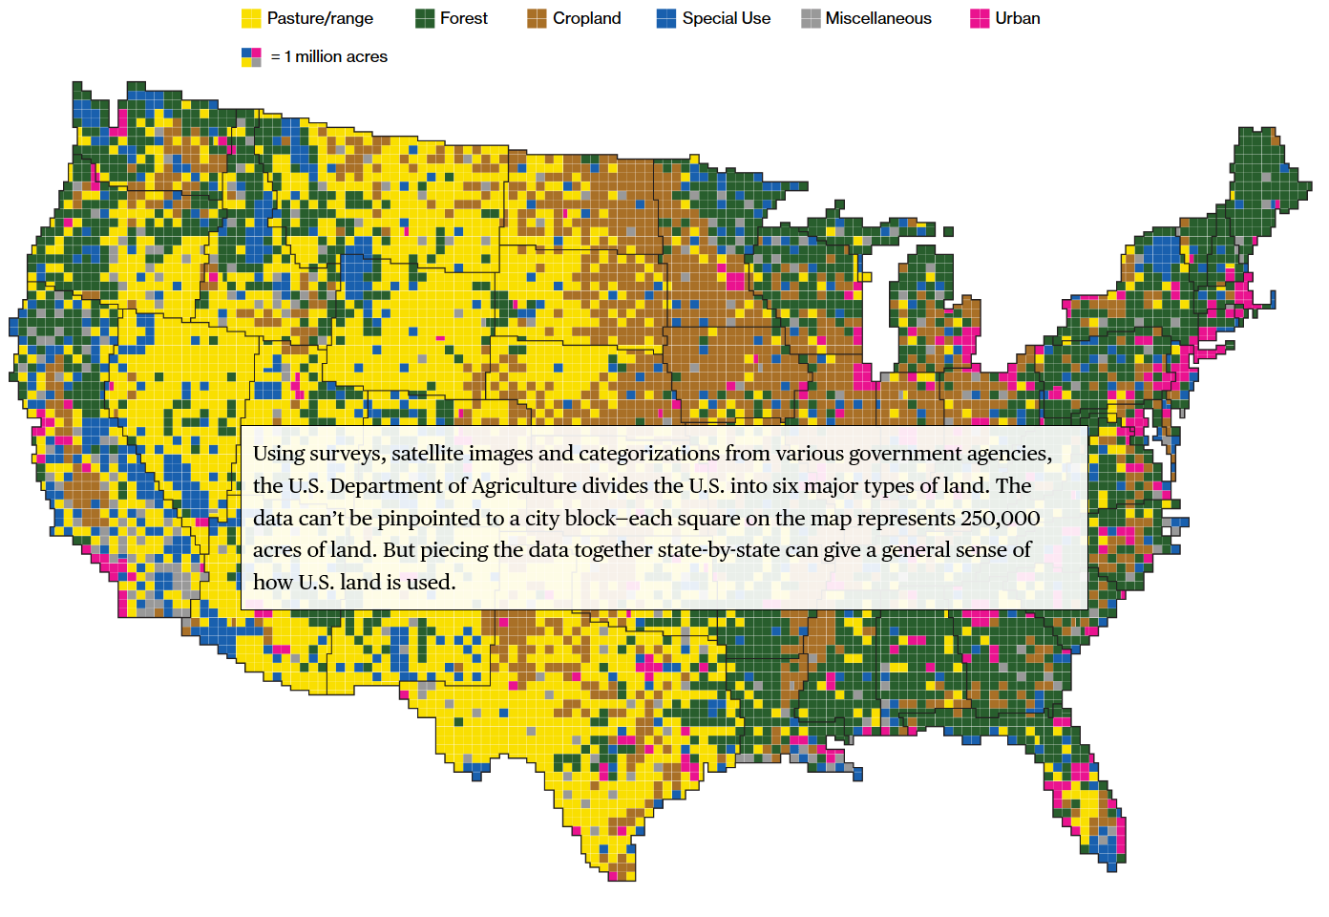
https://www.bloomberg.com/graphics/2018-us-land-use/
Notes:
Using surveys, satellite images and categorizations from various government agencies, the U.S. Department of Agriculture divides the U.S. into six major types of land. The data can’t be pinpointed to a city block—each square on the map represents 250,000 acres of land. But piecing the data together state-by-state can give a general sense of how U.S. land is used.

Slide 8
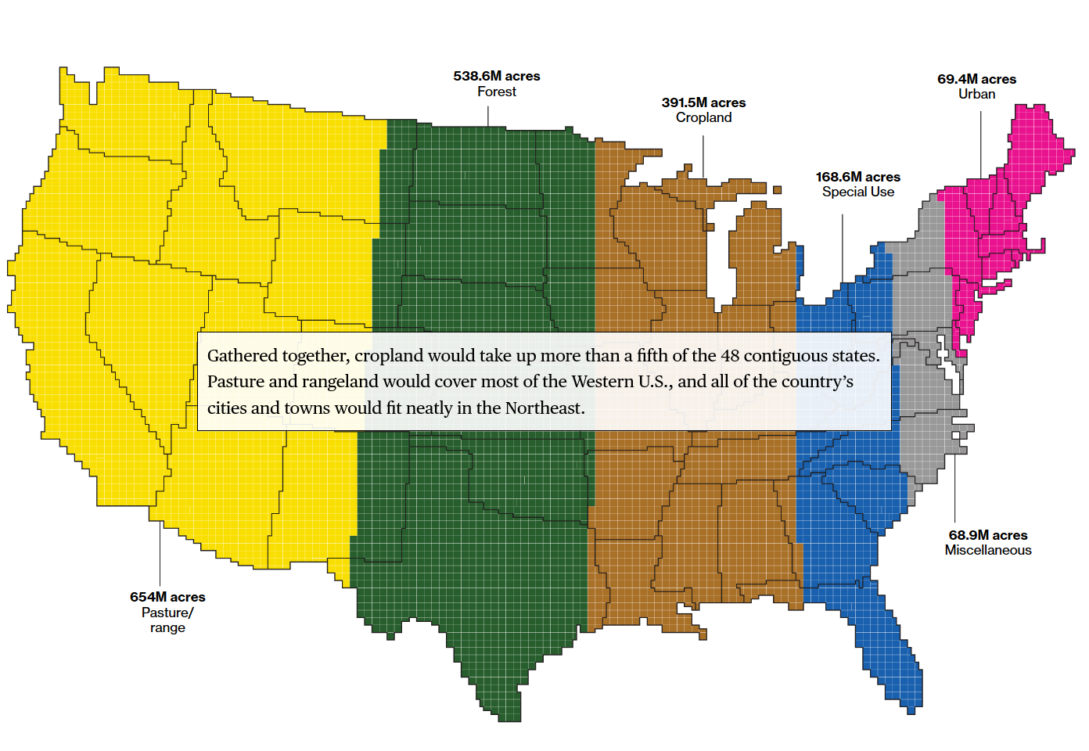
https://www.bloomberg.com/graphics/2018-us-land-use/
Notes:
Gathered together, cropland would take up more than a fifth of the 48 contiguous states. Pasture and rangeland would cover most of the Western U.S., and all of the country’s cities and towns would fit neatly in the Northeast.

Slide 9
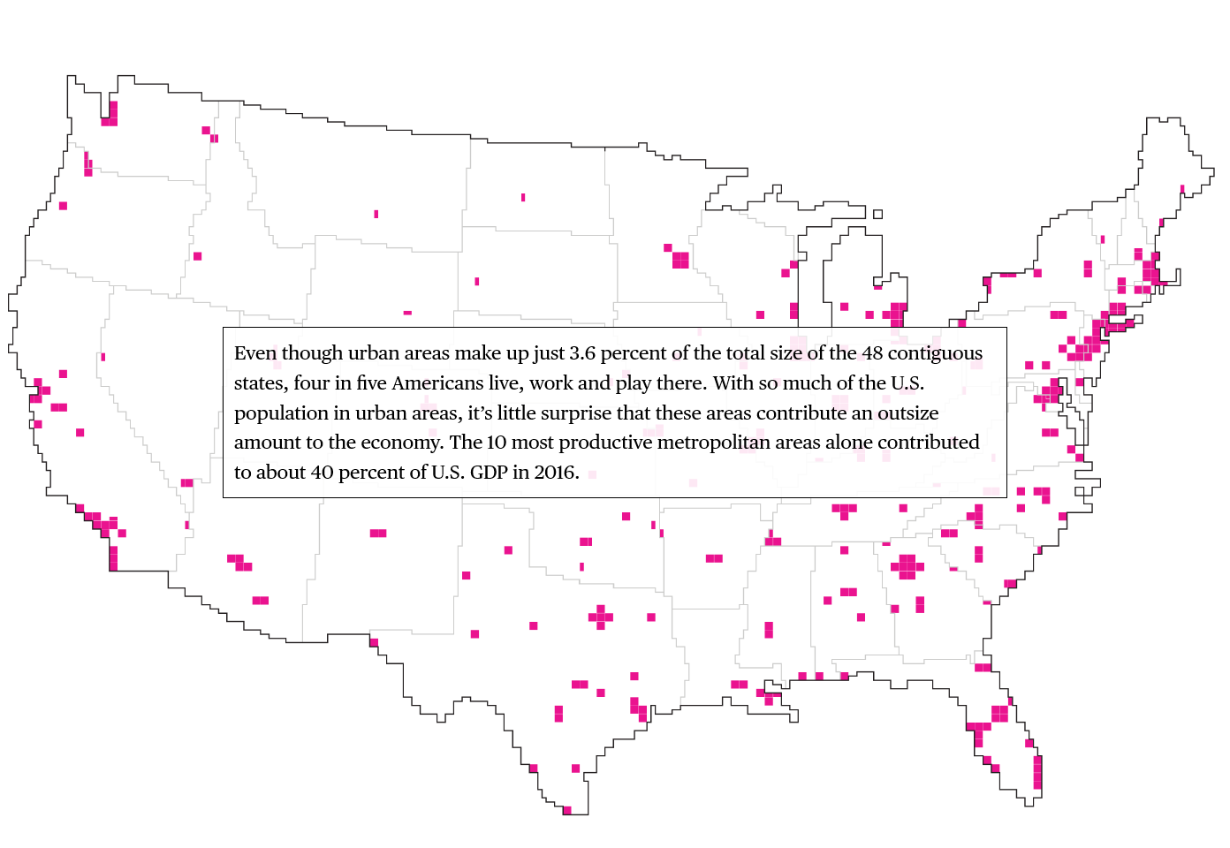
https://www.bloomberg.com/graphics/2018-us-land-use/
Notes:
Even though urban areas make up just 3.6 percent of the total size of the 48 contiguous states, four in five Americans live, work and play there. With so much of the U.S. population in urban areas, it’s little surprise that these areas contribute an outsize amount to the economy. The 10 most productive metropolitan areas alone contributed to about 40 percent of U.S. GDP in 2016

Slide 10
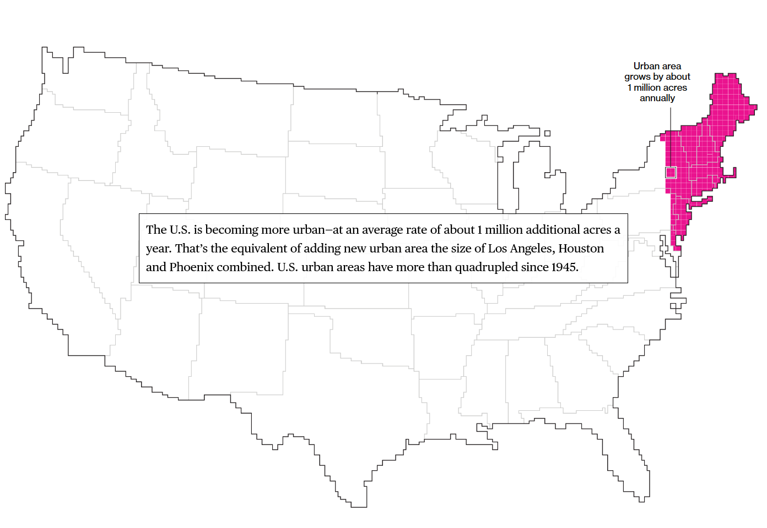
https://www.bloomberg.com/graphics/2018-us-land-use/
Notes:
The U.S. is becoming more urban—at an average rate of about 1 million additional acres a year. That’s the equivalent of adding new urban area the size of Los Angeles, Houston and Phoenix combined. U.S. urban areas have more than quadrupled since 1945.

Slide 11
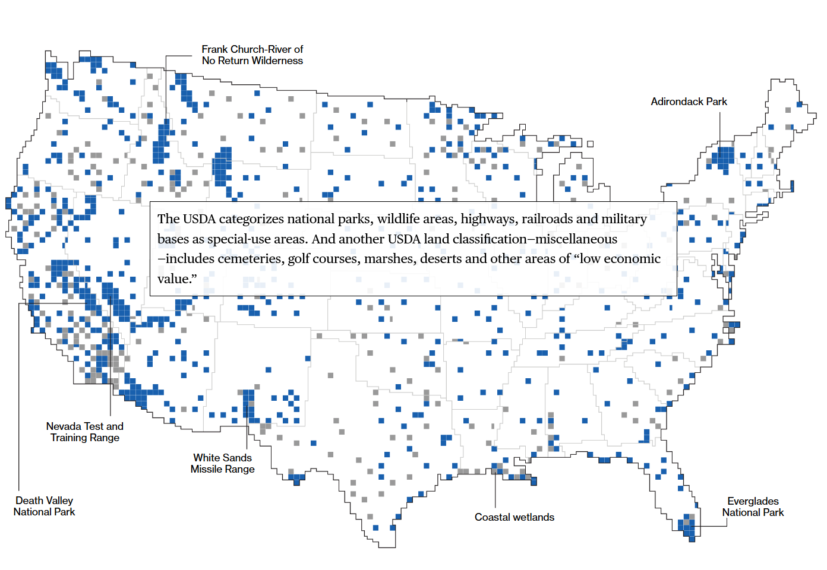
https://www.bloomberg.com/graphics/2018-us-land-use/
Notes:
The USDA categorizes national parks, wildlife areas, highways, railroads and military bases as special-use areas. And another USDA land classification—miscellaneous—includes cemeteries, golf courses, marshes, deserts and other areas of “low economic value.”

Slide 12
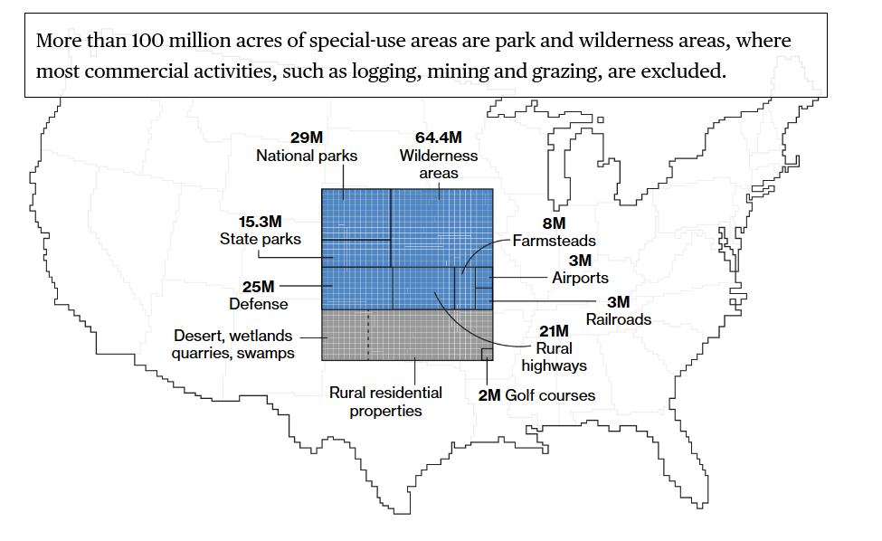
https://www.bloomberg.com/graphics/2018-us-land-use/
Notes:
More than 100 million acres of special-use areas are park and wilderness areas, where most commercial activities, such as logging, mining and grazing, are excluded.

Slide 13
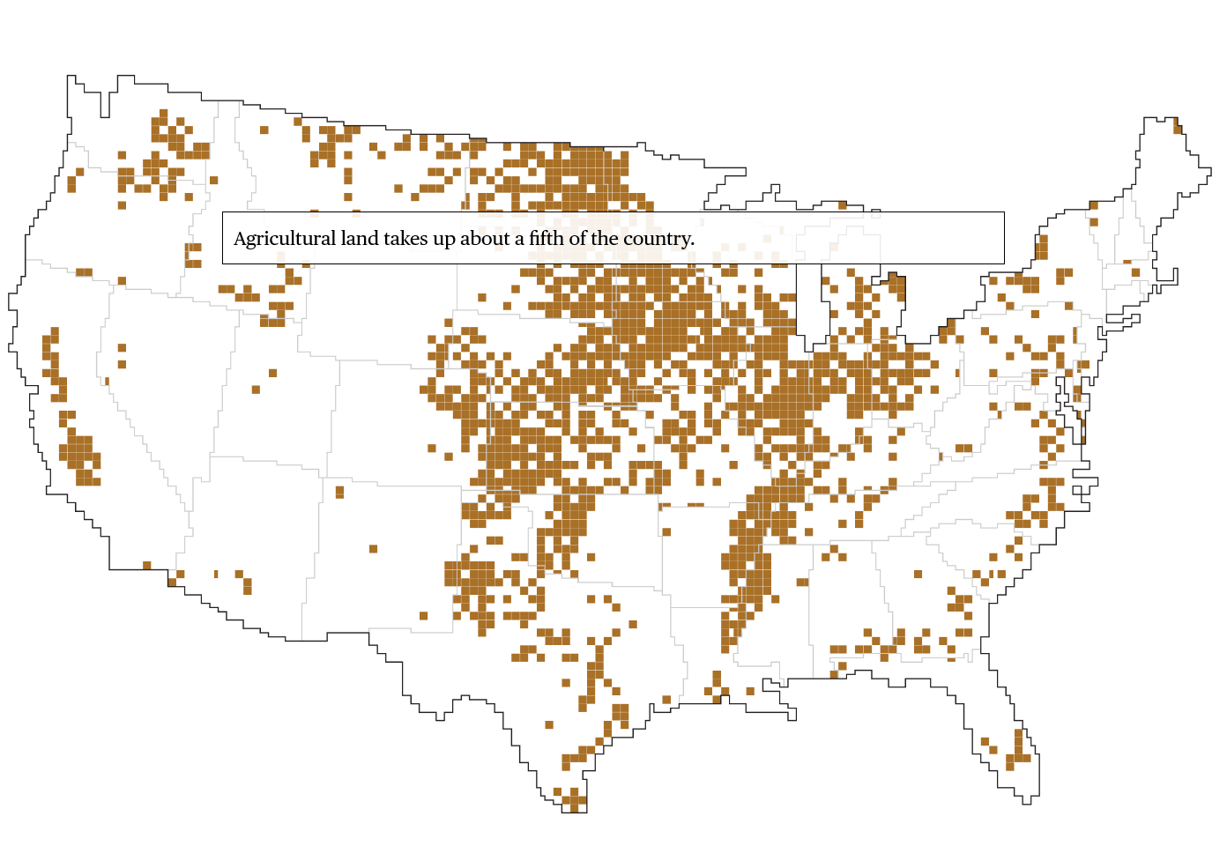
https://www.bloomberg.com/graphics/2018-us-land-use/
Notes:
Agricultural land takes up about a fifth of the country.

Slide 14
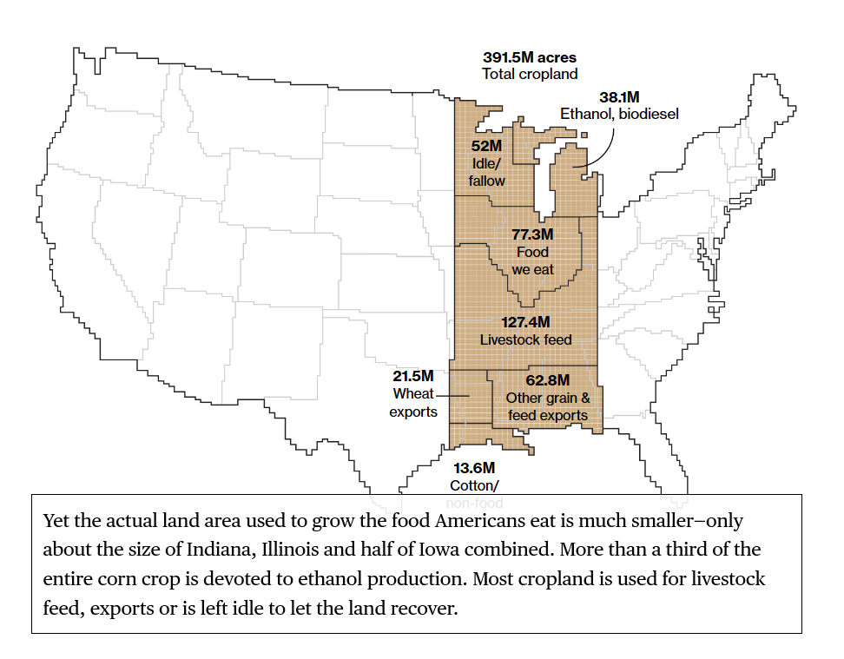
https://www.bloomberg.com/graphics/2018-us-land-use/
Notes:
Yet the actual land area used to grow the food Americans eat is much smaller—only about the size of Indiana, Illinois and half of Iowa combined. More than a third of the entire corn crop is devoted to ethanol production. Most cropland is used for livestock feed, exports or is left idle to let the land recover.

Slide 15
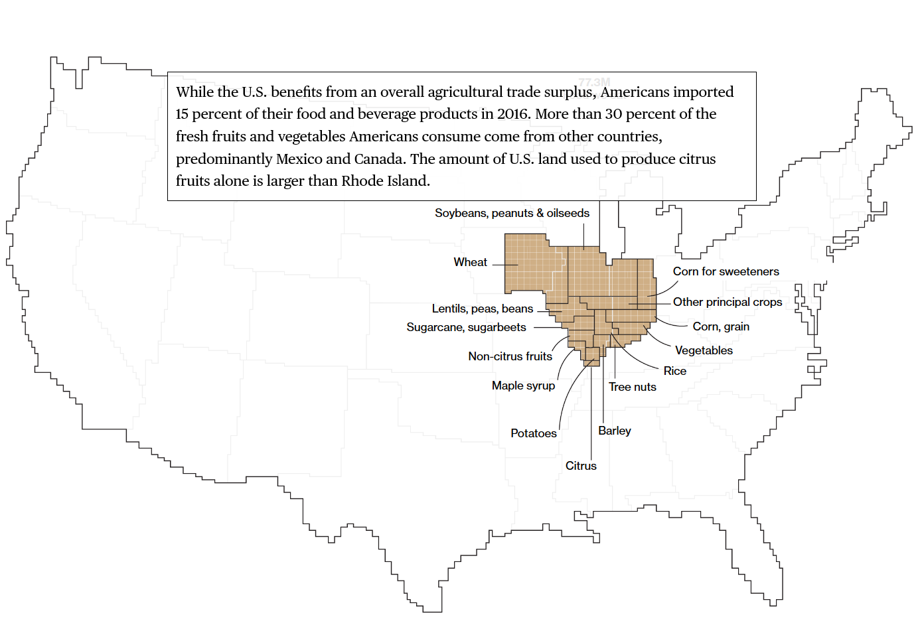
https://www.bloomberg.com/graphics/2018-us-land-use/
Notes:
While the U.S. benefits from an overall agricultural trade surplus, Americans imported 15 percent of their food and beverage products in 2016. More than 30 percent of the fresh fruits and vegetables Americans consume come from other countries, predominantly Mexico and Canada. The amount of U.S. land used to produce citrus fruits alone is larger than Rhode Island.

Slide 16
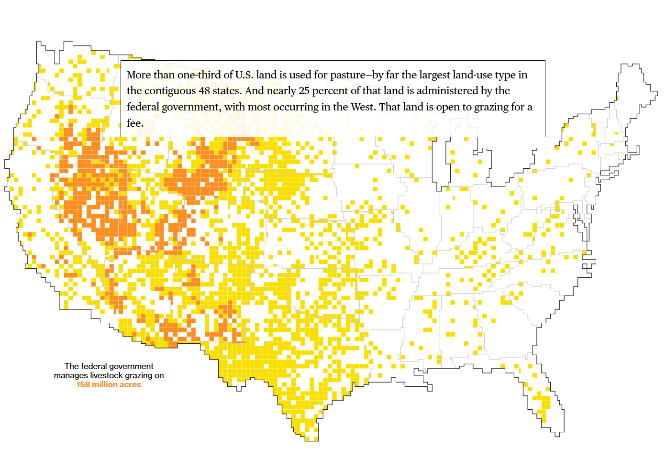
https://www.bloomberg.com/graphics/2018-us-land-use/
Notes:
More than one-third of U.S. land is used for pasture—by far the largest land-use type in the contiguous 48 states. And nearly 25 percent of that land is administered by the federal government, with most occurring in the West. That land is open to grazing for a fee.

Slide 17
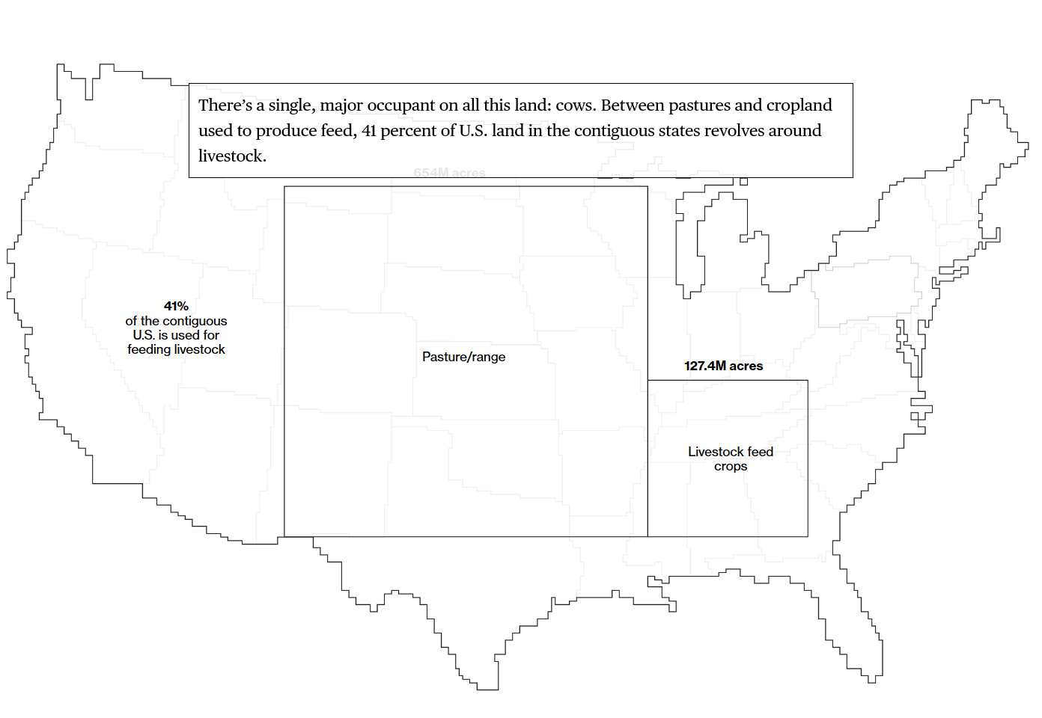
https://www.bloomberg.com/graphics/2018-us-land-use/
Published by Bloomberg new - Bloomberg.com.
Notes:
There’s a single, major occupant on all this land: cows. Between pastures and cropland used to produce feed, 41 percent of U.S. land in the contiguous states revolves around livestock.

Slide 18
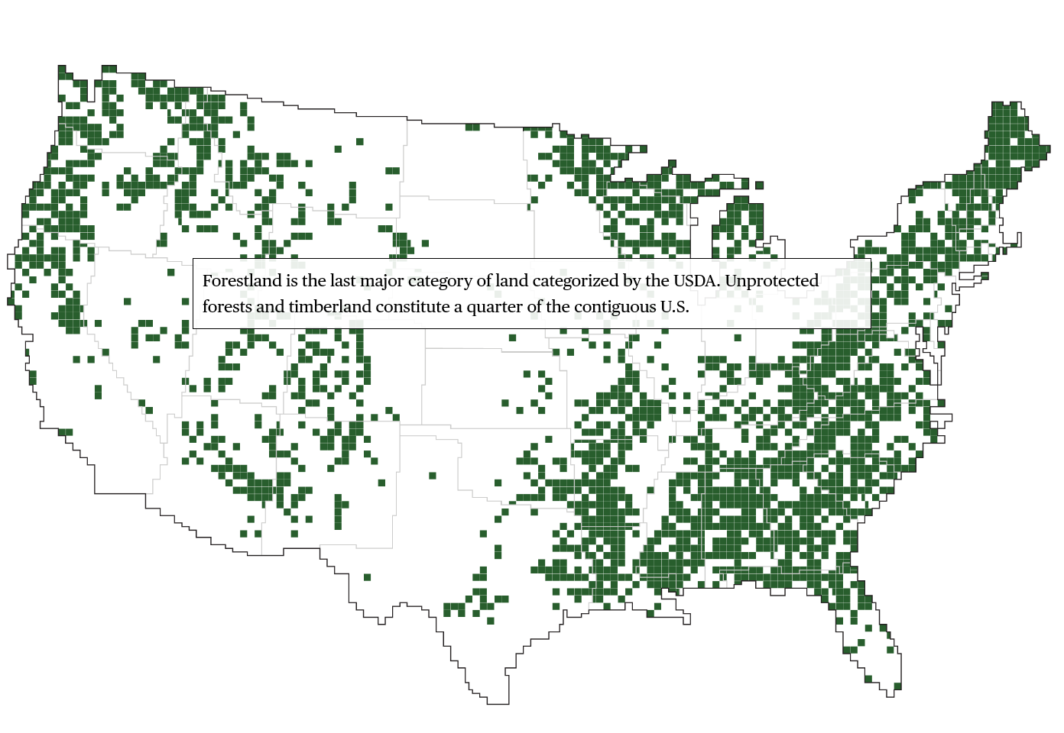
https://www.bloomberg.com/graphics/2018-us-land-use/
Notes:
Forestland is the last major category of land categorized by the USDA. Unprotected forests and timberland constitute a quarter of the contiguous U.S.

Slide 19
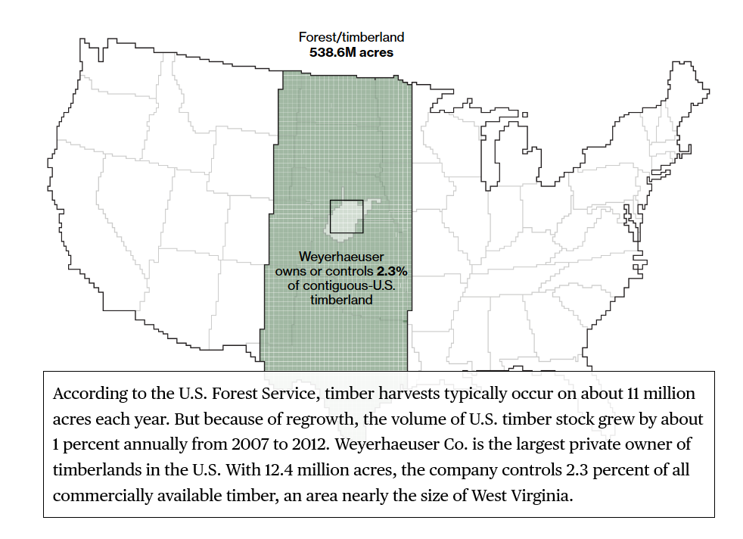
https://www.bloomberg.com/graphics/2018-us-land-use/
Notes:
According to the U.S. Forest Service, timber harvests typically occur on about 11 million acres each year. But because of regrowth, the volume of U.S. timber stock grew by about 1 percent annually from 2007 to 2012. Weyerhaeuser Co. is the largest private owner of timberlands in the U.S. With 12.4 million acres, the company controls 2.3 percent of all commercially available timber, an area nearly the size of West Virginia.

Slide 20
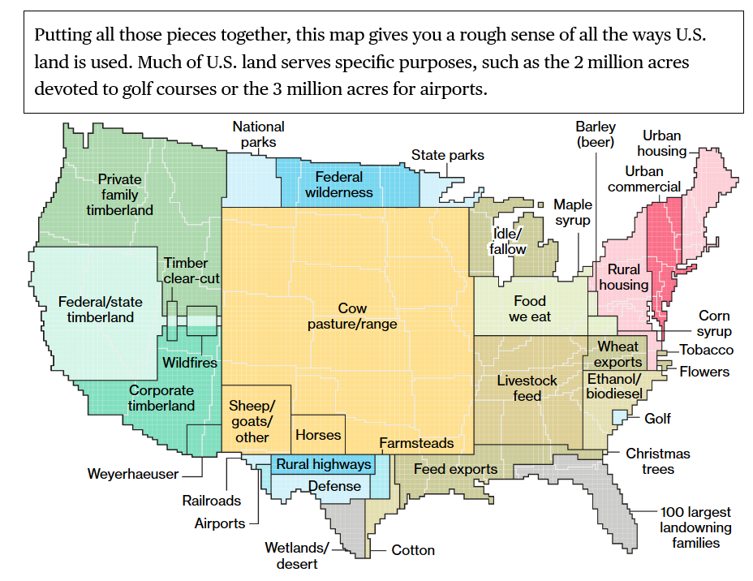
https://www.bloomberg.com/graphics/2018-us-land-use/
Notes:
Putting all those pieces together, this map gives you a rough sense of all the ways U.S. land is used. Much of U.S. land serves specific purposes, such as the 2 million acres devoted to golf courses or the 3 million acres for airports.
On a percentage basis, urban creep outpaces growth in all other land-use categories. Another growth area: land owned by wealthy families. According to The Land Report magazine, since 2008 the amount of land owned by the 100 largest private landowners has grown from 28 million acres to 40 million, an area larger than the state of Florida.

Slide 21
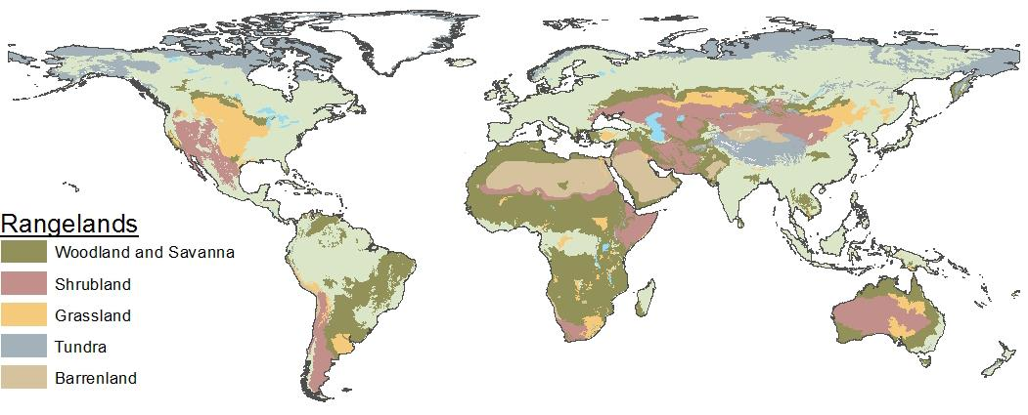
Think Globally – Rangelands vs Grazing Lands
Not all rangeland is grazed by livestock
Not all land grazed by livestock is rangeland
Livestock also graze pastureland, cropland, and forests
Notes:
Rangelands versus Grazing lands
Not all rangeland is grazed by livestock and not all

Slide 22
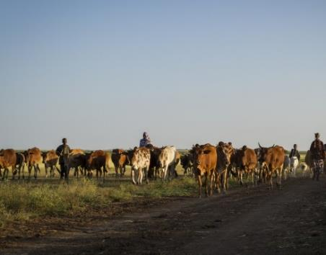
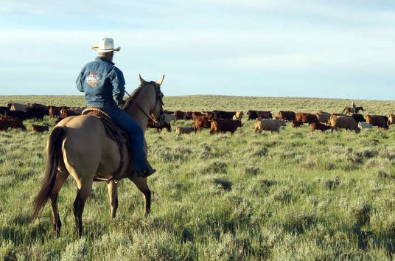
Think Globally – Pastoralism vs Ranching
Pastoralists:
Ranchers:
Kelley Lynch. USAID.gov
Karen Poole-Sage-grouse Initiative FWS.gov
Notes:
Grazing is the major use of rangelands across the globe. There are two basic groups of people that engage in grazing activities: Pastoralists and Ranchers.

Slide 23

Think Globally – Pastoralism vs Ranching
Pastoralists:
Own little or no land individually.
Graze communal or uncontrolled government grazing lands.
Several hundred million people are pastoralists, mostly in Africa and Asia
Production high value food resources where crops cannot be grown.
https://youtu.be/5eJtbsFmoZY
Notes:
The term “pastoralist” is most often used to describe nomadic herders primarily in developing countries. This video describe the extent and importance of pastoralism and the what the Food and Agriculture Organization of the United Nations is doing to help improve the lives of pastoral communities and the natural resources on which they rely.

Slide 24
Think Globally – Pastoralism vs Ranching
Ranchers:
Usually own land – “deeded land”
Graze mix of public and private grazed land.
Often generational family ranches.
Produce livestock at low cost and impact compared to croplands.
Production and conservation goals.
https://youtu.be/Zf1WbCFRpl8
Notes:
Ranchers or grazers (as in Australia) is a term that describe those who own ranches and graze animals in developed countries.

Slide 25
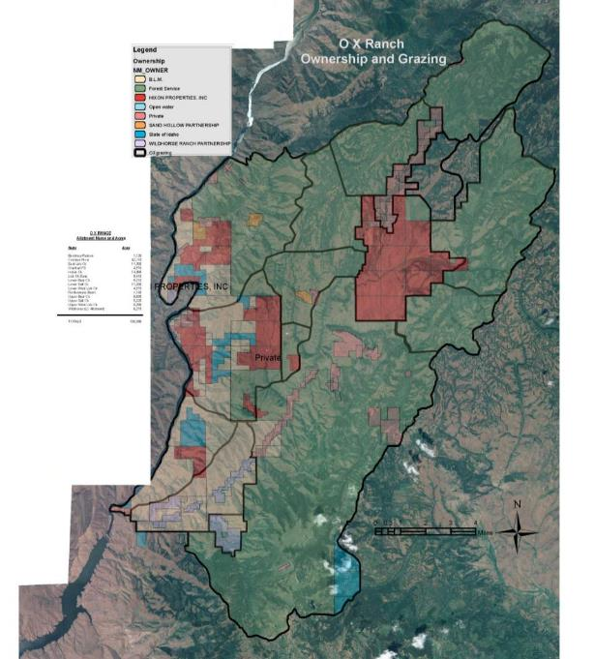
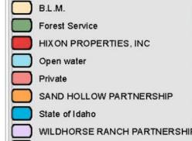
Western Ranch
Mix of public and private land
Completely integrated
OX Ranch Idaho
130,000 acres
Notes:
Many western ranches include leases and permits on public land. When you think of ranching in Idaho, you have to think about integrated land ownership – checkerboard land ownership. These ranches are wholly integrated, there often are not even fences between land ownerships.

Slide 26
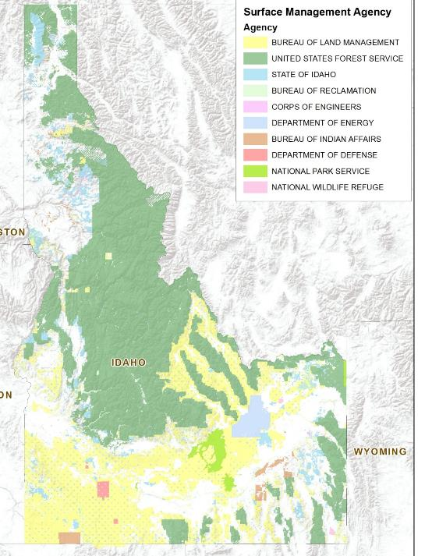
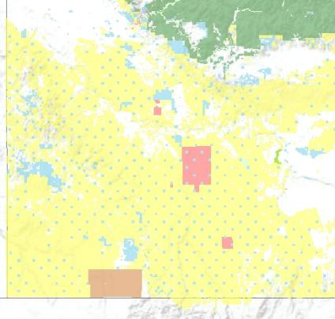
Public Land Survey System
Notes:
Public land survey system

Slide 27
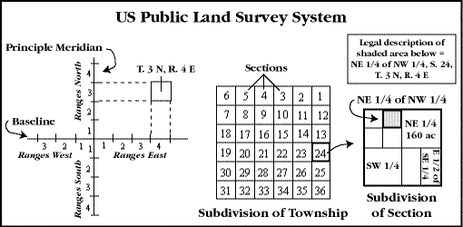
Public Land Survey System
Notes:
Public land survey system

Slide 28
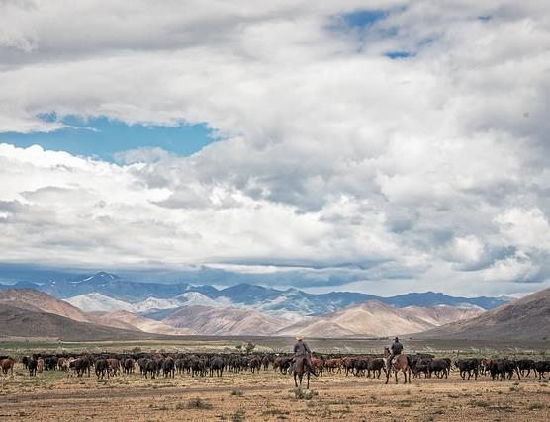
Grazing on Public Lands
Grazing on private lands is wholly integrated with public grazing lands.
  Livestock grazing occurs on:
    95% of BLM land
    58% of U.S. Forest Service lands
  88% of all beef cows in Idaho graze at least part of each year on BLM or USFS lands.
E.Haslam(flickr)
Notes:
Public lands are very important to ranch operations and rural communities in the west. Grazing permits on public lands are also important to sustain red meat for the US and as an export to other countries. Livestock grazing is often the only economic use on western lands as these lands cannot be plowed and converted to croplands..

Slide 29
Ranches Preserving Open Space
Working Landscapes
Conservation easements to maintain space and conserve habitat.
https://youtu.be/OfFegsRVmEY
Notes:
Conservation easements are increasingly used to maintain space and conserve habitat while a working landscapes. Here is an example of a family ranch that is maintaining a working landscape in California.

Slide 30
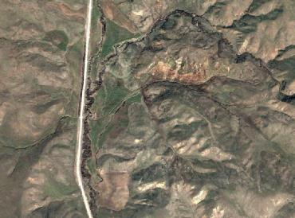
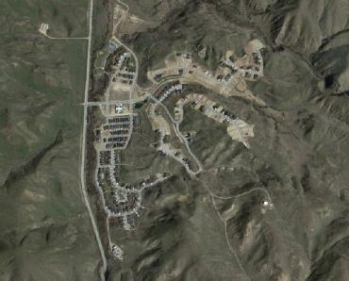
Effects of subdivision & exurban development
Fragmentation
Increased roads & fences
Introduction of exotic species
  Weeds & ornamental plants
  Cats and dogs
Wildlife specialists → generalists
2002
2017
Google Earth image North of Boise, Idaho
Notes:
One of the greatest challenges to ranches and open landscapes is subdivision and exurban development.

Slide 31
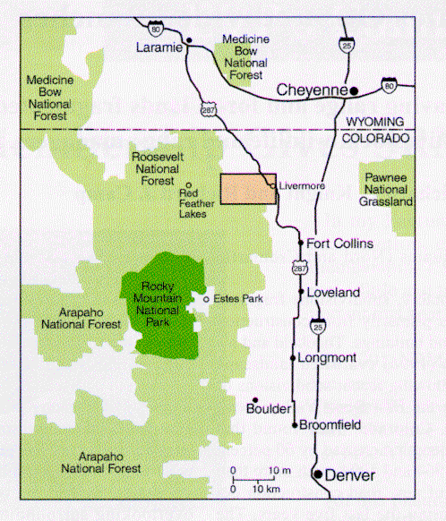
Changes 1957 to 1994
Study in Colorado
Compare Ranches: 1957-1994
Mitchell, Knight & Camp. 2002. Landscape Attributes of Subdivided Ranches
Notes:
The effects of subdivision were documented in this study by Mitchell, Knight and Camp from Colorado state university. They compared lands that were maintained as ranches or sub-divided between 1057-1994 near Livermore, Colorado.

Slide 32
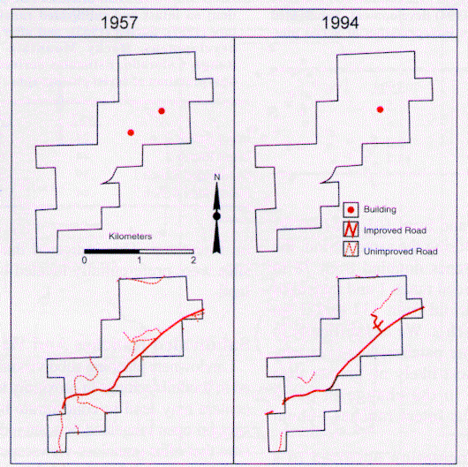
Intact Ranch # 1
Notes:
This ranch was intact and remained a working ranch between 1957 and 1994

Slide 33
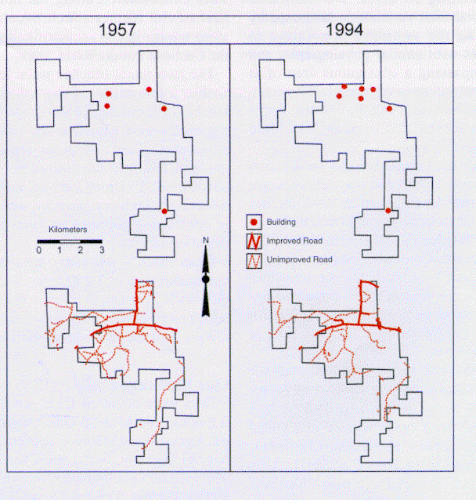
Intact Ranch # 2
Notes:
This ranch also remained intact between 1957 and 1994.

Slide 34
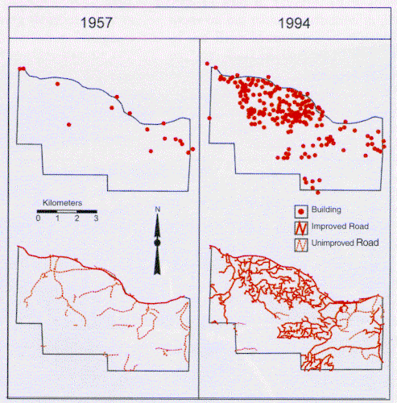
Subdivided Ranch #1
Notes:
This ranch was subdivided into smaller parcels that were developed sometime between 1957 and 1994.

Slide 35
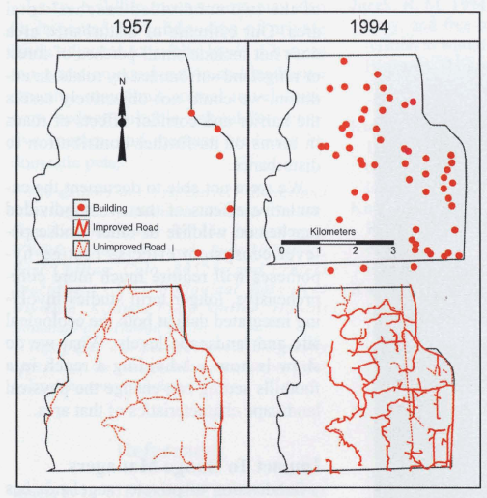
Subdivided Ranch #2
Notes:
This is an example of another ranch in the study area that was subdivided.

Slide 36
Preserving Open Space
 | Road Density (mi./sec.) | No. of Buildings (no./sec.) | No. of Rangeland Patches
 | 1957 1994 | 1957 1994 | 1957 1994
Intact Ranch | 0.84 1.08 | 0.8 0.5 | 35 49
Sudivided Ranch | 0.41 4.55 | 0.7 9.5 | 55 411
Mitchell, Knight & Camp. 2002. Landscape Attributes of Subdivided Ranches
Notes:
The data is clear when the intact ranches were compared to the subdivided ranches.

Slide 37
Preserving Open Space
Plant Cover by Management Regime
a
a
a
y
y
z
Maestas, Knight, and Gilgert. 2002. Cows, Condos, or Neither?
Notes:
Another interesting study by Dr. Knight and his colleagues showed that ranches had more native plant communities and less weeds than subdivided ranches (i.e., ranchettes) or reserves (i.e., parks and wildlife management reserves)

Slide 38
Land-Use and Ownership of Rangelands
NRCS USDA.gov
Jeff Vanuga USDA-NRCS
Mark Goebel-Flickr
Rangeland Principles
Notes:
Land-use and Ownership of Rangelands conclussion

