Slide 1
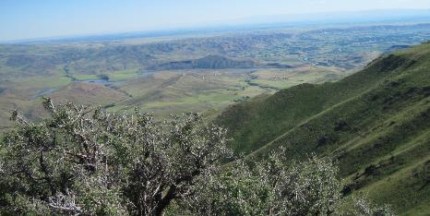
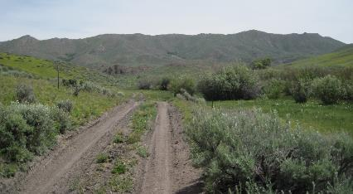

Managing Working Landscapes
Connor White
K. Launchbaugh
Rangeland Principles (REM 151)
Notes:
Managing Working Landscapes Introduction

Slide 2

Planning and Management Challenges
Managing Across Land Ownerships
  All Hands-All Lands
  Collaborative Resource Management
Managing Multiple Use
  Value of land varies across landscapes
  Value changes throughout the year
Managing for Outcomes
  Consider ecological, economic, and social outcomes
  Avoid prescriptions
J. Peterson
Notes:
Planning and Management Challenges
Managing Across Land ownership
Managing Multiple Use

Slide 3
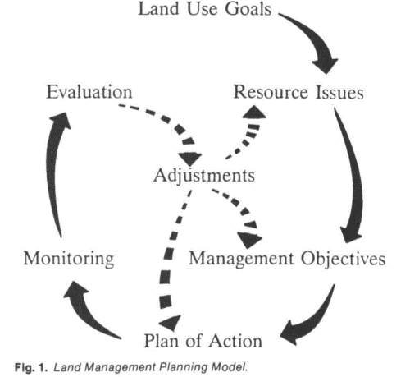
Management Approaches
Many Approaches – A few common elements.
Individually or Collaboratively…
Set goal
Create a plan
Monitor outcomes
Evaluate and adjust
→ Adaptive Management
Olson, N. C., & Burkhardt, J. W. (1992). Land management planning: an assessment. Rangelands, 14(3), 150-152.
Notes:
Management approaches
Many approaches- few common elements
Adaptive management

Slide 4
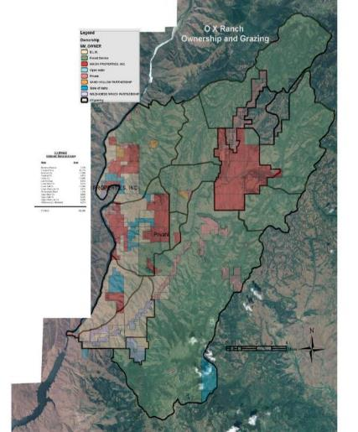

Managing Across Land Ownerships
Natural processes happen across land ownerships
  Fire
  Wildlife
  Water
  Weeds
  Etc.
Management across land ownerships
→ All Lands Approach
OX Ranch Idaho
130,000 acres
Notes:
Managing across Land Ownership- All lands approach

Slide 5
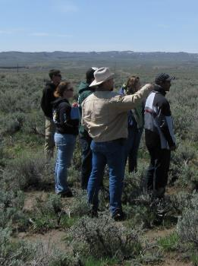
Managing Across Land Ownerships
Groups come together to manage a resources/value
  Cooperative Weed Management Area
  Sage-grouse Working Groups
  Rangeland Fire Protection Associations
  Arctic Grayling Cooperative Conservation
Focus on common goal
Bring diversity of skills & resources
→ Collaborative Resource Management
K. Launchbaugh
Notes:
Managing across land ownerships- collaborative resource management

Slide 6
Managing Multiple Uses
Manage various resource values in combinations that best meets present and future needs.
  Consider interactions among uses
  Balance uses and protection by apply restrictions and enhancements
  Public/cooperator involvement necessary
Required on federal lands by Federal Land Policy and Management Act of 1976.
Applied on private lands to make operation sustainable.
→ Multiple Use Management
Notes:
Managing multiple Uses- multiple use management
FLPMA Definition = “The term ‘multiple use’ means the management of the public lands and their various resource values so that they are utilized in the combination that will best meet the present and future needs of the American people; …

Slide 7
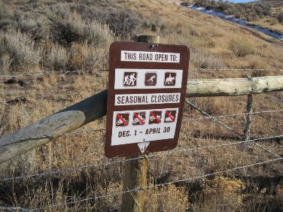
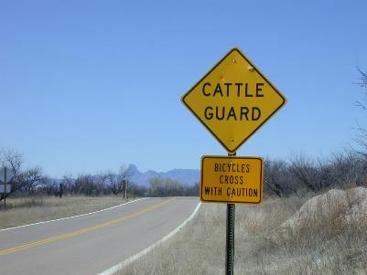

Managing Multiple Uses
Not every use on every acre
Use changes throughout the year
BLM.gov
K. Launchbaugh
Idaho Rangeland Resource Commission
Notes:
Managing multiple uses
Implementation = Travel management (route-by-route), Allotment plans, Specific projects

Slide 8
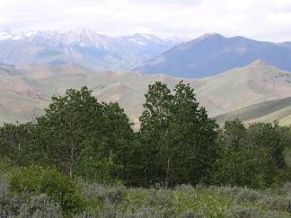





Outcome Based Management
Focus on Outcomes
  Ecological
  Economic
  Social
Avoid prescriptions
  Specific number
  Specific time
→ Outcomes Based Land Management
CURRENT
FUTURE
Ecological
Economic
Social
K. Launchbaugh
Notes:
Outcome based management – Outcomes based land management - present to future

Slide 9
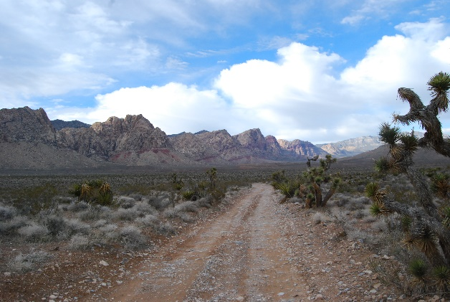
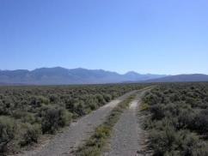
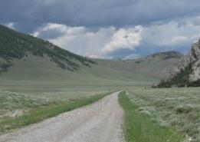
Outcome Based Management
Collaborative at Landscape Scales
Sustainable working landscapes that provide diverse goods and services for people who live, work, and recreate on the land.
→ Outcomes Based Land Management
BLM.gov
K. Launchbaugh
K. Launchbaugh
Notes:
Outcome based management

Slide 10
Managing Working Landscapes
Connor White
K. Launchbaugh
Rangeland Principles (REM 151)
Notes:
Managing Working Landscapes conclussion

