Slide 1
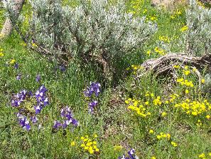
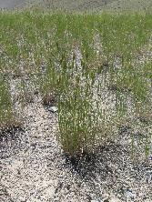
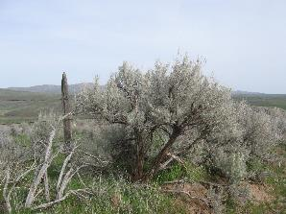
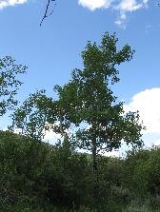

Rangeland Plants
Josh Corbet
K. Launchbaugh
K. Launchbaugh
K. Launchbaugh
Rangeland Principles (REM 151)

Slide 2
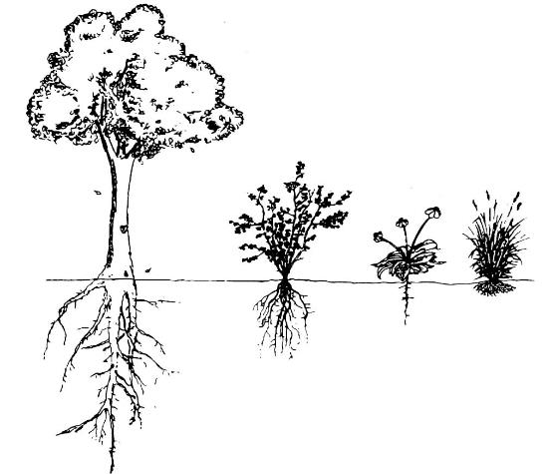
Growth Forms
4 major growth
forms:
  Grasses
  Grass-likes
  Forbs
  Shrubs
Grasses
Grass-like
Tree*
Forbs
Shrubs
Notes:
Monocots vs. Dicots

Slide 3
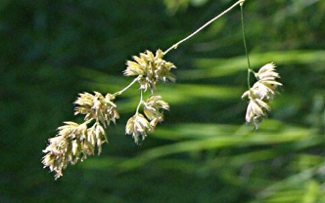
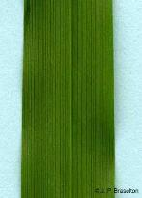
Growth Forms
Monocots
Grasses
Grass-like
Tree*
http://www.ohio.edu/people/braselto/readings/angiosperms.html
Forbs
Shrubs
Notes:
Monocots vs. Dicots

Slide 4
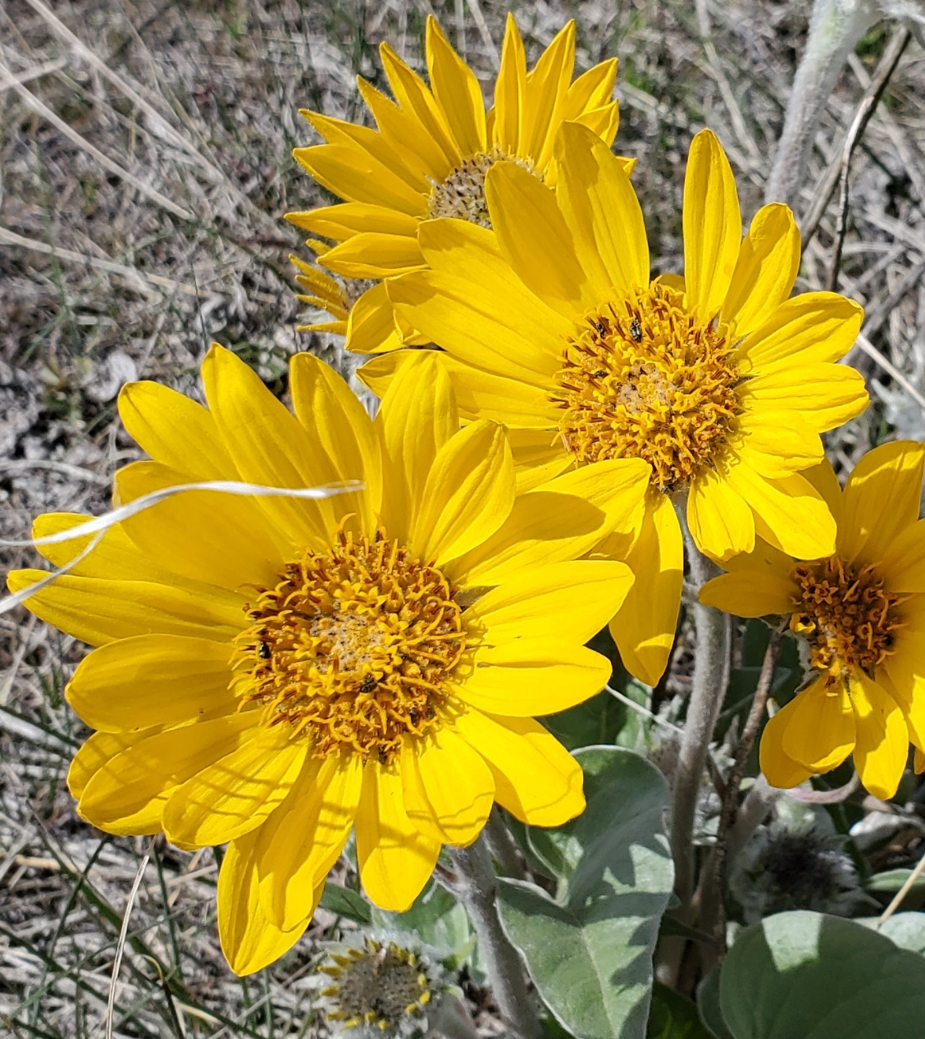
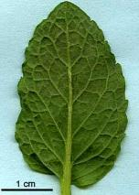
Growth Forms
Dicots
Grasses
Grass-like
Tree*
http://www.ohio.edu/people/braselto/readings/angiosperms.html
Forbs
Shrubs
Notes:
Monocots vs. Dicots

Slide 5
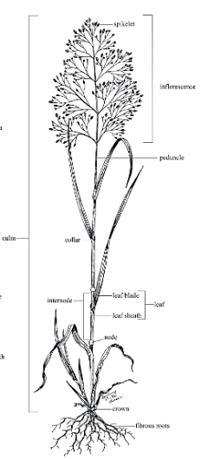
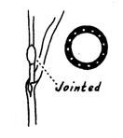
Grasses
Inflorescence
Herbaceous
No showy flowers – Wind Pollinated
Size: very small to very large
Jointed stems
Stems hollow
Parallel veins
Fibrous roots
Internode
Node
Fibrous Roots

Slide 6
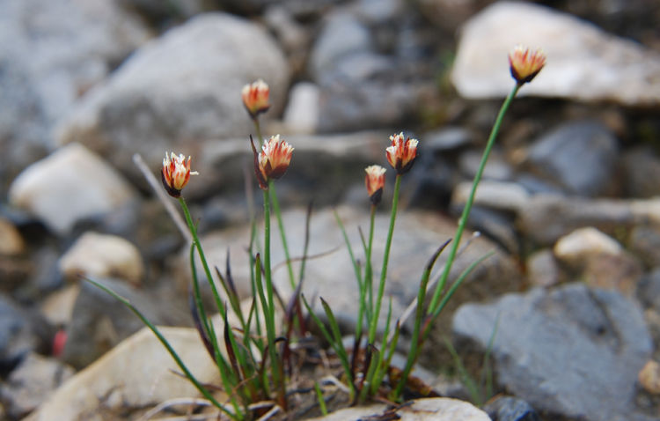

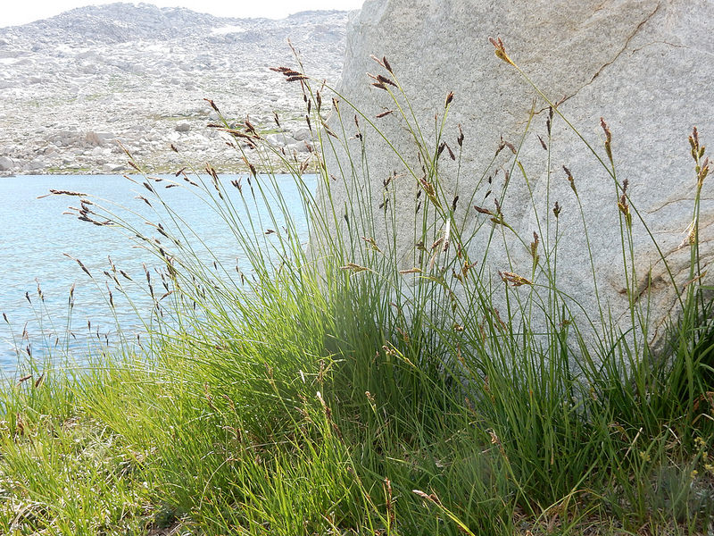

Grass-like
Sedges, rushes & bullrushes
Herbaceous
No showy flowers
Size: very small to very large
Stems without joints
Stems solid - triangular or round
Parallel veins
Fibrous roots
Rushes
idfg.Idaho.gov
Sedges
Matt Lavin

Slide 7
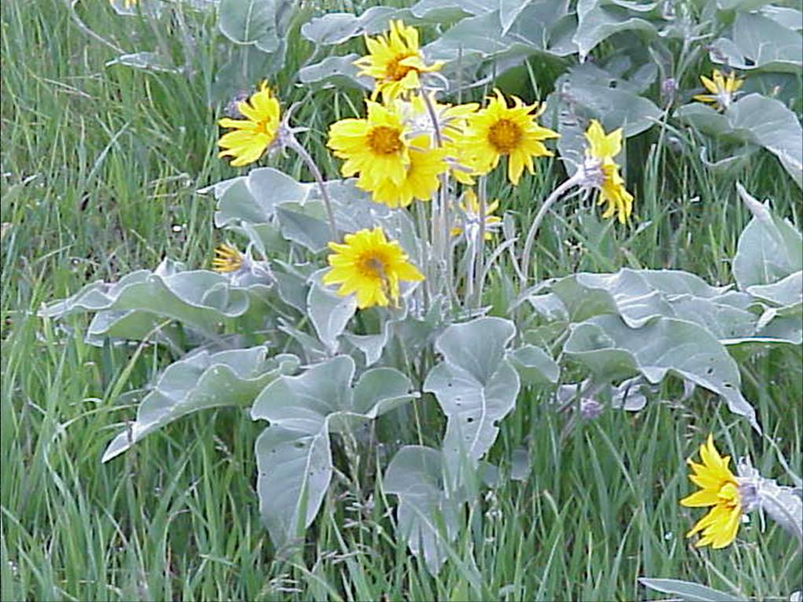

Forbs
Herbaceous
Showy flowers
Solid stems
Broad leaves
Taproots
Above-ground growth dies back each year.
James Kingery
Notes:
Range wildflowers and weeds.

Slide 8
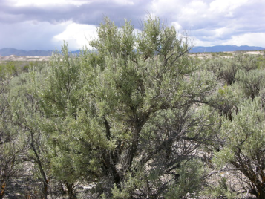

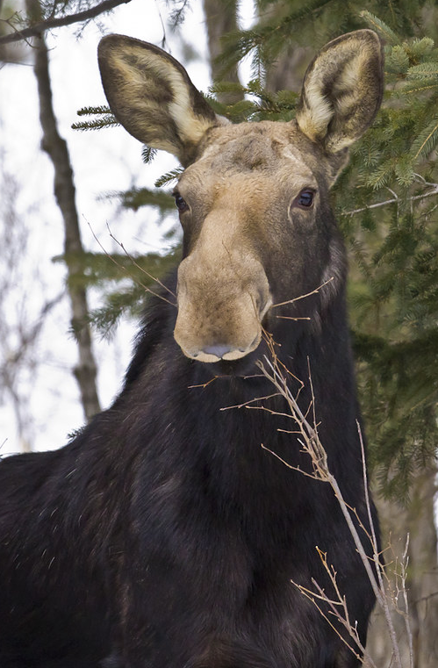
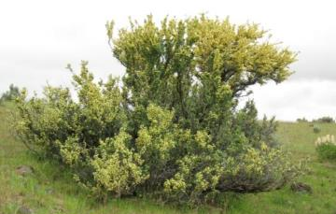
Shrub
Woody
Growth ring every year
Several main stems
Broad leaves
Taproots
Defenses against grazing
Jen Peterson
Browse = New stems and leaves that are eaten as forage
K. Launchbaugh
Notes:
Usually have broad leaves, wood = secondary growth, cambium layer
Taproots = deep roots to tolerate xeric environments
Defense against grazing: chemical, physical, large plants

Slide 9
Life Span
Length of time from the beginning of development to death of the plant
  Annuals – live for one growing season
    Winter annuals
    Summer annuals
  Biennials – live for two growing seasons
  Perennials – live from one year to the next
    Warm season
    Cool Season

Slide 10
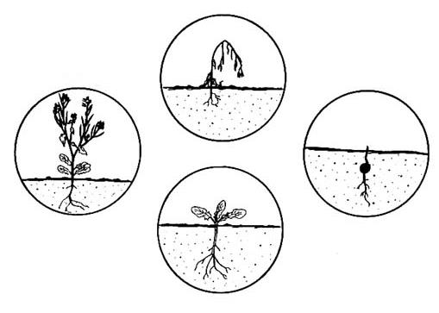
Winter Annuals
Summer
plant dies
Spring
Fall
germinate
produce seed
Winter
dormant

Slide 11
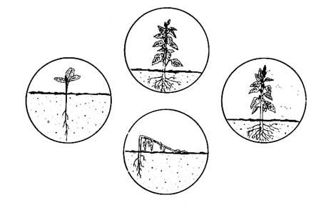
Summer Annuals
Summer
grow
Spring
Fall
germinate
Winter
produce seed
plant dies

Slide 12
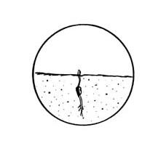
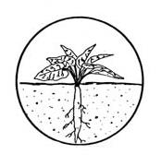
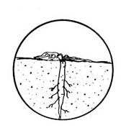
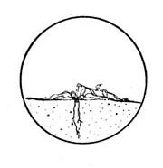
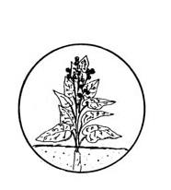
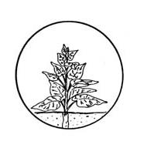
Biennials
Spring
Summer & Fall
Winter
go dormant
germinate
produce rosette & developed roots
Winter
Spring
Summer
plant dies
produce flowering stalk
produce seed

Slide 13
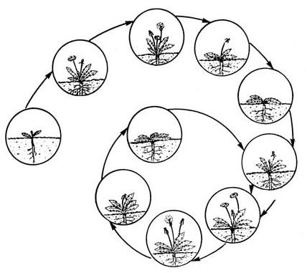
Perennials
produce seed
1st Summer
1st Fall
flower
1st Winter
Winter
go dormant
1st Spring
Spring
germinate
go dormant
Fall
new plant from root
build up root reserves
flower
Summer
produce seed
Cycle continues until plant eventually dies

Slide 14
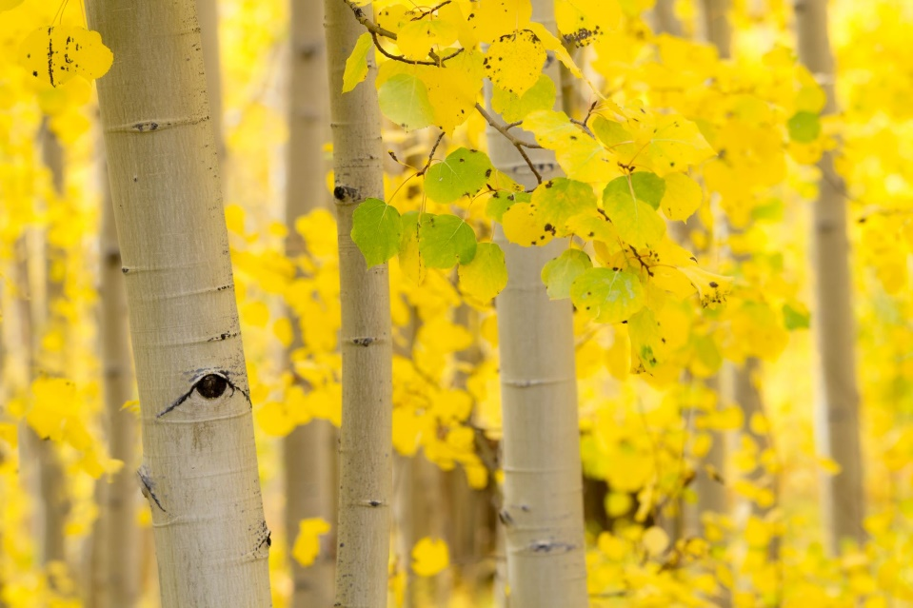
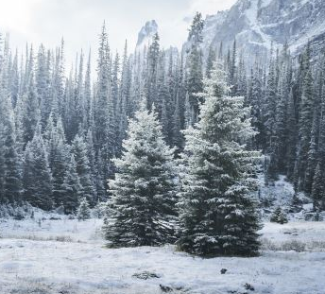
Woody Perennials
Deciduous
  Loses leaves and are leafless in dormant season each year.
  Evergreen
  Has some live leave on plant through out the year.

Slide 15
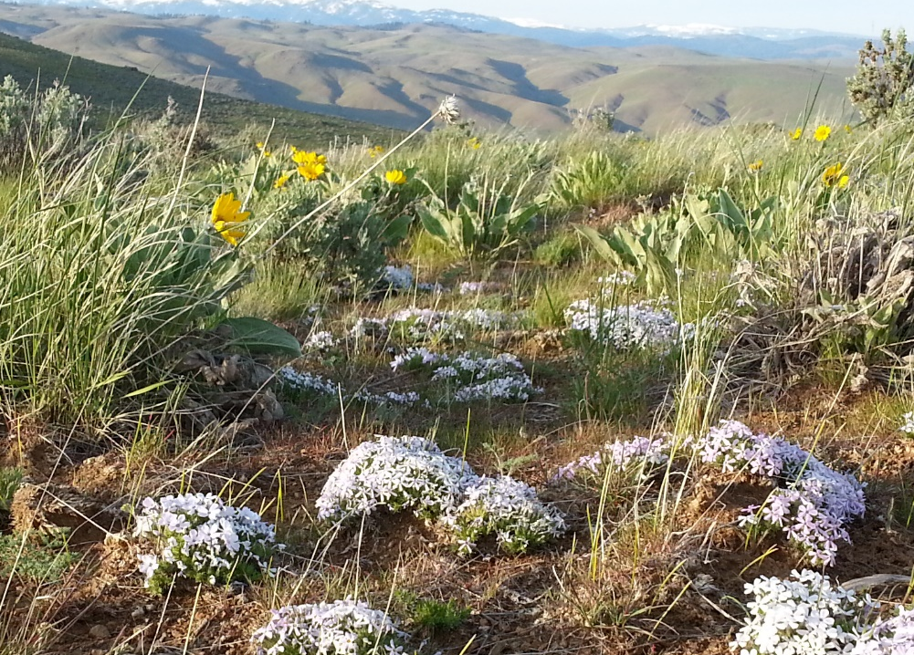
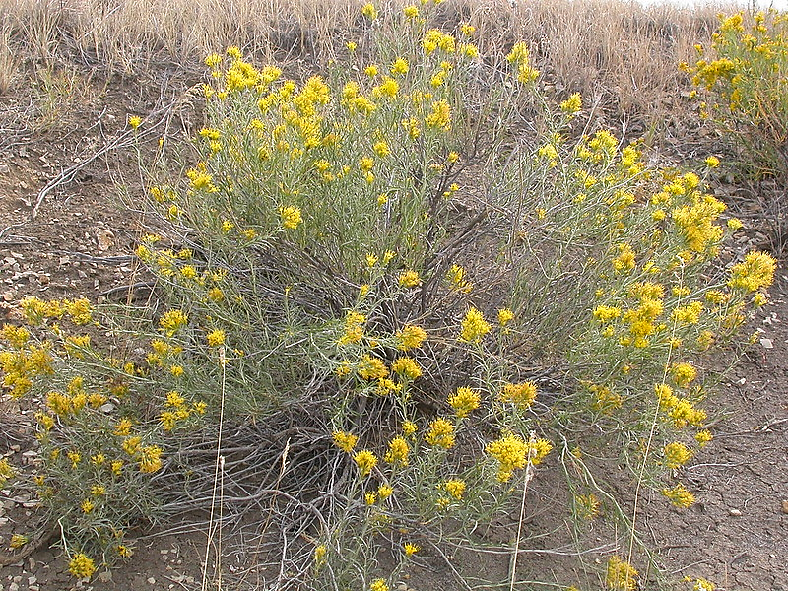
Season of Growth
Cool Season = Most growth in spring and fall.
  C3 plants
Warm Season = Most actively growing in summer.
  C4 plants
K. Launchbaugh
Matt Lavin

Slide 16
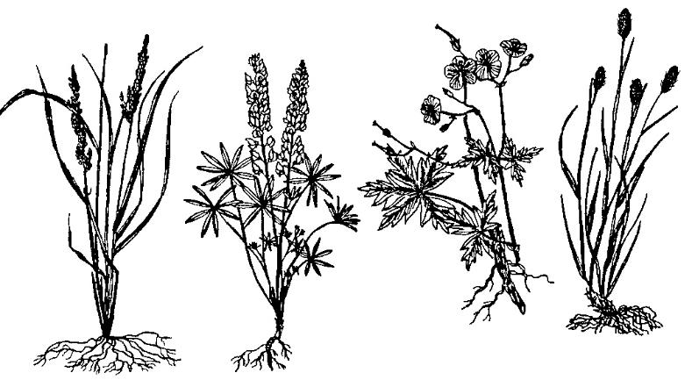
Morphology of Range Plants
The physical form and/or external structures of a plant.
Leaves
Stems
Roots
Flowers
Notes:
What would be a physical form and/or external structure that could be used to describe a plant? Leaves, stems, roots, flowers, etc…

Slide 17
Leaves – photosynthetic organs of the plant
Types
Arrangements
Shapes
Margins
Venations

Slide 18




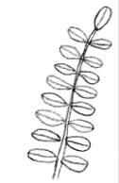
Leaf Type
Simple
Compound
Compound - Palmate
Compound - Pinnate
Leaf is undivided
May be deeply lobed or cleft, but not separated into leaflets
A leaf separated into two or more distinct leaflets
Distinct connection to stem at base of leaf
Notes:
Simple: Undivided, as a leaf blade which is not separated into leaflets (though the blade may be deeply lobed or cleft).
Compound: A leaf separated into two or more distinct leaflets. (Leaflet: a division of a compound leaf).
Compound Palmate: Lobed, veined, or divided from a common point, like the fingers on a hand.
Compound Pinnate: A compound leaf with leaflet arranged on opposite sides of an elongated axis.

Slide 19
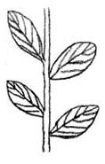
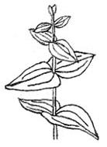

Leaf Arrangement
Alternate
Opposite
Whorled
Leaves alternating up stem.
Leaves across from each other on stem
Ring-like arrangement of leaves around stem
Notes:
Node: The position on the stem where leaves or branches originate.

Slide 20
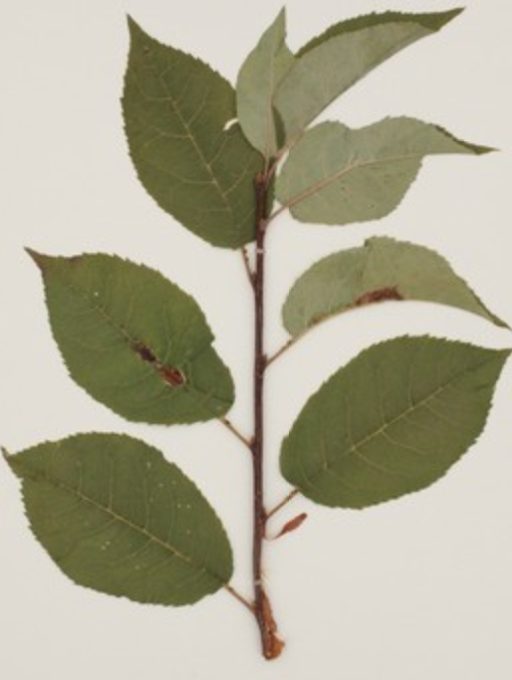
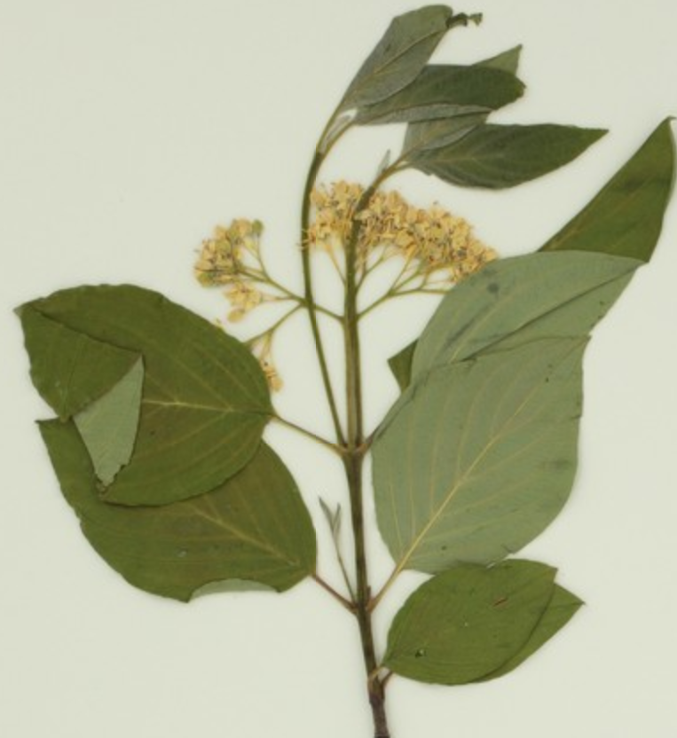
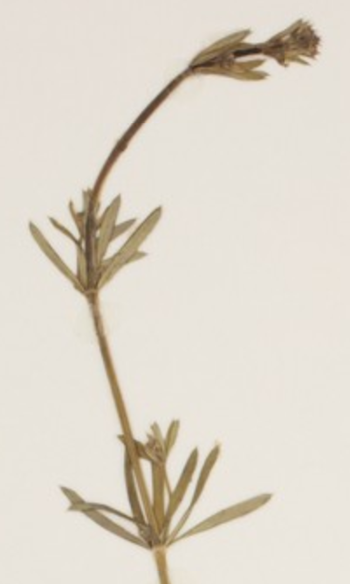
Leaf Arrangement
Alternate
Opposite
Whorled
www.pnwherbaria.org
www.pnwherbaria.org
www.pnwherbaria.org

Slide 21








Leaf Shape
Linear
Oblanceolate
Elliptic
Lanceolate
Ovate
Obovate
Palmate
Notes:
Linear: Resembling a line; long and narrow with more or less parallel sides.
Elliptic: The shape of an ellipse, or a narrow oval; broadest at the middle and narrower at the two equal ends.
Lanceolate: Lance-shaped; much longer than wide, with the widest point below the middle.
Oblanceolate: Inversely lanceolate, with the attachment at the narrower end.
Ovate: Egg-shaped in outline and attached at the broad end.
Obovate: Inversely ovate, with the attachment at the narrower end.
Palmate: Lobed, veined, or divided from a common point, like the finger of a hand.

Slide 22


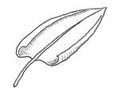

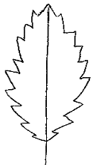

Leaf Margin
Lobed-palmate
Lobed-pinnate
Involute
Entire
Serrate
Sinuate
Notes:
Lobe: A rounded division or segment or an organ, as of a leaf.
Entire: Not toothed, notched, or divided, as the continuous margins of some leaves.
Serrate: Saw-like, toothed along the margin, the sharp teeth pointing forward.
Sinuate: With a strongly wavy margin.
Involute: With the margins rolled inward toward the upper side.

Slide 23

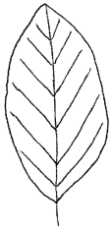
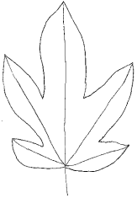
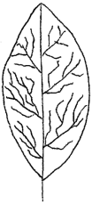
Leaf Venations
Parallel
Pinnate
Palmate
Netted
Notes:
Netted or Net-Veined: in the form of a network.

Slide 24

Stem
The part of the plant bearing nodes, leaves, buds, flowers & fruits

Slide 25



Stems
Grasses
Grass-likes
Forbs
Shrubs
(Sedges)
(Rushes)
Hollow or Pithy
(culm)
Solid Not Jointed
Solid
Woody Solid
Notes:
Grasses: The flowering stem (culm) of grasses is comprised of nodes and internodes yielding a characteristics “jointed” stem. Grass stems have solid joints at the nodes with hollow or pith-filled internodes.
In contrast, rushes and sedges are without nodes and internodes, solid.
Pith: The spongy, parenchymatous central tissue in some stems and roots.

Slide 26
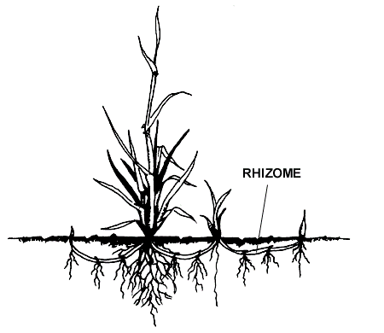
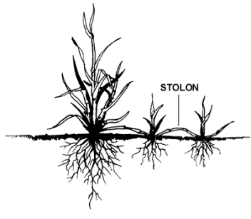
Stems
Rhizomatus Plants
Stoloniferous Plants
Notes:
Structures for Plant Propagation.
Rhizomes are UNDERGROUND modified stems that give rise to new plants.
Stolons are ABOVEGROUND modified stems that give rise to new plants.

Slide 27
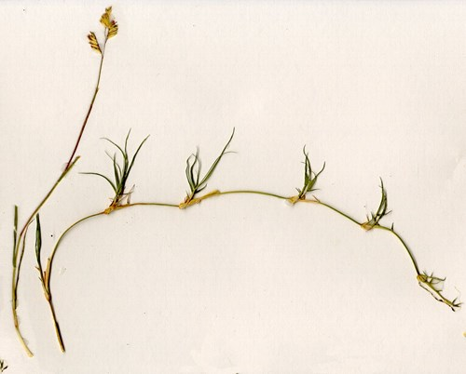
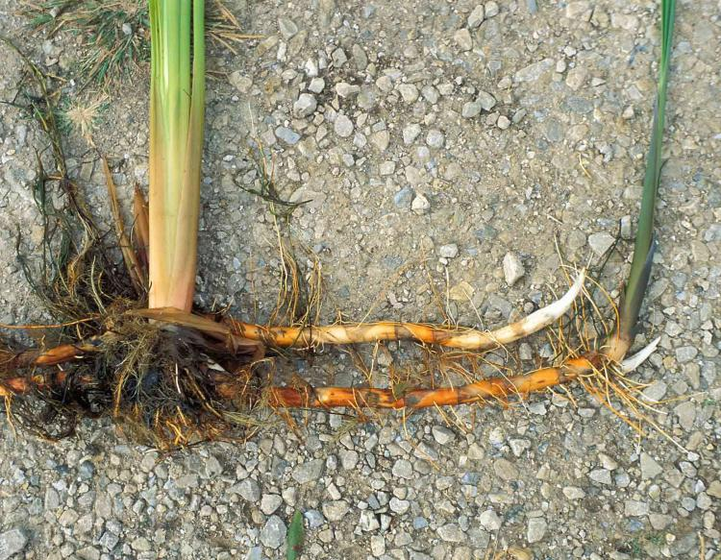
Stems
Rhizomes
Cattail
Stolons
Buffalo grass
warcapps.usgs.gov
nature.mdc.mo.gov
Notes:
Form of asexual reproduction: offspring arise from a single organism.

Slide 28
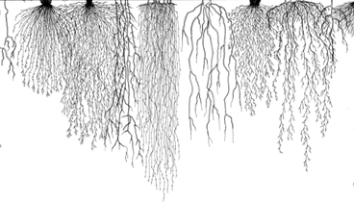
Roots
The part of the plant that absorbs water and nutrients from the soil
Notes:
Stamen: the male reproductive organ of a flower, consisting of an anther and filament.
Pistils: The female reproductive organ of a flower, typically consisting of a stigma, style, and ovary.
Parianth: the calyx and corolla of a flower, collectively, especially when they are similar in appearance.
Sepals: A segment of the calyx. Calyx: the out perianth whorl; collectively term for all of the sepals of the flower.
Petal: An individual segment or member of the corolla, usualy colored or white.

Slide 29
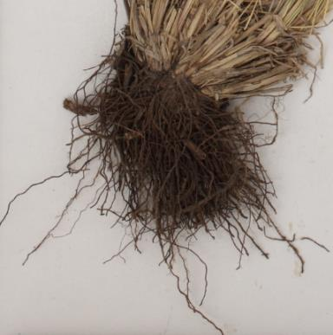
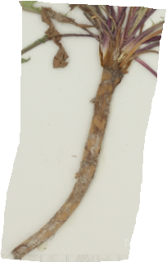
Roots
Fibrous
Taproot
www.pnwherbaria.org
www.pnwherbaria.org
Idaho Fescue
Common dandelion

Slide 30

Flowers
Reproductive part of the plant that produces flowers & fruits
Group of flowers = inflorescence or seedhead
Notes:
Stamen: the male reproductive organ of a flower, consisting of an anther and filament.
Pistils: The female reproductive organ of a flower, typically consisting of a stigma, style, and ovary.
Parianth: the calyx and corolla of a flower, collectively, especially when they are similar in appearance.
Sepals: A segment of the calyx. Calyx: the out perianth whorl; collectively term for all of the sepals of the flower.
Petal: An individual segment or member of the corolla, usualy colored or white.

Slide 31


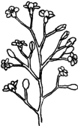


Inflorescence types
Spike
Raceme
Panicle
Umbel
Coyrmb
Notes:
Spike: An unbranched, elongated inflorescence with sessile or subsessile flowers or spikelets maturing from the bottom upwards. Sessile: Attached directly, without a supporting stalk, as a leaf without a petiole.
Raceme: An unbranched, elongated inflorescence with pedicellate flowers maturing from the bottom upwards.
Panicle: A branched, racemose inflorescence with flowers maturing from the bottom upwards.
Umbel: A flat-topped or convex inflorescence with the pedicles arising more or less from a point, like the struts of an umbrella.
Head: A dense cluster of sessile or subsessile flowers; the involucrate inflorescence of the Compositae (Asteraceae).

Slide 32


Flowers - Composite Heads
Ray and Disk Flowers (Sunflower)

Slide 33
Rangeland Plants
Josh Corbet
K. Launchbaugh
K. Launchbaugh
K. Launchbaugh
Rangeland Principles (REM 151)

