Slide 1
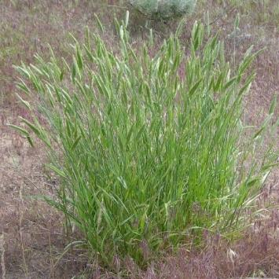
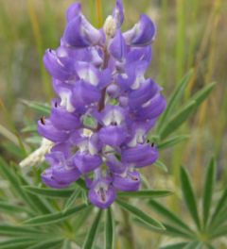

Forage Value & Poisonous Plants
Jennifer Peterson
Rangeland Principles (REM 151)
Jennifer Peterson

Slide 2
Based on the most limiting nutrients on rangelands in the western U.S.
Energy –
  Structural Carbohydrates (e.g., cellulose)
  Sugars & Starch
  Fats (limited, but important for birds and rodents)
Nutrients –
  Protein = nitrogenous compounds
  Phosphorus = generally most limiting mineral on rangelands
  Vitamins = carotene or vitamin A
Notes:
When we talk about animals, we talk about energy requirements. In this presentation we are going to go more in-depth into energy and nutrients. Phosphorus and Vitamin A are two nutrients that are not as readily available in rangelands environments.

Slide 3
What affects plant nutritive value?
Three Major Factors:
Cell structure (ratio of Cell Walls to Cell Contents)
Degree of lignification
“Anti-quality” factors and toxins
Notes:
The ratio of cell wall to cell contents describes the cell structure. Lignin is the component that binds cellulose and makes plants woody. Things that are poisonous and not very digestible are called secondary compounds, or anti-quality factors.

Slide 4
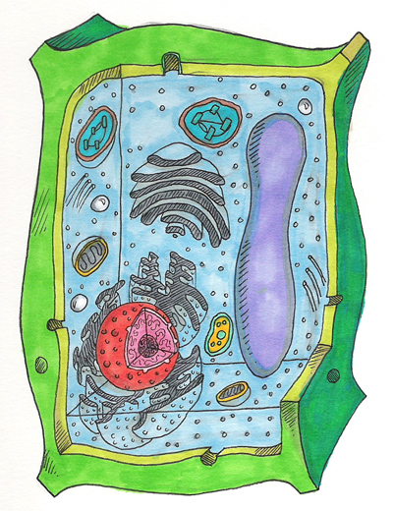
Cell Structure: (Wall:Contents)
Cell Contents
Sugars
Starch
Organic acids
Protein
Cell Wall
Cellulose
Hemicellulose
Pectin
Lignin
Silica
Cutin
Notes:
Mammals cannot deal with any of the components of the cell wall. All the things in the cell contents can be digested by mammals. So anytime you have cells with more cell contents, that cell is going to be more nutritious. What are some of the things that affects the

Slide 5
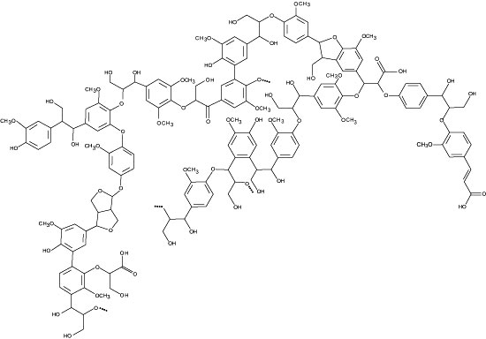
Degree of Lignification
Lignin = indigestible portions of cell walls that impregnates cellulose to form wood.
Lignin Structure is
Complex
Notes:
Lignin is a polymorphic carbon compound that has a complex structure. This structure binds up the cellulose.

Slide 6
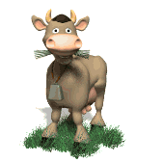
“Anti-quality” Factors
Plants may contain compounds that:
  Are not digestible
  Reduce digestibility of nutrients
  Adversely affect the herbivore
  Make plants “unpalatable”
  More common in forbs and shrubs than grasses.
Notes:
We will talk more about some of these anti-quality factors.

Slide 7
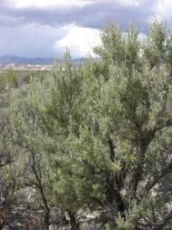
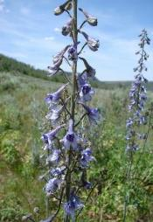
“Anti-quality” Factors
Inhibitors – Inhibit or reduced digestion
  Bind with nutrients to reduce digestibility
  Kill microbes and inhibiting microbial growth in gut
Toxins – Affect herbivores directly
  Cause illness or death
K. Launchbuagh
Sheri Hagwood - BLM
Notes:
Anti-quality factors can be divided into two groups: 1) those that inhibit digestions, 2) those that directly affect the health and production of the animal.

Slide 8
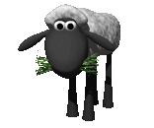
Toxic or Poisonous Plants
  What is a toxic plant?
  What effects do toxic plants have?
    Death
    Birth Defects (called “Teratogenic” effects)
    Reproductive Dysfunction
    Bloat
    Dermatitis and Skin Sores
    Neurological Effects
    Etc. etc. etc.
Plant that causes negative digestive or physiological effect
Notes:
Toxic plants can have many different effects on animals

Slide 9

Toxic Agents in Plants
  Alkaloids
  Glycosides
  Nitrates
  Soluble Oxalates
  Tannins
  Essential oils (or terpenes)
  Compounds that cause photosensitization
  Plants that cause dermatitis

Slide 10
Alkaloids
  Most powerful of toxic plant substances
    caffeine, morphine, codeine, heroine, cocaine
  Often toxic in small quantities
  Remain toxic as plant matures or freezes
  Causes nervous disorders
    Negative reinforcement in skin-defense system (cause pain or sensitivity)
  Often don’t make animals sick so they eat a lot of plants containing alkaloids

Slide 11
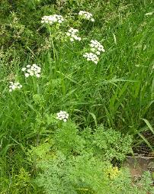
Plants that contain Alkaloids
Lupines (Lupinus)
Locoweeds (Oxytropis and Astragalus)
Larkspurs (Delphinium)
  Tall larkspur causes more livestock deaths than any other toxic plants
Bitterweed (Hymenoxys odorata)
Poison hemlock (Conium maculatum) and Water hemlock (Cicuta douglasii)
J. Peterson
Sheri Hagwood - BLM
K. Launchbaugh

Slide 12
Glycosides
Naturally occurring compounds found in many rangeland plants and forages
Block oxygen transport and release in blood
Can be highly toxic, even causing death
Don’t usually provide a negative post-digestive feedback
Highly variable in time and space - Careful management to prevent high ingestion levels

Slide 13
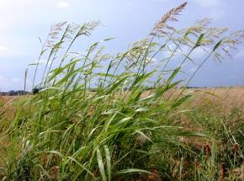
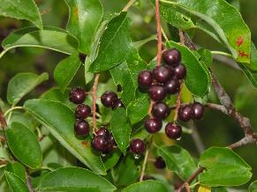
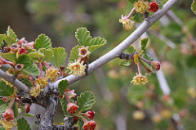
Plants that contain Glycosides
Johnson grass (Sorgham halepense)
Chokecherry (Prunus virginiana)
Mountain mahogany (Cercocarpus montanus)
Serviceberry (Amelanchier alnifolia)
Bur buttercup (Ranunculus testiculatus)
White clover (Trifolium repens)
agriculture.ks.gov
K. Launchbaugh
Andrey Zharkikh

Slide 14
Nitrates
Nitrates accumulate in plants under certain conditions:
  High nitrogen soils
  Drought
  Low light conditions
  Treatments with some herbicides (such as 2,4-D)
Block ability of blood to carry oxygen
Doesn’t usually cause illness leading to aversions

Slide 15
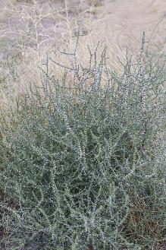
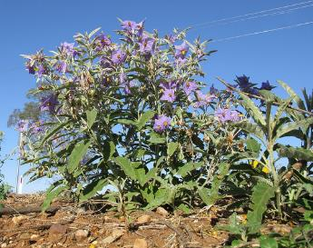
Plants that contain Nitrates
Russian thistle (Salsola iberica)
Silverleaf nightshade (Solanum elaeagnifolium)
Kochia (Kochia scoparia)
Careless weed (Amaranthus retroflexus)
Ed Ogle
Harry Rose

Slide 16
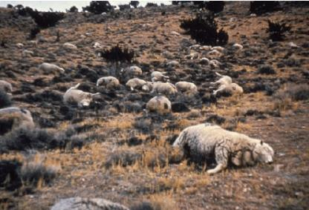
Soluble Oxalates
Oxalates chelate cations, especially calcium, to form insoluble crystalized salts that damage vessels.
Mostly toxic to sheep - Catastrophic Losses
  1942 – Wells, NV – 160 sheep
  1945 – Twin Falls, ID – 275 sheep
  1945 – Raft River Valley, ID – 750 sheep
  1945 – Raft River Valley, ID – 1620 sheep
  1952 – Park Valley, UT – 1200 sheep
Only occasionally toxic to cattle
1250 sheep died after over-ingested halogen near Garrison, UT in 1971

Slide 17
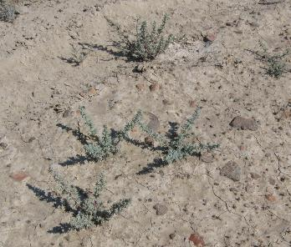
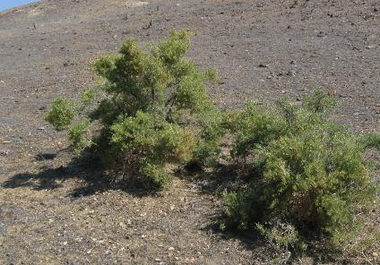
Plants that contain Oxalates
Halogeton
(Halogeton glomeratus)
Greasewood
(Sarcobatus vermiculatus)
K. Launchbaugh
K. Launchbaugh

Slide 18
Tannins
Reduce protein digestion
Don’t cause nausea leading to aversions except at very high levels
Decrease weight gain because of decreased protein availability
Lethal at high quantities – not common but can occur such as does in “oak poisoning”

Slide 19
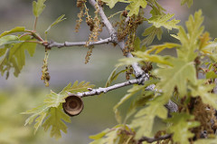
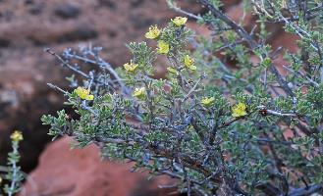
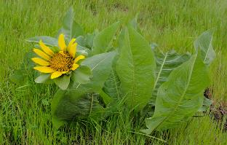
Plants that contain Tannins
Most oak-brushes
(e.g., Quercus gambellii)
Blackbrush
(Coleogyne ramosissima)
Mules ear
(Wyethia amplexicaulis)
Andrey Zharkikh
Andrey Zharkikh
Miguel Vieira

Slide 20
Essential Oils or Terpenes
Give distinctive odor to plant (an essence)
Kill rumen microbes (i.e., “pine-sol effect”)
Can cause illness and nausea
Decrease weight gain
Lethal in high quantities

Slide 21
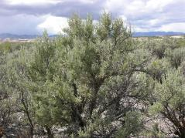
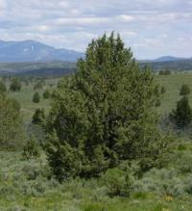
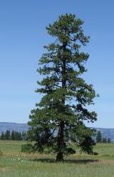
Plants that contain Essential Oils
Sagebrush
  (e.g., Artemisia tridentata)
Juniper
  (e.g., Juniperus occidentalis)
Pine
  (e.g., Pinus ponderosa)
J. Peterson
J. Peterson
J. Peterson

Slide 22
Compounds that cause Photosensitization
Causes swelling of head and ears.
Sloughing of skin when exposed to sun.
Prevents liver’s ability to breakdown certain pigments.
Can cause death.
Does not generally cause illness that could lead to conditioned flavor aversions.

Slide 23
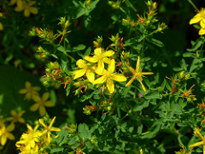
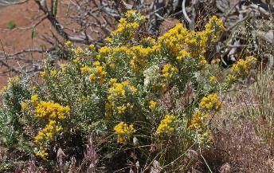
Plants that cause Photosensitization
St. John’s wort
(Hypericum perforatum)
Horsebrush
(Tetradymia canescens)
Rusty Clark
Andrey Zharkikh

Slide 24
Plants substances causing Dermatitis
Toxins that are poisonous upon contact
Affect skin defense system
Rarely lethal but cause production losses

Slide 25
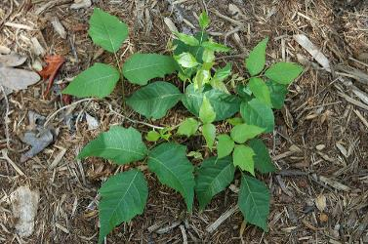
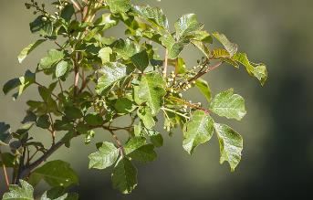
Plants causing Dermatitis
Poison ivy
(Rhus rydbergii )
Poison sumac
(Rhus venix)
Poison oak
  (Toxicodendron diversilobum)
flickr.com/cygnus921
Greg Shine, BLM

Slide 26
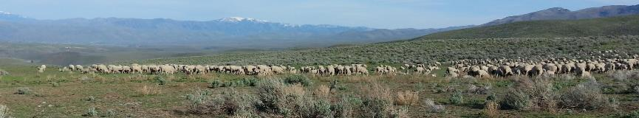
Preventing Animal Poisoning
Provide adequate supply of good forage
Provide salt and minerals
Don’t put hungry animals in pastures with abundant toxic plants
Be careful when introducing animals to new pastures
Be aware of conditions that create toxic plants and where toxic plants are located
K. Launchbaugh

Slide 27
Toxic or Poisonous Plants
Type | Name | Longevity | Origin
Forb | Tailcup Lupine | Perennial | Native
Forb | Tall Larkspur | Perennial | Native
Notes:
Many plants include toxic compounds and are therefore called “poisonous plants”. We will examine just two in this class.

Slide 28
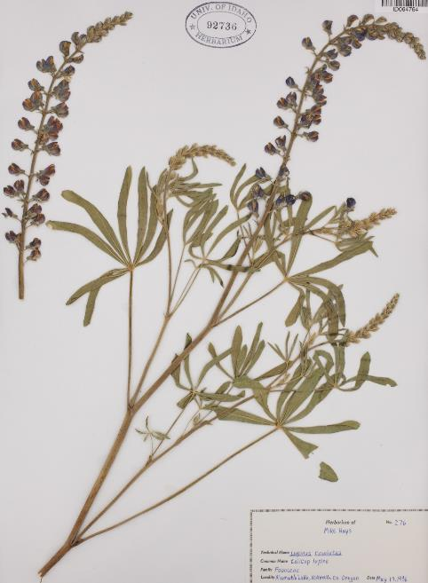
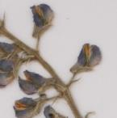
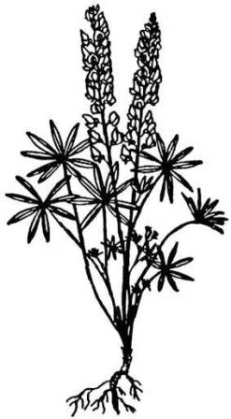
Tailcup Lupine
Perennial | Native
Raceme Seedhead
Blue or Purple Flower
Palmately Compound Leaves
University of Idaho Stillinger Herbarium (http://www.pnwherbaria.org
Notes:
Tailcup lupine is just one of many lupines on the range that can negatively affect the animal. All lupines have a similar “look” so you may not know the exact species but it is important to recognize a lupine when you see it.

Slide 29
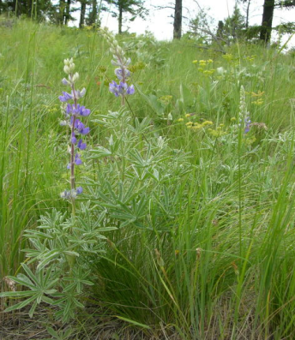
Tailcup Lupine
Perennial | Native
Contains alkaloids
Nervousness
Excessive salivation
or frothing at the mouth
Reluctance to move about
Difficulty breathing
Twitching leg muscles
Loss of all muscular control
Convulsions
Coma & Death
Some lupines cause birth defects
Jennifer Peterson
Jennifer Peterson
Notes:
Lupines contain alkaloids that affect the nervous system of the animal.

Slide 30
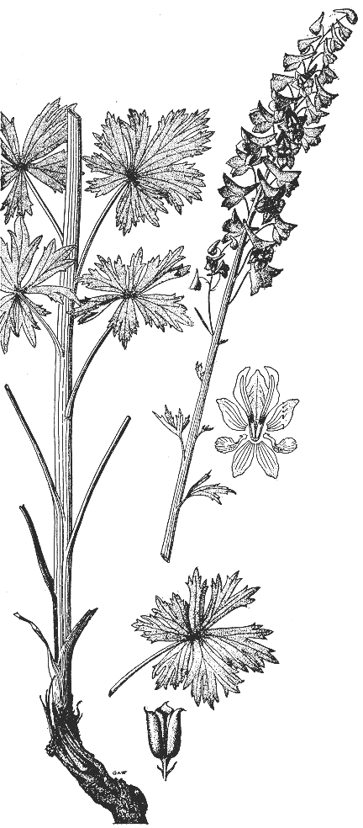
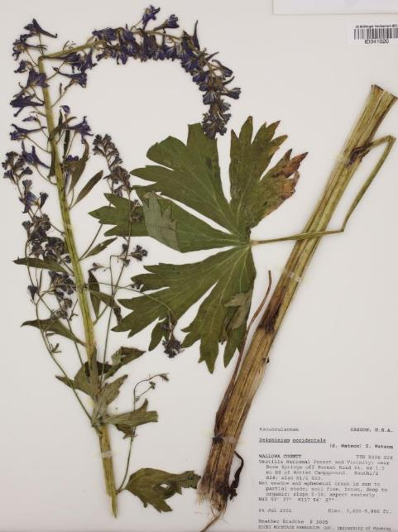
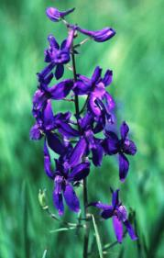
Tall Larkspur
Perennial | Native
Raceme Seedhead
Purple Flowers
Palmately Lobed Leaves
Some lupines cause birth defects
University of Idaho Stillinger Herbarium (http://www.pnwherbaria.org
Notes:
Tall larkspur is a very deadly plant that can be recognized by its raceme of purple flowers and it’s large palmately-lobed leaves.

Slide 31
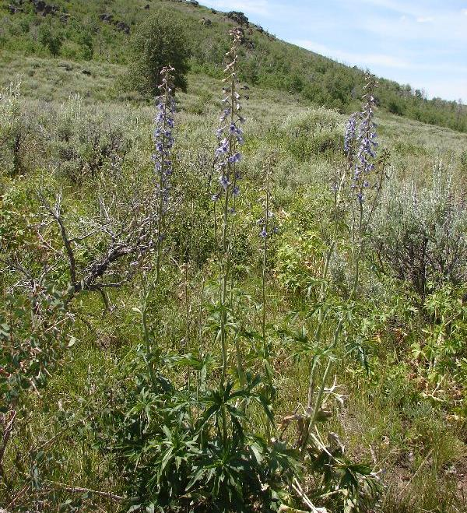
Tall Larkspur
Perennial | Native
Contains Alkaloids:
More livestock die from this plant than any other plant in North America.
Symptoms:
  Nervousness
  Rapid, irregular pulse
  Weakness & staggering
  Animal may fall suddenly
  Death
Excitement and physical exercise intensifies all signs of poisoning
Sheri Hagwood, BLM
Notes:
Responsible for more livestock death than any other plant in the N. America. Flowers have a spur on them which is where the name “larkspur” comes from.

Slide 32
Forage Value & Poisonous Plants
Jennifer Peterson
Rangeland Principles (REM 151)
Jennifer Peterson

