Slide 1
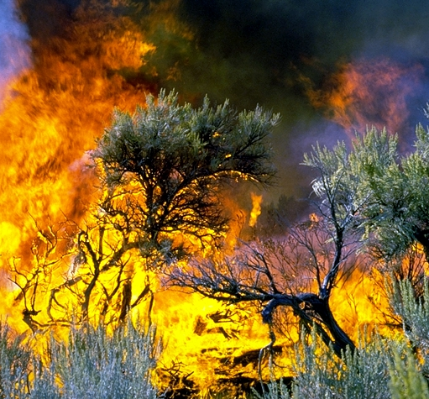
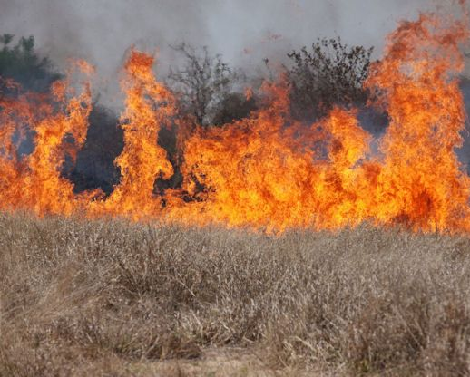
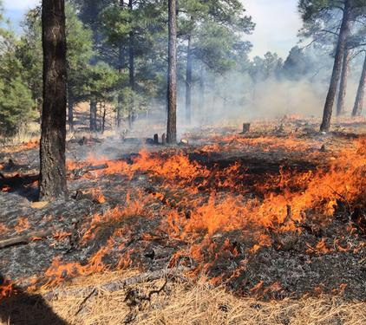

Plant Response to Fire
Steve Bunting
USDA NRCS
USGS
Rangeland Principles (REM 151)
Notes:
Plant Response to Fire introdution
How plants grow and respond to disturbance…

Slide 2
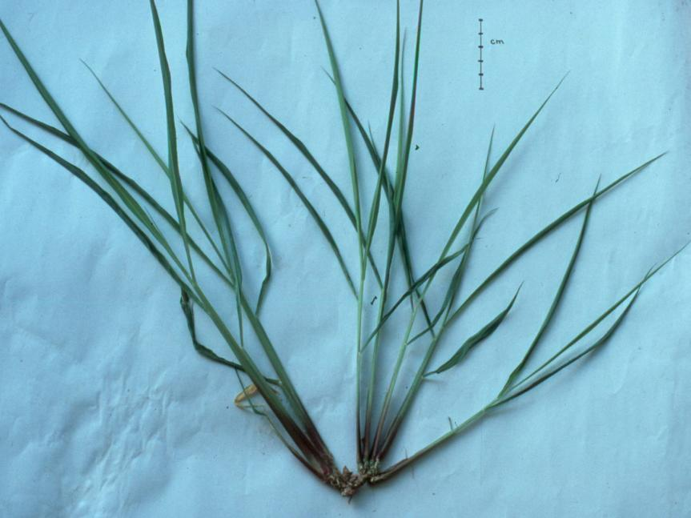
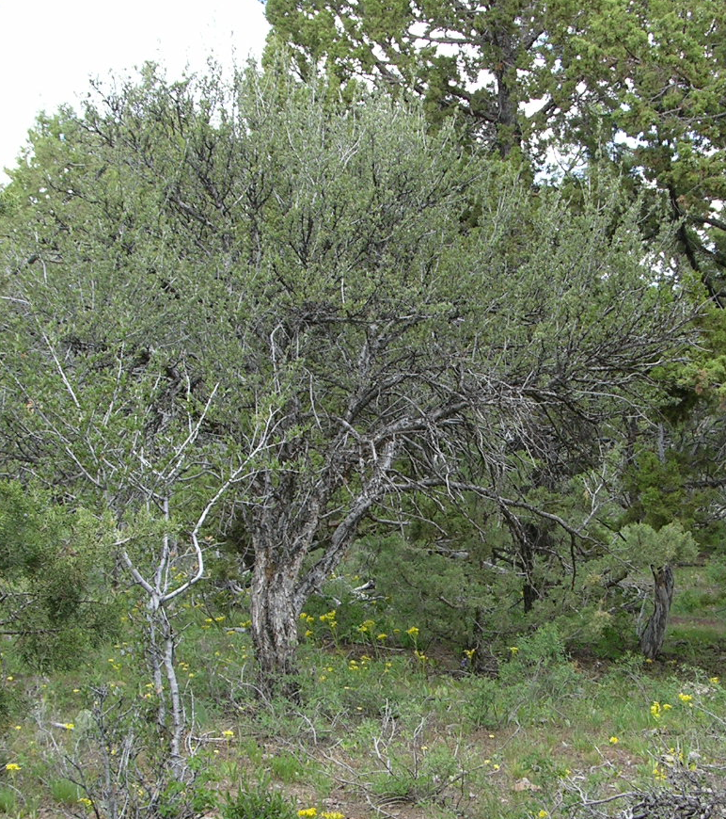
Location of Growing Points
Notes:
Location of Growing Points:
Meristem is the tissue that is actively dividing cells. Some of added to the roots but most of them are added to the region of elongation.
For grasses, when you’re applying a management practice, you must be aware of the morphology of the plants in the community being treated. Grasses with growing points at the base are more resistant to fire and grazing.

Slide 3
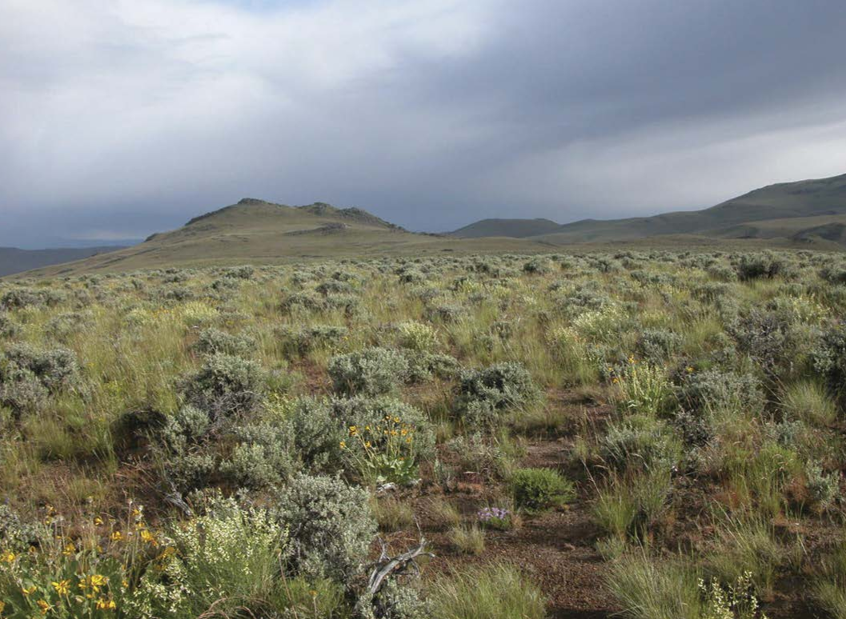
Season is Important
  Phenological stage
  Opportunity for re-growth
Kirk Davies USDA-ARS
Notes:
Season of use & Phenological stage -- Plants are more resistant to intense herbivory during dormancy than in active growth.
Opportunity for re-growth – Will plants be able to produce new leaves and develop strong root systems prior to entering dormancy following defoliation?

Slide 4
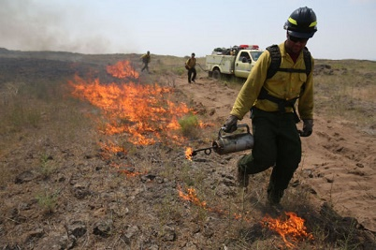
Types of Fires
Wildfire -
Wildland Use Fire -
Prescribed Fire -
Fire started under natural conditions and control is attempted
Fire started under natural conditions but withing prescription and allowed to burn
USDA NRCS
Fire intentionally set under strictly set conditions (temp & wind)
Sage-grouse Initiative (USDS) Steve Stuebner
Notes:
Three types of fires on rangelands:
Wildfire started by lightening or by humans
Prescribed Fire – intentionally set under specific conditions
Wildland Fire Use – unintentional ignition, but not suppressed because it meets guidelines in wildland fire plan.
Exact terminology changes from time to time. But, the concept stays the same

Slide 5
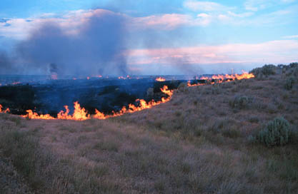
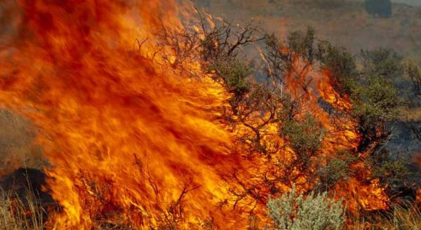
Factors that Influence Plant Response
Fire characteristics
  fire intensity
  duration of combustion
  burn severity
  time of the year
Rate of heat release per linear foot
  Related to fuel properties
  Assessment of heat pulse (time and intensity) for effect on herbaceous plants and soil. Heat upward may have stronger effects on shrubs and trees.
Mike Munts, NPS.gov
  Higher temps and lower relative humidity increase fire severity.
BLM.gov
Notes:
Factors that Influence Plant Response
Recovery after fire is influenced by:
Fire Characteristics – Fire intensity is how much the fire changed the community but burn severity reflects the damage to plants and the plant community.

Slide 6
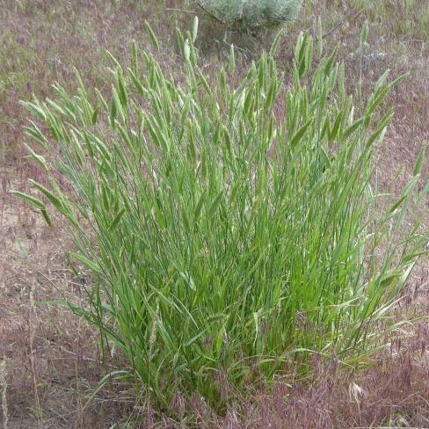
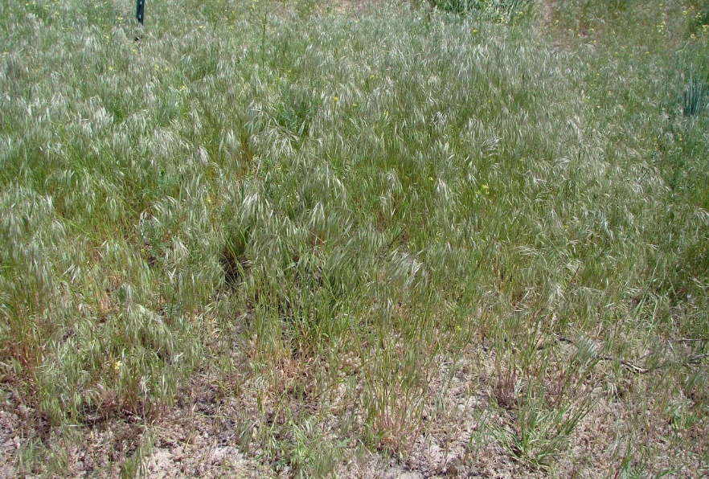
Community Affects Fire Characteristics
Fire characteristics
  fire intensity
  duration of combustion
  burn severity
  time of the year
More and drier fuels increase intensity
  More fuel and larger or more compact fuels increase burn duration
Affected by intensity and duration. Depends on plant community because it is based on community response.
Jennifer Peterson
  Some plants dry out earlier or later in the year. Amount of fuel also changes throughout the year.
USDA.Plants.gov
Notes:
Factors that Influence Plant Response
Recovery after fire is influenced by:
Fire Characteristics – Fire intensity is how much the fire changed the community but burn severity reflects the damage to plants and the plant community.

Slide 7
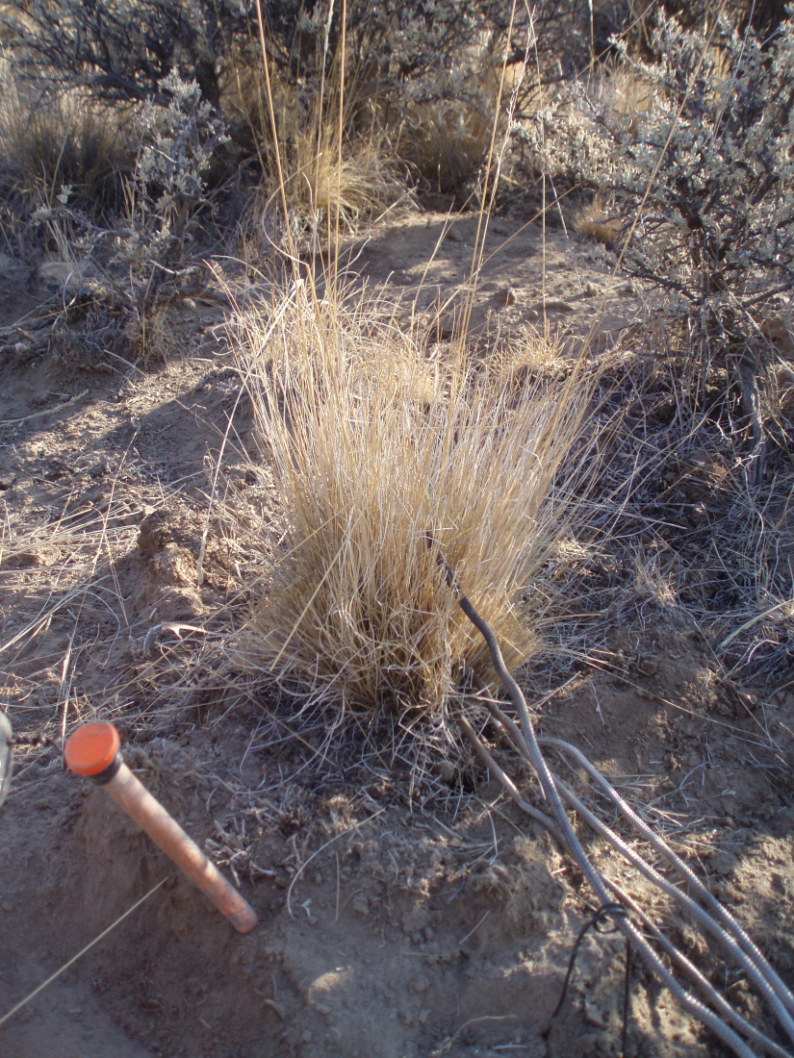
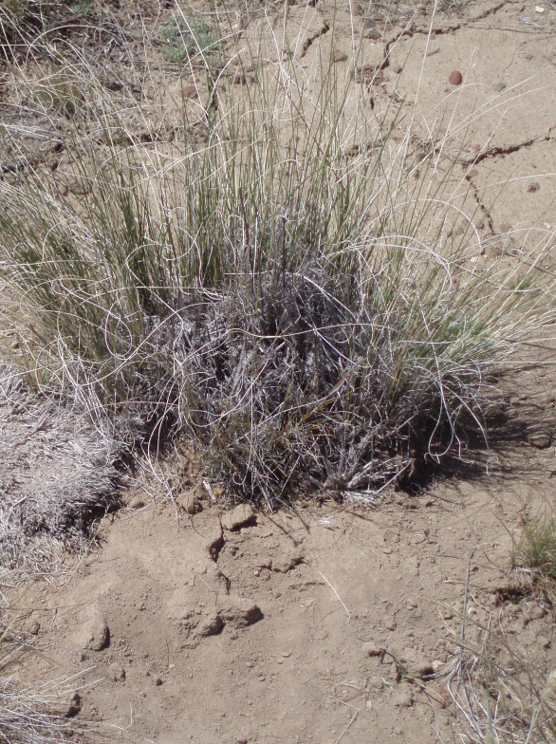
Factors that Influence Recovery
Plant Characteristics
  adaptations to fire
  age
structural and physical characteristics
Photo: Mike Munts, NPS.gov
Notes:
Recovery after fire is influenced by:
Plant Characteristics – plants vary in how well they are adapted to fire and how they respond.
Sod grasses generally more able to survive fire than bunchgrasses.
Fire is generally more lethal to very dense bunchgrasses than bunchgrasses with fewer stems that are more widely spaced.
Location of buds relative to surface fuels

Slide 8
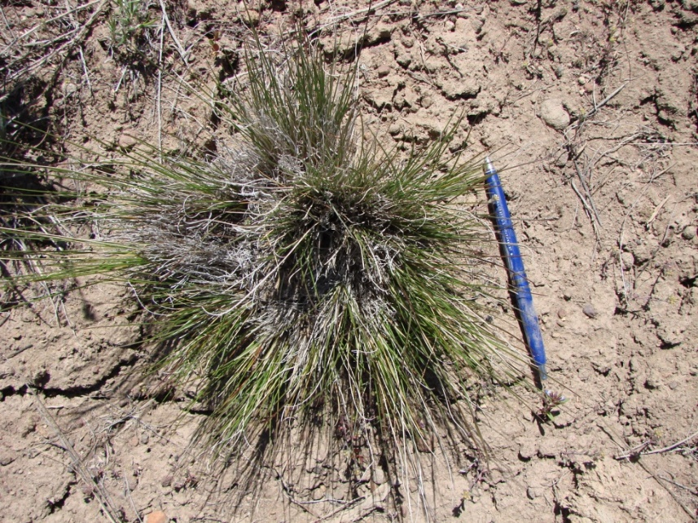
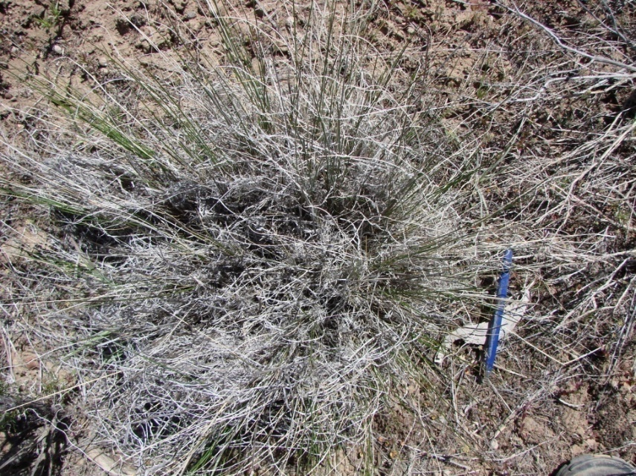
Factors that Influence Recovery
Plant Characteristics
  adaptations to fire
structural and physical characteristics
Mike Munts, NPS.gov
Notes:
Recovery after fire is influenced by:
Plant Characteristics – plants vary in how well they are adapted to fire and how they respond.
Ratio of live to dead of leaves and stems
Grass type affects intensity and duration of fire
Bunchgrasses have accumulation of dense culms at the base
Extended smoldering can cause mortality

Slide 9
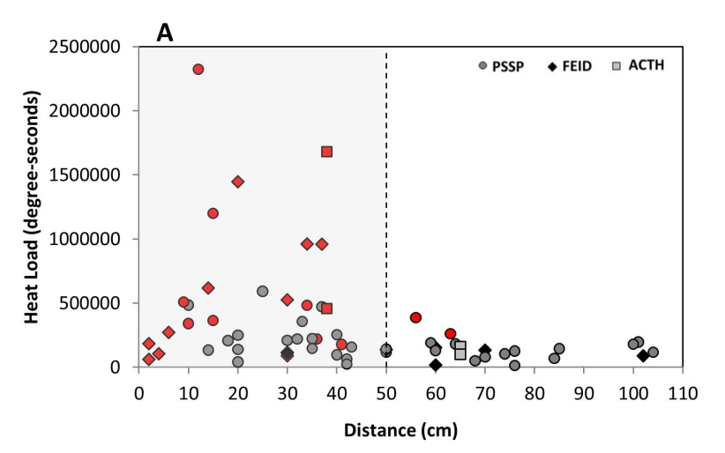
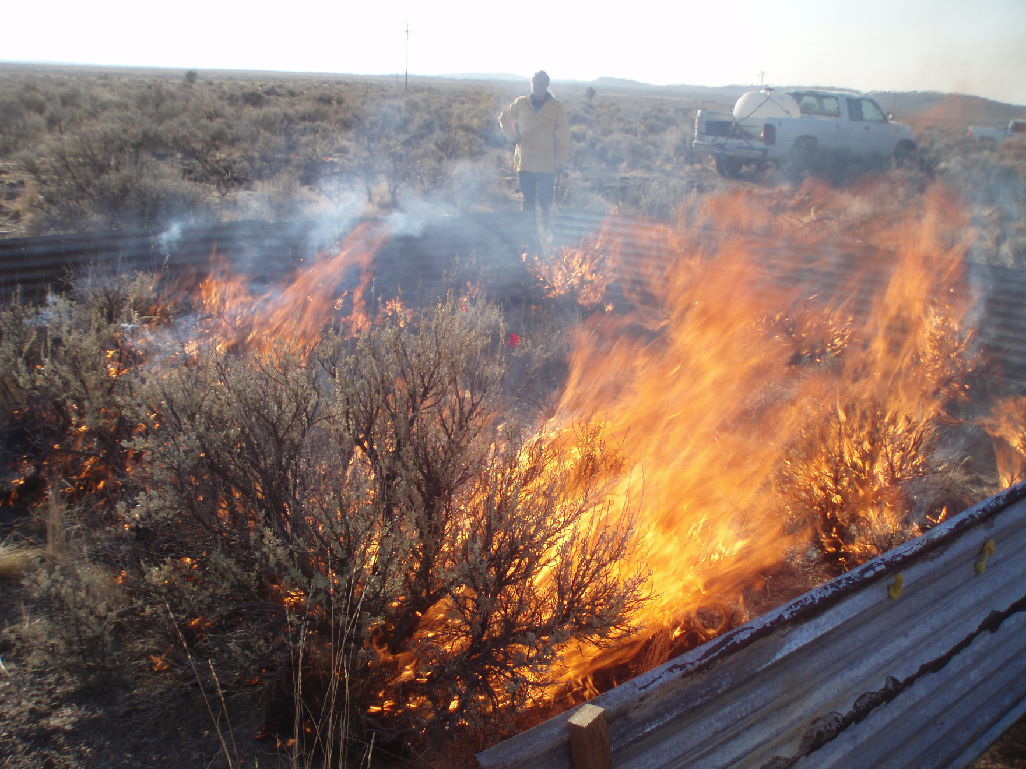
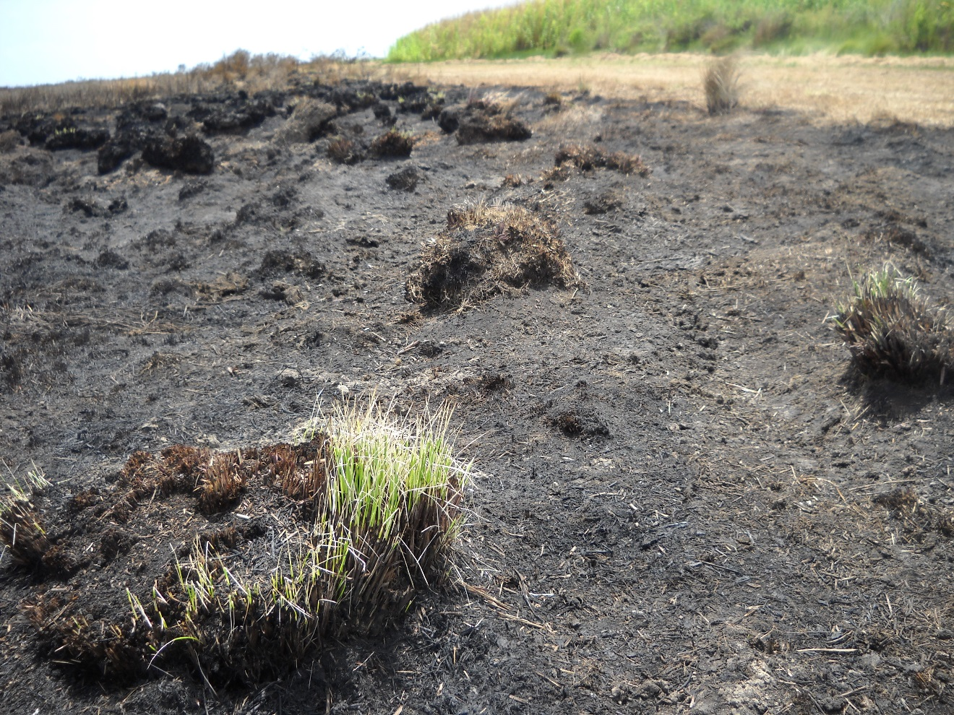
Plant Mortality
  Depends on temperature and duration
  Growing points heat sensitive
    Especially while actively growing compared to dormant
1 day post-fire after a prescribed fire in Texas
Heather Heward
Notes:
Pant Mortality
In an ideal world, plants that we don’t want would die and those that we want would live. But, it is more complex than this.
Plant, just like us, can handle some level or heat – but it depends on time. For example, we can put our hand it water that is 140 F, but we can’t leave our hand in hot water for very long.
First order effects are the direct result of the fire … when the fire is actually burning or smoldering.
Second order effects are the complicating factors such as being grazed after fire, drought after fire or susceptibility to disease.

Slide 10
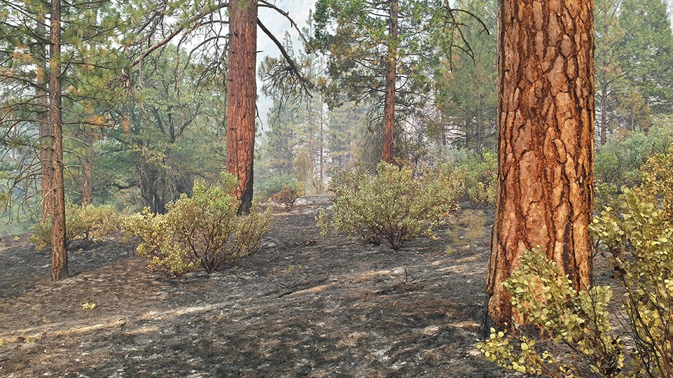
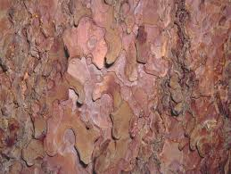
Factors that Influence Recovery
Plant Characteristics
  adaptations to fire
structural and physical characteristics
NPS.gov
Anthony Caprio – NPS.gov
Notes:
Factors that Influence Recovery
Stem mortality
Cambium layer heating
Layer beneath bark
Kills trees and shrubs
Cambium and buds affected by:
Bark thickness
Bark texture
Presence of wounds or pitch
Fuel at plant base

Slide 11
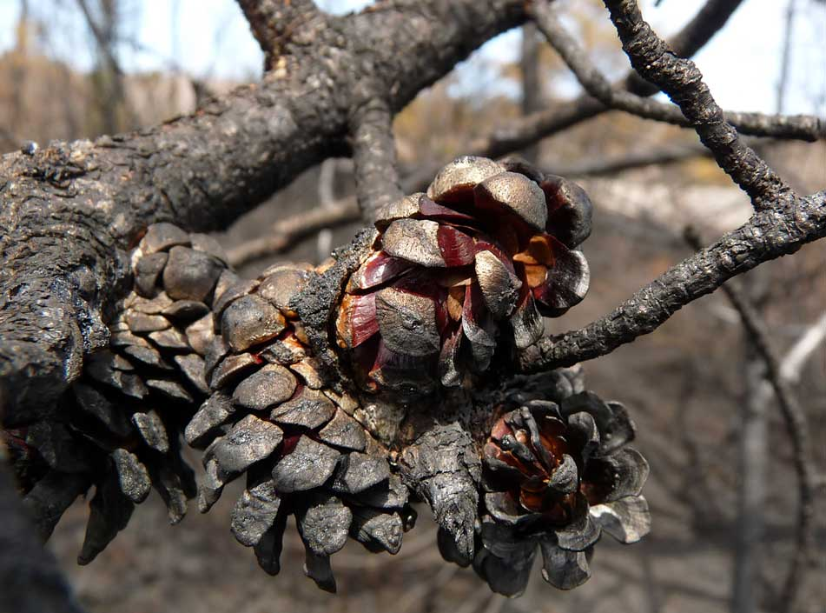
Factors that Influence Recovery
Plant Characteristics
  adaptations to fire
  mechanisms of recovery
Mike Munts, NPS.gov
Serotinous Cones
http://www.nswildflora.ca/species/Pinaceae/PBanksiana/JackPine/FireMay4ConesLG.jpg
Notes:
Factors that Influence Recovery
Recovery after fire is influenced by:
Plant Characteristics – plants vary in how well they are adapted to fire and how they respond.
Serotinous Cones: Lodgepole pine

Slide 12
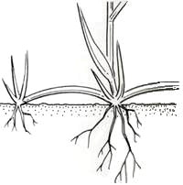
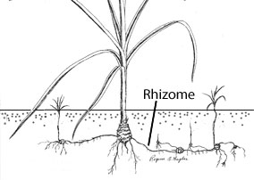
Factors that Influence Recovery
Plant Characteristics
  adaptations to fire
  mechanisms of recovery
Mike Munts, NPS.gov
Notes:
Factors that Influence Recovery
Images from UC IPM online http://www.ipm.ucdavis.edu/PMG/WEEDS/ID/sedroots.html
Stolons are more susceptible than rhizomes during the fire, but stoloniferous plants can spread more quickly after a fire.
Buds located in tissue of upright stems
Above ground (e.g. rabbitbrush, bitterbrush)
Below ground (e.g. serviceberry, ninebark)

Slide 13
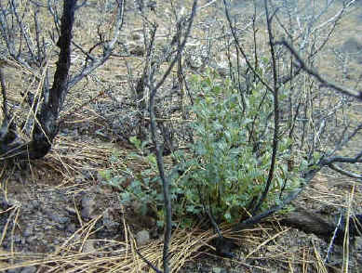
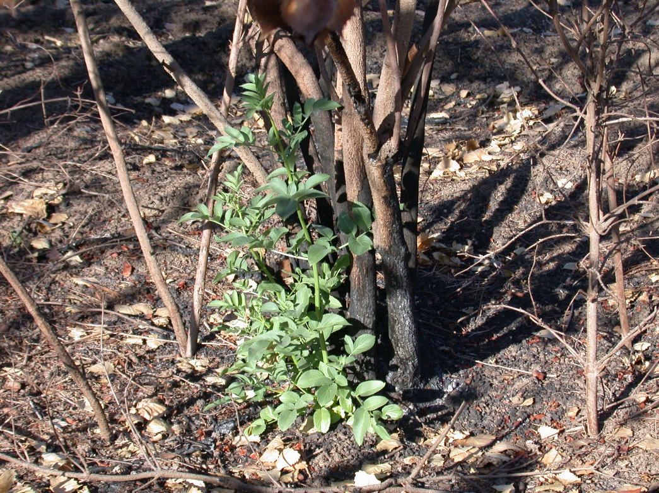
Factors that Influence Recovery
Plant Characteristics
  adaptations to fire
  mechanisms of recovery
Mike Munts, NPS.gov
http://www.sepulvedabasinwildlife.org/images/resprout%20elderberry.jpg
Notes:
Factors that Influence Recovery
Buds located on roots (shoots)
E.g. aspen, fireweed, horse brush
Depending on the plant, sprouts can be above ground or below litter, duff, or soil
Sprouting stimulated chemically or by light
Varies with plant age
Some plants sprout from base. Others do not. This determines how well an individual will survive the fire.

Slide 14
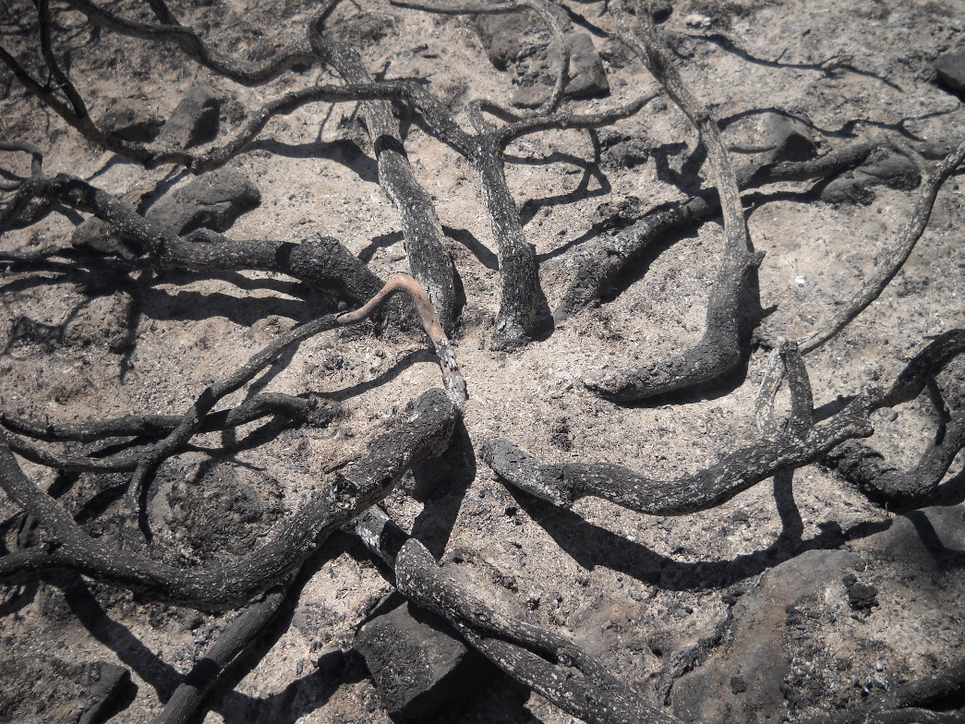
Factors that Influence Recovery
Plant Characteristics
  adaptations to fire
  mechanisms of recovery
Sprouting ability is strongly related to burn severity
  Low severity fire = highest chance sprouting
    Few reproductive parts are damaged (stolons, stem buds)
  Moderate severity fire = sprouting from below duff or soil
    Kills or consumes plant structures in litter (stolons, shallow rhizomes, buds at root crowns)
  High severity fire = significant soil heating greatly reduces sprouting
    Can destroy reproductive parts both above and below ground (sprouting can only occur from deeply rooted parts)
Mike Munts, NPS.gov
Notes:
Factors that Influence Recovery
Basal buds may re-sprout, depending on fire severity.
Root mortality
Greatest loss of lateral roots near the surface
Roots in organic layers more likely to be consumed or lethally heated
Burn severity good indicator of root mortality
Soil moisture affects penetration of heat

Slide 15
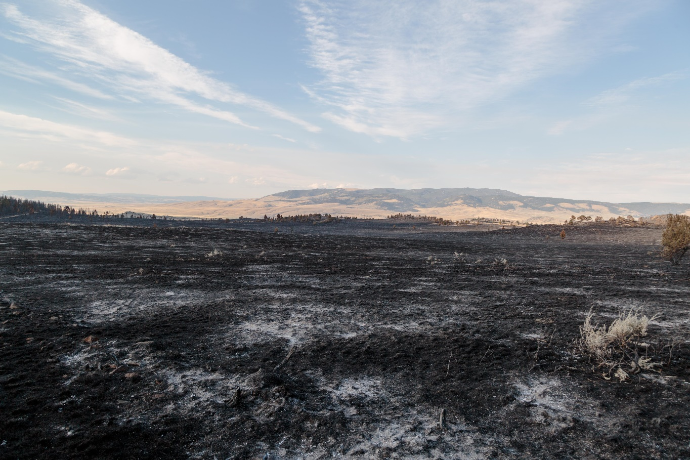
Factors that Influence Plant Response
Environmental Factors
  time since the last fire
  pre-fire weather
  post-fire weather
  post-fire animal use
  plant competition
Seedbank
inciweb.nwcg.gov
Notes:
Factors that Influence Recovery
Recovery after fire is influenced by:
Environmental Factors – conditions before and after fire affect recovery.
Fire is one way we can create microsites for plants that need bare soil (exposed to mineral soil) to establish.
Benefits of fire:
May volatilize allelopathic chemicals
Some nutrients become more available
Ash
Soil
Fire enhanced seed production (pinegrass, wiregrass)

Slide 16
Factors that Influence Plant Response
Environmental Factors
  time since the last fire
  pre-fire weather
  post-fire weather
  post-fire animal use
  plant competition
Weather/Climate is the most important factor in long-term changes to rangeland plant communities
inciweb.nwcg.gov
Notes:
Recovery after fire is influenced by:
Environmental Factors – conditions before and after fire affect recovery.
Pre-fire Climate
Available fuels influenced by pre-fire climate
Drought, high winds, low humidity all affect fire climate
Post-fire Climate
Affects plant survival
Plants must restore carbohydrate reserves
Primary factor for determining range readiness for post-fire grazing

Slide 17
Factors that Influence Plant Response
Environmental Factors
  time since the last fire
  pre-fire weather
  post-fire weather
  post-fire animal use
  plant competition
Degree of regrowth depends on survival of photosynthetic material
Video
inciweb.nwcg.gov
Wildfire and Wildlife
https://youtu.be/CjCkMqzHlf0
Notes:
Recovery after fire is influenced by:
Environmental Factors – conditions before and after fire affect recovery.

Slide 18
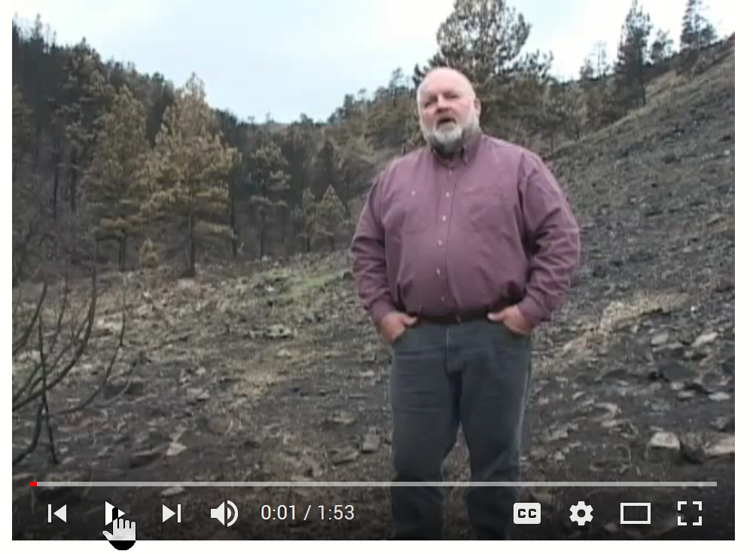
Factors that Influence Plant Response
Video
Wildfire and Wildlife
https://youtu.be/CjCkMqzHlf0
Notes:
Recovery after fire is influenced by:
Environmental Factors – conditions before and after fire affect recovery.

Slide 19
Factors that Influence Plant Response
Environmental Factors
  time since the last fire
  pre-fire weather
  post-fire weather
  post-fire animal use
  plant competition
Degree of regrowth depends on survival of photosynthetic material
Video
inciweb.nwcg.gov
Wildfire and Wildlife
https://youtu.be/CjCkMqzHlf0
Notes:
Recovery after fire is influenced by:
Environmental Factors – conditions before and after fire affect recovery.

Slide 20
Factors that Influence Plant Response
Environmental Factors
  time since the last fire
  pre-fire weather
  post-fire weather
  post-fire animal use
  plant competition
Growth and reproduction of one plant is hampered by another; or resources required by one plant are reduced by another
inciweb.nwcg.gov
Notes:
Recovery after fire is influenced by:
Environmental Factors – conditions before and after fire affect recovery.
Depends on:
timing of germination and growth
germination and establishment requirements
rate of growth
requirements for water and nutrients
reproduction method

Slide 21
Differences between grazing & fire
Grazing
Selects palatable over unpalatable.
Live tissue preferentially removed.
No heat produced.
Recycles nutrients in organic (feces) and inorganic (urine) forms.
Recycles nutrient in patches.
Patchiness on a plant-scale.
Occurs year round.
Can cause compaction through hoof action.
Generally reduces seed viability though some seed require consumption to become viable.
Fire
No selection for specific plants.
Removes dead and live tissue.
Produces heat.
Recycles nutrients in inorganic forms.
Recycles nutrients in a relatively even layer across the landscape.
Patchiness on a landscape scale.
Most likely in dry-hot season.
May create hydrophobic soil layer but, doesn’t yield compaction.
Generally reduces seed viability, though some seeds require fire to be viable.
Notes:
Differences between grazing and fire

Slide 22
Plant Response to Fire
Steve Bunting
USDA NRCS
USGS
Rangeland Principles (REM 151)
Notes:
Plant Response to Fire conclusion
How plants grow and respond to disturbance…

