Slide 1
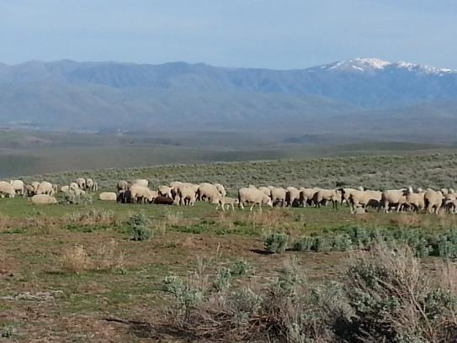
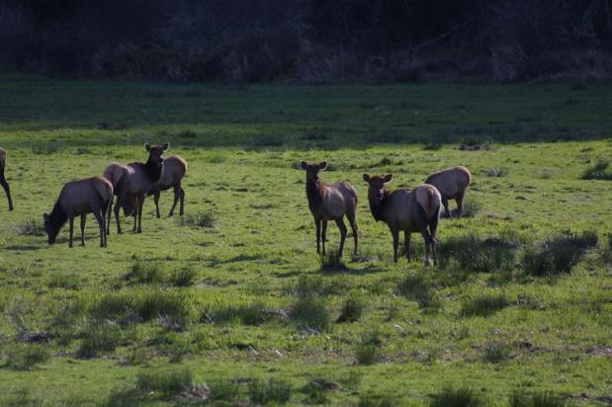
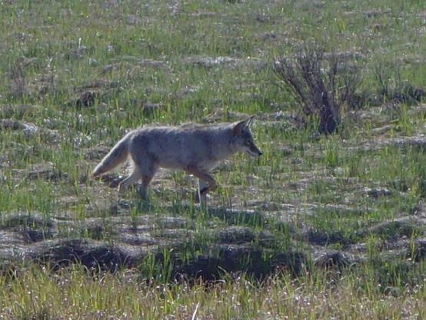

Rangeland Animal Habitat
K. Launchbaugh
BLM.gov
J. Olness
Rangeland Principles (REM 151)

Slide 2

What is a Habitat?
The “home” of a species.
Biotic
Climatic
Edaphic
Notes:
The “home” of a species.
Habitat is the natural abode (house/home) of a plant or animal, including biotic (living: plants and animal interactions), climatic (e.g., temperature: elevation) and edaphic factors (soil-physical (texture/structure), and chemical (cation exchange capacity, pH) affecting life.

Slide 3
4 Basic Elements of a Habitat
Water
Food
Cover
Space
Notes:
Basic requirements that limit the size, growth, and/or quality of an animal population

Slide 4
4 Basic Elements of a Habitat
Food
Energy:
Nutrient:
Mineral:
starches, sugars, fats, and cellulose.
protein and vitamins.
phosphorus and potassium.
Notes:
Energy: Requirements can come from starches, sugars, fats, and cellulose.
Nutrient: Requirements come mostly from protein and vitamins.
Minerals: Requirements come mostly from phosphorus and potassium.

Slide 5
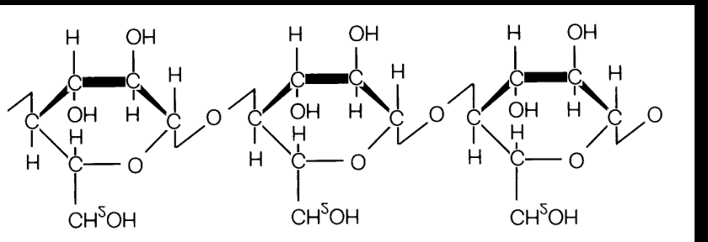
4 Basic Elements of a Habitat
Food
Cellulose is the most abundant source of energy on rangelands.
Notes:
Cellulose: is a carbohydrate that forms the skeleton of most plant structures and plant cells. Great source for dietary fiber.
3 different types of animals: concentrate selectors, ruminants, hind-gut fermenters

Slide 6
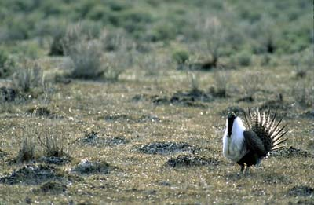
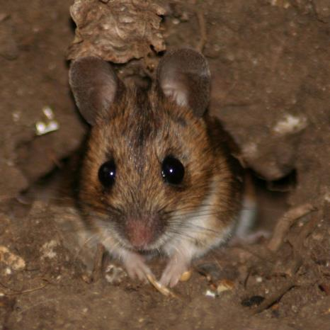
4 Basic Elements of a Habitat
Concentrate Selectors:
Food
Cannot digest cellulose.
Herbivores
USGS.gov
Linsimages
Notes:
Herbivores: Plant eaters (Graze and browse vegetation)
Herbivores with limited ability to ferment and use cellulose.
Get energy from simple carbohydrates like sugars & starches.
Eat roots, berries, seeds, young shoots.

Slide 7
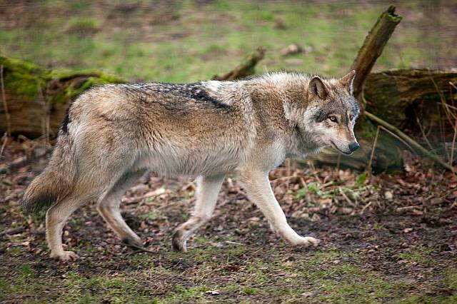
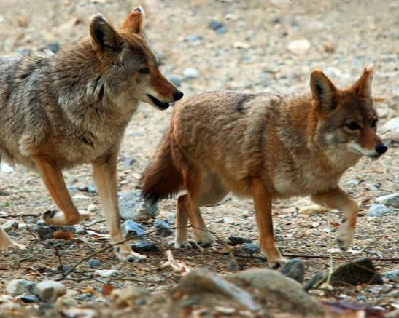
4 Basic Elements of a Habitat
Concentrate Selectors:
Food
Cannot breakdown cellulose.
Carnivores
Graeme
Lonnie Dean
Notes:
Carnivores: Meat eaters (Search, hunt, and consume other animals).
Carnivores cannot breakdown cellulose
Get energy and nutrients from “pre-formed” compounds = meat
Search, hunt, and consume other animals

Slide 8
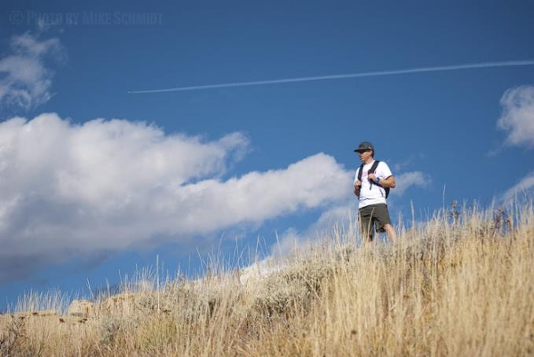
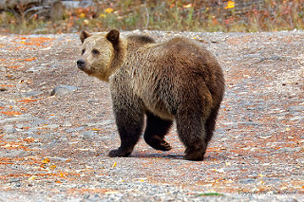
4 Basic Elements of a Habitat
Concentrate Selectors:
Food
Cannot breakdown cellulose.
Omnivores
Mike Schmidt
Jim Zenock
Notes:
Omnivores: Eat plants and animals. Eat meat and vegetation like roots, berries, seeds, and young shoots.
Omnivores – cannot breakdown cellulose
Bears, pigs, and humans
Get energy and nutrients from plants and animals
Eat meat and vegetation like roots, berries, seeds, and young shoots

Slide 9
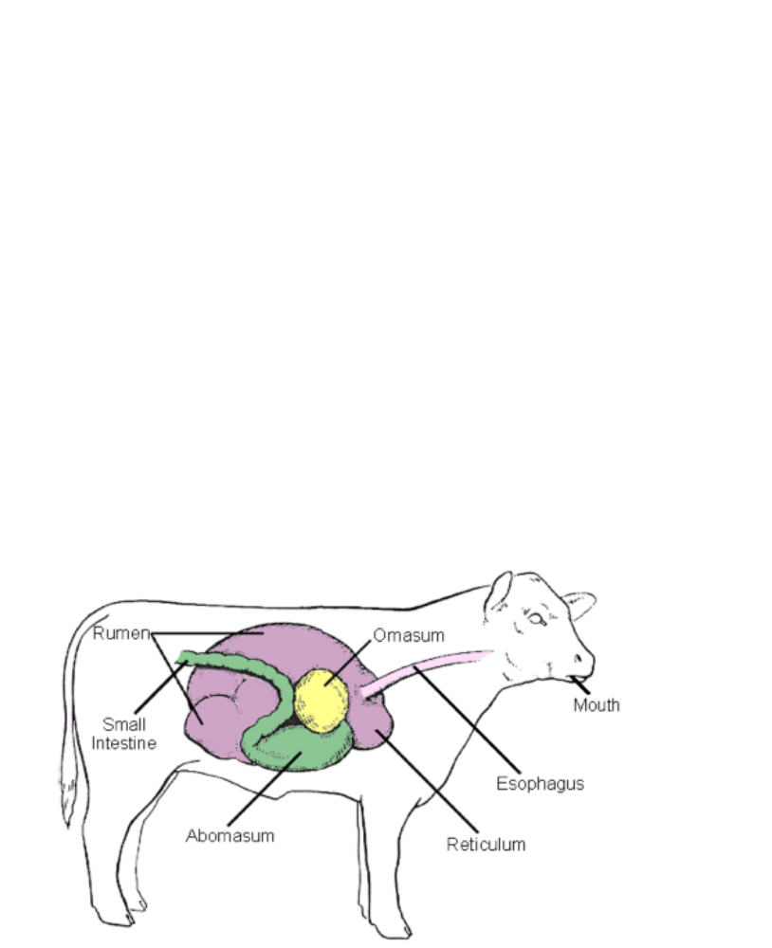
4 Basic Elements of a Habitat
Ruminants:
Food
Specialize 4-part stomach with microbes to break down cellulose.
Notes:
Enlarged fermentation organ (reticulum & rumen) that houses microbes (mostly bacteria and protozoa) that break down cellulose (into Volatile Fatty Acids or VFAs) that can be used as energy by the ruminant.

Slide 10
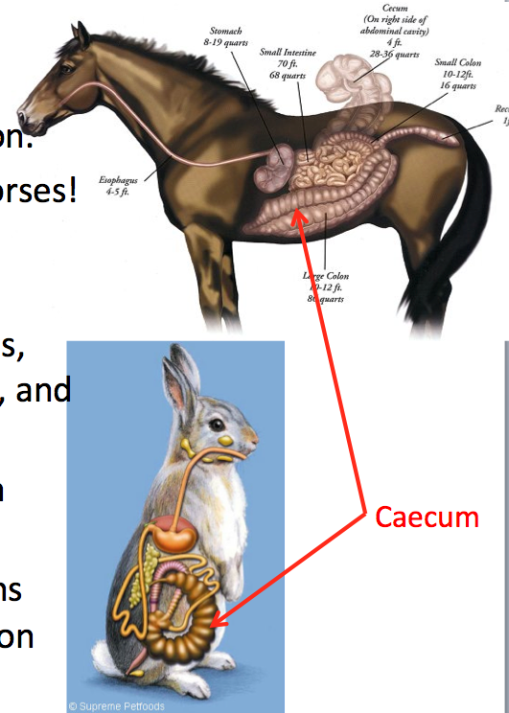
4 Basic Elements of a Habitat
Hind-gut Fermenters:
Food
Enlarged cecum with microbes to breakdown cellulose bonds.
Notes:
Enlarged fermentation organ (reticulum & rumen) that houses microbes (mostly bacteria and protozoa) that break down cellulose (into Volatile Fatty Acids or VFAs) that can be used as energy by the ruminant.
Cecum = after absorptive area of intestines

Slide 11
How much do you eat?
The amount of food required by rangeland animals varies on the type of animal.
Food
Concentrate selectors:
Ruminants:
Hind-gut fermenters:
Wide range depending on primary diet
Eat 2.5% of their body weight
25% more than ruminant of similar weight
Notes:
Concentrate selectors: eat 0.25% of their body weight per day.
FWS: Greater sage-grouse hens weight between 2-3 lbs, so how much would they eat in a day?
Ruminants: eat 2.5% of their body weight per day. 1000 lb cow, how much do they eat a day?
Hind-gut fermenters: eat 3.0% of their body weight per day. 1100 lb horse, how much does it eat a day?

Slide 12
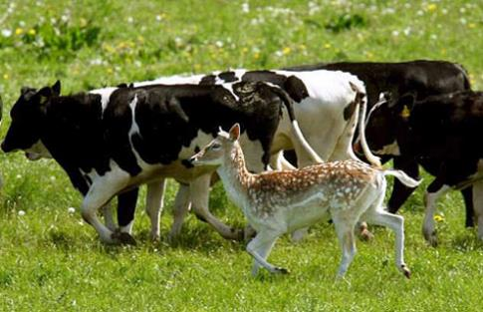
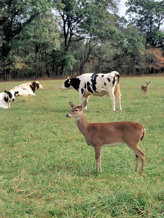
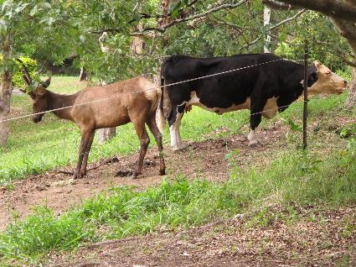
Diet Preferences
Food
Cattle
Bison
Bighorn
Sheep
Pronghorn
Deer
Goat
Elk
GRASS
FORBS
SHRUBS & TREES
Myth mad man
Basspro.com
Wordpress.com
Notes:
Shrubs and Trees = browse

Slide 13
Ben
4 Basic Elements of a Habitat
Water requirements vary for animals depending on the species, weather, and climate.
Water
Sheep: 1-1.5 gallons once/2 days
Goats: 1-1.5 gallons once/2 days
Donkeys: 3-4 gallons once/day
Horses: 5-8 gallons once or twice/day
Cattle and Bison: 8-10 gallons once/1-2 days

Slide 14
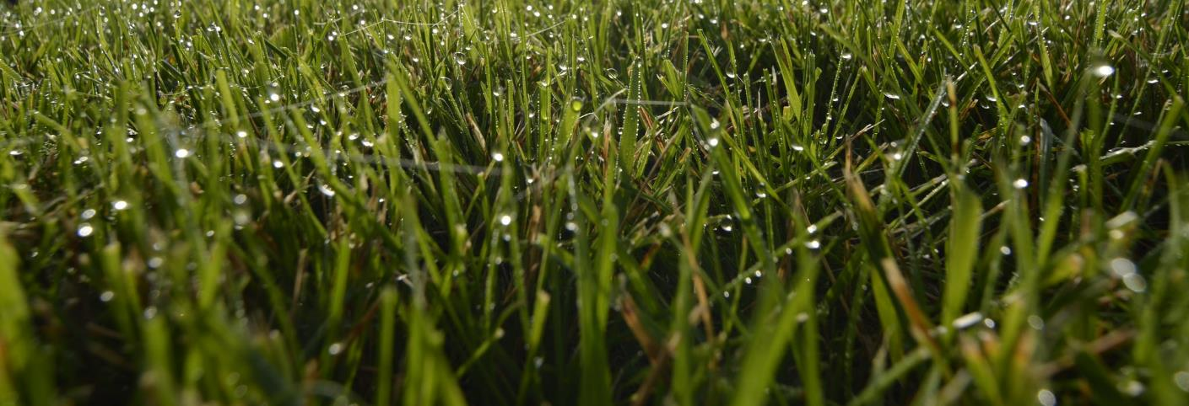
Ben
4 Basic Elements of a Habitat
Moisture content of forage.
Water
Immature grasses may be up to 75% water.
Jordan Schulz (Flickr)
Notes:
Young plants have lots fo water in them. In fact, some animals can get nearly all the water they need from the plants they eat.

Slide 15
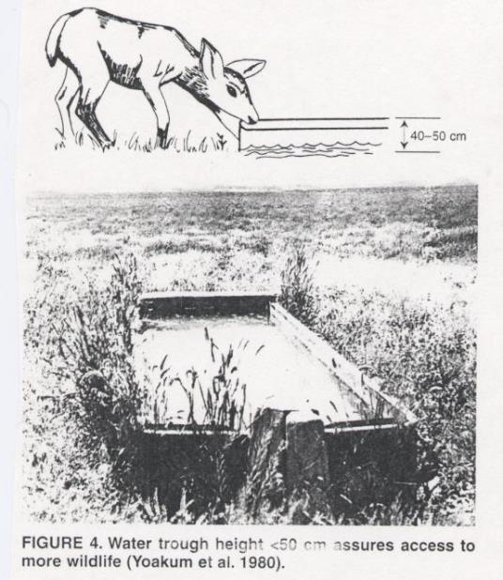
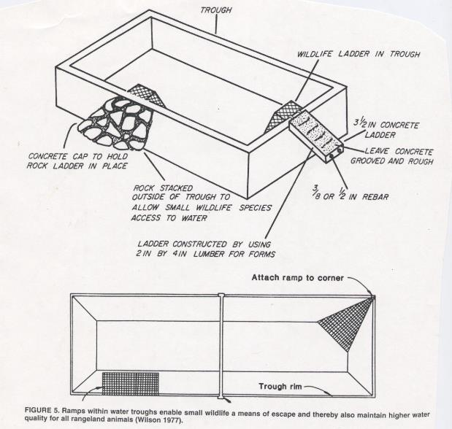
Ben
4 Basic Elements of a Habitat
Properly constructed water sources provide wildlife access to water.
Water

Slide 16
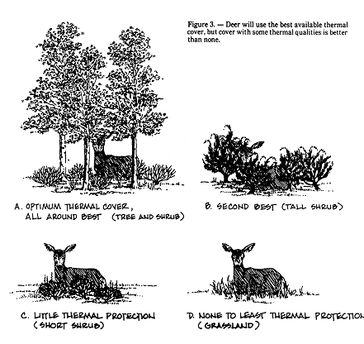
Sophie
4 Basic Elements of a Habitat
Cover
Shade
Shelter
Visual Obstruction
Notes:
Shade in summer.
Shelter from cold wind in winter
Hiding cover: visual obstruction.
Important for protecting young (e.g., nesting, fawning…)

Slide 17
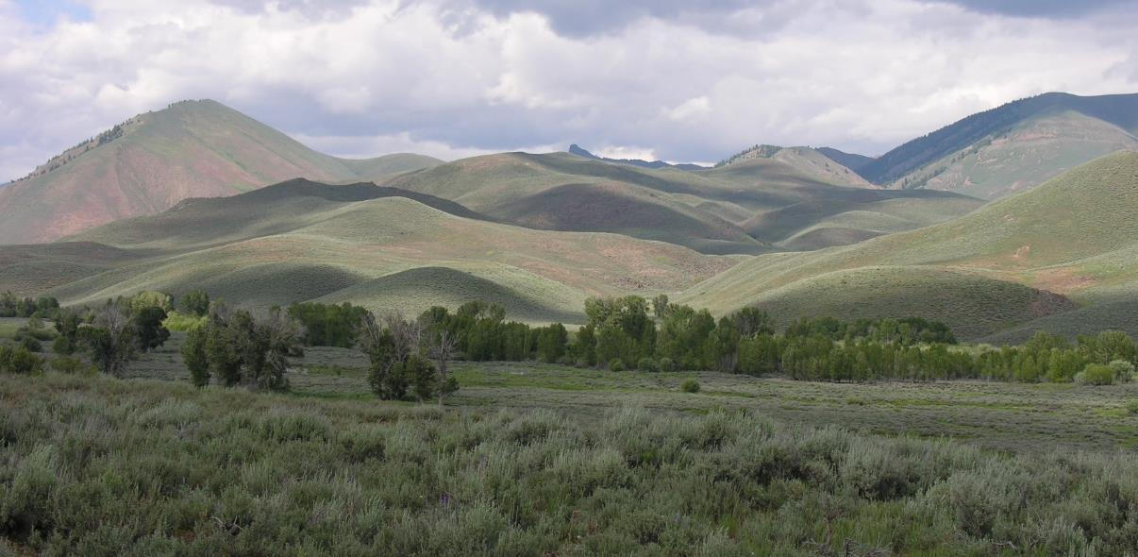
Sophie
4 Basic Elements of a Habitat
Cover
K. Launchbaugh
Notes:
Diversity in both plant species and plant communities over short distances is the key to healthy wildlife populations. For example with deer, removing juniper and other brush may improve forage production but if this is performed over large continuous areas could also remove cover for thermal protection and hiding

Slide 18
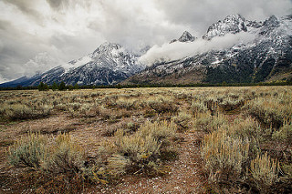
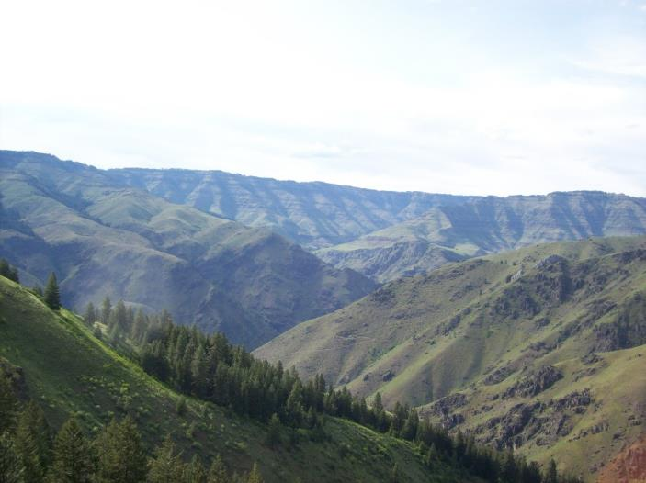
Sophie
4 Basic Elements of a Habitat
Cover
Kirk Lougheed
K. Launchbaugh
Notes:
Opening up dense stands of brush with fire, mechanical treatment, or herbicide can increase the availability of forbs and palatable browse to deer, but should be done so that strips or blocks of brush remain. Continuity of plants communities (leave corridors for travel…do not fragment the habitat).

Slide 19
4 Basic Elements of a Habitat
Breeding and nesting
Home range
Social intolerance
Space
Summer Range
Spring/Fall
Winter Range
Notes:
Animal relationships are affected by grazing season. Winter typically the time when competition is highest because animals are forced into the same areas

Slide 20
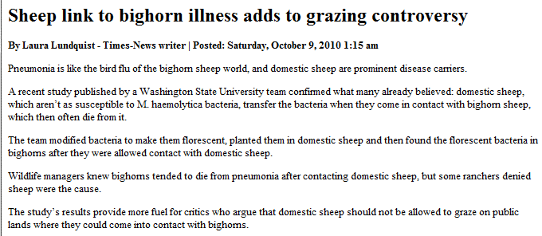
4 Basic Elements of a Habitat
Disease transmission
Space

Slide 21
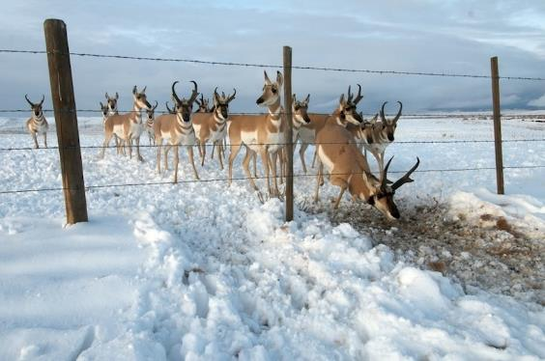
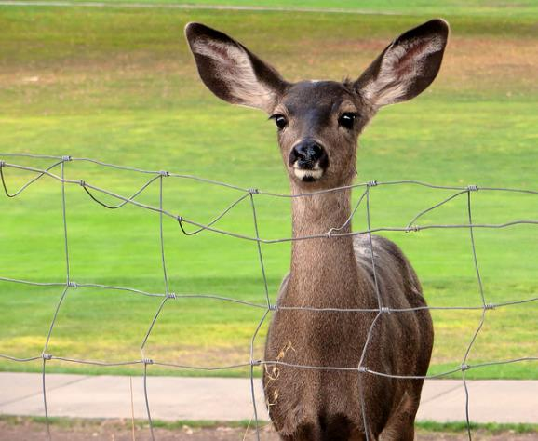
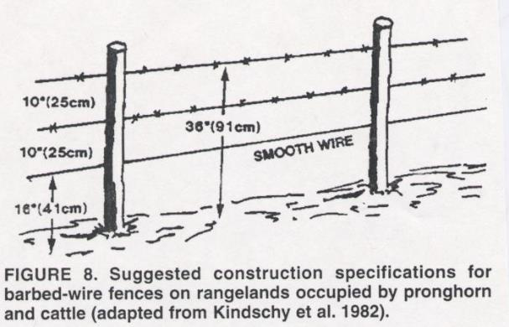
4 Basic Elements of a Habitat
Fences
Space
Missoulian.com
Don DeBold (Flickr)
Notes:
Fences can restrict movement
However, also produces an edge effect can benefit some wildlife species (i.e. such as producing cover through accumulation of snow and subsequently greater plant growth). Provide perches for birds.
Smooth wire to allow pronghorn movement through fences

Slide 22
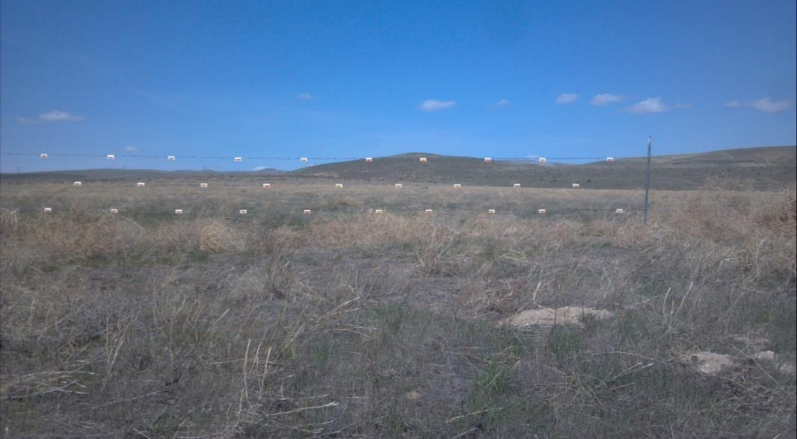
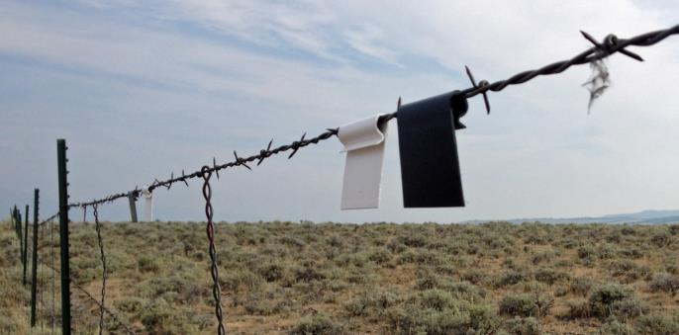
4 Basic Elements of a Habitat
Fences
Space
Truckbeds.com
Vitaleapp.com
Notes:
Sage grouse fly low at speeds of up to 50 mph. Fence markers can make a tremendous difference in their ability to avoid catastrophe.

Slide 23

Limiting Factors
Basic requirements that limit the size, growth, and/or quality of an animal population.
Habitat Restoration

Slide 24
Rangeland Animal Habitat
K. Launchbaugh
BLM.gov
J. Olness
Rangeland Principles (REM 151)

