Slide 1
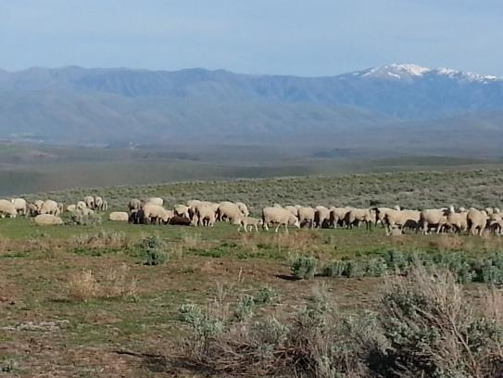
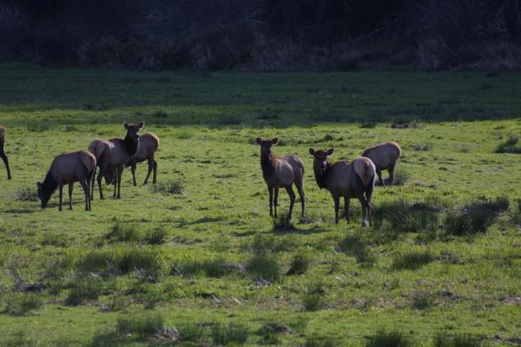
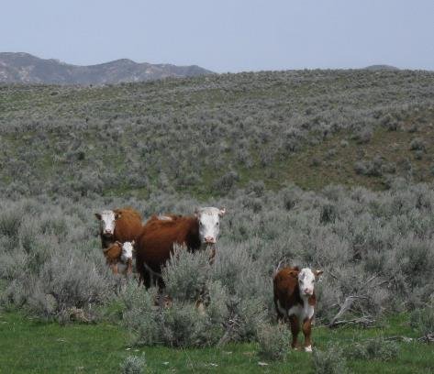

Range Animal Nutrition
K. Launchbaugh
K. Launchbaugh
BLM.gov
Brooke Jacobson
Rangeland Principles (REM 151)

Slide 2
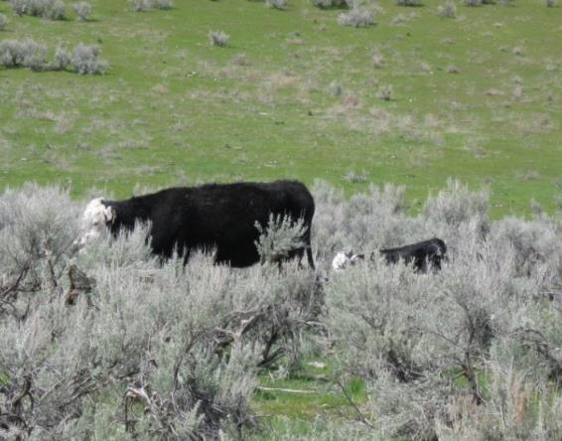
Animal Requirements
Maintenance
Growth
Lactation
Reproduction
Level of Activity
Environmental Conditions
K. Launchbuagh
Notes:
An understanding of animal nutrition starts with an understanding of what attributes of the animal and the environment that affect the nutrients and energy animals need to live and reproduce

Slide 3
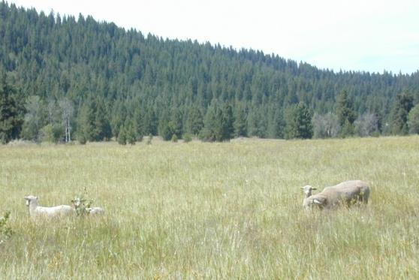
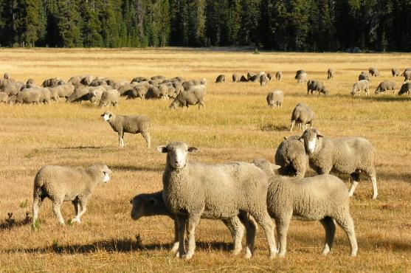
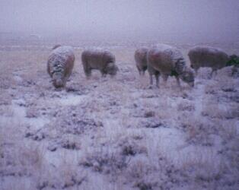
Maintenance
Josie
= Basal Metabolism + Minimum Movement + Foraging
  On a yearly basis requires greatest amount of energy by the animal.
K. Launchbaugh
K. Launchbaugh
K. Launchbaugh
Notes:
Basal Metabolism = energy required to maintain vital functions of an organism at complete rest such as breathing and circulation of the blood.

Slide 4
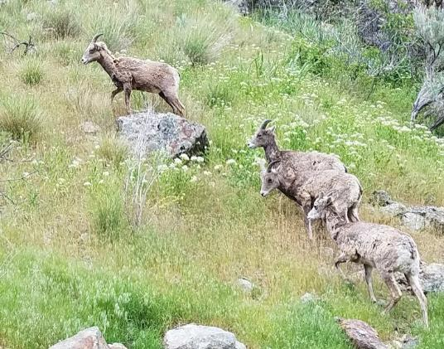
Maintenance
Josie
Maintenance requirements depends on:
Size: Larger animals have lower basal metabolic rate (as a % of body size) than smaller animals
Age: Young > Old
  For example, basal metabolic rate of sheep:
    birth = 132 kcal /m³
    5 weeks = 68 kcal / m³
    6 years = 52 kcal / m³
  Young animals (under 6 months) can be permanently stunted if subjected to severe under-nutrition.
Domestic vs Native: Most wildlife species have lower basal metabolism and the ability to vary their basal metabolic rate with season.
K. Launchbuagh
Notes:
Amount of energy and nutrients needed by animals is affected by their size, age, and genetic background (i.e., domesticated or native)

Slide 5
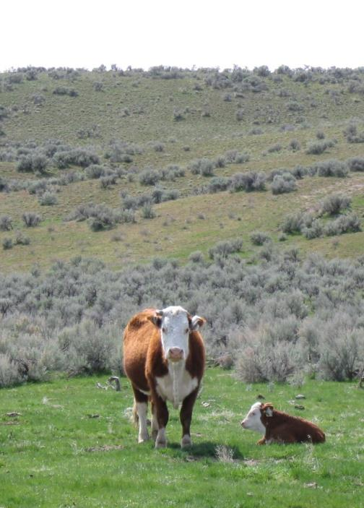
Animal Requirements
Growth - important energy demand in young animals & gestating females
  10- 15% increased requirements above maintenance in last trimester
Lactation - greatest energy requirement above maintenance for mature females
  Requires 25 to 40% greater energy supply than maintenance
Reproduction –
  Last trimester of pregnancy for females
  During breeding season for males
K. Launchbuagh
Notes:
75% of fetal growth occurs in last trimester.

Slide 6



Animal Requirements
Josie
Level of activity:
  15% greater energy required for standing compared to lying down.
  40-46% more energy needed for range animals than stall-fed animals.
Environmental conditions:
  Cold environments require more energy for maintenance.
  Hot environments require more water for perspiration.

Slide 7
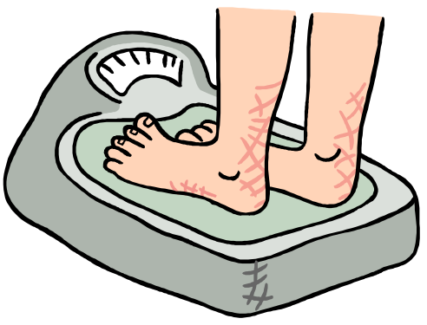
Gaining or Losing Weight
Based on activities and conditions that create energy demand, what could you do if you wanted to lose weight?

Slide 8
Gaining or Losing Weight
Based on activities and conditions that create energy demand, what could you do if you wanted to lose weight?
  Lactate --Not very easy to accomplish. But, it does explain by new mothers often lose weight
  Exercise -Stand instead of sit, take stairs instead of elevator, run, walk, swim, or work.
  Stay in the cold or hot - Keep your
  house/apartment cold or spend more
  time outside.

Slide 9
Yearly Demand Cycle - Females
Birth & Lactation
Last
Trimester
Weaning
Maintenance
Amounts of Energy & Nutrient
Spring
Summer
Fall
Winter
- - - - - - - - Season - - - - - - - - -

Slide 10
Yearly Supply Cycle for Range Forage
Forage Supply
Amounts of Energy & Nutrient
Spring
Summer
Fall
Winter
- - - - - - - - Season - - - - - - - - -

Slide 11
Supply-Demand Cycle
Animal Demand
Forage Supply
Amounts of Energy & Nutrient
Spring
Summer
Fall
Winter
- - - - - - - - Season - - - - - - - - -

Slide 12
Supply-Demand Cycle
Animal Demand
Forage Supply
Amounts of Energy & Nutrient
Spring
Summer
Fall
Winter
- - - - - - - - Season - - - - - - - - -

Slide 13

How to Meet Demand?
Timing – greatest animal demand coincides with greatest nutrient supply
Birth in spring when forage is of greatest quality
  Native animals already do this through natural selection
Follow the Green
  Animals moving up in elevation as season progresses?
            Watch this video “Following the Green”
            https://bit.ly/folllowthegreen

Slide 14
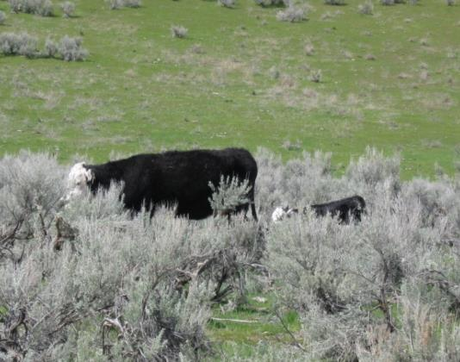
How to Meet Demand?
Timing – greatest animal demand coincides with greatest nutrient supply
Type of operation
  Stocking steers during growing season vs year-round cow/calf?
Type of forage
  Focus on winter forage
K. Launchbuagh

Slide 15
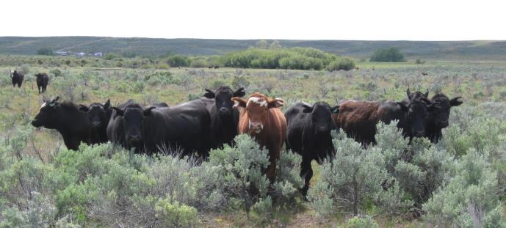
How to Meet Demand?
Stock Conservatively – set demand well below supply
More forage for animals to choose from:
  Each animal can select most nutritious foods for diet.
  Maximum selectivity results in improved diet quality.
Also reduces energy required to find adequate diet.
K. Launchbuagh

Slide 16
How to Meet Demand?
Manipulate vegetation to meet animal needs.
  Plant introduced pastures
  Manage for palatable shrubs
  Manage for plant diversity
Feed Supplements
  Hay
  Grains & energy supplements
  Liquid protein & energy
  Protein important if range forage < 6% protein
Notes:
Plant introduced pastures - to provide abundant high quality forage during a particular season. For example:
Crested wheatgrass provides good spring/fall grazing because of its growth pattern.
New rye grasses are being developed with maintain energy and even protein values well into winter. These grasses tend to be tall to stick up above the snow and tent to act as "black bodies" for earlier snow melt and spring green-up.
Manage for palatable shrubs
to create protein and phosphorus supply during dormancy. On the benches above Logan research has been conducted to use cattle to reduce grass biomass so that shrubs will grow. Shrubs are needed for deer winter habitat.
Manage for plant diversity
Seasonal forage supply is improved as plant diversity increases because plant mature at different rates and have different levels of nutrients.

Slide 17
How do wildlife cope with seasons of low quality?
Karen – Will Present
Build up fat when forage quality is high
  Grazing animals with good fat reserves can survive 30-60 days with little or no food consumptions.
  Mule deer does with high levels of fat reserves have survived periods of complete starvation up to 64 days.
  Fat supplies energy and vitamin A which stored in fat
Native animals lower their metabolic rate and consequently lower energy requirements.
Nitrogen recycling in ruminants
  Some of the nitrogen that gets absorbed out of the rumen is put in saliva where it goes back into the digestive system, for possible absorption, instead of being lost in urine.
Soil ingestion – can play a critical role in permitting ruminants to meet critical mineral needs.

Slide 18
Range Animal Nutrition
Karen – Will Present
K. Launchbaugh
BLM.gov
K. Launchbaugh
Rangeland Principles (REM 151)
Notes:
How plants grow and respond to disturbance…

