Slide 1
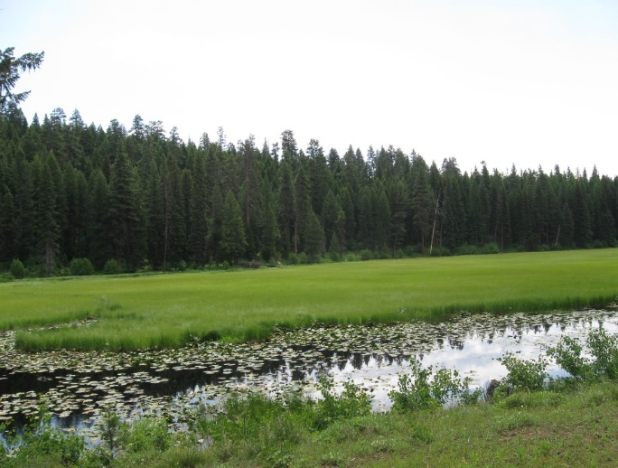
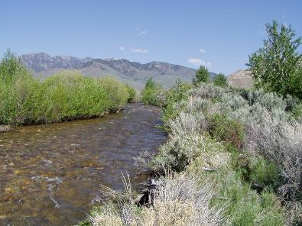
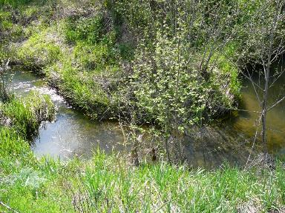

Riparian Ecosystems, Wetland & Watersheds
K.Launchbaugh
Juley Hankins-Smith
K.Launchbaugh
Rangeland principles, REM 151
Notes:
Riparian and Wetland Ecosystems Introduction

Slide 2
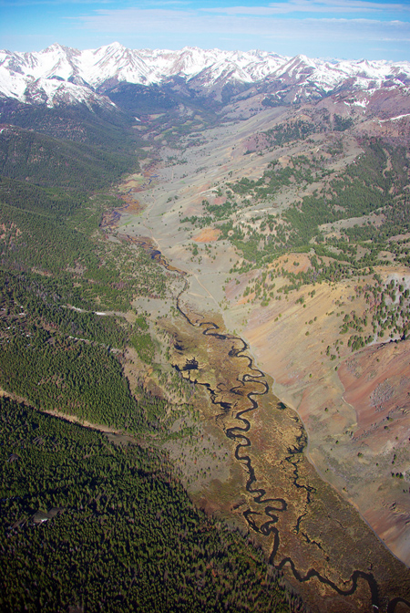
Watersheds
An area of land that water flows across, under, or through on its way to a stream, river, lake, ocean, or other body of water.
Size is determined by the topography of the area.

Slide 3
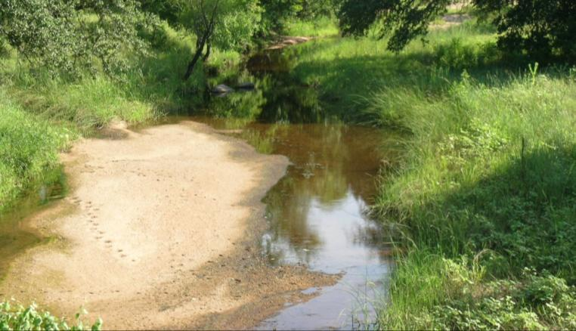
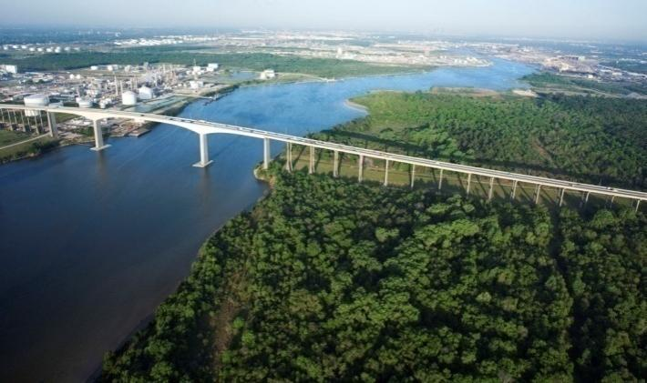
What Do Watersheds
Look Like?
Variable shapes and sizes:
  Can include farmland, rangeland, small towns, or big cities.
  Can have hills, mountains, or be nearly flat.
  Can range from a few acres to millions of square miles.
Notes:
Presentation
So what do watersheds actually look like? Well, watersheds come in many different shapes and sizes and have many different features. They can have hills or mountains or can be nearly flat. They may include farmland, rangeland, small towns, or big cities. Watersheds can range in size from a few acres to as large as the Mississippi River Basin, which drains 1.2 million square miles.
3

Slide 4
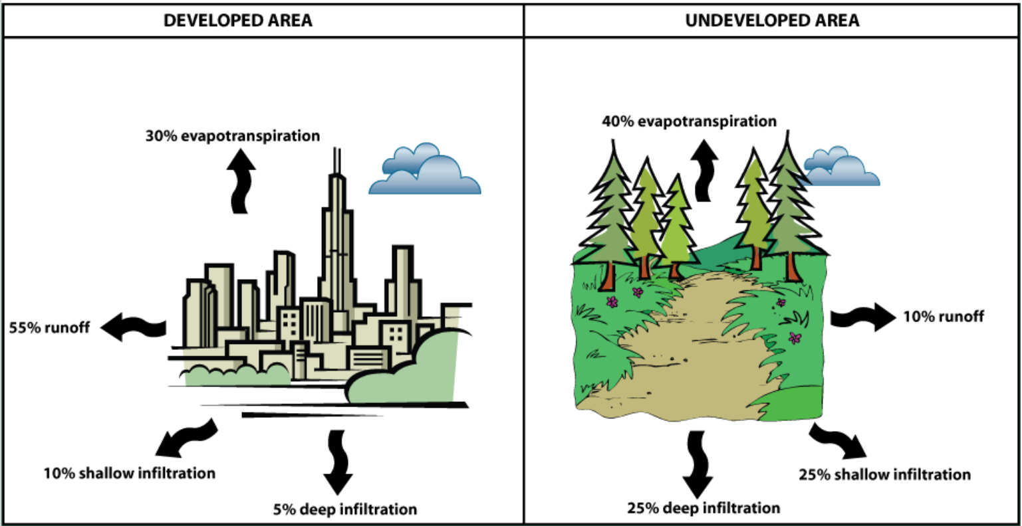

Slide 5
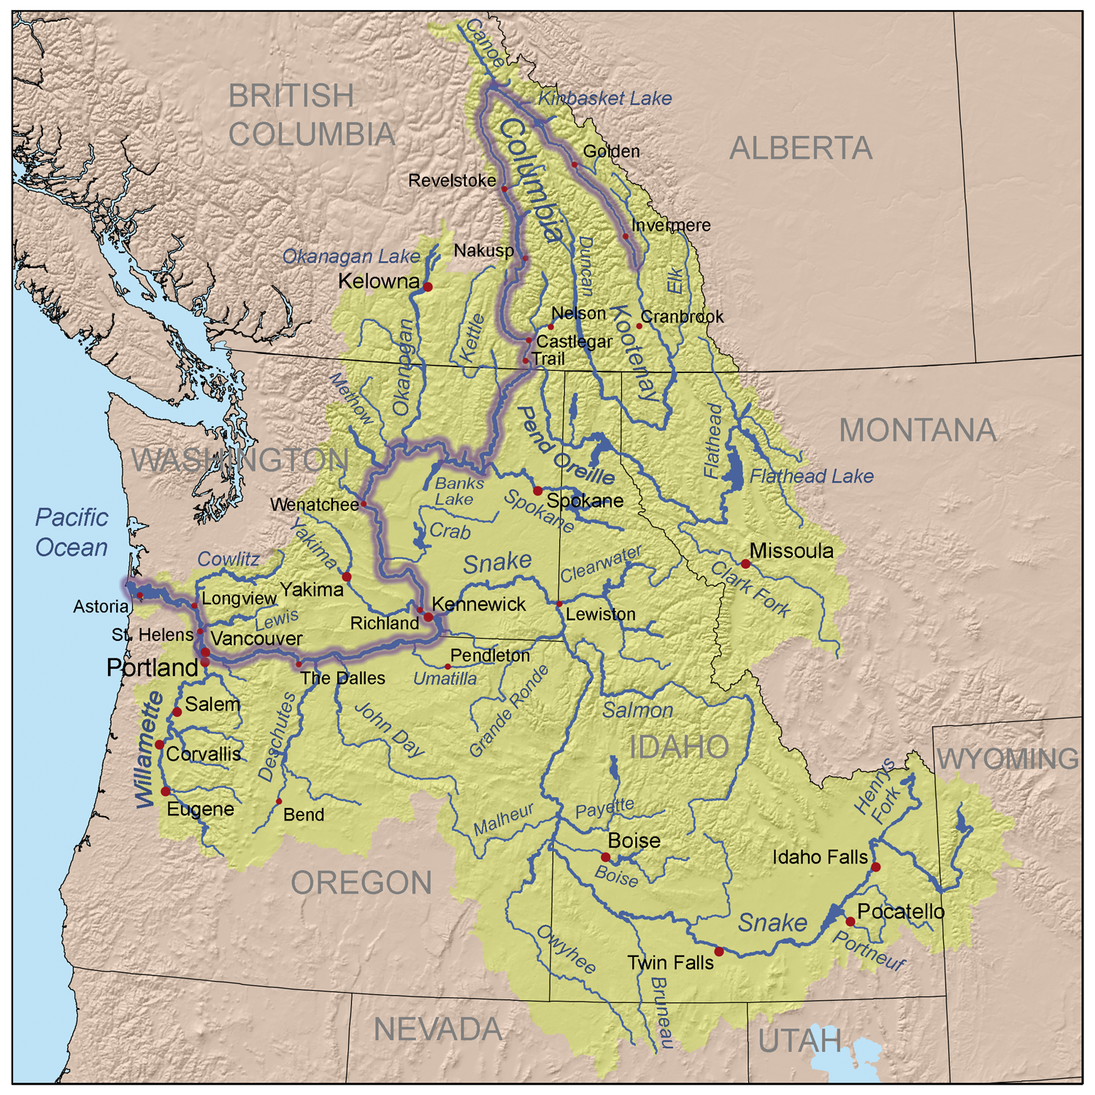
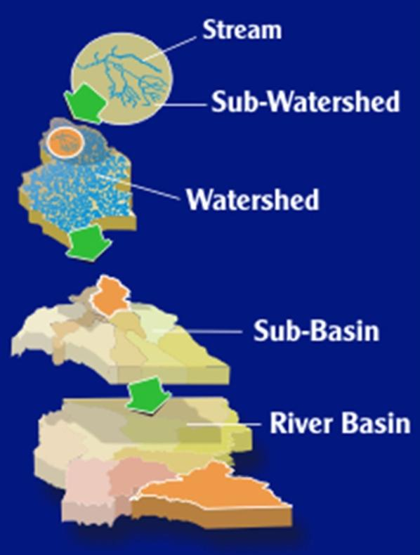
WATERSHED
Watershed are segments of larger-scale River Basins
Notes:
Watersheds are nested systems and include smaller watersheds called sub-watersheds, and larger collections of watersheds called sub-basins and river basins. We can look at a watershed from any of these different scales, the smallest being the stream itself, all the way up to a scale as large as a river basin, which is simply a collection of many different watersheds.

Slide 6
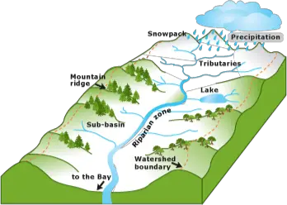
Water that hits the ground either...
Evaporates
Soaks into soil
Absorbed by plants
Infiltrates into ground water basin
Important for
Capture
Storage
Release
of water
Watershed management affects these processes

Slide 7
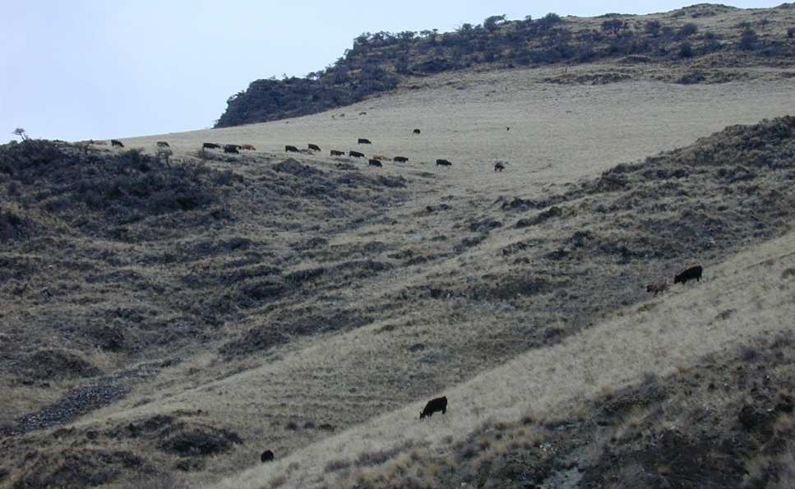
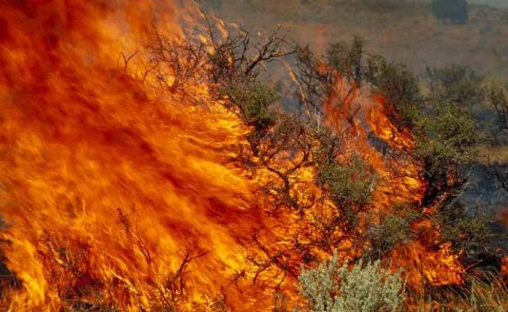
Fire & grazing can affect how a watershed works
Affect:
Infiltration
Runoff
Erosion

Slide 8
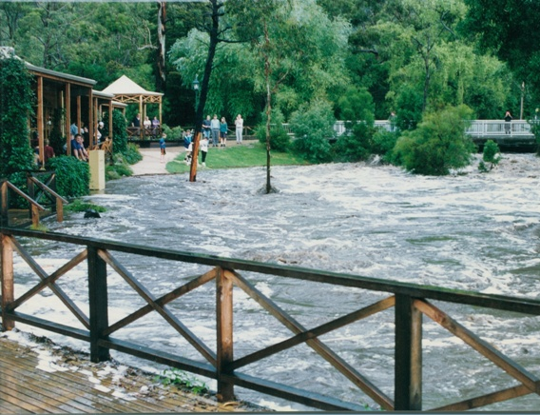
Higher Peak Flows
Leads to flooding
Less plant material to capture and slow down runoff

Slide 9
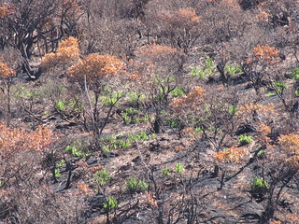
Erosion
Caused by “overland flow” on bare ground or with little vegetation or litter on surface
Topsoil loosens and erodes during severe weather events
Major road damage can occur through erosion

Slide 10
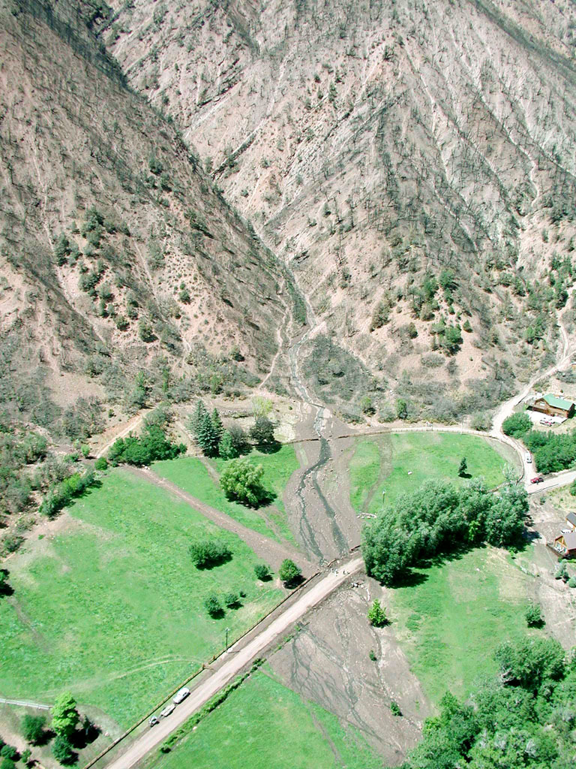
Landslides
Affected by slope
Affected by soil structure and texture
Severe weather usually initiates slides

Slide 11
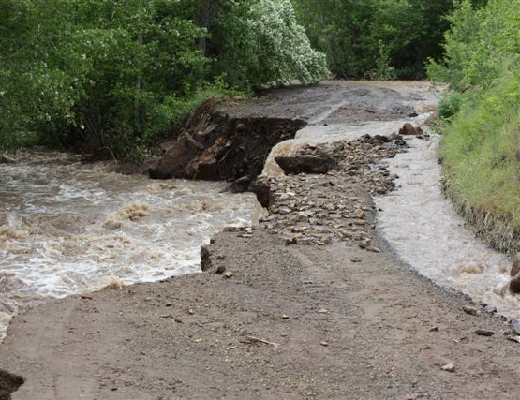
Water Quality
Temperature increase due to lack of shade
Turbidity or clouding of water increased due to particles in water

Slide 12
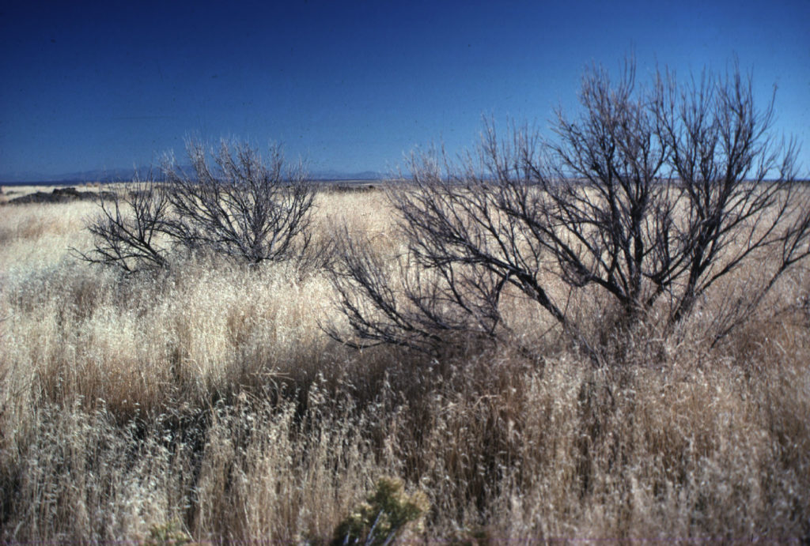
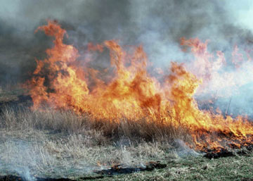
Invasive Species
Bare ground makes seeds easier to invade
Increased nitrogen due to burned plant materials provides food for invasives
Riparian areas in watershed provide needed moisture
Notes:
Rush skeletonweed is a common range invasive species; Downy Brome or cheatgrass burns quickly, invades, reseeds using the nitrogen from the burned materials and increases its territory.

Slide 13
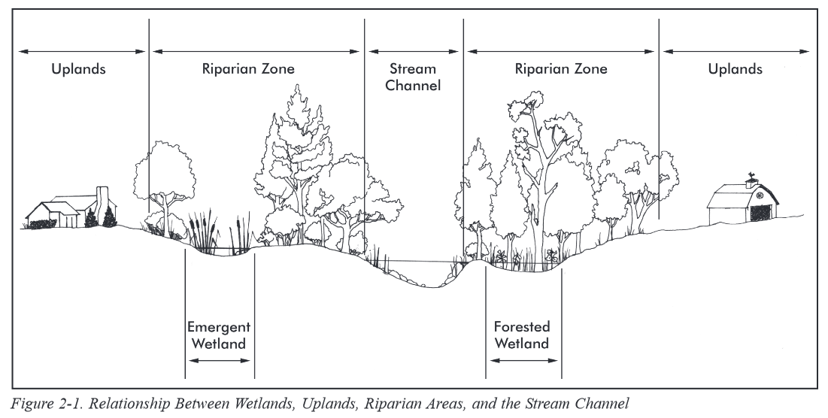
Uplands vs. Riparian vs. Wetlands
Flood Plain
http://water.epa.gov
Notes:
Uplands versus Riparian versus Wetlands

Slide 14
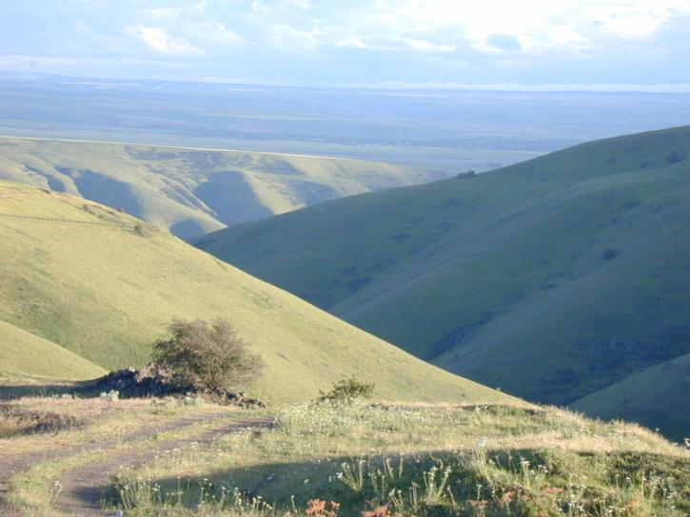
Uplands
Dry areas on a landscape that are only wet for short periods after precipitation events.
K.Launchbaugh
Notes:
Uplands:
Drier areas that are only wet for short periods if time after precipitaiton events

Slide 15
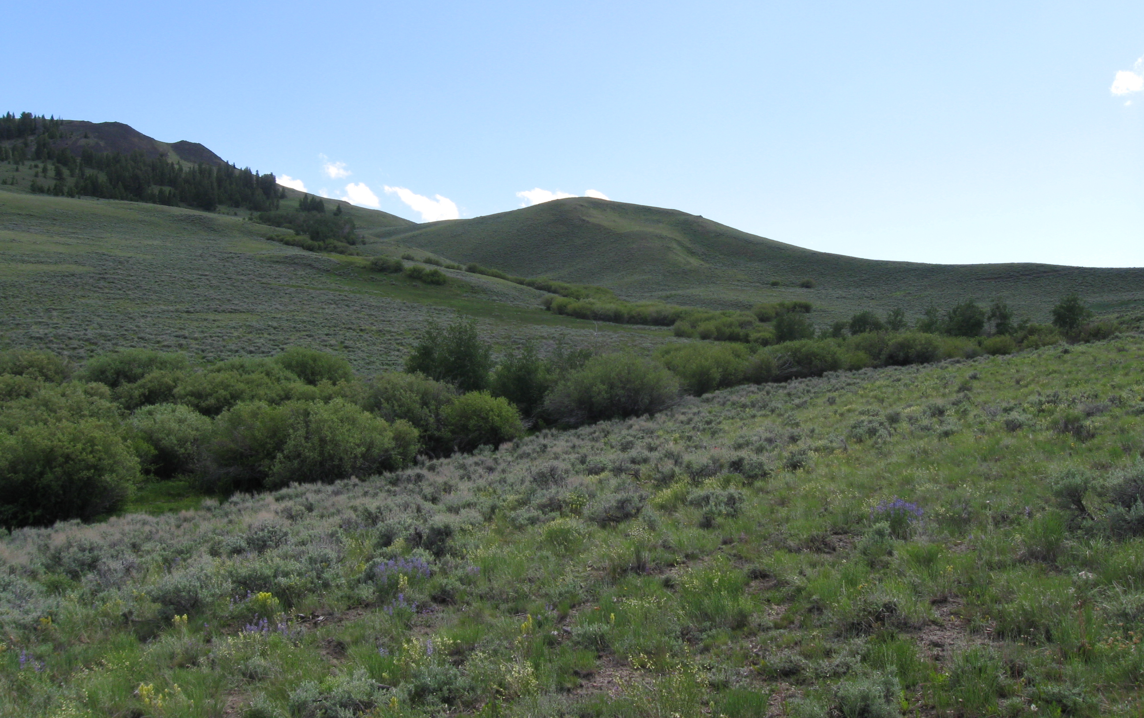
Riparian
Vegetation adjacent to surface waters, such as stream banks and shorelines.
K. Launchbaugh
Notes:
Riparian:
Greener vegetation because of water sources.
Of all the rangeland regions, riparian areas are the most ecologically important and the most sensitive to degradation. Riparian areas require special consideration in management strategies.

Slide 16
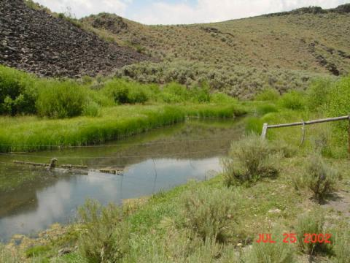
Riparian Area
Transition between the aquatic and upland areas.
Vegetation and physical (soil) characteristics reflect the influence of permanent surface or ground water
Land along streams, ponds, marshes, springs, and seeps are examples.
Notes:
Riparian Area—A form of wetland transition between permanently saturated wetland and upland areas. These areas exhibit vegetation or physical characteristics reflective of permanent surface or subsurface water influence. Lands along, adjacent to, or contiguous with perennial and intermittently flowing rivers and stream, glacial potholes, and the shores of lakes and reservoirs with stable water levels are typical riparian areas. Excluded are such sites as ephemeral streams or washes that do not exhibit the presence of vegetation dependent upon free water in the soil. (TR 1737-9, p. 1)

Slide 17
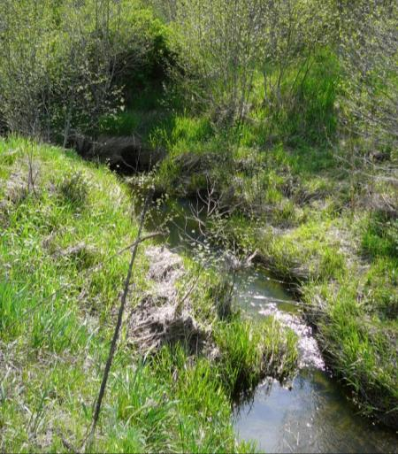
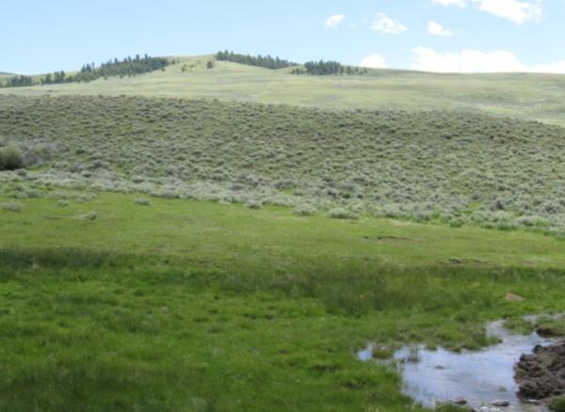
Riparian
Lotic
Two types:
Lotic
Lentic
K.Launchbaugh
K.Launchbaugh
Notes:
Riparian:
Lotic: associated with flowing water.
Lentic: associated with standing water.
In the absence of proper management, ungulates (livestock and wild horses) can do great deal of damage to riparian areas.
Livestock, especially cattle, tend to congregate and mill about riparian areas, seldom venturing out onto the uplands. This heavy use pattern leads to extensive trampling of riparian vegetation, creating a wider, shallower, and warmer stream channel, damage to wildlife habitat, and damage to fisheries.

Slide 18
Wetlands
Areas with “hydric” soils that are permanently or seasonally saturated by water.
K.Launchbaugh
K. Launchbaugh
Notes:
Wetlands:
Areas with Hydric soils that are permanently wet

Slide 19
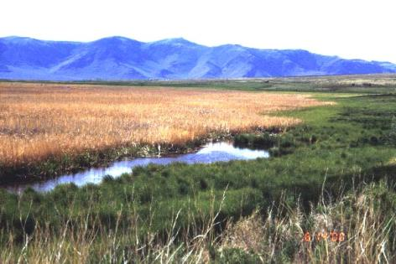
Wetland
Areas inundated or saturated by surface or ground water
Supports a prevalence of vegetation suited to saturated soils
Includes marshes, shallow swamps, sloughs, lakeshores, wet meadows, springs, seeps, and riparian areas
Notes:
We need to provide some definitions to help us to understand the vocabulary and communicate.
Wetland—Wetlands are areas that are inundated or saturated by surface or ground water at a frequency and duration sufficient to support, and which, under normal circumstances do support, a prevalence of vegetation typically adapted for life in saturated soil conditions. Riparian-Wetland management areas includes marshes, shallow swamps, lake shores, bogs, muskegs, wet meadows, estuaries, and riparian areas as wetlands. (TR 1737-9, p 1)

Slide 20
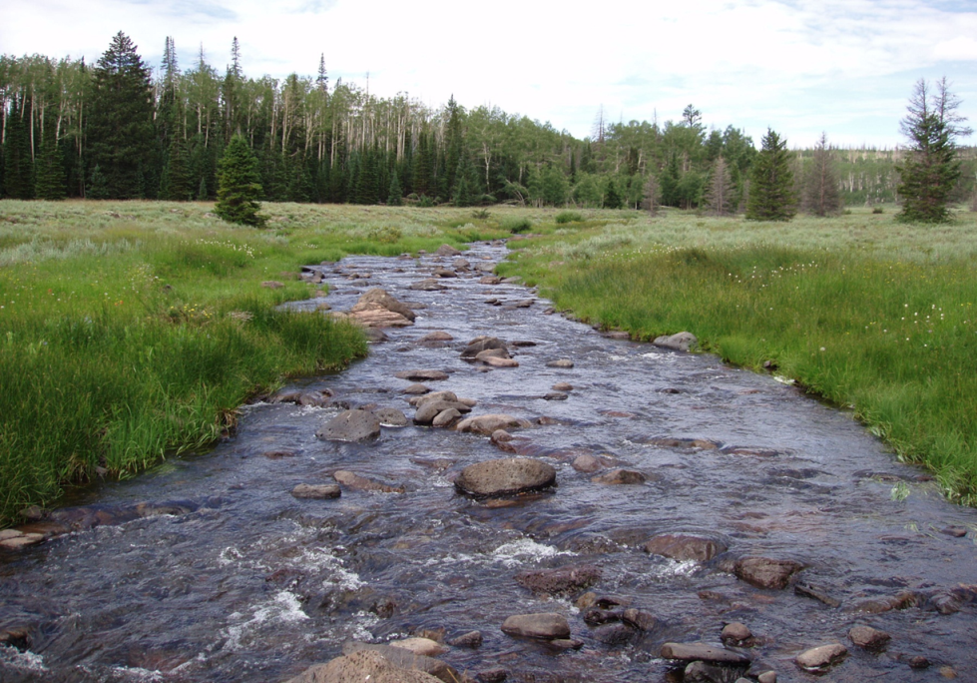
Healthy?
Mammoth Creek, Utah – PFC Presentation 2011

Slide 21
What are Healthy Riparian Area?
Vegetation and roots protect and stabilize banks
Elevated saturated zone -- increased subsurface storage of water
Increased summer streamflow
Cooler water in summer, warmer & less icy in winter
Improved habitat for fish and other aquatic organisms
High forage production and quality
High diversity of wildlife habitat

Slide 22
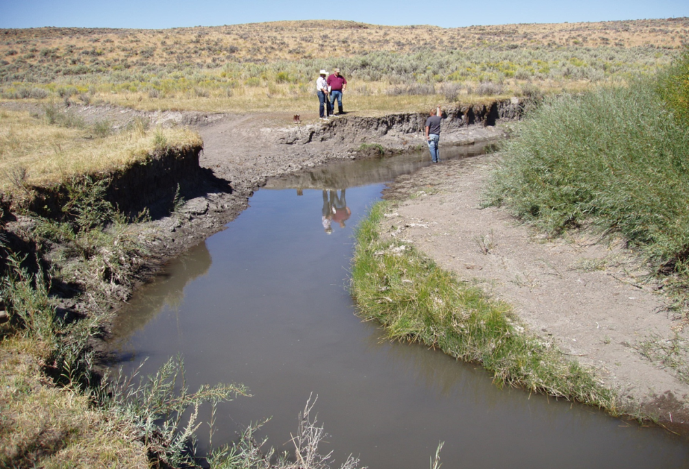
Healthy?
N. Fork Humboldt River – PFC Presentation 2011
Notes:
Healthy

Slide 23
What are Degraded Riparian Area?
Little vegetation to protect & stabilize banks
Lowered saturated zone
Little or no summer stream flow
Warm water in summer & icy water in winter
Poor habitat for fish and other aquatic organisms
Low forage production & quality
Low diversity of wildlife habitat
Notes:
Degraded Riparian Areas

Slide 24
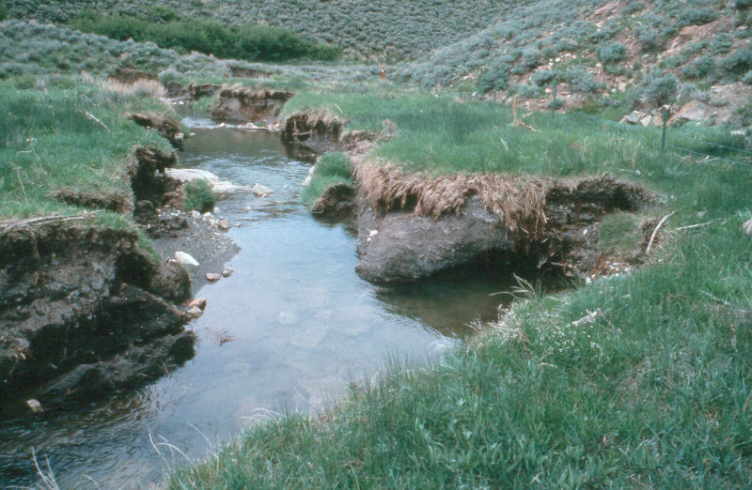

Potential for Recovery?
W. Elmore
Notes:
One problem we have is not being able to tell wide varitey of audiences what potential of degraded systems really is. This is a before picture of a stream that has downcut and widened and is ready to recover.

Slide 25
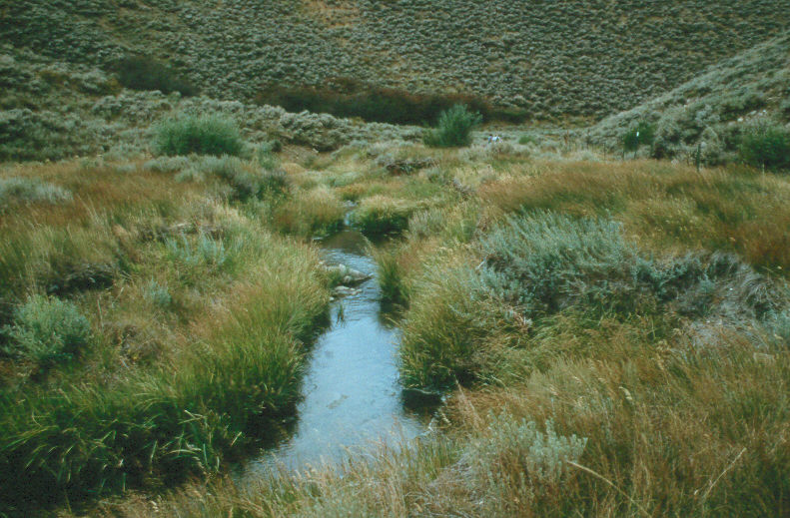
12 years later
W. Elmore
Notes:
This is the after picture 12 years later with a change in management. This is totally natural recovery.

Slide 26
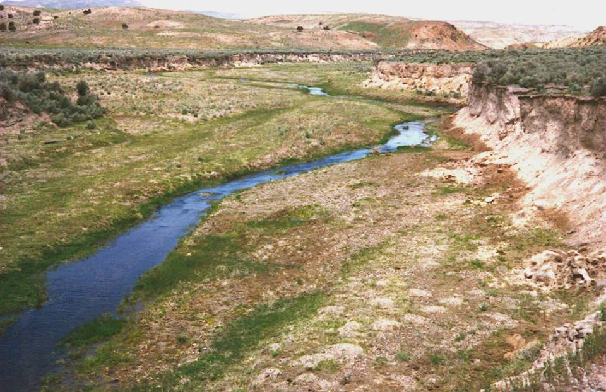
Potential for Recovery?
W. Elmore
Notes:
Another example of before management change. What do you think the potential is for this site.

Slide 27
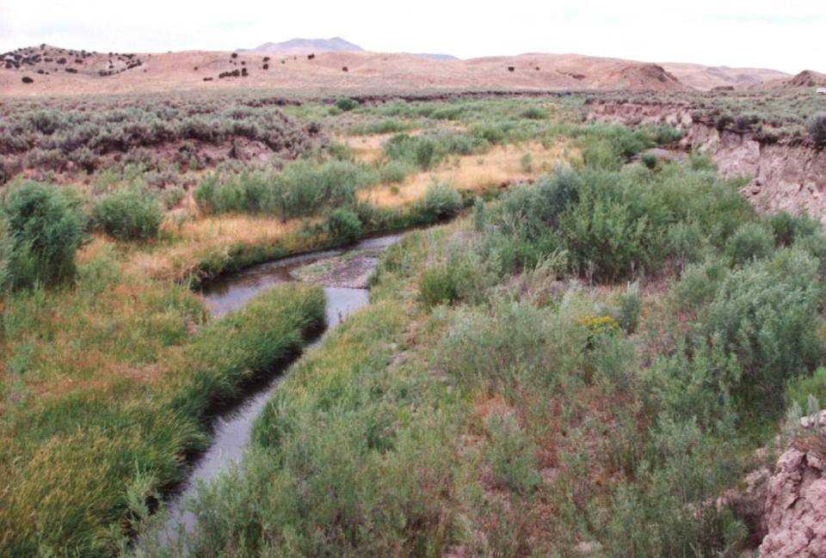
10 years later
W. Elmore
Notes:
Approximately 10 years later. No reduction in livestock numbers only a change in the season of use. Ask what differences so you see between the before and after.

Slide 28
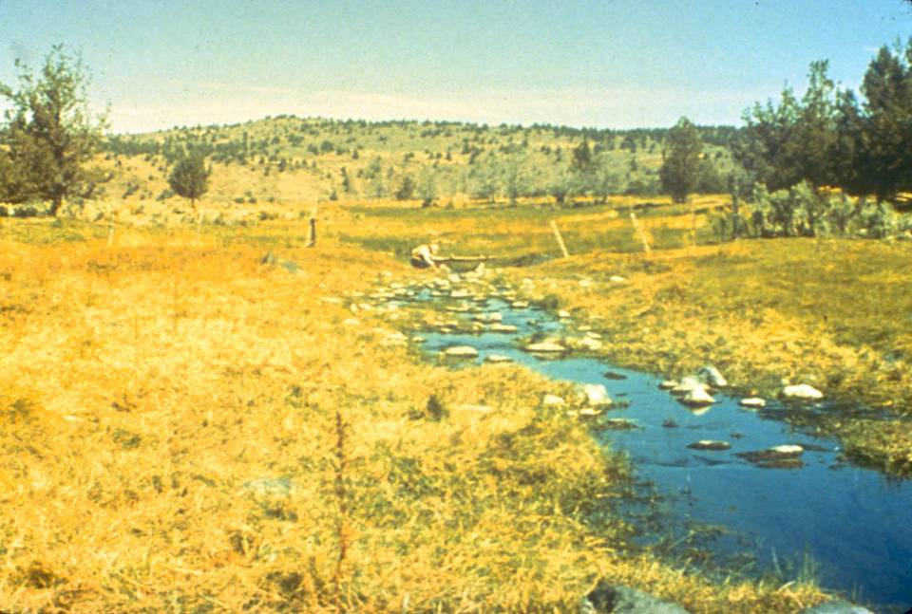
SF Crooked River, OR 1976
Season long use
W. Elmore
Notes:
SF Crooked River, OR 1976
Season long use

Slide 29
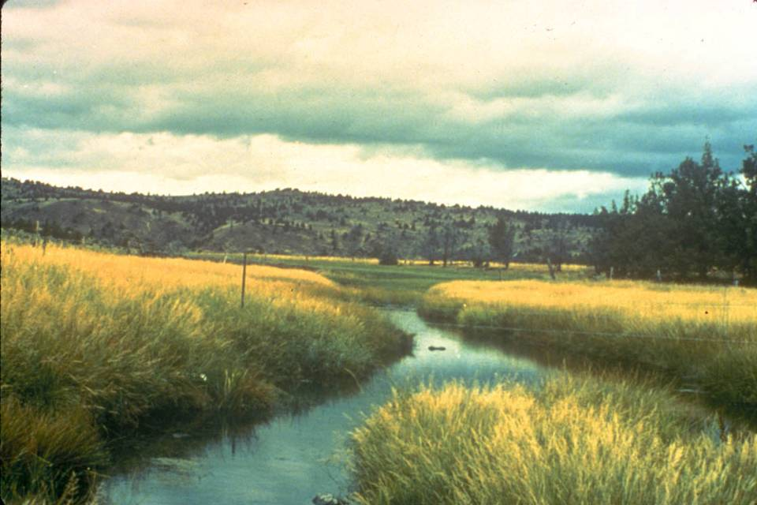
S. Fork Cr. River 1984 after two years of rest followed by early season grazing
W. Elmore
Notes:
S. Fork Cr. River 1984 after two years of rest followed by early season grazing. What species would like this benefit from this change and which one would not.

Slide 30
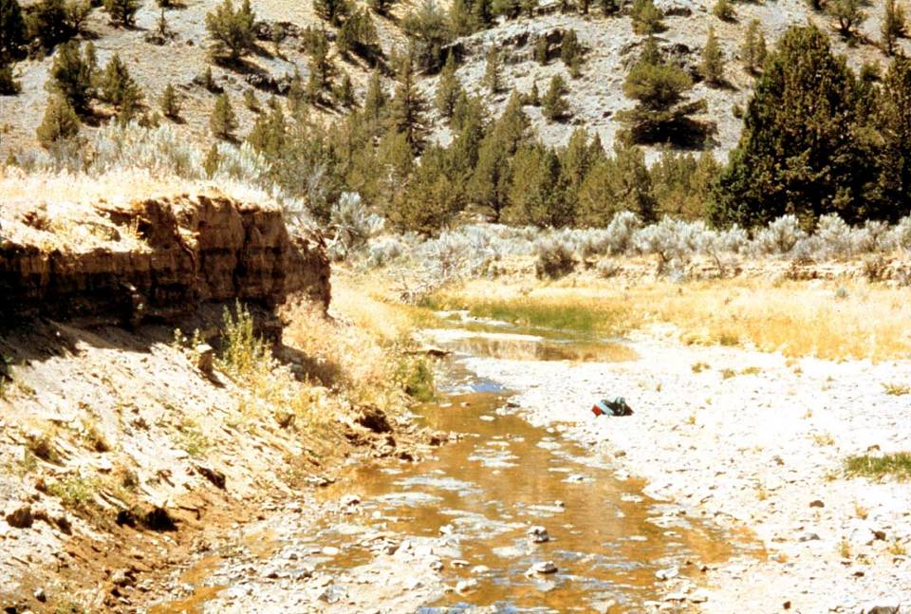
W.Elmore
W. Elmore
Bear Creek May 1977
Notes:
Bear Creek was season long grazed for 100+ years. In the 1950’s the willows were sprayed to reduce water use and in 1964 there was a 100+ year event (rain on snow 12-24-64) and the stream downcut and in this photo has widened out. The current livestock use is 25 cows/calves for three months (June, July, Aug) or 75 AUM’s. The vegetation is mostly upland species with some Baltic rush (dark green in center of picture). Uplands are dominated by basin big sagebrush and western juniper. Reference points are the plump juniper on the right and the snag on the left. The juniper in the foreground will be cut before the next photo was taken. The following is 27 years of change on this stream. The management was changed initially to two years of rest, followed by late winter (mid Feb) to early spring (mid April) grazing.

Slide 31
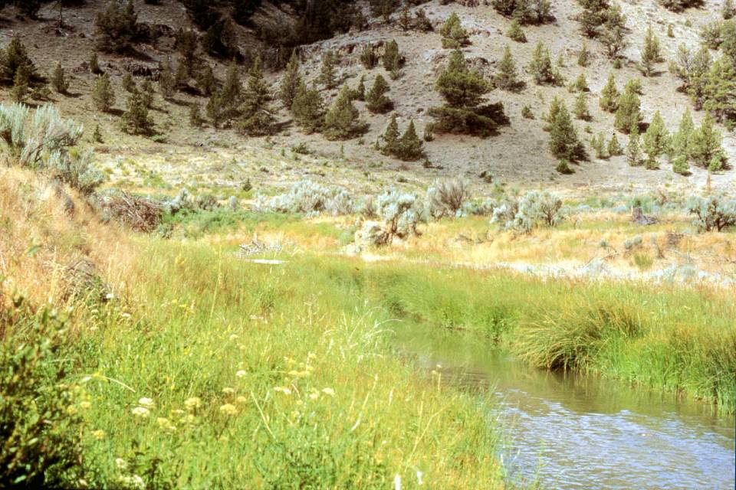
W. Elmore
9 years later - Aug 1986
Notes:
A flood plain is developing on both sides of the stream and vegetation has changed to a more mesic (water loving) mix of plants that includes Nebraska sedge, Small-fruit bulrush, beaked sedge, spike rush, brook grass, three square bulrush, and some reed canarygrass.

Slide 32
Riparian Plants – Are Important
Underestimated for potential to “control” stream systems
  Large Woody Debris or Rocks/Boulders usually considered first
Plants mold the stream to fit the power of the water.
Notes:
Riparian plants:
Control streams and plants mold the stream to fit the power of the water

Slide 33
Root Length is Significant
Notes:
Root Length significance

Slide 34
Channel Stability Rating
Notes:
Stability Rating

Slide 35
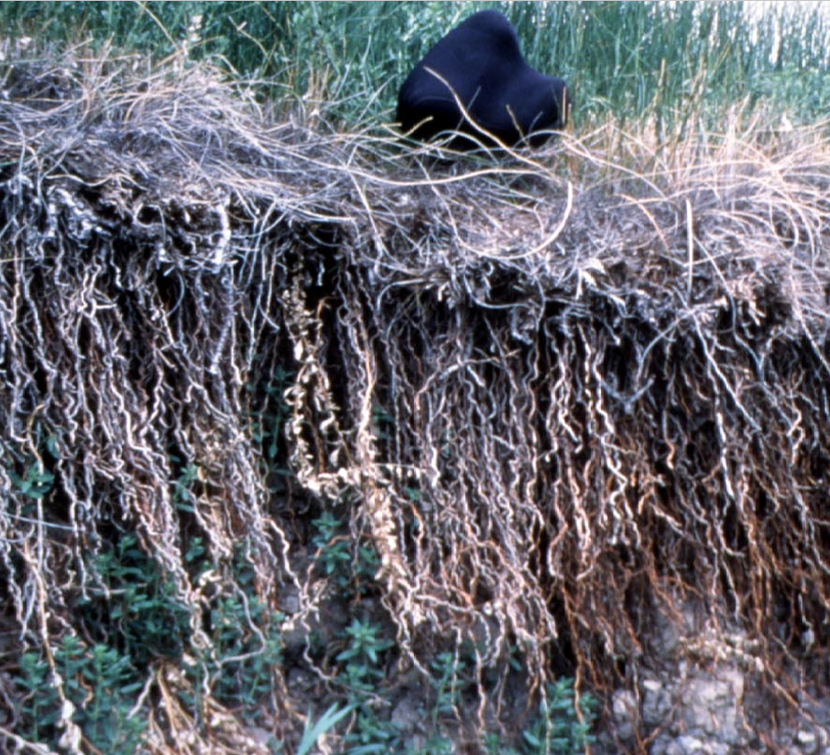
For Example – Baltic Rush Roots
Notes:
Baltic Rush Roots

Slide 36
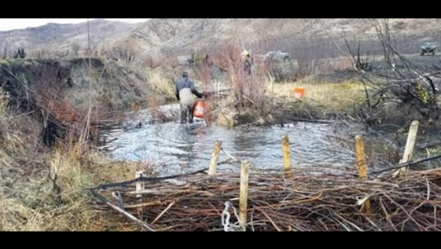
Beavers and Beaver Dam Analogs
https://youtu.be/fjS9-bhAfiQ?si=aiy5c50_sSGsq8NH

Slide 37
Riparian and Wetland Ecosystems
K.Launchbaugh
Juley Hankins-Smith
K.Launchbaugh
Rangeland principles, REM 151
Notes:
Riparian and Wetland Ecosystems Introduction

