Slide 1
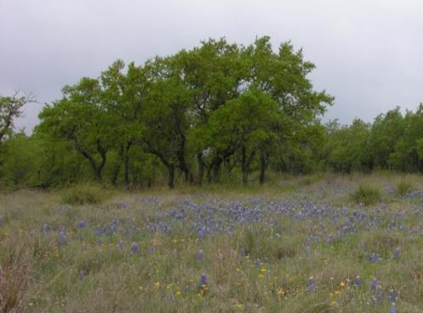
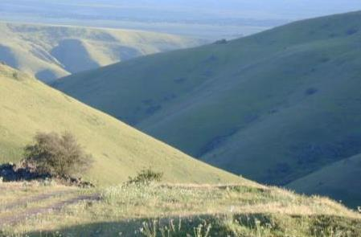
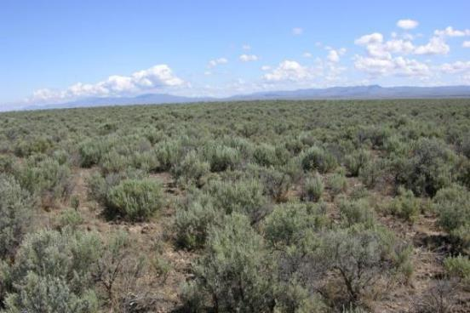

Rangelands of the US
Part 1 – Pacific & Great Basin
K. Launchbaugh
K. Launchbaugh
J. Peterson
Rangeland principles, REM 151

Slide 2
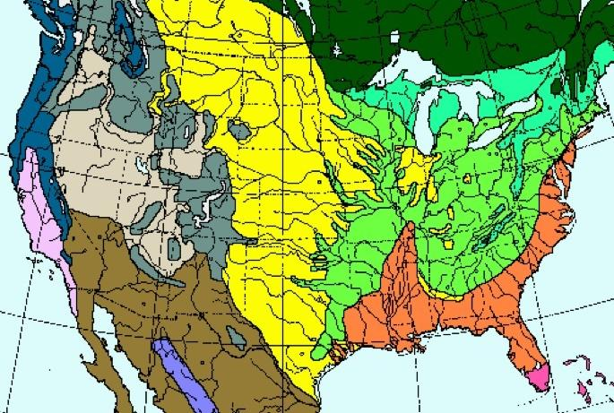
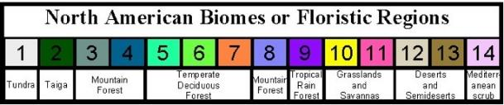
Grassland & Savannas
Deserts & Semideserts
Mediterranean
Deserts & Semideserts
Notes:
http://www.virtualfieldwork.org/MapPing_US_%26_North_American_Earth_Systems/Entries/2009/9/19_Biomes_of_North_America.html

Slide 3
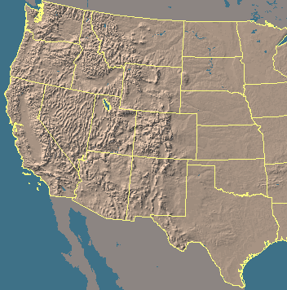
Climate Regions
Pacific Northwest
Patterns of precipitation and temperature determine:
Plant type
Biomass
Will examine types of rangeland by region.
Rocky Mountains
Great Plains
Great
Basin
Mediterranean
Southwest Deserts

Slide 4
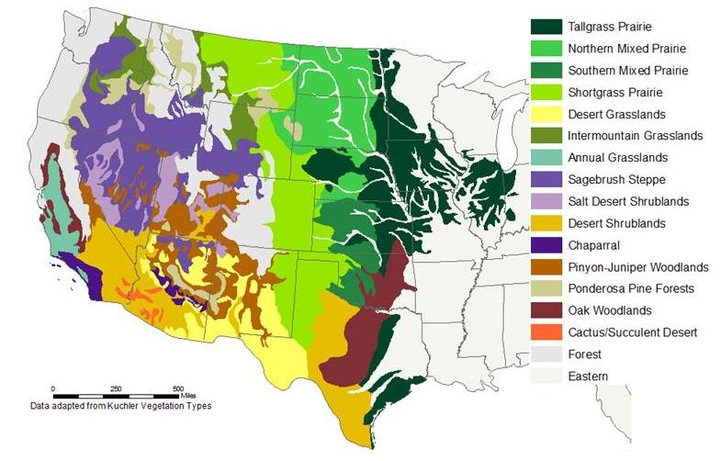
RANGELANDS OF THE US

Slide 5
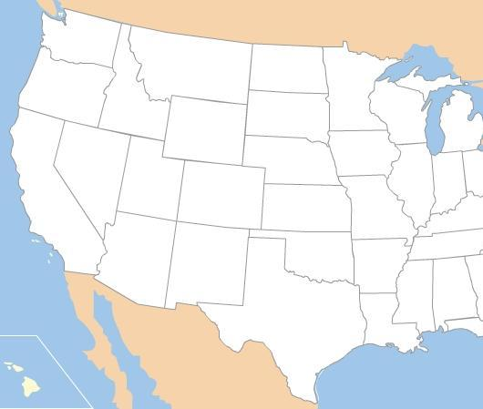

RANGELANDS OF THE US
(SIMPLIFIED)
Intermountain Grasslands
Shortgrass Prairie
Sagebrush Steppe
Mixed Prairie
Tallgrass Prairie
Oak
Woodlands
Annual
Grasslands
Salt Desert
Shrubland
Oak
Woodlands
Pinyon-Juniper
Woodlands
Desert Shrubland
& Grasslands
Notes:
Generalized map of rangeland vegetation types of the United States. Based mostly on A. S. Kuchler 1964. Potential natural vegetation of the conterminous Unites States. American Geographical Soc. Publ. #36.

Slide 6
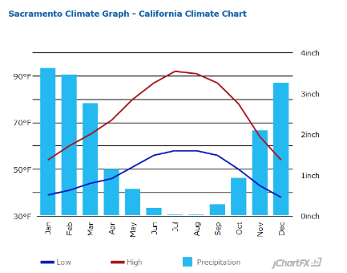
Mediterranean
Pacific Northwest
Great
Basin
Rocky Mountains
Great Plains
Mediterranean
Southwest Deserts
Mediterranean climate
Wet winters, warm dry summers

Slide 7
Annual
Grasslands
Notes:
Once this region was a subset of the Pacific Bunchgrass dominated by needlegrasses.
The Mediterranean climate (warm dry summers/cool wet winters) were well adapted to exotic annual plants such as cheatgrass and medusahead.
These plants were introduced at a time when heavy grazing was occurring the gold rush & western development. The region was quickly converted from perennial bunchgrasses to annual plants. LONGEST HISTORY OF LIVESTOCK GRAZINGNearly all range plants in this region are annual and exotic.
Today more than half of the region is farmed.

Slide 8
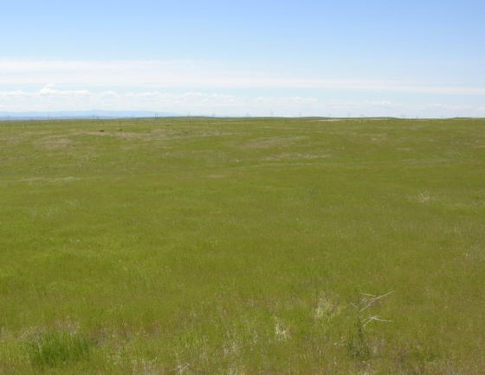
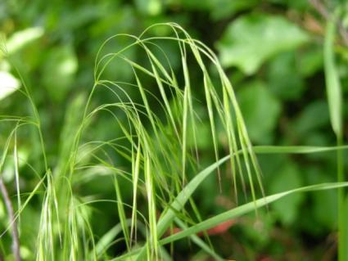
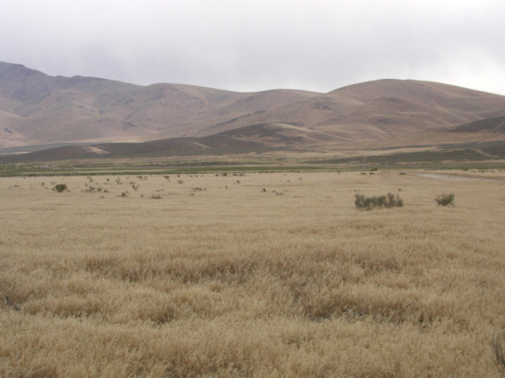
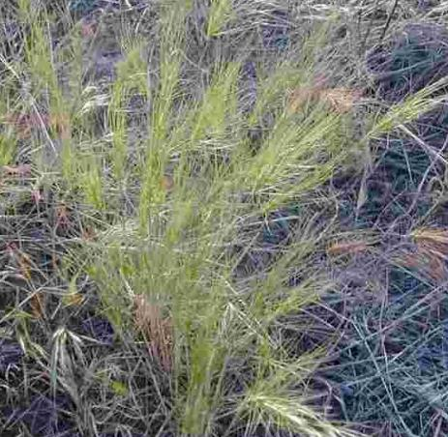
Annual Grasslands
Cheatgrass
Jennifer Peterson
Medusa head
Jennifer Peterson
www.werc.usgs.gov
Lovina Roselle

Slide 9
Annual Grasslands
Cheatgrass
Once dominated by needlegrasses.
Mediterranean climate (warm dry summers/cool wet winters) well adapted to exotic annual plants such as cheatgrass & medusahead
Annuals introduced when heavy grazing was occurring in the gold rush & western development. Region was quickly converted from perennial bunchgrasses to annual plants.
Today, more than half of the region is farmed.
Jennifer Peterson
Medusa head
Jennifer Peterson
www.werc.usgs.gov
Lovina Roselle

Slide 10
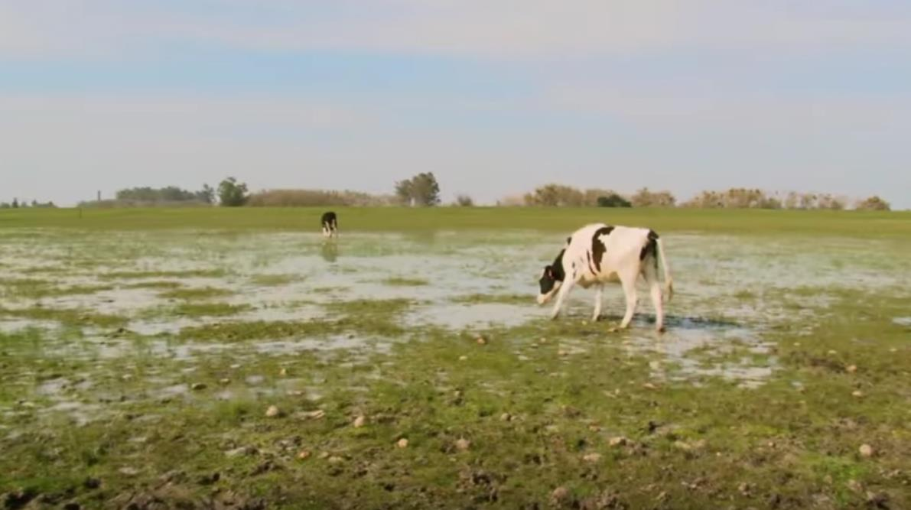
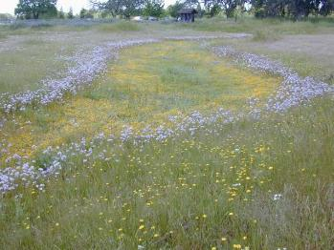

Annual Grasslands
The Critical Cows of the Merced Vernal Pools Grassland National Reserve
Vernal Pools: Support endemic rare plant and animal species, including many that are designated by federal and state government as rare, threatened, or endangered.
https://youtu.be/DMhdeQwSxVk
Notes:
https://www.youtube.com/watch?v=DMhdeQwSxVk
vernal ponds or ephemeral pools, are temporary pools of water that provide habitat for distinctive plants and animals.

Slide 11
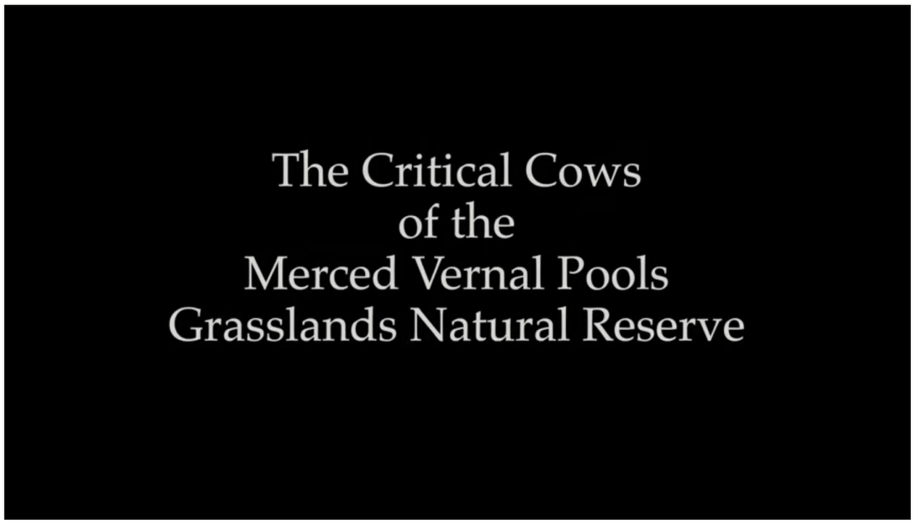
Annual Grasslands
Vernal Pools: Support endemic rare plant and animal species, including many that are designated by federal and state government as rare, threatened, or endangered.
https://youtu.be/DMhdeQwSxVk
Notes:
https://www.youtube.com/watch?v=DMhdeQwSxVk
vernal ponds or ephemeral pools, are temporary pools of water that provide habitat for distinctive plants and animals.

Slide 12
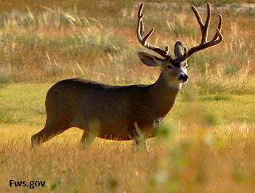

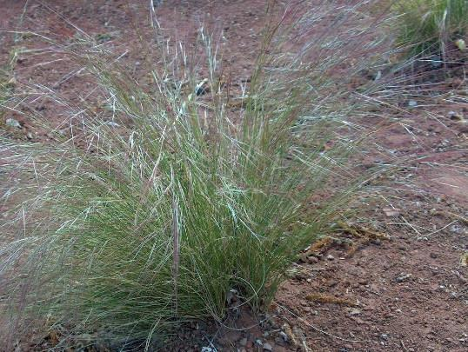
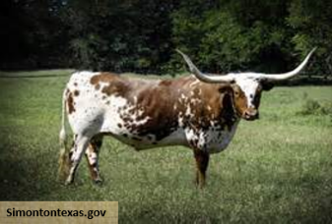

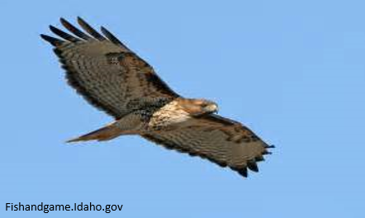
Annual Grasslands
Major Plants
Cheatgrass*
Medusahead
Purple Needlegrass
Major Animals
Cattle*
Deer*
Red-tailed Hawk*
Cheatgrass
Purple Needlegrass
Medusahead
Jennifer Peterson
NPS.gov
Lovina Roselle
* Plants and animals on the study list for this course

Slide 13
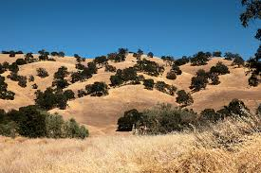
Oak Woodlands
Mediterranean & Moderate Climates
Savanna
Oak Woodlands
Notes:
Several types: oak savanna, Gambel oak woodlands, shinnery oak shrublands, and live oak woodlands.
Moderate climates, depending on region.
Understory of grasses - can be true savanna.
Important wildlife habitat (including acorns).
Fire important to maintain savannas
Leaves of gambel oak provides valuable browse for deer and elk. Acorns of oaks are harvest by a variety species from black bear, deer, and rodents. While acorn crops are variable from year to year a good acorn crop can improve the animals body condition going into winter.
In the winter and early spring before snow melt buds on the branches of gambel oak are accessible for grazing and make them important component of winter range

Slide 14
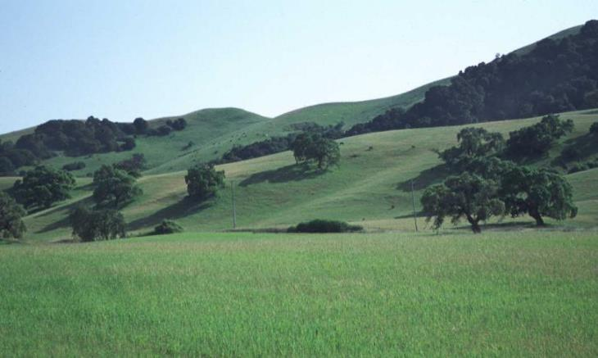
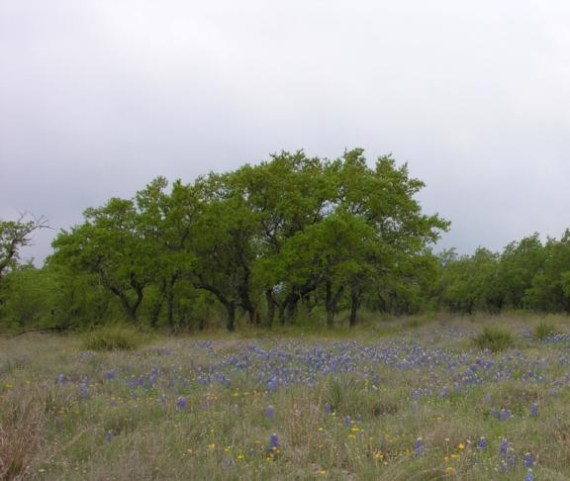
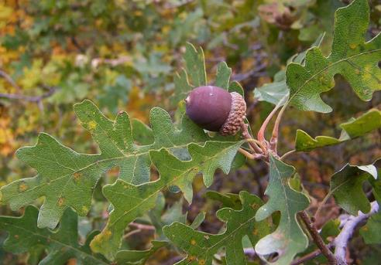
Oak Woodlands
K. Launchbaugh

Slide 15
Oak Woodlands
Several types: oak savanna, gambel oak woodlands, shinnery oak shrublands, and live oak woodlands.
Moderate climates, depending on region.
Understory of grasses - can be true savanna.
Important wildlife habitat; including acorns.
Fire important to maintain savannas
K. Launchbaugh

Slide 16
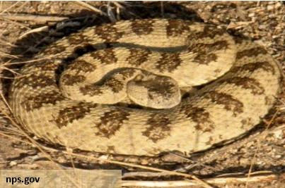
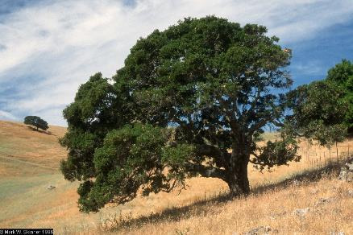
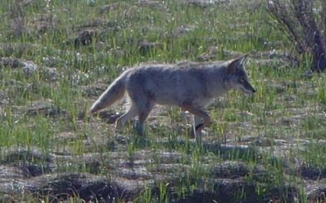
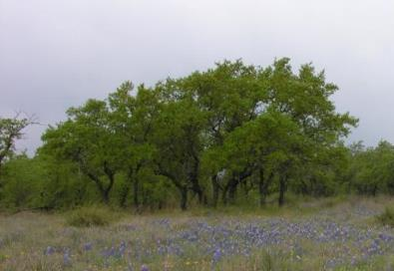
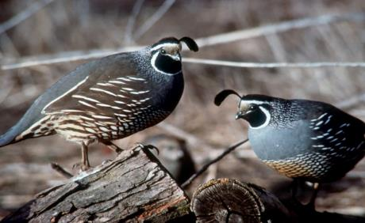
Oak Woodlands
Major Plants
Live Oak*
Cheatgrass*
Major Animals
Rattlesnake*
Coyote
California quail
Cheatgrass
Jennifer Peterson
J. Olnes
K. Launchbaugh
idfg.Idaho.gov

Slide 17
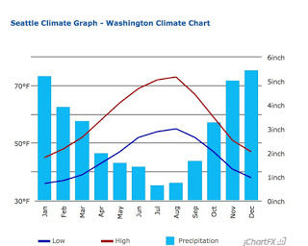
Pacific Northwest
Pacific Northwest
Great
Basin
Rocky Mountains
Great Plains
Mediterranean
Southwest Deserts
Mediterranean climate
Wet winters, moderate summers

Slide 18
Intermountain Grasslands
Palouse Prairie and Canyon Grasslands
Notes:
Loess soils = wind blow soils, silts…
This region includes the Palouse Prairie and Canyon Grasslands of ID, WA, OR & MT.
Major grasses include bunchgrasses such as bluebunch wheatgrass and Idaho fescue.
Late summer rains are uncommon in this region and therefore lightening-ignited wildfire was historically uncommon. Invasion of trees and shrubs into the grasslands was reduced because of the long, dry summers that make establishment of trees difficult.
The Palouse is a unique are of loess soils that is great for farming – therefore only about 1% of the original prairie exists today.

Slide 19
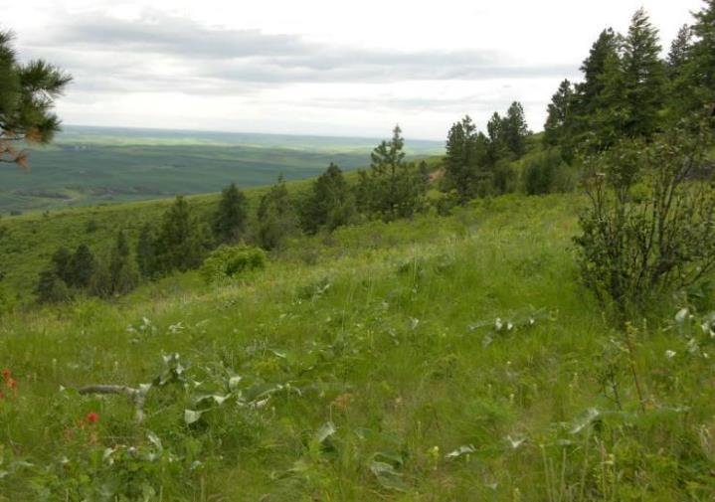
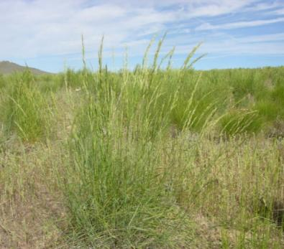
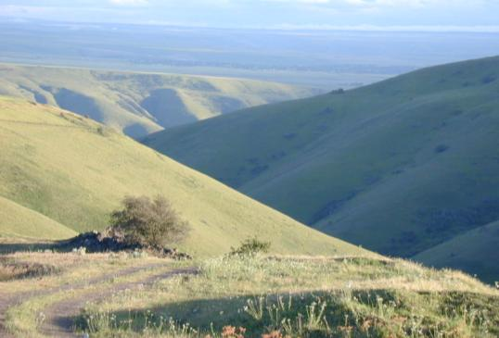
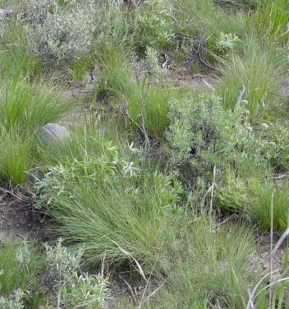
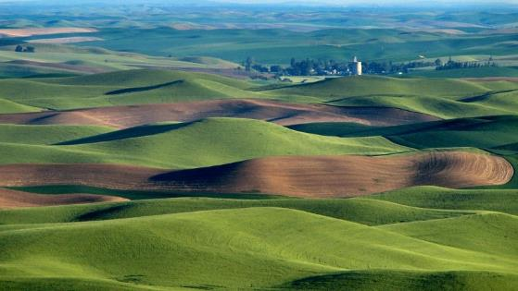
Intermountain Bunchgrass
Bluebunch Wheatgrass
Jennifer Peterson
Idaho Fescue
Jennifer Peterson
K. Launchbaugh
Jennifer Peterson
Notes:
Photos by Karen Launchbaugh & Jennifer Peterson (www.cnr.uidaho.edu/range_tour/photo_search.asp)

Slide 20
Intermountain Bunchgrass
Bluebunch Wheatgrass
This region includes the Palouse Prairie and Canyon Grasslands.
Major grasses: Bluebunch Wheatgrass and Idaho Fescue.
Late summer rains are uncommon - therefore lightening-ignited wildfire was historically uncommon.
Long, dry summers make establishment of trees and shrubs difficult.
The Palouse is a unique area of loessal soils that is great for farming – therefore only about 1% of the original prairie exists today.
Jennifer Peterson
Idaho Fescue
Jennifer Peterson
K. Launchbaugh
Jennifer Peterson
Notes:
Photos by Karen Launchbaugh & Jennifer Peterson (www.cnr.uidaho.edu/range_tour/photo_search.asp)

Slide 21
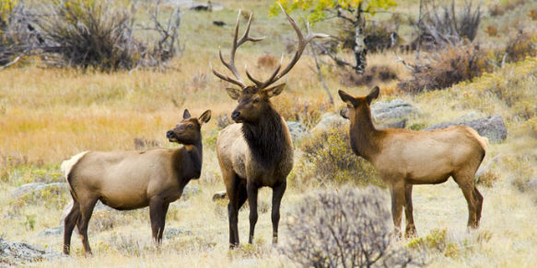

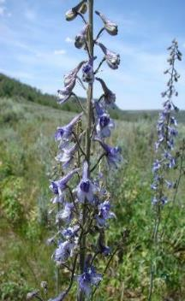
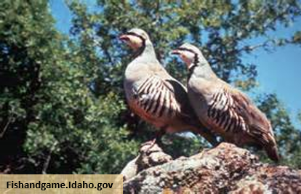

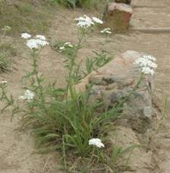
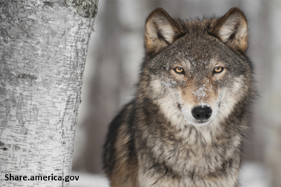
Intermountain Bunchgrass
Major Plants
Bluebunch Wheatgrass*
Idaho Fescue*
Tall Larkspur*
Western Yarrow*
Major Animals
Elk
Chucker*
Wolf*
Bluebunch Wheatgrass
NPS.gov
Idaho Fescue
Jennifer Peterson
Sheri Hagwood - BLM
Jennifer Peterson
Jennifer Peterson
Notes:
Photos by Karen Launchbaugh & Jennifer Peterson (www.cnr.uidaho.edu/range_tour/photo_search.asp)

Slide 22
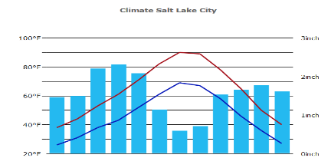
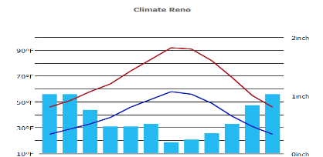
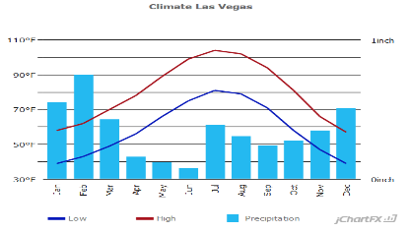
Great Basin
Salt Lake City, UT Average annual precip. =18.6"
Salt Lake City Average annual precip. =18.6"
3”
Pacific Northwest
Reno, NV Average annual precip. =7.5"
2”
Great
Basin
Rocky Mountains
Great Plains
Mediterranean
Las Vegas, NV Average annual precip. = 4.2"
Southwest Deserts
1”

Slide 23
Sagebrush Steppe
Semi-arid
Precip 8-20”/yr
Warm summers
Notes:
One of the most extensive range types in Western North America.
Mostly public ownership (65% public/35% private)
Semiarid climate (precip. 8-20 in./yr). Dry summers.
Fire historically patchy when shrubs would burn and perennial grasses would grow till shrubs took over again.
Invasion of annual grasses changed fire regime at lower elevations such that fire occurs so frequently the native grasses and shrubs are severely reduced.
At higher elevation, invasive juniper plants reduce sagebrush communities because of reduced fire frequency.

Slide 24
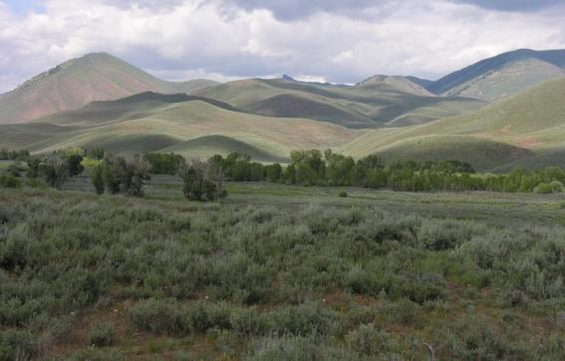
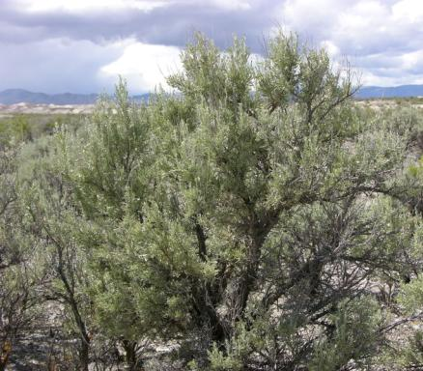

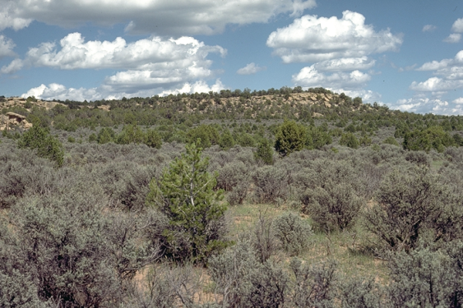
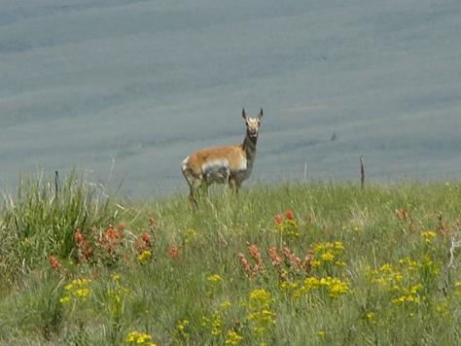
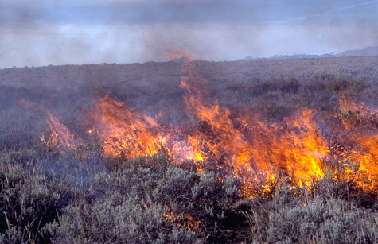
Sagebrush Steppe
Big Sagebrush
K. Launchbaugh
Jennifer Peterson
Jennifer Peterson
Jennifer Peterson
Jennifer Peterson
Jennifer Peterson
S.C. Bunting
Notes:
Map from Branson 1985. Vegetation Changes on Western Rangelands. Published by the Society for Range Management. Range Monograph No. 2.

Slide 25
Sagebrush Steppe
Big Sagebrush
One of the most extensive range types in Western U.S.
Mostly public ownership (65% public/35% private)
Fire kills sagebrush but important to ecosystem
Historically: Patchy fire → Perennial grasslands → Shrublands → Fire
At low elevation: Invasive annual grasses changed fire regime and increased fire frequency.
At higher elevation: Juniper invasion reduce sagebursh communities because of reduced fire frequency.
K. Launchbaugh
Jennifer Peterson
Jennifer Peterson
Jennifer Peterson
Jennifer Peterson
Jennifer Peterson
S.C. Bunting
Notes:
Map from Branson 1985. Vegetation Changes on Western Rangelands. Published by the Society for Range Management. Range Monograph No. 2.

Slide 26
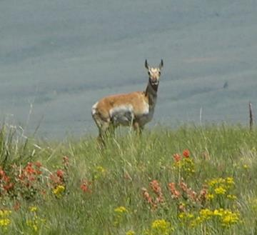

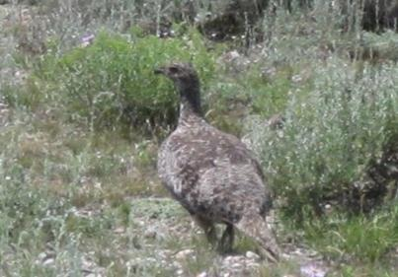




Sagebrush Steppe
Major Plants
Big Sagebrush*
Bluebunch Wheatgrass*
Spotted Knapweed
Cheatgrass
Major Animals
Pronghorn*
Sagegrouse*
Feral Horse*
Big Sagebrush
Bluebunch Wheatgrass
J. Peterson
Spotted Knapweed
Jennifer Peterson
Cheatgrass
K. Launchbaugh
Jennifer Peterson
K. Launchbaugh
Notes:
Map from Branson 1985. Vegetation Changes on Western Rangelands. Published by the Society for Range Management. Range Monograph No. 2.

Slide 27

Salt Desert Shrubland
Very dry climate
  3-10”/yr
Soils mostly Aridisols
Notes:
Very dry climate (3-10 in./yr precip.) with Aridisols
Often located parts of landscape that accumulate salts. Therefore, the region occurs in bands an strips on the landscape. Closed basin with high evaporation make for salty soils. Warmer sites due to elevation in comparison to sagebrush steppe communities
Plants mostly shrubs of the Chenopodiaceous adapted to salty soils (i.e., shadscale saltbrush).
The shrubs, like most shrubs, are nutritious in the winter and this vegetaton type is important for winter grazing by sheep, cattle, and wildlife.
Invasive annual plants are the greatest threat to this ecosystems.

Slide 28




Salt Desert Shrub
Greasewood
K. Luanchbaugh
Shadscale Saltbrush
Jennifer Peterson
J. Peterson
J. Peterson
J .Peterson
Jennifer Peterson
Notes:
Map from Branson 1985. Vegetation Changes on Western Rangelands. Published by the Society for Range Management. Range Monograph No. 2.

Slide 29
Salt Desert Shrub
Greasewood
Often located parts of landscape that accumulate salts. Therefore, the region occurs in bands an strips on the landscape.
Plants mostly shrubs of the Chenopodiaceous adapted to salty soils (e.g., Shadscale Saltbrush).
The shrubs, like most shrubs, are nutritious in the winter and this veg type is important for winter grazing by sheep, cattle, and wildlife.
Invasive annual plants are the greatest threat to this ecosystems.
K. Lanchbaugh
Shadscale Saltbrush
Jennifer Peterson
Jennifer Peterson
Jennifer Peterson
Jennifer Peterson
Jennifer Peterson
Notes:
Map from Branson 1985. Vegetation Changes on Western Rangelands. Published by the Society for Range Management. Range Monograph No. 2.

Slide 30



Invasive Poisonous Halogeton
K. Launchbaugh
K. Launchbaugh

Slide 31

Pinyon-Juniper Woodlands
Mid-elevation
Expansion = reduced fire frequency.
Notes:
Widely spread region occurs at mid-elevation.
Has many forms from mostly pinion pine solid stands of Juniper woodlands.
Expansion in recent decades because of reduced fire frequency largely because of human fire suppression.
Map from Branson 1985. Vegetation Changes on Western Rangelands. Published by the Society for Range Management. Range Monograph No. 2.

Slide 32


Pinyon-Juniper Woodlands
K. Launchbaugh
J. Peterson
Notes:
Map from Branson 1985. Vegetation Changes on Western Rangelands. Published by the Society for Range Management. Range Monograph No. 2.

Slide 33
Pinyon-Juniper Woodlands
Has many forms from mostly Pinyon Pine solid stands of Juniper woodlands.
Expansion in recent decades because of reduced fire frequency largely because of human fire suppression.
K. Launchbaugh
J. Peterson
Notes:
Map from Branson 1985. Vegetation Changes on Western Rangelands. Published by the Society for Range Management. Range Monograph No. 2.

Slide 34



Fuel buildup = catastrophic fire
Coalescing rills = high erosion
Loss of understory and seedbank = weed dominance
Loss of sagebrush = wildlife at risk

Slide 35
Rangelands of the US
Part 1 – Pacific & Great Basin
K. Launchbaugh
K. Launchbaugh
J. Peterson
Rangeland principles, REM 151

