Slide 1

WildLand Plants of the Great Plains and the Southwest
University of Idaho Rangeland Program
Notes:
NOTE:
To change the image on this slide, select the picture and delete it. Then click the Pictures icon in the placeholder to insert your own image.

Slide 2
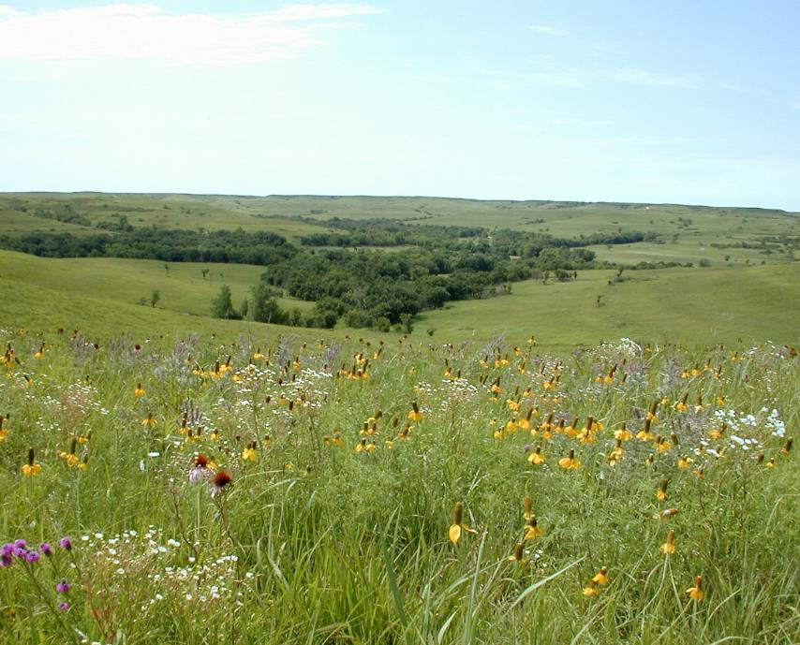
WildLand Plants of the Great Plains
University of Idaho Rangeland Program
Michael Haddock
Notes:
NOTE:
To change the image on this slide, select the picture and delete it. Then click the Pictures icon in the placeholder to insert your own image.

Slide 3
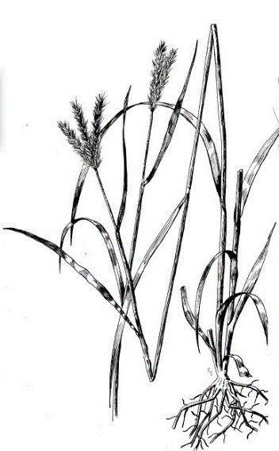
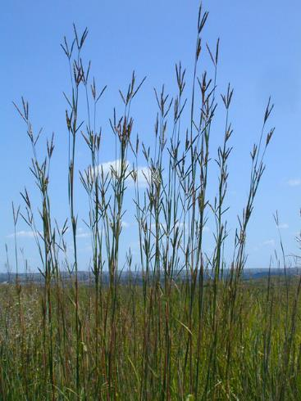
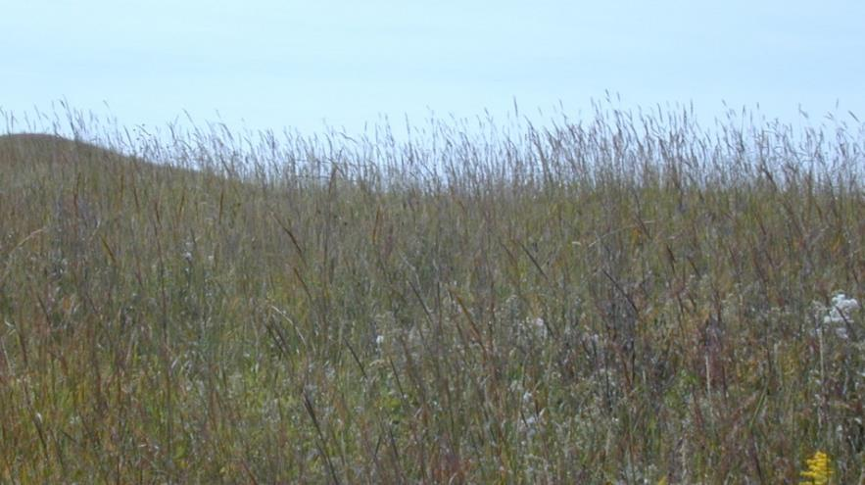
Big Bluestem
Perennial | Native
Large sodgrass with thick base
Can have strong scaly rhizomes
Inflorescence is a panicle with three spicate branches like a “turkey foot”
Mike Haddock
K. Launchbuagh

Slide 4
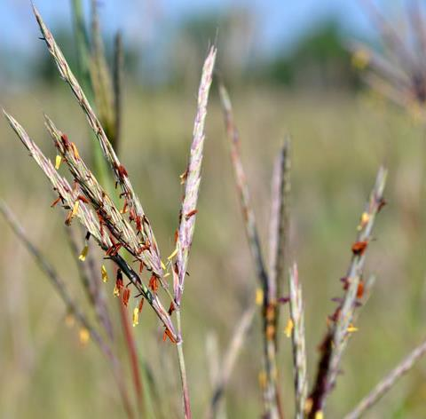
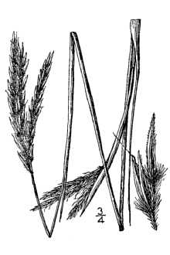
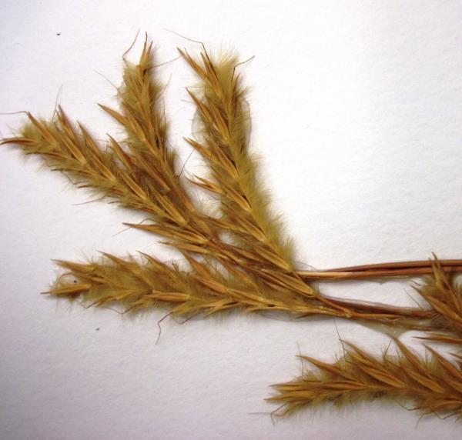
Big Bluestem
Perennial | Native
  Seeds have small kinky awn and may be fuzzy hairy
  Usually, golden red in color
Mike Haddock

Slide 5
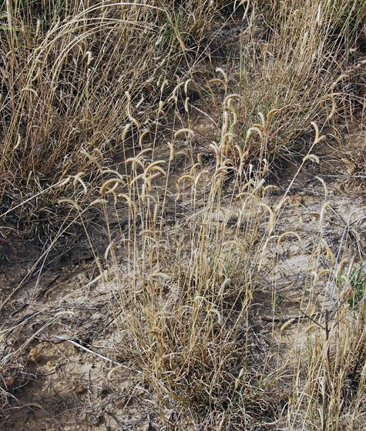
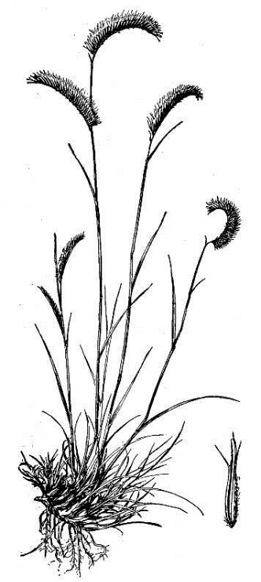
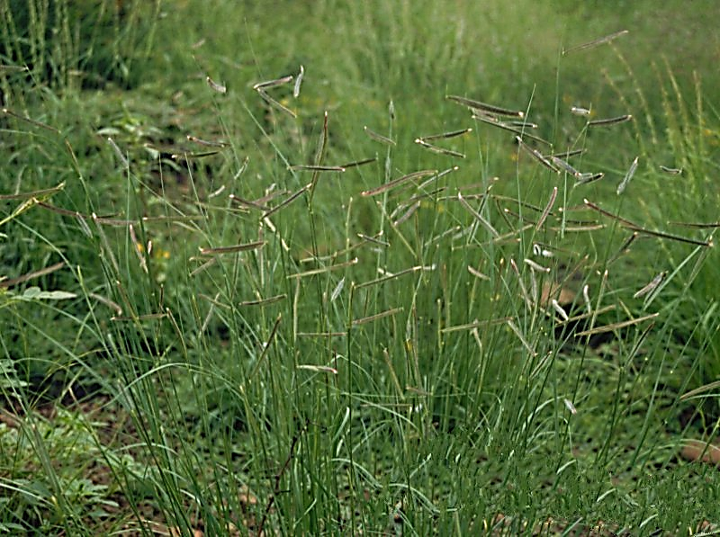

Blue Grama
Perennial | Native
Densely tufted plant with short, mostly basal, leaves
Mike Haddock
Texas A&M Virtual Herbarium

Slide 6
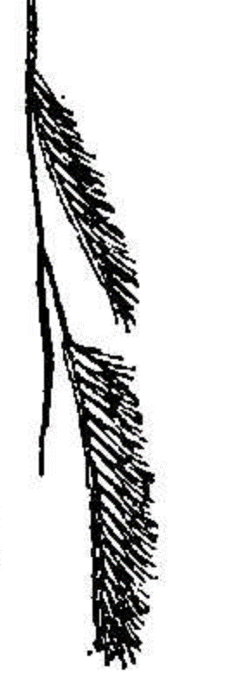
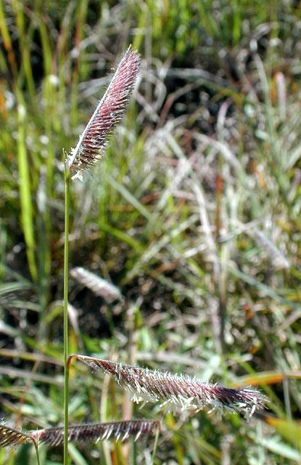
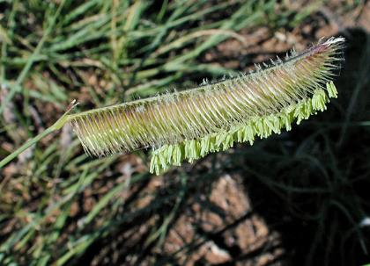
Blue Grama
Perennial | Native
2-3 spicate branches like dense eyebrows
Spikelets are densely crowded on comb-like branches
Mike Haddock
Mike Haddock

Slide 7
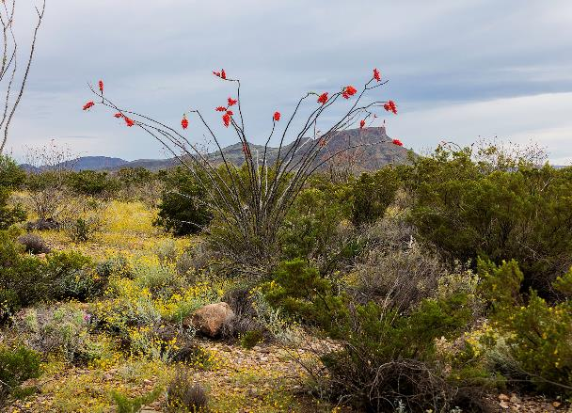
Wildland Plants of the SouthWest
University of Idaho Rangeland Program
Gary Nored, Flickr
Notes:
NOTE:
To change the image on this slide, select the picture and delete it. Then click the Pictures icon in the placeholder to insert your own image.

Slide 8
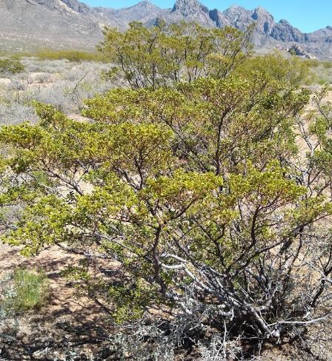
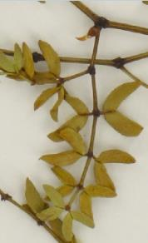
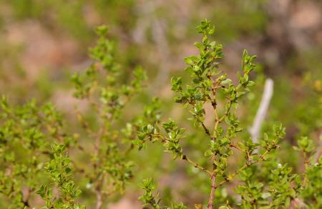

Creosotebush
Perennial | Native
Shrub up to 9 feet tall with no well-defined trunk
Leaves are opposite and glossy
Foliage emits creosote odor, particularly
when wet or burned
Patrick Alexander
Jason Karl

Slide 9
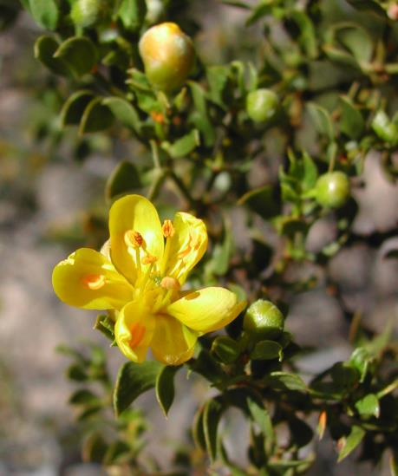
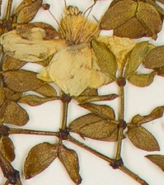
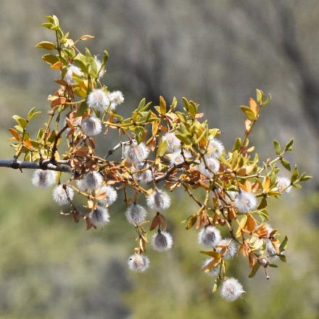
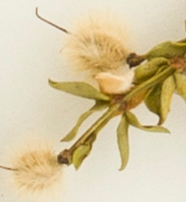
Creosotebush
Perennial | Native
Flowers yellow with 5 petals
Fruits are fuzzy white spheres
Zachery Berry
Max Licher

Slide 10
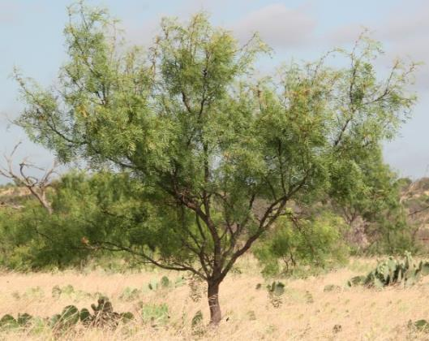
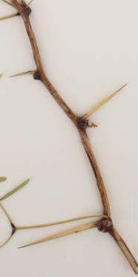
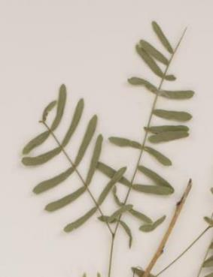
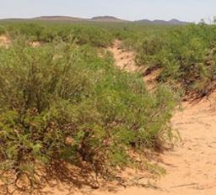
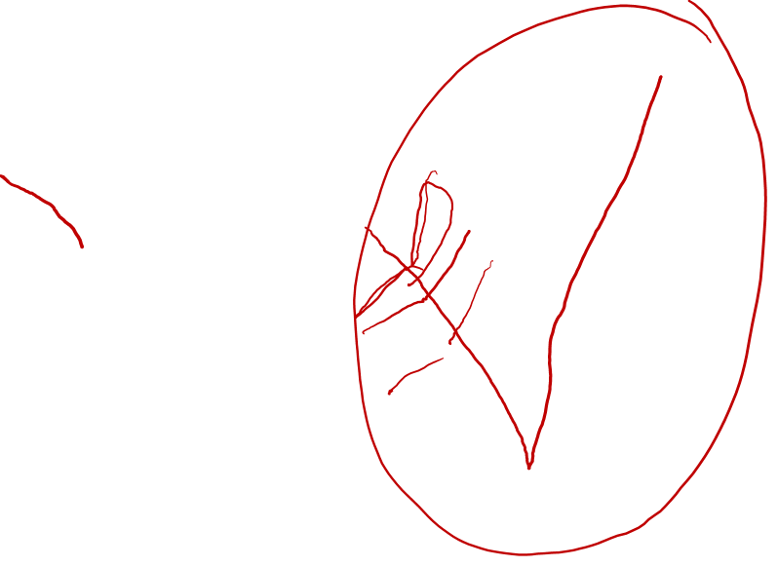
Honey Mesquite
Perennial | Native
Shrub or small tree 20-feet tall
Compound leaves with oblanceolate leaflets
Small straight thorns
AgriLife Extension Texas A&M System
Jason Karl

Slide 11
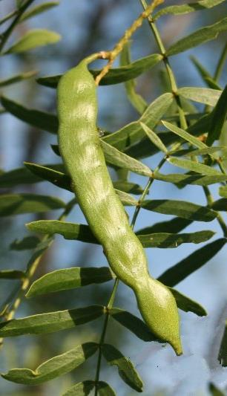
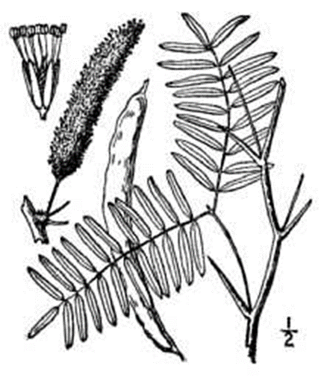
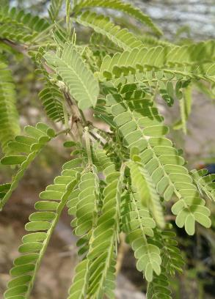
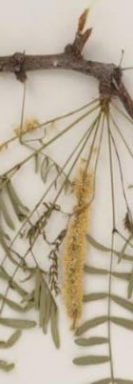
Honey Mesquite
Perennial | Native
Inflorescences greenish-yellow to creamy yellow
Fruits are like big pea pods. Mesquite is in same family as peas
AgriLife Extension: Texas A&M System
Jason Karl

Slide 12
WildLand Plants of the Great Plains and the Southwest
University of Idaho Rangeland Program
Michael Haddock
Notes:
NOTE:
To change the image on this slide, select the picture and delete it. Then click the Pictures icon in the placeholder to insert your own image.

