Slide 1
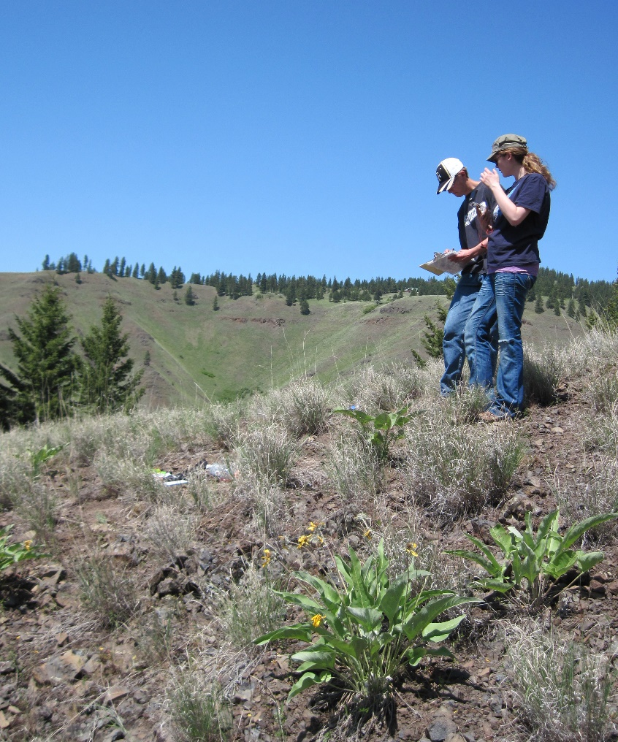

Describing and Monitoring
Rangelands
Rangeland principles, REM 151

Slide 2
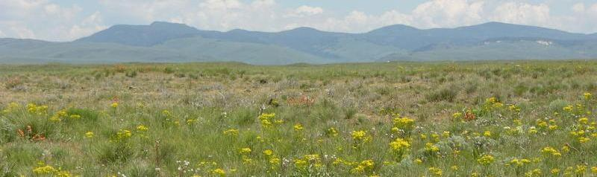
Inventory vs. Assessment vs. Monitoring
Record of resources at
one point in time
J. Peterson
Notes:
Quantitative are objective and valuable.

Slide 3
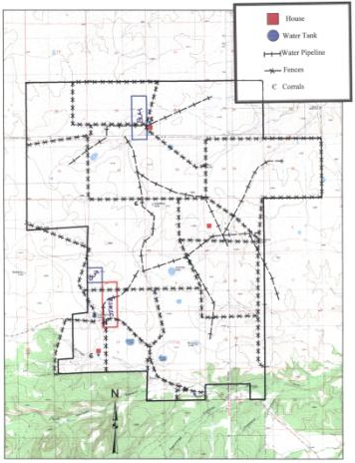
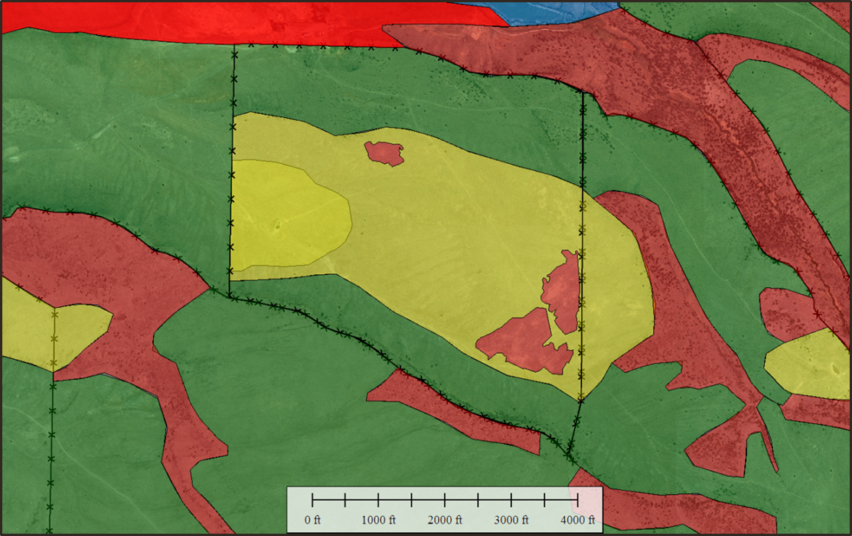
Inventory
Land Area & Pasture Sizes
Roads & Trails
Water (e.g., water development)
Corrals, Buildings, Fences
Maps (e.g., land ownership, vegetation, watershed)
Notes:
Maps for Management:
Good land management requires a good map. With GIS this is made much easier. Information about the resources can also be tied to the GIS map. For example, you could list vegetation types, water sources, roads, etc.

Slide 4
Inventory
Land Area & Pasture sizes
Roads & Trails
Water (e.g., water development)
Corrals, Buildings, Fences
Maps (e.g., land ownership, vegetation, watershed)
Vegetation
Livestock & Wildlife
Human Resources
Past Management Actions
Notes:
Maps for Management:
Vegetation map
Range map
Watershed map
Land ownership

Slide 5
Inventory vs. Assessment vs. Monitoring
Evaluation of conditions at one point in time.
J. Peterson
Notes:
Usually involve protocols based on “qualitative” attributes (rather than “quantitative” measures).

Slide 6
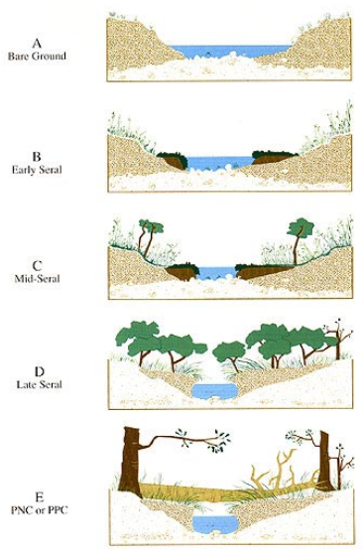
Assessment
Riparian Proper Functioning Condition
https://www.blm.gov/or/programs/nrst/files/Final%20TR%201737-16%20.pdf
Notes:
Riparian Proper Functioning Condition (PFC) is a qualitative method (PFC is a qualitative assessment based on quantitative science) for assessing the condition of riparian wetland areas. The term PFC is used to describe both the assessment process and a defined, on the-ground condition of a riparian-wetland area. The PFC assessment refers to a consistent approach for considering hydrology, vegetation, and erosion/deposition (soils) attributes and processes to assess the condition of riparian wetland areas.
https://www.blm.gov/or/programs/nrst/files/Final%20TR%201737-16%20.pdf

Slide 7
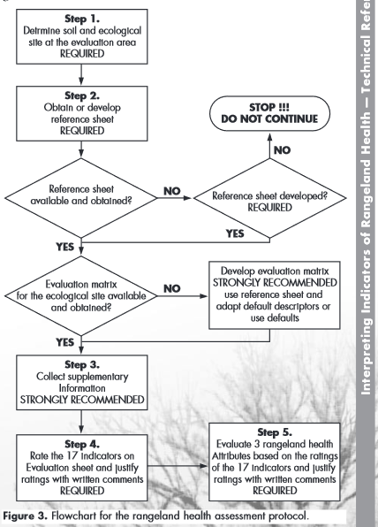
Assessment
Riparian Proper Functioning Condition
Rangeland Health Assessment
http://www.nrcs.usda.gov/Internet/FSE_DOCUMENTS/stelprdb1043944.pdf
Notes:
Rangeland Health: Qualitative assessments of rangeland health provide land managers and technical assistance specialists with a good communication tool for use with the public. Many of these tools have been used successfully for this purpose over the past 100 years. This technique, in association with quantitative monitoring and inventory information, can be used to provide early warnings of resource problems on upland
rangelands.

Slide 8
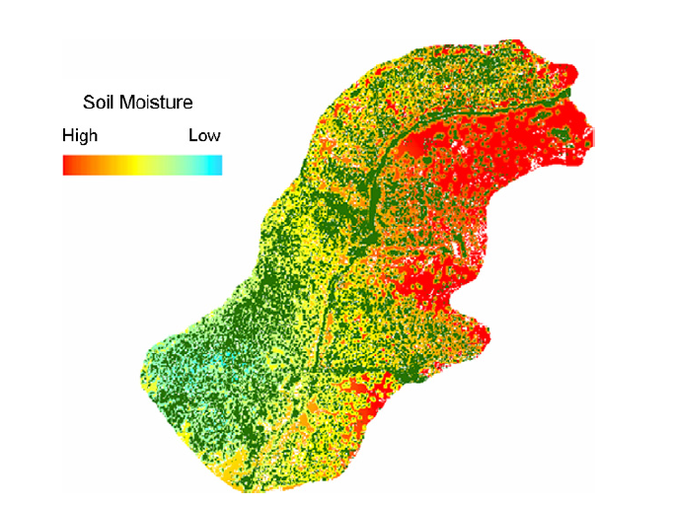
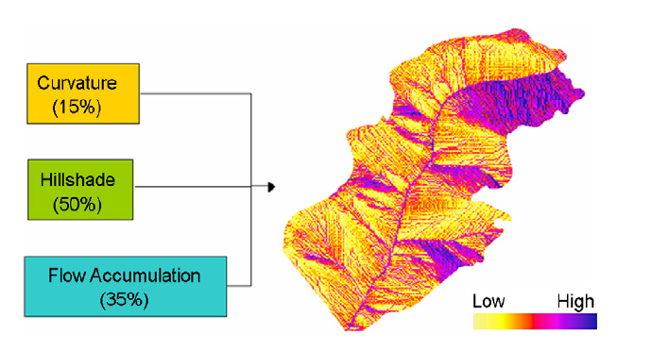
Assessment
Riparian Proper Functioning Condition
Rangeland Health Assessment
Ecosystem Integrity (remote sensing → rapid ground-based → intensive ground-based)
Petersen, S.L., and T. K. Stringham. 2008. Development of GIS-based models to predict plant community structure in relation to western juniper establishment. Forest Ecology and Management 256:981-989
Notes:
An Ecological Integrity Assessment (EIA) is an approach to systematically rate the current ecological integrity of an occurrence of a plant association or ecological systems. The goal of an EIA is to provide a succinct assessment of the current status of the composition, structure, processes, and connectivity of a particular occurrence of an ecosystem type, interpreted in light of reference conditions based on natural ranges of variation, and with a practical interpretation that can inform management decisions and guide conservation and restoration activities.
The EIA can be applied to multiple spatial scales (e.g., landscape or site-scale) and with a variety of data types (e.g., GIS or field-based). EIAs are developed using a three level approach to identify a suite of metrics, including Level 1 (remote sensing), Level 2 (rapid ground-based), and Level 3 (intensive ground-based) metrics.
https://www.dnr.wa.gov/NHP-EIA

Slide 9
Inventory vs. Assessment vs. Monitoring
Series of measurements
spanning time
Notes:
Monitoring: information taken over time. Lets you know if the land is getting better or worse (Monitoring enables managers to take appropriate actions and change course if needed).
The word “monitor” is rooted in a term meaning “to warn”
Conducted to record changes in resource status, usually to assess the response to a management program at a site.

Slide 10
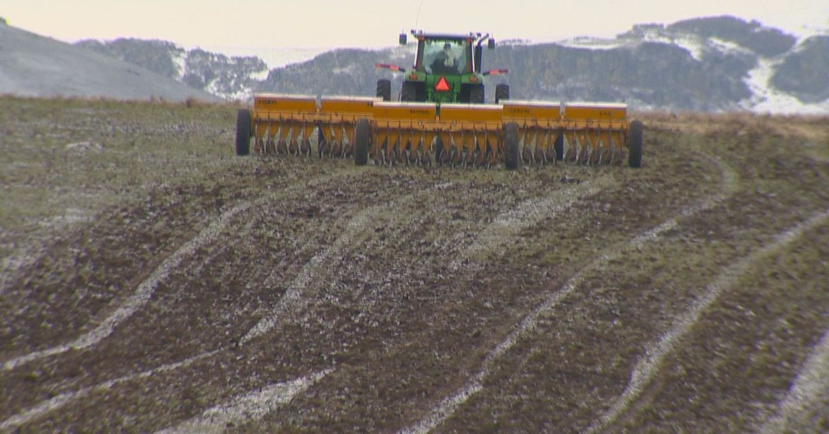
Monitoring
Restoration following Wildfire
Notes:
After a wildfire, a land manager of this sagebrush steppe area in Southern Idaho may implement a monitoring program to determine if and when the burned area recovers a plant community similar to an unburned area.

Slide 11
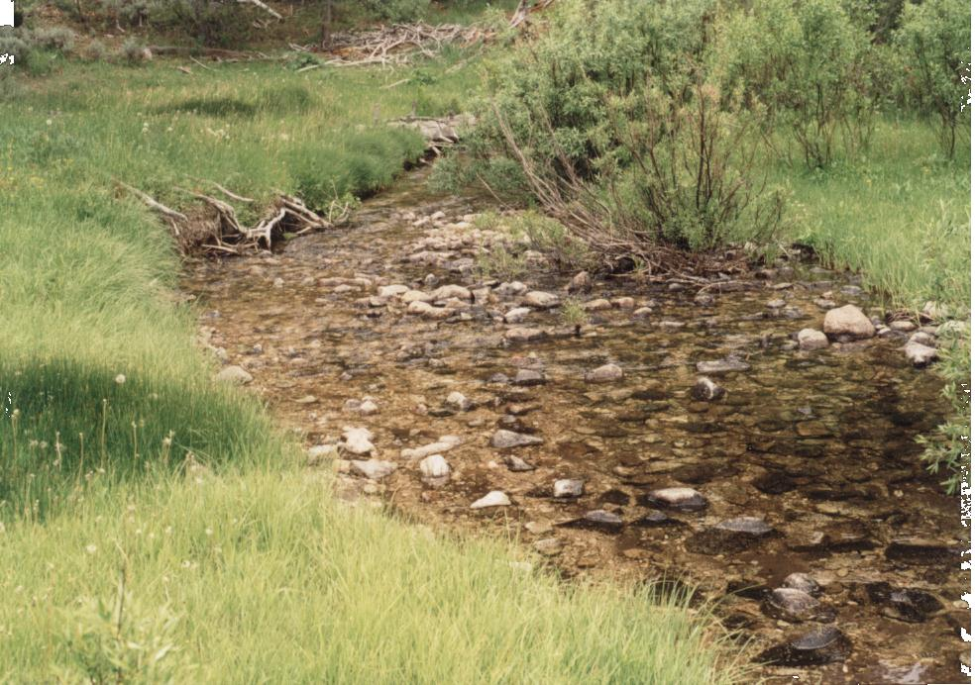
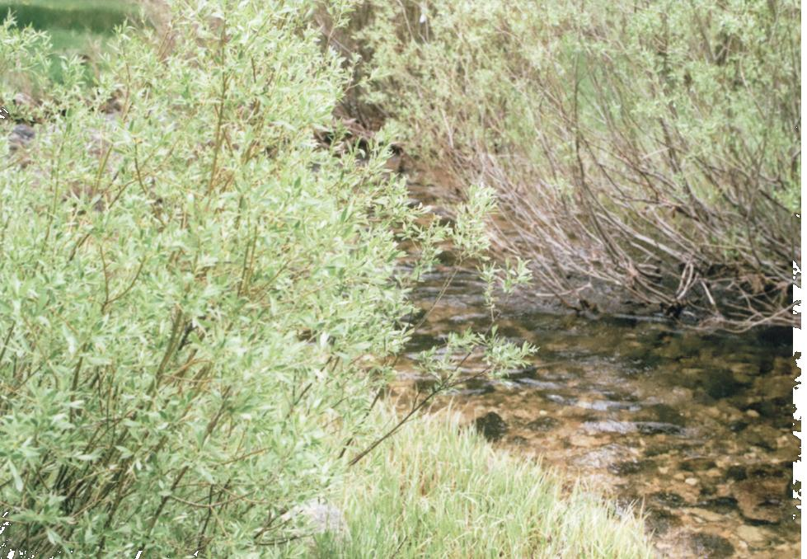
Monitoring
June 11, 2001
June 18, 2011
Decrease browse on Willows
Photos: Amanda Gearhardt
Notes:
A rancher may implement a monitoring protocol to determine if a new grazing system is affecting establishment of sedges or willows along a stream improving the stability of stream banks.

Slide 12
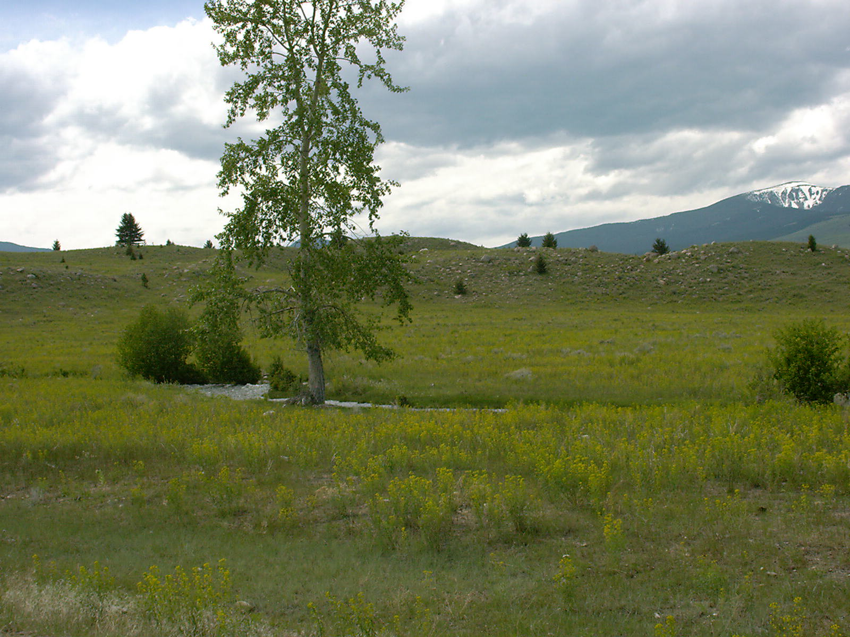
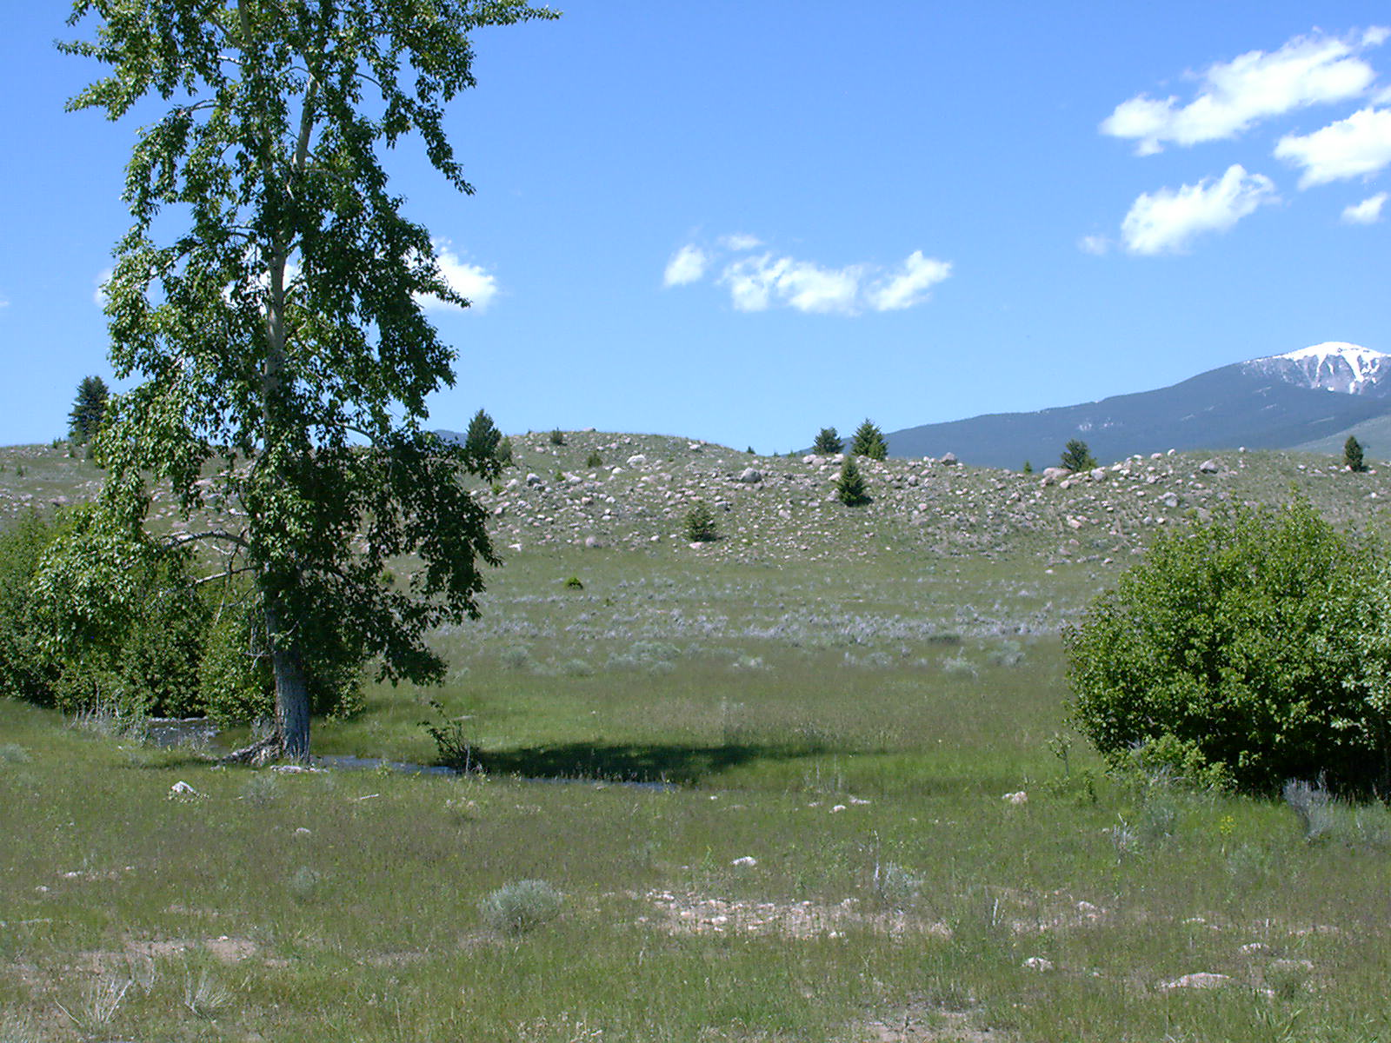
Monitoring
Leafy spurge patch
Notes:
A leafy spurge patch such as this could be monitored to determine if the weed management plans are effective…is the weed population getting better or worse?

Slide 13
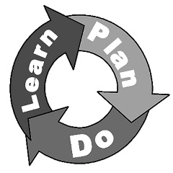
Monitoring: The Main Steps
Complete Inventory/Goals
Adaptive Management
Describe where you are right now.
Identify what you want to achieve LONG-TERM on the land.
Biological Planning
Boyd, C.S., and T.J. Svejcar. 2009. Managing Complex Problems in Rangeland Ecosystems. Rangeland Ecology and Management 62:491-499
Notes:
Know what resources you have available
Sage-Grouse example: Goal to increase sage-grouse population OR Goal to maintain/improve sage-grouse habitat…

Slide 14
Monitoring
Complete Inventory/Goals
Develop objectives
Adaptive Management
Biological Planning
Set SMART objectives
Boyd, C.S., and T.J. Svejcar. 2009. Managing Complex Problems in Rangeland Ecosystems. Rangeland Ecology and Management 62:491-499
Notes:
One example of a planning model.
Explore Possible Enterprises, Develop plan

Slide 15
SMART Objectives
Specific – Objectives should specifically state what you want to achieve on the land you are managing.
Goals = long-term; Objectives = short-term
Notes:
Specific: example: goal to maintain a sustainable operation

Slide 16
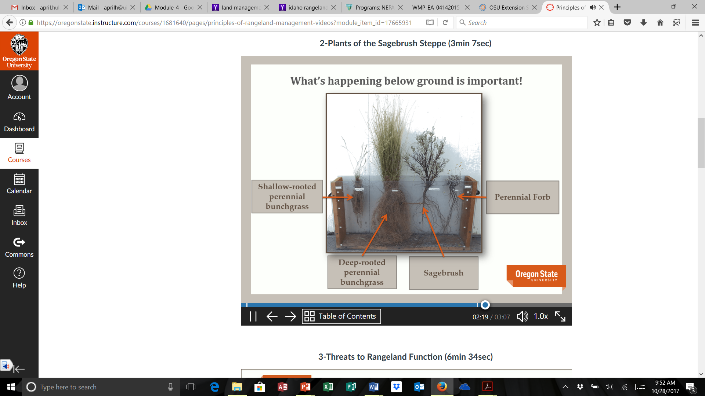
SMART Objectives
Measurable – It must be possible to measure whether you are meeting the objectives or not.
Increase deep rooted perennial bunchgrass
Decrease annual grasses
Decrease browse on willows
Decrease bare ground
Notes:
Objectives: Increase deep rooted perennial bunchgrasses and decrease bare ground.

Slide 17
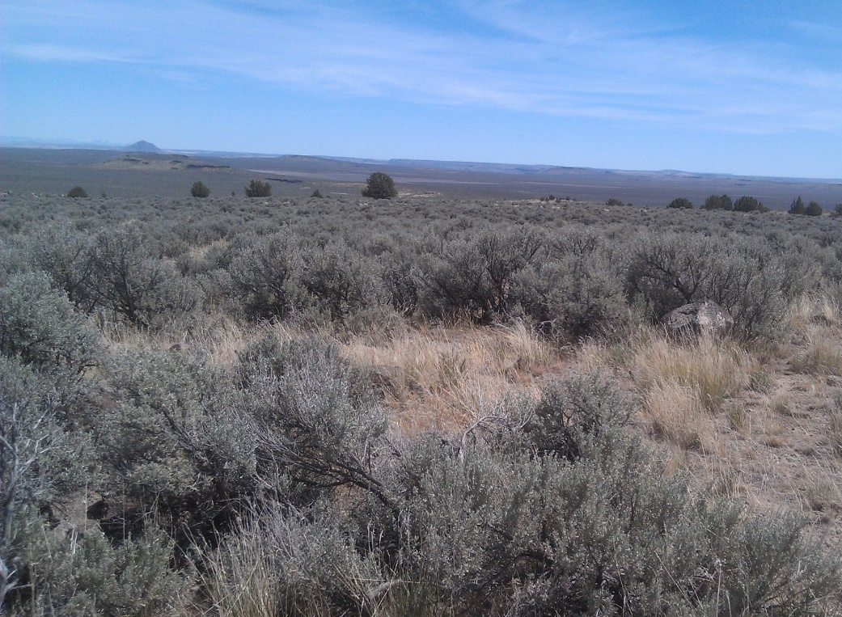
SMART Objectives
Achievable - Are the objectives you set, achievable in your current setting?
Economic Parameters
Environmental Constraints
Legal Requirements
Societal Expectations
Technological Limitations
Notes:
What your land is capable of:
Ecological site
Climate
Condition

Slide 18

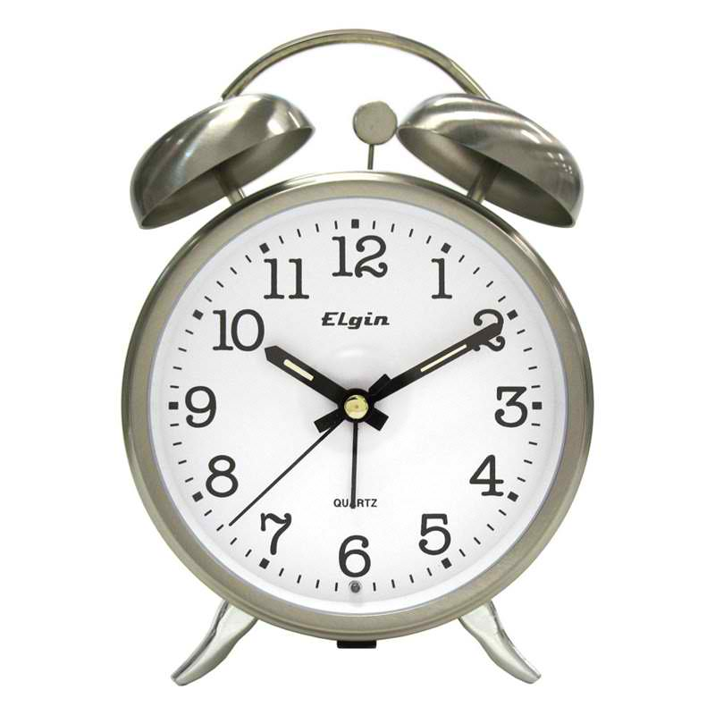
SMART Objectives
Realistic – Set objectives that you can realistically achieve given the natural and management context of your situation.
What resources do you have?
What are you capable of?
Time – Set a time horizon for management objective.
Notes:
What resources you have…Land, human capital, economic
What you are capable of…skills, abilities, knowledge.

Slide 19
Monitoring
Complete Inventory/Goals
Develop objectives
Design and implement management
Adaptive Management
Biological Planning
Conservation Design
Conservation Implementation
Boyd, C.S., and T.J. Svejcar. 2009. Managing Complex Problems in Rangeland Ecosystems. Rangeland Ecology and Management 62:491-499
Notes:
Monitoring:
Complete inventory and goals
Develop objectives
Design and implement management

Slide 20
Monitoring
Complete Inventory/Goals
Develop objectives
Design and implement management
Design the monitoring methodology
Adaptive Management
Biological Planning
What/how can I realistically monitor?
Monitoring & Research
Conservation Design
Conservation Implementation
Boyd, C.S., and T.J. Svejcar. 2009. Managing Complex Problems in Rangeland Ecosystems. Rangeland Ecology and Management 62:491-499
Notes:
There is no point in laying out a very intensive monitoring system if you are not able to carry it out, for whatever reason. This has been a problem with both the FS and BLM in the past. They over commit then end up doing nothing in frustration.

Slide 21
Monitoring
Complete Inventory/Goals
Develop objectives
Design and implement management
Design the monitoring methodology
Evaluate management actions.
Adaptive Management
Biological Planning
Monitoring & Research
Conservation Design
How is it going?
What needs to change (if anything)?
Conservation Implementation
Boyd, C.S., and T.J. Svejcar. 2009. Managing Complex Problems in Rangeland Ecosystems. Rangeland Ecology and Management 62:491-499
Notes:
If monitoring shows that we did not meet our objectives, we need to determine why. However, we should not just jump to the conclusion that our management was at fault. Sometimes we set unrealistic management objectives that are not achievable, at least in the time frame we specified in our objectives. On the other hand, if monitoring shows we have met our objectives, it may be time to set new objectives. Do we want to maintain the condition of the resources where we are or do we want additional improvement? Regardless of the scenario, we need to re-evaluate the management plan and make any needed changes. Again, this should be done as soon after the grazing season has ended as possible so there are no surprises at turnout the next grazing season to any of the involved parties.

Slide 22
Monitoring Trend
Trend = upward or downward based on conditions measured at least 2 points in time:
  Used to evaluate management actions
  Measures change over time
  Best if done frequently
Apparent Trend = attributes measured at one time point in time to infer trend
  Often misleading
Ecological Status
Time
What factors influence trend?
Notes:
Trend is the primary monitoring tool we should be using. Change is generally slower on arid rangelands than where we have higher precipitation, but it can still happen in one year. That is why it is best to monitor on an annual basis. Otherwise, we may not discover what caused the change. Beware of the idea of apparent trend—snapshot investigations may not be telling the whole story.
This graph shows the challenge in monitoring trend. A one point in time analysis of ecological status does not indicate trend. If the analysis is done during a drought, it may make it appear the range is in trouble, but a year later following abundant rain, the range may look in great shape.

Slide 23
Factors Influencing Trend
Weather
Grazing/Browsing
Insects
Recreation
Fire
Trampling
Rodents
Etc.
All of these can be beneficial or detrimental, depending on circumstances.
Notes:
There are many factors that affect rangelands besides livestock grazing. Weather is definitely a factor. It does not matter to the plant whether it is bitten off by a domestic cow or an elk. It is how the animals are managed or not managed that controls the effect on the plant. Animals can cause soil compaction and erosion. On the other hand, they can help plant seed through hoof action. Rodents can also have a tremendous effect, both above ground and underground. Insects, such as crickets and grasshoppers can have a tremendous effect on plants. Some references state that insects use more plant matter than livestock. As with grazing, insects, and wildlife, fire can have beneficial effects as well as detrimental effects. It is all a matter of timing, intensity, etc. Recreation is increasingly have an impact on rangelands and forestland. As for as the resource is concerned, I know of no beneficial effect. But it can certainly have a negative effect, especially off-road vehicles.

Slide 24
Describing and Monitoring
Rangelands
Rem 151 fall semester 2016
Notes:
Next class….quick introduction video to range monitoring…
https://youtu.be/OYPeGZzgmUM

Slide 25
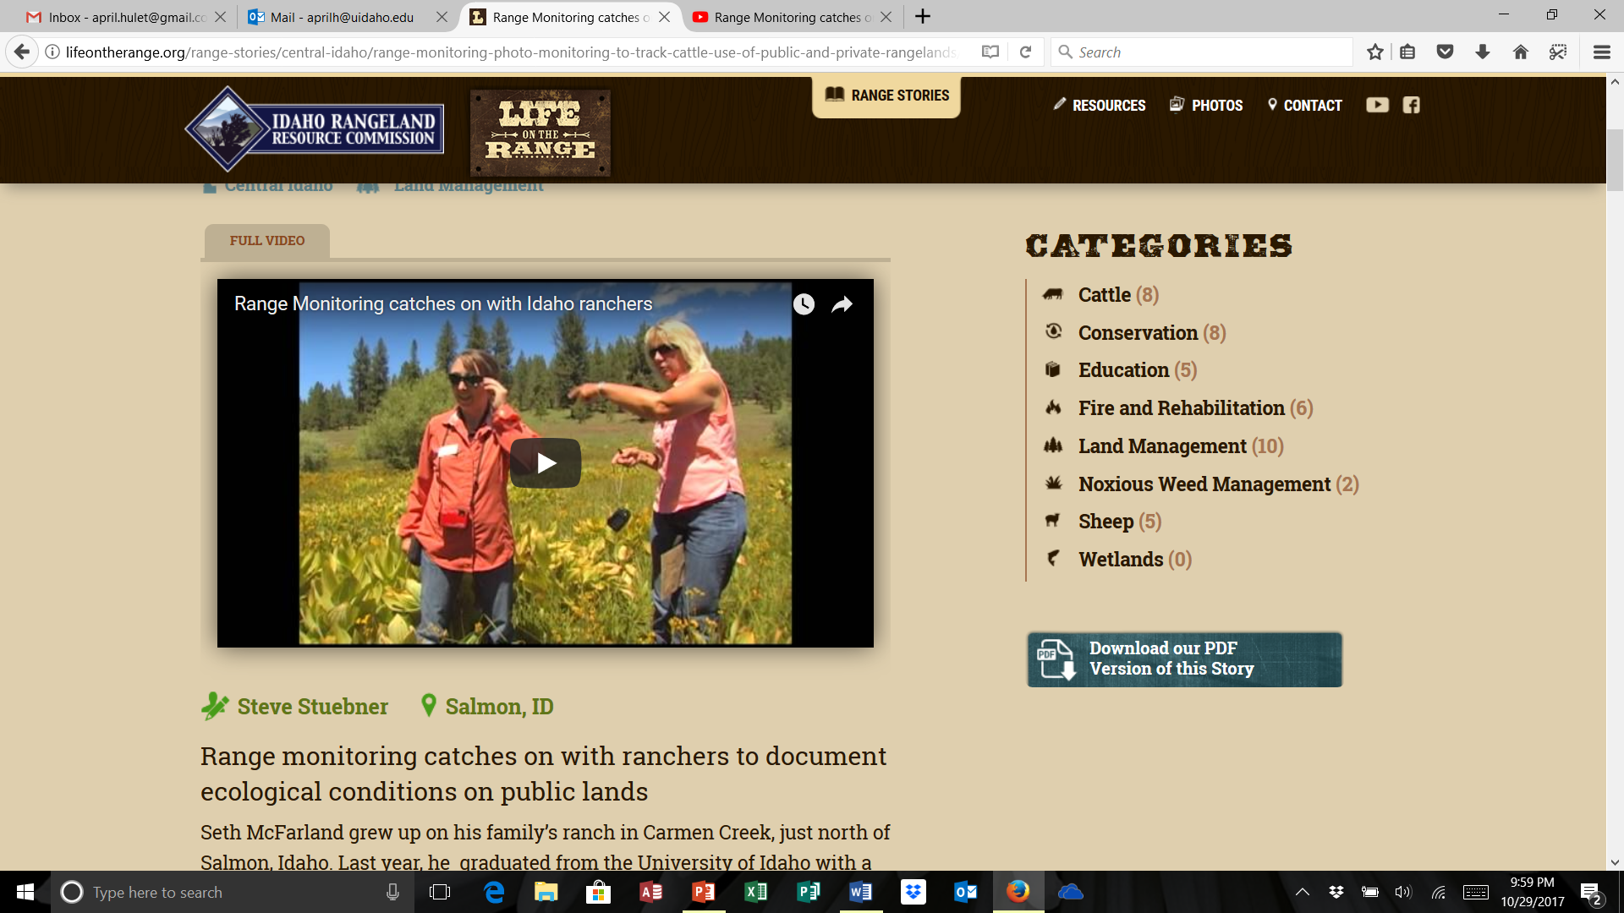
WATCH
https://youtu.be/OYPeGZzgmUM

