Slide 1
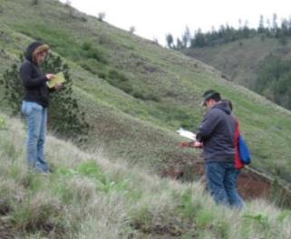
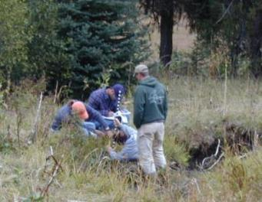
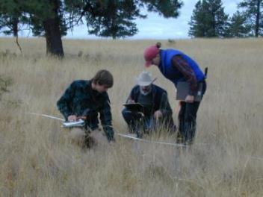

Measuring Rangelands
K. Launchbaugh
K. Launchbaugh
K. Launchbaugh
Rangeland Principles – REM 151

Slide 2
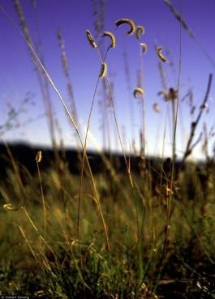
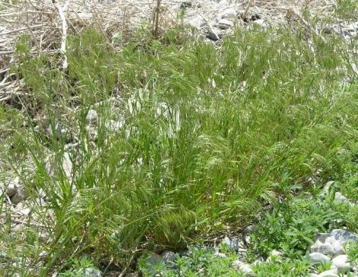
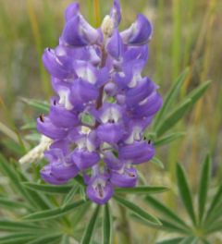
Vegetation Attributes (biotic attributes)
Plant Species (genetically unique)
Robert Soreng
Jennifer Peterson
Jennifer Peterson
Blue Grama
Cheatgrass
Tailcup Lupine
Notes:
Vegetation attributes
Plant species

Slide 3
Vegetation Attributes (biotic attributes)
Life Span
Robert Soreng
Jennifer Peterson
Jennifer Peterson
Perennial
Annual
Perennial
Notes:
Vegetation attributes
Life span

Slide 4
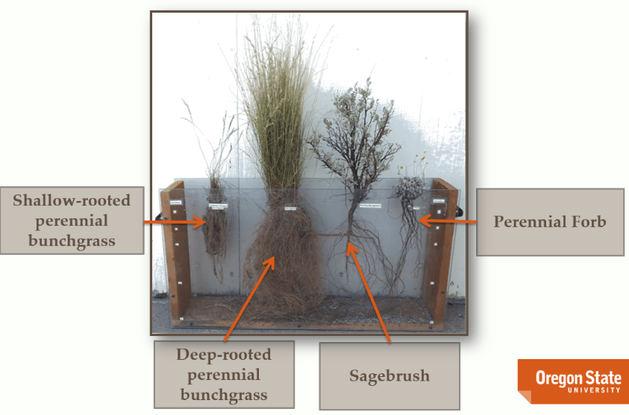
Vegetation Attributes (biotic attributes)
Functional Group
Photo: Dustin Johnson
Notes:
Functional groups: use resources in a similar way (they get their water/nutrients from the same soil profile), they respond similar to disturbance and management practices, they compete with other vegetation similarly.

Slide 5



Monitoring Methods
Frequency
Density
Cover
Biomass
Structure
Plant Composition
Notes:
Monitoring Methods:
Frequency
Denstiy
Cover
Biomass
Structure
Plant composition

Slide 6
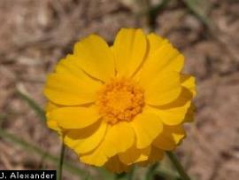
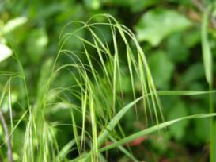

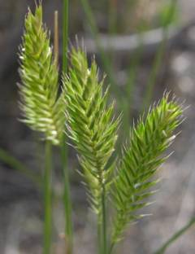
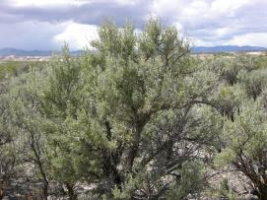
Frequency
How often a plant occurs within a sample area.
Proportion (%) of times a plant occurs in the total number of plots examined.
What is the frequency of cheatgrass?
Occurs in 2 of the 5 plots = 40%
Notes:
Cheatgrass: occurs in 2 of the 5 plots observed = 40%

Slide 7
Frequency
How often a plant occurs within a sample area
Proportion (%) of times a plant occurs in the total number of plots examined.
What is the frequency of sagebrush?
Occurs in 1 of the 5 plots = 20%
Notes:
Sagebrush: occurs in 1 of the 5 plots observed = 20%

Slide 8
Frequency
How often a plant occurs within a sample area
Proportion (%) of times a plant occurs in the total number of plots examined.
What is the frequency of perennials?
Occurs in 3 of the 5 plots = 60%
Notes:
Perennials: occurs in 6 of the 5 plots observed = 60%

Slide 9
Density
Number of individuals per unit area.
What is the density of yellow triangles?
2 yellow triangles/m²
1.0 m
What is the density of circles?
8 circles/m²
1.0 m
Notes:
Unit area = Plants/m2 or Plants/hectare or Plant/acre

Slide 10
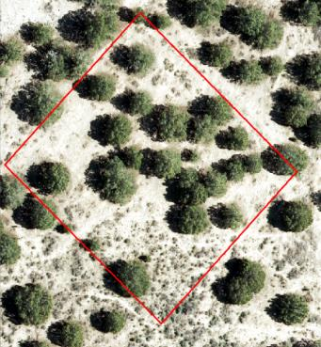
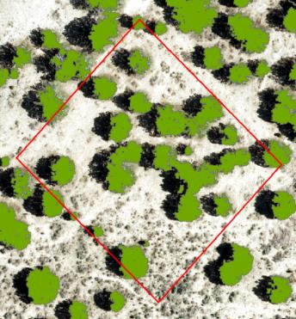
Density
Number of individuals per unit area.
What is the number of juniper trees/ha?
20 juniper/0.01 ha²
OR
2,000 juniper/ha²
0.1 ha
0.1 ha
Notes:
Unit area = Plants/m2 or Plants/hectare or Plant/acre

Slide 11
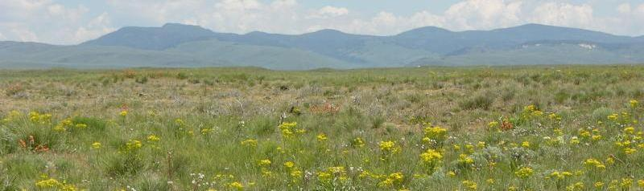
Plant Composition
A calculation based on proportions of biomass or cover.
Proportion (%) of various plants (or life forms) in relation to total plant biomass or cover.
Notes:
Plant composition
A calculation based on proportions of biomass or cover

Slide 12
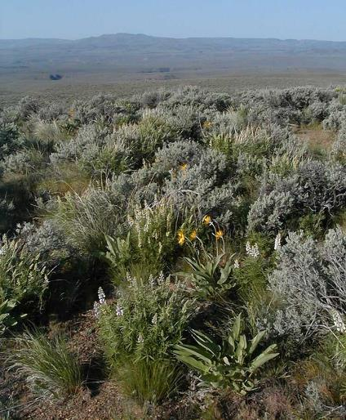
Plant Composition
Functional Groups | Foliar Cover | Composition
Shrub | 40
Tall Grasses (Perennial) | 30
Short Grass (POSE) | 15
Perennial Forb | 18
Annual Forb | 5
Annual Grass (Introduced) | 2
Total Foliar Cover (i.e., 40+30+15+18+5+2 = 110).
Divide individual foliar cover by the total foliar cover, then multiply by 100 to get % composition (i.e., Shrub: (40/110)*100 = 36.4%).
Notes:
Plant Composition

Slide 13
Plant Composition
Functional Groups | Foliar Cover | Composition
Shrub | 40 | 36.4%
Tall Grasses (Perennial) | 30 | 27.3%
Short Grass (POSE) | 15 | 13.6%
Perennial Forb | 18 | 16.4%
Annual Forb | 5 | 4.5%
Annual Grass (Introduced) | 2 | 1.8%
Notes:
Plant Composition

Slide 14
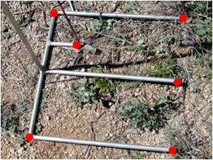

Cover
Proportion of ground surface covered by vegetation or other objects.
Notes:
Measured with points or plots.
Other objects: rocks, litter (dead plant matter), moss, lichen, bare ground

Slide 15
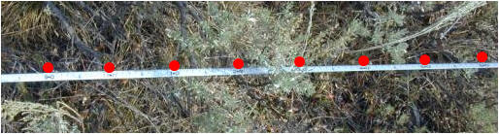
Cover
Proportion of ground surface covered by vegetation or other objects.
39
Perennial Grasses (PG): hit PG 12 times out of 31 points sampled= PG ____ % cover.
Annual Grasses (AG): 21 out of 31 points sampled = AG ____% cover.
68
Notes:
Cover:
Proportion of ground surface covered by vegetation or other objects

Slide 16
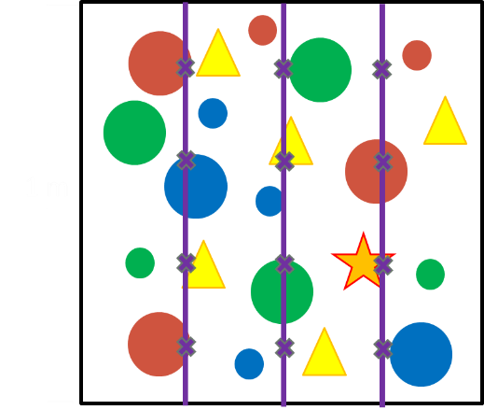
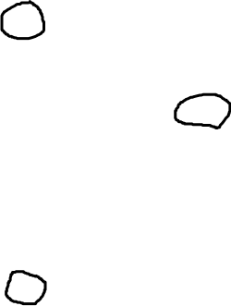
Cover
Proportion of ground surface covered by vegetation or other objects.
Estimate the cover of Red Circles using line-point intercept.
Hit red circles 3 times out of 12 points sampled = red circles 25% cover
1 m
Notes:
Measured with points

Slide 17
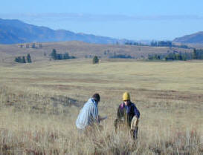
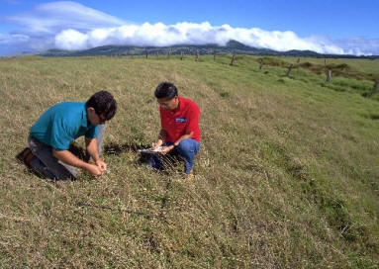
Biomass
Total weight of living organisms, including plants and animals, for a given area.
Notes:
In range assessments: biomass often refers to just plants.
Determined by clipping and weighing.
Usually expressed as kg/ha or lbs/acre.

Slide 18
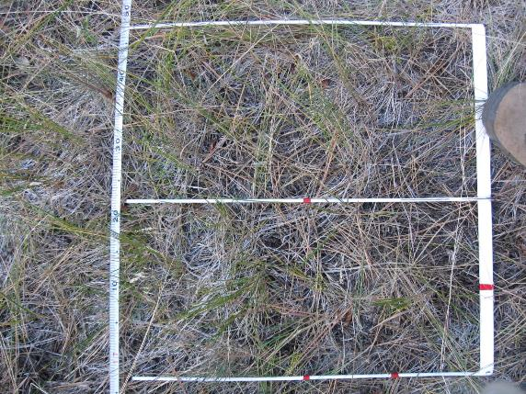
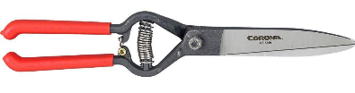
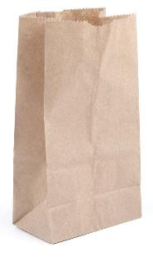
Biomass
Total weight of living organisms, including plants and animals, for a given area.
Notes:
In range assessments: biomass often refers to just plants.
Determined by clipping and weighing.
Usually expressed as kg/ha or lbs/acre.

Slide 19
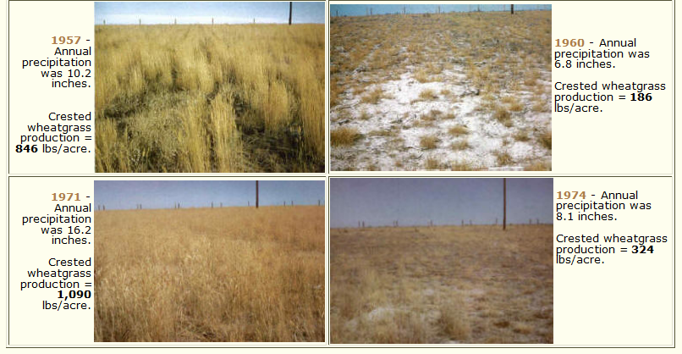
Biomass
Notes:
Biomass

Slide 20
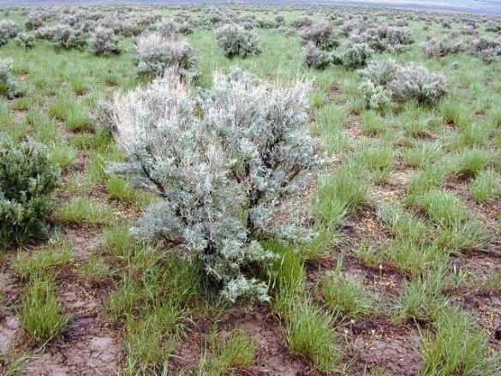
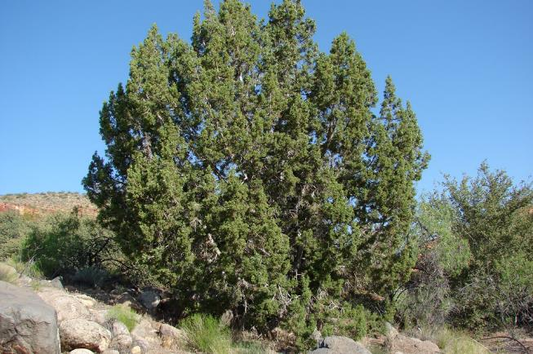
Biomass
Notes:
Biomass

Slide 21
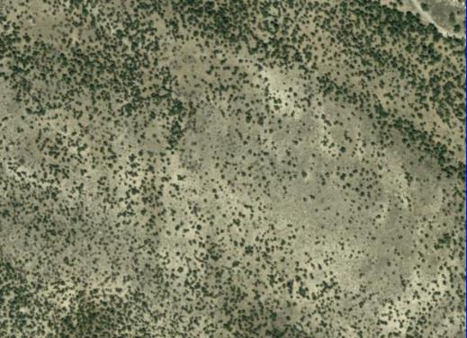
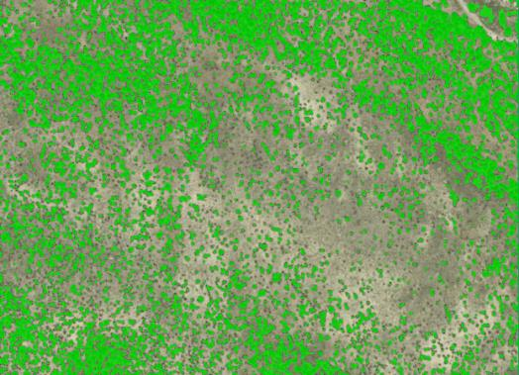
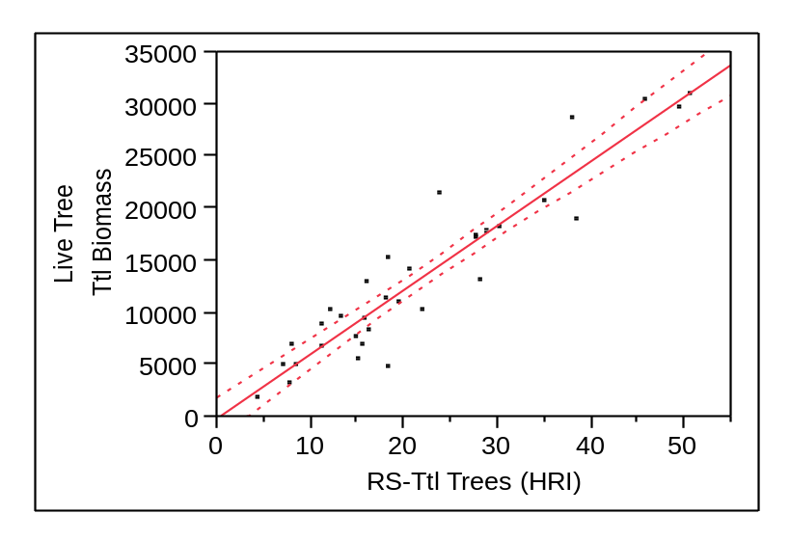
Biomass
r² = 0.88
Notes:
Biomass

Slide 22
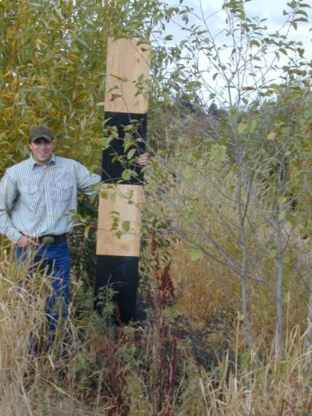
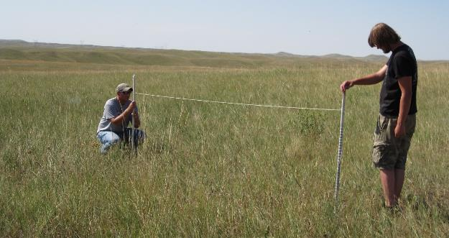
Structure
Three-dimensional arrangement of a plant community.
Notes:
Hiding cover, thermal cover, wildland fuels.
Cover board method, robel pole- measuring height and vertical density = visual obstruction method

Slide 23
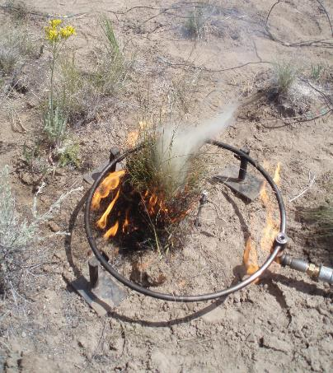
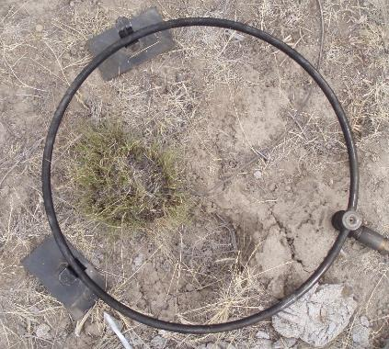
Structure
Three-dimensional arrangement of a plant community.
Notes:
Hiding cover, thermal cover, wildland fuels.

Slide 24
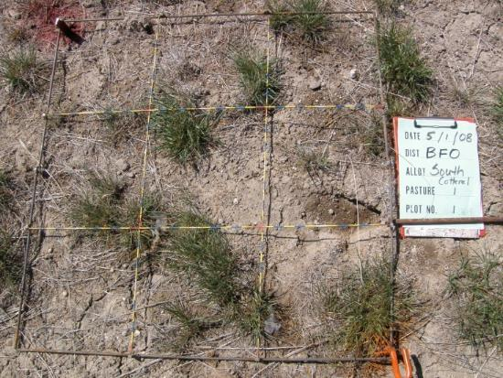
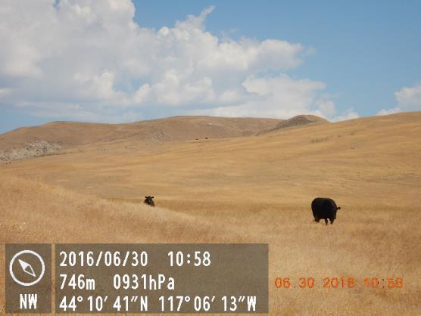
Photo Monitoring
Notes:
Gather your equipment
Take your pictures at the same time every year
Select sites that reflect your management goals
Record your locations
Include a distinct landscape feature
Always use a photo board
Make notes in your field notebook
Download and print photos

Slide 25
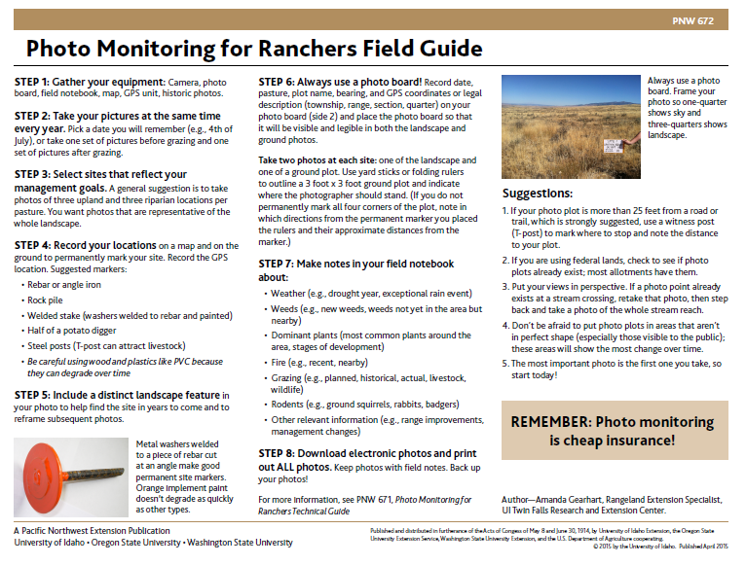
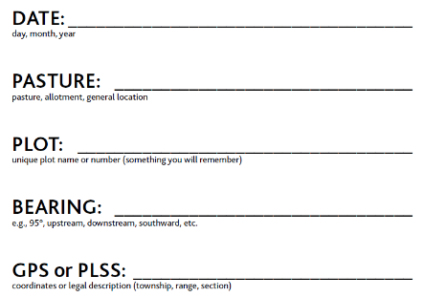
Photo Monitoring

Slide 26
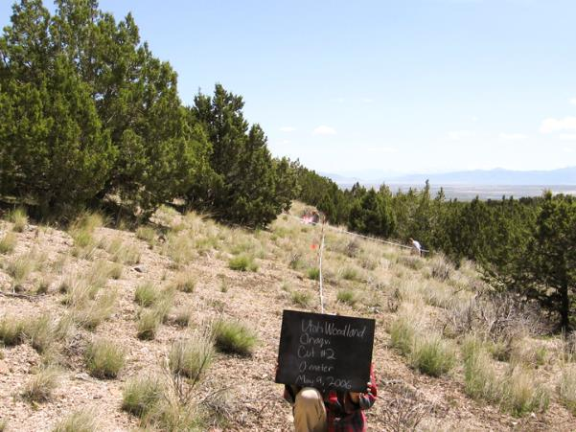
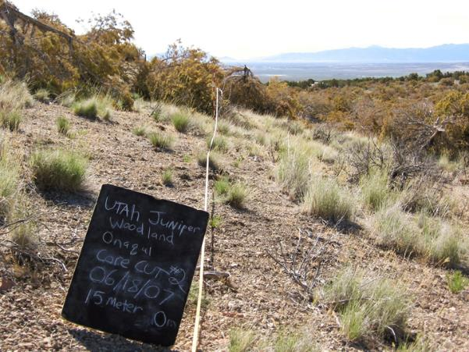
Photo Monitoring
www.sagestep.org
Notes:
Objectives:
Reduce pinyon-juniper
Reduce Bare Ground
Increase Perennial Bunchgrasses

Slide 27
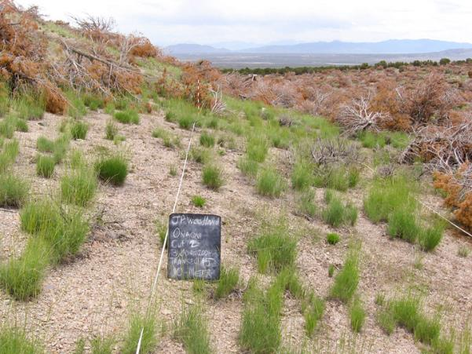
Photo Monitoring
www.sagestep.org
Notes:
Objectives:
Reduce pinyon-juniper
Reduce Bare Ground
Increase Perennial Bunchgrasses

Slide 28
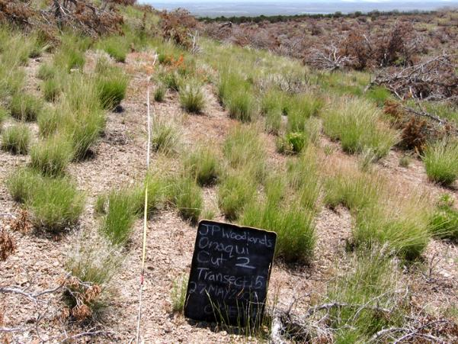
Photo Monitoring
www.sagestep.org
Notes:
Objectives:
Reduce pinyon-juniper
Reduce Bare Ground
Increase Perennial Bunchgrasses

Slide 29
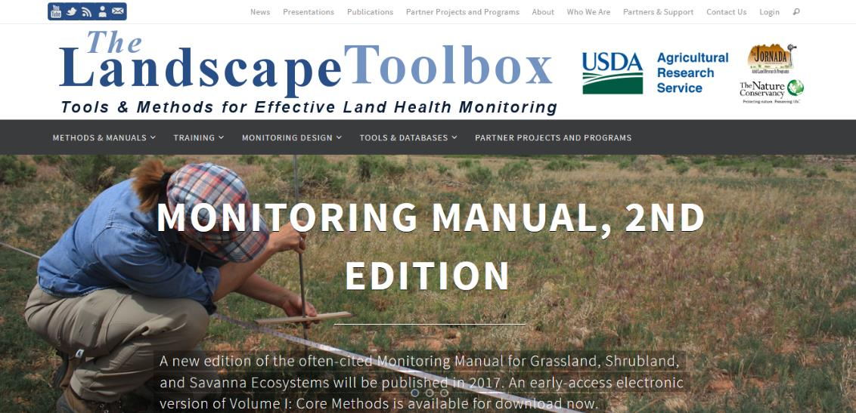
http://www.landscapetoolbox.org/

Slide 30
Measuring Rangelands
K. Launchbaugh
K. Launchbaugh
K. Launchbaugh
Rangeland Principles – REM 151

