Slide 1


Forces of Change
Rem 151

Slide 2

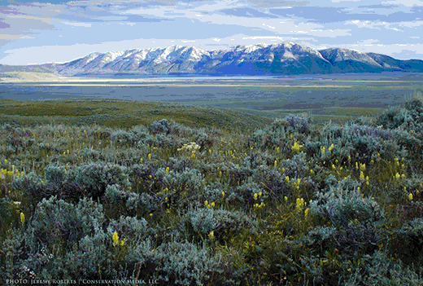
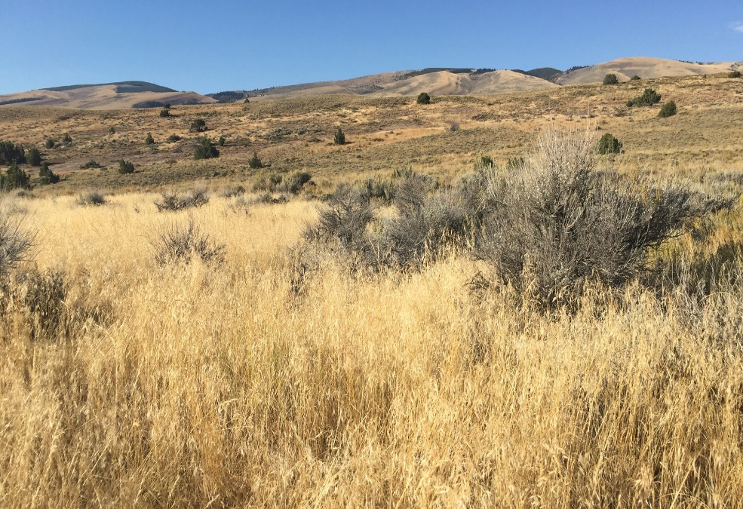
What causes change?
Healthy
Unhealthy
Notes:
What changes nature? Discuss the forces of change…
What services and products can rangeland provide? What are the tools that we have to manage these services and goods? These are essentially the same as the forces of change—the same tools that nature uses.
Tools for stewardship
Human Impacts: Recreation, Development

Slide 3
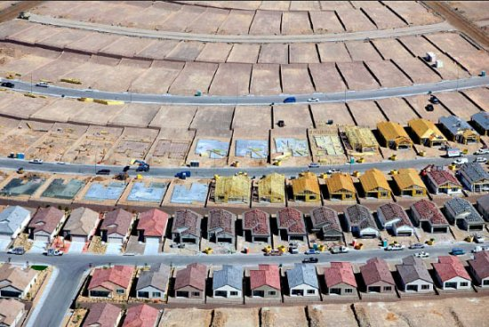
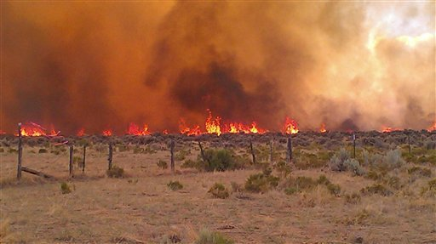
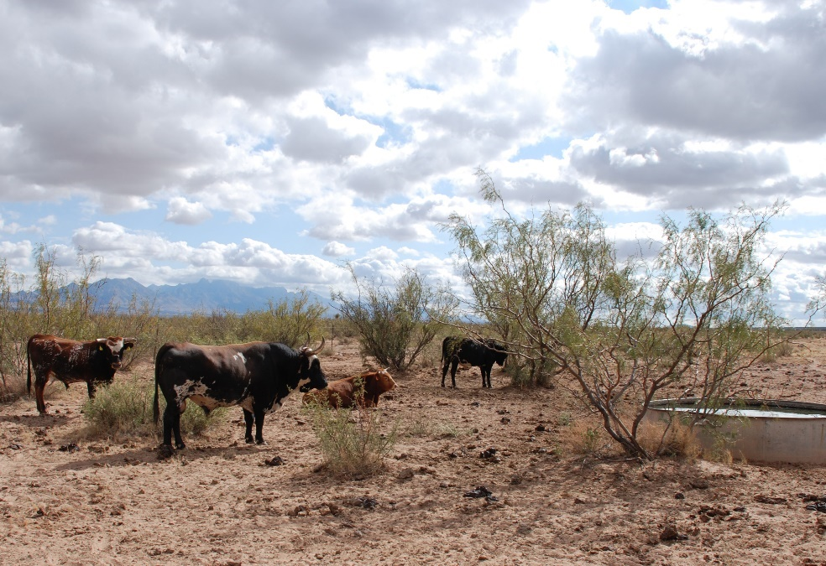
Forces & Impacts
Fire
Herbivory
Invasion
Human Uses
Climate Change
www.carriagetrade.org
www.oregonlive.com
eco-intelligent.com
Notes:
What changes nature? Discuss the forces of change…
What services and products can rangeland provide? What are the tools that we have to manage these services and goods? These are essentially the same as the forces of change—the same tools that nature uses.
Tools for stewardship
Human Impacts: Recreation, Development

Slide 4
Forces & Impacts
Fire
Herbivory
Invasion
Human Uses
Climate Change
What services and products can rangelands provide?
Notes:
What changes nature? Discuss the forces of change…
What services and products can rangeland provide? What are the tools that we have to manage these services and goods? These are essentially the same as the forces of change—the same tools that nature uses.
Tools for stewardship
Human Impacts: Recreation, Development

Slide 5
Forces & Impacts
Fire
Herbivory
Invasion
Human Uses
Climate Change
Ecological Services & Resources
Forage for livestock
Wildlife habitat
Watershed Management
Biodiversity Conservation
Open Space
Carbon sequestration
Notes:
What changes nature? Discuss the forces of change…
What services and products can rangeland provide? What are the tools that we have to manage these services and goods? These are essentially the same as the forces of change—the same tools that nature uses.
Tools for stewardship
Human Impacts: Recreation, Development

Slide 6
Forces & Impacts
Fire
Herbivory
Invasion
Human Uses
Climate Change
Ecological Services & Resources
Forage for livestock
Wildlife habitat
Watershed Management
Biodiversity Conservation
Open Space
Carbon sequestration
What tools do we have for management?
Notes:
What changes nature? Discuss the forces of change…
What services and products can rangeland provide? What are the tools that we have to manage these services and goods? These are essentially the same as the forces of change—the same tools that nature uses.
Tools for stewardship
Human Impacts: Recreation, Development

Slide 7
Forces & Impacts
Fire
Herbivory
Invasion
Human Uses
Climate Change
Ecological Services & Resources
Forage for livestock
Wildlife habitat
Watershed Management
Biodiversity Conservation
Open Space
Carbon sequestration
Tools
Fire
Livestock Grazing
Weed Mgmt
Human Impacts
Restoration
Notes:
What changes nature? Discuss the forces of change…
What services and products can rangeland provide? What are the tools that we have to manage these services and goods? These are essentially the same as the forces of change—the same tools that nature uses.
Tools for stewardship
Human Impacts: Recreation, Development

Slide 8
Dial Down
Fire
  Prescribed Fire
  Fuel
  Fight Fire
  Reduce probability
Livestock Grazing
  Species
  Stocking Rate
  Season
  Distribution
Weed Management
  Chemical
  Cultural
  Mechanical
  Biological
  Pyric
Dial Down
Human Impacts
  Manage Recreation.
  Travel Mgmt.
  Zoning
  Easement
Restoration
Notes:
What changes nature? Discuss the forces of change…
What services and products can rangeland provide? What are the tools that we have to manage these services and goods? These are essentially the same as the forces of change—the same tools that nature uses.
Tools for stewardship
Human Impacts: Recreation, Development

Slide 9
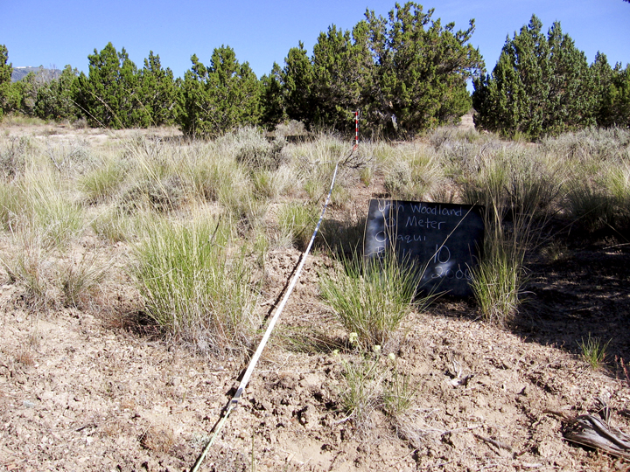
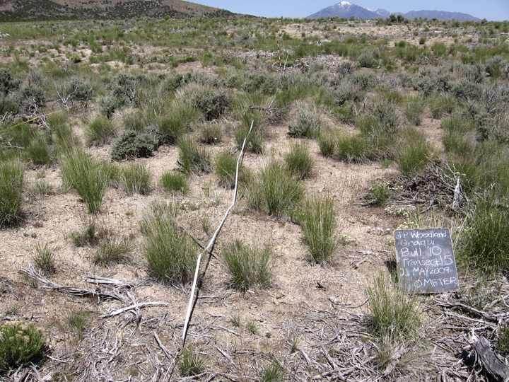
Juniper woodland
Sagebrush/bunchgrass community
Tools
Fire (or lack of) | Livestock Grazing (or removal) | Weed Management | Human Impacts | Restoration

Slide 10
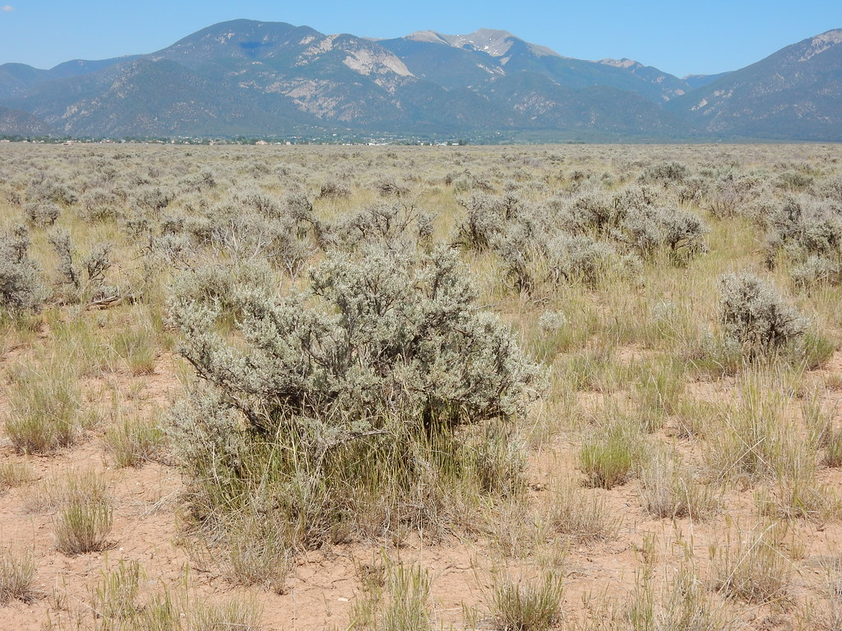
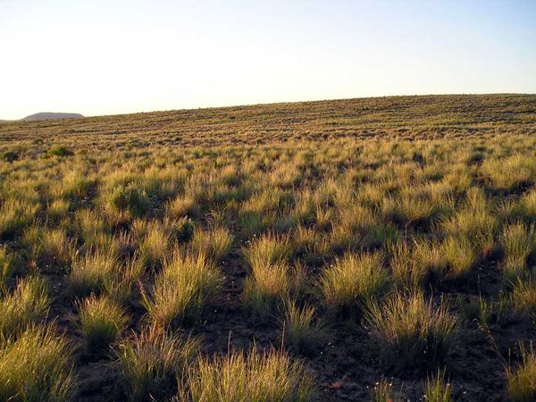
Sagebrush steppe
Bunchgrass dominated
Tools
Fire (or lack of) | Livestock Grazing (or removal) | Weed Management | Human Impacts | Restoration

Slide 11
Bunchgrass dominated
Sagebrush steppe
Tools
Fire (or lack of) | Livestock Grazing (or removal) | Weed Management | Human Impacts | Restoration

Slide 12
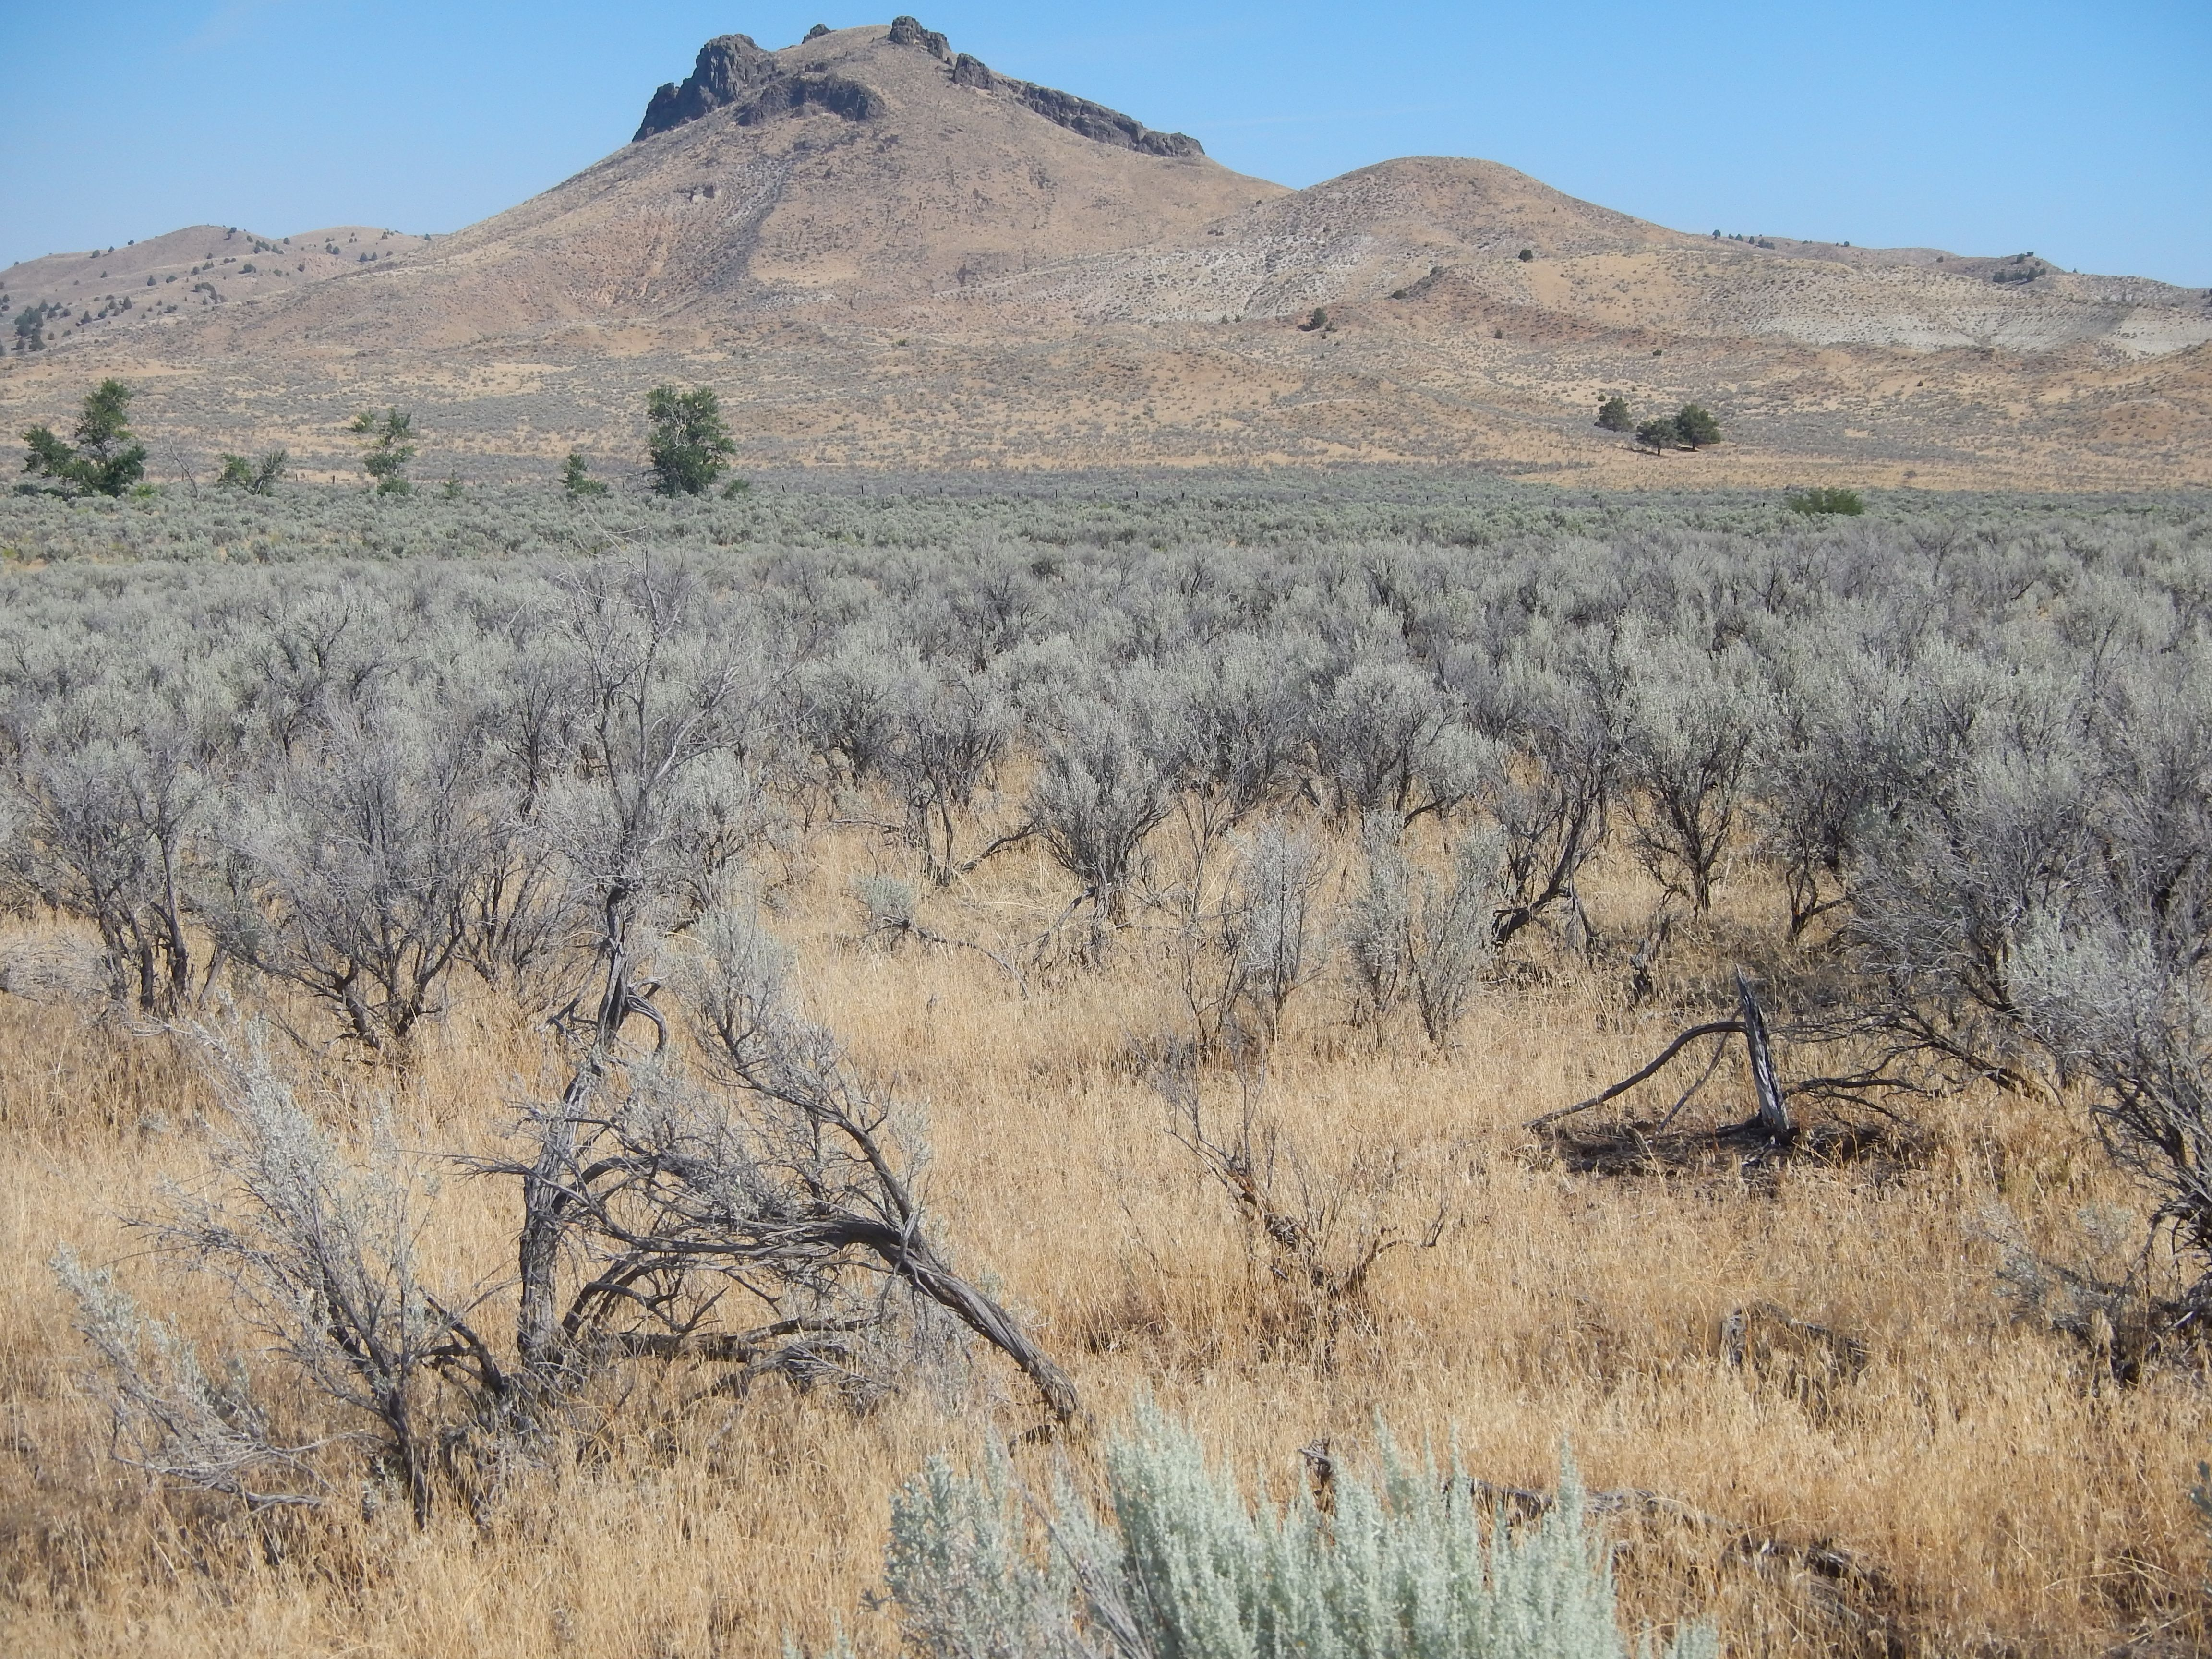
Cheatgrass invaded sagebrush
Sagebrush/bunchgrass community
Tools
Fire (or lack of) | Livestock Grazing (or removal) | Weed Management | Human Impacts | Restoration

Slide 13
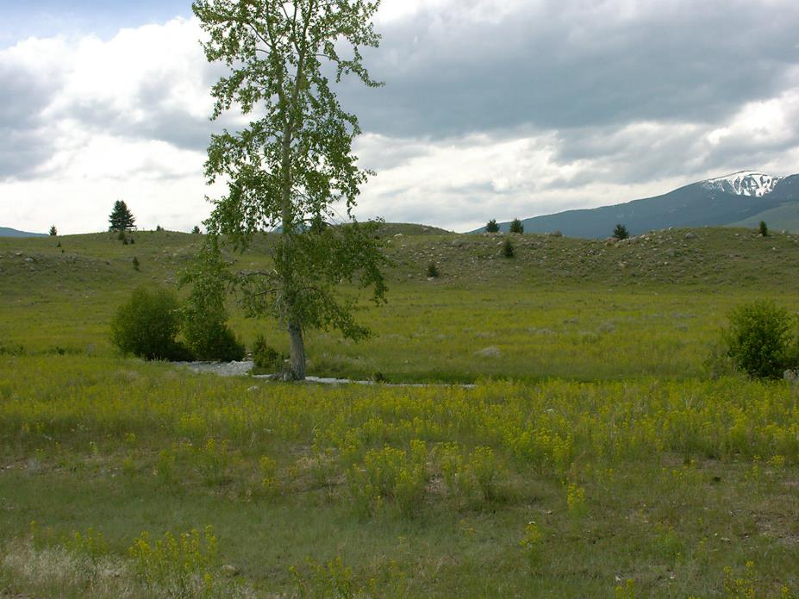
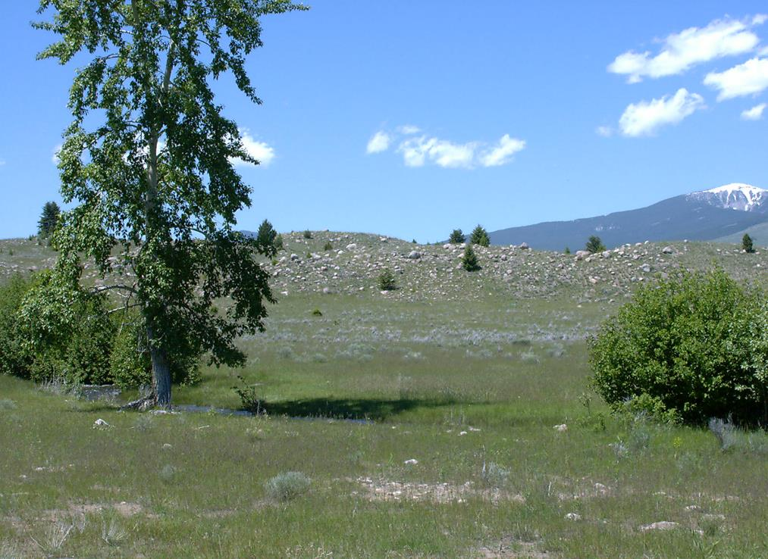
Leafy spurge invasion
Leafy spurge free
Tools
Fire (or lack of) | Livestock Grazing (or removal) | Weed Management | Human Impacts | Restoration

Slide 14
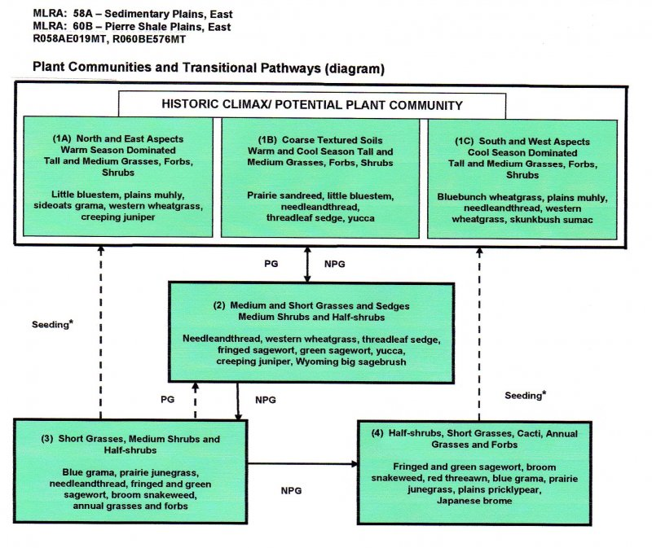
Next steps
PG = Prescribed Grazing
NPG = No Prescribed Grazing

Slide 15
Different Impacts
Woody Plant and Herbaceous Plants – Fire
Not all woody plants are the same – Resprouting plants have meristems at the base
Herbaceous annuals vs perennial – Fire
Depends on species of livestock
  Woody plants choose goats suppress. Cattle & horses will graze grasses and reduce competition.
  Grazing annual vs perennials depends on season.

Slide 16
Forces of Change
Rem 151

