Slide 1
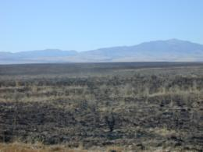
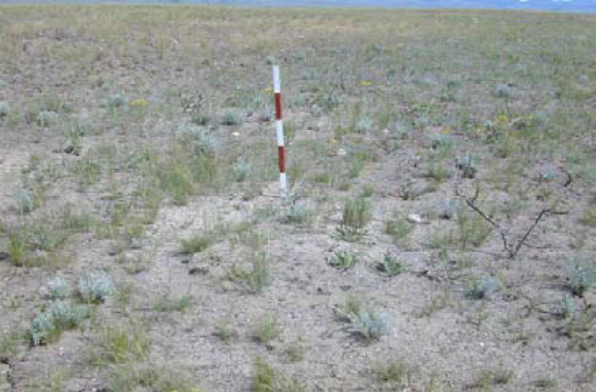
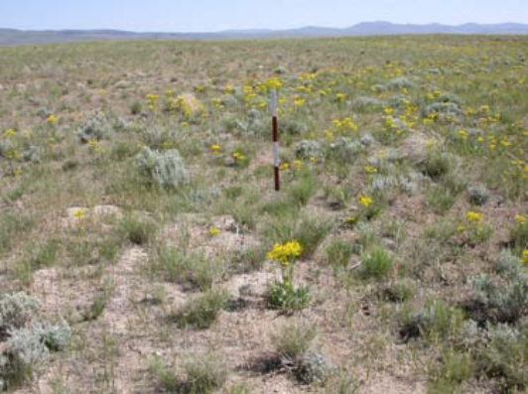
Rangeland Succession
L. Englund
L. Englund
L. Englund
Rangeland Principles (Rem 151)

Slide 2
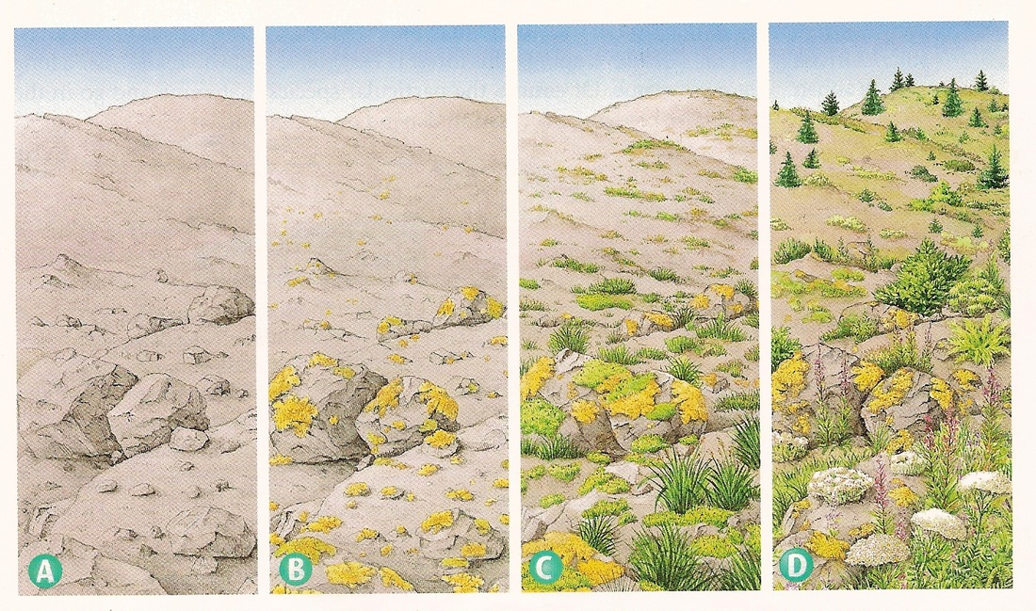
What is Succession?
The directional change of plant communities over time.
Notes:
What is Succession? The directional change of plant communities over time.
The shifts are usually predictable and most often gradual.
Plants become more or less abundant depending on the stage of succession.
Seasonal changes are not succession.
The progressive replacement of one dominant type of species or community by another in an ecosystem until a stable climax community is established.

Slide 3
Primary Succession
Begins Without Soil:
Volcanoes
Landslides
Floods
Notes:
Conceptual illustration showing the increasing complexity of species over time under primary succession.
Primary Succession begins in a place without any soil: sides of volcanoes, landslides, flooding. Starts with the arrival of living things such as lichens that do not need soil to survive…called PIONEER SPECIES.

Slide 4
Primary Succession
Pioneer Stage:
Lichens
Moss
Notes:
Conceptual illustration showing the increasing complexity of species over time under primary succession.
Primary Succession begins in a place without any soil: sides of volcanoes, landslides, flooding. Starts with the arrival of living things such as lichens that do not need soil to survive…called PIONEER SPECIES.
Soil starts to form as lichen and the forces of weather and erosion help break down rocks into small pieces.
When lichen dies, they decompose, adding small amounts of organic matter to the rock to make soil…

Slide 5
Primary Succession
Early Seral:
Annual Plants
Herbaceous
Invasive Characteristics
Notes:
Conceptual illustration showing the increasing complexity of species over time under primary succession.
Early seral species with are herbaceous and often annual
Early seral plants have invasive characteristics.
Animals and plants continue breakdown of rocks into mineral soil and add organic matter

Slide 6
Primary Succession
Late Seral:
Perennial Long-Lived Plants
Diverse Community Plants & Animals
PNC=Potential Natural Community
Notes:
Conceptual illustration showing the increasing complexity of species over time under primary succession.
Late Seral stages include long-lived plants including shrubs and trees.
A diverse community of plants and animals becomes apparent.
Soil characteristics are distinctive and stable.
Final Stable State = PNC = Potential Natural Community

Slide 7
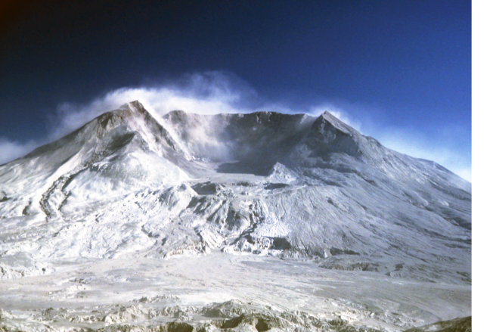
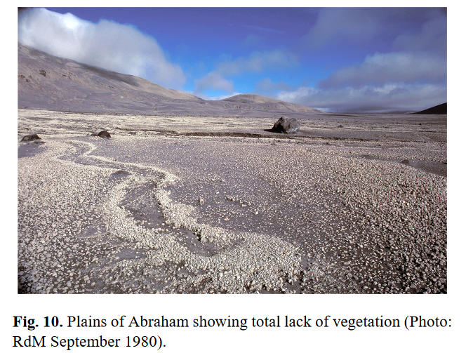
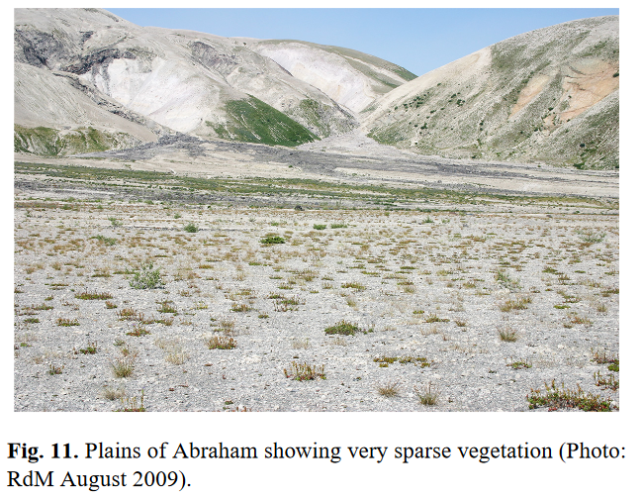
Primary Succession
Mount Saint Helens in Washington erupted in 1980 creating large expanses of barren terrain.
R. del Moral, August 1980
1980
2009
del Moral, R. and Magnússon, B.: Surtsey and Mount St. Helens: A comparison of early succession rates, Biogeosciences, 11, 2099-2111, doi:10.5194/bg-11-2099-2014, 2014.

Slide 8
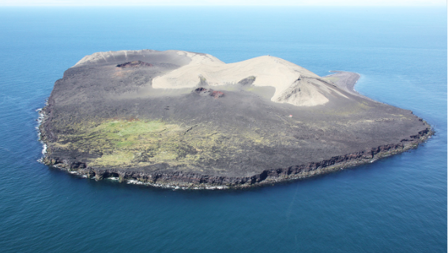
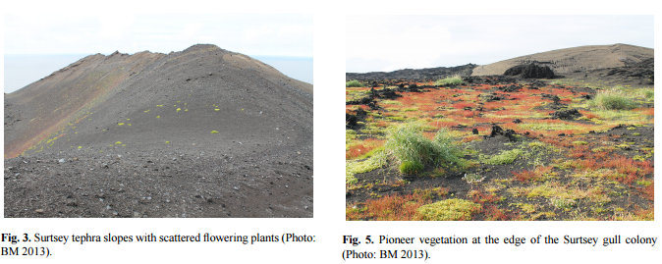
Primary Succession
Surtsey Volcano emerged in North Atlantic Ocean southwest coast of Iceland in 1963 and continued to erupt until 1967.
Erling Ólafsson, 2010
del Moral, R. and Magnússon, B.: Surtsey and Mount St. Helens: A comparison of early succession rates, Biogeosciences, 11, 2099-2111, doi:10.5194/bg-11-2099-2014, 2014.
Notes:
Colonies of gulls important in succession. Gulls nested on lava and brought organic matter and seeds to the island.

Slide 9
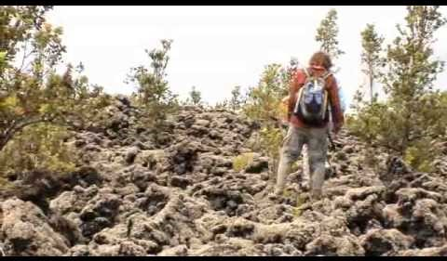
Primary Succession
https://www.youtube.com/watch?v=TLpc71YOtcE

Slide 10
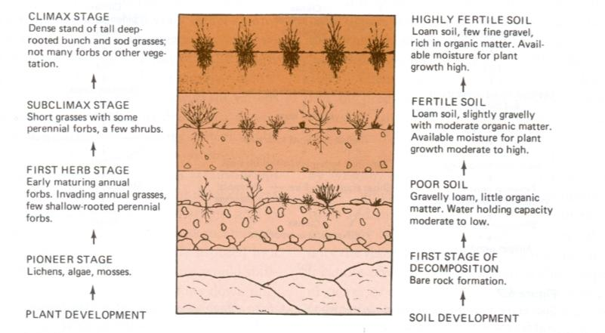
Primary Succession
Primary succession on grassland rangelands. From Gay 1965
Notes:
Succession is a process that changes the biotic (i.e., vegetation) and abiotic (i.e. soil nutrients levels) aspects of a site.

Slide 11
Potential Natural Community (PNC)
The end point of succession = PNC or Climax
  Depends on climate and soils
Stable community of plants and animals:
  Trees in forests
  Grasses in prairies
  Cacti in deserts
  Lichens and shrubs in the tundra
Notes:
The end point of success depends on climate.
Lots of moisture = forest. Moderate precipitation and temperature = prairie, hot/dry = desert, cold/dry = lichens and shrubs, etc. etc.

Slide 12
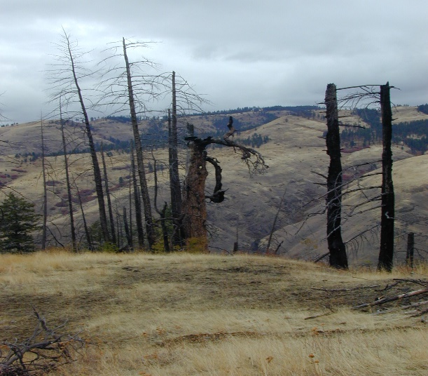
Two Kinds of Succession
Primary & Secondary Succession
Primary
  Begins on rocky surface
  No Soil
Secondary
  Begins after a disturbance that leaves soil on the site.
  Soil of some sort exists on the site.
R. del Moral, August 1980
Josh Corbett

Slide 13
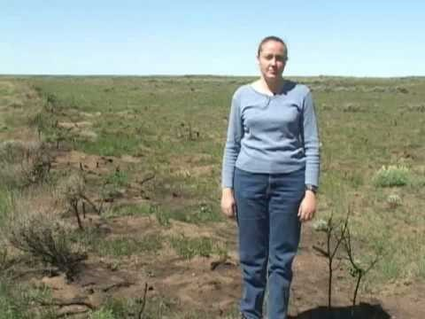
Primary & Secondary Succession
https://www.youtube.com/watch?v=C2ZRe_kIRdA

Slide 14
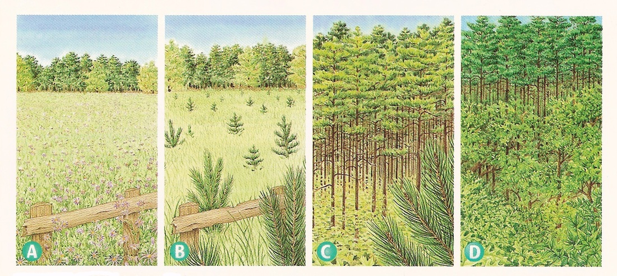
Secondary Succession
Begins With Soil:
Fire
Drought
Landslide
Flood
Pioneer Species:
Herbaceous
Invasive Characteristics
Notes:
Occurs faster and has different pioneer species than primary succession.
There are many examples of when secondary succession occurs = after drought, fire, landslides, floods, overgrazing, etc.
We often think of secondary succession as “site recovery” or stage in restoration.

Slide 15
Secondary Succession
Seral Stage: distinct community type within the sequence of succession.
Pioneer Community
PNC - Climax Community
Notes:
Stages of Change:
Seral Stage = distinct community type within a the sequence of succession.
Initial stage referred to as pioneer community
Final stage referred to as a climax community.
The end points depends on climate. Lots of moisture = forests. Moderate precipitation and temperature = prairie, shrublands. Hot/dry = desert, cold/dry = shurblands

Slide 16
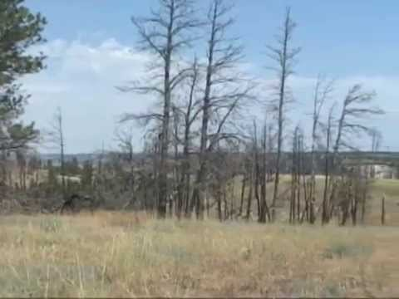
Secondary Succession
https://www.youtube.com/watch?v=CQ2Xl6ZqzRI
Notes:
Stages of Change:
Seral Stage = distinct community type within a the sequence of succession.
Initial stage referred to as pioneer community
Final stage referred to as a climax community.
The end points depends on climate. Lots of moisture = forests. Moderate precipitation and temperature = prairie, shrublands. Hot/dry = desert, cold/dry = shurblands

Slide 17
Review
Would the following events on rangeland lead to primary or secondary succession?
A prescribed fire to reduce juniper trees: ______________
An erosion event that removes all the soil and leaves bedrock: ______________
Overgrazing by elk and cattle on canyon grasslands: ___________
A restoration practice where the land managers sprayed cheatgrass with herbicide and reseeded with perennial grasses: ____________
secondary
primary
secondary
secondary

Slide 18
Basic idea of Secondary Succession
Simple pioneer plants die, adding more organic matter.
Soil layer thickens.
Herbaceous plants (grasses and forbs) begin to grow.
Plants and animals add more nutrients to the soil.
Shrubs and trees can then survive.
Insects, small birds, and mammals begin to inhabit.
Notes:
From rock to vegetation = the miracle of succession.
We manage forces that cause these changes. We simply try to understand success and guide or copy what nature does.

Slide 19
Forces of Ecosystem Change
Immigration and establishment of plants
Competition between plants
Site Modifications add organic matter, change available moisture and nutrients
Stabilization reduce yearly variation in kind and amount of plants and animals
Notes:
These are 4 widely recognized forces of succession. As land managers, we manage these forces.

Slide 20
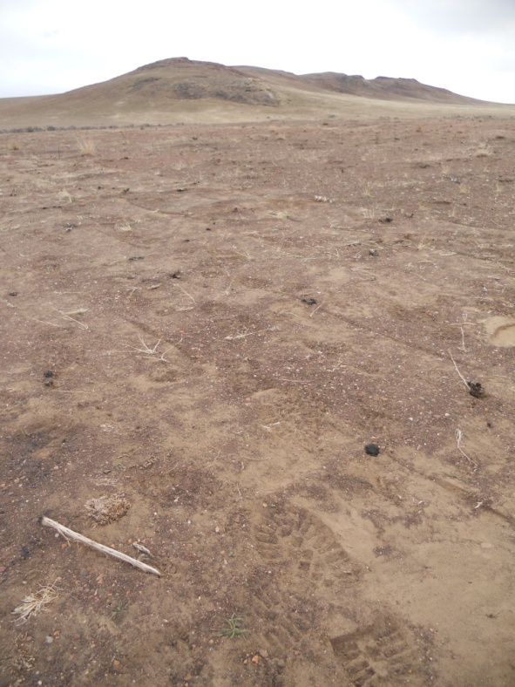
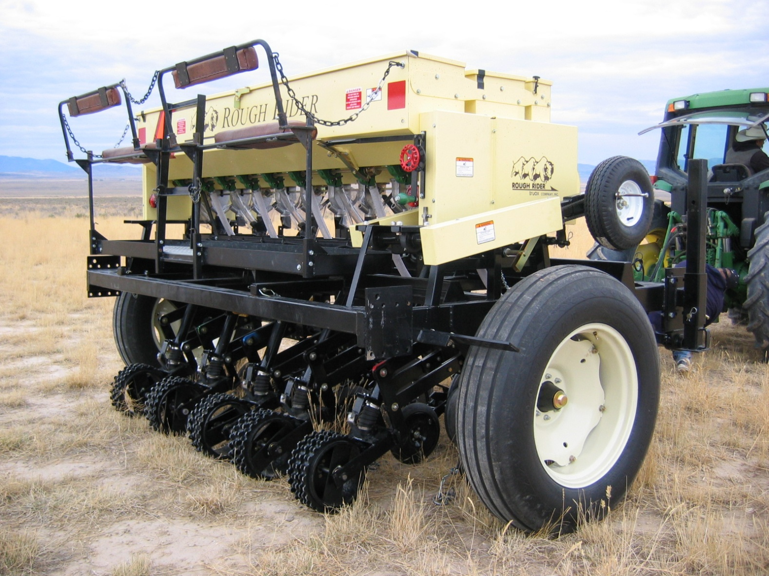
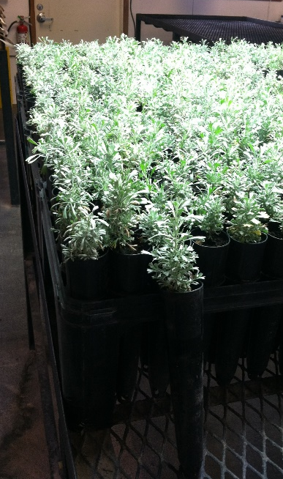
Forces of Ecosystem Change
Immigration and establishment of plants.
Notes:
Photos: April Hulet
Left: Post-burn sagebrush seeding following the Holloway fire in southeastern Oregon (broadcast seeding following by a packer to increase seed/soil contact)
Center: Sagebrush plugs (seedlings) for post-fire restoration
Left: Truax rough rider rangeland-drill

Slide 21
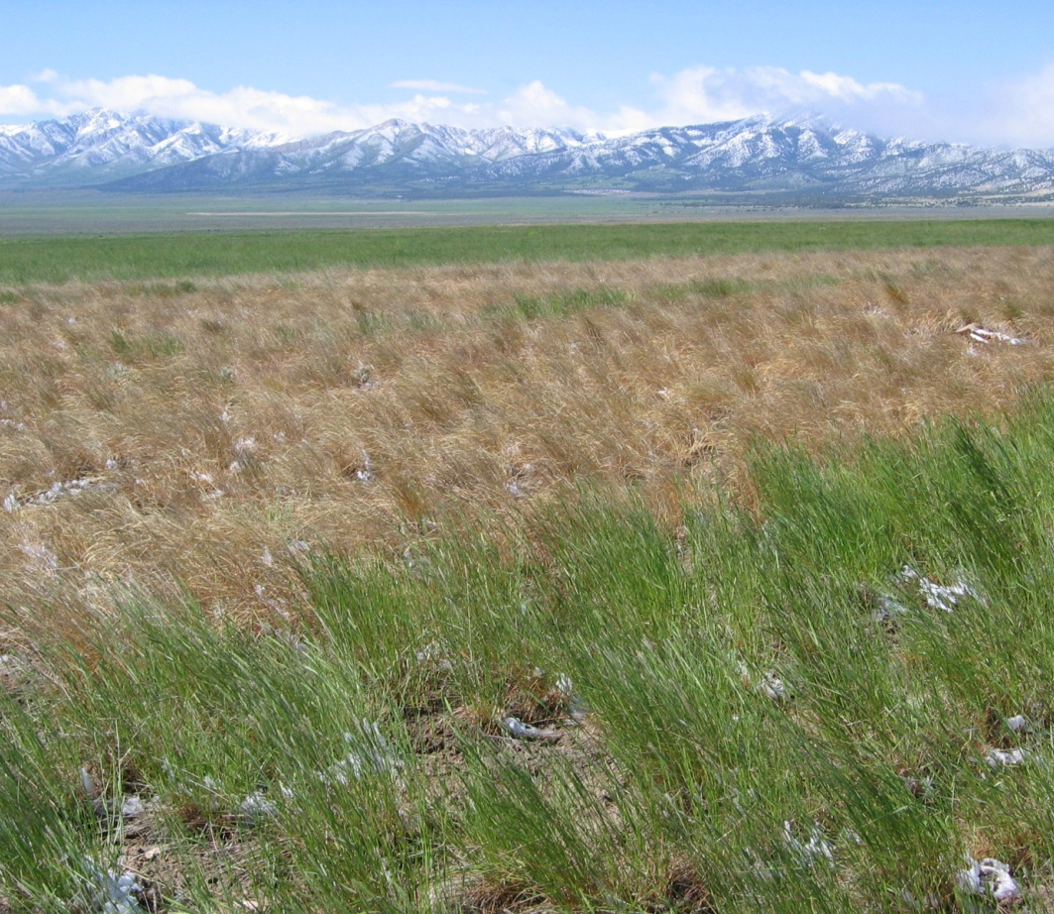
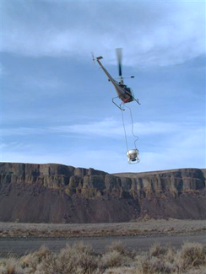
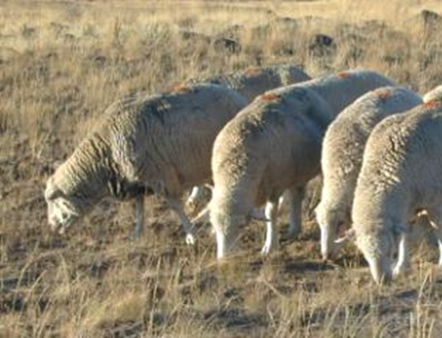
Forces of Ecosystem Change
Competition between plants.
1 Year After Fire
Notes:
Left picture: April Hulet (herbicide application (roundup) on crested wheatgrass)
Center picture: SageSTEP (www.sagestep.org); tebuthiuron (spike) treatment (http://www.sagestep.org/about_the_project/treatments/other_sage.html)
Right picture: Lovine Englund plant response 1 year following wildfire showing plants competing for resources.

Slide 22
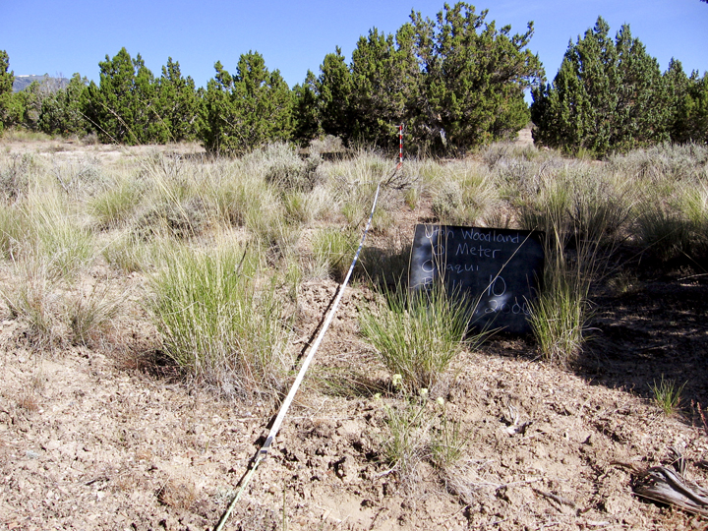
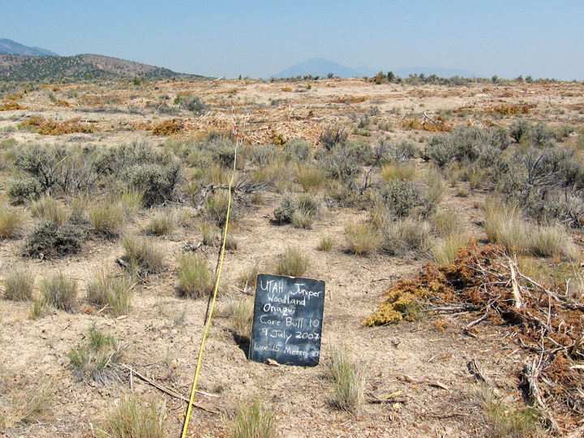
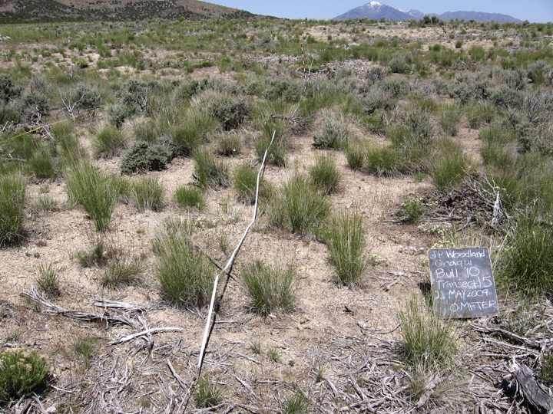
Forces of Ecosystem Change
Site Modifications - add organic matter, change available moisture and nutrients
Notes:
Photos: SageSTEP research project (www.sagestep.org)
Left: juniper woodland (pre-treatment), center: mastication (aka: bullhog 1-year post-treatment); right: mastication 2-years post-treatment (sites in Tooele county, Utah)

Slide 23
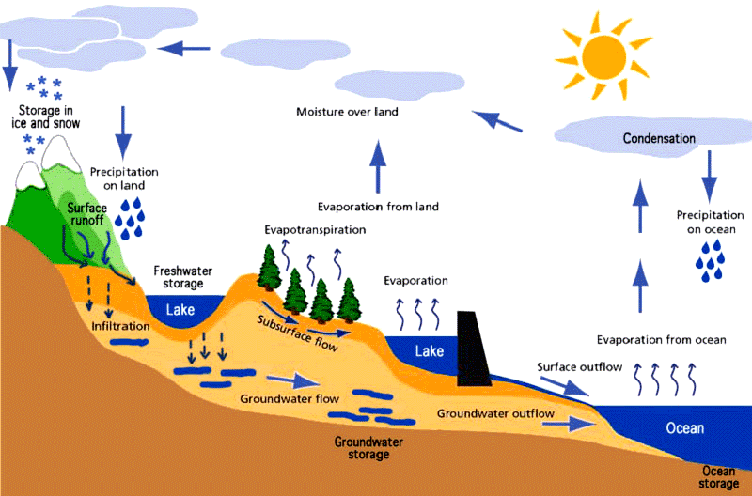
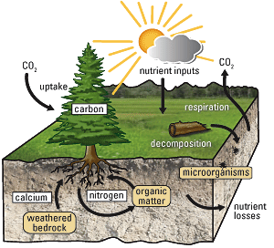
Forces of Ecosystem Change
Stabilization (reduce yearly variation in kind and amount of plants and animals).
Hydrologic Cycle
Nutrient Cycle

Slide 24
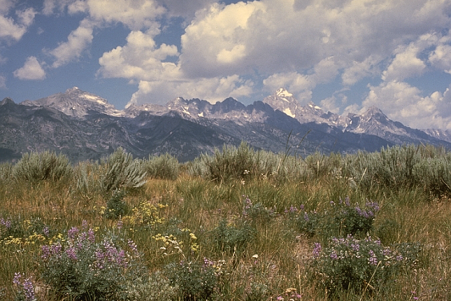
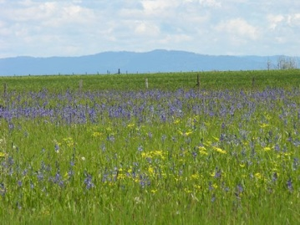
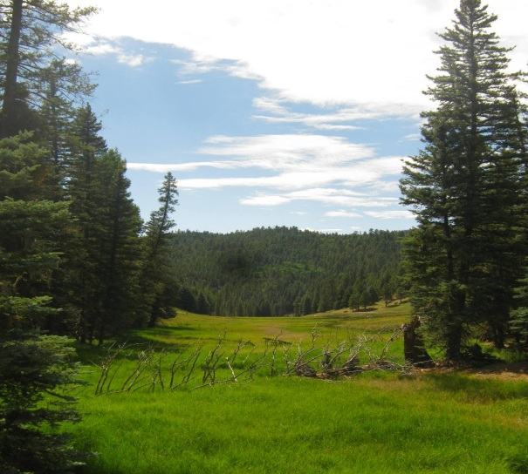
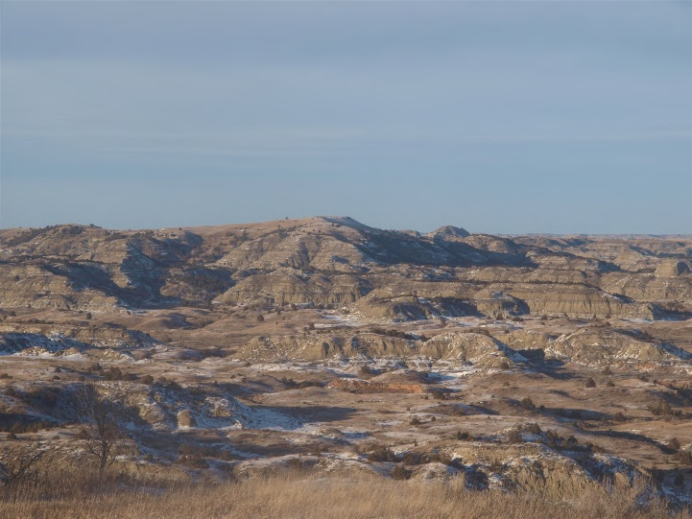
Important Concepts of Succession
Ecological Sites
  A distinctive kind of land that produces a distinctive kind and amount of vegetation based on a specific type of soil, climate, and topography.
  Product of all the environmental factors that influence the development of soils and vegetation, includes natural disturbance

Slide 25
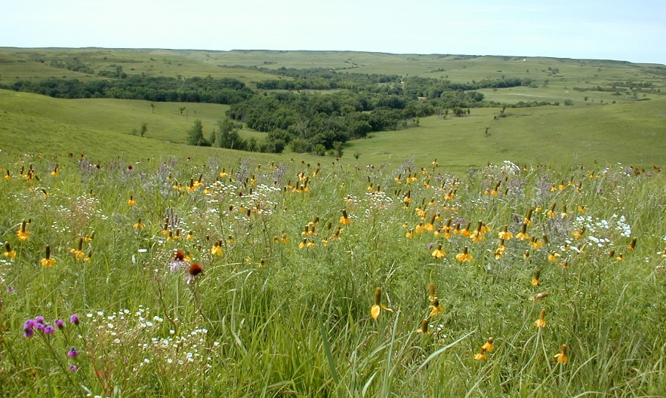
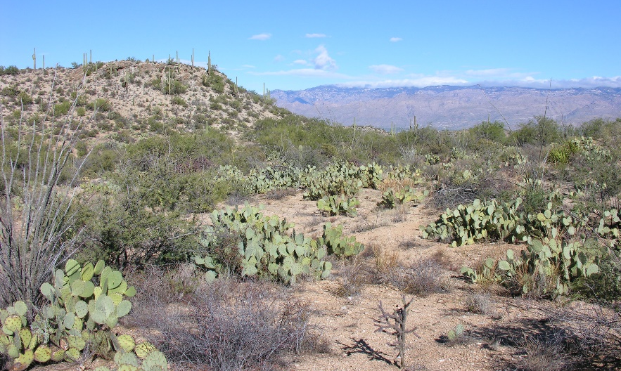
Important Concepts of Succession
Community Resilience
  Ability of a plant community to return to prior composition and structure after a disturbance.
Community Resistance
  Plant community’s ability to avoid being changed following disturbance.
M. Haddock
G.K. Launchbaugh
Notes:
Some communities like tallgrass prairie (top) are composed of plants that have an ability to recover quickly after disturbance (e.g., grazing & fire).
Other communities like the southwest desert (bottom) try to avoid (or resist) disturbance with plant that that have spines and open space between plants decreasing the chances of fire spreading throughout the community.

Slide 26

Ecological Services
& Resources
forage for livestock
wildlife habitat
watershed management
biodiversity conservation
open space
carbon sequestration
Forces & Impacts
Herbivory
Climate
Change
Fire
Human Uses
Development,
Fragmentations,
& Recreation
Invasion
Rangelands
Grasslands, Shrublands, Woodlands
Notes:
What changes nature? Discuss the forces of change (more discussion later in class). What services and products can rangelands provide? What are the tools that we have to manage these services and goods? These are essentially the same as the forces of change – the same tools that nature uses.

Slide 27
Ecological Services
& Resources
forage for livestock
wildlife habitat
watershed management
biodiversity conservation
open space
carbon sequestration
Forces & Impacts
Herbivory
Climate
Change
Fire
Human Uses
Development,
Fragmentations,
& Recreation
Invasion
Rangelands
Grasslands, Shrublands, Woodlands
Fire
Tools for Stewardship
Weed
Mgmt
Livestock
Grazing
Human
Impacts
Restoration/
Rehabilitation
Notes:
We use human tools in a managed way, unlike nature.

Slide 28
Rangeland Succession
L. Englund
L. Englund
L. Englund
Rangeland Principles (Rem 151)

