Slide 1
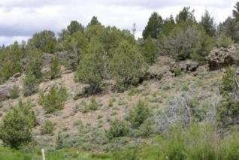
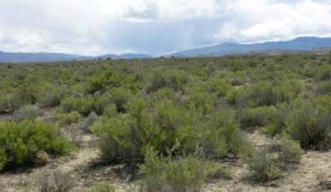
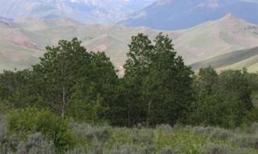

State & Transition Models
Rangeland Principles (Rem 151)

Slide 2
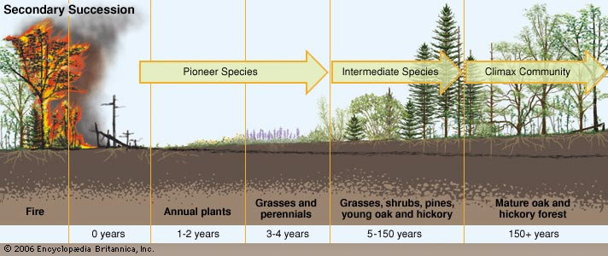
Problems with linear succession?

Slide 3
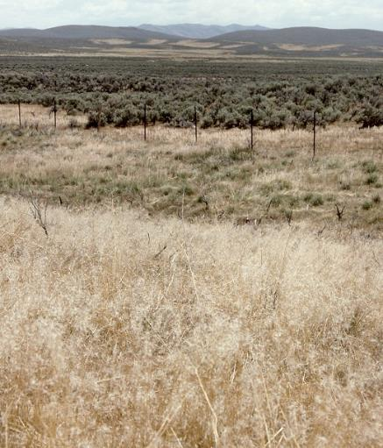
Problems with linear succession?
Demographic inertia
Removal of disturbance may not result in successional progress.
Notes:
Dominance by non-climax competitive species…

Slide 4
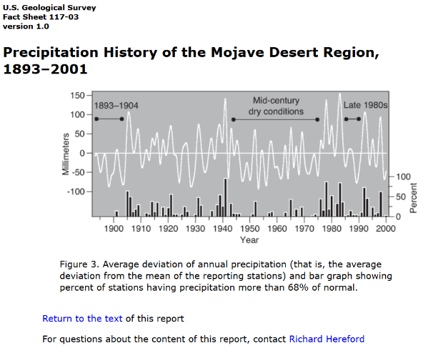
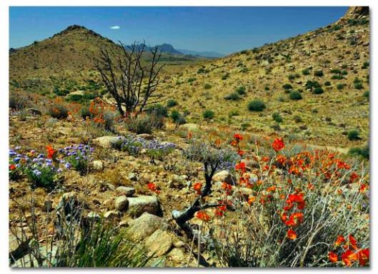
Problems with linear succession?
Demographic inertia
Plant composition is dynamic
http://www.desertusa.com/wildflo/mnp.html
Notes:
Plant composition is dynamic- varies with wet and dry years (e.g. Mojave wildflowers)
Climate change

Slide 5
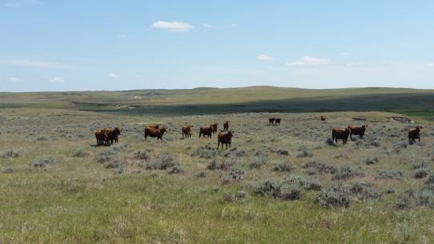
Problems with linear succession?
Demographic inertia
Loss of plant materials
Overgrazing on certain species may eliminate them.
Species may be outcompeted by other plants, lost to drought.
https://www.ag.ndsu.edu/publications/livestock/determining-carrying-capacity-and-stocking-rates-for-range-and-pasture-in-north-dakota

Slide 6
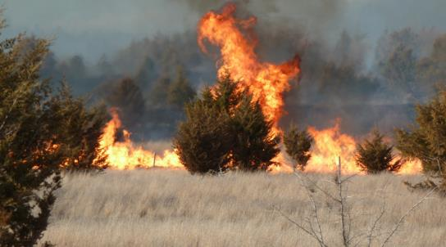
Problems with linear succession?
Demographic inertia
Loss of plant materials
Fire feedbacks
Grasses increase fire frequency and are promoted by fires
http://www.nature.org/ourinitiatives/habitats/forests/explore/slide-show-of-controlled-burns.xml

Slide 7
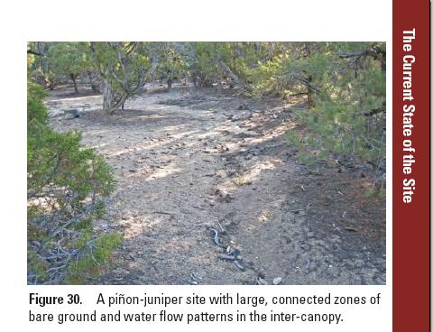
Problems with linear succession?
Demographic inertia
Loss of plant materials
Fire feedbacks
Soil feedbacks
Erosion, loss of seedbank, loss of nutrients, compaction, etc.

Slide 8
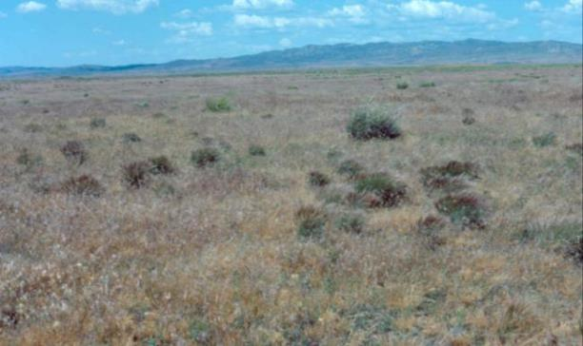
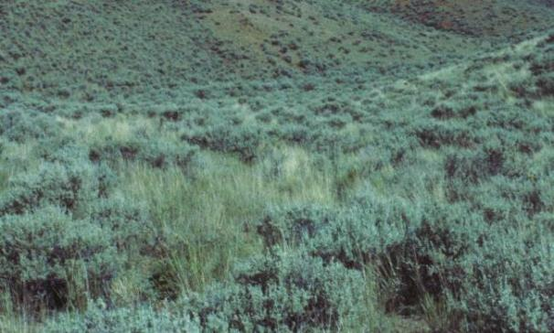
Wyoming big sagebrush/bluebunch wheatgrass steppe near Mtn. Home, ID
Wyoming big sagebrush/bluebunch wheatgrass steppe, central Idaho
Multiple pathways of succession
Multiple stable vegetation types
No single and certain end-point
Problems with succession models?
Notes:
Here are two examples of different community types occupying the same habitat type (Wyoming big sagebrush/bluebunch wheatgrass). The photo on the left is dominated by cheatgrass and bottlebrush squirreltail, and the photo on the right is dominated by Wyoming big sagebrush and bluebunch wheatgrass. Both communities are relatively stable.
Notes from Steve Bunting – University of Idaho
multiple pathways of succession
multiple stable vegetation types
no single and certain end-point

Slide 9
Problems with linear succession?
Equating climax composition to range condition confuses evaluation of rangelands and their potential

Slide 10
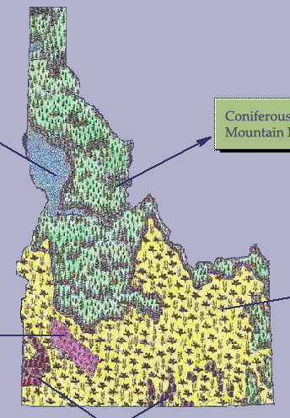
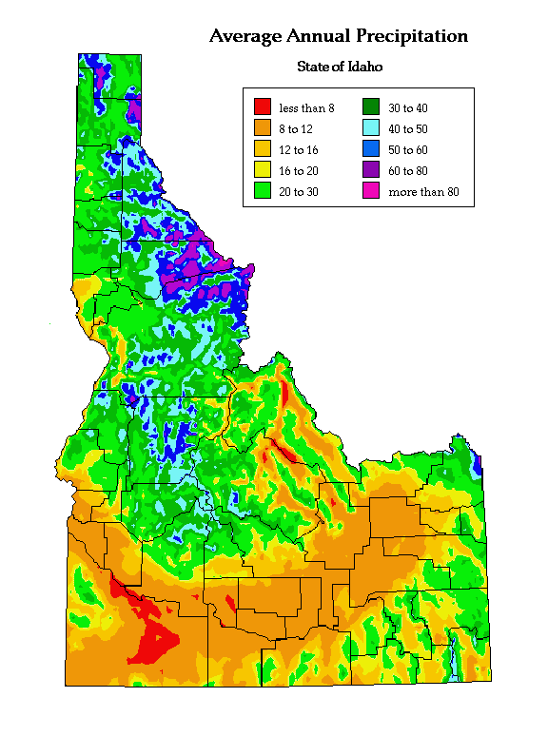
Pacific
Bunchgrass
Coniferous Forest
and Mountain Meadows
Sagebrush
Grasslands
Salt
Desert
Shrublands
Juniper Woodlands

Slide 11
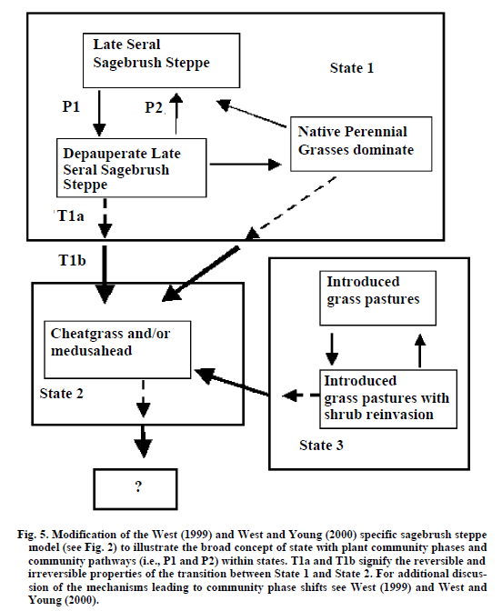
State and Transition Model:
“State-and-transition models hold great potential to aid in understanding rangeland ecosystems’ response to natural and/or management induced disturbances by providing a framework for organizing current understanding of potential ecosystem dynamics”
Describe vegetation dynamics and assess the risk of change to another stable state
Design and interpret monitoring based on expected responses to management or climatic changes.
Stringham et al. 2003. State and transition modeling: An ecological process approach. Journal of Range Management 56:106-113
Notes:
The information required to develop these models:
potential alternative vegetation states on a site
potential transitions between states
opportunities to achieve favorable transitions between vegetation states and hazards to avoid unfavorable transitions

Slide 12
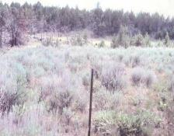
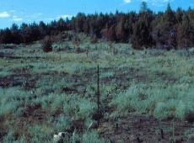
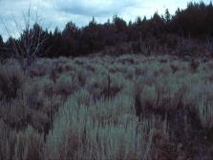
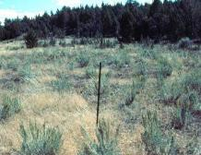
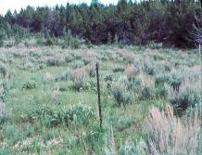
Steady State:
Forces hold a community in suspended succession unless something happens to change it.
1979 - Pre-burn
1980- 1st year after fire
1994
1983
1989
Dr. Stephen Bunting
Notes:
The sequence of photos illustrates a 15-year period of vegetation succession following a prescribed fire in mountain big sagebrush/Idaho fescue steppe. The density and coverage of sagebrush has nearly developed back to the pre-burn level during this time.
Notes from Steve Bunting – University of Idaho

Slide 13
Transition:
Disturbance or competition can cause a plant community to shift to a different community within a stable state.
1979 - Pre-burn
1980- 1st year after fire
1994
1983
1989
Dr. Stephen Bunting

Slide 14
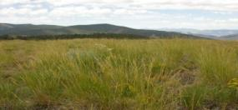
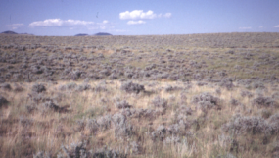
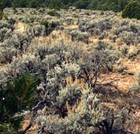
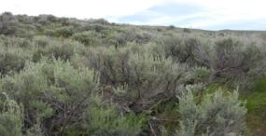
Example - Sagebrush Steppe States
Transitions= compositional change resulting in the change in plant community (state)
Grassland
Open
Sagebrush
Fire transition
Succession transition
Depleted
Sagebrush
Closed
Sagebrush
Improper grazing transition

Slide 15

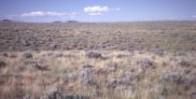
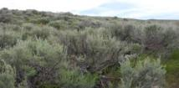
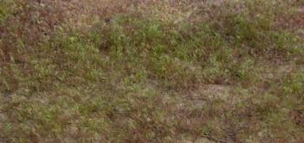
Threshold:
A transition where a resource is lost so the community cannot go back to the previous steady state without significant resource input by humans.
Sagebrush Steppe State
Open
Sagebrush
Grassland
Depleted
Sagebrush
Closed
Sagebrush
Threshold
Annual Grass
Dominated State
Notes:
In some areas of the Great Basin we can observe a third state- that dominated by annual grasses such as cheatgrass or ripgut brome. The movement back into either the sagebrush state or the woodland state is difficult in these environments.

Slide 16

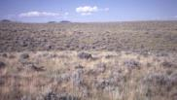


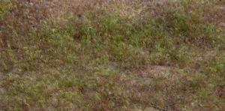
Sagebrush Steppe State
Open
Sagebrush
Grassland
Depleted
Sagebrush
Closed
Sagebrush
Threshold
Thresholds = transitions that are nearly irreversible & sometimes unpredictable.
Annual Grass
Dominated State
Grazing reduces likelihood of fire
Notes:
In some areas of the Great Basin we can observe a third state- that dominated by annual grasses such as cheatgrass or ripgut brome. The movement back into either the sagebrush state or the woodland state is difficult in these environments.

Slide 17
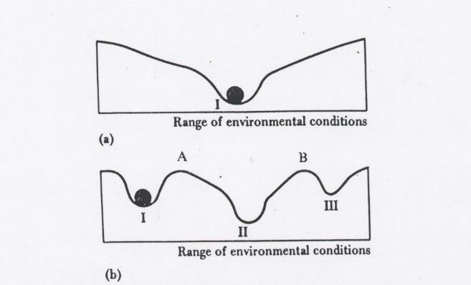
Rangelands can have multiple steady states.
Laycock et al. 1991
Ball and Cup (trough) Analogy
Notes:
Fig. 2. Diagrams illustrating the ball and cup or trough analogy to Illustrate global and local stability concepts. The community is represented as a black ball
on a topographic surface (cup or trough) which represents the range of environmental conditions under which the community is stable. In (a) the community is both locally and globally stable because, after all disturbances or perturbations, it will return to configuration. In (b) the community is locally
stable, but if perturbed beyond a certain critical range, it will cross threshold A and move to a new locally stable configuration II. From Ecology: The Experimental Analysis of Distribution and Abundance, Third Edition by Charles J. Krebs. Copyright @ 1985 by Harper and Row Publishers, Inc. Reproduced by permission of Harper Collins Publishers, Inc.

Slide 18
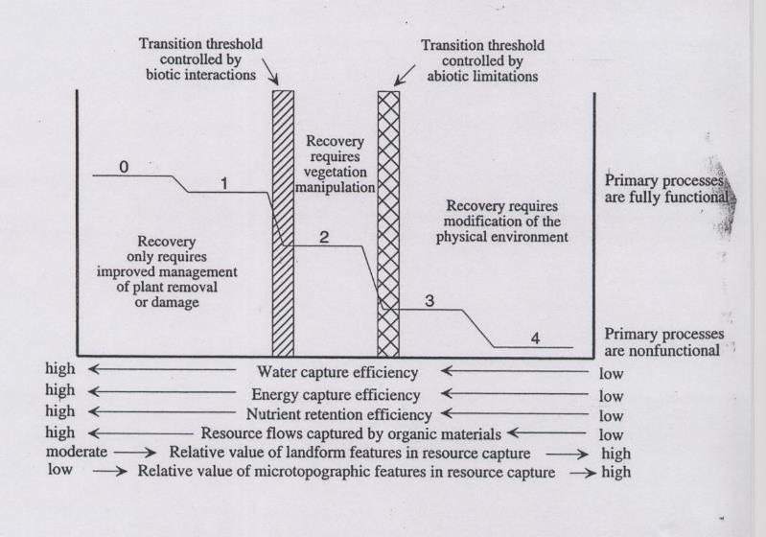
STEPWISE DEGRADATION
Groups: defined by functional integrity and transition limitation
“…It is particularly important to recognize the early symptoms of degradation, since management expenses increase with each additional step in the degradation process.”
-Whisenant 1999
Whisenant 1999

Slide 19
STEPWISE DEGRADATION
Biotic: vegetation manipulation
Abiotic: physical manipulation
Whisenant 1999

Slide 20
Sagebrush Steppe State
Open
Sagebrush
Grassland
Biotic Threshold?
Abiotic Threshold?
Depleted
Sagebrush
Closed
Sagebrush
Threshold
Annual Grass
Dominated State

Slide 21
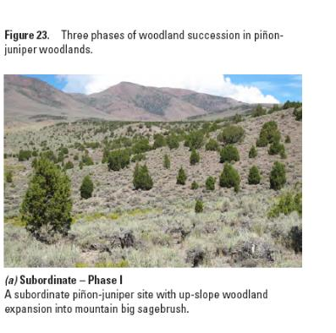
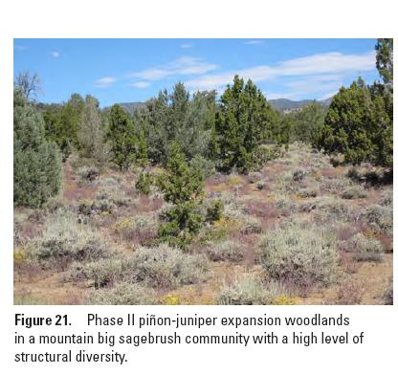
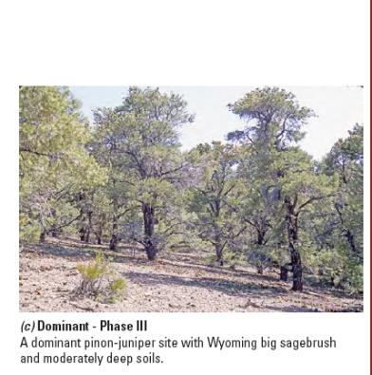
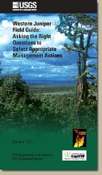
Phase I
Shrubs > 2/3 of relative cover
Phase II
Shrubs and trees share relative cover
Phase III
Trees > 2/3 relative cover
Biotic Threshold?
Abiotic Threshold?

Slide 22

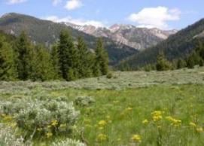
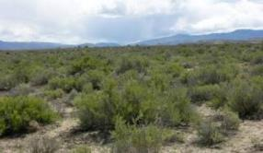

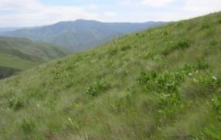
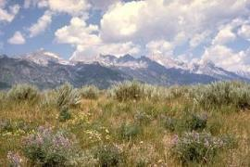
Rangelands are Dynamic!
…But dynamic patterns can be described in state and transition models.
…We manage transitions.
Label Each Arrow with one or more the following:
Bad-Grz = Excessive grazing mgmt. (Poor time or excessive intensity)
Good-Grz = Appropriate grazing (managed time/intensity or no grazing)
Ex-Fire = Excessive fire (too frequent, too intense)
Good-Fire = Appropriate fire (natural frequency, low intensity)
No-Fire = No regular fires occurring
Shr-Control = Shrub control by herbicides or mechanical
Immigrate = Immigration and establishment of plants
Till/Seed = Tillage by machinery Seeding of native or introduced plants
Clim/Weath = Climate/weather including drought

