Slide 1
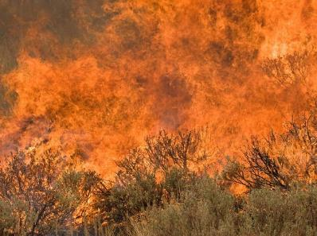
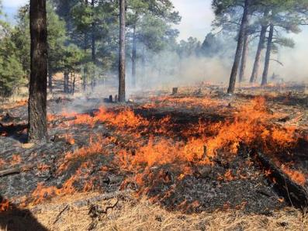
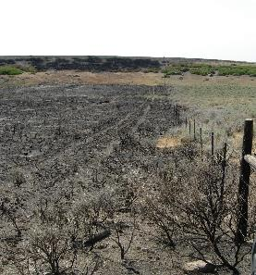
Wildland Fire
USFWS
USGS
N. Rimbey(UIdaho)
Rangeland Principles (REM 151)
Notes:
Fire has always been an important component in most ecosystems in North America. Over time, land management agencies have accepted fire as part of an ecosystem's natural cycle. Previously, agencies labeled all fires as bad or detrimental to the health of wildlands. Land managers' efforts in the past, therefore, concentrated on suppressing all fires. Today, some wildland fires are allowed to burn, and some fires are ignited by trained fire specialists.

Slide 2
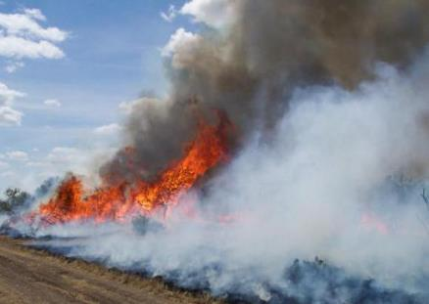
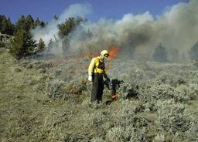
Types of Fires
Photo: US Geological Survey
1. Wildfire: started by lightning or by humans
Photo: Sagebrush Sea
Notes:
Three types of fires on rangelands (Exact terminology changes from time to time. But, the concept stays the same)
Wildfire started by lightening or by humans

Slide 3

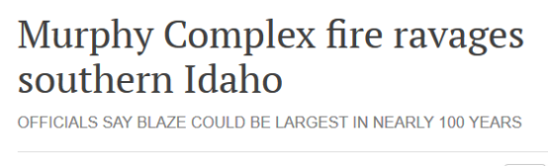
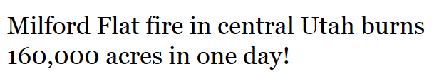


652,016 ac
363,052 ac
Magic Valley Times-News July 23, 2007
557,628 ac
The Wildlife News
July 8, 2007
The Oregonian, July 28, 2012
395,747 ac
KBOI2.com, July 16, 2014
279,144 ac
KTVB.com, Aug 14, 2015

Slide 4
Types of Fires
Photo: US Geological Survey
1. Wildfire: started by lightning or by humans
2. Wildland Fire Use: unintentional ignition, but not suppressed because it meets guidelines in wildland fire plan
Photo: Sagebrush Sea
Notes:
Three types of fires on rangelands:
Wildfire started by lightening or by humans
Wildland Fire Use – unintentional ignition, but not suppressed because it meets guidelines in wildland fire plan…Fires started by natural causes such as lightning or lava which are closely monitored are called wildland fire use. Both of these types of fire are managed for their benefit to the ecosystem.

Slide 5
Types of Fires
Photo: US Geological Survey
1. Wildfire: started by lightning or by humans
2. Wildland Fire Use: unintentional ignition, but not suppressed because it meets guidelines in wildland fire plan
3. Prescribed Fire: Intentionally set under specific conditions
Photo: Sagebrush Sea
Notes:
Three types of fires on rangelands:
Wildfire started by lightening or by humans
Prescribed Fire – intentionally set under specific conditions. Fires started by professionals are termed prescribed fires.
For example, regular prescribed fires can reduce the amount of ground fuels, thereby lowering the potential for large wildfires. If future wildland fires should occur, the fires would be less intense and easier to contain. Fuel reduction can help lessen the possibility of high intensity crown fires. However, in five to eight years enough litter can accumulate in a forest to return ground fuel quantity to the pre-fire level. Therefore, it is important that a regular, planned burning program is followed rather than a single fire event.

Slide 6
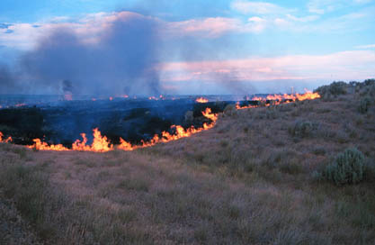
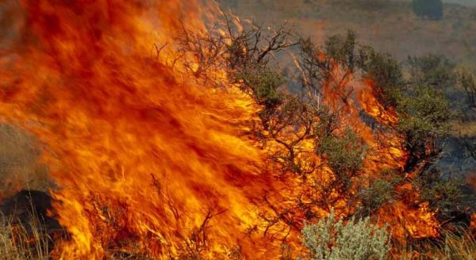
Factors that Influence Plant Response
Fire characteristics
  fire intensity
  duration of combustion
  burn severity
  time of the year
Rate of heat release per linear foot
  Related to fuel properties
  Assessment of heat pulse (time and intensity) for effect on herbaceous plants and soil. Heat upward may have stronger effects on shrubs and trees.
Mike Munts, NPS.gov
  Higher temps and lower relative humidity increase fire severity.
BLM.gov

Slide 7
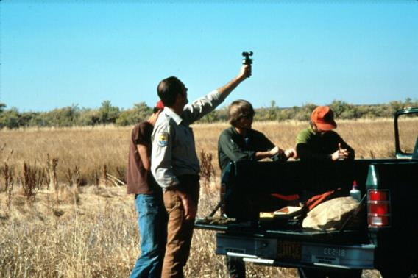
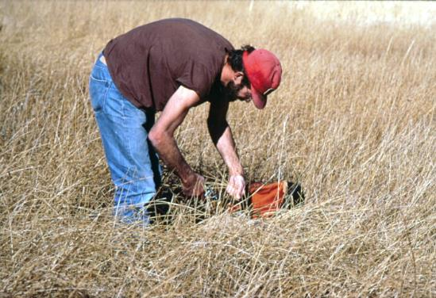
The prescription indicates the acceptable fuel and weather conditions under which a fire should be set so that the blaze can be controlled.
Temperature
Slope
Wind
Humidity
Fuel moisture content
Notes:
Before a fire is set or allowed to burn, weather conditions are assessed for likelihood of the fire burning out of control. Many conditions can affect the size and intensity of a fire. Winds, soil and fuel moisture content, and slope of the land are a few factors that influence fire behavior. These factors are weighed carefully before decisions are made about whether to start a burn or allow an already burning fire to continue.

Slide 8
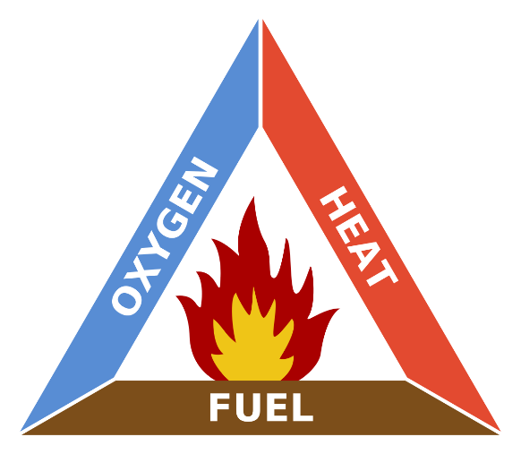
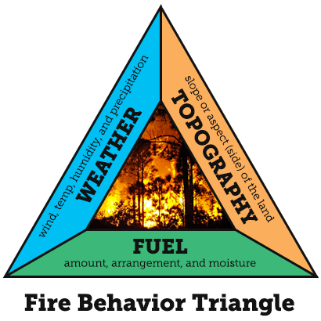
Fire Plan
Fire Triangle
Notes:
A management ignited prescribed fire (also called a prescribed or controlled burn) is a calculated and carefully planned event. Fire managers construct a fire plan that considers elements such as wind conditions, weather, season, humidity, dampness, and quantity and availability of fuel (natural build up of leaf litter and woody growth). As part of the plan, fire managers determine how hot the fire will burn and in what direction the blaze will travel.
Weather conditions such as wind, temperature and humidity also contribute to fire behavior. Wind is one of the most important factors because it can bring a fresh supply of oxygen to the fire as well as push the fire toward a new fuel source.

Slide 9
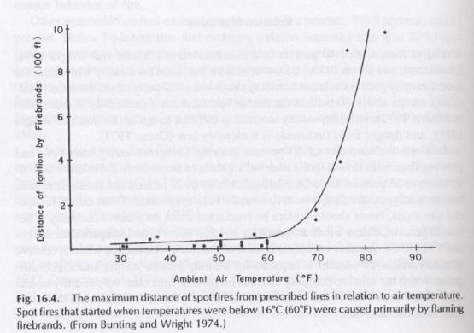
Temperature
< 32° F: grass is hard to ignite
40-60° F: fire behavior more or less
uniform
>67°: increased firebrand distance
>80°: red flag
Notes:
Red flag: means conditions are high risk if you burn, fire is more likely to get away from you
Firebrands: burning fuels

Slide 10
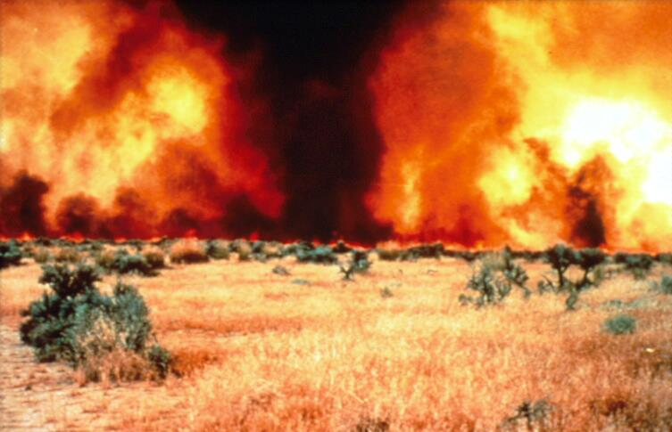
Relative Humidity
< 20%: red flag
20-40%: fire behavior is more or
less uniform
60%: uniform
> 60%: fire doesn’t carry well
Notes:
Relative humidity: term to describe the amount of water vapor that exists in the air and water vapor.

Slide 11
Wind
< 6 mph: glowing fire brands don’t ignite
6 mph: minimum speed for non-contiguous fuels
8 mph: consume woody fuels
>20 mph: red flag
brings a fresh supply of oxygen to the fire
pushes the fire toward a new fuel source
Notes:
On the day of the prescribed burn, the fire crew considers all environmental elements, the most important being wind speed and wind direction. Wind determines where the fire will be ignited and in which direction it will burn (the fire plan includes all possibilities).

Slide 12
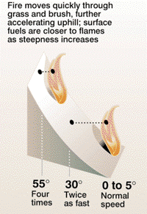
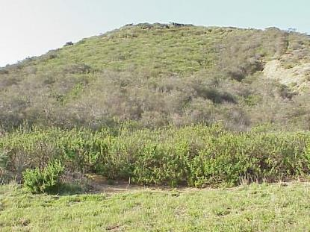
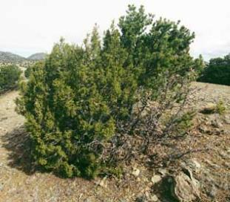
Slope
Volatility
Notes:
Some plants, shrubs and trees contain oils or resins that promote combustion, causing them to burn more easily (how easily a plant catches on fire), quickly or intensely than those without such oils
High (more oils): chaparral, conifers, dead aspen, dead PJ
Medium: sagebrush, oaks, live aspen, slash
Low (less oils): grasses, most hardwoods
Need wider fire lines for more volatile fuels (use mowing, retardents, sprinklers).

Slide 13
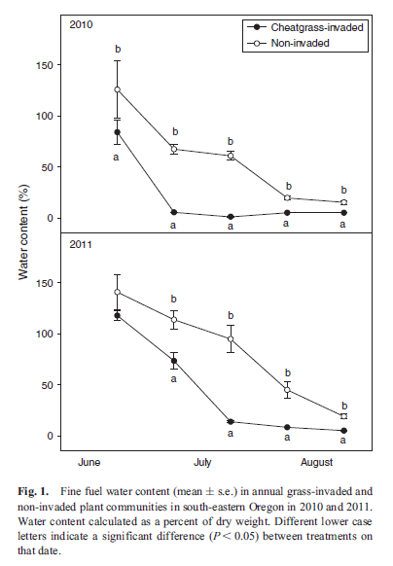
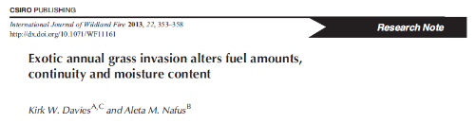
Fuel Moisture Content
The moisture content and distribution of these fuels define how quickly a fire can spread and how intense or hot a fire may become.
Live Fuel Moisture
Dead Fuel Moisture
Notes:
Fuel moisture content is the amount of water in a fuel expressed as a percent of the over dry weight of the fuel.
Fuel Moisture Content: is among the most important fuel characteristics affecting fire behavior. It determines how much fuel is available for burning, and ultimately, how much is consumed. Fuel moisture: both live and dead fuels can slow, stop, or contribute to fire spread, depending on their moisture content.
Natural fuels range: Live fuels: 30->300%, dead fuels 2-30%.
Live trees usually contain a great deal of moisture while dead logs contain very little. High moisture content will slow the burning process since heat from the fire must first eliminate moisture.
Live fuel moisture:
Internal factors: Fuel moisture fluctuates diurnally
Climatic variations: length of growing season, climate patterns
Site factors: elevation, aspects
Species groups: deciduous vs. evergreen
Plant parts: foliage moisture is greatest in new foliage
Dead Fuels:
Particle size: small fuels can gain and lose moisture faster than large fuels
Weather: midday sun, night, clouds
Topography
Decay class: moisture can be gained or lost more rapidly in decayed wood
Fuel composition: herbaceous material, leaf litter, cones, twigs, branches, logs
Moisture level is the most important consideration.

Slide 14
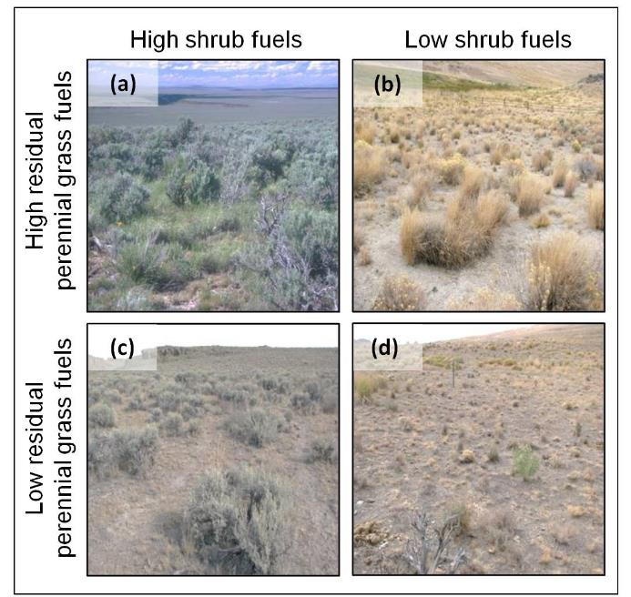
Fuels
Density of a fuel influences its flammability
Fuel particle close together: burn readily
Fuel particles too close: fuel will not burn freely
Hulet, A., C.S. Boyd, K.W. Davies, and T.J. Svejcar. 2015. Prefire (Preemptive) Management to Decrease Fire-Induced Bunchgrass Mortality and Reduce Reliance on Postfire Seeding. Rangeland Ecology and Management 68:437-444.
Notes:
If fuel particles are close together, they will ignite each other, causing the fuel to burn readily. But, if fuel particles are so close that air cannot circulate easily, the fuel will not burn freely.

Slide 15
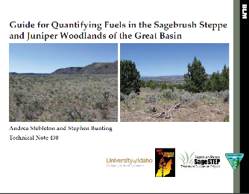
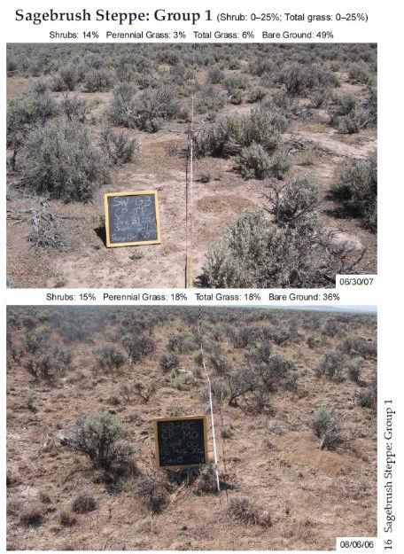
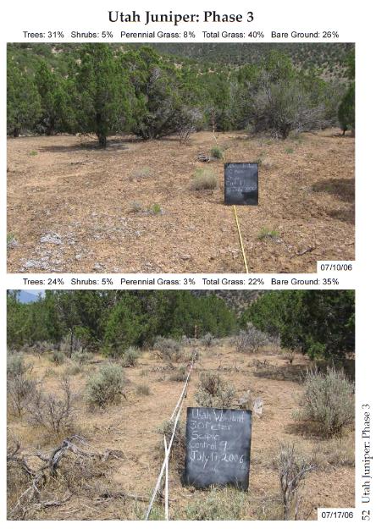
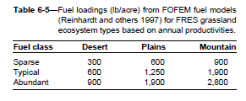
http://www.sagestep.org/pdfs/SageSTEPFuelsGuide.pdf
Notes:
Fuel Loads: is a mass of available fuel in a given locale. It includes distribution of materials into size classes with differing timelags to reach a standard moisture equilibrium with the environment.

Slide 16
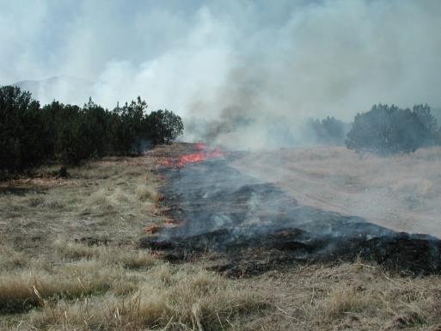
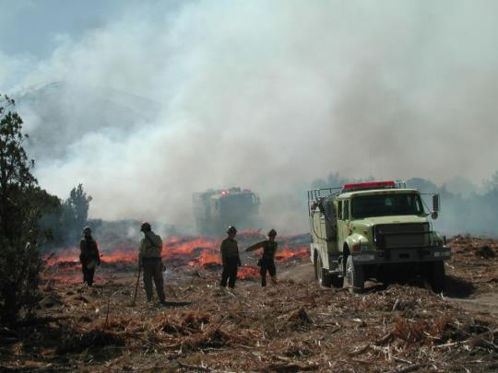
Challenges
NEPA
Fireline prep work
Timing of weather, personnel availability
Caution, safety, trained personnel
Flight plans, burn plans, safety plans
Scale and risk
Notes:
Air quality, weather, and person risk influence weather a fire is allowed to burn or if a prescribed fire can be conducted and whether a fire is allowed to burn.

Slide 17
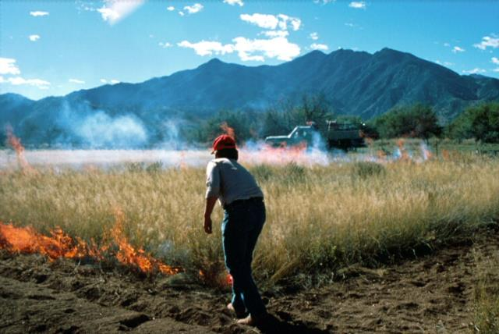
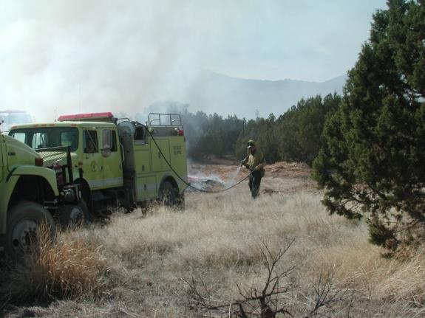
Fire Breaks
Notes:
One way managers decrease the risk is by constructing a barrier around the prescribed burn site.
Fire Breaks: a break in fuel, made by cutting, scraping or digging (all fuels removed, scraped to mineral soil, or change in fuel structure).
Natural firebreaks: roads, ditches, water or other physical features devoid of natural fuel are the best barriers.
Built firebreaks: mowing, wetting down (sprinkles), retardants, chained, dozed
Most often, however, a firebreak must be built ahead of time to burn away materials that would fuel a wildfire. Occasionally, mowing or "wetting down" an area will prevent fire from burning outside the prescribed area.

Slide 18
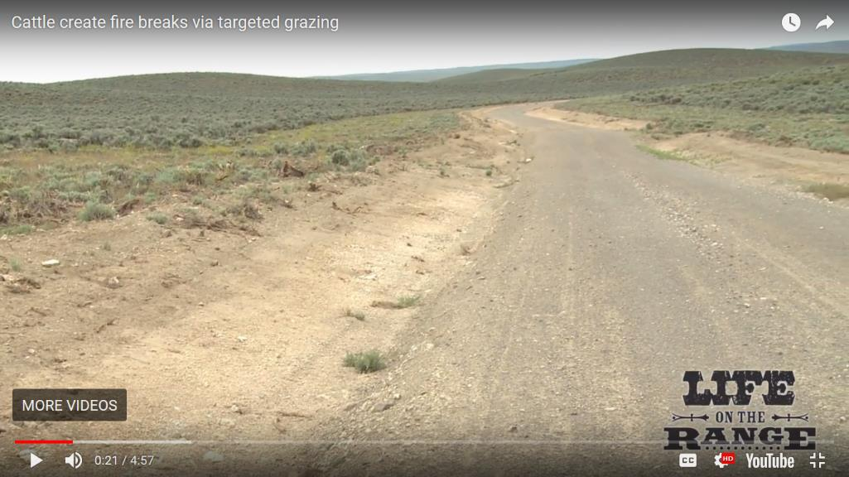
WATCH
https://youtu.be/sTfQnpahqss
Notes:
Livestock to grazing can be applied in specific areas to reduce fuels on the landscape.

Slide 19
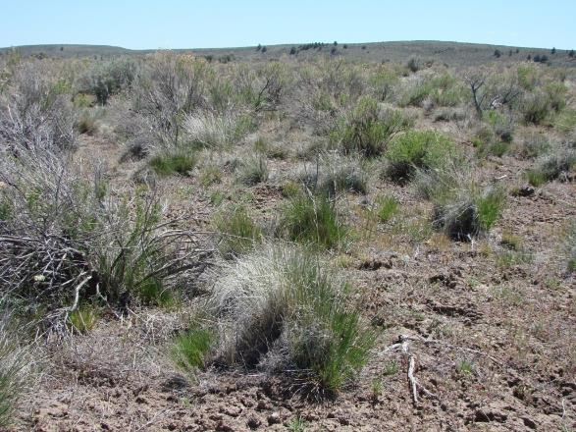
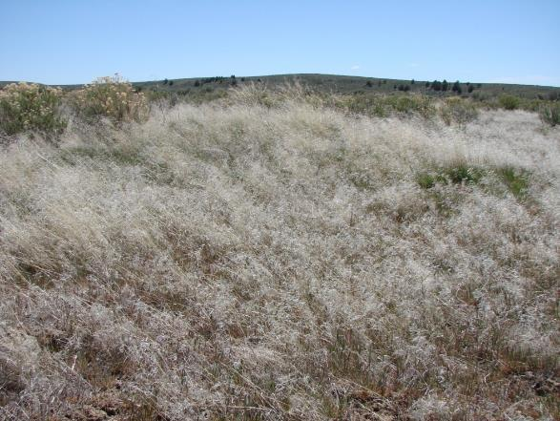
Grazed, Burned
15 years post-fire
Ungrazed, Burned
15-years post-fire

Slide 20
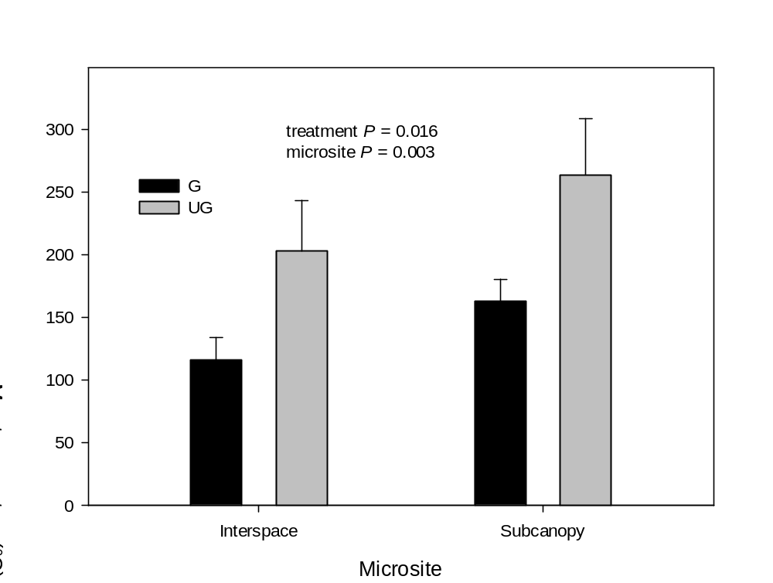
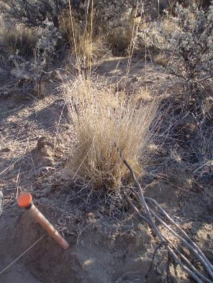
Maximum Temperature
Davies, K.W., C.S. Boyd, J.D. Bates, and A. Hulet. 2015. Winter grazing can reduce wildfire size, intensity and behavior in a shrub-grassland. International Journal of Wildland Fire 25:191-199

Slide 21
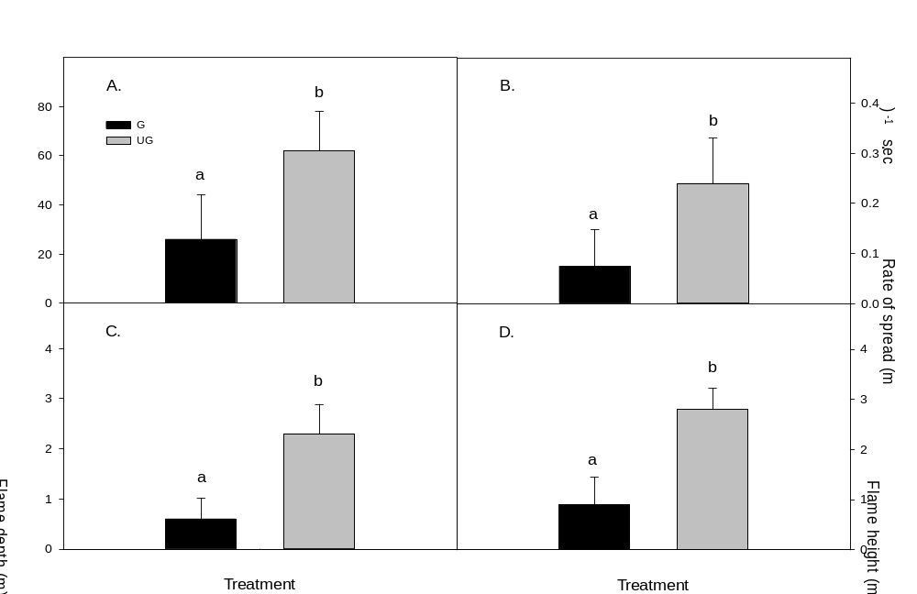
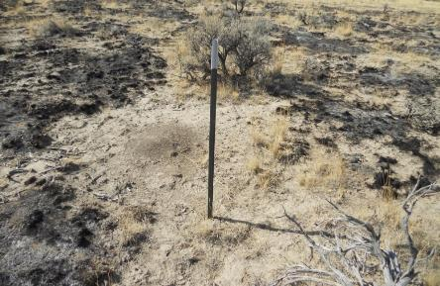
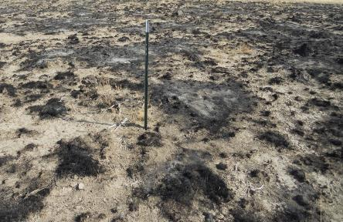
grazed
Area Burned
ungrazed

Slide 22


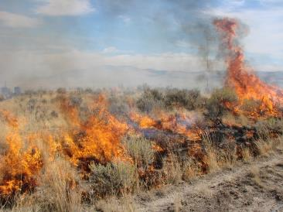
Rate of Spread
Flame Depth
Flame Height

Slide 23
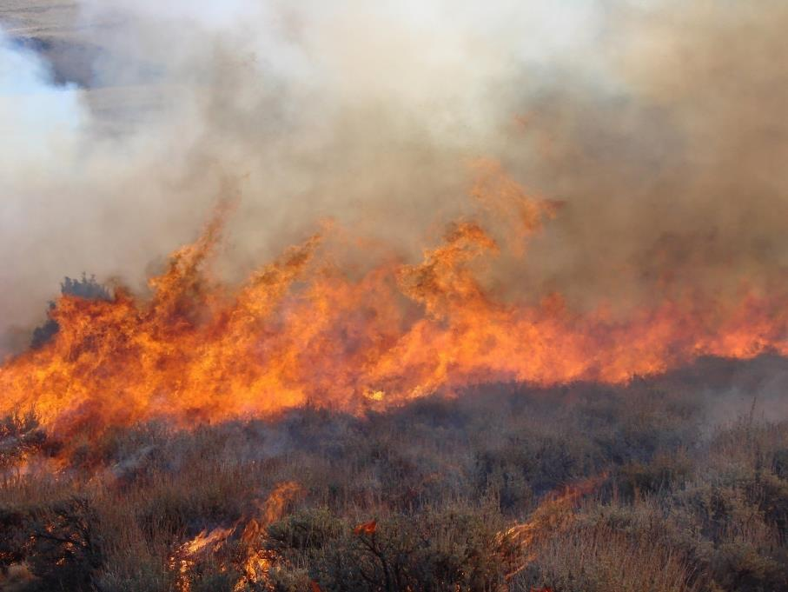
…not IF it burns, but WHEN it burns…
How do we learn to live with fire in terms of land management?
Notes:
How do we learn to live with fire in terms of land management?
Learn to use prescribed fire
Prepare for wildfires in terms of personnel
Plan for wildfire occurrence and condition – long term based on environmental conditions.
Communication and education people to accept wildfire
Establish relationships for managing wildfire across land ownerships.

Slide 24
Pros
↓ Insect Infestation
↓ Disease
Provide shelter for animals
↓ fuel loads
Nutrients are released
↓ competition
Serotinous
Mosaic pattern
Notes:
Wildland fires can be beneficial.
In forests, fires help diminish the threats of insect infestation and disease. By burning infected, dead or dying trees that harbor unwanted pests, fire reduces the likelihood that insect or disease related problems will occur. Burned standing and fallen logs provide food and shelter for animals such as millipedes, termites, ants and some bird species.
They reduce fuel loads, such as dead standing or fallen limbs, logs, leaves, pine needles, shrubs, excess grass and also living trees and shrubs. Such periodic burning reduces the intensity of each fire that occurs in subsequent years, consequently decreasing the impact of fire on fire tolerant plants and burrowing animals. When the fuel loads are reduced, undesired fires can be minimized.
When fires are allowed to burn, nutrients are released into the soil that would otherwise be held in leaf litter and undergrowth. Once these nutrients are released, grasses and other plants often spring to life and cover the ground in recently burned areas. Underground plant structures, such as roots, rhizomes and bulbs, also are stimulated to sprout if the fire does not burn extremely hot.
In the absence of fire, fire dependent ecosystems would be unable to reproduce or would be out competed by other species. For example, in prairie ecosystems, fire removes less fire tolerant non-native species of plants that out compete native prairie plants. Also, some pine cones will not open and release their seeds until they have been through a fire. These type of cones are called serotinous. Lodgepole pine and the giant sequoia trees have serotinous cones.
As fire burns across an area, not everything is impacted. Wildland fires create a mosaic pattern, often leaving some parts of the burn zone untouched. Inside the fire perimeter, some areas are completely burned, other areas have various levels of impact and some areas are completely untouched. This mosaic pattern provides for a diversity of vegetative regrowth and, in turn, a diversity of animal life. This biological diversity (the sum total of all living organisms and their interactions) is most important for a healthy ecosystem.

Slide 25
Pros
Cons
↓ Insect Infestation
↓ Disease
Provide shelter for animals
↓ fuel loads
Nutrients are released
↓ competition
Serotinous
Mosaic pattern
Threat to humans
  Wildland /Urban Interface (WUI)
  Financial loss
  Loss of habitat
  Nutrients are released
  ↓ competition
Notes:
Fire can be a threat to humans. Wildfires burn timber that often would have been harvested for lumber or paper products. Fire can destroy homes and other structures. More and more, human communities are vulnerable to the effects of fire.
As human populations grow, city boundaries expand and neighborhoods develop into wildland areas, now called the wildland/urban interface. These areas have a greater chance of being impacted by fire because they contain large amounts of plant landscaping, fuel sources and structures that could sustain a fire. Most wildland fires, however, occur in sparsely populated areas and are managed to remain within park or forest boundaries. Large, damaging wildfires can be minimized with proper management, but they never will be eliminated.
Furthermore, a burned tree is not wasted. It can provide nesting sites for birds, homes for small mammals and a base from which new plants can grow. When the dead tree begins to decay, it releases nutrients into the soil, enhancing growth of surrounding flora.

Slide 26
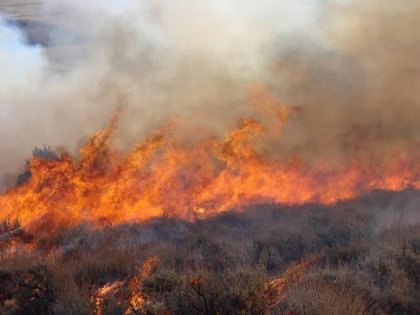
Pros
Cons
↓ Insect Infestation
↓ Disease
Provide shelter for animals
↓ fuel loads
Nutrients are released
↓ competition
Serotinous
Mosaic pattern
Threat to humans
  Wildland /Urban Interface
  Financial loss
  Loss of habitat
  Nutrients are released
  ↓ competition
Fire does not imply death,
but rather change
Notes:
Furthermore, a burned tree is not wasted. It can provide nesting sites for birds, homes for small mammals and a base from which new plants can grow. When the dead tree begins to decay, it releases nutrients into the soil, enhancing growth of surrounding flora.

Slide 27
Management Applications:
All communities
Shrublands
Maintain/increase species diversity
Maintain “natural” disturbance regime
Conversion to grasslands
Decrease fuel loads
Diversity
Grasslands
Control undesirable shrubs
Remove dead debris
Increase yield, palatability
Alter species composition
Forest
Decrease fuel loads
Diversity
Fire won’t improve a range in poor condition
Notes:
Catalyst for promoting biological diversity and healthy ecosystems.

Slide 28
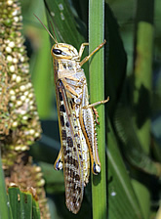
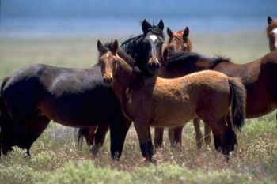
Factors that influence recovery – Animal use
Post-fire animal use
  Grazing animals attracted to burned areas
  Vegetation is more accessible, palatable, and nutritious
USDA ARS
USDI BLM

Slide 29
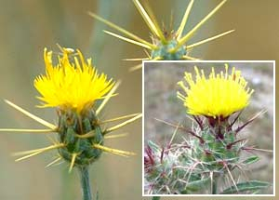
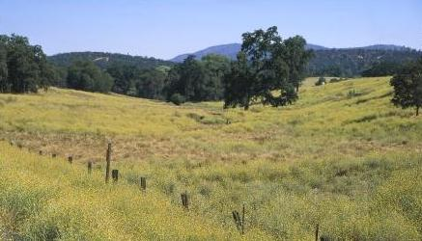
Post-fire management
  Management of herbivory (livestock, wildlife)
  Monitor for and control invasive species
US National Park Service
Joseph DiTomaso

Slide 30
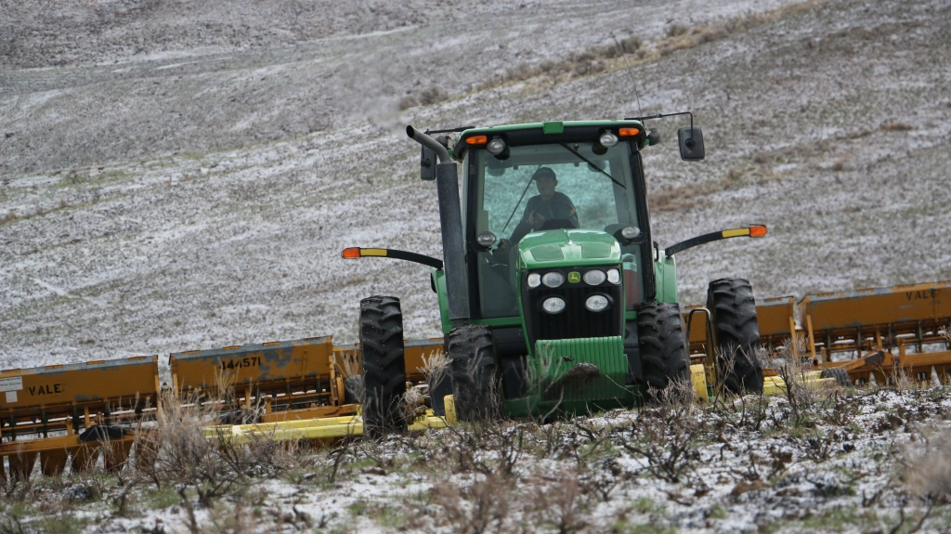
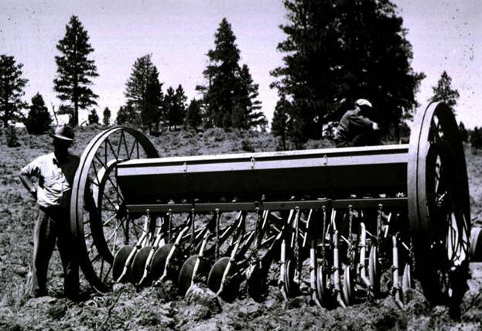
Post-fire management
  Management of herbivory (livestock, wildlife)
  Monitor for and control invasive species
  Reseeding and soil erosion control measures
USDI BLM
Rangeland Technology and Equipment Council

Slide 31
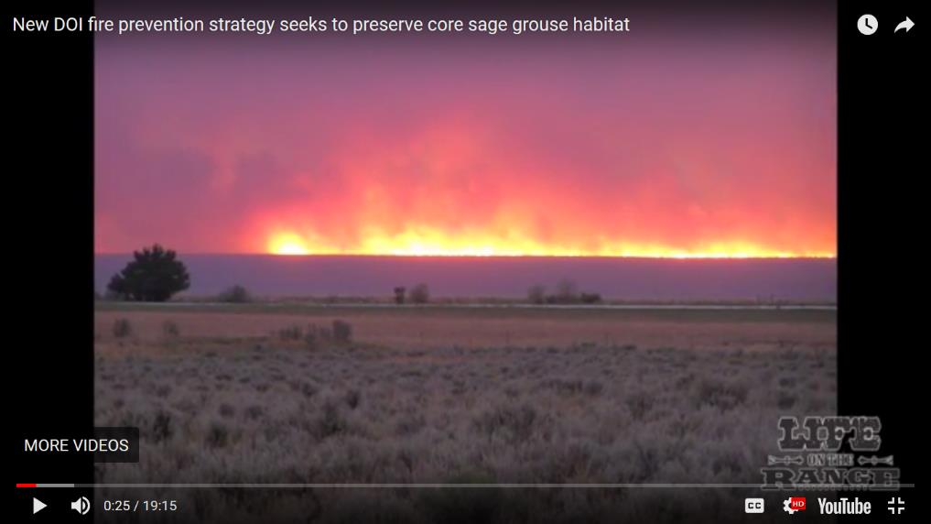
WATCH
https://youtu.be/_n6nTNwvCLg

