Slide 1
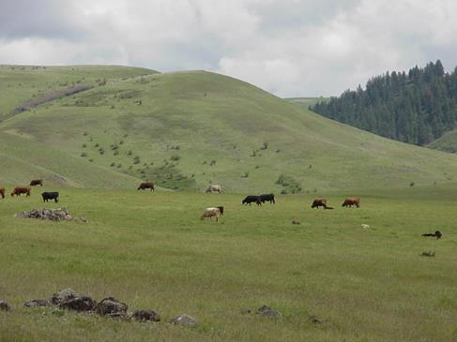
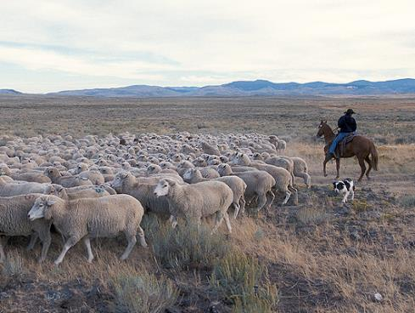
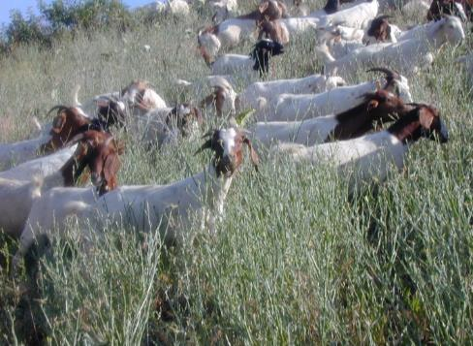

Targeted Grazing for vegetation management & landscape enhancement
K. Launchbaugh
USDA - ARS
K. Launchbaugh
Rangeland principles, rem151

Slide 2
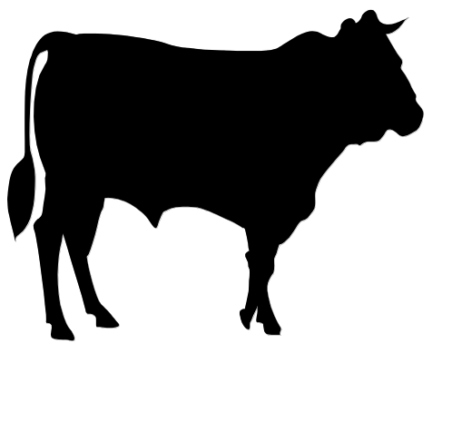
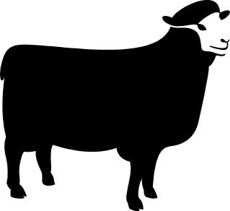
Products of Livestock Grazing
Meat & Livestock
Products
Manage Plant
Communities

Slide 3
Products of Livestock Grazing
Meat & Livestock
Products
Manage Plant
Communities

Slide 4
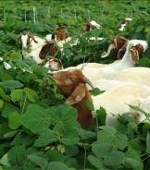
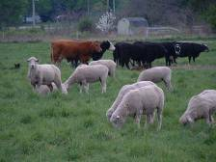

Targeted Grazing
The application of a specific kind of livestock at a determined season, duration, and intensity to accomplish defined vegetation or landscape goals.
Pay attention to:
  Desired Landscape
  Grazing Animal
Frost & Launchbaugh. 2006. Prescription grazing for rangeland weed management. Rangelands, 25(:43-47.

Slide 5
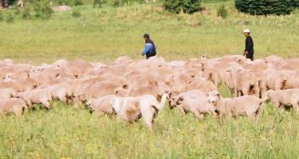
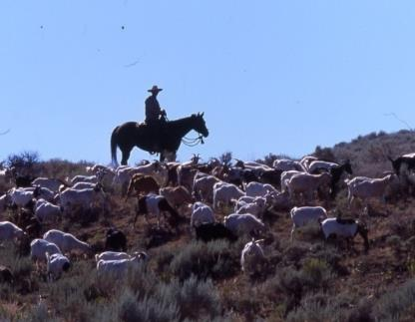
Landscape Goals
Reduce weeds on cropland, pastures & wildlands
Control herbaceous biomass in tree crops
Improve wildlife habitat
Reduce fire fuel load
Manage watershed characteristics
Wildland land restoration
K. Launchbaugh
R. Daines

Slide 6
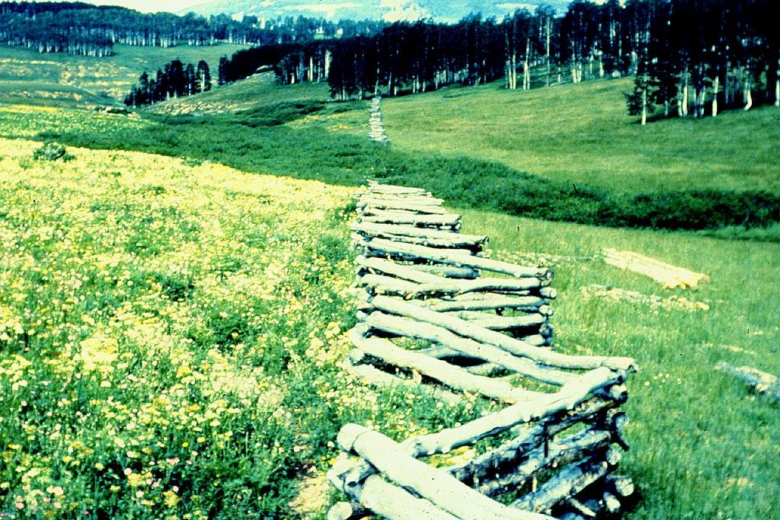
Sheep Reduce Forbs
John Walker

Slide 7
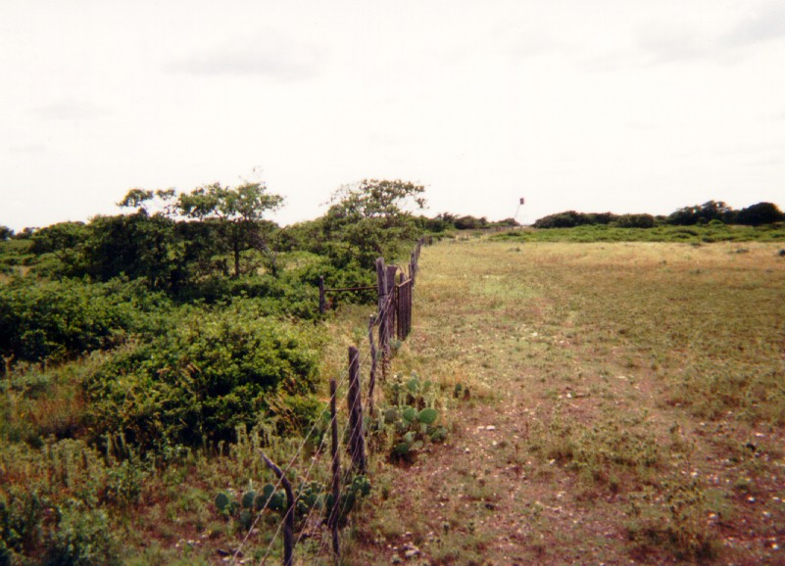
Goats Control Oak
Goats Reduce Shrubs
John Walker

Slide 8
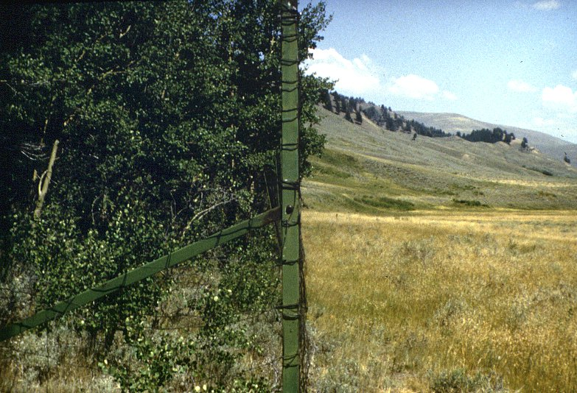
Exclosure inYNP
Winter Browsing Reduces Willows
John Walker

Slide 9
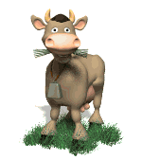
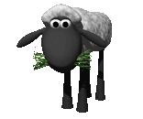
Targeted Grazing – Innovations in Grazing
“Goats enlisted in war on weeds”
“Weed-eating goats provide herbicide alternative”
“Only Ewes can stop wildfire”
“Wooly Weed Eaters”
“Ovines and Vines”

Slide 10
Livestock affect Weeds
Increase Spread
of Weeds
Suppress
Weeds
Stress weeds
Reduce root biomass
Reduce seed production
Reduce competitive edge
Cause disturbance
Transport seeds
Reduce competition from native plants

Slide 11
Livestock affect Weeds
Increase Spread
of Weeds
Suppress
Weeds
Uncontrolled
or Improper
Grazing
Targeted Grazing
in an
Integrated System

Slide 12
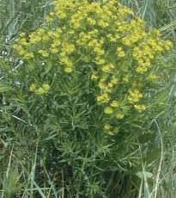
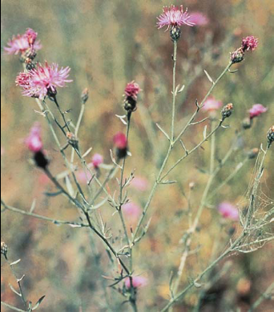
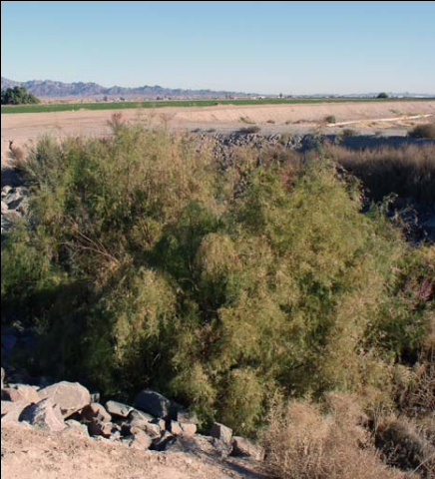
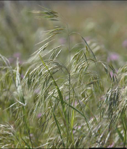
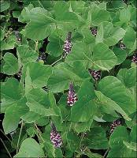
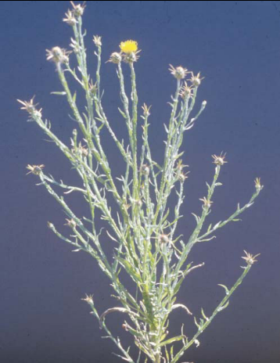
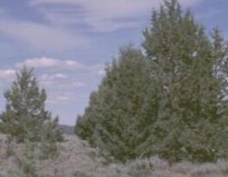
Some Plants are Easier than Others
Easy Difficult
Leafy Spurge
Knapweeds
Salt Cedar
Cheatgrass
Kudzu
Starthistle
Juniper

Slide 13
Targeted Grazing – Innovations in Grazing
Accomplished by control of:
  Season
  Species
  Individual

Slide 14
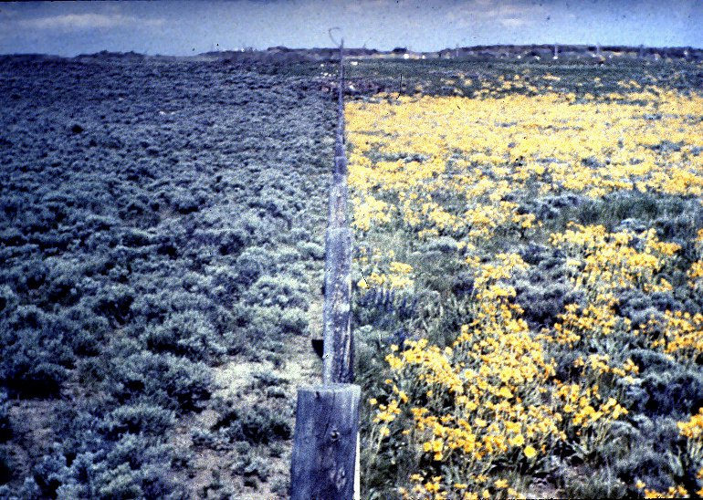
Season Matters
Spring Grazed
Fall Grazed
John Walker

Slide 15
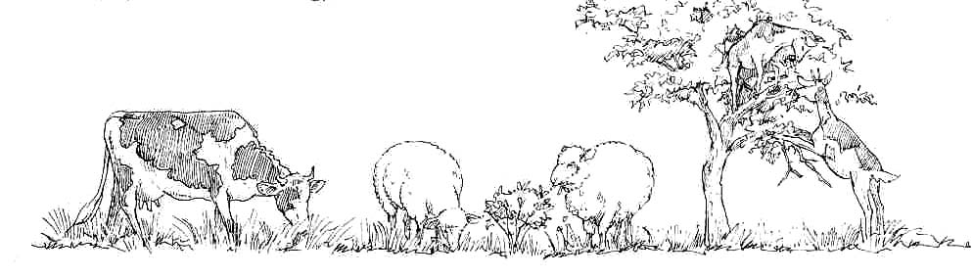
Species Matters

Slide 16
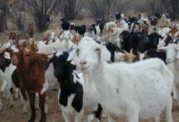
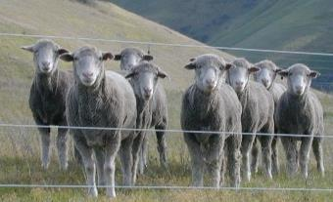
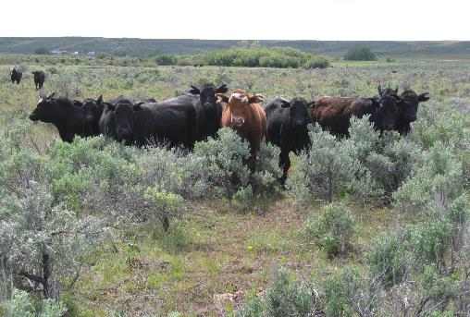
Select, Train & Entice Individual
K. Launchbaugh
K. Launchbaugh
K. Launchbaugh

Slide 17
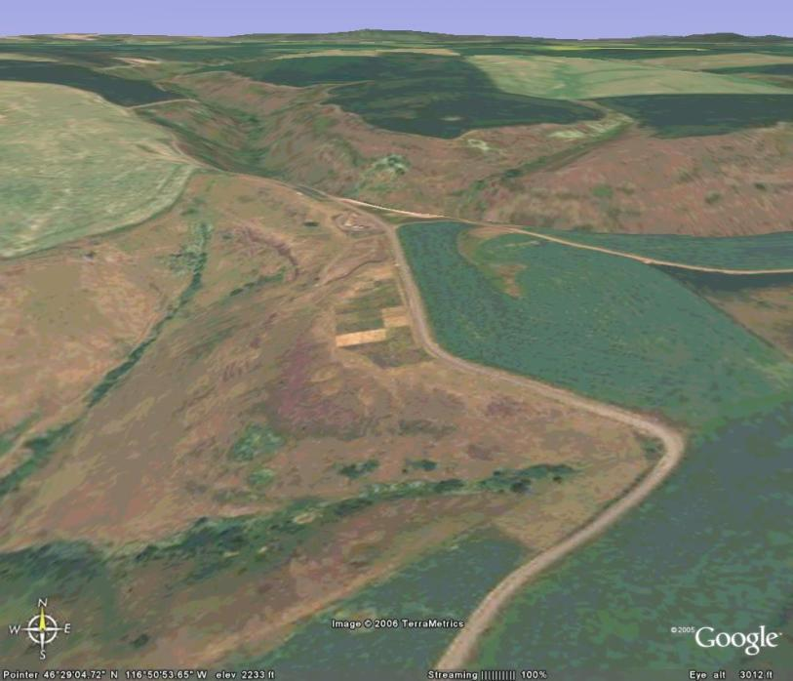
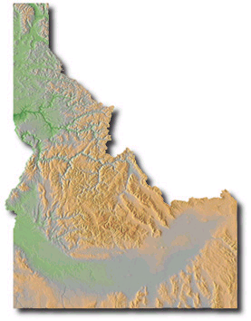
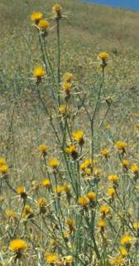
Yellow Starthistle Grazing
Rolling to gently sloped bench
Abundance of yellow starthistle
Perennial grasses

Slide 18
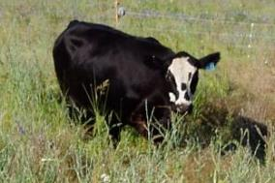
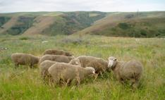
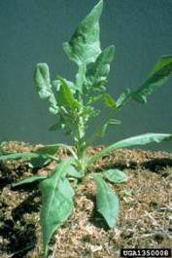
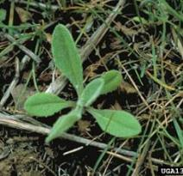
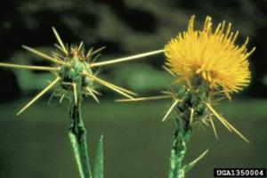
Yellow Starthistle Studies
Consider Species and Season
Plant Response to Grazing
in North Idaho
Cattle, Sheep, or None
Three Phenological Stages
Rosette, Bolting, or Flowering
4 Replications
= 27 paddocks (80 x 80 feet)

Slide 19
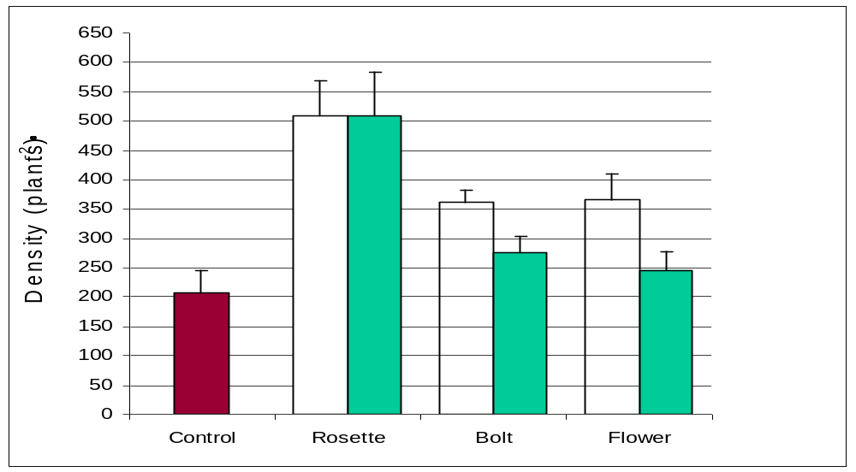
Season and Species
Spring Yellow Starthistle Density after 2 Years Grazing
Cattle
Sheep
Graze vs No Graze **

Slide 20
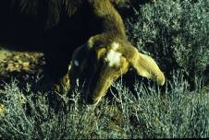
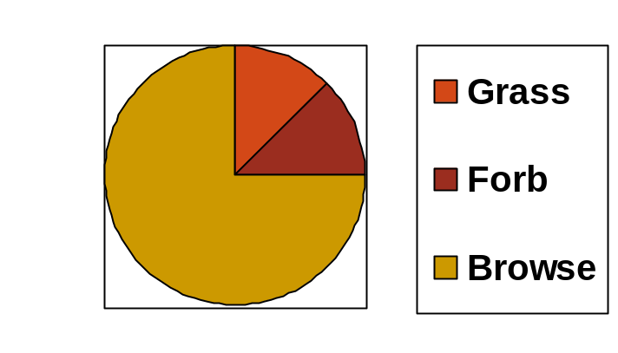
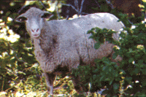
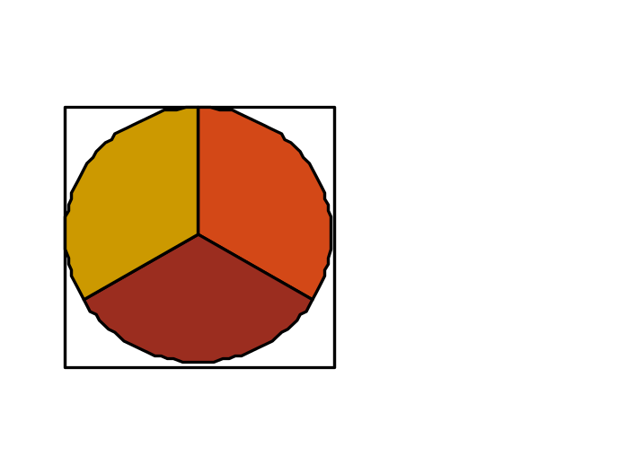
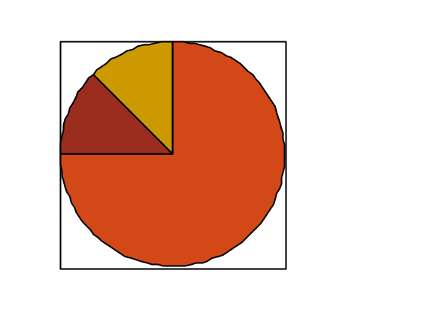
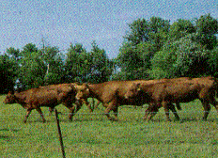
Select and Prepare Herbivores
Concentrate Feeder (browse)
Intermediate Feeder (forbs)
Roughage Feeder (grass)

Slide 21
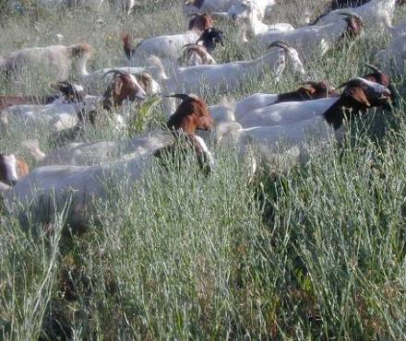
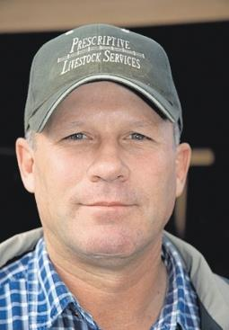
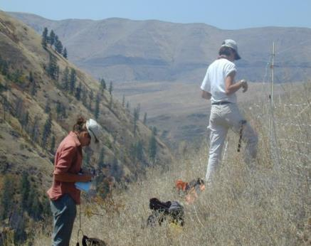
Yellow Starthistle Grazing by Goats
K. Launchbaugh
K. Launchbaugh

Slide 22
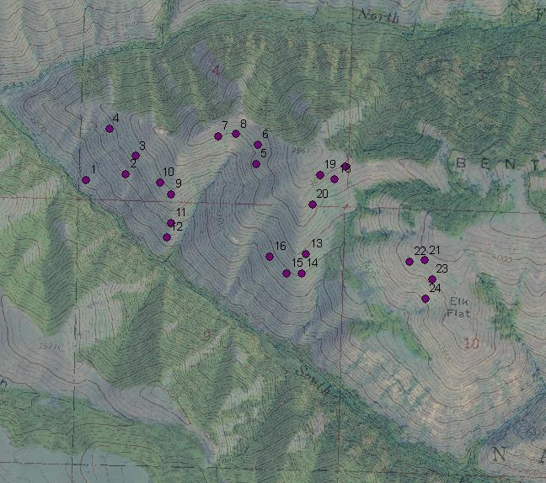
Bentz Ridge near White Bird Creek
Sources: Idaho Geospatial Data Clearinghouse, USDA-FSA-APFO
U.S. Geological Survey (USGS)
Notes:
Why this study site—abundance of YST and rough terrain—landscape scale study.
**Bullet 24 paired plots across landscape
24 plots—6 groups of 4 in 2006. Plots occurred on slopes between 20 and 35 degrees.
**acreage involved as a bullet

Slide 23
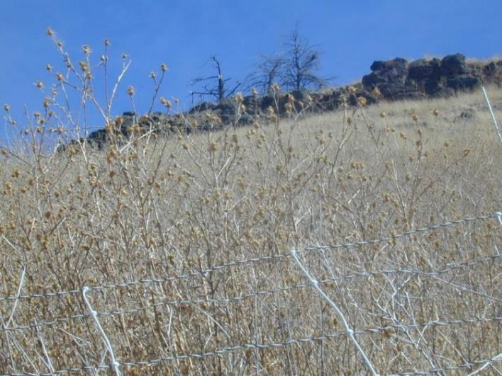
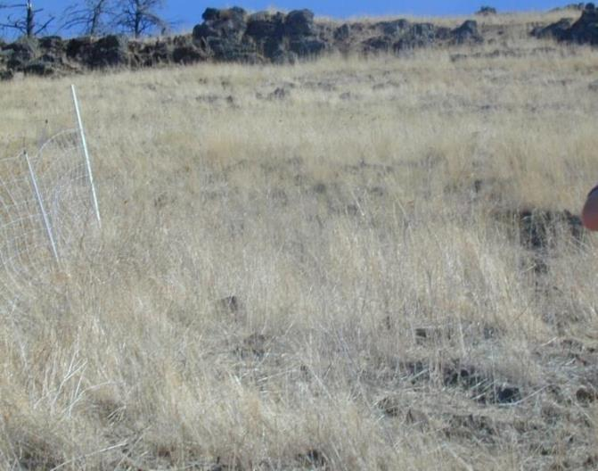
Ungrazed vs. Grazed
Photo by Brianna Goehring
Photo by Brianna Goehring
Yellow starthistle density, seed production & cover ↓↓
Forb cover stayed the same
Grass cover ↑↑
Goehring, Launchbaugh, & Wilson. 2010. Late-Season Targeted Grazing of Yellow Starthistle (Centaurea solstitialis) with Goats in Idaho. Invasive Plant Science and Management. 3(2):148-154.
Notes:
Plot 6—postgrazing: control and treatment
**Now I’m going to show results of our comparisons…cool transition, we can actually see the difference
Plants decreased by 54%, 72%, 58% for 2006-08 . For a 61% average
Seedheads decreased by 92, 99, and 94%
Following grazing, plant density of treatments areas was 61% lower, on average for the three study years, than the ungrazed control.
Yst cov decreased by 77 and 72% for 2007 and 2008

Slide 24
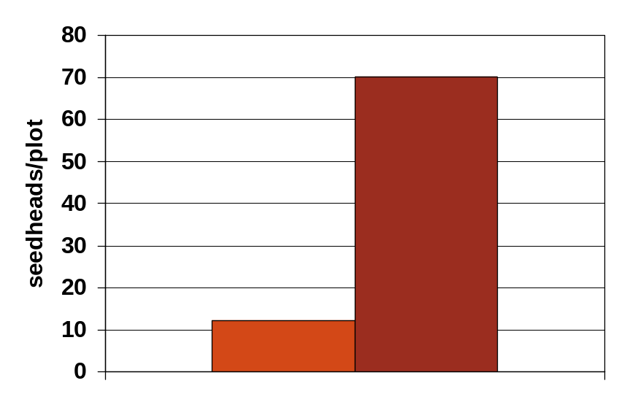
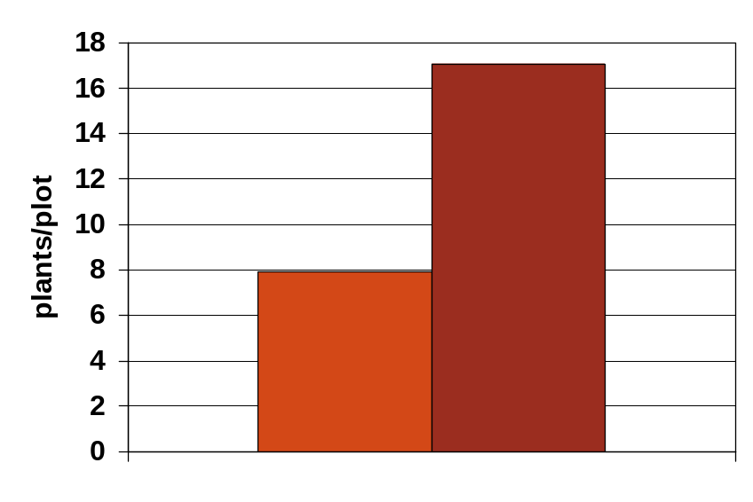
Yellow Starthistle Response
Seedheads per Plant
Ungrazed
Plants per Plot
Ungrazed
Grazed
Grazed

Slide 25
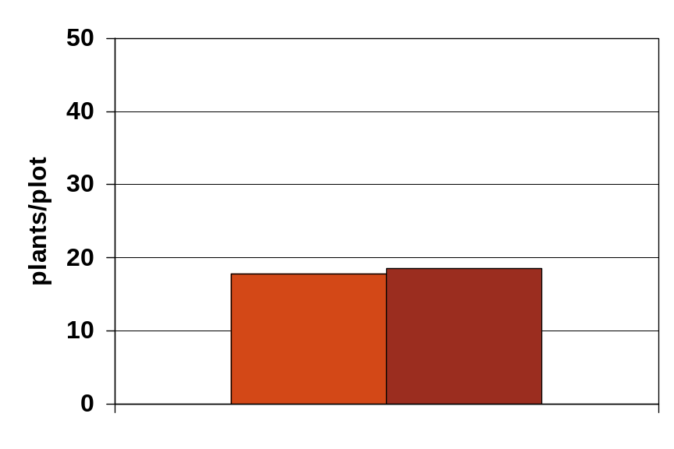


Vegetation Cover Response
Forb Cover
Starthistle Cover
Ungrazed
Grazed
Grazed
Ungrazed
Grass Cover
Grazed
Ungrazed

Slide 26




Jean-Marie Luginbuhl
Jean-Marie Luginbuhl
Before Grazing
After Grazing
Jean-Marie Luginbuhl
Jean-Marie Luginbuhl
Notes:
Right: Area where goats did not browse
Left: Area where goats browsed – one year later

Slide 27

Jean-Marie Luginbuhl
Jean-Marie Luginbuhl
Before Grazing
After Grazing
Happy Goats!
Jean-Marie Luginbuhl
Jean-Marie Luginbuhl
Jean-Marie Luginbuhl
Notes:
Right: Area where goats did not browse
Left: Area where goats browsed – one year later

Slide 28

Leafy Spurge
Widespread
Sheep and goats successfully used for spurge control
Considered a “good forage” for sheep
Some cattle producers contract sheep producers
John Walker

Slide 29

Leafy Spurge
Add Sheep Grazing
Johnston, and Peake (1960). Effect of selective grazing by sheep on the control of leafy spurge (Euphorbia esula L.). Journal of Range Management, 13:192-195.

Slide 30

Leafy Spurge Prior to Sheep Grazing – June 7, 2002
Deer Lodge Valley

Slide 31

Sheep Grazing Leafy Spurge after 1 Year – June 17, 2003
Deer Lodge Valley

Slide 32

Sheep Grazing Leafy Spurge after 2 Years – June 18, 2004
Deer Lodge Valley

Slide 33

Sheep Grazing Leafy Spurge after 3 Years – June 20, 2005
Deer Lodge Valley

Slide 34


After 4 Years of Targeted Sheep Grazing

Slide 35


2003
Weiser River Corridor Project
Idaho
2008
Photos Patrick Kane

Slide 36

Cheatgrass or Downy Brome
Palatable and nutritious in early spring
Grazed by sheep and cattle
Key is to remove livestock before perennial grasses grow significantly

Slide 37
Grazing
Cheatgrass
Early Spring Grazing can Reduce Cheatgrass
No Sheep Grazing After 2002
Davison et al. 2004

Slide 38






Grazing
Cheatgrass
Early Spring Grazing can Reduce Cheatgrass
8-year Grazing Study in Northern Arizona
Moderate grazing had less cheatgrass then no grazing
Moderate grazing also had less cheatgrass than heavy “High Impact” grazing
High Impact grazing caused a great increase in cheatgrass after drought year.
Loeser et al. 2007
Notes:
Loeser, M. R., Sisk, T. D., & Crews, T. E. (2007). Impact of grazing intensity during drought in an Arizona grassland. Conservation Biology, 21(1), 87-97.

Slide 39
High
Grazing during the dormant season does not affect cover of perennial grass but can reduce fuel loads and density of cheatgrass.
Early spring grazing can suppress cheatgrass and promote perennial grasses
Cheatgrass Cover
In the absence of livestock grazing, cheatgrass will likely increase to its ecological potential for the site.
If grazing occurs as perennial grasses begin to flower, cheatgrass will likely increase.
Low
No Grazing Early Spring Peak Season Dormant Season

Slide 40


www.EBIPM.org

Slide 41

Wildland Fuel & Fire
Fires > 300 acres
1970 - 2007

Slide 42

Grazing Affects Wildland Fuel & Fire
  Perimeter or Extent
  Patchiness
  Intensity
  Flame Length
  Rate of Spread

Slide 43

Grazing Affects Wildland Fuel & Fire
M. Pellant

Slide 44



Research on Managing Fuel Loads
Wyoming Big Sagebrush
Targeted grazing by cattle
Two sites in Idaho
Big sagebrush
Mountain Big Sagebrush
Chris Schachtschneider
Chris Schachtschneider

Slide 45

Flame Height

Slide 46
Flame Height
Grazing was influential in areas with less than 20% sagebrush cover.

Slide 47







Targeted Grazing
Depends on Skill & Knowledge!!

Slide 48

Benefits of Targeted Grazing
can be highly effective
improve pasture quality
no pesticide residue… ‘environmentally friendly’
lower effect on non-target species
convert weeds into a
saleable product
more sustainable control
feasible in rough terrain

Slide 49

Costs of Targeted Grazing
Cost of animals & potential losses
Fencing, water, herders, trailers
Reduced animal production
You can’t “hang them up in the barn”

Slide 50







Land Planning With Weeds
Integrated Weed Management
Cultural
Biocontrol
Chemical
Mechanical
Weed Control

Slide 51



www.Targetedgrazing.wordpress.com

