Slide 1

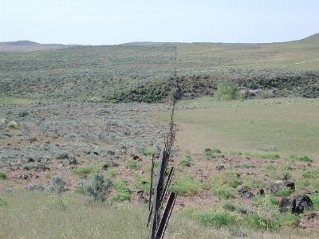
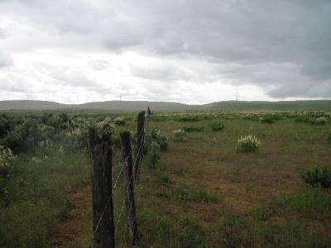
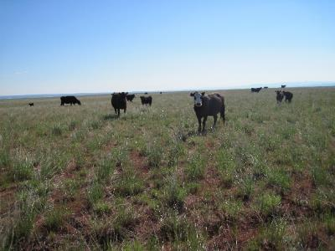

Grazing Methods or Systems
J. Peterson
J. Hinson
K. Launchbaugh
C. White
Rangeland Principles (Rem 151)
Notes:
Grazing methods also call grazing systems

Slide 2
What can grazing methods accomplish?
Maintain or accelerate vegetation improvement.
Improve uniform use of all grazing units.
Stabilize the forage supply throughout the grazing season.
Enhance forage quality for livestock and wildlife.
Improve function of ecological processes.
Protect watersheds.
Enhance wildlife habitat.
J. Hinson
From National Range and Pasture Handbook

Slide 3
Terms of Grazing Methods
Grazing System = a planned effort to leave some areas unused for at least part of the year.
Grazing Period = season and number of days when pasture is grazed.
Deferment = a period of non-grazing until key forage species set seeds.
Rest = a period of non-grazing for a full year.

Slide 4

Deferment vs Rest
Rest
Deferment
Potential Damage
Green-up
Growth Initiation
Flowering/Seed Set
Dormancy
Notes:
To summarize the effect of grazing on perennial grass plants, when grazing occurs above the growing points at the base of the leaf blades, growth continues unimpeded (provided there is
enough moisture, sunlight and sunshine for growth to occur). Growth immediately after grazing allows the plant to continue to produce carbohydrates. Most of these carbohydrates become the
leaves and stems that create forage for livestock. The quicker the regrowth, the more the plant can grow and the more forage that is produced. Some of the carbohydrates produced by the plant are called soluble carbohydrates and they become stored energy reserves that help the plant regrow at the beginning of the next growing season. Energy reserves are stored in the buds at the base of tillers, buds on the root crown and in the roots. Large energy reserves are needed to keep the buds alive when they are dormant during the winter and then to provide enough energy for the first 2 to 3 leaves to emerge the next spring. If the plant does not store enough energy to have large buds, the buds will die or the leaves will not emerge. Eventually the plant will die.

Slide 5
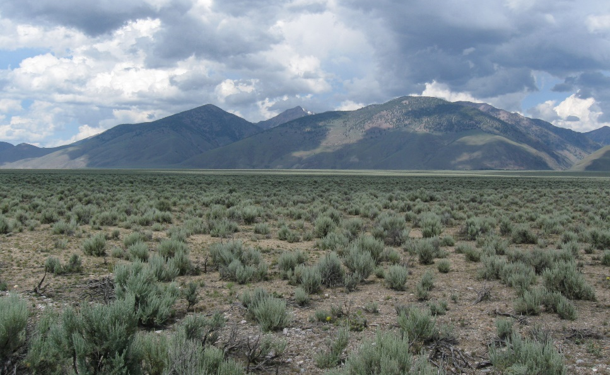
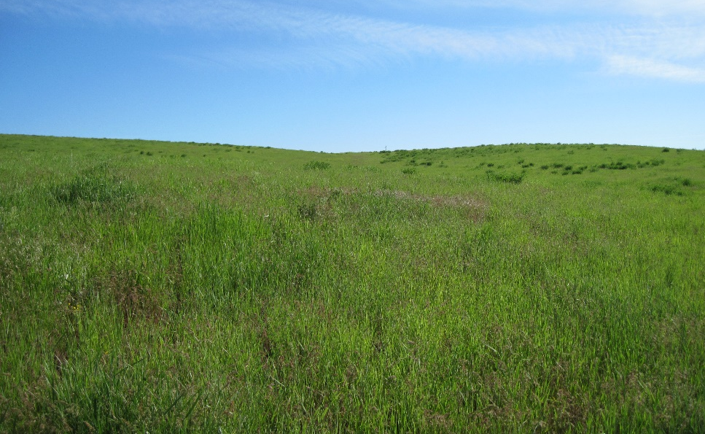
Grazing Season vs Growing Season
Rangelands: Grazing season is generally longer than the growing season.
Introduced (or Tame) Pasture: Grazing season matches the growing season to harvest forage near maximum quality.
Notes:
Rangelands: grazing season is generally longer than the growing season. This requires stockpiling forage for use during the non-growing season. This frequently involves very light use during the peak growing season.
Pastures: grazing season matches the growing season to harvest forage near maximum quality. Stockpiling forage usually involves shortening the grazing period during active growth.

Slide 6
Basic Grazing Systems
Continuous Grazing: Grazing the whole area for the whole grazing season.
Pros/Cons?
Simple/low input
Animals get maximum choice and have high animal performance.
Plants and areas that livestock prefer can be excessively used and become degraded.
Ranch
Headquarters
Map Legend
Water tanks
Salt
Perennial Stream
Steep rocky
range site
Notes:
We will examine 5 basic approaches.
Livestock placed in pasture in spring and removed at end of grazing season, or grazing all year in one pasture.
Plants and areas that livestock prefer (such as riparian areas)…

Slide 7
Basic Grazing Systems
Deferred Rotation: Do not graze at least one pasture until after it has set seed (defer). In subsequent years, change the pasture deferred so the deferment is rotated among all the pastures over years.
 | Deferred Rotation - 1 Herd|3 Pasture
 | Months of the Year
Year 1 | A | M | J | J | A | S | O
North
South
Upland
Year 2 | A | M | J | J | A | S | O
North
South
Upland
Year 3 | A | M | J | J | A | S | O
North
South
Upland
North River Pasture
Upland Pasture
Grazed
Grazed
Deferred
Grazed
Deferred
Grazed
South River Pasture
Grazed
Grazed
Grazed
Deferred
Grazed
Grazed

Slide 8
Basic Grazing Systems
Deferred Rotation: Do not graze at least one pasture until after it has set seed (defer). In subsequent years, change the pasture deferred so the deferment is rotated among all the pastures over years.
Pros/Cons?
Rangeland condition can improve because pastures are occasionally not grazed when they are most sensitive to grazing.
Can reduce animal performance a little because animal opportunity to choose among plants and places is restricted.
Requires more fencing and management.

Slide 9
Basic Grazing Systems
Rest Rotation: Do not graze at least one pasture for a whole year (rest). In subsequent years, change the pasture rested so rest is rotated among all the pastures.
Hill Pasture
Spring Pasture
 | Rest Rotation - 1 Herd|3 Pasture
 | Months of the Year
Year 1 | A | M | J | J | A | S | O | N
Spring
Hill
Creek
Year 2 | A | M | J | J | A | S | O | N
Spring
Hill
Creek
Year 3 | A | M | J | J | A | S | O | N
Spring
Hill
Creek
Grazed
Grazed
No grazing
Grazed
No grazing
Grazed
Creek Pasture
No grazing
Grazed
Grazed
Notes:
Guss Hormay, Forest Service employee that promoted this system.

Slide 10
Basic Grazing Systems
Rest Rotation: Do not graze at least one pasture for a whole year (rest). In subsequent years, change the pasture rested so rest is rotated among all the pastures.
Pros/Cons?
Rangeland condition can improve because pastures are allowed to be rested and set seed every few years.
Can reduce animal performance because stocking rate is increased on grazed pastures (since at least 1 pasture is not grazed) and animals are always moved into pastures that were not recently grazed and have dormant stems mixed with green growth.

Slide 11
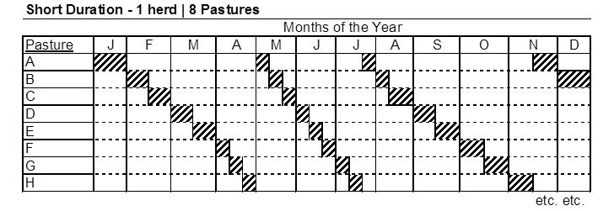
Basic Grazing Systems
Short-Duration: Each pasture in the unit is grazed for a short time and animals are rotated through all available pastures so that each pasture is grazed at least two times per year.
Pasture A
Pasture B
Pasture H
Pasture C
Water tanks
Well with water line
Pasture G
Pasture D
Pasture F
Pasture E
Notes:
Short duration (Intensive Rotation)

Slide 12
Basic Grazing Systems
Short-Duration: Each pasture in the unit is grazed for a short time and animals are rotated through all available pastures so that each pasture is grazed at least two times per year.
Pros/Cons?
Stocking rate often higher because animals eat all plants.
Forage quality can be higher because animals are always eating green fresh regrowth.
Range condition sometimes improves because all plants are grazed…not just the plants that animals favor.
Animal performance is usually low on this system because animals have to eat all plants available…can’t only eat their favorites.
Rangeland condition can be decreased because plants never get a rest or deferment.
Notes:
Short duration (Intensive Rotation)

Slide 13
Basic Grazing Systems
Seasonal-Suitability: Moving livestock to different areas of range depending on growth patterns of different vegetation types (i.e., following the green).
Summer Range
Spring/Fall
Winter Range
 |  |  |  | Seasonal Suitability - 1 Herd|Multiple Pastures/Grazing Areas
 |  |  |  | Months of the Year
Pastures and
Grazing Areas |  | J | F | M | A | M | J | J | A | S | O | N | D
Winter Range
Spring/Fall
Summer (Mtn)
Graze
Graze
Graze
Graze
Graze

Slide 14
Basic Grazing Systems
Seasonal-Suitability: Moving livestock to different areas of range depending on growth patterns of different vegetation types (i.e., following the green).
Pros/Cons?
Animals have green forage most of year = high growth and performance.
Plants mostly grazed early in season before seedset.
High management/herding input.
Summer range many not get deferment.
Summer Range
Spring/Fall
Winter Range

Slide 15
Decisional or Management Intensive
One Herd: Multiple Pastures
Make decisions based on management considerations such as:
These systems are probably the most common in the world and their success…
Available forage
Available water
Cover for calving and lambing
To facilitate other practices such as haying or prescribed fire
depends on the experience and decisions of the manager.
Notes:
These systems are probably the most common in the world and their success depends on the experience and decisions of the manager.

Slide 16
Decisional or Management Intensive
Best-pasture system: Move livestock to pasture that looks the “best” in terms of forage availability.
Complementary system: Designed in the central plains where animals rely on:
Seasonal-suitability: Movement of livestock to different areas of range depending on:
Designed for arid areas where rain may improve forage on one part of a ranch but not affect another part.
Cultivated or improved pastures for part of the year and then are moved to native range.
…the growth patterns of different vegetation types.

Slide 17
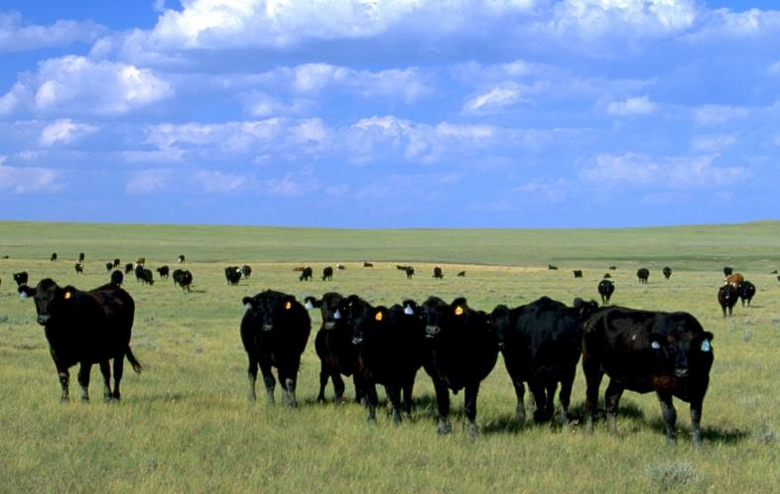
Which grazing system is best?
There is no “silver bullet” system that will work everywhere.
There are thousands of variations on a theme…
All systems need to be flexible to manage unexpected disturbance such as fire or weed invasions.
Blm.gov
Notes:
There are thousands of variations on a theme. The exact ways that rest, deferment grazing, and rotation are combined can create new and appropriate systems.
Livestock animal performance…Riparian areas…wildlife populations…wildfire

Slide 18
Which grazing system is best?
There is no “silver bullet” system that will work everywhere.
Success of grazing systems depends on:
Type of forage
Terrain
Weather patterns
Skill of manager
Blm.gov
No matter the system—stocking rate, species of grazing animal, and distribution patterns—are important in determining how the systems affect vegetation communities.
Notes:
Depends on the skill of the manager. Nearly all of these systems will work with a well skill manager.

Slide 19
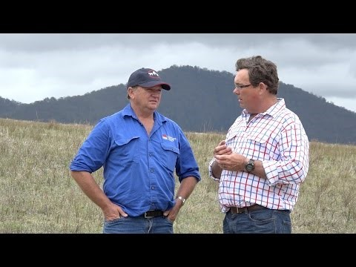
What can grazing systems accomplish?
A view from Australia
https://www.youtube.com/watch?v=Jygi7ftAe8Q

Slide 20
Quiz/Exam Review
Define grazing system, grazing period, deferment, rest, and stock density.
Describe the 5 basic grazing systems (continuous, deferred rotation, rest rotation, short duration, seasonal-suitability) and the pros/cons for each.
Describe best-pasture system and complementary system.
Which grazing system is best?
What can grazing systems accomplish?
What can grazing systems not accomplish?

Slide 21
Grazing Methods or Systems
J. Peterson
J. Hinson
K. Launchbaugh
C. White
Rangeland Principles (Rem 151)
Notes:
Grazing methods also call grazing systems

