Slide 1
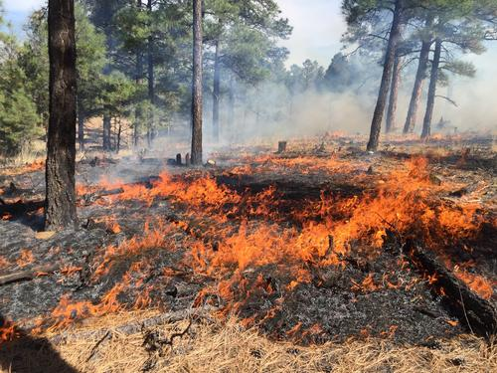
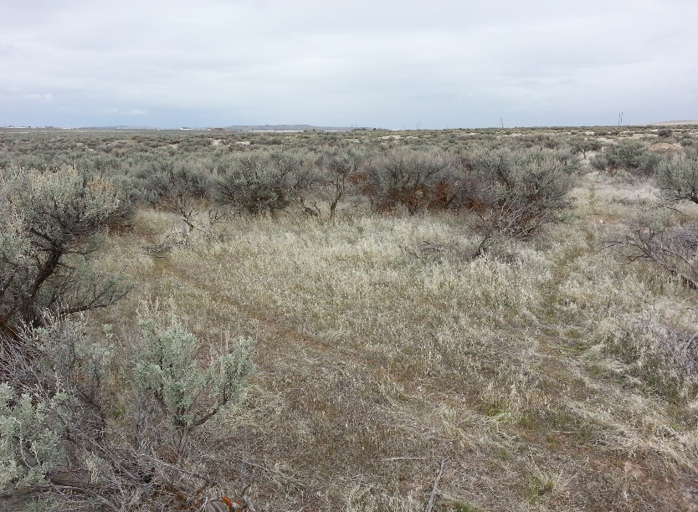
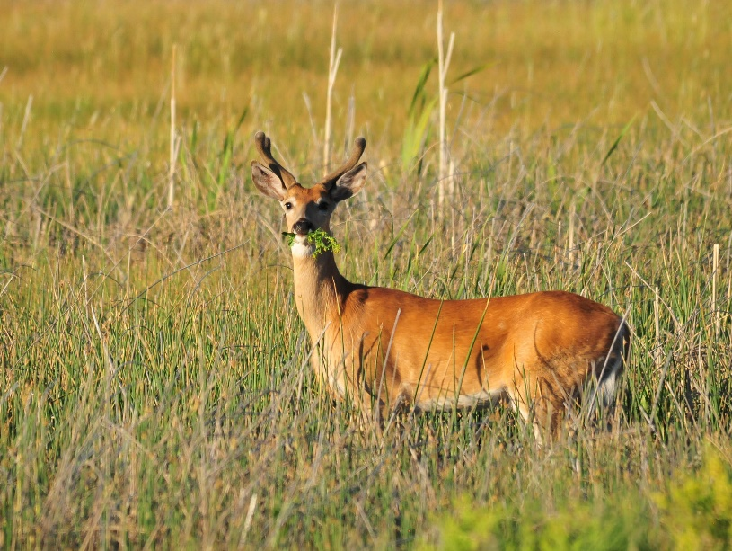

Adaptive Management
USGS
K. Launchbaugh
Tom Koerner (USFWS)
Rangeland Principles (REM 151)

Slide 2
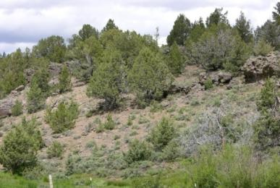
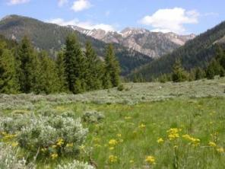
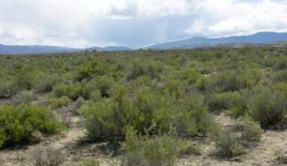
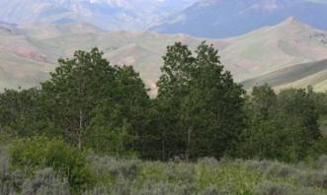
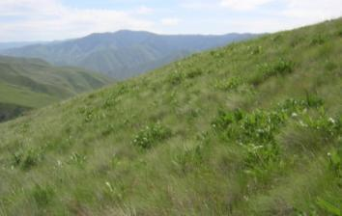
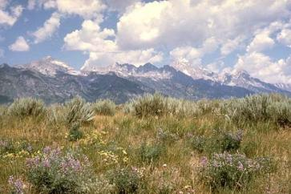
Rangelands are Dynamic!
Dynamic patterns can be describe in state and transition models.
How do we manage for transition?
Adaptive Management!

Slide 3
MANAGING COMPLEX PROBLEMS
IN RANGELAND ECOSYSTEMS
Chad Boyd and Tony Svejcar
…We argue instead for a management approach that embraces the complexities of important rangeland issues and a science-oriented framework that unites an understanding of process-based ecology with management opportunities in space and time…
Objectives:
Differentiate simple & complex problems
Examine importance of continual knowledge acquisition to addressing complex problems
Discuss barriers to adaptive management of complex problems
Propose alternative to traditional adaptive management involving stronger relationship between science and management across years and sites
Chad S. Boyd, Tony J. Svejcar. 2009. Managing Complex Problems in Rangeland Ecosystems. Rangeland Ecol Manage 62:491–499
Notes:
The bulk of the information presented in this lecture was taken from Chad S. Boyd and Tony J Svejcar’s paper “managing Complex Problems in Rangeland Ecosystems.”
In their paper, Chad and tony identify 4 areas of interest regarding adaptive management.
Differentiate simple and complex problems.
Examine the importance of evolutionary (i.e. continual) knowledge acquisition in addressing complex problems.
Discuss barriers to adaptive management of complex problems
Propose an alternative to traditional adaptive management that involves strengthening the relationship between science and management across years and sites.

Slide 4
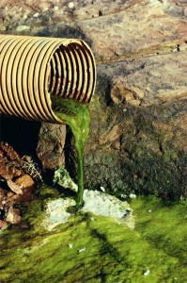
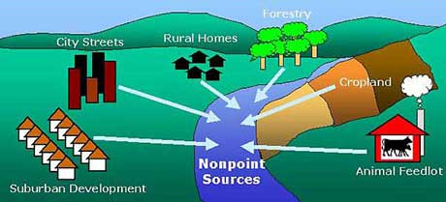
Objective 1: Differentiate simple and complex problems
Simple
Complex
Point Source
http://oceanservice.noaa.gov/education/tutorial_pollution/04nonpointsource.html
Notes:
Differentiating simple and complex problems may seem…simple to us. However, complex problems can often appear simple at first. Over time, what appears to have been a simple problem, begins to reveal it’s complex nature.

Slide 5
Objective 1: Differentiate simple and complex problems
Simple:
‘‘Simple’’ problems are those in which the input variables and relationships between those variables are basically constant.
Management actions usually have predictable outcomes for simple problems.
Simple solution -
Just take half, leave half…easy!
Complex:
Problems become “complex” when input variables are not constant and/or when the relationships between those variables are dynamic over space and time
Solutions to a complex problem vary over both time and space time.
Complex solution -
Process-based understanding of the biology of the underlying problem…wait what?
Simple problems can transform into complex problems as the scale of the problem increases
Notes:
Focus is again on differentiating simple and complex problems. Having students shout out what they believe are examples of simple and complex problems may be a good idea here. As a class, you can talk over why a problem is either simple or complex. It is harder to differentiate simple problems from complex problems than we may want to admit.

Slide 6
The Brutal Facts!
1. No single conservation entity can handle all aspects of the task
2. Significant knowledge gaps exist, and will continue to exist, because of the complex nature of the problems
How could we ever possibly minimize the effects of such brutality?
Adaptive Management!
Notes:
Now that we have differentiated simple and complex issues we can move on to why adaptive management is so necessary for improving rangelands. Chad and Tony list two “brutal facts” which emphasize why adaptive management is essential to success.

Slide 7
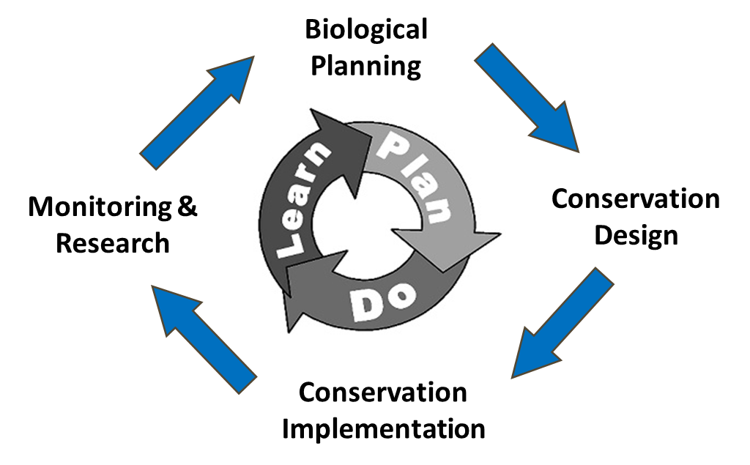
Objective 2: Examine the importance of evolutionary (i.e. continual) knowledge acquisition in addressing complex problems.
We have a problem!
Assess the problem, and develop management actions
Design management actions. How are we going to create change? How to monitor change? What will indicate success or failure?
Implement management actions.
Monitor, evaluate monitoring, learn, incorporate
Develop management actions…
Notes:
There are many forms of this adaptive management loop. The one used here is the one used in Chad and Tony’s paper. It emphasizes learning, planning, implementing and learning again. The primary concept driving adaptive management is that it is cyclic. What was learned is incorporated into our management planning phase. We then implement and monitor what was planned. Our monitoring is then evaluated, learned from, and incorporated back into our planning.
The idea here is that because our rangelands are constantly changing both spatially and temporally, our solutions also need to change spatially and temporally. Without adaptive management our solutions stay constant while our problems evolve and increase in complexity.

Slide 8
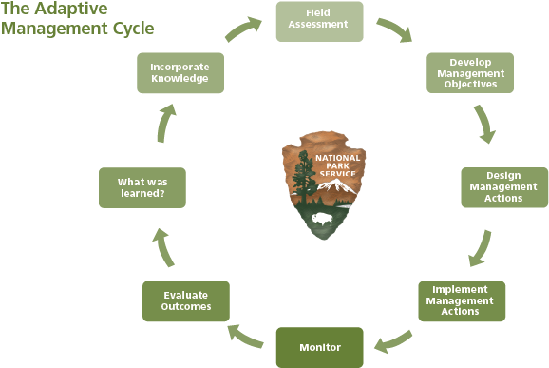
Objective 2: Examine the importance of evolutionary (i.e. continual) knowledge acquisition in addressing complex problems.
Adaptive management is essentially a feedback loop which supplies us with either positive or negative feedback in which to alter our management objectives with
www.nps.gov
Notes:
This is another example of an adaptive management loop used by the U.S. Parks Service.

Slide 9
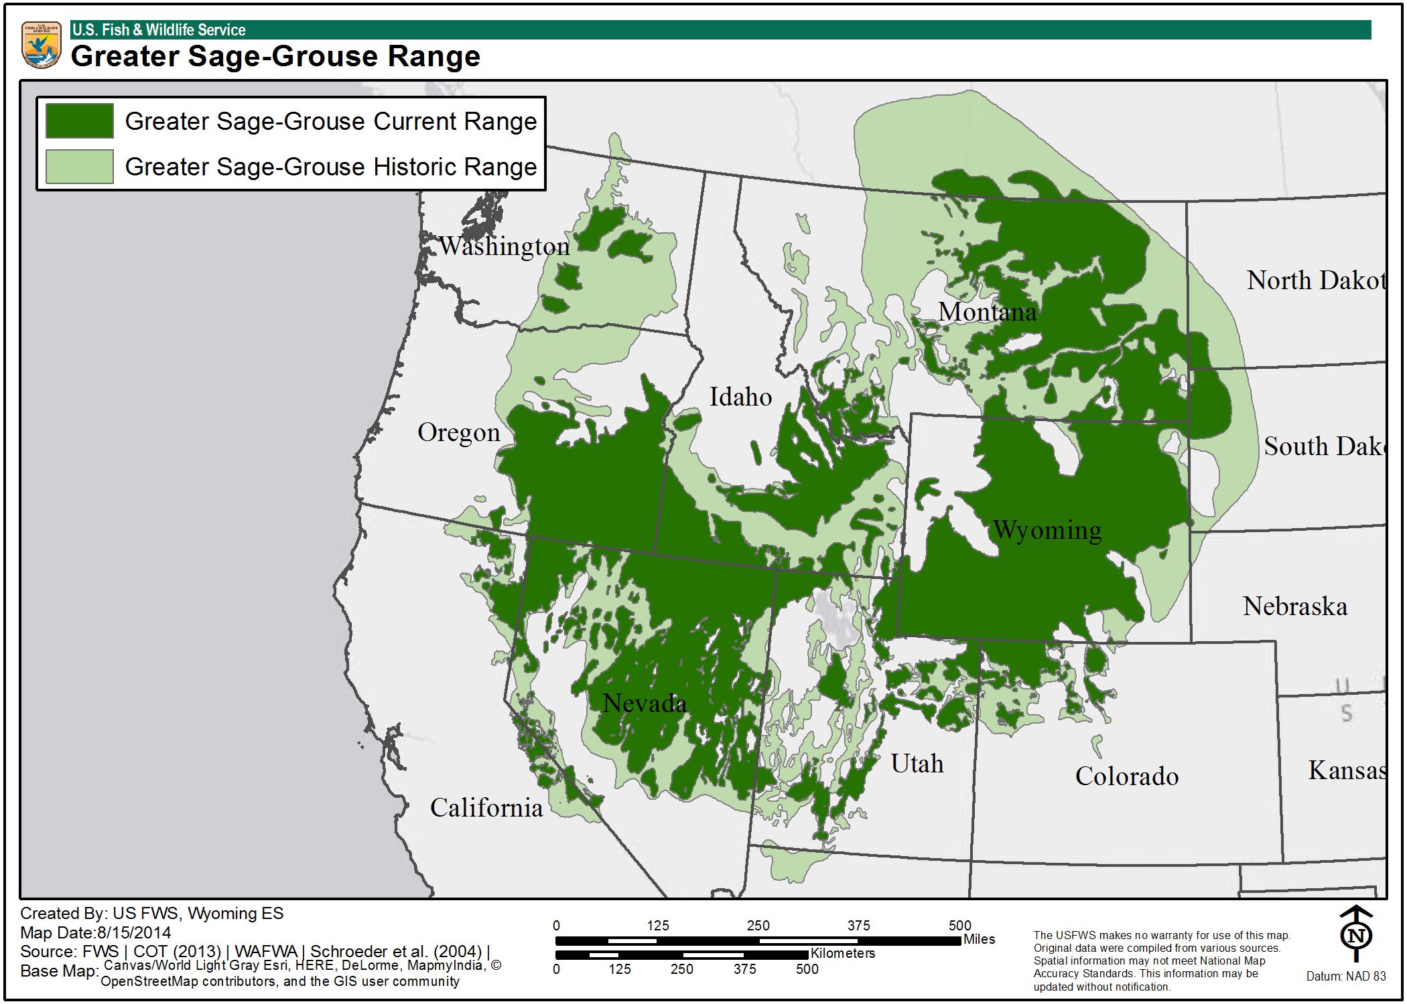
Objective 3: Barriers to adaptive management of complex problems
What are some barriers to management we might imagine when managing for something like greater sage-grouse habitat?
What about re-vegging large-scale wild fires like the Soda Fire?
Selkirk Caribou? Buffalo? Grizzly bears?
Notes:
This a map of historic vs. current range for the greater sage-grouse. Just focus on the current range. What are some obvious barriers to management?
State lines…
County lines…
Agency lines…
Ownership lines…basically, every line that a problem crosses increases it’s complexity.
Fire, weeds and animals pay no attention to these lines, which, again, increases complexity.

Slide 10
Objective 3: Barriers to adaptive management of complex problems
Programmatic success vs. biological success
  Compartmentalization of various agency functions into discrete programs
  Reliance on point-in-time knowledge, which in turn, leads to dangerous overgeneralizations and continuance of marginally effective management practices.
  Conservation Partner Ecosystems
  Complex problems require cooperation among a diverse set of stakeholders
Ecological Frameworks
  Theory/practice gap
  The problem-solving focus of applied research has led to a plethora of published papers along the lines of treatment ‘‘x’’ effects on ecological property ‘‘y’’ within ecosystem system ‘‘z’’
  Rangeland Management in Space and Time
  These rangeland systems are so dynamic. Even with a thorough understanding of the ecological processes at work some years will still be harder than others
Notes:
Chad and Tony list 4 barriers to adaptive management.
Programmatic success vs. biological success
The nature of many federal agencies when confronted by a problem is to create a “program.” These programs are then charged with “solving” the problem. The example used in Chad and Tony’s paper is post-fire re-seeding. Instead of a post-fire re-seeding efforts success being measured in biological success, which would be % of seeds planted which germinated and established, they are measured in programmatic success, which is so X# of seeds planted over X# of acres in X amount of time successfully…We can maybe begin to sense the issue at hand here. Granted, this paper was written in 2009 and much has changed with the way our agencies measure success today. However, we must keep this idea in the back of our minds when making any management decision, “am I planning for programmatic success or biological success?”
Conservation partner ecosystems
Complex problems require cooperation. In slide 9 we went looked at barriers to adaptive management in regards to sage-grouse habitat. In slide 9 one of the primary barriers that should have been identified was the long list of interstate, intercounty, interagency and private stakeholders that every complex problem includes. Though these many stakeholders increase the complexity of an issue, without their inclusion proper management would be impossible. In most any case these stakeholders will be the people implementing and monitoring any management plan. Without stakeholder approval any management plan is doomed to fail. I’ve worked with too many people who didn’t agree with the way a management plan was implemented, and, to be completely honest, the amount of interest they had in the plans success was at most zero and in many cases detrimental to the plans success. It’s just a sad reality of natural resource management.
Another component to this barrier would also be the specialized nature of our educations now a days. No single land manager has all the answers. Together, however, with a group of well informed specialist a land manager is equipped with the knowledge to face any problem no matter how simple or complex it may be. Communication is key in any facet of life. Great ideas are not created in a vacuum.
Ecological frameworks
This looks at the theory/practice gap. The theory/practice gap basically states that there is a considerable difference between what is learned in school and what actually goes on in the real-world. The real-world requires solutions that are cheap, fast, and simple. The key here is, in my opinion, to take those expensive and complicated methods we were taught in school and adapt them to real-word applications. A growth chamber for growing seedlings can easily cost $10,000…I once saw a guy make one out of an old table, duct tape and Styrofoam though and it worked great. The duct tape growth chamber is definitely not precise enough for research, but it certainly is in the real-world. the key is, again, take what you learned in school, and adapt it to the real-world.
Range mgmt. in space and time
This is a relatively simple barrier to understand. It is just plain hard to manage in space and time. The amount of effort and time that go into managing rangelands are already exhausting on what appear to be ever-dwindling budgets. Though adaptive management is essential to the effective management of rangelands, adaptive management is, in itself, a barrier to itself. The extra time and effort included in planning and monitoring involved with adaptive management is just too difficult to accomplish without the necessary time and money.

Slide 11
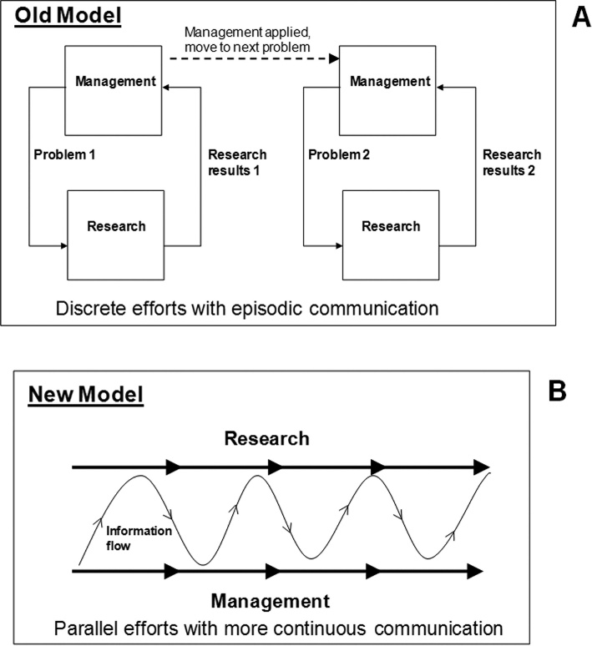
Objectives 4: Propose an alternative to traditional adaptive management that involves strengthening the relationship between science and management across years and sites.
Conservation Partner Ecosystems
Problem-by-problem basis
Continuous basis
Notes:
This last objective concerns the lack of trust/communication between land managers and scientists. With increased communication comes increased trust. Management requires research in order to make informed decisions. Research requires management to put their work into action. Without the other, both fail. A strong relationship between science and management means that both management and research can gear their objectives toward one another. This simplifies a seemingly complex method for management. As stated in slide 10, adaptive management is, in itself, a barrier to itself due to its complexity. Any chance to simply this process must be explored.

Slide 12

Recap
Differentiate simple and complex problems.
The importance of continual knowledge acquisition in addressing complex problems.
Barriers to adaptive management of complex problems
Alternatives to traditional adaptive management which involves strengthening the relationship between science and management across years and sites.

