Slide 1
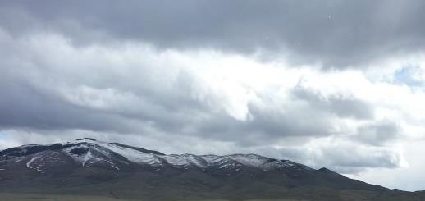
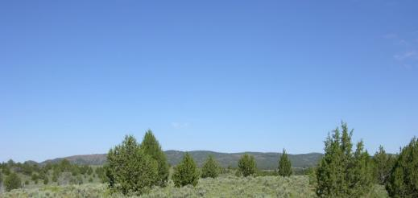

Changing Climate on Range
K. Launchbaugh
K. Launchbaugh
S. Bunting
Rangeland Principles (Rem 151)

Slide 2
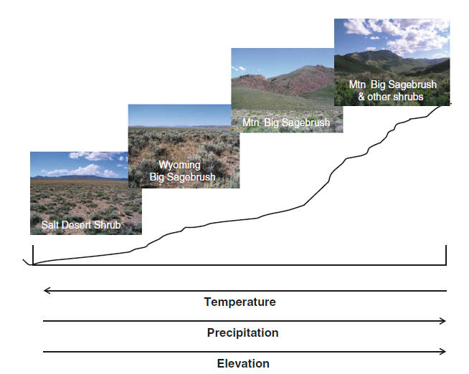
Focus on Sagebrush -Steppe
Mesic Frigid Cryic
Aridic < 12” Mesic > 12”
Also basin big sagebrush, mostly lost to agriculture
Chambers et al. 2013
Notes:
Temperature regimes Mesic (Wyoming sage) Frigid (Mtn big sage) Cryic (Mtn big sage with woodland expansion)
Soil moisture regimes aridic < 12” and mesic (xeric??) > 12”

Slide 3
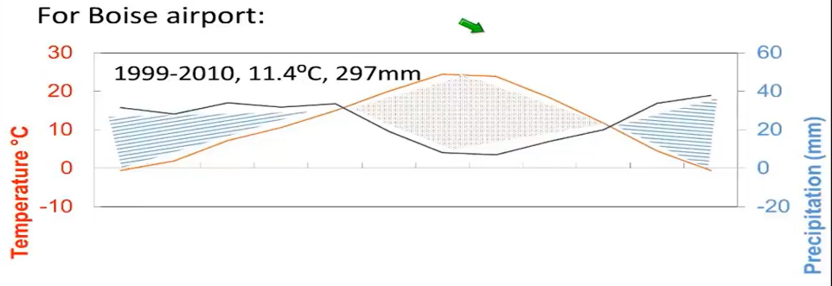
Current Climate
More summer rains in eastern and southeastern portion of sagebrush range
Germino 2017

Slide 4
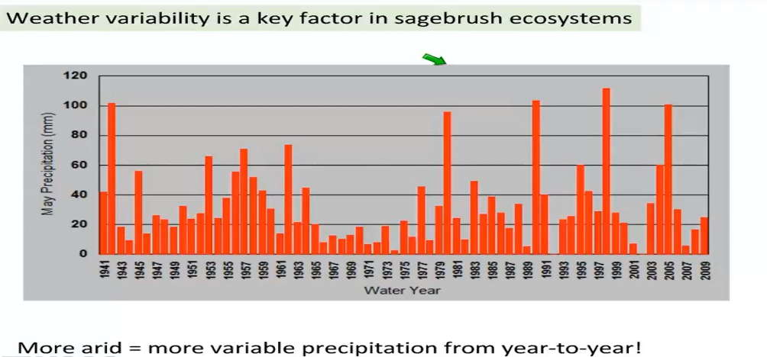
Climate Viability
Germino 2017

Slide 5
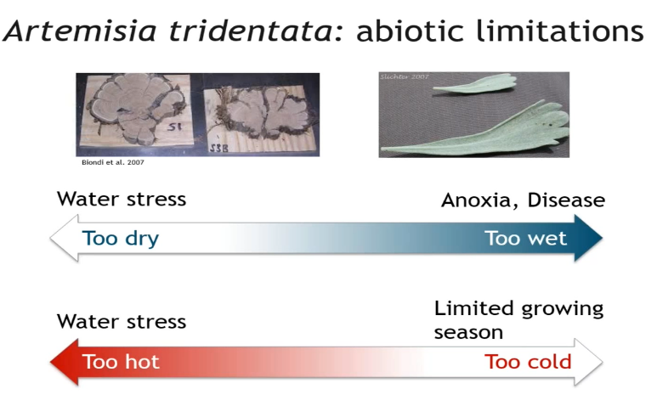
Big sagebrush limitations

Slide 6
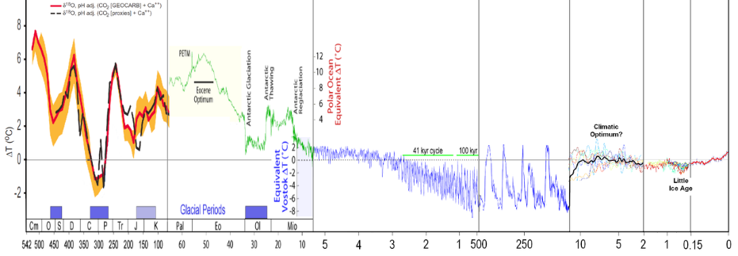
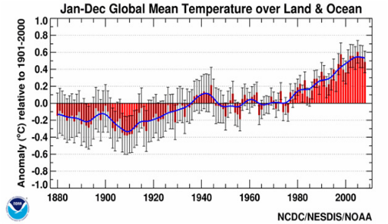
Global Climate Considerations
CLIMATE CHANGE
NOT NEW TO EARTH, BUT NEW TO US…
-------------------------Millions of years ago---------------------------
----Thousands of years ago------

Slide 7
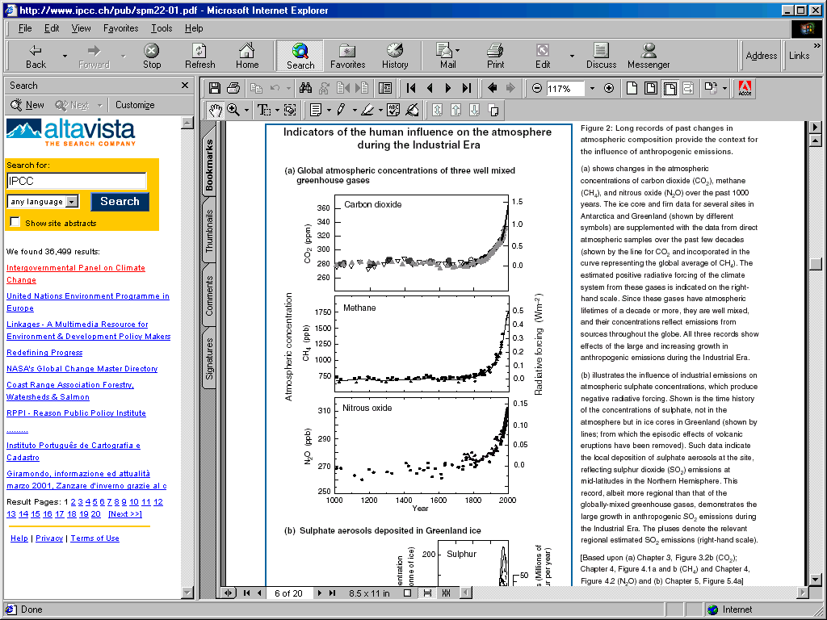
Greenhouse Gasses
CO₂ content has increased by 31% since 1750
Higher concentration now than at any time in last 650,000 yr, and probably more than at any time in last 20 million yr
Rate of increase in concentration is unprecedented in the last 20,000 yr
UN Intergovernmental Panel on Climate Change 2000
Notes:
Many have attributed this temperature increase to increased concentrations of atmospheric carbon dioxide since the industrial revolution.

Slide 8
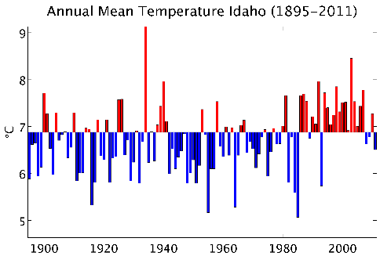
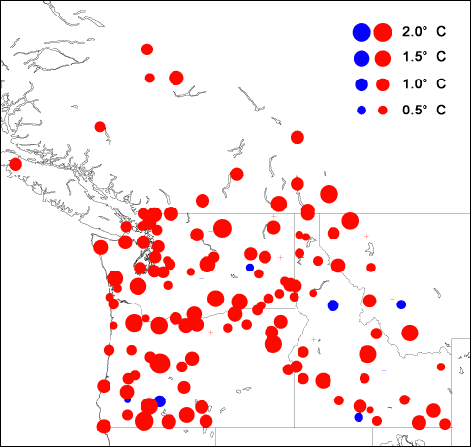
Warmer/Hotter
This increase in temperature is observed for most locations in the region
Change in Mean Annual Temperature
(1920 – 2000)
Temperatures are getting hotter across the region, particularly over the past 30 years

Slide 9
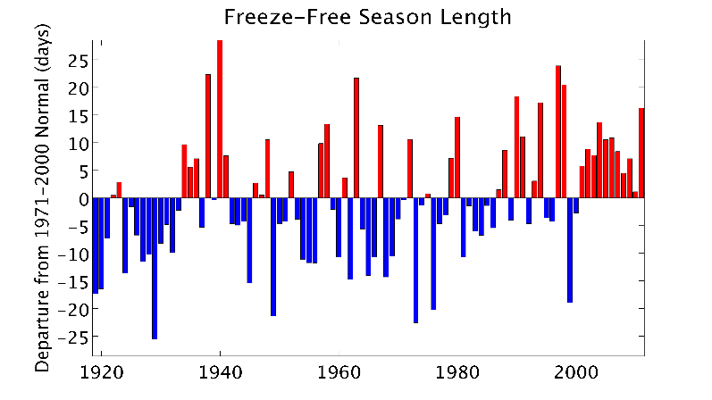
Frost-Free Growing Season
The frost-free growing season is lengthening

Slide 10
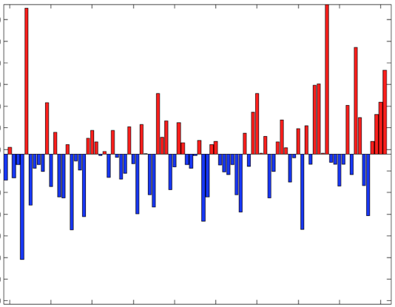
Intensified Spring Precipitation.
The intensity of spring rainfall events is increasing

Slide 11
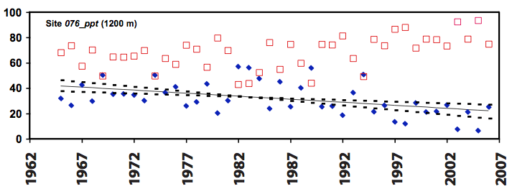
Winter Shifts from Snow to Rain
Rain
% of annual precipitation
Snow
Reynolds Creek, Idaho
Nayak et al. 2010

Slide 12
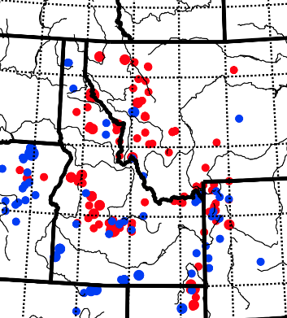
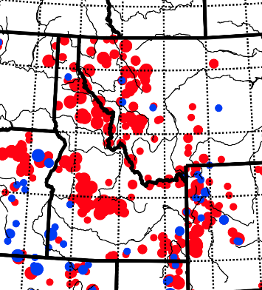
Decreasing Snowpack
There is a large decrease in snowpack present on April 1st. This doesn't mean that the rate of snowfall is decreasing for all of winter, just that the snow is melting sooner, and some of the early spring snows are changing to rains.
January Measurements
April Measurements
Observed change
over 20th Century
Increase
Decrease
Niemeyer et al., in prep. Changing snowpack and melt with a changing climate in the western U.S. (Data: NRCS)

Slide 13
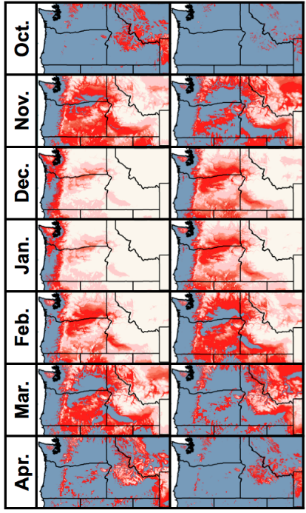
Hotter Temperatures = More Rain & Less Snow
The length of the cold-season is shrinking, and by the mid-century, much of the region will transition from a winter that is snow-dominated, to a winter dominated by more of a rain-snow mix.

Slide 14
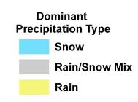
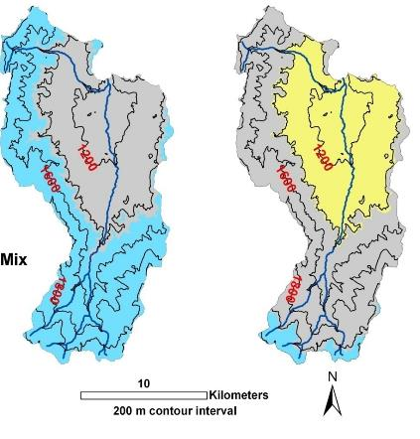
Elevational Change in Precipitation Regime, 1984 to 2010
Reynolds Creek
Experimental Watershed
Proportion of snow to rain has decreased across all elevations.
Annual precipitation and total streamflow is unchanged, but seasonal water availability has been greatly altered.
Streamflow is greater in winter/early spring, and reduced in late spring/summer.
Low
Elev.
54%
Snow
4%
Snow
High
Elev.
Images and data courtesy of Fred Pierson and Jason Williams, NW Watershed Research Center

Slide 15
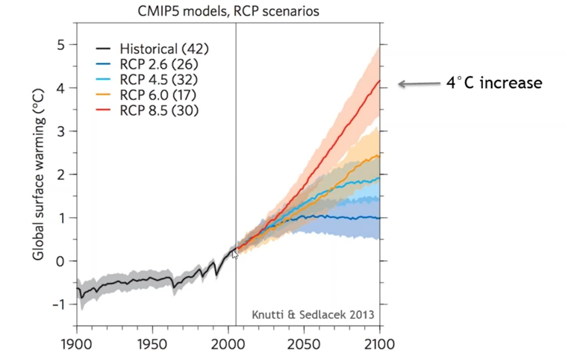
What about the future?

Slide 16
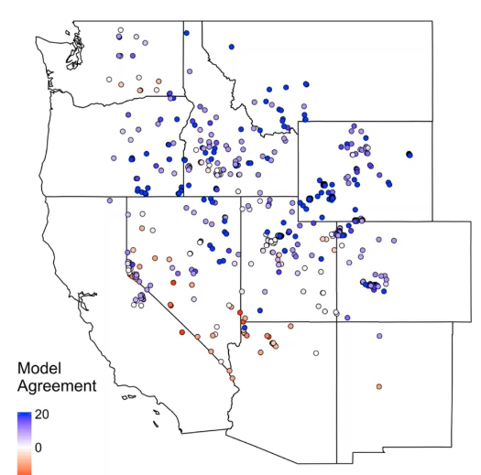
How will Sagebrush Change?
Blue – increased performance for sagebrush
Red – decreased performance for sagebrush

Slide 17
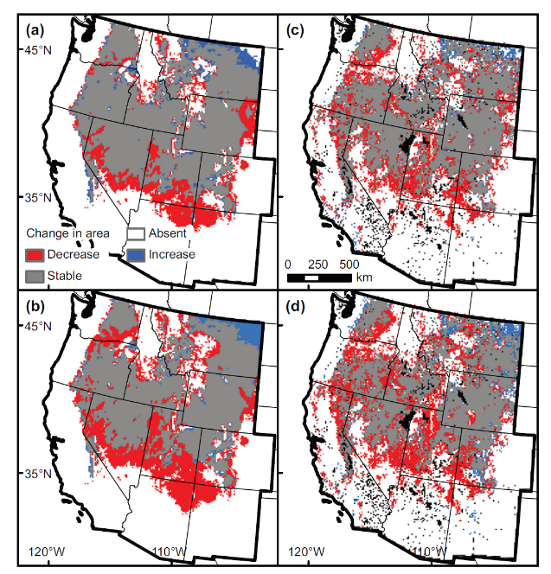
How will species change?
Current (a) vs 2070-2099 (c) (B1 climate scenario)
Current (b) vs 2070-2099 (d) (A2 climate scenario)
Schlaepfer et al. 2012

Slide 18
What about indirect effects?

Slide 19
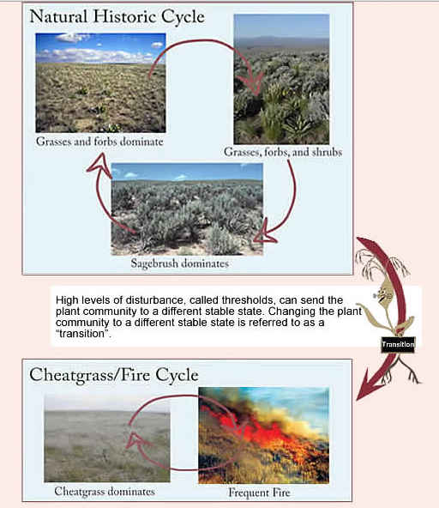
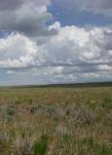
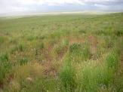
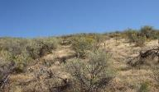
Cheatgrass?
Cheatgrass may increase, further impacting fire regimes (coupling of fire and climate)
Increase of disease and insect outbreaks
  Cheatgrass leads to desertification, lower plant and animal diversity, lower nutrient cycling, less biomass,
  Lower winter precipitation would decrease cheatgrass
  Germino 2017
Grasses and forbs dominate
Grasses, forbs, shrubs
Shrubs dominate
Cheatgrass dominate
Frequent fires

Slide 20
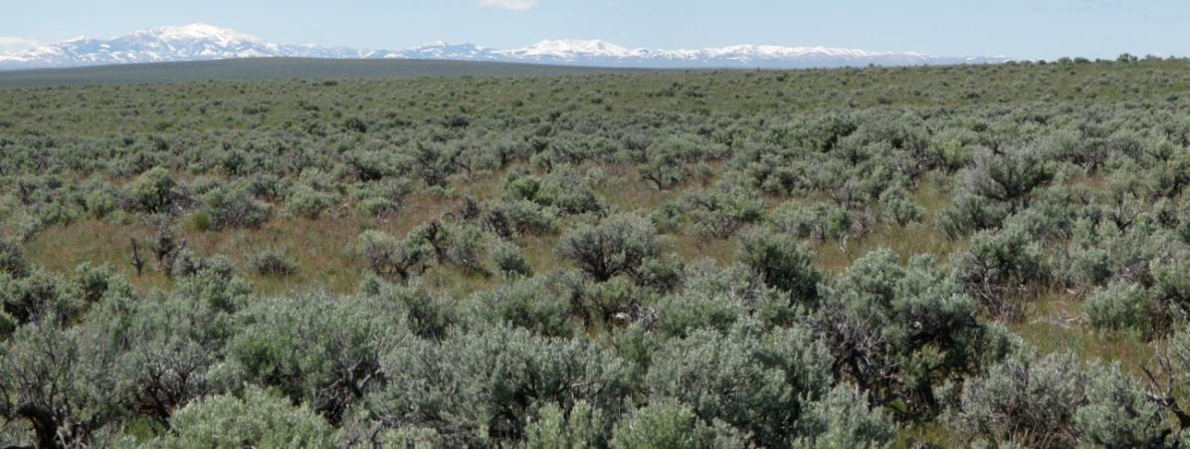
Wyoming Big Sagebrush/Bluebunch Wheatgrass
Photo by S. Bunting

Slide 21
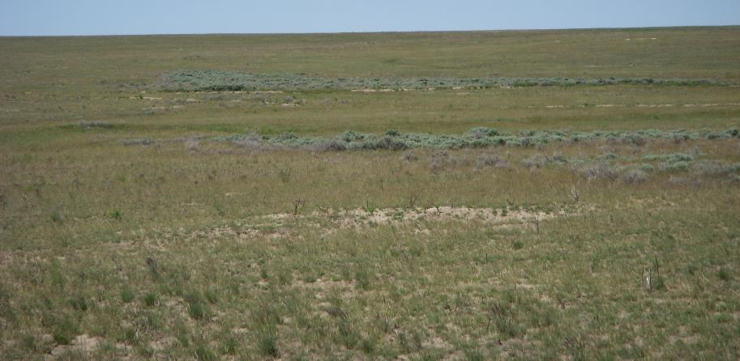
Patches of Sagebrush
Photo by S. Bunting

Slide 22
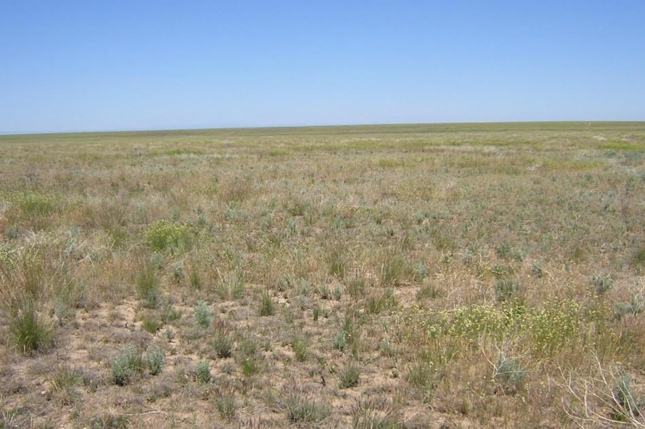
Photo by S. Bunting
Wyoming big sagebrush/bluebunch wheatgrass southern Idaho- 2 years post-burn

Slide 23
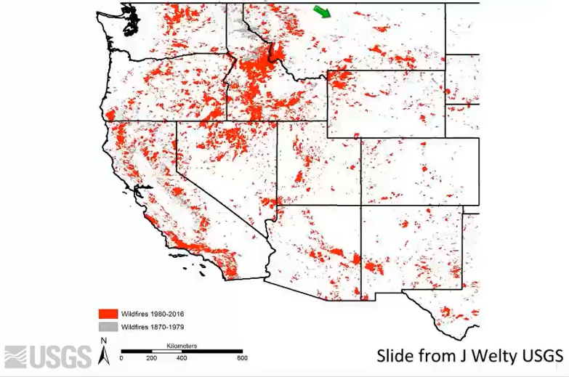
Fire will be a key factor in sagebrush ecosystems
Barren landscape after fire, wind erosion removing nutrients and seedbank
Precipitation in the year after fire is very important
Perennial grasses (higher precip) or annual (lower precip)
Germino 2017

Slide 24
Implication and Adaptation
High elevation sites
Productivity may increase because of higher temperatures and increased CO₂
Perennial grasses can respond quicker after fire
Low elevation sites
Resistance and resilience map may help prioritize after management.
Low investment in low elevation sagebrush
Negative impacts in warmest part of the range with low R&R
Mid elevation sites
Mid elevations will need input from management
Post-fire precipitation will be important for recovery
Following big fires big sagebrush is in big trouble because it cannot re-sprout. Fires used to be smaller and patchy.

Slide 25
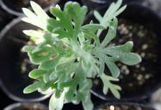
Seeding and planting sagebrush
Seeding sagebrush generally unsuccessful
Seed sources often do not contain information about source or climate of where the seed was obtained.
Match the climate of origin of the seed source to the place where it is planted (more important than subspecies, especially if seeds come from far away)
Germino 2017

Slide 26
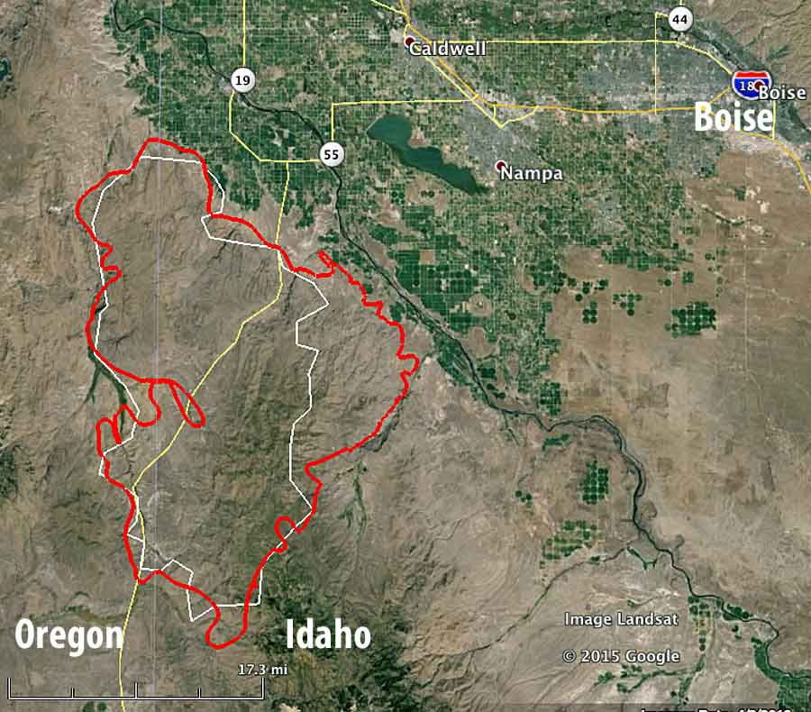
Lessons from the 2015 Soda Fire
Seed from warmer sites had higher success.
Weather after seeding is important, more success if cooler wetter year after seeding.
Better records of the source of seeds and where they are planted is needed.
Germino 2017

Slide 27
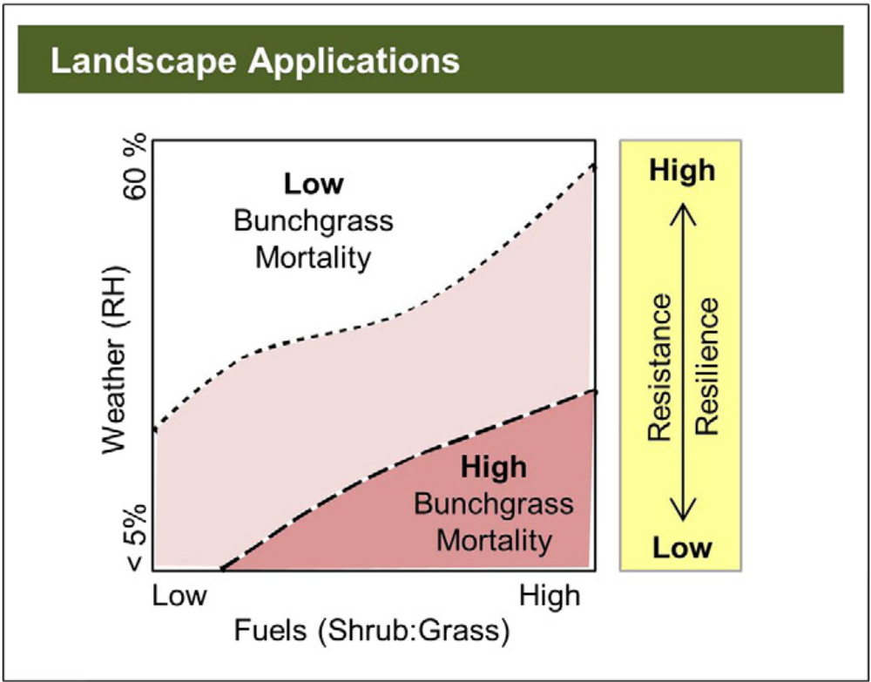
Perennial grass mortality model
Pre-fire preemptive restoration
Hulet et al. 2015

Slide 28
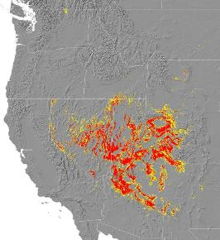
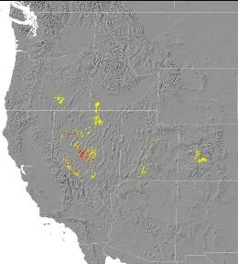
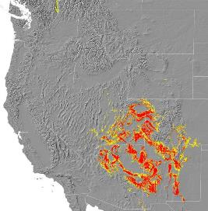
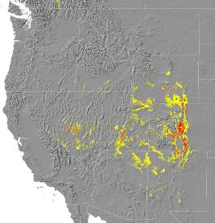
Species will respond individually to climate change
2000
2090
Utah
juniper
2000
2090
Pinyon
pine
Courtesy of G. Rehfeldt, US Forest Service
Notes:
Currently the ranges of Utah juniper and pinyon pine coincide to a large degree resulting today in the Utah juniper/pinyon pine woodland of the Great Basin and Colorado Plateau. Rehfeldt et al. (2006) predict that the habitat suitable for supporting these species will correspond less in the future. Areas in red signify very high probability, yellow signifies high to moderate probability of occurrence.

Slide 29
Changing Climate on Range
K. Launchbaugh
K. Launchbaugh
S. Bunting
Rangeland Principles (Rem 151)

