Slide 1

Flower and Inflorescence Types
What you need to know to identify plants
Wildland Plant Identification
REM 252

Slide 2
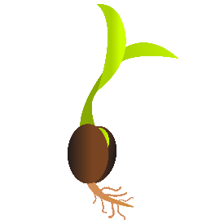
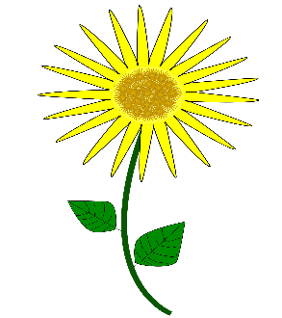

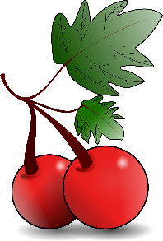
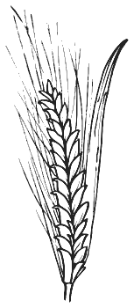

Flowers and Reproduction
Flower
Pollination
Fruit/Seed
New Plant

Slide 3
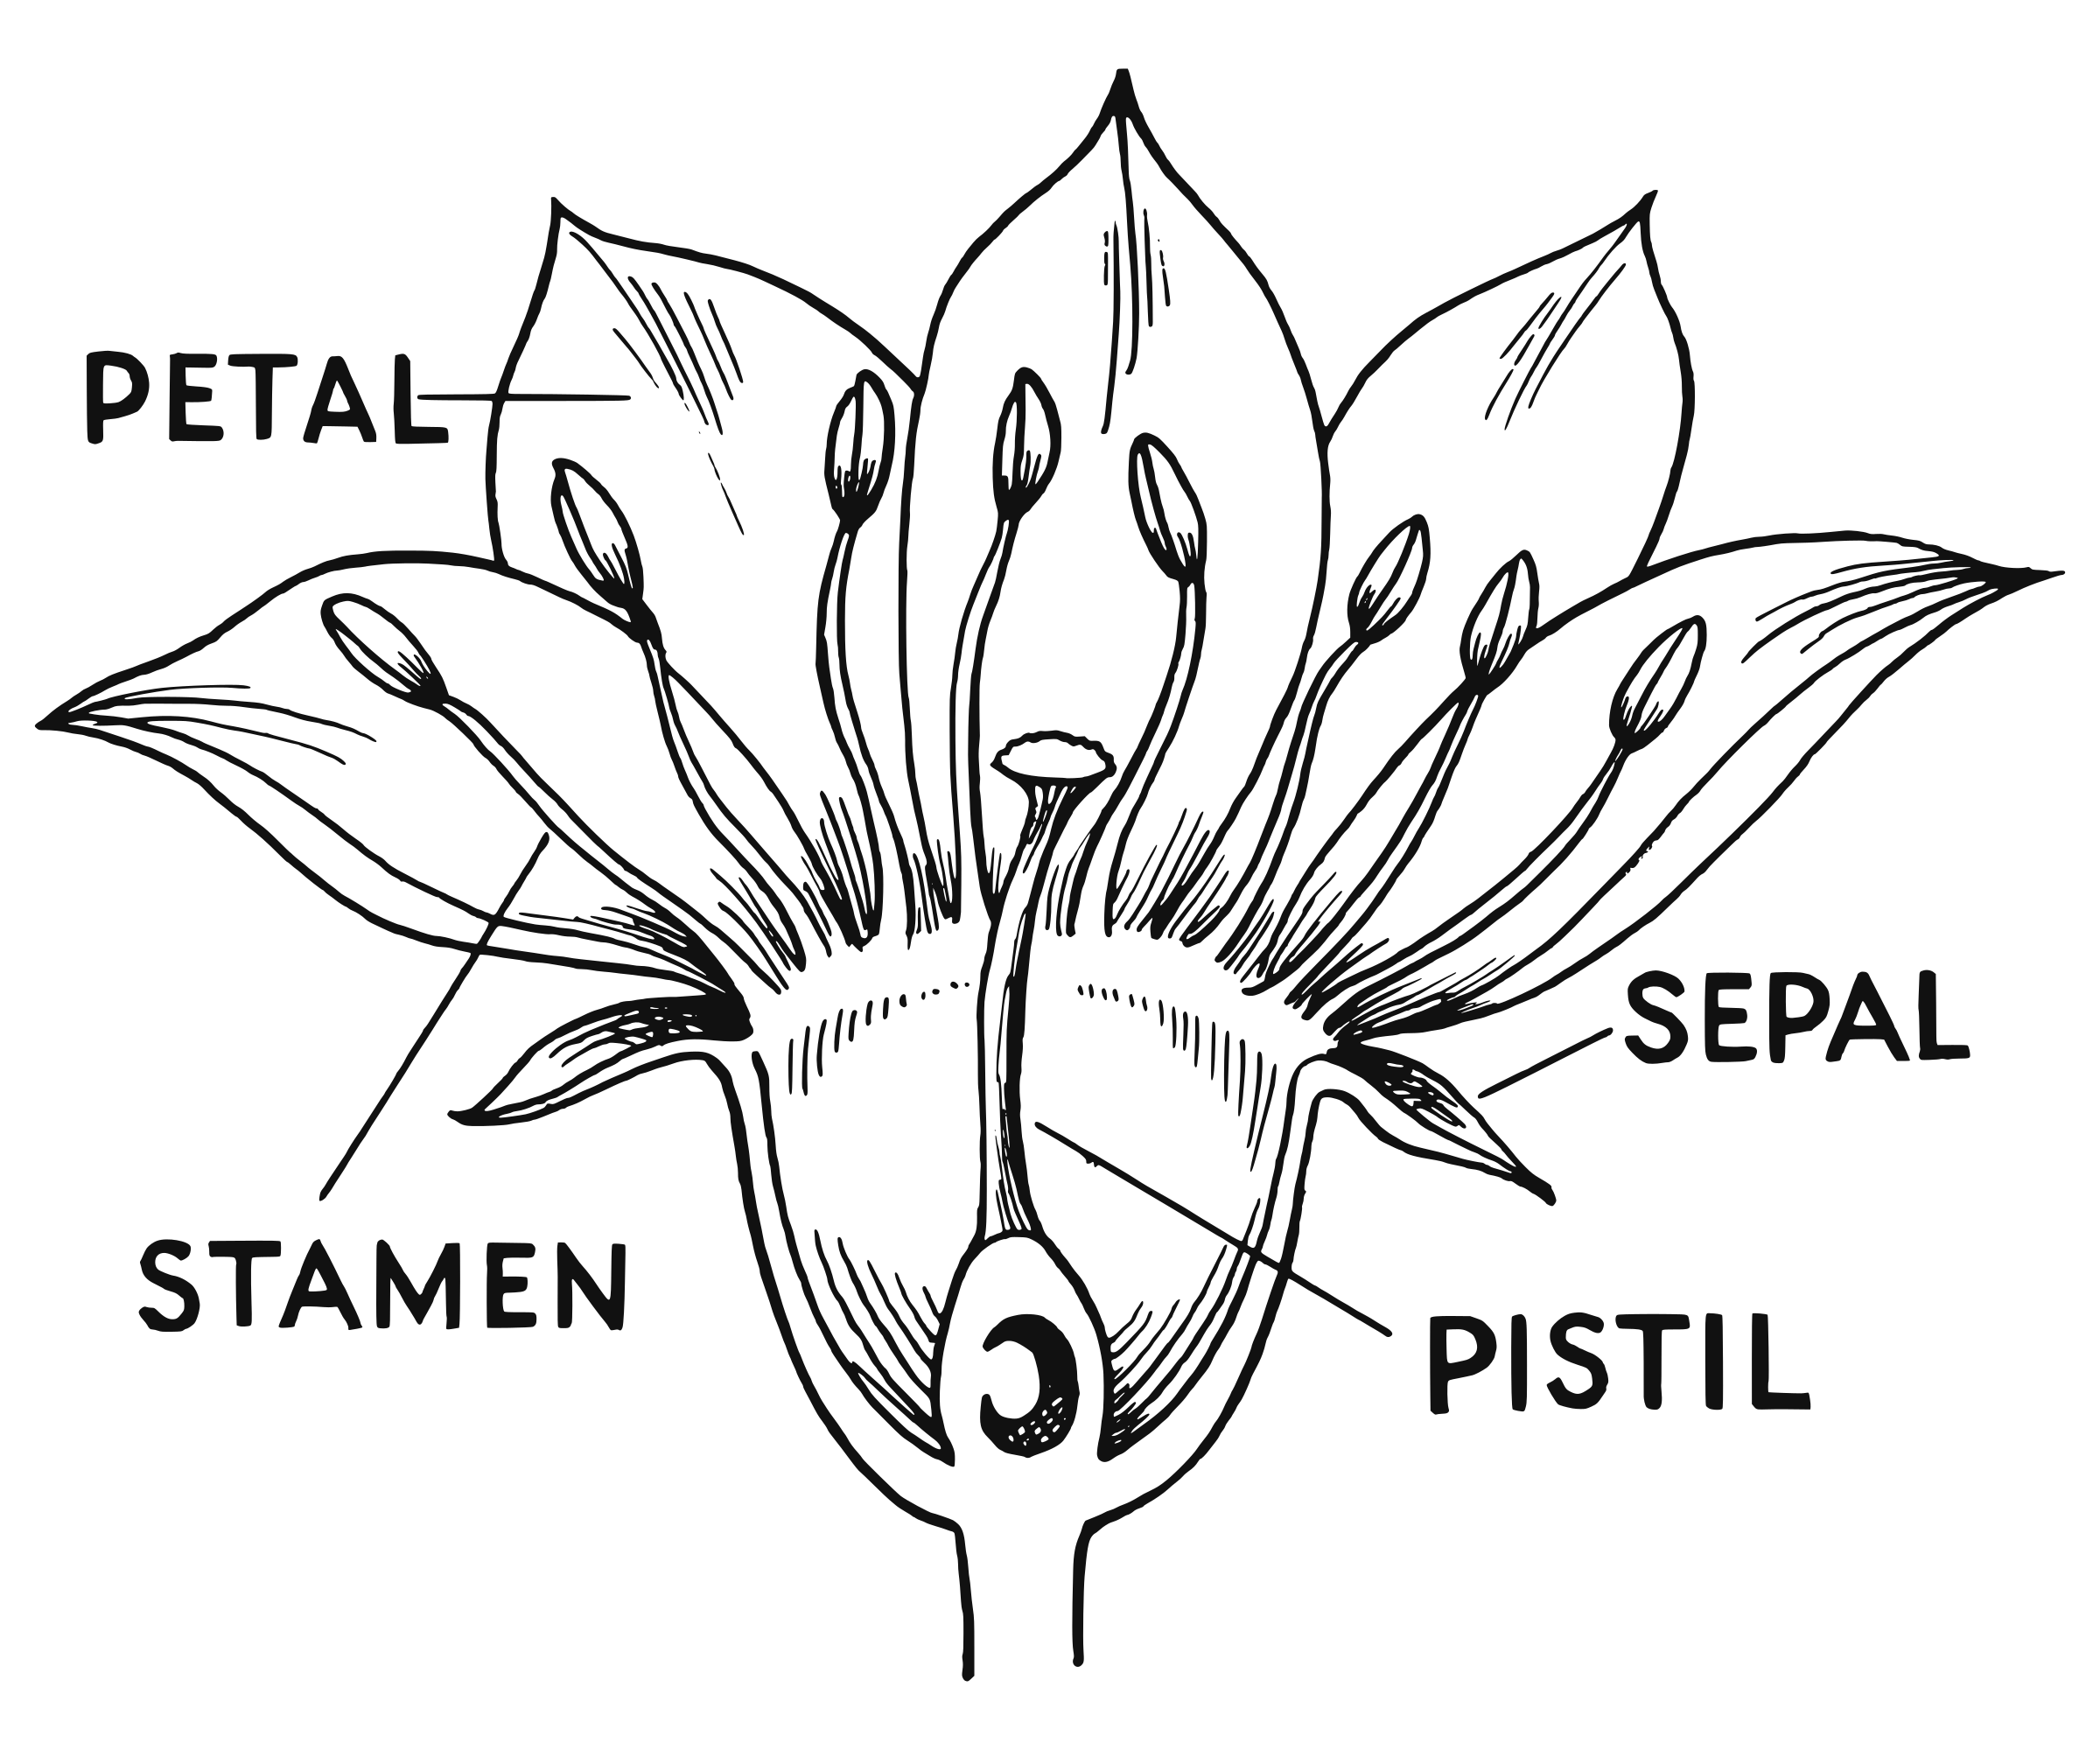
Structure of Flowers
Male Flower Parts
Female Flower Parts

Slide 4
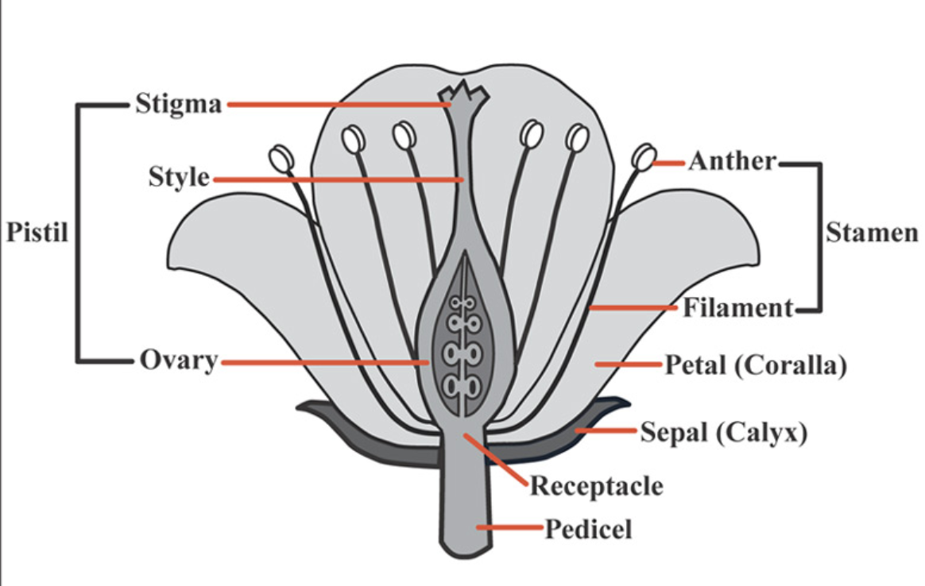


Structure of Flowers
Female Flower Parts
Male Flower Parts
PERFECT Flower = includes stamens (♂ or male) AND pistil (♀ or female)
IMPERFECT Flower = has stamens (♂ or male) OR pistil (♀ or female) but not both

Slide 5
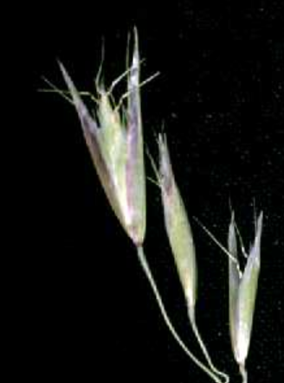
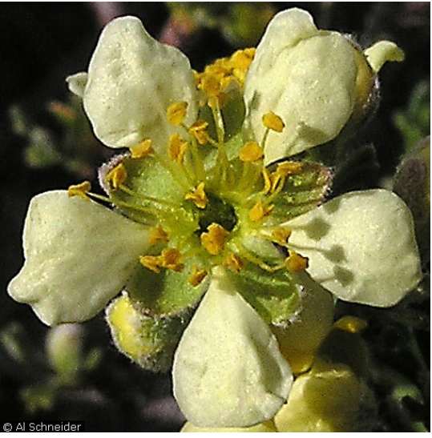
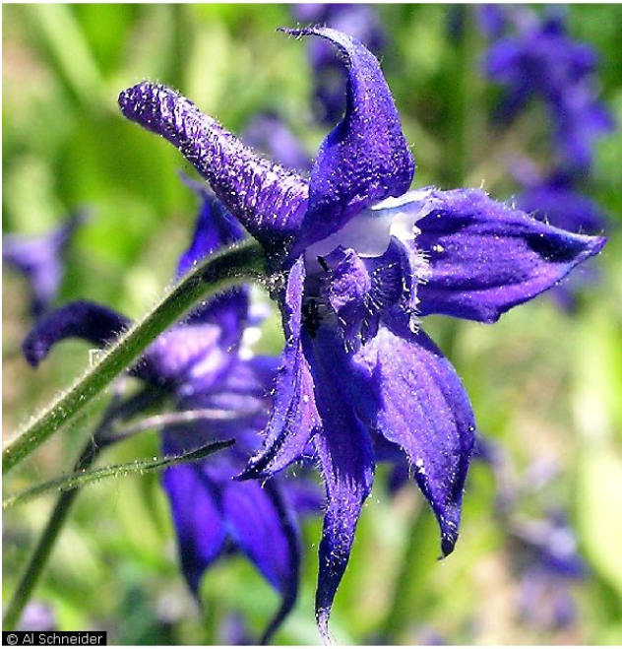
Perfect Flowers
Notes:
California Oatgrass Tall Larkspur Antelope Bitterbrush

Slide 6
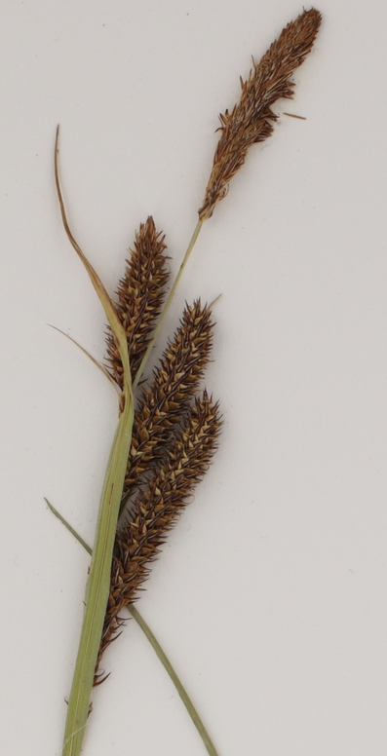
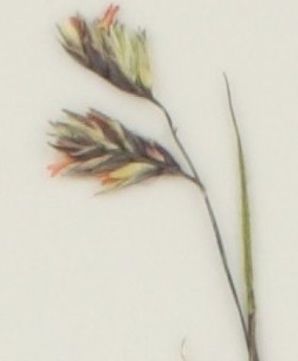
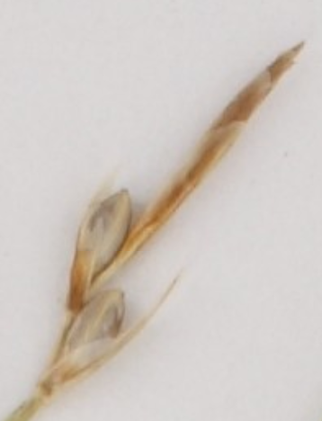
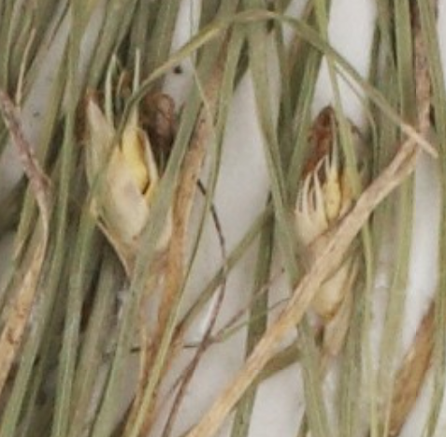
Imperfect Flowers
Monoecious - ♂ and ♀ flowers on SAME plant
Dioecious - ♂ and ♀ flowers on SEPARATE plants
Monoecious
Dioecious
Male →
Male Plant
← Female
Male →
← Female
Female Plant
Notes:
Nebraska sedge Elk sedge Buffalograss

Slide 7
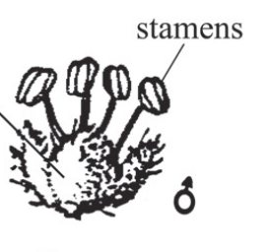
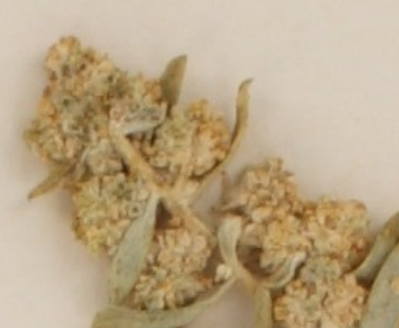
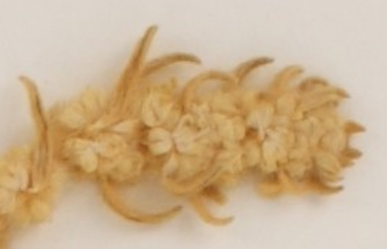
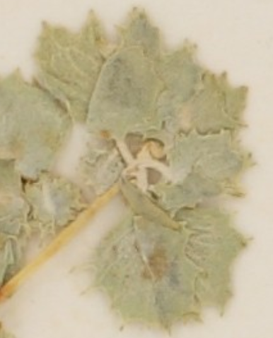
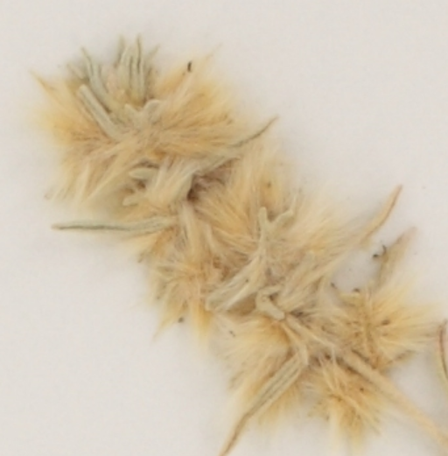
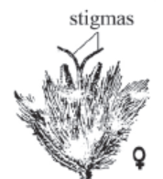
Imperfect Flowers
Monoecious - ♂ and ♀ flowers on SAME plant
Dioecious - ♂ and ♀ flowers on SEPARATE plants
Monoecious
Dioecious
Male Plant
Male →
← Female
Female Plant
Notes:
Winterfat Four-wing saltbrush

Slide 8
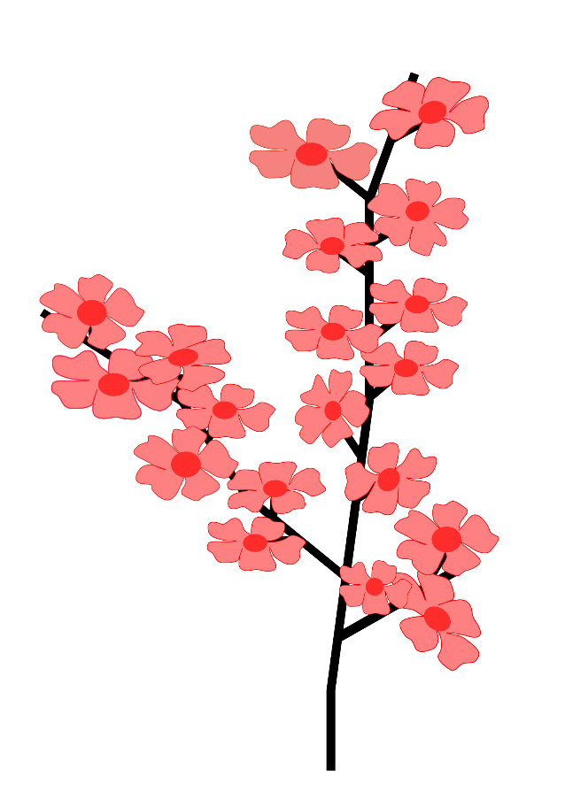

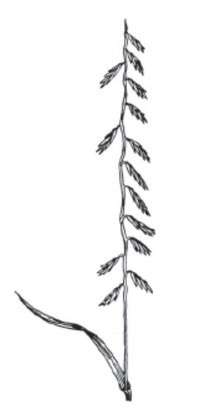
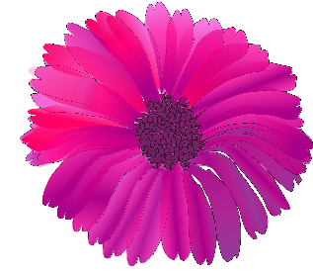
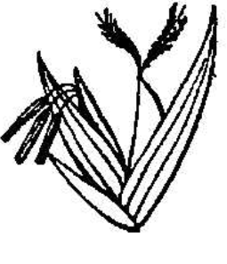
Structure of Flowers
Flower
Inflorescence
Notes:
Endemic ladies tress

Slide 9
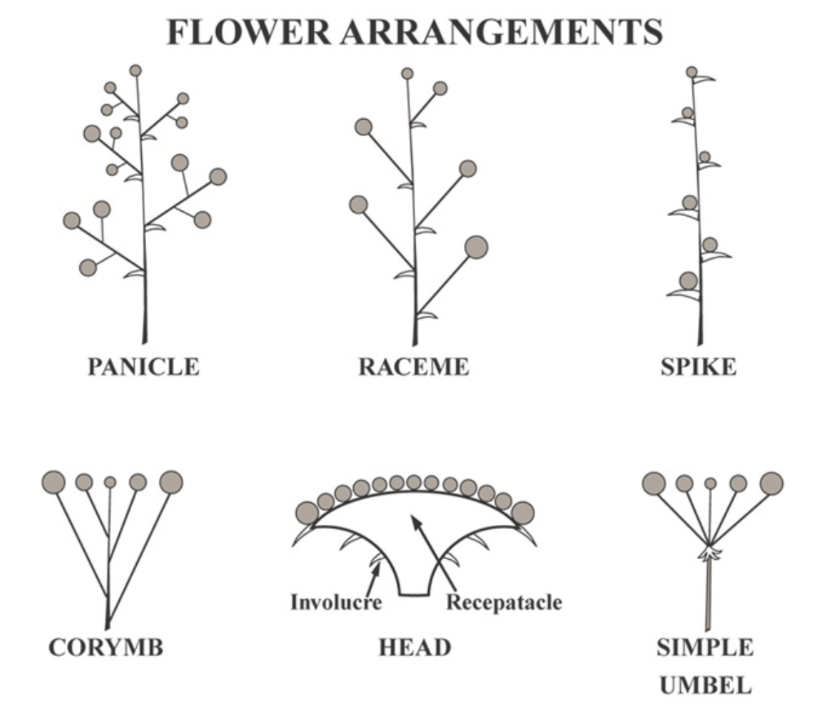
Structure of Flowers
Inflorescence - Group of flowers

Slide 10
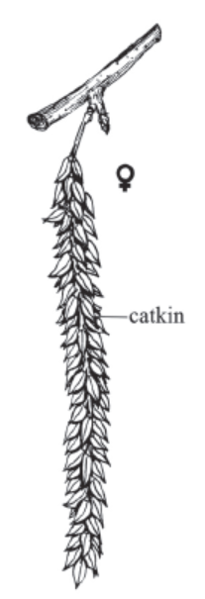
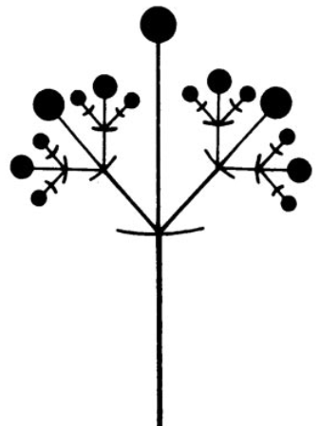
Structure of Flowers
Catkin = a dense spike or raceme with many small, usually naked, flowers.
Cyme = a convex or flat-topped flower cluster with the central flower the first to open. A determinate inflorescence.

Slide 11
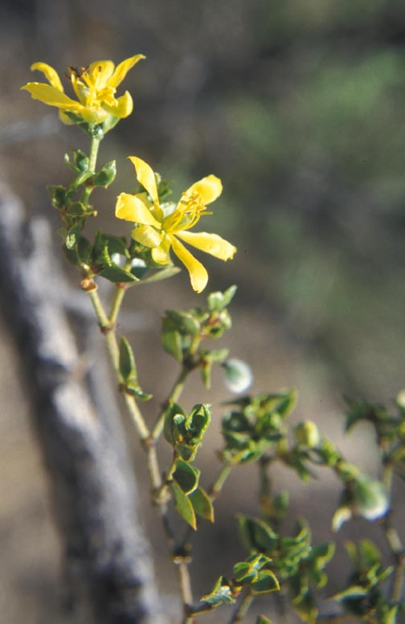
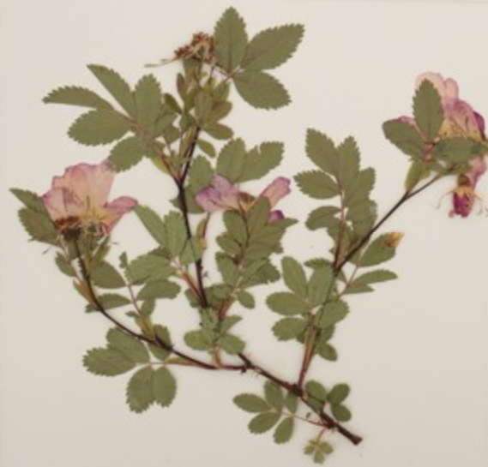
Solitary
Individual flowers on single branch, not in an inflorescence

Slide 12
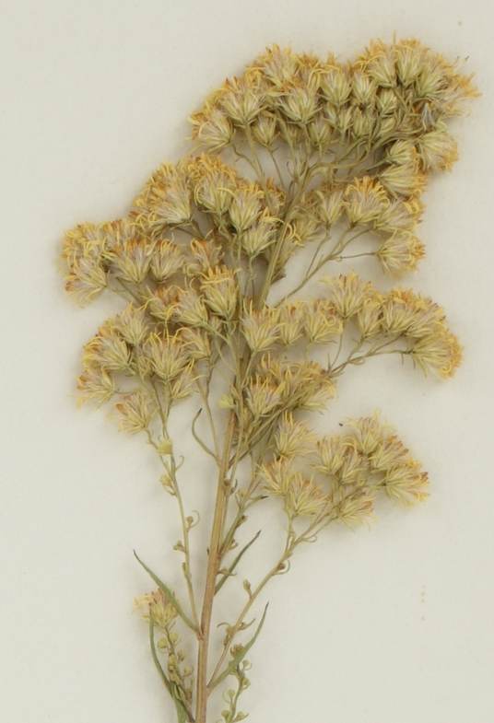
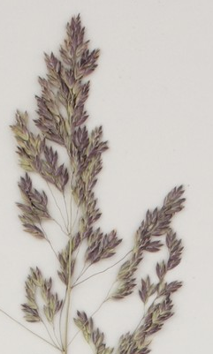
Panicle
Flowers attached to branching branches
Notes:
Missouri Goldenrod Kentucky bluegrass

Slide 13
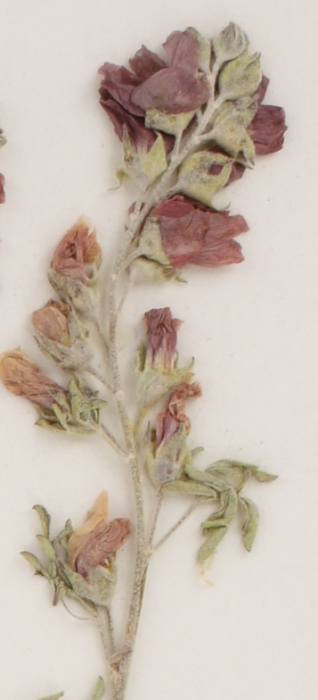
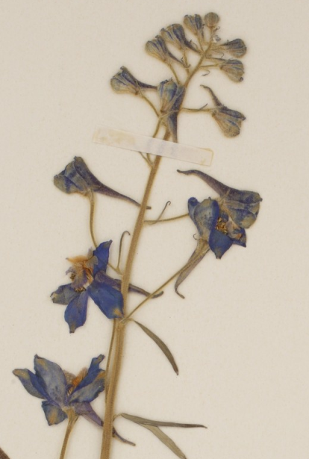
Raceme
Flowers attached to main stalk with pedicels
Notes:
Tall Larkspur Scarlet Globemallow

Slide 14
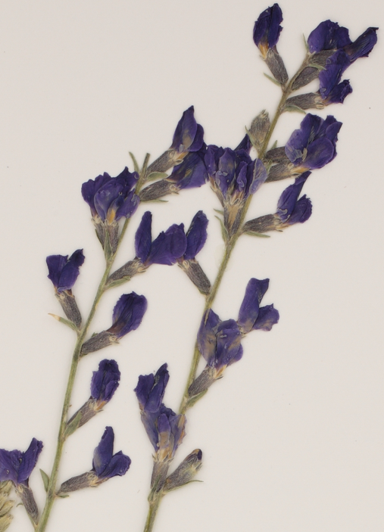
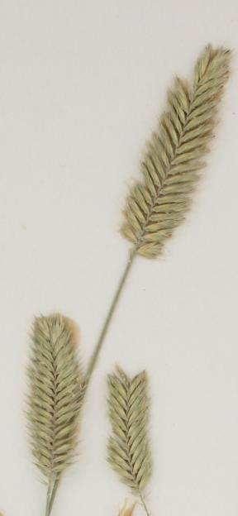
Spike
Flowers connected directly to main stalk
(not on panicle branches off main stem)
* You do not need to memorize the terms pedicel or sessile
Notes:
Purple Locoweed Crested wheatgrass

Slide 15
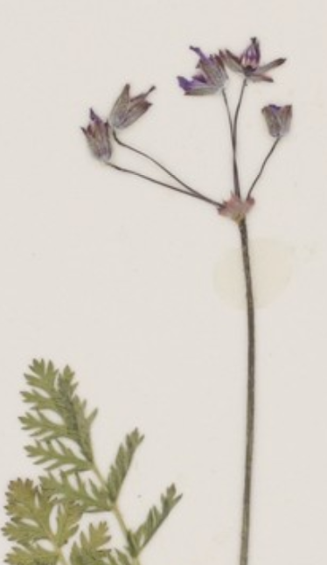
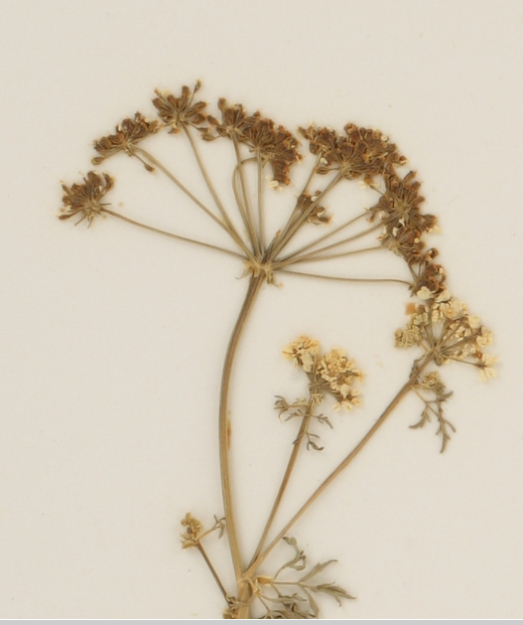
Umbel
All pedicles (branches for each individual flower) about the same length
  connect to stalk at same location
Pedicle
This is a compound umbel
(umbel with umbels at the tips)
Notes:
Storksbill Poison Hemlock

Slide 16
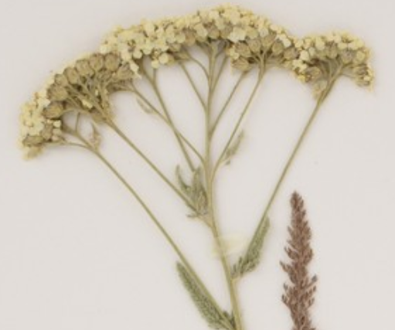
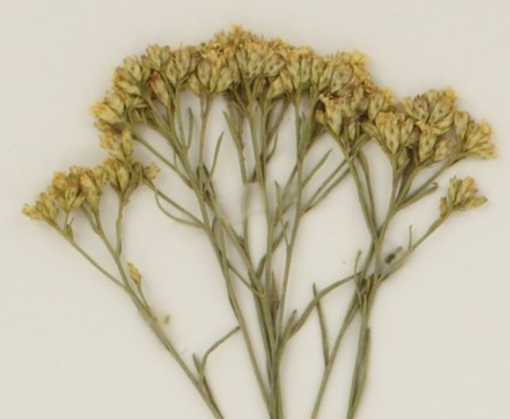
Corymb
Raceme with longer (uneven) pedicle at bottom of inflorescence
  Flowers appear to be at the same height
Corymb = a simple racemose inflorescence that is flat-topped.
An indeterminate inflorescence.
Notes:
Western Yarrow Broom snakeweed

Slide 17
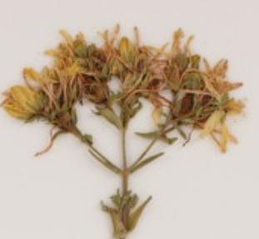
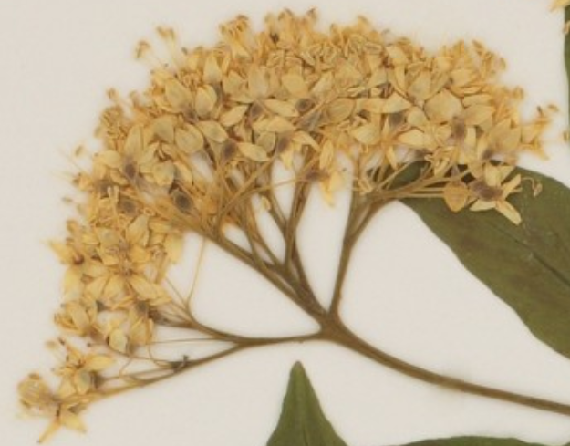
Cyme
Oldest flower in center. Younger flowers grow on outside with longer pedicles so flowers appear to be at the same height.
Cyme - a convex or flat-topped flower cluster with the central flower the first to open.
A determinate inflorescence.

Slide 18
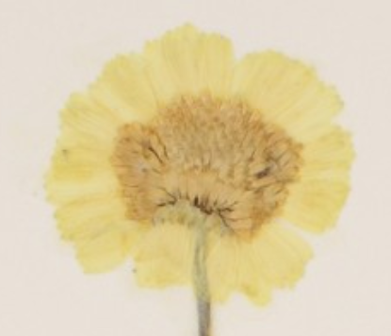
Inflorescence
Composite/Head
Ray and Disk flowers
Family Asteraceae (daisy/sunflower family)
Ray flowers
Disk flowers
Notes:
Desert Baileya

Slide 19
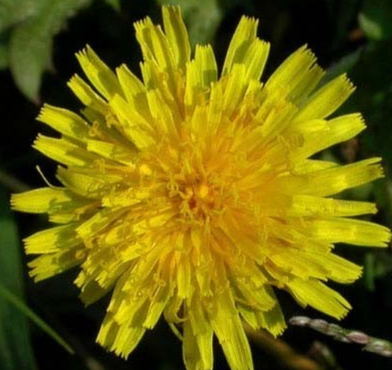
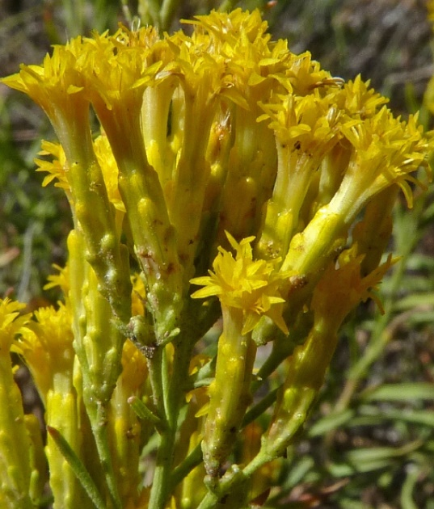
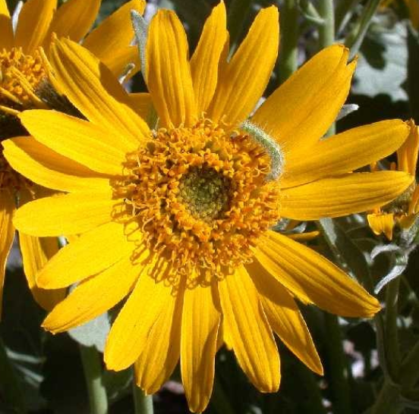
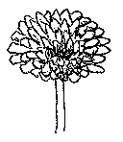
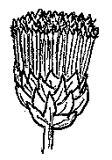
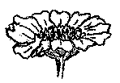
Composite Heads
Ray Flowers
Disk Flowers
Ray and Disk Flowers
Notes:
Dandelion Hawksbeard Arrowleaf balsamroot

